Slide 1



CS4352 Operating Systems
Lecture 2
Instructor: Tommy Dang, Ph.D.
Assistant Professor
Department of Computer Science
Texas Tech University

Slide 2
Outline
Questions?
Computer Hardware Review
Processors, instruction set, registers
Pipeline, superscalar, multithreaded/multicore chips
Memory hierarchy, disks, virtual memory
I/O devices, I/O methods
Buses
Operating System Concepts
Processes/threads, process tree and IPC
Files, protection and security
Shell

Slide 3
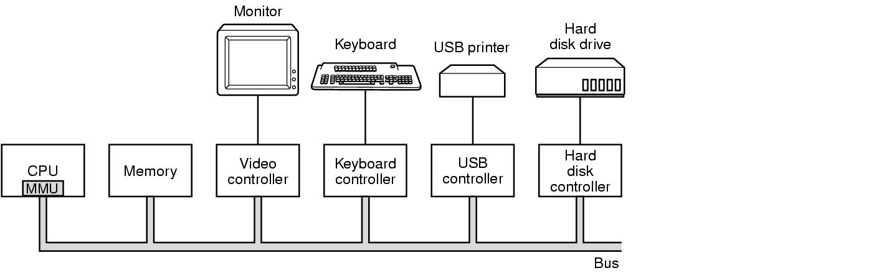
Computer Hardware Review
Figure 1-3. Some of the components of a simple personal computer.

Slide 4
Processors, Instruction Set and Registers
Processors: fetch, decode, and execute instructions
Instruction Set
Each processor has a specific set of instructions that it can execute
“Architecture”, e.g. X86 v.s. SPARC, CISC v.s. RISC
TRAP instruction: from user mode to kernel to execute a system call
Registers
Most registers are a type of “memory”
Hold instructions, key variables, and temporary results to bridge gap b.t. processors and main memory
Notes:
Terms: “Processor”, “Core”, “CPU”, “Chip”, “Node”

Slide 5
Special Registers
Program Counter (PC) ?
Contains the memory address of the next instruction to be fetched
“instruction address”
Stack Pointer (SP) ?
Points to the top of the current stack in memory
Memory divided into three segments “text” “data (heap)” “stack”
Program Status Word (PSW) ?
Contains the condition code bits, e.g. CPU priority, mode (user/kernel)
Needed in system calls and I/O
Managed by software (complier, OS):
“context switch” for time multiplexing
Need to save/restore all these registers

Slide 6
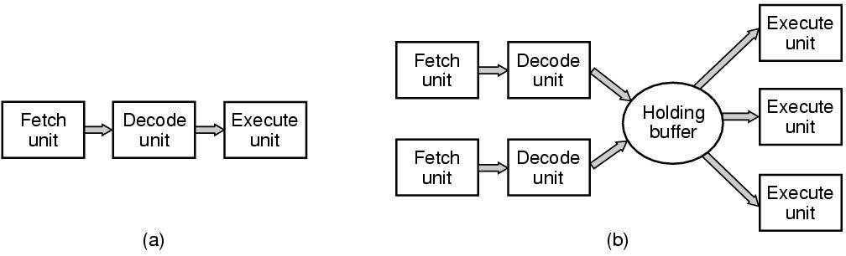
Pipeline and Superscalar
Multiple functional units
Often “out-of-order” execution
Execute multiple instructions in one cycle
Figure 1-7. (a) A three-stage pipeline. (b) A superscalar CPU.

Slide 7
Multithreaded Processor/Chip
Replicate both functional units & control logic (PCs, SPs, etc.)
“multithreading” or “hyperthreading” (Intel) processors/chips
The processor holds state of multiple threads and switch back & forth
Does not offer true parallelism but switching at the order of a nanosec
A multithreaded processor appears as multiple CPUs to OS
Each thread appears as a separate CPU
Impact scheduling
Notes:
Threads: lightweight processes
Does not offer true parallelism: still only one process running at the same time, share address space, same pipeline

Slide 8
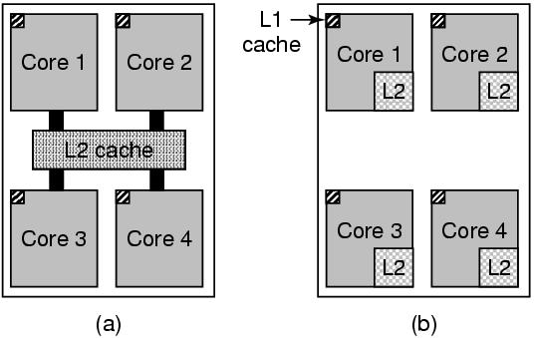
Multicore Processor/Chip
A chip/processor has multiple “complete cores” on it
Independent functional & control units, independent pipelines, independent registers (&L1 cache)
Parallel computing becomes universal
“Thinking in parallel” needed for CS students
Figure 1-8. (a) A quad-core chip with a shared L2 cache. (b) A quad-core chip with separate L2 caches.

Slide 9
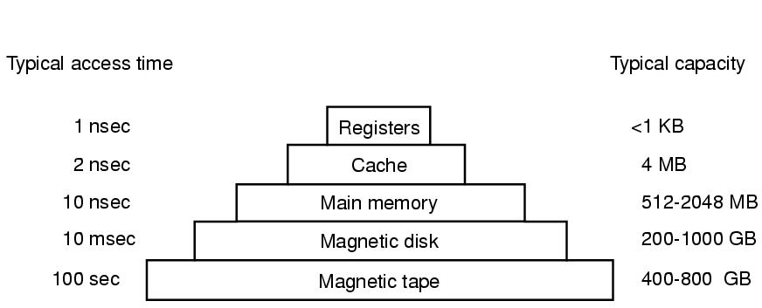
Memory Hierarchy
Closer to processor: faster, smaller, and more expensive
Figure 1-9. A typical memory hierarchy. The numbers are very rough approximations.

Slide 10
Registers and Cache Memory
Registers
Part of CPU (internal), nearly no delay
Typically 32x32-bits for a 32-bit CPU/64x64-bits for a 64-bit CPU
Managed by?
Cache (memory)
Principle of ?
Store temporary data/instructions to explore programs’ spatial/temporal locality
Main memory divided into cache lines (blocks) & temp stored in cache
Cache hit, cache miss, average memory access time
Inclusive v.s. exclusive
Placement (n-way set associative), replacement (pseudo-LRU)
Managed by ?
(software)
Principle of Locality!
(hardware)

Slide 11
Cache Memory (cont.)
Multiple levels of cache memory usually
First level cache (L1 cache)
Inside CPU
Separate for data and inst.; L1 data cache/L1 inst. cache
Second level cache (L2 cache)
Usually shared for data and instructions
Larger and longer latency than L1
Can be on-chip/off-chip
Can be shared/separate for multicore processors
“LLC”: Last Level Cache
“Cache” “Cash”
“L1$” “L2$”
Notes:
Cache simulators:

Slide 12
Main Memory and Other Memory
RAM (Random Access Memory), volatile
Managed by software (with hardware support)
Nonvolatile RAM:
ROM (Read Only Memory) (programmed at factory, can’t be changed)
EEPROM (Electrically Erasable Programmable ROM)
Flash memory (for firmware)

Slide 13
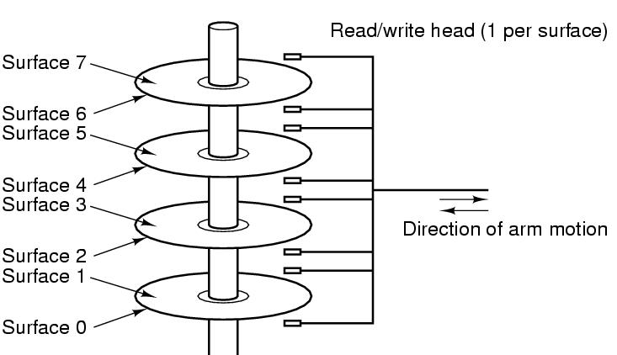
Disks (Hard Disk Drives)
90% of data stored in HDDs
Platter, surface, arm, head
Track, sector (fixed size, e.g. 512B)
Cylinder
Physical addressing (CHS)
Cylinder, Head, Sector
Flash-memory based storage will eventually replace
Figure 1-10. Structure of a disk drive.

Slide 14
Virtual Memory
Allow programs larger than physical memory to be run
Give programmers a “virtual address space” to code programs with memory requirement larger than physical memory
Managed by OS, hide details to programmers
Placing part of programs on disks and use main memory as a “cache”
Requires remapping memory addresses on the fly
To convert the addr the program generated (virtual address) to the physical address in RAM
An MMU (Memory Management Unit), part of CPU, specifically handles this

Slide 15
Tapes
Magnetic tape, often used as a backup storage
Large capacity, cheap, but can only be accessed in sequential
A robot fetches, mount, and unmount tapes for large data warehouse

Slide 16
I/O Devices
I/O devices heavily interact with OS (in addt. to CPU & memory)
Generally consist of
A controller: a chip/a set of chips controlling the device (can be complex)
The device itself, e.g. disks, NIC (network interface card)
Device Driver
The software that talks to the controller
Part of OS, manage devices and hide dirty hardware details

Slide 17
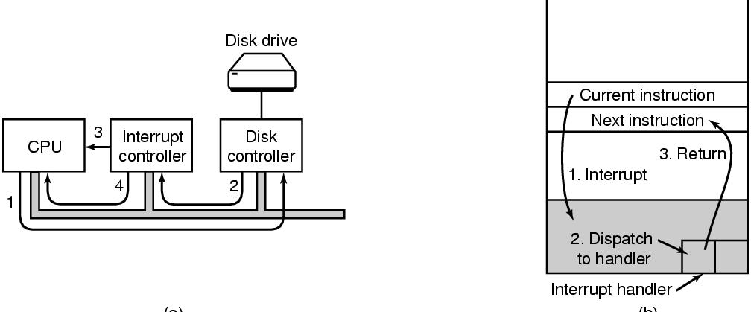
I/O Methods
Busy waiting: CPU sits waiting for I/O to be completed, very low CPU utilization
Interrupt driven: I/O device signal CPU (interrupt) at completion, critical & complex OS design
DMA (Direct Memory Access) method: a direct DMA chip handles I/O, “offloading”, interacts with CPU via interrupts
Figure 1-11. (a) The steps in starting an I/O device and getting an interrupt. (b) Interrupt processing involves taking the interrupt, running the interrupt handler, and returning to the user program.

Slide 18
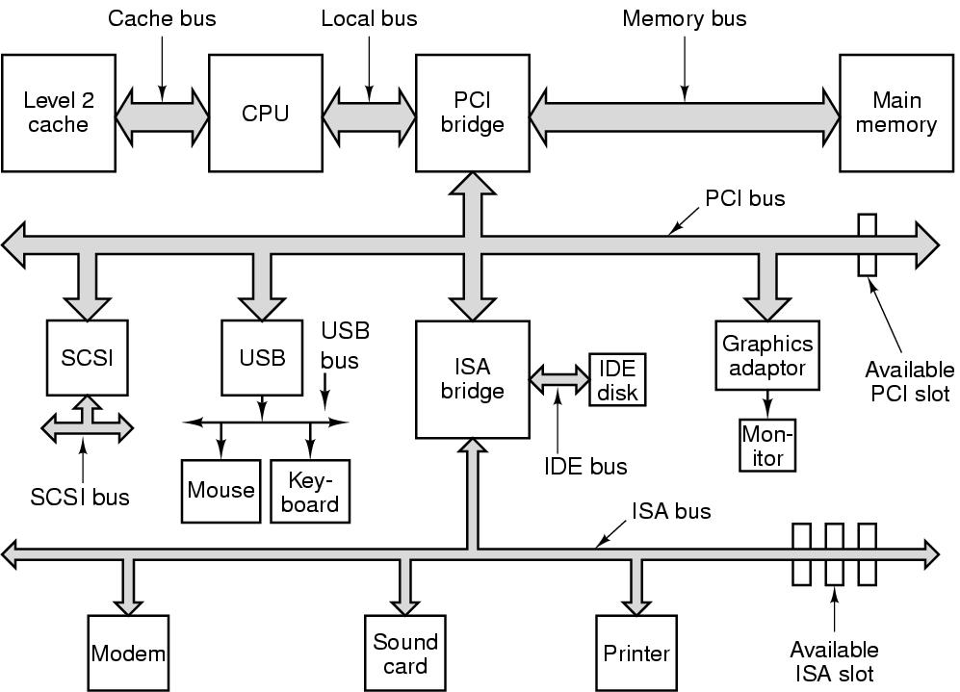
Buses
More than a single bus in practice!
Cache bus
Local bus
Memory bus
PCI/PCI-e bus (Peripheral Component Interconnect)
SCSI (Small Computer System Interface)
USB (Universal Serial Bus)
IDE (Integrated Drive Electronics) bus
ISA (Industry Standard Architecture) bus
Figure 1-12. The structure of a large Pentium system

Slide 19
Booting the Computer
Starting from executing a BIOS program on a parentboard/motherboard
BIOS: Basic Input Output System
Scanning and checking hardware devices
Low-level I/O software, read the keyboard, write to display, disk I/O, etc.
Determines boot device and load
The 1st sector examines the partition table to determine an active
A secondary boot loader read from the active partition and loads OS

Slide 20
Outline
Questions?
Computer Hardware Review
Processors, instruction set, registers
Pipeline, superscalar, multithreaded/multicore chips
Memory hierarchy, disks, virtual memory
I/O devices, I/O methods
Buses
Operating System Concepts
Processes/threads, process tree and IPC
Files, protection and security
Shell

Slide 21
Processes/Threads
Processes: running programs
Associated with an Address Space
text/program, data, stack
“core image”: content of address space
Associated with registers
Including PCs, SPs
Associated with other resources
List of open files, signals, related processes
Process control block (PCB)/process table: a data structure (array/linked list) managing associated resources
Threads: lightweight processes, without own address space
A process is fundamentally a container that holds all the information needed to run a program
Notes:
Example: vide editor, web browser, email receiver.
Switch
Keep the same state it was stopped
Information explicated stored somewhere
Store in process table,
Core image for text, data, stack; process table for registers, other resources.

Slide 22
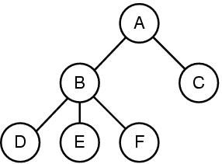
Process Tree and IPC
A process can create other processes
Root/Child processes, process tree
In Unix, an “init” process is the root of all other processes with PID=1 usually
Interprocess Communication (IPC)
Figure 1-13. A process tree. Process A created two child processes, B and C. Process B created three child processes, D, E, and F.
Notes:
1. Command interpretator shell, take command, create new process to run compiler, finish then terminate
2. Sometime processes need to collaborate and synchronize with each other, so they need interprocess communication
Virtual memory
Paging/Page replacement

Slide 23
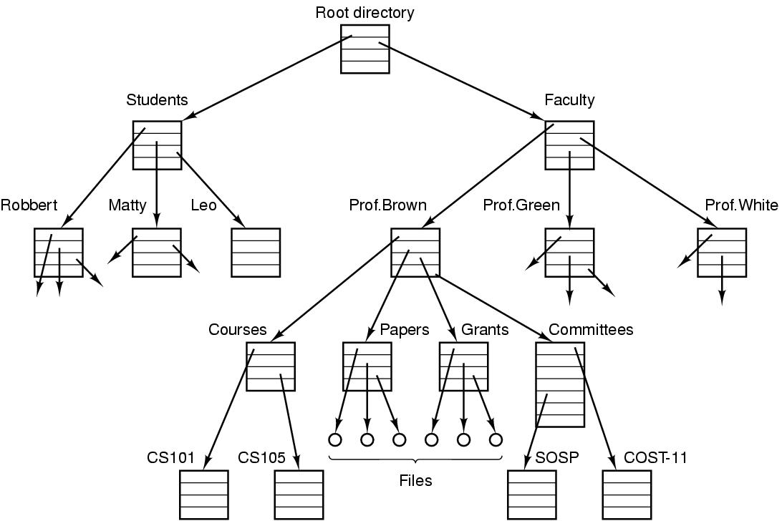
Files
File: an abstraction of a collection of bytes
Directory: a special file containing “pointer” to other files/directories
Root directory: top of the directory hierarchy
Path (absolute/relative)
/Students/Leo/foo
Working directory
File descriptor (FD)
File system: a collection of files, directories, and metadata
Figure 1-14. A file system for a university department.
Notes:
Comparing to process hierarchy , file trees can be deep but process trees are shallow, 3 level is rare
Process table lasts short time, minutes, but file tree lasts for years
Absolute path name vs relative
Working directory, system call to change, relative directory
Open a file, permission, file descriptor

Slide 24
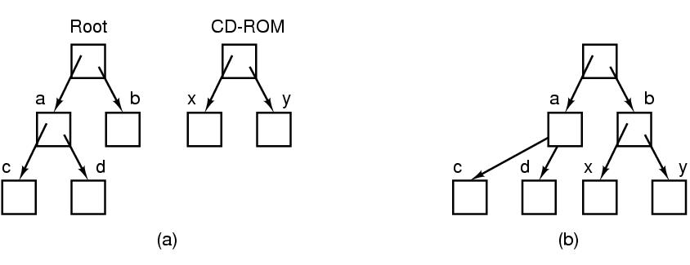
Files (cont.)
File systems can be joined with “mounting”
Figure 1-15. (a) Before mounting, the files on the CD-ROM are not accessible. (b) After mounting, they are part of the file hierarchy.

Slide 25
Readings
Chapter 1
Section 1.3
Section 1.5

Slide 26
Questions? Questions/Suggestions/Comments are always welcome! Write me: yong.chen@ttu.edu Call me: 806-834-0284 See me: ENGCTR 315

