Slide 1



CS4352 Operating Systems
Lecture Final

Slide 2
Outline
Memory Abstraction: Address Space
Managing Free Memory
Virtual Memory
Paging
Page tables
Speeding up paging
Page tables for large memories

Slide 3
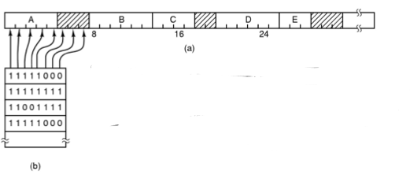
Memory Management with Bitmaps
Memory divided into allocation units and mapped to a bitmap
Size of allocation unit needs a balance (bitmap storage v.s. waste of allocation unit)
Drawback: need search (slow) to find out available memory
Figure 3-6. (a) A part of memory with five processes and three holes. The tick marks show the memory allocation units. The shaded regions (0 in the bitmap) are free. (b) The corresponding bitmap.
Notes:
Drawback: need search (slow) to find out available memory: bring a k-unit process into memory -> search for k consecutive bit of 0

Slide 4
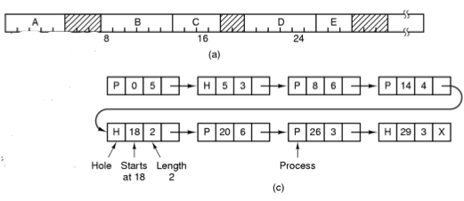
Memory Management with Linked Lists (1)
Linked list of segments
P: Process
H: Hole
Figure 3-6. (c) The same information as a list.

Slide 6
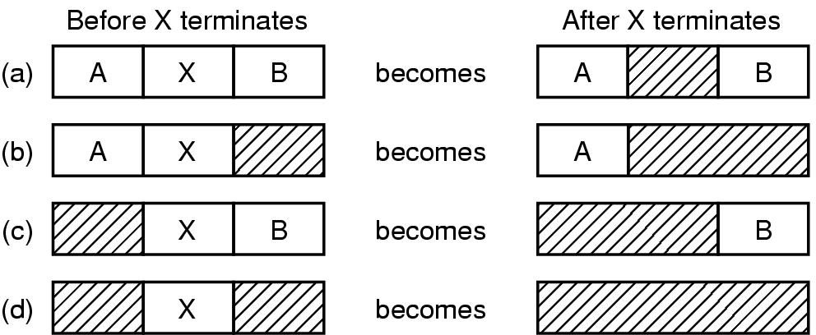
Memory Management with Linked Lists (2)
Memory merge for process termination/swapped out
Double-linked list preferred rather on single-linked list
Figure 3-7. Four neighbor combinations for the terminating process, X.
Notes:
- Memory merge for process termination/swapped out: 4 situations are depicted in the Figure
- Double-linked list: to find the previous item since the process table only point to processes (don’t know the order)

Slide 7
Memory Management with Linked Lists (3)
Memory allocation for process creation/swapped in
First fit (searches from the beginning of the linked list)
Next fit (searches from left off last time)
Best fit (take the smallest adequate hole, widely used, example fitting a process of size 2 into Fig 3-6)
Worst fit (takes the largest hole, example fitting two processes of size 1 and then 2 into Fig 3-6)
Quick fit (quick allocation for common sizes, e.g. maintaining extra lists of points to 4KB, 8KB … time and space trade-off )
Notes:
We assume that memory management know how much memory to allocate for the process

Slide 8
Outline
Questions?
Memory Abstraction: Address Space
Managing Free Memory
Virtual Memory
Paging
Page tables
Speeding up paging
Page tables for large memories

Slide 9
Virtual Memory
Driven by the need of running programs that are too large to fit in memory (or collectively with multiple programs)
Each process has its own address space, divided into pages
Pages mapped onto physical memory (not all)
When a process refers part of address space in physical memory, a hardware/software performs mapping on the fly
When not in memory, the OS load and re-execute instruction
Notes:
Designed by John Fotheringham in 1961

Slide 10
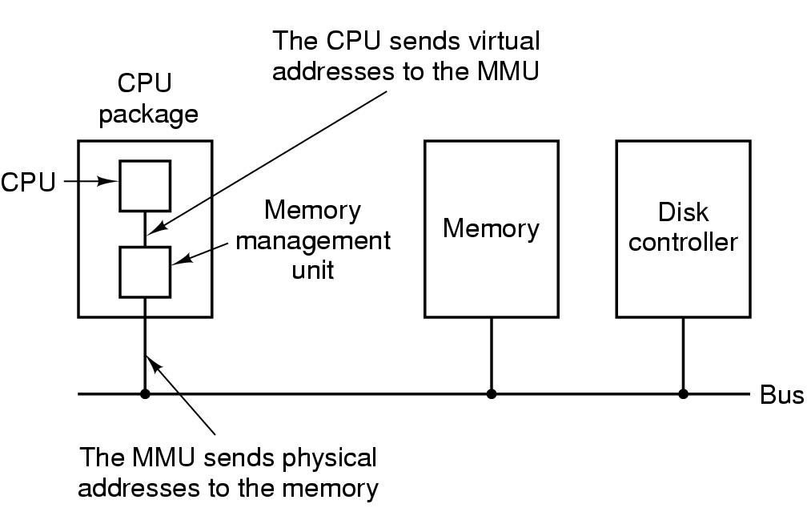
Paging (1)
Paging
Virtual address (CPU generated)
Virtual address space
MMU (Memory Management Unit)
Figure 3-8. The position and function of the MMU – shown as being a part of the CPU chip (it commonly is nowadays). Logically it could be a separate chip, was in years gone by.

Slide 11
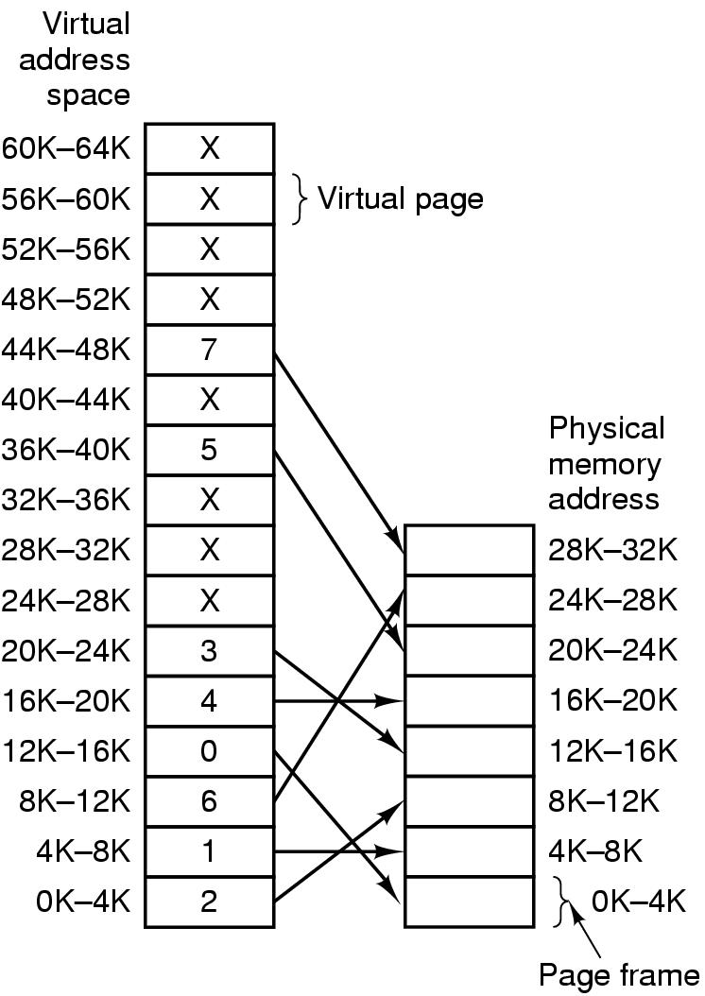
Paging (2)
Pages
Page frames
Page table (mapping function)
Page fault
Present/absent bit
Figure 3-9. Relation between virtual addresses and physical memory addresses given by page table.
Notes:
Where is the physical memory located? Where is the virtual memory located?
What is the size of the physical memory in the picture? = 32K

Slide 12
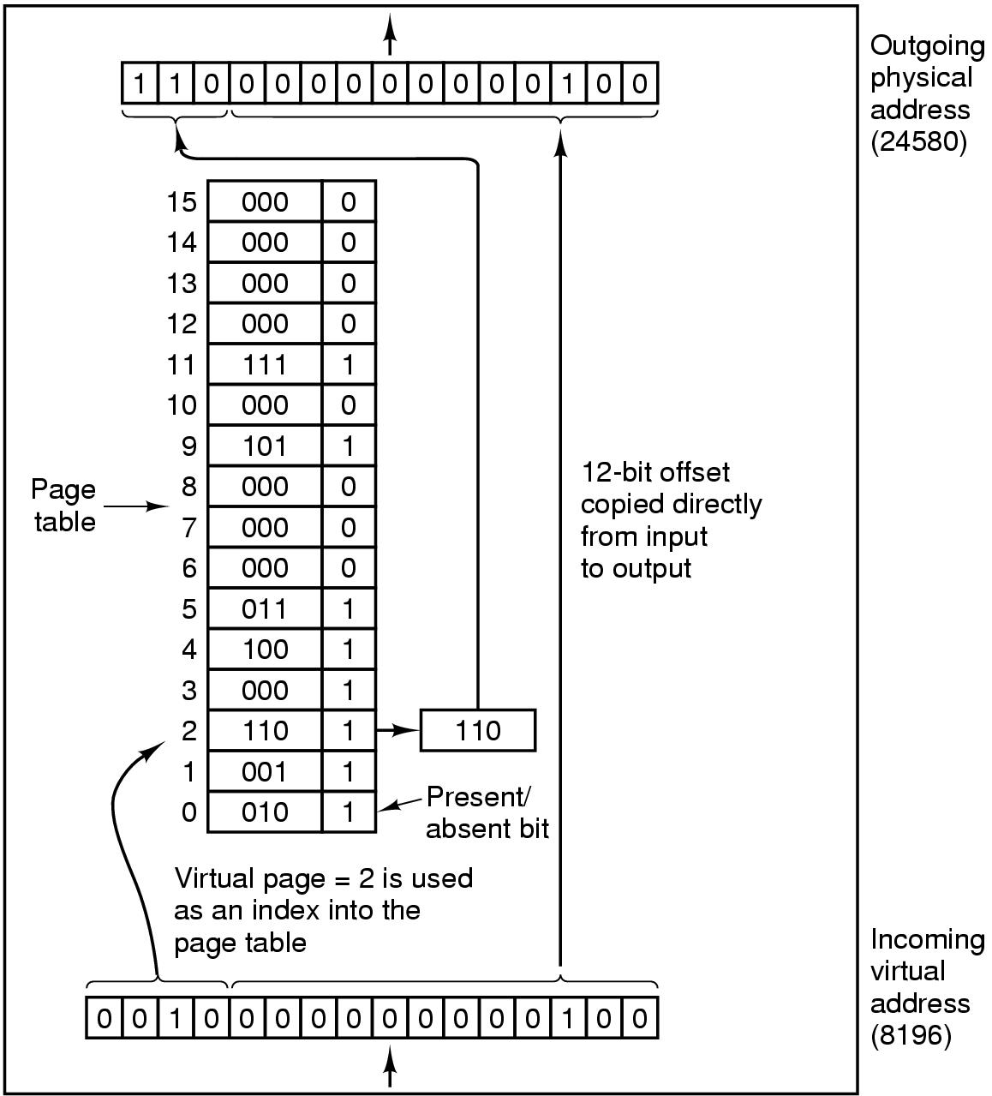
Paging (3)
64KB of virtual address space (16 4KB pages) mapped onto 32KB of physical memory
Page number used as an index into the page table (mapping function)
Figure 3-10. The internal operation of the MMU with 16 4-KB pages.

Slide 14
Paging implementation issues:
Virtual address to physical address mapping must be fast
Must be done every memory reference
If virtual address space is large, the page table will be large
With 4KB page size, 32-bit address -> how many pages,
With 4KB page size, 64-bit address -> how many pages,
Notes:
With 4KB page size, 32-bit address has 1M (2²⁰) pages,
64-bit address has 2⁵² (4K trillion) pages

Slide 15
Outline
Questions?
Virtual Memory
Paging, Page tables
Speeding up paging
Page tables for large memories
Page Replacement Algorithms
Optimal algorithm
NRU, FIFO, Second-chance algorithms
Clock, LRU, Aging algorithms
Working set
Summary

Slide 16
Page Replacement Algorithms
When a page fault occurs, if page frames full, OS needs to choose a page to evict to make room
Similar to cache line replacement
Different in how fast they require
If the evicted page is dirty, it needs to be written back to disk
If clean, no rewrite needed
Naïve random algorithm possible, but we can do a better job!
Notes:
Page Replacement occurs in other areas of computer design: web browsers, catch in CPU.

Slide 17
Optimal Page Replacement Algorithm (OPT)
Best possible algorithm is to pick the page who has the furthest distance to be accessed again
E.g. if pages A, B, C, D in memory, E is referenced and needs to replace a page, with future accesses A, C, D, B, C, …Which one to be picked?
B
Impossible to implement though, need a magic fortune teller!

Slide 18
Not Recently Used (NRU)
Associate two bits for each page
R: reference bit, set when referenced (read/written)
M: modified bit, set when written
OS classifies into 4 classes and NRU picks a random page from the lowest-numbered nonempty class (higher priority to stay with reuse)
Class 0: not referenced, not modified
Class 1: not referenced, modified
Class 2: referenced, not modified
Class 3: referenced, modified
Notes:
Referenced is reset by OS every clock cycle (interrupt): Class 1 can achieved by resetting Referenced on class 3 on clock cycle.
Referenced is more important than Modified in NRU. For example: class 2 and class 1

Slide 19
First-In First-Out (FIFO)
FIFO picks the oldest page as the victim page to be replaced
Low-overhead, little book-keeping, easy to implement (FIFO queue)
Issue: ?
heavily-used early arrival page can be replaced

Slide 20
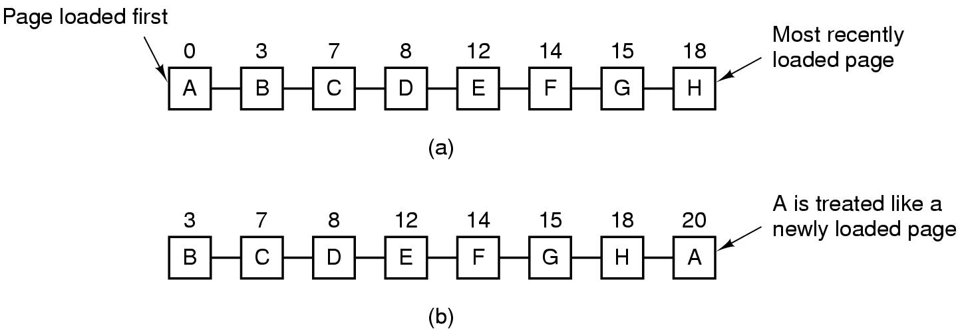
Second Chance Algorithm
Follows FIFO, but check R bit; if 0, replaced; if 1, clear R bit and put into the end of the queue
Figure 3-15. Operation of second chance. (a) Pages sorted in FIFO order. (b) Page list if a page fault occurs at time 20 and A has its R bit set. The numbers above the pages are their load times.
Notes:
What if are pages are referrenced in the Figure A? -- > It become FIFO

Slide 21
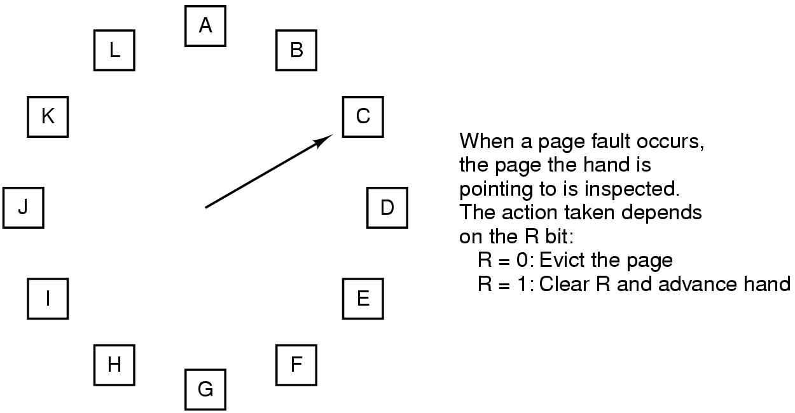
The Clock Page Replacement Algorithm
Figure 3-16. The clock page replacement algorithm.
Notes:
Similar to FIFO with second chance. But this move the pointer instead of move the page to the end of the list

Slide 22
Least Recently Used (LRU) Algorithm (1)
LRU picks the page that has not been used for the longest time
Good approximation of OPT
Not cheap to implement though
Needs a linked list and needs to update this linked list on every memory reference
Hardware implementations
With a counter incrementing after each instruction (“timer”); each page table entry stores a counter value, entry with lowest counter picked
With a matrix of n x n bits, for n page frames

Slide 23
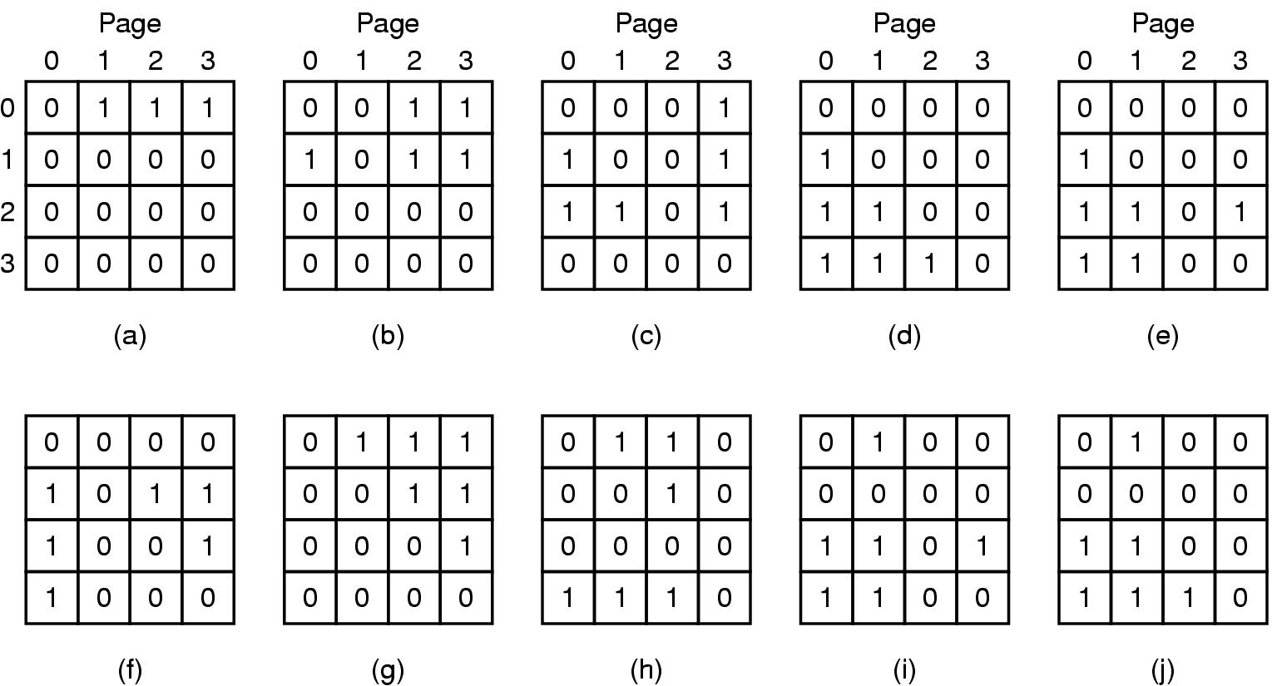
Least Recently Used (LRU) Algorithm (2)
When page frame k referenced, row k sets to 1, col k sets to 0
Row with lowest binary value picked
LRU using a matrix when pages are referenced in the order 0, 1, 2, 3, 2, 1, 0, 3, 2, 3.
Notes:
By setting row sets to 1, he makes sure he is the highest priority
Setting col to 0 reserves the order of priorities. Why? Notice that after after c) all rows have 1 different bit
LRU requires a field (usually 64 bit) in each page table entry

Slide 24
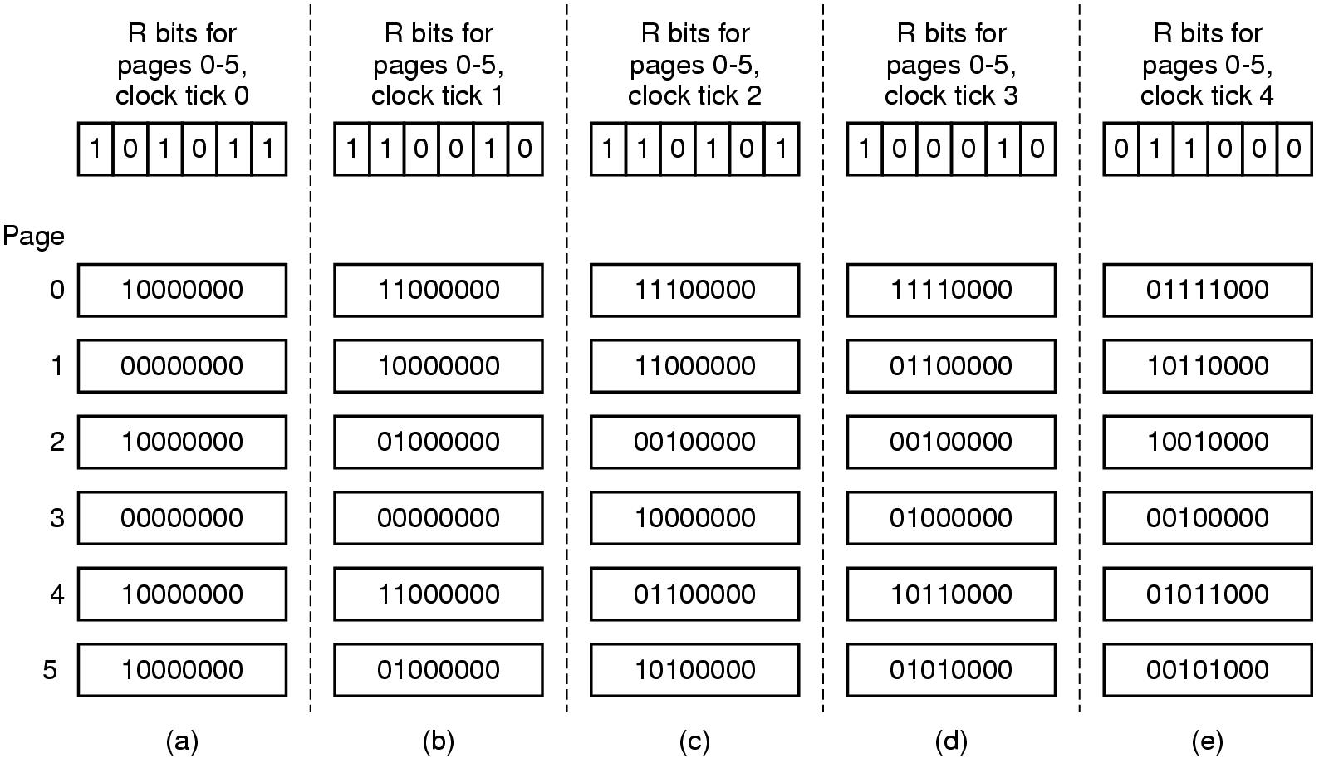
Simulating LRU in Software – Aging Algorithm
Software counter associated with each page
Counter shifted right 1 bit, and R bit added in to the leftmost, at each clock interrupt
Not exact LRU, e.g. pages 3 and 5 after not referenced a while
Figure 3-17. The aging algorithm simulates LRU in software. Shown are six pages for five clock ticks. The five clock ticks are represented by (a) to (e).
Notes:
We are able distinguish within 8 clock cycle but not more than 8 clock cycle

Slide 25
Working Set Page Replacement (1)
The set of pages a process currently using called working set
Principle of locality
Thrashing: if a process has frequent page faults e.g. every few instructions
Demand paging
Prepaging (working set model)
Working set page replacement algorithm
Find a page not in the working set and evict it

Slide 26
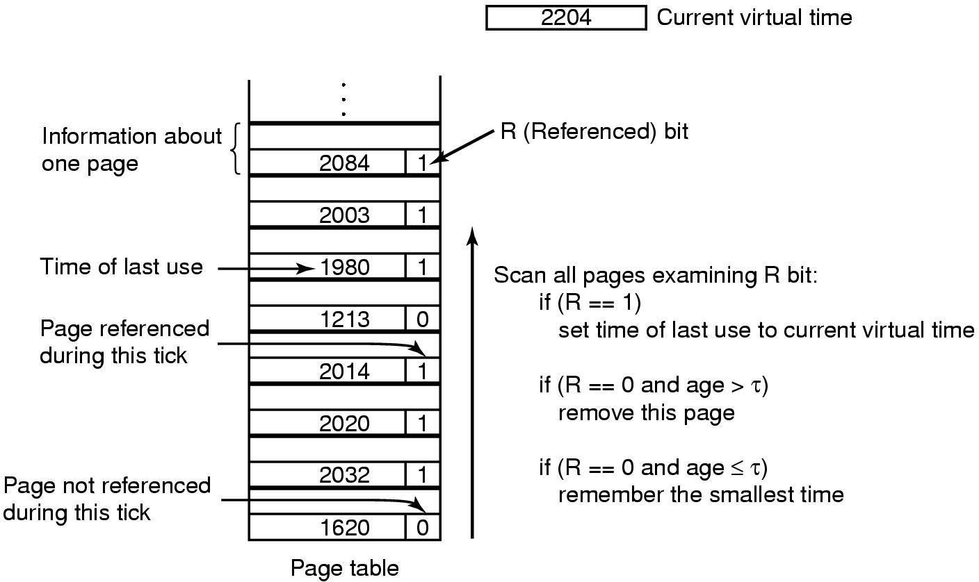
Working Set Page Replacement (2)
Current virtual time: amount of CPU time a process has used since started
τ: a threshold for defining working set
Figure 3-19. The working set algorithm.

Slide 27
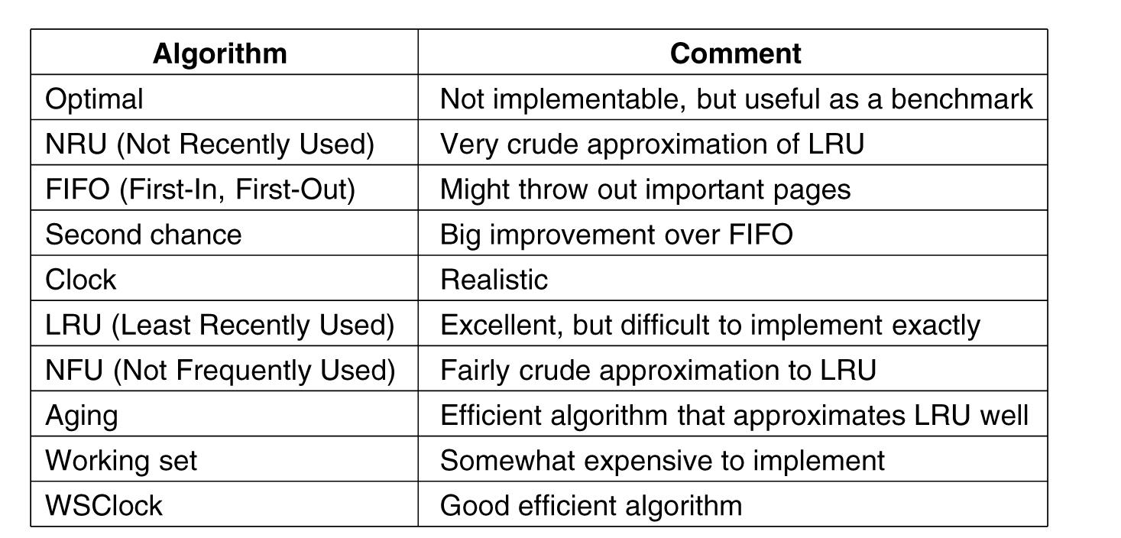
Summary of Page Replacement Algorithms
Figure 3-21. Page replacement algorithms discussed in the text.

Slide 28
Readings
Chapter 3:
Section 3.2
Section 3.3
Section 3.4

Slide 29
Outline
Design Issues for Paging Systems
Local versus global policies
Load control, Page size
Shared pages and shared libraries

Slide 30
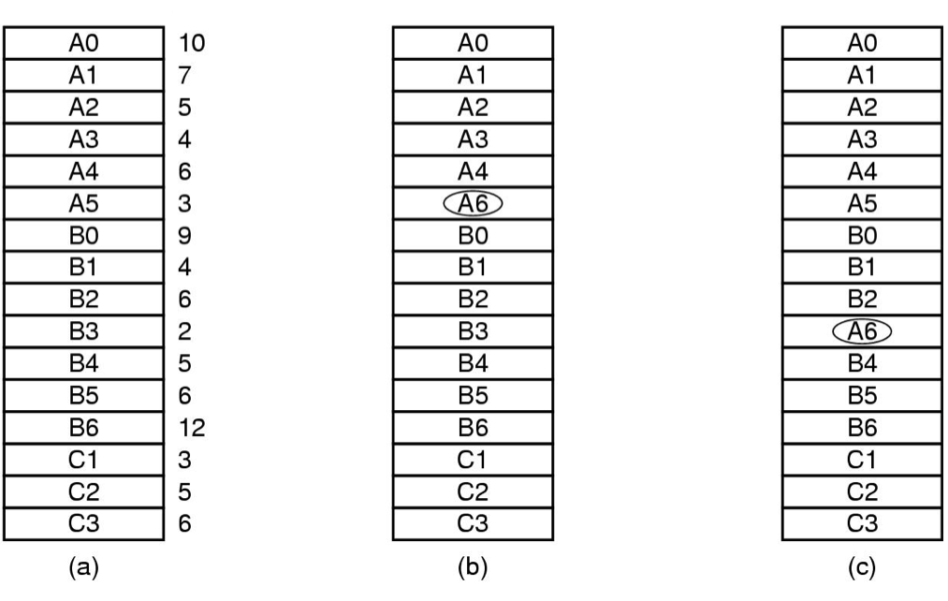
Local versus Global Policies (1)
Local page replacement v.s. global page replacement
Figure 3-22. Local versus global page replacement. (a) Original configuration.
(b) Local page replacement. (c) Global page replacement.
Notes:
Number are counters

Slide 31
Local versus Global Policies (2)
Local page replacement
Allocating each process fixed fraction of memory
Can waste memory if working set shrinks
Can cause thrash if working set grows
Global page replacement
Dynamically allocate page frames among runnable processes
A minimum number of pages for each process still desired

Slide 32
Local versus Global Policies (3)
Two-level page management
Page allocation algorithm + page replacement algorithm
Page allocation algorithm
Equal share of page frames among processes
Proportional to process size
Proportional to Page Fault Frequency (PFF)

Slide 33
Local versus Global Policies (4)
Not all algorithms applicable to global page replacement
What can you think of?
Working set replacement
Applicable to both local and global
OPT
NRU
FIFO, second chance
LRU (and variants), aging

Slide 34
Page Size
It is really a tradeoff and balance among several factors
Small page size
Pros?
Low internal fragmentation
Avoids loading unnecessary program/data and waste of memory
Cons?
Large page table, longer context switch
More times of page transfer
Large page size
The opposite!

Slide 35
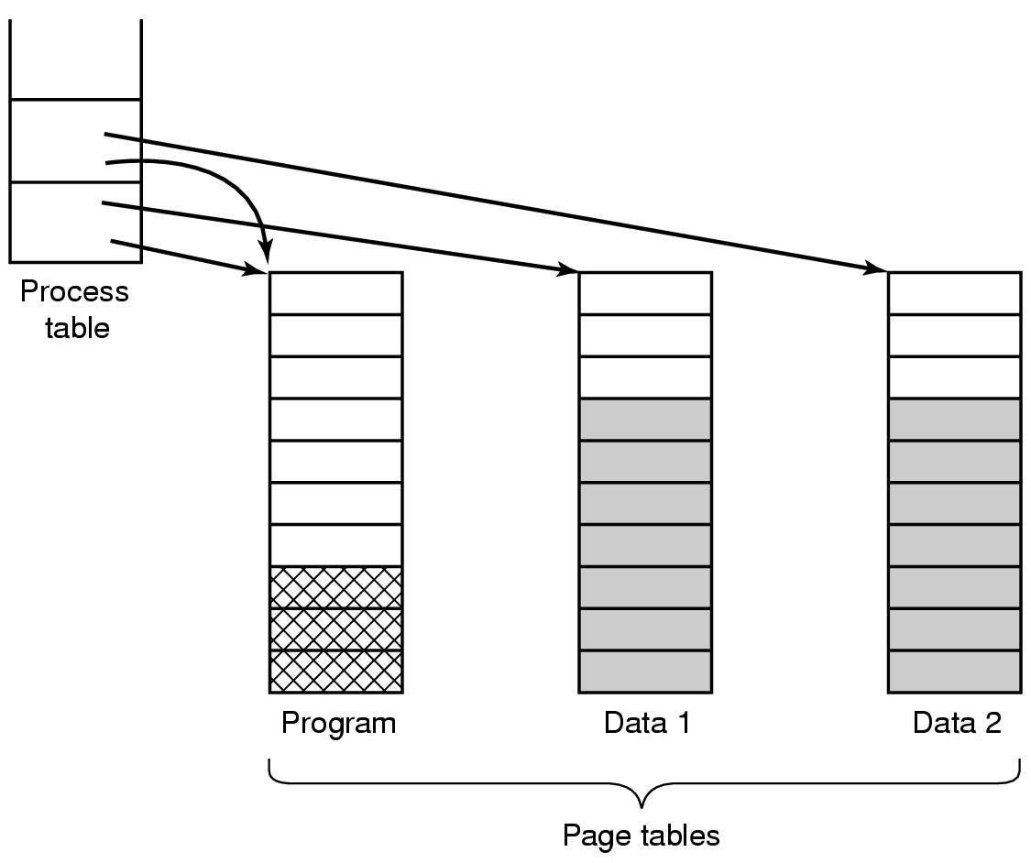
Shared Pages
Sharing program text very common
Sharing data sometimes, what can you think of
Figure 3-25. Two processes sharing the same program sharing its page table.

Slide 36
Readings
Chapter 3:
Section 3.4
Section 3.5

Slide 37
Outline
Questions?
File Systems
Files
File system implementation
Implementing files
Implementing directories

Slide 38
File Systems
Essential requirements for long-term information storage:
It must be possible to store a very large amount of information.
The information must survive the termination of the process using it.
Multiple processes must be able to access the information concurrently.

Slide 39
File Systems
Files
Logical units of information created by processes (abstraction)
File system
An OS component that manages files

Slide 40
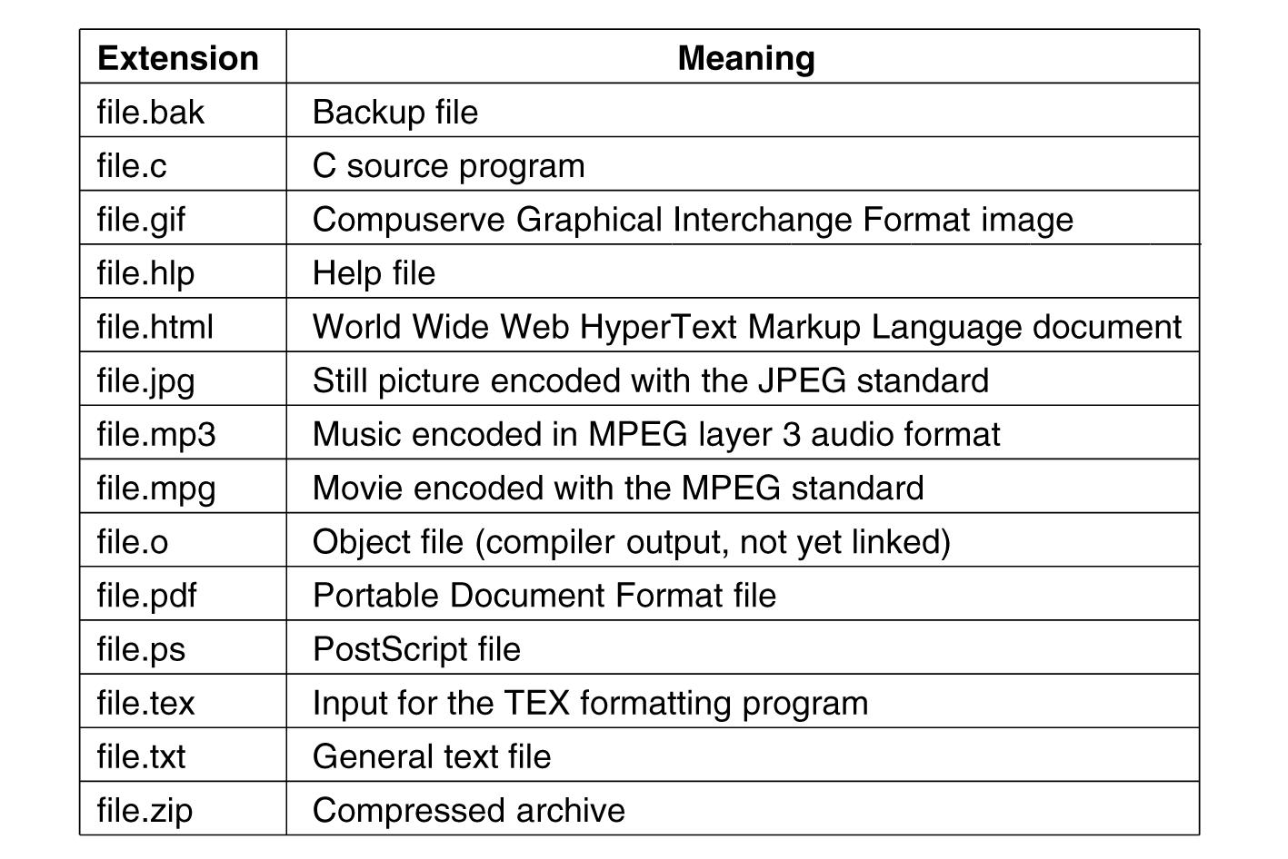
File Naming
Exact file naming rules vary among OSs
E.g. some distinguish between upper/lower case letters whereas others don’t
Usually a two-part file name, separated by a period
The part after the period is called file extension
Figure 4-1. Some typical file extensions.

Slide 41
File Types (1)
Regular files
ASCII files
Binary files
Directories
$file foo.c
Determines file type
Notes:
ASCII files contain lines of text and each line ends by a carriage return character. -> can be edited in text editor
Binary files only for specific program. For example executable files.

Slide 42
File Operations
The most common system calls relating to files:
Create
Delete
Open
Close
Read
Write
Append
Seek
Get Attributes
Set Attributes
Rename

Slide 43
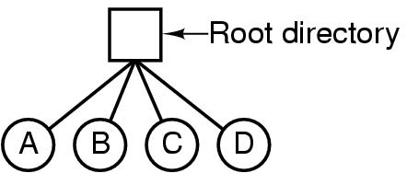
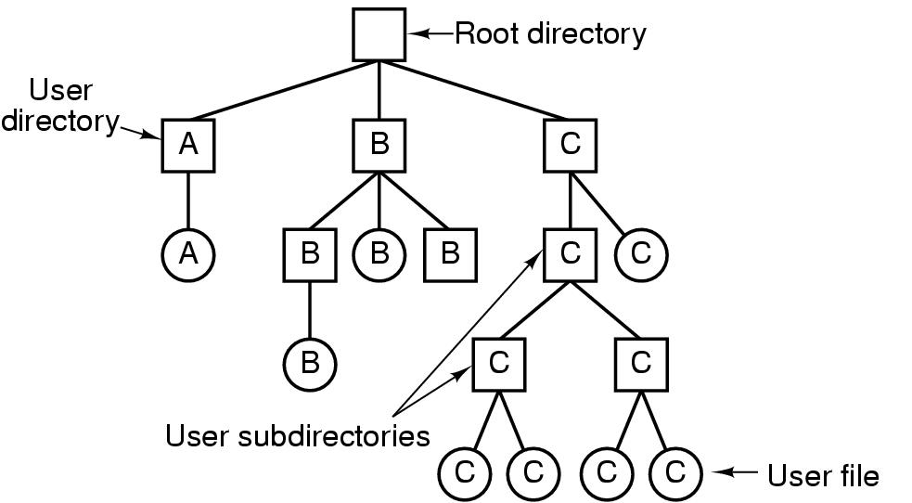
Directories
Directories/folders
Keep track of files (a collection of files/dirs)
Single-level directory systems
Hierarchical directory systems
Figure 4-6. A single-level directory system containing four files.
Figure 4-7. A hierarchical directory system.

Slide 44
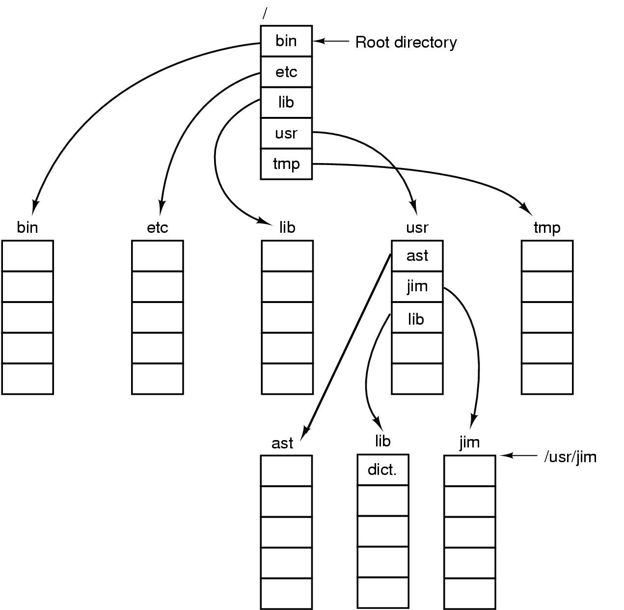
A UNIX directory tree
Figure 4-8. A UNIX directory tree.

Slide 45
Directory Operations
System calls for managing directories:
Create
Delete
Opendir
Closedir
Readdir
Rename

Slide 46
File System Layout
MBR: (Master Boot Record)
Boot block
Superblock
Figure 4-9. A possible file system layout.
Notes:
Master Boot Record is used to boot the computer.
Partition table contain the starting and ending address of each partition.

Slide 47
Implementing Files (2)
OS needs to keep track of which block goes to which file
Contiguous allocation
Linked List Allocation
Linked List Allocation Using a Table in Memory
i-nodes

Slide 48
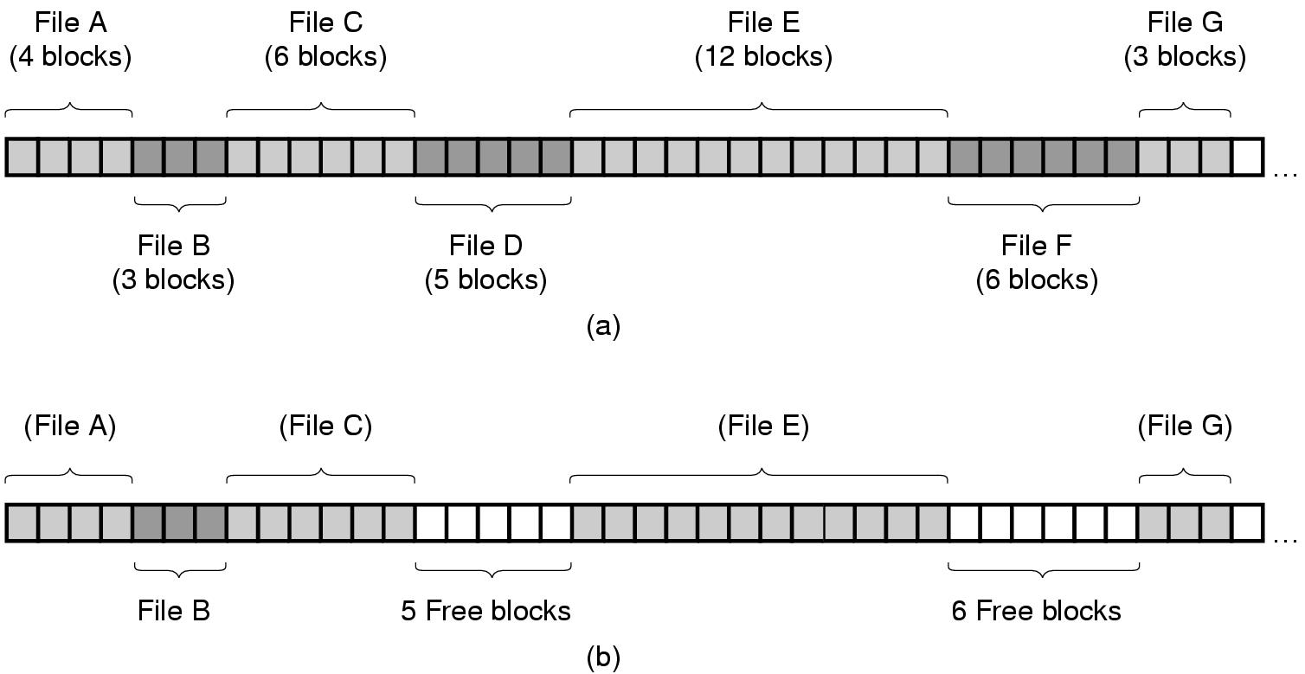
Contiguous Allocation (1)
Figure 4-10. (a) Contiguous allocation of disk space for 7 files.
(b) The state of the disk after files D and F have been removed.

Slide 49
Contiguous Allocation (2)
Pros
Simple to implement (only need to know start addr and num. of blocks)
Sequential access: good performance. Remember the disc structure?
Cons
Need to know file size in advance
Fragmentation (external fragmentation). How to reduce external fragmentation?

Slide 50
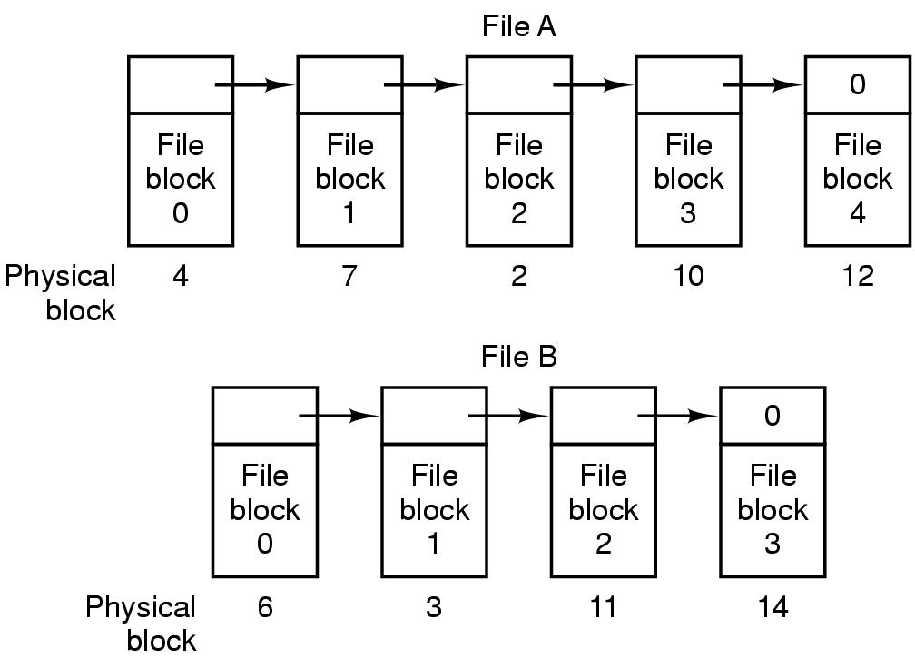
Linked List Allocation (1)
Figure 4-11. Storing a file as a linked list of disk blocks.

Slide 51
Linked List Allocation (2)
Pros
No need to know file size in advance
No external fragmentation, only internal fragmentation
Cons
Random access is slow: need to traverse the next pointer. For example, what is the physical block of the third block of file B?
Irregular storage management: not power of 2 any more. Why?
Notes:
not power of 2 any more due to small size for the next pointer

Slide 52
Linked List Allocation Using a Table in Memory (1)
File Allocation Table (FAT)
Figure 4-12. Linked list allocation using a file allocation table in main memory.

Slide 53
Linked List Allocation Using a Table in Memory (2)
Pros
No need to know file size in advance
No external fragmentation, only internal fragmentation
Easy random access (FAT is entirely in memory -> no disk reference)
Regular storage management (no extra pointer)
Cons
Entire table must be in memory, needing huge memory space
Example on page 286

Slide 54
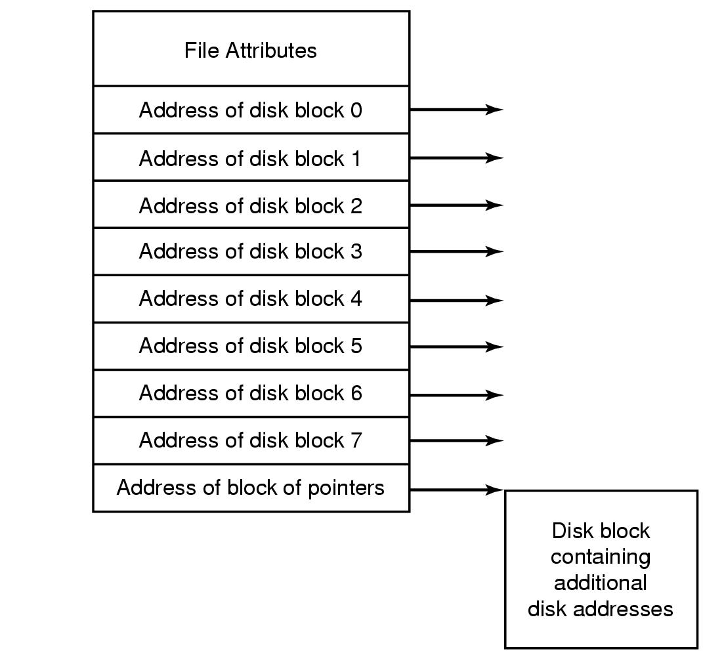
i-nodes
i-nodes: index-nodes
Have all advantages of FAT, plus controlled memory consumption:
i-node only need to be in memory when the file is open
Figure 4-13. An example i-node.

Slide 55
i-nodes
Pros
Only i-nodes of opened files need to be in memory -> not proportional to the disk size
Cons
When a file grows beyond the fixed number of block for each i-nodes?
The solution is to reserve the lost disk address for another i-nodes (see the previous Figure) -> becomes linked list.
Notes:
FAT is proportional to the disk size

Slide 56
Disk Space Management: Block Size (1)
Block size selection is a tradeoff, similar as page size
Large block size
Better performance, more storage waste due to fragmentation (less storage utilization)
Small block size
Better storage utilization (less fragmentation), more seeks and rotational delays (lower performance)

Slide 57
Disk Space Management Block Size (2)
Figure 4-20. Percentage of files smaller than a given size (in bytes).

Slide 58
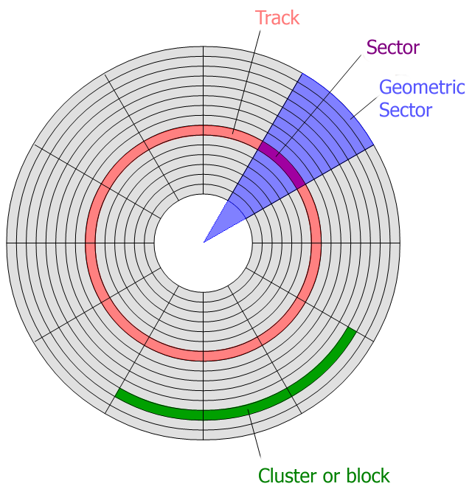
Example on page 301
The image is retrieved from http://keywordsuggest.org/gallery/807348.html

Slide 59
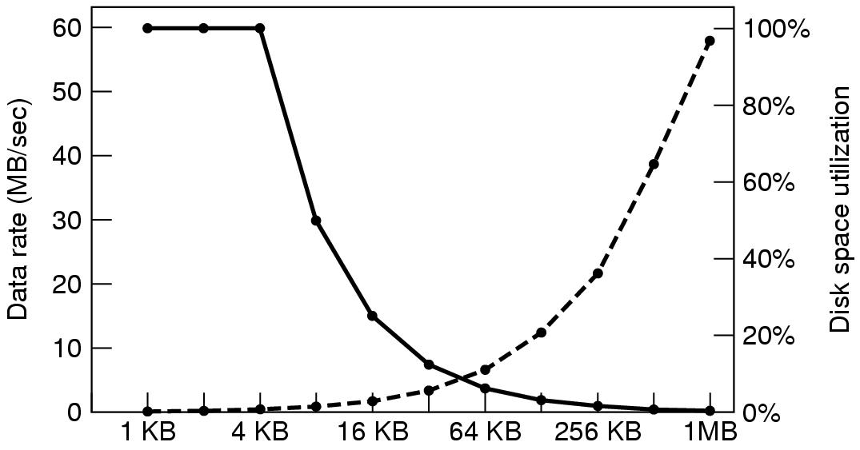
Disk Space Management Block Size (3)
Figure 4-21. The dashed curve (left-hand scale) gives the data rate of a disk. The solid curve (right-hand scale) gives the disk space efficiency. All files are 4 KB.
Notes:
Performance and space utilization is in conflict.

Slide 60
Keeping Track of Free Blocks
Figure 4-22. (a) Storing the free list on a linked list. (b) A bitmap.

Slide 61
File System Backups (1)
File system backups often performed to recover from disaster
Full backup v.s. incremental backup (incremental dump)
Physical dump v.s. logical dump (dominant)
Physical dump simple and perform fast, but incapable of skipping bad blocks, incremental backups, and restoring individual files

Slide 62
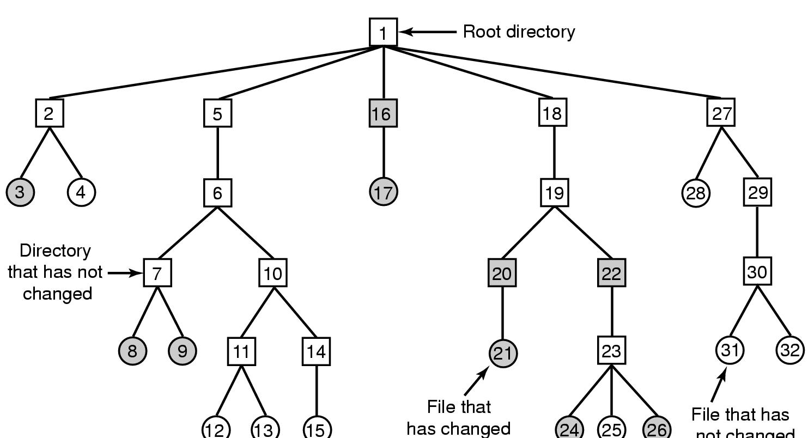
File System Backups (2)
A typical backup algorithm example
Figure 4-25. A file system to be dumped. Squares are directories, circles are files. Shaded items have been modified since last dump. Each directory and file is labeled by its i-node number.

Slide 63
File System Performance
Access to disk is much slower than access to memory
Typical techniques used for optimizing file system performance
Caching
Block read ahead (prefetching)
Reducing disk arm motion

Slide 64
Caching (1)
Buffer Cache (Block Cache)
When a request comes in
Check to see if needed blocks in the cache; if yes, satisfied immediately
If not, bring the block into buffer cache (find a replacement victim if needed) and serves the request
Replacement algorithms discussed for paging system apply to buffer cache replacement too
Caching can also be “bypassed” (dis-abled) when not beneficial

Slide 65
Block Read Ahead
“Prefetching”
When the file system fetches the requested block k, it also fetches block k+1, k+2, …, k+d
Assuming and beneficial for sequential accesses
If a file is being randomly access -> it hurts

Slide 66
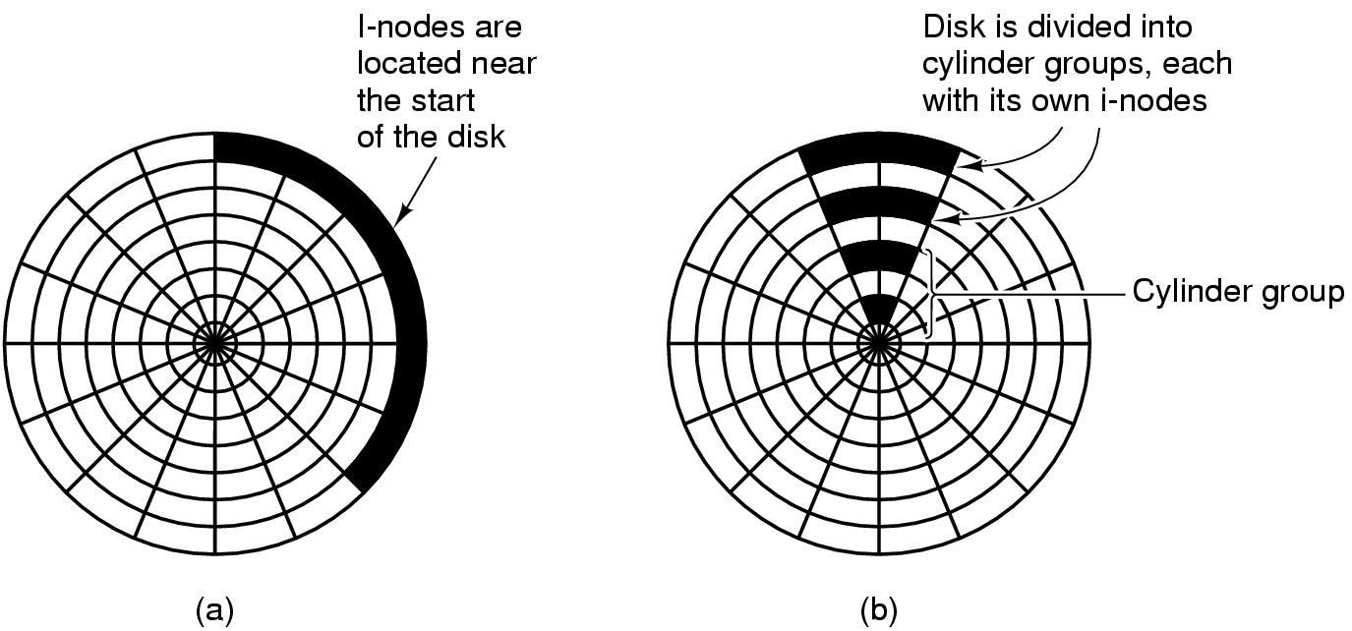
Reducing Disk Arm Motion
Placing contiguous blocks close, e.g. in the same cylinder
Placing i-node block in the middle of block: reduce the seeking time of the i-node and the fist block by a factor of 2
Using cylinder groups: i-node can be in any group but try to find block in the same (or nearby cylinder group).
Figure 4-29. (a) I-nodes placed at the start of the disk. (b) Disk divided into cylinder groups, each with its own blocks and i-nodes.
Notes:
When allocate a new block for a file, it is easier if free block are recorded in bitmap rather than in free list.

Slide 67
Readings
Chapter 4:
Section 4.3
Section 4.4

Slide 68
Outline
Example file systems
MS-DOS file system
Unix v7 file system
CD-ROM file systems

Slide 69
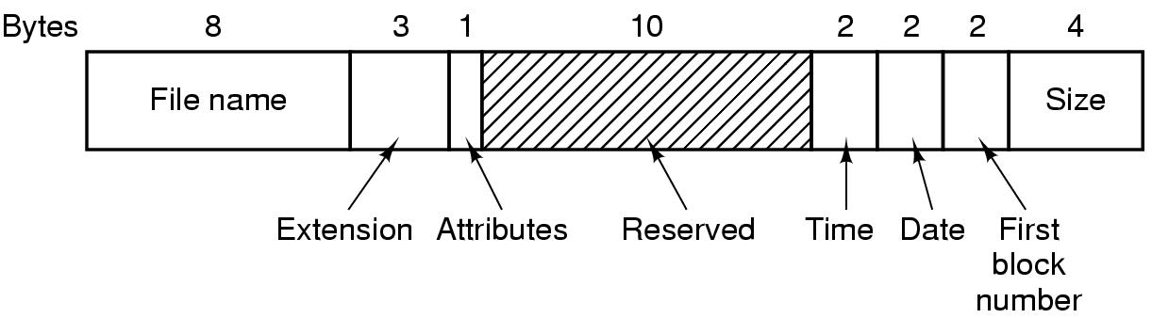
The MS-DOS File System (1)
Have been used through Windows 98/ME/XP
Uses a file allocation table (FAT) to keep track of free blocks
FAT-12, FAT-16, FAT-32: differ on the number of bits a disk address contains
Figure 4-30. The MS-DOS directory entry.
Notes:
Attributes: read-only, is Hidden, or is system file

Slide 70
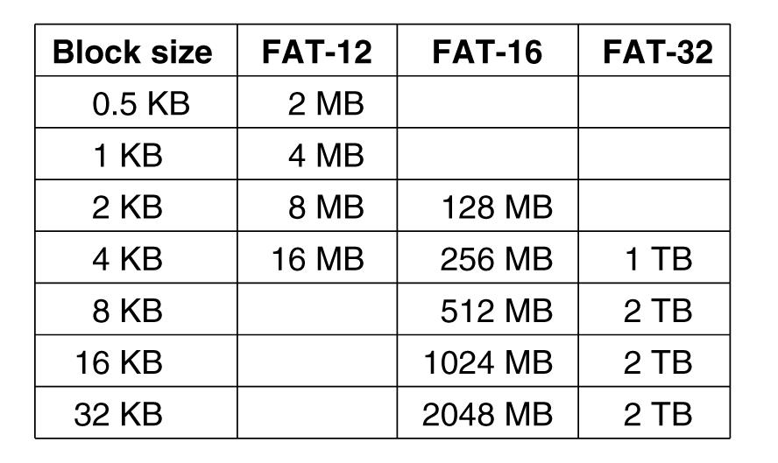
The MS-DOS File System (2)
Figure 4-31. Maximum partition size for different block sizes
Notes:
Eg FAT-16 with 2KB block size: 2^16*2^11=128MB

Slide 71
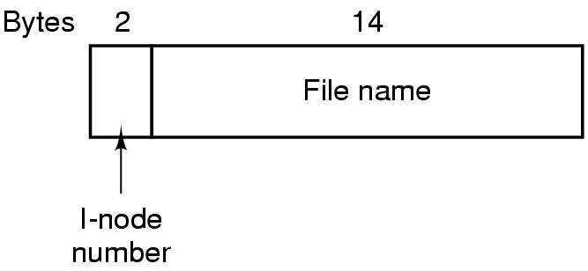
The UNIX V7 File System (1)
Hierarchical structure
What is the maximum number of files (including directories) per V7 file system can have?
Figure 4-32. A UNIX V7 directory entry.
Notes:
2 bytes = 16 bits. => 2^16 (or 64K) different files/directories

Slide 72
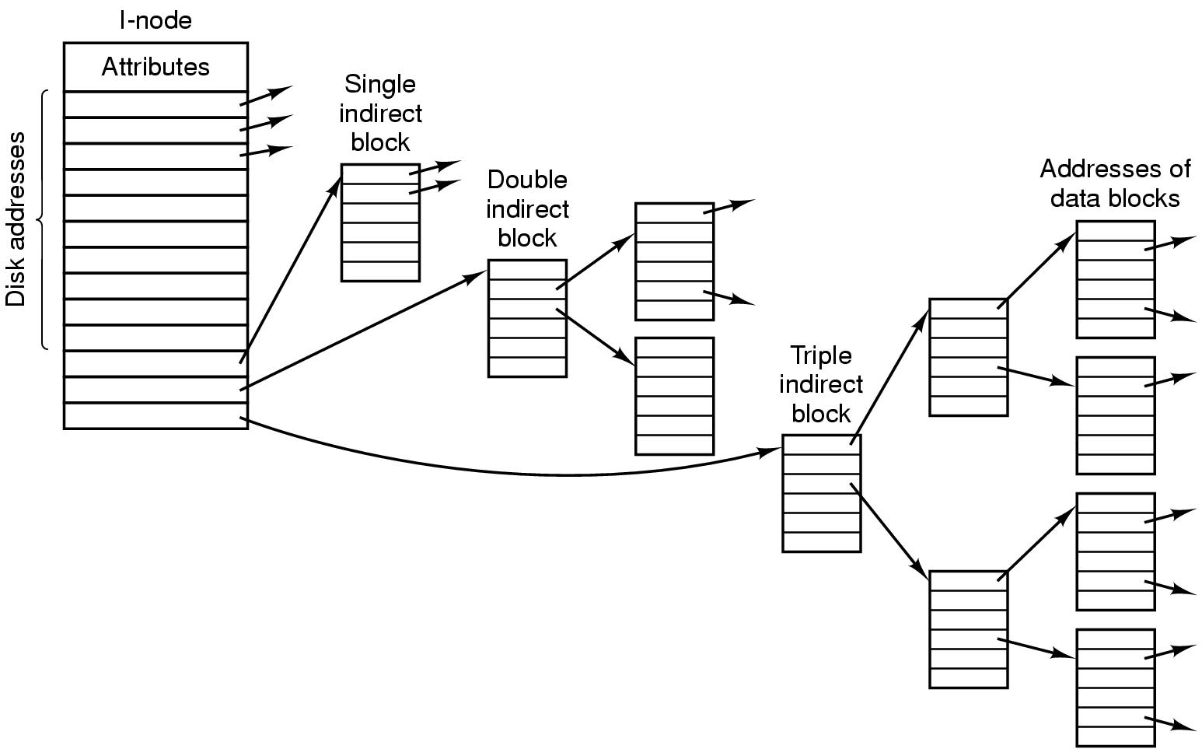
The UNIX V7 File System (2)
Figure 4-33. A UNIX i-node.
Notes:
10*1KB + 256 * 1KB + 256 * 256 * 1KB

Slide 73
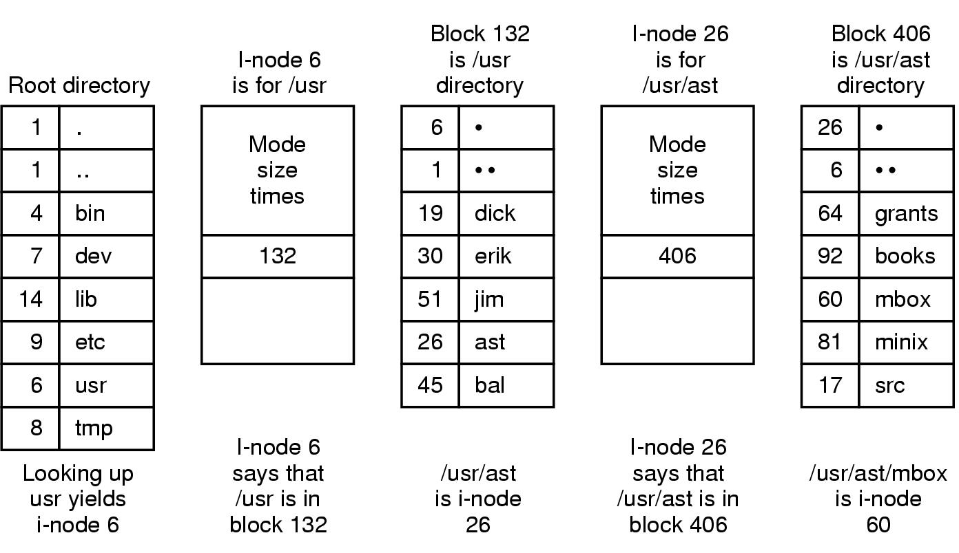
The UNIX V7 File System (3)
Figure 4-34. The steps in looking up /usr/ast/mbox

Slide 74
Readings
Chapter 4:
Section 4.5
Section 4.6

Slide 75
I/O Devices (2)
I/O devices cover a huge range in speeds and needs software to perform well over orders of magnitude in data rates
Figure 5-1. Some typical device, network, and bus data rates.

Slide 76
Device Controllers
I/O devices typically consist of a mechanical component and an electronic component
Mechanical component: The device itself
Electronic component: Device controller (or adapter)
Often follows a standard interface
E.g. ANSCI, IEEE, ISO, USB, FireWire (IEEE 1394)
Has registers (for commands) and data buffer to communicate with CPU, e.g. video RAM

Slide 77
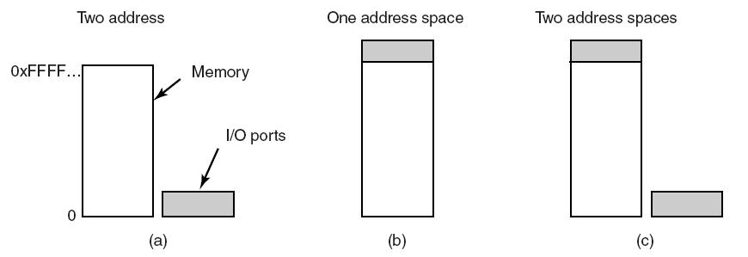
Direct I/O
Two alternatives exist for how CPU communicates with the control registers and the device data buffers
Direct I/O (separate I/O and memory space, I/O-mapped I/O)
Each control register assigned an I/O port number (forms an I/O port space)
Use explicit I/O instruction to access I/O
E.g. IN REG, PORT; OUT PORT, REG
Completely different address spaces
for memory and I/O
Figure 5-2. (a) Separate I/O and memory space

Slide 78
Memory-Mapped I/O (1)
Memory-mapped I/O: map all control registers into the memory space (single unified address space)
Control registers assigned unique memory addresses (at top)
Usually a second signal line used to tell whether I/O space or memory space needed, then memory or I/O responds
Hybrid scheme also exists
Figure 5-2. (b) Memory-mapped I/O. (c) Hybrid.

Slide 79
Memory-Mapped I/O (2)
Advantages
Device control registers can be addressed in C/C++ (like other variables) thus programs can be written entirely in C/C++
No special protection needed, OS simply refrains from putting the portion of address space containing control registers to any virtual address space
Every instruction that can reference memory can be used to reference control registers

Slide 80
Memory-Mapped I/O (3)
Disadvantages
Caching is problematic, need to disable caching control registers, per page basic -> add complexity

Slide 81
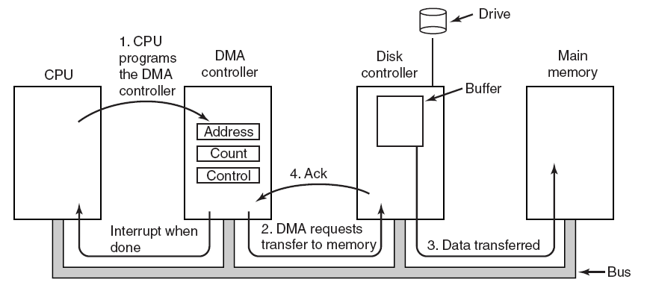
Direct Memory Access (DMA)
CPU can waste cycles if directly interacts with I/O devices
A DMA scheme is often used to free up CPU
Figure 5-4. Operation of a DMA transfer.
Notes:
Without DMA, OS use CPU to transfer byte by byte or word by word between Main memory and I/O devices.
DMA can be on each device controller or on the mother board.
DMA can handle multiple transfers at a time -> Scheduling FIFO, or round robin

Slide 82
Direct Memory Access (DMA)
DMA varies, the simple one handles one transfer at a time
Complex ones handle multiple transfers once
Device internal buffer needed even with DMA as:
Verify the checksum before a DMA transfer
Better efficiency

Slide 83
Outline
Questions?
Quiz 3 review
Principles of I/O Hardware
I/O devices and device controllers
Memory-mapped I/O and Direct Memory Access (DMA)
Principles of I/O Software
Goals of I/O software
Programmed I/O, interrupt-driven I/O and I/O using DMA

Slide 84
Goals of the I/O Software (1)
Device independence
Programs developed should be independent from devices
E.g. read a file on a hard disk drive/CD-ROM/DVD/USB drive
OS needs to take care of the difference of devices and hides them
Uniform naming
Name of a device should be a string or an integer, independent from the device
Error handling
Error handling should be as close to the hardware as possible
E.g. controller -> device driver -> upper layers

Slide 85
Goals of the I/O Software (2)
Synchronous v.s. Asynchronous
Synchronous: blocking (lower performance), easier to develop programs
Asynchronous: interrupt-driven, non-blocking, harder to develop
Buffering (often needed)
Sharable v.s. dedicated devices
Some devices can be shared by multiple users simultaneously, e.g. disks, whereas some others are not, e.g. printers

Slide 86
Readings
Chapter 5:
Section 5.1
Section 5.2

Slide 87
I/O Software Layers

Slide 88
Device Drivers (1)
Device driver: a device-specific code that controls devices
Normally provided by devices’ manufacturer
Usually handles one device type or one class of related devices
Normally part of OS kernel
Normally needs OS to have a well-defined model for what an outsider driver does and how interacts with the rest OS

Slide 89
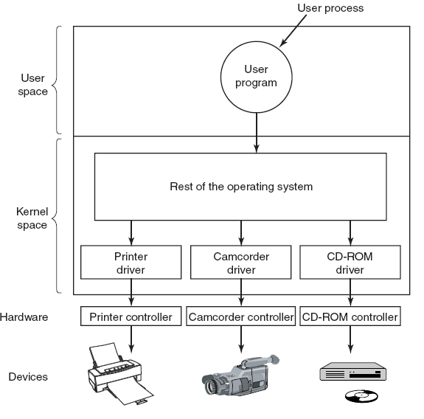
Device Drivers (2)
Figure 5-12. Logical positioning of device drivers. In reality all communication between drivers and device controllers goes over the bus.

Slide 90
Device Drivers (3)
Functionalities
Accept abstract read/write requests from the device-independent software above it
Manage devices, initialize devices, manage power and logs

Slide 91
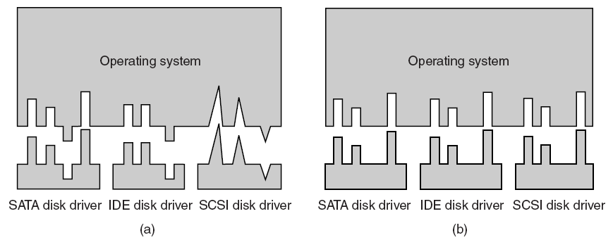
Uniform Interfacing for Device Drivers
Same driver interface desired
OS defines a set of functions that drivers must supply
OS sets unified device names as well, e.g. with major device number and minor device number
Figure 5-14. (a) Without a standard driver interface. (b) With a standard driver interface.

Slide 92
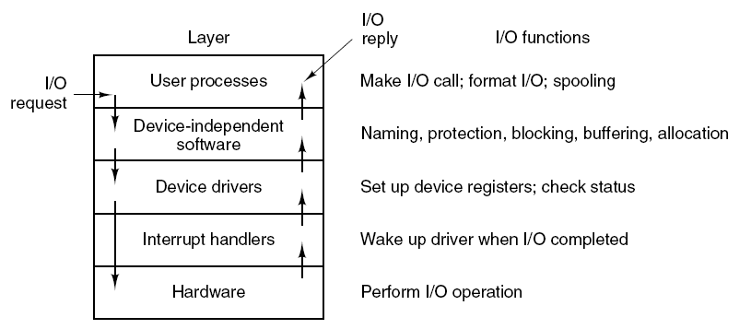
Summary of I/O Software Layers
Figure 5-17. Layers of the I/O system and the main functions of each layer.

Slide 93
Outline
Questions?
Principles of I/O Software
Programmed I/O, interrupt-driven I/O and I/O using DMA
I/O Software Layers
Interrupt handlers, device drivers
Device-independent I/O software, user-space I/O software
Disks
Magnetic disks

Slide 94
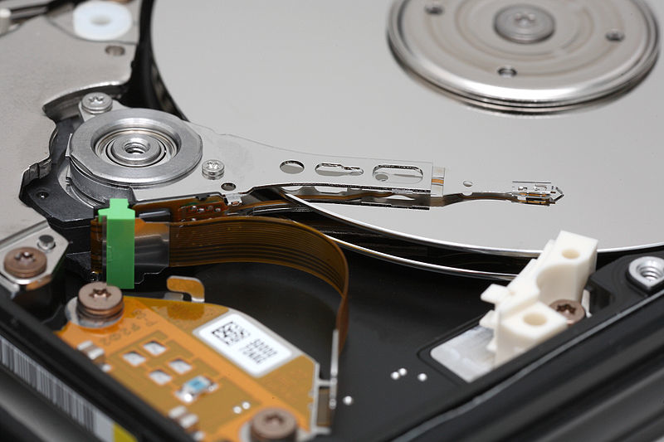
Magnetic Disks

Slide 95
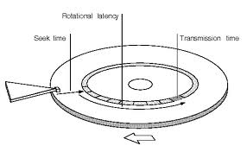
Disk Drive Performance
Write/Read Requests arrive at the disk as block (sector) requests
Seek Time: Disk head must move to the correct track
Latency: Time for the rotation of the disk to reach the correct sector
Best Case: 0
Worst Case: Full Rotation (15K RPM = 250 RPS = 4 millisecs)
Access Time
Seek Time + Latency + Transfer Time

Slide 96
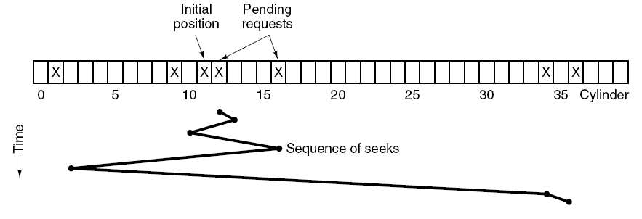
Disk Arm Scheduling Algorithms (2)
FCFS performs poorly and has low efficiency even fair
E.g. requests: cylinder 11, 1, 36, 16, 34, 9, 12
Shortest Seek First (SSF) optimizes seek time but loses fairness
Figure 5-24. Shortest Seek First (SSF) disk scheduling algorithm.

Slide 97
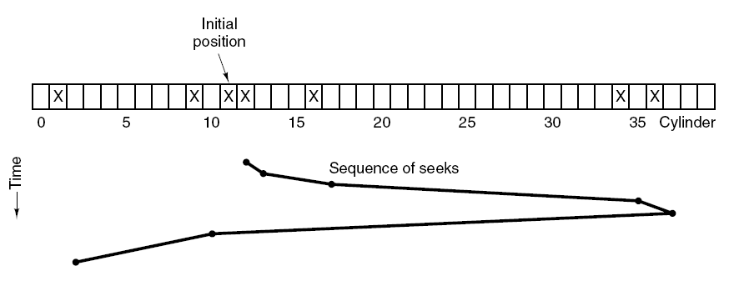
Disk Arm Scheduling Algorithms (3)
Elevator algorithm
Moving UP
Moving DOWN
Figure 5-25. The elevator algorithm for scheduling disk requests.

Slide 98
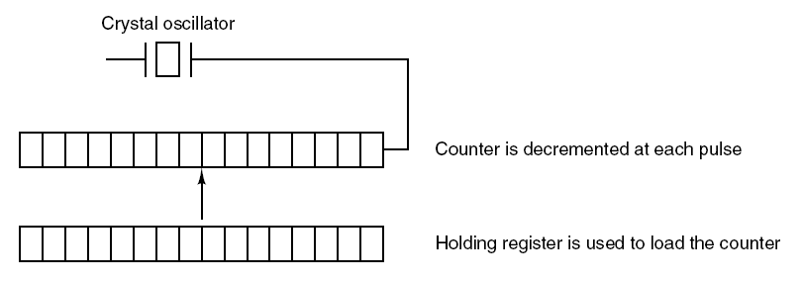
Clocks and Clock Hardware (1)
Clocks (timers) maintain time and generate interrupts
Old clocks use voltage cycle to generate interrupt at 50/60Hz
Common clocks nowadays use crystal oscillator (up to 1000MHz)
Interrupt intervals can be programmed with the register, “clock ticks”
Figure 5-28. A programmable clock.

Slide 99
Outline
Questions?
Clocks
Clock hardware, synchronization
Clock software, soft timers
User interface devices
Input devices
Output devices
Power management
Hardware/software

Slide 100
Readings
Chapter 5

