Slide 1



CS4352 Operating Systems
Lecture 5
Instructor: Tommy Dang, Ph.D.
Assistant Professor
Department of Computer Science
Texas Tech University

Slide 2
Outline
Questions?
Processes
Process model
Process creation, termination, hierarchy, states
Implementation of processes
Modeling multiprogramming
Threads
Thread usage
Thread model
POSIX Threads

Slide 3
Processes
Process: a running program, associated with all resources
Address space
Registers
Open files
Etc.
A program running twice (two “instances”) creates two processes (can possibly share the text segment)
Abstraction supports multiprogramming
Support pseudo concurrent operation even on single (uni-core) CPU
“pseudoparallelism”
Notes:
What is a true parallelism?
In this lecture, we assume there is only 1 CPU.

Slide 4
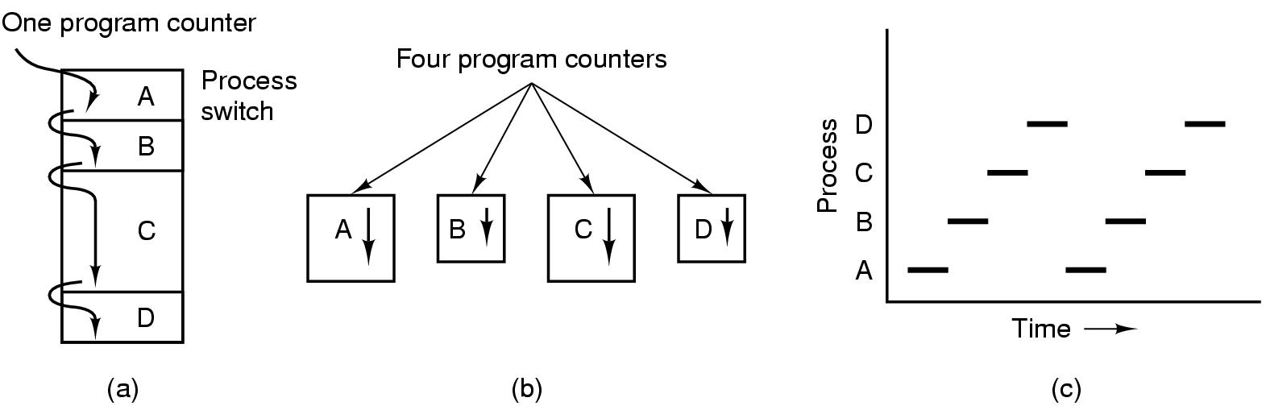
The Process Model
Figure 2-1. (a) Multiprogramming of four programs. (b) Conceptual model of four independent, sequential processes. (c) Only one program is active at once.
Notes:
(c): Vertical line meet only 1 line. How about the case of multicore?

Slide 5
Process Creation
Four primary events causing processes to be created
System initialization
Execution of a process creation system call by a running process
A user request to create a new process
Initiation of a batch job (job queue)
Technically a new process is created by having an existing process execute a process creation system call
Unix: fork()
Windows: CreateProcess()
foreground processes
background processes (daemons)
$ ps

Slide 6
Process Termination
Conditions
Normal exit (voluntary)
Error exit (voluntary)
Fatal error (involuntary)
Killed by another process (involuntary)
Unix: kill() with SIGKILL
Windows: TerminateProcess()
Notes:
Normal: when the program is done. For example, in C
Error: program bugs. Segmentation faults, out of heap, divide by 0.
Fatal: Compile/Execute a file that does not exist.
Kill: Kill live-server or using Activity monitor

Slide 7
Process Hierarchies
Processes not necessarily organized in a hierarchy structure
Unix:
Processes organized in a hierarchical way
All processes are descendants of an init process
Windows:
No concept of process hierarchy; processes are equal

Slide 8
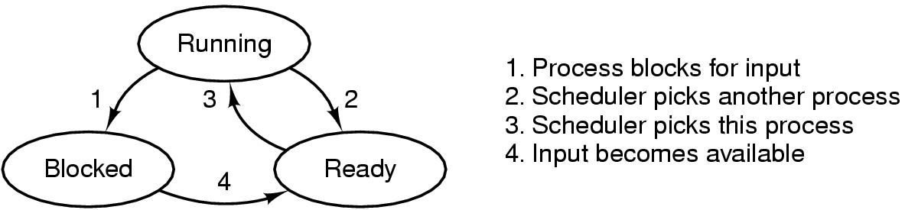
Process States
Process scheduler
Figure 2-2. A process can be in running, blocked, or ready state. Transitions between these states are as shown.
Notes:
From Running, what is the difference between 1 and 2
Can we go from Blocked to Running?
Can we go from ready to blocked?

Slide 9
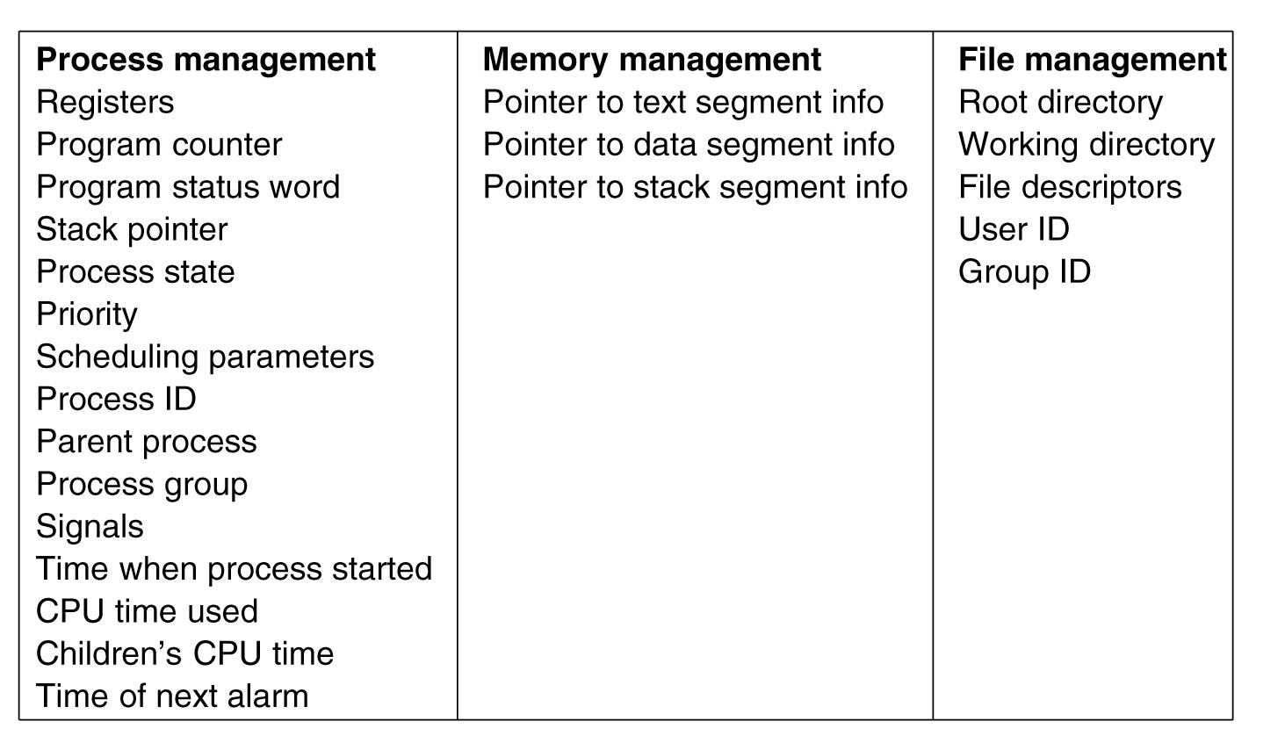
Implementation of Processes
Process table or Process Control Blocks (PCB) table
Figure 2-4. Some of the fields of a typical process table entry.

Slide 10
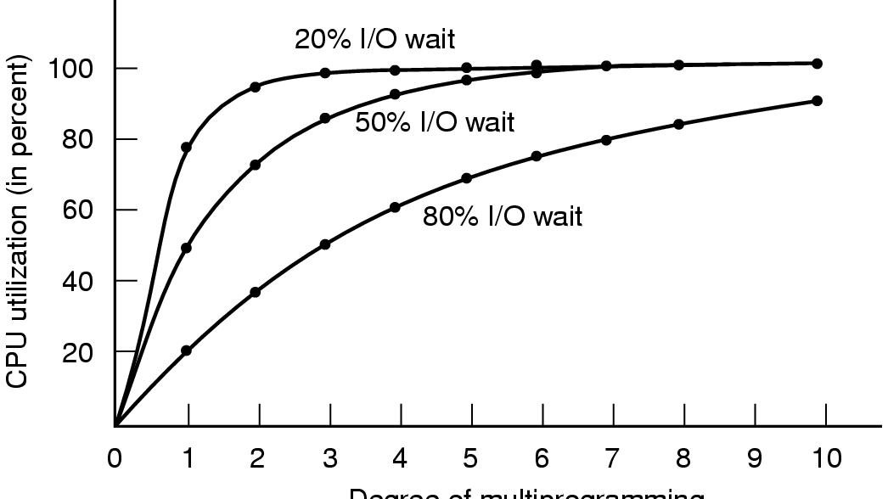
Modeling Multiprogramming (1)
CPU utilization = 1 – p^{n}
p: I/O fraction time
n: number of processes
Assuming processes are independent (e.g. without scheduling conflict)
Degree of multiprogramming
Figure 2-6. CPU utilization as a function of the number of processes in memory.
Notes:
With 50% I/O for 2 processes, what is the wait time?
In this figure, How many processes do we need to keep the waste time of CPU less than 10%.
Use the Graph and Formula

Slide 11
Modeling Multiprogramming (2)
Approximate predictions about CPU utilization, e.g.
A computer has 512 MB of memory, with OS taking up 128 MB and each user program also taking up 128 MB
3 user programs to be in memory at once
With an 80% average IO wait, a CPU utilization of 1 - 0.8³ or ~49%
Adding another 512 MB allows the system to go from three-way multiprogramming to seven-way multiprogramming, CPU: ~79%
Adding yet another 512 MB would only increase CPU utilization from 79% to 91% (only 12%)

Slide 12
Outline
Questions?
Processes
Process model
Process creation, termination, hierarchy, states
Implementation of processes
Modeling multiprogramming
Threads
Thread usage
Thread model
POSIX Threads

Slide 13
Threads
Threads: lightweight processes
Multiple threads of control but share an address space
Why threads are desired?
Ability of share an address space and data
Lightweight and easier to create and destroy (creating a thread is 10 to 100 times faster than creating a process)
Performance gain for mixed computing and I/O (higher degree of parallelism)
Map to multithreaded/multicore processors

Slide 14
Readings
Chapter 2:
Section 2.1
Section 2.2

