Slide 1



CS4352 Operating Systems
Lecture 3
Instructor: Tommy Dang, Ph.D.
Assistant Professor
Department of Computer Science
Texas Tech University
Tommy Dang made minor modifications on the slides

Slide 2
Outline
Questions?
Computer Hardware Review
Processors, instruction set, registers
Pipeline, superscalar, multithreaded/multicore chips
Memory hierarchy, disks, virtual memory
I/O devices, I/O methods
Buses
Operating System Concepts
Processes/threads, process tree and IPC
Files, protection and security
Shell

Slide 3
Processes/Threads
Processes: running programs
Associated with an Address Space
text/program, data, stack
“core image”: content of address space
Associated with registers
Including PCs, SPs
Associated with other resources
List of open files, signals, related processes
Threads: lightweight processes, without own address space
A process is fundamentally a container that holds all the information needed to run a program
Notes:
Example: vide editor, web browser, email receiver.
Switch
Keep the same state it was stopped
Information explicated stored somewhere
Store in process table,
Core image for text, data, stack; process table for registers, other resources.

Slide 4
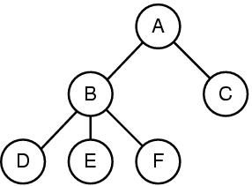
Process Tree and IPC
A process can create other processes
Root/Child processes, process tree
In Unix, an “init” process is the root of all other processes with PID=1 usually
Interprocess Communication (IPC)
Figure 1-13. A process tree. Process A created two child processes, B and C. Process B created three child processes, D, E, and F.
Notes:
1. Command interpretator shell, take command, create new process to run compiler, finish then terminate
2. Sometime processes need to collaborate and synchronize with each other, so they need interprocess communication
Virtual memory
Paging/Page replacement

Slide 5
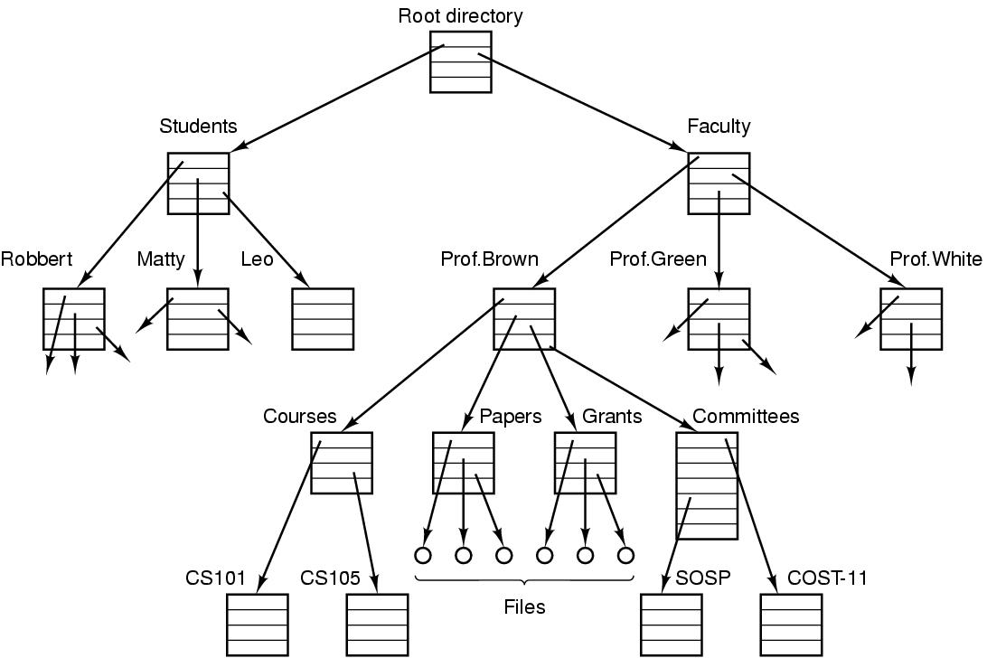
Files
File: an abstraction of a collection of bytes
Directory: a special file containing “pointer” to other files/directories
Root directory: top of the directory hierarchy
Path (absolute/relative)
/Students/Leo/foo
Working directory
File descriptor (FD)
File system: a collection of files, directories, and metadata
Figure 1-14. A file system for a university department.
Notes:
Comparing to process hierarchy , file trees can be deep but process trees are shallow, 3 level is rare
Process table lasts short time, minutes, but file tree lasts for years
Absolute path name vs relative
Working directory, system call to change, relative directory
Open a file, permission, file descriptor

Slide 6
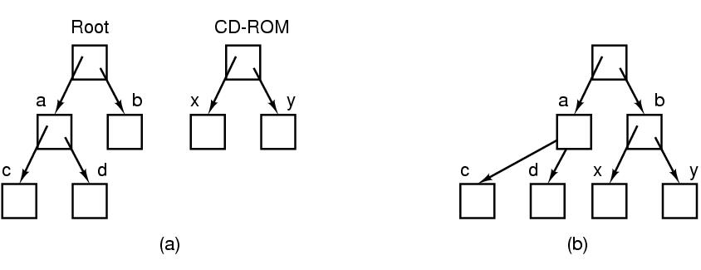
Files (cont.)
File systems can be joined with “mounting”
Figure 1-15. (a) Before mounting, the files on the CD-ROM are not accessible. (b) After mounting, they are part of the file hierarchy.

Slide 7
Outline
Questions?
Operating System Concepts
Files, protection and security
Shell
Unix/Linux Beginner Guide and Shell Programming
System Programming

Slide 8
Protection and Security
User management (UID: User ID)
A superuser “root” with UID=0 in Unix
Group management (GID: Group ID)
Protection mechanisms exist in OS for security
E.g. files in Unix are protected with a 9-bit binary code
Three 3-bit fields, for owner, group members, and everyone else
A 3-bit field: rwx bits, indicate the privilege of read/write/execute
E.g. rwxr-x—x. How to change permission?
What are rwx for a directory?
Notes:
The first character is file type: - is for regular file, d is for directory, and so on.
For directory, x is for searching the content
https://unix.stackexchange.com/questions/150449/what-does-execute-permission-mean-on-a-folder
With the execute bit set you have the permission
1) to cd into the directory (The execute bit is needed to be able to change into the directory.)
2) Also for long listing ls -l i.e. to view the meta data of the files inside the directory (Provided that read permission is there for the directory.
644 means that files are readable and writeable by the owner of the file and readable by users in the group owner of that file and readable by everyone else.
755 is the same thing, it just has the execute bit set for everyone

Slide 9
Shell
Shell: a command-line interface between the user and OS
Many shells exist, e.g. csh, bash
GUI can be another interface, e.g. Gnome on Linux or Windows Explorer
“prompt”: a character telling user waiting to accept a command
E.g. “$” for bash, “%” for csh
Examples
$ date
$ date > file
$ sort < file1 > file2
Notes:
⟨ ⟩ — pointy brackets, angle brackets, triangular brackets, diamond brackets, tuples, or chevrons
< > — inequality signs, pointy brackets, or brackets.

Slide 10
Common Unix/Linux Commands
ls (directory) list your files ls src
ls -a (file/dir) hidden files ls -a
ls -l (file/dir) list size/detail ls -l mpi.c
mkdir (dir) create a directory mkdir src
cd (directory) change to directory cd src;cd ../bin
cd (blank) to your home dir cd
rm (file) delete a file rm a.out
rm -r (dir) delete a directory rm -r src
vi (file) terminal text editor vi mpi.c
mv (file/dir) move/rename mv src src1
man command display help info man ls
Learn to use online help with “man” or “info” command, or search on the Internet

Slide 11
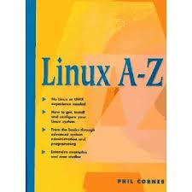
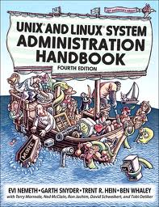
More Unix/Linux Commands
$ info bash
$ man bash
Search online “linux commands”
Books:
“Linux A-Z”, by by Phil Cornes
“UNIX and Linux System Administration Handbook”, by Nemeth

Slide 12
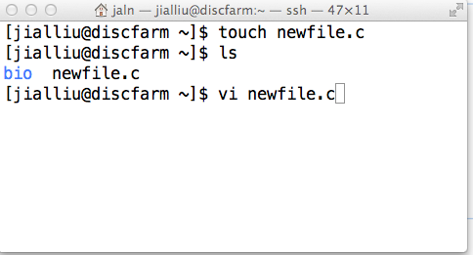
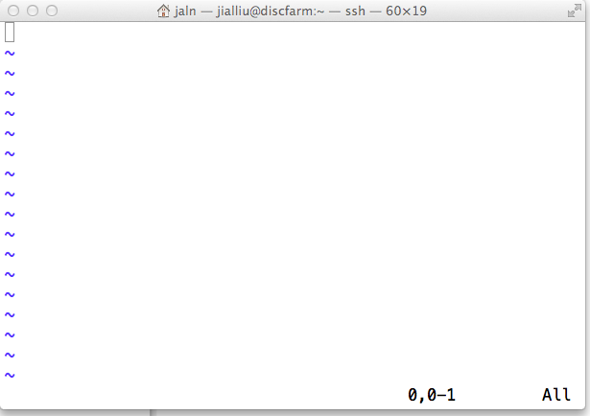
Editing Source Files (1)
Create new file
touch newfile.c
Edit existing file
vi newfile.c
an empty file

Slide 13
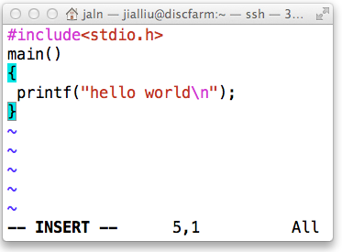
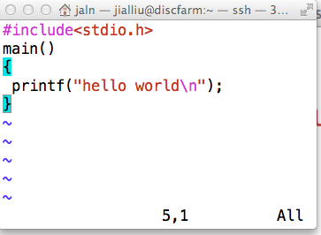
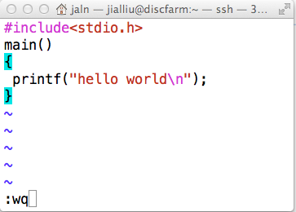
Editing Source Files (2)
Save and quit a file
type i to enter the insert mode
type esc to exit insert mode
type :wq to save&exit
type :q! to exit without save

Slide 14
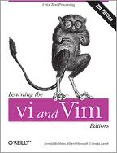
Editing Source Files (3)
vi/vim: (visual editor/vi improved) standard text editor on Unix/Linux platforms
More info: http://www.vim.org/
Book: “Learning the vi and Vim Editors” by Robbins, et. al.
You can also use GNU Emacs editor
http://www.gnu.org/software/emacs/

Slide 15
Shell Programming/Shell Scripting (1)
A shell script is a text file with Unix/Linux commands in it
Shell scripts usually begin with a #! and a shell name (complete pathname of shell).
Pathname of shell can be found using the which command.
The shell name is the shell that will execute this script.
E.g: #!/bin/bash
If no shell is specified in the script file, the default is chosen to be the currently executing shell.
Notes:
Exclamation mark, Exclamation point, or Bang

Slide 16
Shell Programming/Shell Scripting (2)
A shell script as a standalone is an executable program:
Must use chmod to change the permissions of the script to be executable also.
Can run script explicitly also, by specifying the shell name.
E.g: $ bash myscript
E.g: $ csh myscript
A convention is to use suffix .sh, i.e. myscript.sh, to indicate it’s a shell script

Slide 17
Shell Programming/Shell Scripting (3)
Why write shell scripts ?
To avoid repetition:
If you do a sequence of steps with standard Unix/Linux commands over and over, why not do it all with just one command?
Or in other words, store all these commands in a file and execute them one by one.
To automate difficult tasks:
Many commands have subtle and difficult options that you don’t want to figure out or remember every time .
Notes:
Example: create new t.sh and run

Slide 18
Simple Example (1)
Assume that I need to execute the following commands once in a while when I run out of disk space:
$ rm –rf *.stderr
$ rm –rf *.stdout
$ rm –rf *.tmp

Slide 19
Simple Example (2)
We can put all those commands into a shell script, called cleanup.sh.
$ cat cleanup.sh
#!/bin/bash
rm -rf *.out
rm -rf *.err
rm -rf *.tmp
echo "Deleted files with suffix out, err, tmp"

Slide 20
Simple Example (3)
To run the script:
Step 1:
$ chmod u+x cleanup.sh
Step 2:
Run the script:
$ ./cleanup.sh
Each line of the script is processed in order.

Slide 21
Simple Example (4)
To display current date, time, username, and current directory
#!/bin/bash
echo "Hello, $LOGNAME”
echo "Current date is `date`”
echo "User is `whoami`”
echo "current directory is `pwd`"

Slide 22
Environmental Variables
Environmental variables hold special values.
Environmental variables are set by the system on initial login
/etc/profile, /etc/profile.d/ and ~/.bash_profile or ~/.profile.
If you want to know what the variable holds call it with a "$" sign:
$ echo SHELL
SHELL
$ echo $SHELL
/bin/bash
$ echo $HOME
/cchome/arodrigu1
$ echo $PATH
/usr/X11R6/bin:/usr/local/bin:/bin:/usr/bin
env command

Slide 23
More Environmental Variables
PATH: The search path for commands
LOGNAME: contains the user name
HOSTNAME: contains the computer name.
MACHTYPE: system hardware
PWD: current path you are at
Please note unless you add current directory “.” into the PATH variable, otherwise you need to use like “./a.out” to a program called “a.out” in the current directory. It is NOT recommended to add current directory “.” into the PATH for security reason.

Slide 24
Local Variables
We can use variables as in any programming languages
Stored as strings
Declaring a variable:
$ STR='Hello World!'
$ echo $STR
Hello World!
Assign a value to a variable
Call the variable by putting the '$' at the beginning
This '$’ is different from the first $ the beginning of command line

Slide 25
Control Statements
Three most common types of control statements:
Conditionals: if/then/else, case, ...
Loop statements: while, for, until, do, ...
Please read more from “man bash” or “info bash” or from the Internet

Slide 26
An Example
Given in the lecture

Slide 27
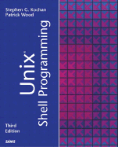
More on Shell Programming
Search “shell programming” or “shell scripting”
Book:
“Unix Shell Programming” by Kochan

Slide 28
Outline
Questions?
Operating System Concepts
Files, protection and security
Shell
Unix/Linux Beginner Guide and Shell Programming
System Programming

Slide 29
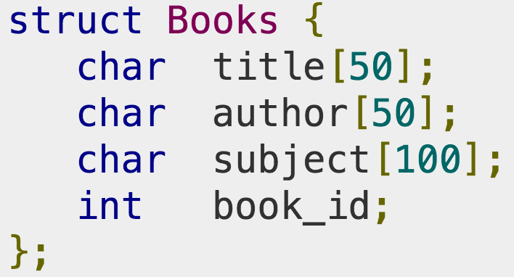
C Language Review
OS are large C/C++ programs
The C language
Pointer (example on page 74),
Struct
Explicit memory management (malloc, free), …
Header files
Declarations, definitions, macros
Large programming projects
Preprocessor
Compiler
Linker
Notes:
Difference between Shallow copy and Deep copy
http://net-informations.com/faq/net/shallow-deep-copy.htm

Slide 30
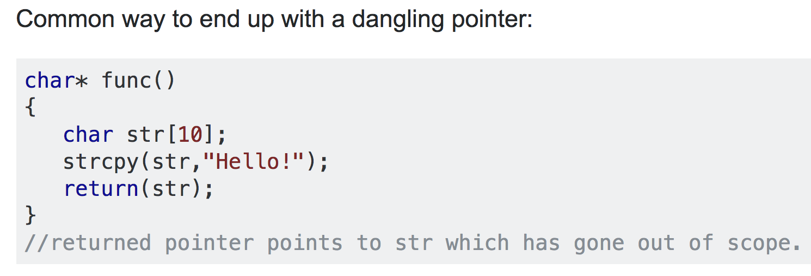
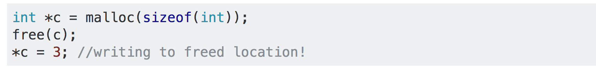
C Language Review
Dangling pointer
Notes:
Another common dangling pointer example is an access of a memory location via pointer, after free has been explicitly called on that memory.
TD: In the second example, after free(c), c can point to any part of the memory -> What if c is pointing to some memor that is currently used by OS or program -> *c = 3 could create a problem
http://www.acodersjourney.com/2018/05/top-20-c-pointer-mistakes/

Slide 31
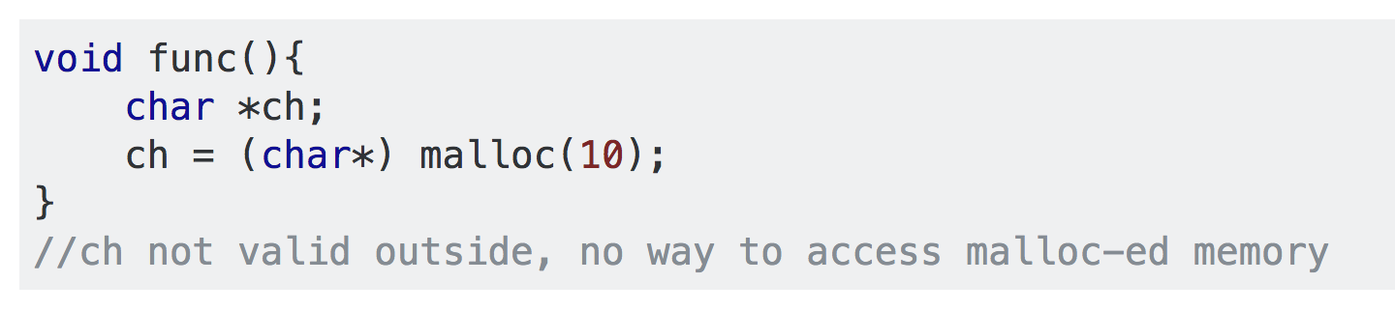
C Language Review
Memory leak
Notes:
Another common dangling pointer example is an access of a memory location via pointer, after free has been explicitly called on that memory.

Slide 32
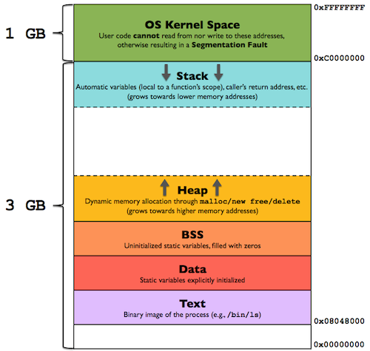
New slide
https://gabrieletolomei.wordpress.com/miscellanea/operating-systems/in-memory-layout/
Notes:
Nice info about Virtual Memory mapping: https://gabrieletolomei.wordpress.com/miscellanea/operating-systems/virtual-memory-paging-and-swapping/

Slide 33
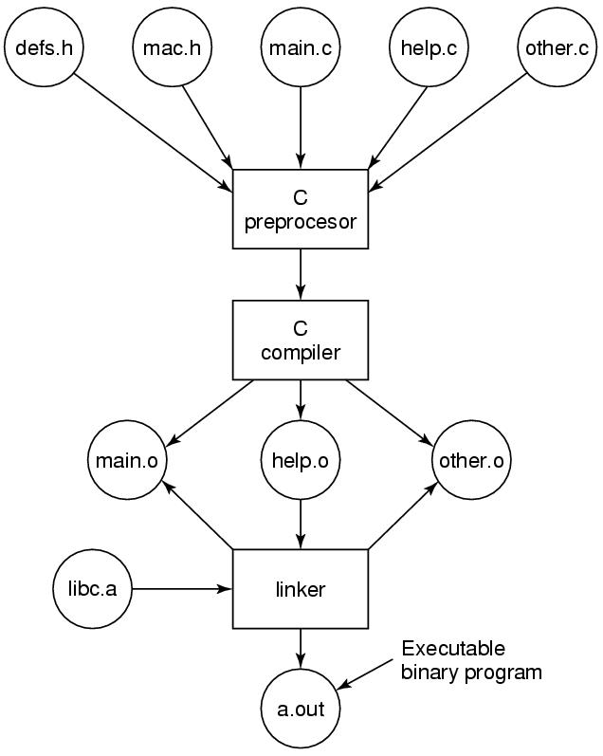
C Project Review
Figure 1-30. The process of compiling C and header files to make an executable.

Slide 34
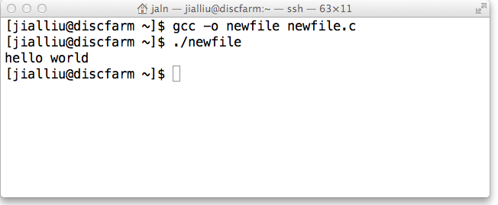
Compiling and Running
Compile
gcc –o newfile newfile.c
Run
./newfile
(Optional) Redirect output
./newfile > output

Slide 35
Examples
Some examples:
http://www.programmingsimplified.com/c-program-examples
Scanf reference:
https://www.tutorialspoint.com/c_standard_library/c_function_scanf.htm
Notes:
Example Fibonacci + Factorial

Slide 36
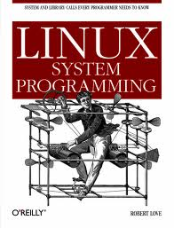
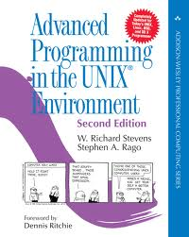
Programming Materials
Books:
“Linux System Programming”
“Advanced Programming in the Unix Environment” (APUE) by W. Richard Stevens
Online:
Stack Overflow
www.unix.com
The Geek Stuff
Tutorial for Beginners
Advanced Linux Programming

Slide 37
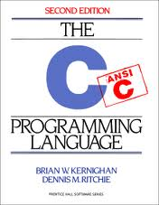
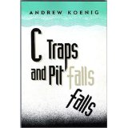
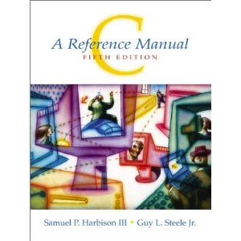
C Language Books
C Programming Language (2nd Edition)
By Brian W. Kernighan, Dennis M. Ritchie
C: A Reference Manual (5th Edition)
By Samuel P. Harbison, Guy L. Steele, Guy L. Steele Jr
C Traps and Pitfalls
By Andrew Koenig

Slide 38
Readings
Chapter 1
Section 1.5
Section 1.8

