Slide 1



CS4352 Operating Systems
Lecture 13
Instructor: Yong Chen, Ph.D.
Assistant Professor
Department of Computer Science
Texas Tech University

Slide 2
Course Info
Lecture Time: Tue. and Thur., 11 a.m. – 12:20 p.m.
Lecture Location: Engineering Center 204
Instructor: Yong Chen, Ph.D., 806-834-0284, Assistant Professor
Contact: yong.chen@ttu.edu,, EC 315
Office Hours: Tue. and Thur., 10 a.m. – 11 a.m., or by appointment
TA: Mr. Heng Wu, heng05.wu@ttu.edu Office Hours: Wed. and Fri., 10 a.m. – 12 p.m., or by appointment
Mail: Texas Tech University, Box 43104, Lubbock, TX 79409-3104
More info:
http://www.myweb.ttu.edu/yonchen
http://discl.cs.ttu.edu; http://cac.ttu.edu/

Slide 3
Reminders/Announcements
WA#3 due on 10/13
Please note this is a hard deadline
Review session scheduled on 10/13
Midterm exam scheduled on 10/18, class time
Covers chapter 1, 2, and 3

Slide 4
Outline
Questions?
Design Issues for Paging Systems
Shared libraries, Cleaning policy
Implementation Issues for Paging Systems
OS involvement, page fault handling
Locking pages, backing store
Separation of policy & mechanism
Segmentation

Slide 5
Shared Libraries (1)
Sharing can happen at the library level, e.g. GUI library
Statically binding them to every executable expensive
Waste disk storage
Waste memory (no way to know they’re sharing!)
Shared libraries (or DLLs, Dynamic Link Libraries on Windows)
Linker includes a small stub routine binds and loads at run time (paged in, and no need to load if another program already loads it)
Make efficient use of memory and storage
More importantly, update/patch much easier! (no need to recompile programs using it)

Slide 6
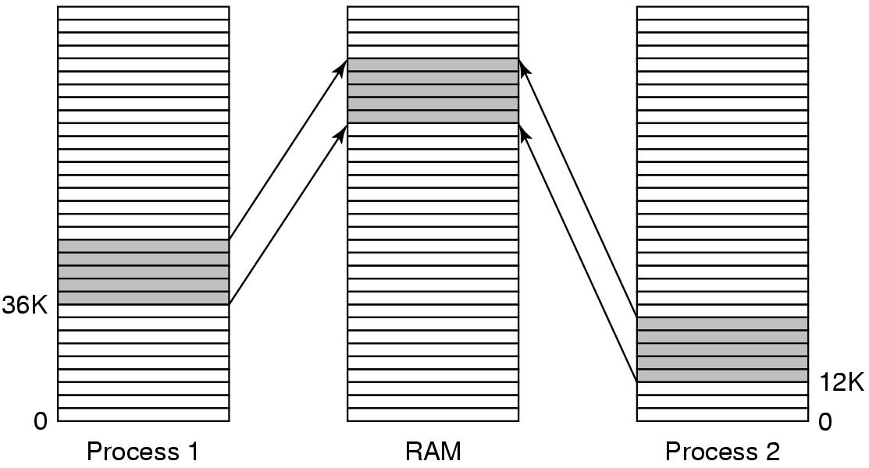
Shared Libraries (2)
When compiling a code as a shared library, need to tell the compiler not to produce any instruction using absolute addr
Need to use relative offsets, “position-independent code (PIC)”
E.g. gcc -fpic
Figure 3-26. A shared library being used by two processes.

Slide 7
Cleaning Policy
Paging works best when they are plenty of free page frames
Paging daemon used in many OSs for this purpose
Periodically inspects memory and write dirty pages to disk if too few page frames free (in an asynchronous manner)
Pages still stay and can be reclaimed if pages needed again

Slide 8
Operating System Involvement with Paging
Process creation time
Page table allocation, swap area allocation, recorded in process table
Process execution time
TLB flush, prepaging
Page fault time
Locate page on disk, find available page frame, read page
Process termination time
Deallocate page table and swap area (shared pages/swap areas can only be deallocated by the last process)

Slide 9
Page Fault Handling
The hardware traps to the kernel, saving the program counter
The operating system discovers which virtual page is needed
Checks if addr valid and the protection consistent with access
Checks if a page frame free, uses replacement algo
If selected page frame dirty, scheduled for transfer to disk
When page frame clean, looks up the disk address where the needed page is, schedules a disk operation to bring it in
When disk interrupt indicates page has arrived, page tables updated to reflect position, frame marked as being in normal
Faulting instruction backed up and program counter reset
Faulting process scheduled and continue execution

Slide 10
Locking (Pinning) Pages in Memory
A subtle implementation issue for page replacement algo.
Occasionally pages serving as I/O buffers can be potentially picked as replacement candidates
Removing these pages can cause errors for outstanding DMA transfers
One solution is to lock pages engaged in I/O, “pinning”
Can also do all I/O to kernel buffers, then copy to user space

Slide 11
Separation of Policy and Mechanism
Memory management system is divided into three parts:
A low-level MMU handler.
A page fault handler that is part of the kernel.
An external pager running in user space.
Pros: separation; modular code; greater flexibility
Cons: extra overhead of crossing boundaries and message passing
Figure 3-29. Page fault handling with an external pager.

Slide 12
Outline
Questions?
Design Issues for Paging Systems
Implementation Issues for Paging Systems
Segmentation
Needs and concept
Implementation of pure segmentation
Segmentation with paging: MULTICS

Slide 13
Segmentation (1)
Having two or more separate virtual address spaces may be desired than having only one
A compiler has many tables that are built up as compilation proceeds, possibly including:
The source text being saved for the printed listing
The symbol table – the names and attributes of variables.
The table containing integer, floating-point constants used.
The parse tree, the syntactic analysis of the program.
The stack used for procedure calls within the compiler.

Slide 14
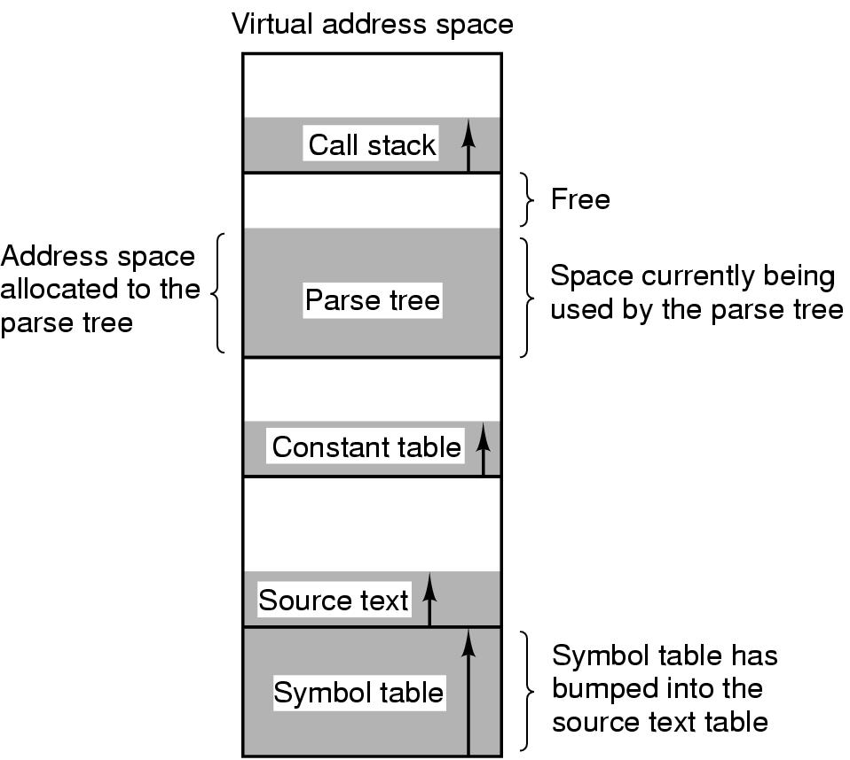
Segmentation (2)
Figure 3-30. In a one-dimensional address space with growing tables, one table may bump into another.

Slide 15
Segmentation (3)
Provides many independent address space, “segments”
Freeing programmers from managing expanding/contracting tables
Each segment has a linear sequence of addrs, 0 to some max
Segments can have different lengths
Segment length may change during execution
Two-part addr: a segment number + addr within the segment
Advantages:
Simplifying handing of data structures growing/shrinking (modularity)
Facilitates sharing library/procedures/data
Facilitates different protections for different segments

Slide 16
Segmentation (4)
Figure 3-31. A segmented memory allows each table to grow or shrink independently of the other tables.

Slide 17
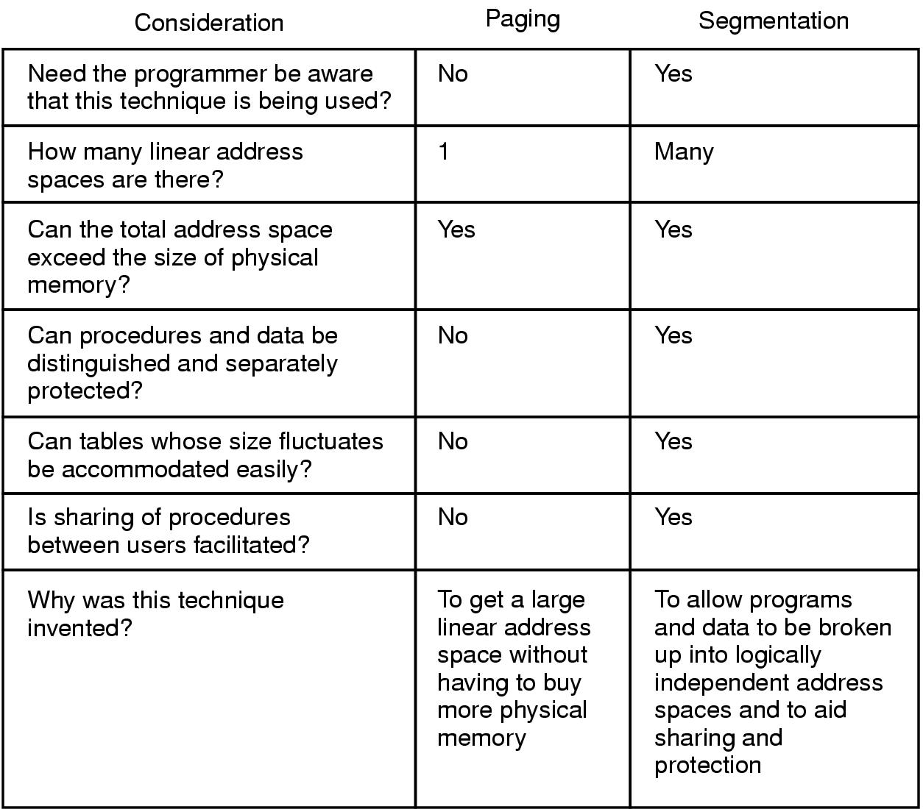
Comparison of Paging and Segmentation
Figure 3-33. Comparison of paging and segmentation.

Slide 18
Implementation of Pure Segmentation
Pages are fixed size; segments are not
External fragmentation/checkerboarding; Compaction
Figure 3-33. (a)-(d) Development of checkerboarding. (e) Removal of the checkerboarding by compaction.

Slide 19
Segmentation with Paging: MULTICS (1)
Paging segments when they’re large (not to keep in main memory in their entirety), e.g. MULTICS (Intel X86 machines and OSs have similar design)
Figure 3-34. The MULTICS virtual memory. (a) The descriptor segment points to the page tables.

Slide 20
Segmentation with Paging: MULTICS (2)
When a memory reference occurs, the following algorithm is carried out:
The segment number used to find segment descriptor.
Check is made to see if the segment’s page table is in memory.
If not, segment fault occurs.
If there is a protection violation, a fault (trap) occurs.

Slide 21
Segmentation with Paging: MULTICS (3)
Page table entry for the requested virtual page examined.
If the page itself is not in memory, a page fault is triggered.
If it is in memory, the main memory address of the start of the page is extracted from the page table entry
The offset is added to the page origin to give the main memory address where the word is located.
The read or store finally takes place.

Slide 22
Segmentation with Paging: MULTICS (4)
Figure 3-37. Conversion of a two-part MULTICS address into a main memory address.

Slide 23
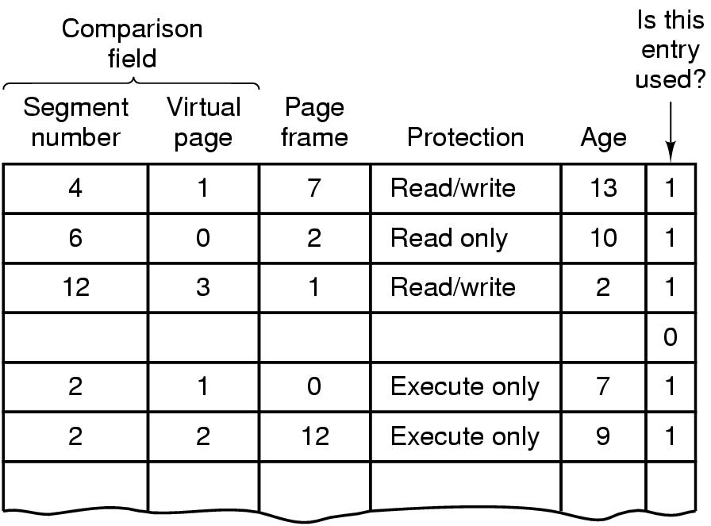
Segmentation with Paging: MULTICS (5)
Figure 3-38. A simplified version of the MULTICS TLB. The existence of two page sizes makes the actual TLB more complicated.

Slide 24
Readings
Chapter 3:
Section 3.5
Section 3.6
Section 3.7

Slide 25
Questions? Questions/Suggestions/Comments are always welcome! Write me: yong.chen@ttu.edu Call me: 806-834-0284 See me: ENGCTR 315

