Slide 1



CS4352 Operating Systems
Lecture 13
Instructor: Yong Chen, Ph.D.
Assistant Professor
Department of Computer Science
Texas Tech University
Tommy Dang made minor modifications on the slides

Slide 2
Disk Space Management: Block Size (1)
Block size selection is a tradeoff, similar as page size
Large block size
Better performance, more storage waste due to fragmentation (less storage utilization)
Small block size
Better storage utilization (less fragmentation), more seeks and rotational delays (lower performance)

Slide 3
Disk Space Management Block Size (2)
Figure 4-20. Percentage of files smaller than a given size (in bytes).

Slide 4
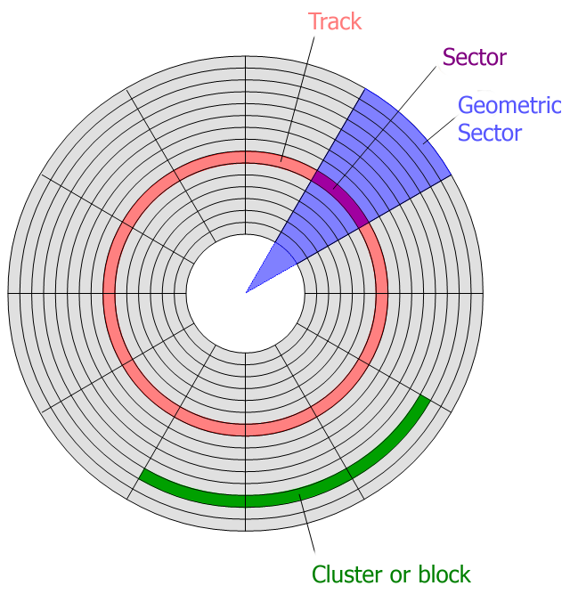
Example on page 301
The image is retrieved from http://keywordsuggest.org/gallery/807348.html

Slide 5
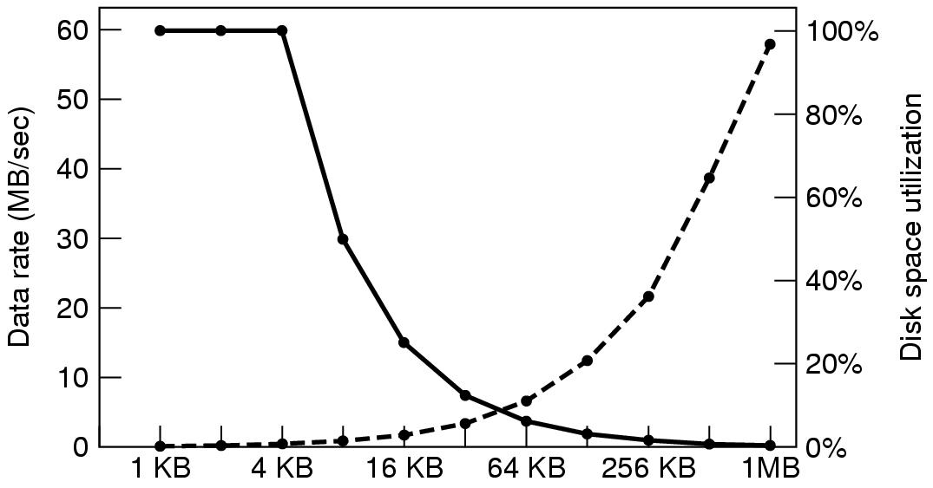
Disk Space Management Block Size (3)
Figure 4-21. The dashed curve (left-hand scale) gives the data rate of a disk. The solid curve (right-hand scale) gives the disk space efficiency. All files are 4 KB.
Notes:
Performance and space utilization is in conflict.

Slide 6
Keeping Track of Free Blocks
Figure 4-22. (a) Storing the free list on a linked list. (b) A bitmap.

Slide 7
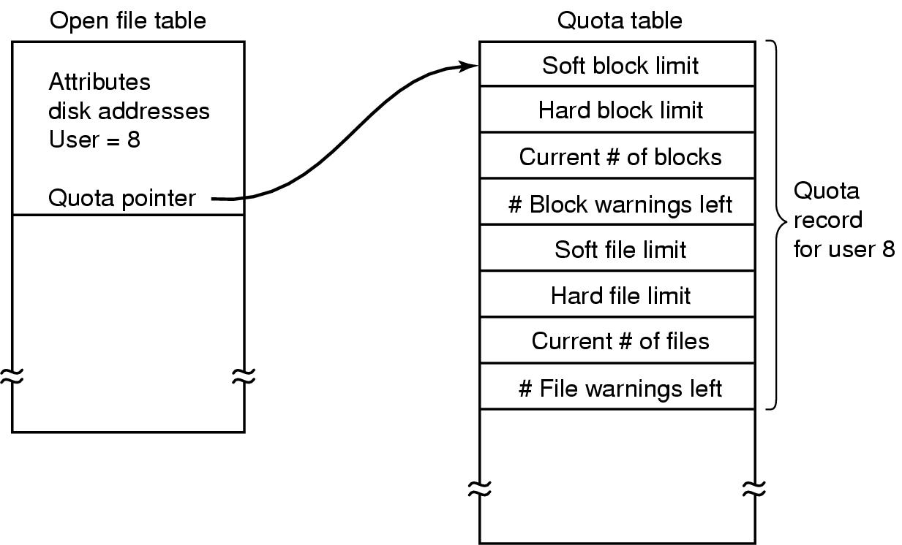
Disk Quotas
Figure 4-24. Quotas are kept track of on a per-user basis in a quota table.

Slide 8
File System Backups (1)
File system backups often performed to recover from disaster
Full backup v.s. incremental backup (incremental dump)
Physical dump v.s. logical dump (dominant)
Physical dump simple and perform fast, but incapable of skipping bad blocks, incremental backups, and restoring individual files

Slide 9
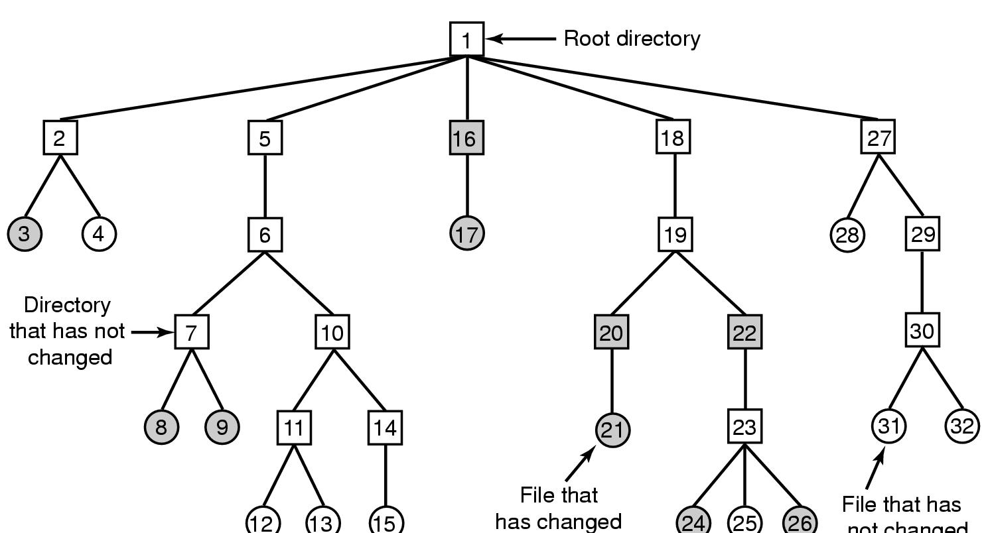
File System Backups (2)
A typical backup algorithm example
Figure 4-25. A file system to be dumped. Squares are directories, circles are files. Shaded items have been modified since last dump. Each directory and file is labeled by its i-node number.

Slide 10
File System Performance
Access to disk is much slower than access to memory
Typical techniques used for optimizing file system performance
Caching
Block read ahead (prefetching)
Reducing disk arm motion

Slide 11
Caching (1)
Buffer Cache (Block Cache)
When a request comes in
Check to see if needed blocks in the cache; if yes, satisfied immediately
If not, bring the block into buffer cache (find a replacement victim if needed) and serves the request
Replacement algorithms discussed for paging system apply to buffer cache replacement too
Caching can also be “bypassed” (dis-abled) when not beneficial

Slide 12
Block Read Ahead
“Prefetching”
When the file system fetches the requested block k, it also fetches block k+1, k+2, …, k+d
Assuming and beneficial for sequential accesses
If a file is being randomly access -> it hurts

Slide 13
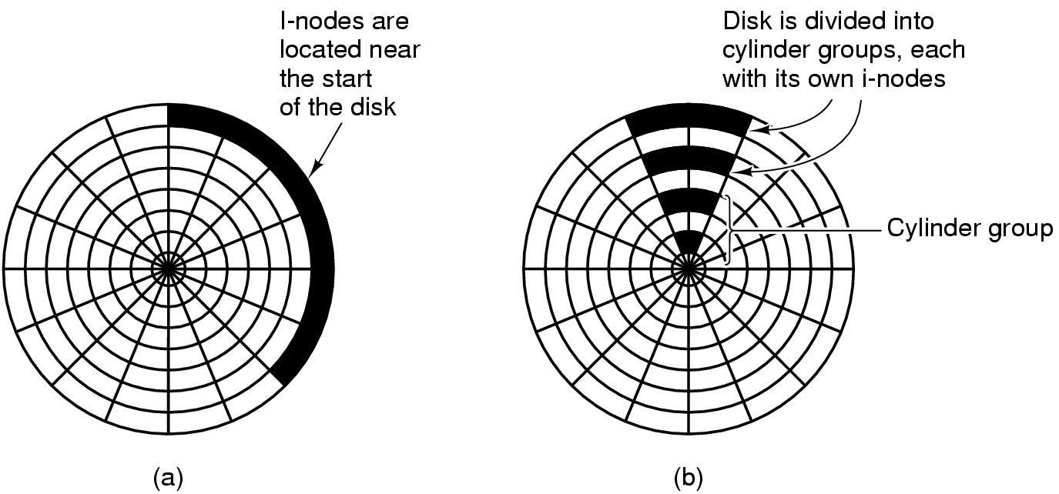
Reducing Disk Arm Motion
Placing contiguous blocks close, e.g. in the same cylinder
Placing i-node block in the middle of block: reduce the seeking time of the i-node and the fist block by a factor of 2
Using cylinder groups: i-node can be in any group but try to find block in the same (or nearby cylinder group).
Figure 4-29. (a) I-nodes placed at the start of the disk. (b) Disk divided into cylinder groups, each with its own blocks and i-nodes.
Notes:
When allocate a new block for a file, it is easier if free block are recorded in bitmap rather than in free list.

Slide 14
Readings
Chapter 4:
Section 4.3
Section 4.4

Slide 15
Outline
Questions?
Example file systems
MS-DOS file system
Unix v7 file system
CD-ROM file systems

Slide 16
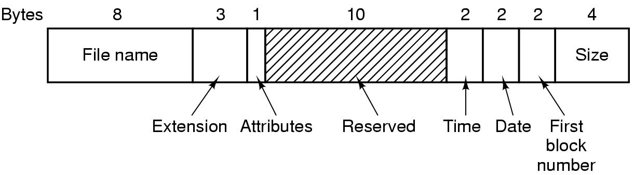
The MS-DOS File System (1)
Have been used through Windows 98/ME/XP
Uses a file allocation table (FAT) to keep track of free blocks
FAT-12, FAT-16, FAT-32: differ on the number of bits a disk address contains
Figure 4-30. The MS-DOS directory entry.
Notes:
Attributes: read-only, is Hidden, or is system file

Slide 17
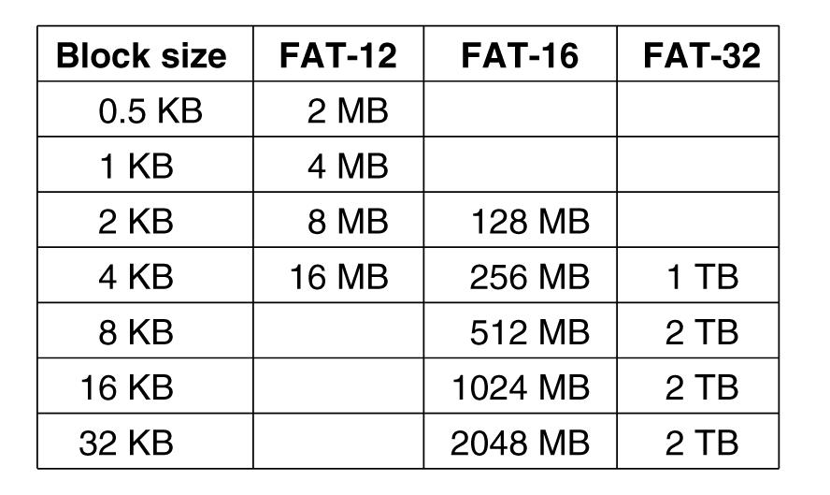
The MS-DOS File System (2)
Figure 4-31. Maximum partition size for different block sizes
Notes:
Eg FAT-16 with 2KB block size: 2^16*2^11=128MB

Slide 18
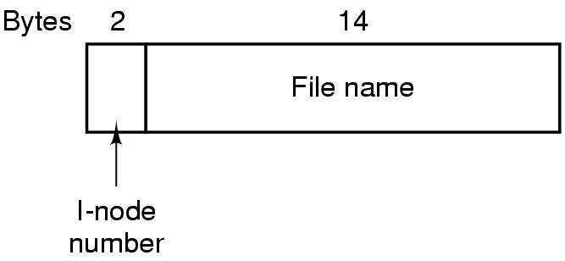
The UNIX V7 File System (1)
Hierarchical structure
What is the maximum number of files (including directories) per V7 file system can have?
Figure 4-32. A UNIX V7 directory entry.
Notes:
2 bytes = 16 bits. => 2^16 (or 64K) different files/directories

Slide 19
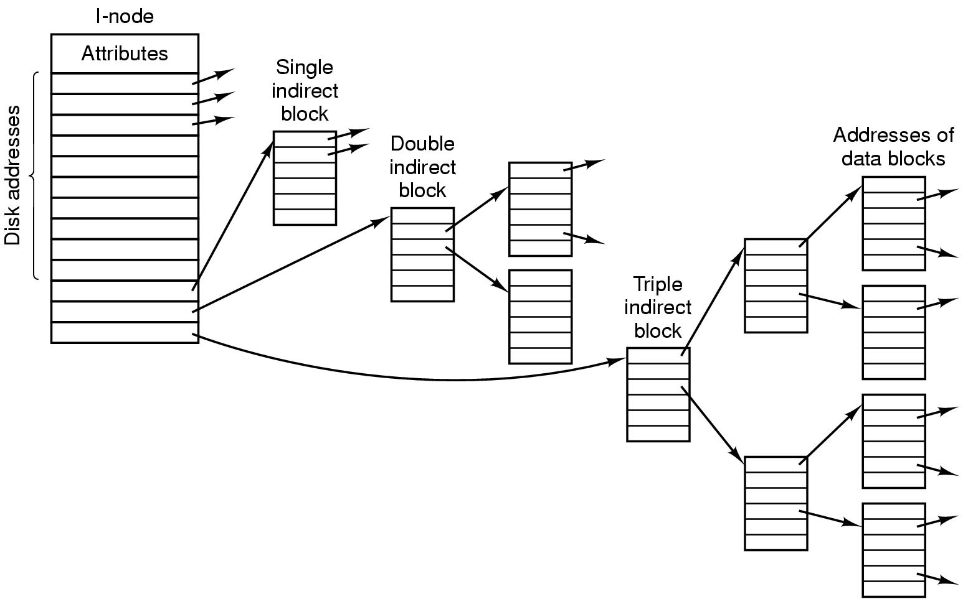
The UNIX V7 File System (2)
Figure 4-33. A UNIX i-node.
Notes:
10*1KB + 256 * 1KB + 256 * 256 * 1KB

Slide 20
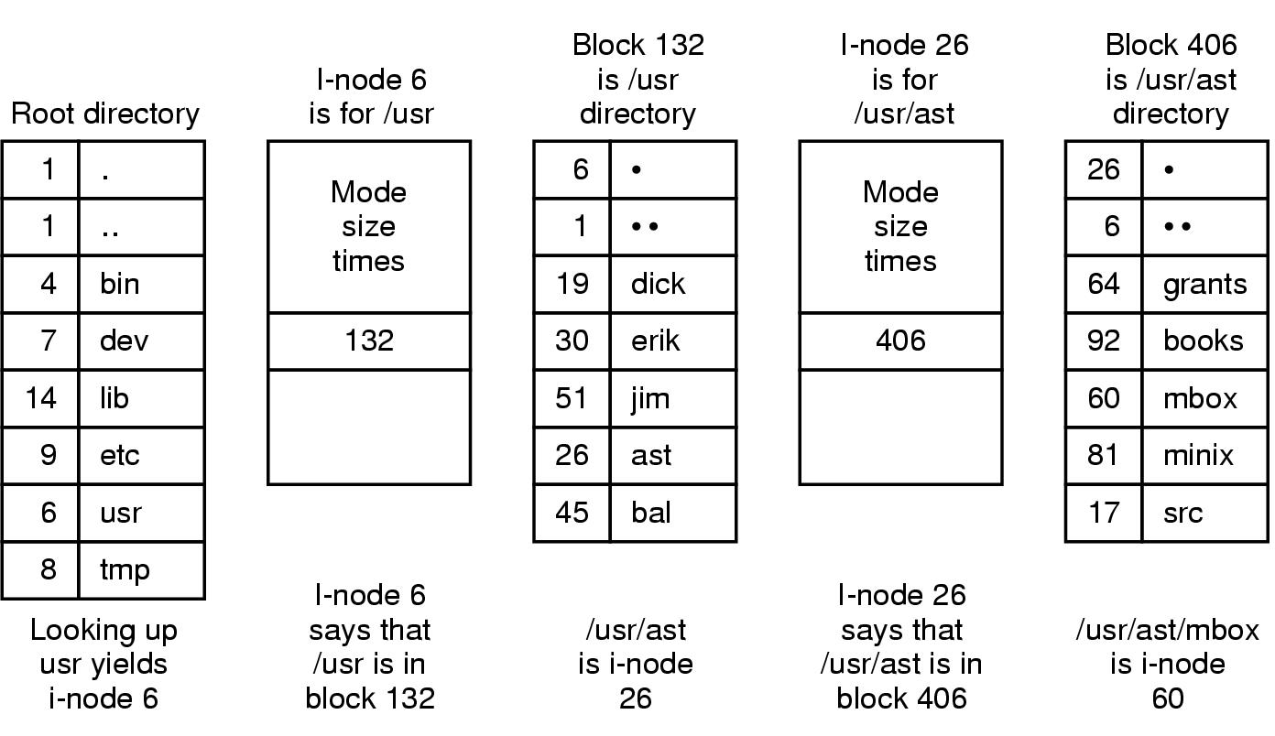
The UNIX V7 File System (3)
Figure 4-34. The steps in looking up /usr/ast/mbox

Slide 21
CD-ROM File Systems
Designed for write-once media
E.g. no keeping track free blocks
ISO 9660 file system
Block size: 2KB/4KB/8KB
First 16 blocks undefined (up to manufacturer, e.g. make it bootable)
Primary volume descriptor (“superblock”, contains root directory)
Files stored as contiguous blocks
Figure 4-35. The ISO 9660 directory entry.

Slide 22
Readings
Chapter 4:
Section 4.5
Section 4.6

