Slide 1



CS4352 Operating Systems
Midterm review

Slide 2
What Is An Operating System (1)
A modern computer consists of:
One or more processors
Main memory
Disks
Printers
Various input/output devices
Managing all these components requires a layer of software – the operating system
Not a shell/GUI (Graphical User Interface)

Slide 3
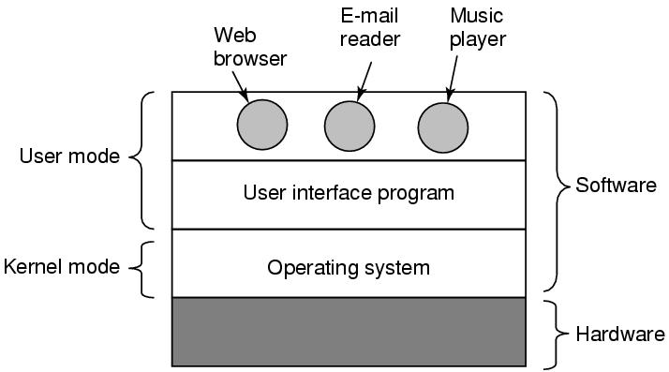
What Is An Operating System (2)
Figure 1-1. Where the operating system fits in.

Slide 4
Roles of An Operating System
What are the two main functions of an operating system?

Slide 5
Roles of An Operating System
Perform two basic functions:
Providing application programmers a clean abstract set of resources instead of the messy hardware ones (“extended machine”)
Managing hardware resources (“resource manager”)

Slide 6
Operating System as an Extended Machine (1)
Computer architecture at the machine language level is primitive and awkward to programmers
Instruction set
Memory organization
I/O
Bus structure
A simple, high-level abstraction desired
E.g. a collection of named files for read/write/close

Slide 7
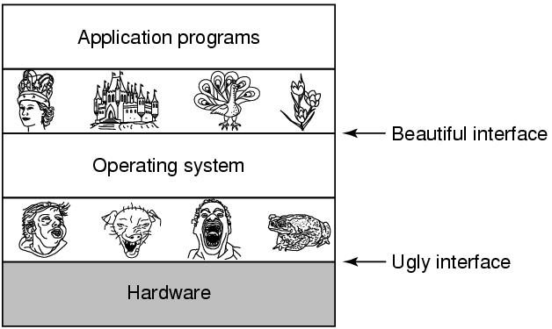
Operating System as an Extended Machine (2)
Hide the hardware ugly details and present programs (and their programmers)
with nice, clean, elegant, and consistent abstractions
Figure 1-2. Operating systems turn ugly hardware into beautiful abstractions.

Slide 8
Operating System as a Resource Manager (1)
A top-down view: OS as providing abstractions
A bottom-up view: OS manages all the pieces of resources
Processors, memories, timers, disks, networks, printers, etc.
Provide an orderly and controlled allocation for competing apps
E.g. a printer shared by multiple programs
E.g. memory and disks shared by multiple users

Slide 9
Operating System as a Resource Manager (2)
Managing and sharing (multiplexing) resources in two different ways
In time – time multiplexing
Multiple programs share a single CPU
In space – space multiplexing
Main memory and hard disks shared by multiple programs/users

Slide 10
What is multiprogramming?
Notes:
Multiprogramming is the rapid switching of the CPU between multiple processes in memory. It is commonly used to keep the CPU busy while one or more processes are doing I/O.

Slide 11
Special Registers
Program Counter (PC) ?
Contains the memory address of the next instruction to be fetched
“instruction address”
Stack Pointer (SP) ?
Points to the top of the current stack in memory
Memory divided into three segments “text” “data (heap)” “stack”
Program Status Word (PSW) ?
Contains the condition code bits, e.g. CPU priority, mode (user/kernel)
Needed in system calls and I/O
Managed by software (OS):
“context switch” for time multiplexing
Need to save/restore all these registers

Slide 12
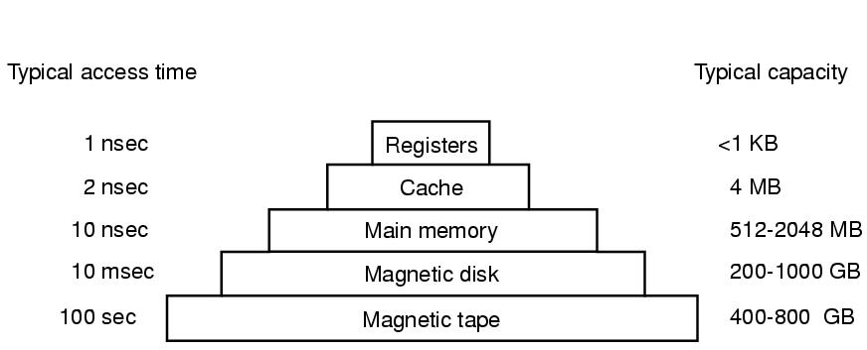
Memory Hierarchy
Closer to processor: faster, smaller, and more expensive
Figure 1-9. A typical memory hierarchy. The numbers are very rough approximations.

Slide 13
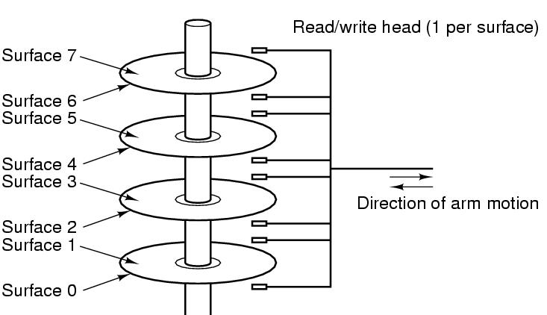
Disks (Hard Disk Drives)
90% of data stored in HDDs
Platter, surface, arm, head
Track, sector (fixed size, e.g. 512B)
Cylinder
Physical addressing (CHS)
Cylinder, Head, Sector
Flash-memory based storage will eventually replace
Figure 1-10. Structure of a disk drive.

Slide 14
I/O Devices
I/O devices heavily interact with OS (in addt. to CPU & memory)
Generally consist of
A controller: a chip/a set of chips controlling the device (can be complex)
The device itself, e.g. disks, NIC (network interface card)
Device Driver
The software that talks to the controller
Part of OS (can run kernel mode), manage devices and hide dirty hardware details

Slide 15
Processes/Threads
Processes: running programs
Associated with an Address Space
text/program, data, stack
“core image”: content of address space
Associated with registers
Including PCs, SPs
Associated with other resources
List of open files, signals, related processes
Threads: lightweight processes, without own address space
A process is fundamentally a container that holds all the information needed to run a program
Notes:
Example: vide editor, web browser, email receiver.
Switch
Keep the same state it was stopped
Information explicated stored somewhere
Store in process table,
Core image for text, data, stack; process table for registers, other resources.

Slide 16
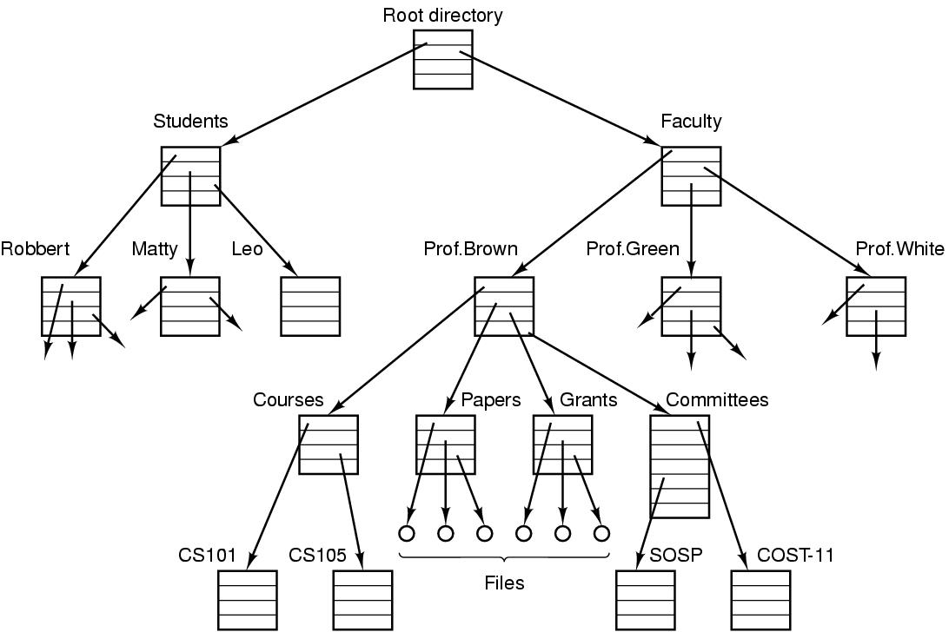
Files
File: an abstraction of a collection of bytes
Directory: a special file containing “pointer” to other files/directories
Root directory: top of the directory hierarchy
Path (absolute/relative)
/Students/Leo/foo
Working directory
File descriptor (FD)
File system: a collection of files, directories, and metadata
Figure 1-14. A file system for a university department.
Notes:
Comparing to process hierarchy , file trees can be deep but process trees are shallow, 3 level is rare
Process table lasts short time, minutes, but file tree lasts for years
Absolute path name vs relative
Working directory, system call to change, relative directory
Open a file, permission, file descriptor

Slide 17
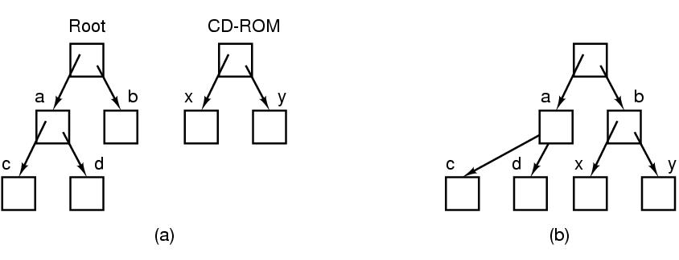
Files (cont.)
File systems can be joined with “mounting”
Figure 1-15. (a) Before mounting, the files on the CD-ROM are not accessible. (b) After mounting, they are part of the file hierarchy.

Slide 18
Outline
Questions?
Operating System Concepts
Files, protection and security
Shell
Unix/Linux Beginner Guide and Shell Programming
System Programming

Slide 19
Protection and Security
User management (UID: User ID)
A superuser “root” with UID=0 in Unix
Group management (GID: Group ID)
Protection mechanisms exist in OS for security
E.g. files in Unix are protected with a 9-bit binary code
Three 3-bit fields, for owner, group members, and everyone else
A 3-bit field: rwx bits, indicate the privilege of read/write/execute
E.g. rwxr-x—x. How to change permission?
What are rwx for a directory?
Notes:
The first character is file type: - is for regular file, d is for directory, and so on.
For directory, x is for searching the content

Slide 20
Memory Layout
Figure 1-20. Processes have three segments: text, data, and stack.
Notes:
A text segment is also known as a code segment, a text segment is placed below the heap or stack in order to prevent heaps and stack overflows from overwriting it.
The text segment is read-only and sharable so that only a single copy needs to be in memory for frequently executed programs, such as text editors
Data segment is not read-only.

Slide 21
Figure 1-20. Processes have three segments: text, data, and stack.
Notes:
The stack grows the opposite direction of heap
When the stack pointer met the heap pointer, free memory was exhausted. What happen?
Each time a function is called, the address of where to return to and certain information about the caller’s environment, such as some of the machine registers, are saved on the stack. The newly called function then allocates room on the stack for its automatic and temporary variables.
Heap is the segment where dynamic memory allocation usually takes place.
The heap area begins at the end of the BSS segment and grows to larger addresses from there. The Heap area is managed by malloc, realloc, and free

Slide 22
Processes
Process: a running program, associated with all resources
Address space
Registers
Open files
Etc.
A program running twice (two “instances”) creates two processes (can possibly share the text segment)
Abstraction supports multiprogramming
Support pseudo concurrent operation even on single (uni-core) CPU
“pseudoparallelism”

Slide 23
Process States
What are different states of a process?
Please explain the transitions between process states.

Slide 24
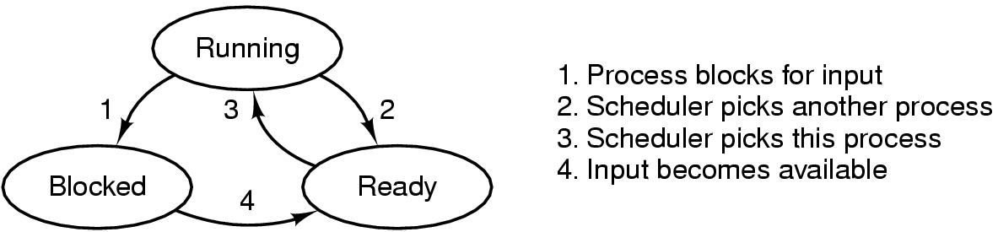
Process States
Process scheduler
Figure 2-2. A process can be in running, blocked, or ready state. Transitions between these states are as shown.
Notes:
From Running, what is the difference between 1 and 2
Can we go from Blocked to Running?
Can we go from ready to blocked?

Slide 25
Threads
Threads: lightweight processes
Multiple threads of control but share an address space
Why threads are desired?
Ability of share an address space and data
Lightweight and easier to create and destroy (creating a thread is 10 to 100 times faster than creating a process)
Performance gain for mixed computing and I/O (higher degree of parallelism)
Map to multithreaded/multicore processors

Slide 26
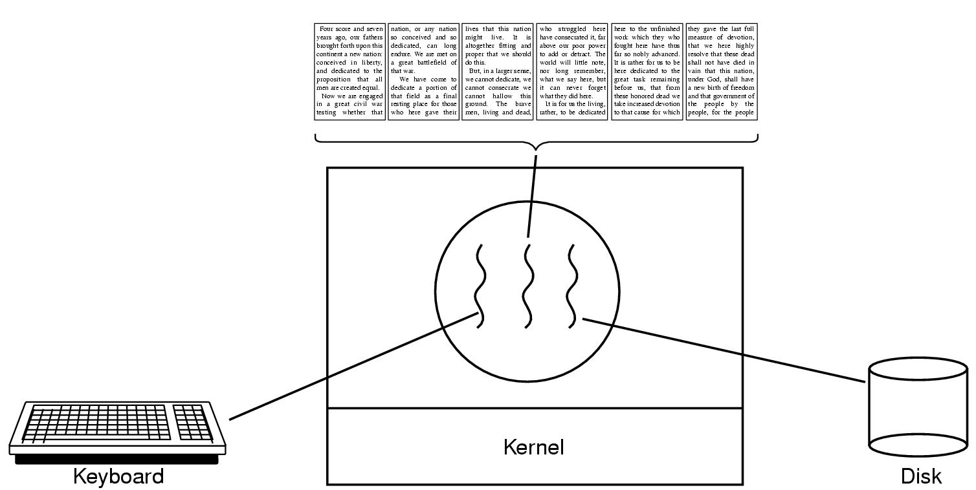
Thread Usage (1)
Figure 2-7. A word processor with three threads.

Slide 27
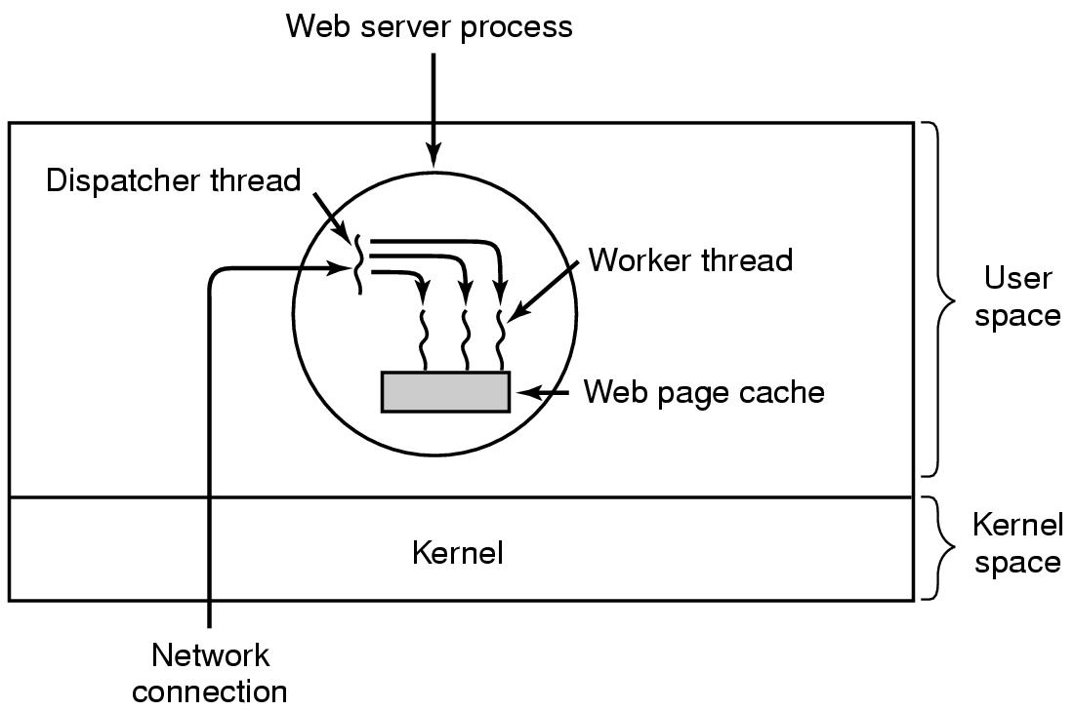
Thread Usage (2)
Figure 2-8. A multithreaded Web server.
Notes:
Why do we need cache?
Multiple threads can share global variables. For ex, number of accepted html requests.

Slide 28
Implementing Threads in User Space (1)
In user space
Entirely in user space, kernel knows nothing
Kernel manages ordinary single-threaded processes
User-level threads can be implemented on an operating system that does not support threads (in kernel)

Slide 29
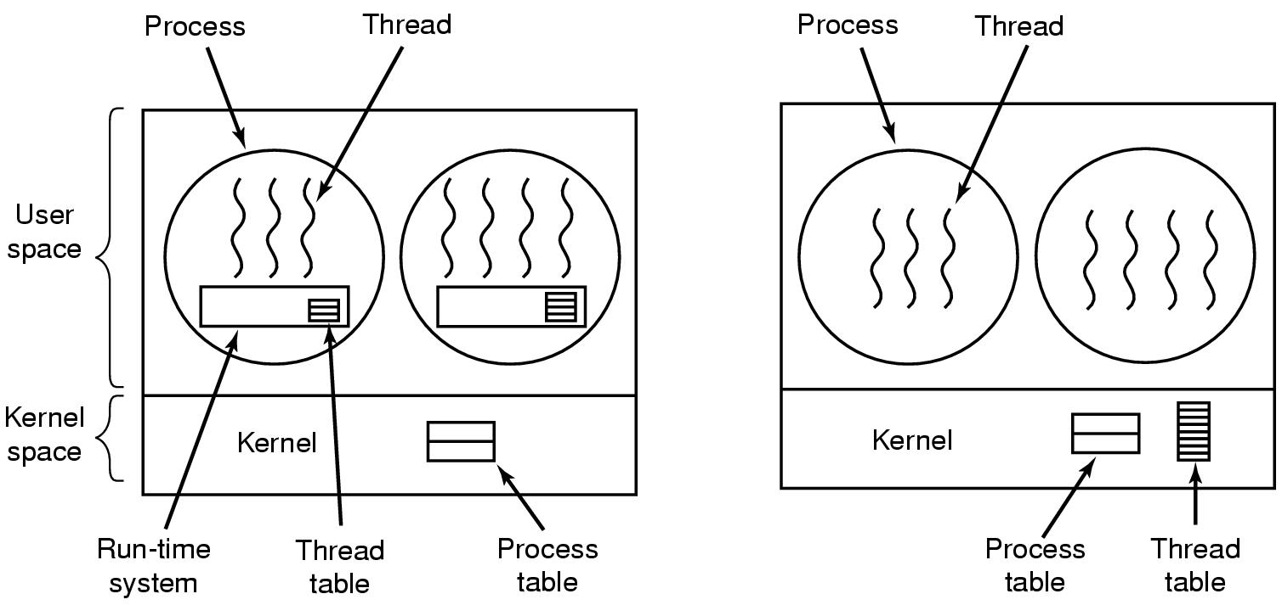
Implementing Threads in User Space (2)
Figure 2-16. (a) A user-level threads package

Slide 30
Implementing Threads in User Space (3)
Advantages
Fast thread switching than trapping to the kernel (an order of magnitude faster normally)
Each process can have its own customized scheduling algorithm
Disadvantages
Blocking system calls
Page faults (detailed discussion when studying chapter 3)
Limited performance gain (system calls block threads)
Notes:
Fast thread switching because no trap, not context switching, no cached memory flushed.

Slide 31
Implementing Threads in Kernel Space (1)
In kernel space
No run-time system and thread table needed in each process
Kernel manages a thread table keeping track of threads
Thread table holds the same info as with user-level threads

Slide 32
Implementing Threads in Kernel Space (2)
Figure 2-16. (b) A threads package managed by the kernel.

Slide 33
Implementing Threads in Kernel Space (3)
Advantages
When a thread blocks, the kernel can schedule another thread from the same process (if ready) or a thread from a different process to run
No new nonblocking system calls required (including dealing with page faults)
Performance gain
Disadvantages
Higher cost of creating/destroying threads (system calls)
Notes:
Other issues remain, e.g. multithreaded process forks/signals

Slide 34
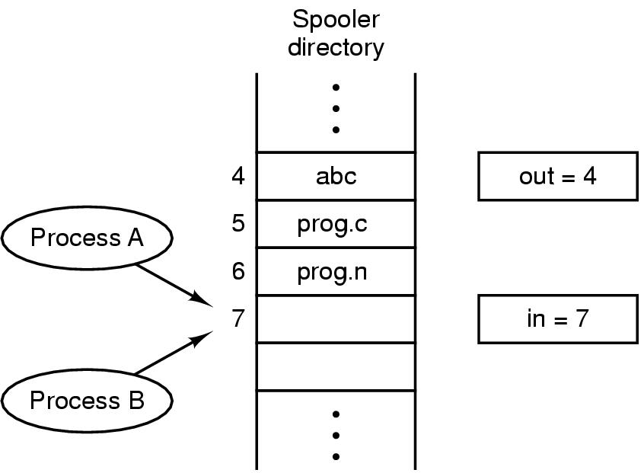
Race Conditions
In IPC, where two or more processes read/write some shared data, if the final result depends on who runs precisely when, such a situation is called race conditions
Figure 2-21. Two processes want to access shared memory at the same time.

Slide 35
Critical Regions (1)
Mutual exclusion needed to avoid race conditions
Applies to shared memory, shared files, and shared everything else
Part of the program where shared resources are accessed is called the critical region or critical section
No two processes may be simultaneously inside their critical regions.
No assumptions may be made about speeds or the number of CPUs.
No process running outside its critical region may block other processes.
No process should have to wait forever to enter its critical region.
Notes:
Mutual exclusion make sure that if 1 process use a shared file/variable, other processes will be excluded from doing the same thing.

Slide 36
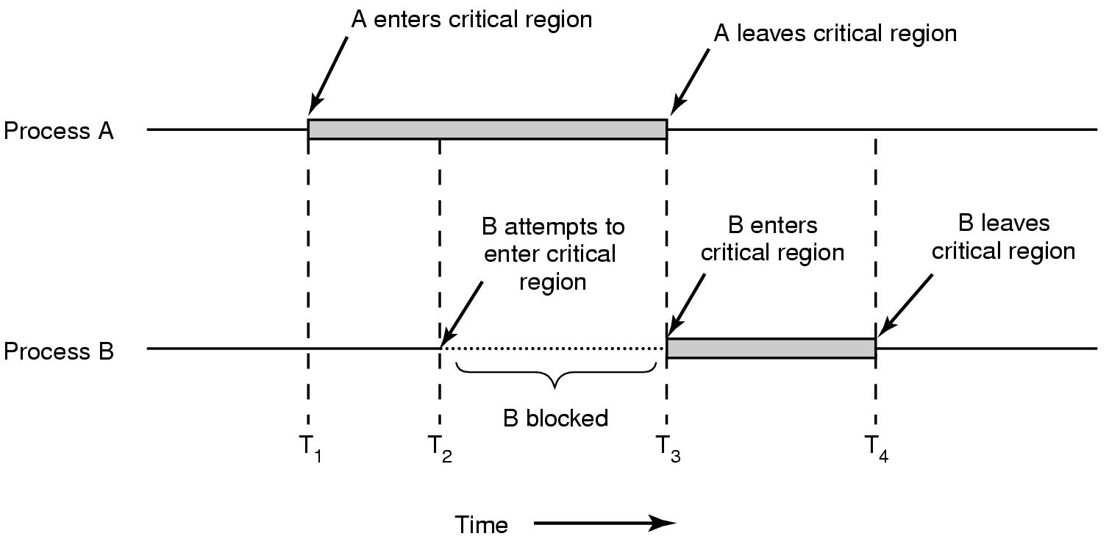
Critical Regions (2)
Figure 2-22. Mutual exclusion using critical regions.

Slide 37
Mutual Exclusion with Busy Waiting
Proposals for achieving mutual exclusion:
Disabling interrupts (doesn’t work for multicore chips. Why?)
Lock variables (set the lock variable to 1 when after entering. What problem?)
Strict alternation
Peterson's solution
The TSL/XCHG instruction
Notes:
Disabling interrupts: unattractive to give control to user processes? Since it can disable interrupts and run forever.
Disabling interrupts can be used in OS, for example to save data to a process table.
Disable interrupt Is from the process view.
Non-preemtive if from scheduler view

Slide 38
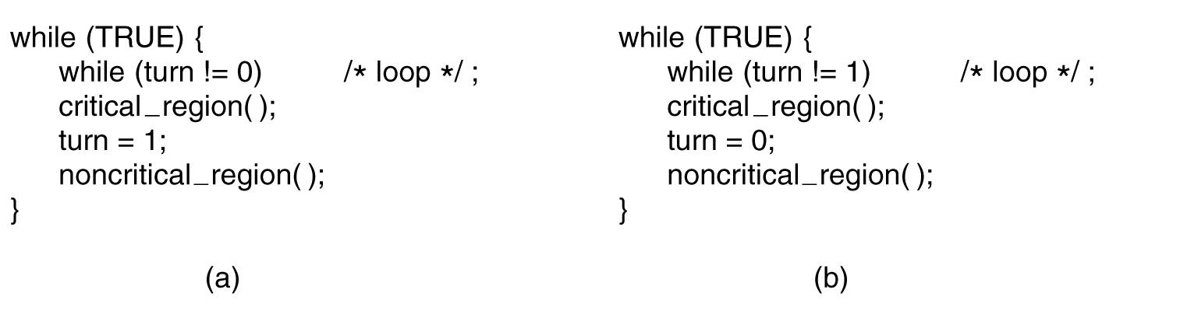
Strict Alternation
Busy waiting
Spin lock
Figure 2-23. A proposed solution to the critical region problem. (a) Process 0. (b) Process 1. In both cases, be sure to note the semicolons terminating the while statements.
Notes:
This is called bus waiting. This should be avoid since wasting CPU.
This also violate condition 3. Why?

Slide 39
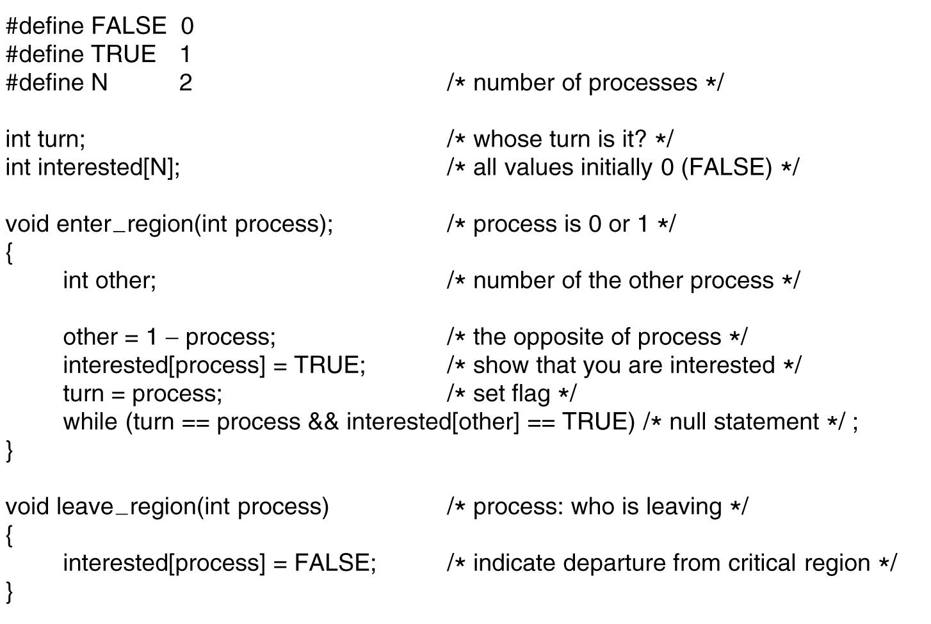
Peterson's Solution
Figure 2-24. Peterson’s solution for achieving mutual exclusion.
Notes:
If one process enter region -> fine
If both enter the region? -> fine why?

Slide 40
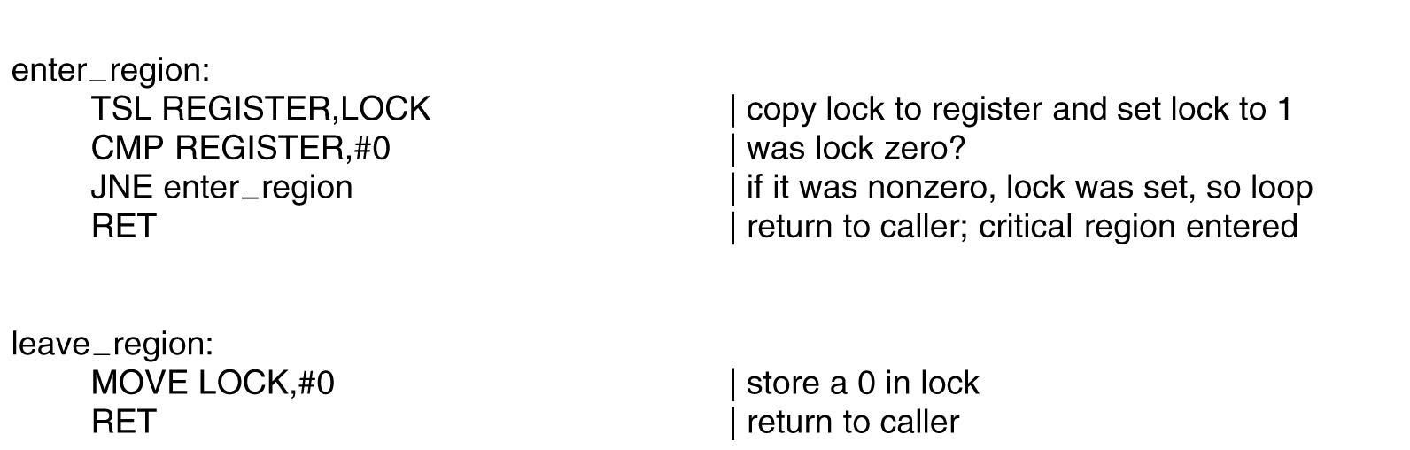
The TSL Instruction
Figure 2-25. Entering and leaving a critical region using the TSL instruction.
Notes:
TSL is indivisible. No other processor can access until the instruction is finish.

Slide 41
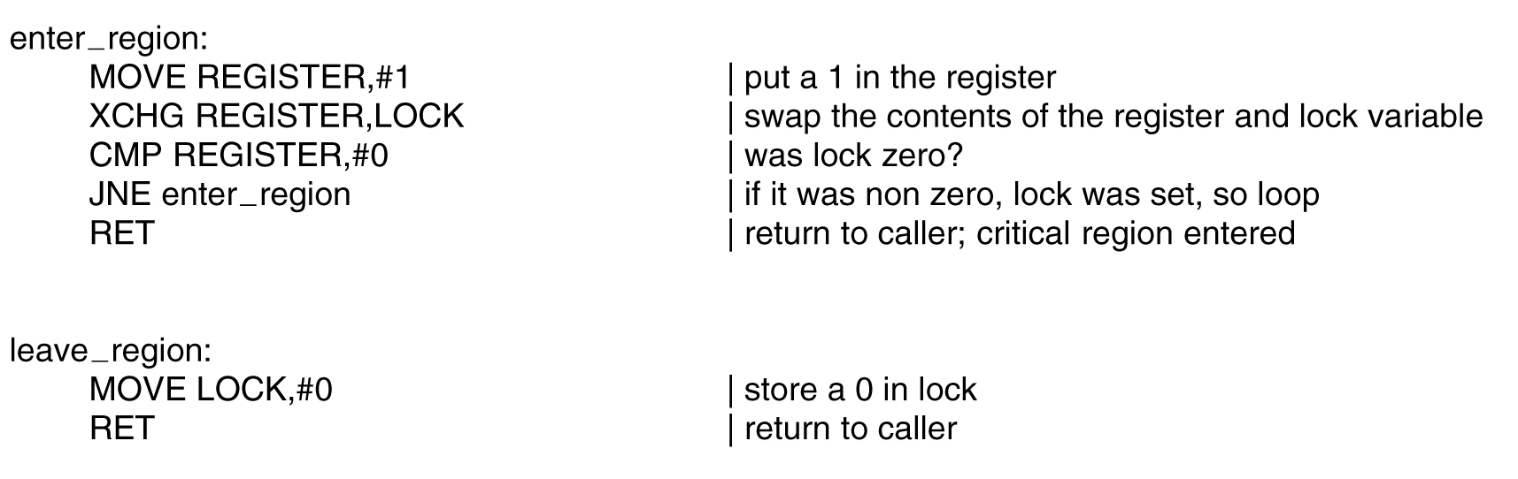
The XCHG Instruction
Figure 2-26. Entering and leaving a critical region using the XCHG instruction.
Notes:
Similar to TSL but swap memory content

Slide 42
Sleep and Wakeup
Previous solutions have the defect of requiring busy waiting
If an entry not allowed, sits in a tight loop waiting until it is
Wastes CPU cycles
IPC primitives block (and release CPU) instead of wasting CPU cycles
Sleep: a system call causes the caller to block and release CPU until another process wakes it up
Wakeup: a system call wakes up another process
Notes:
Sleep and wakeup are not part of standard C, but presumably we have these system calls

Slide 43
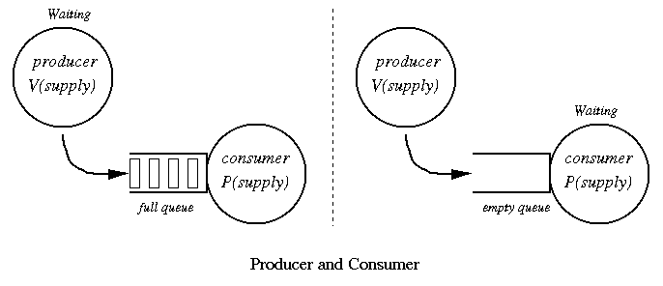
The Producer-Consumer Problem

Slide 44
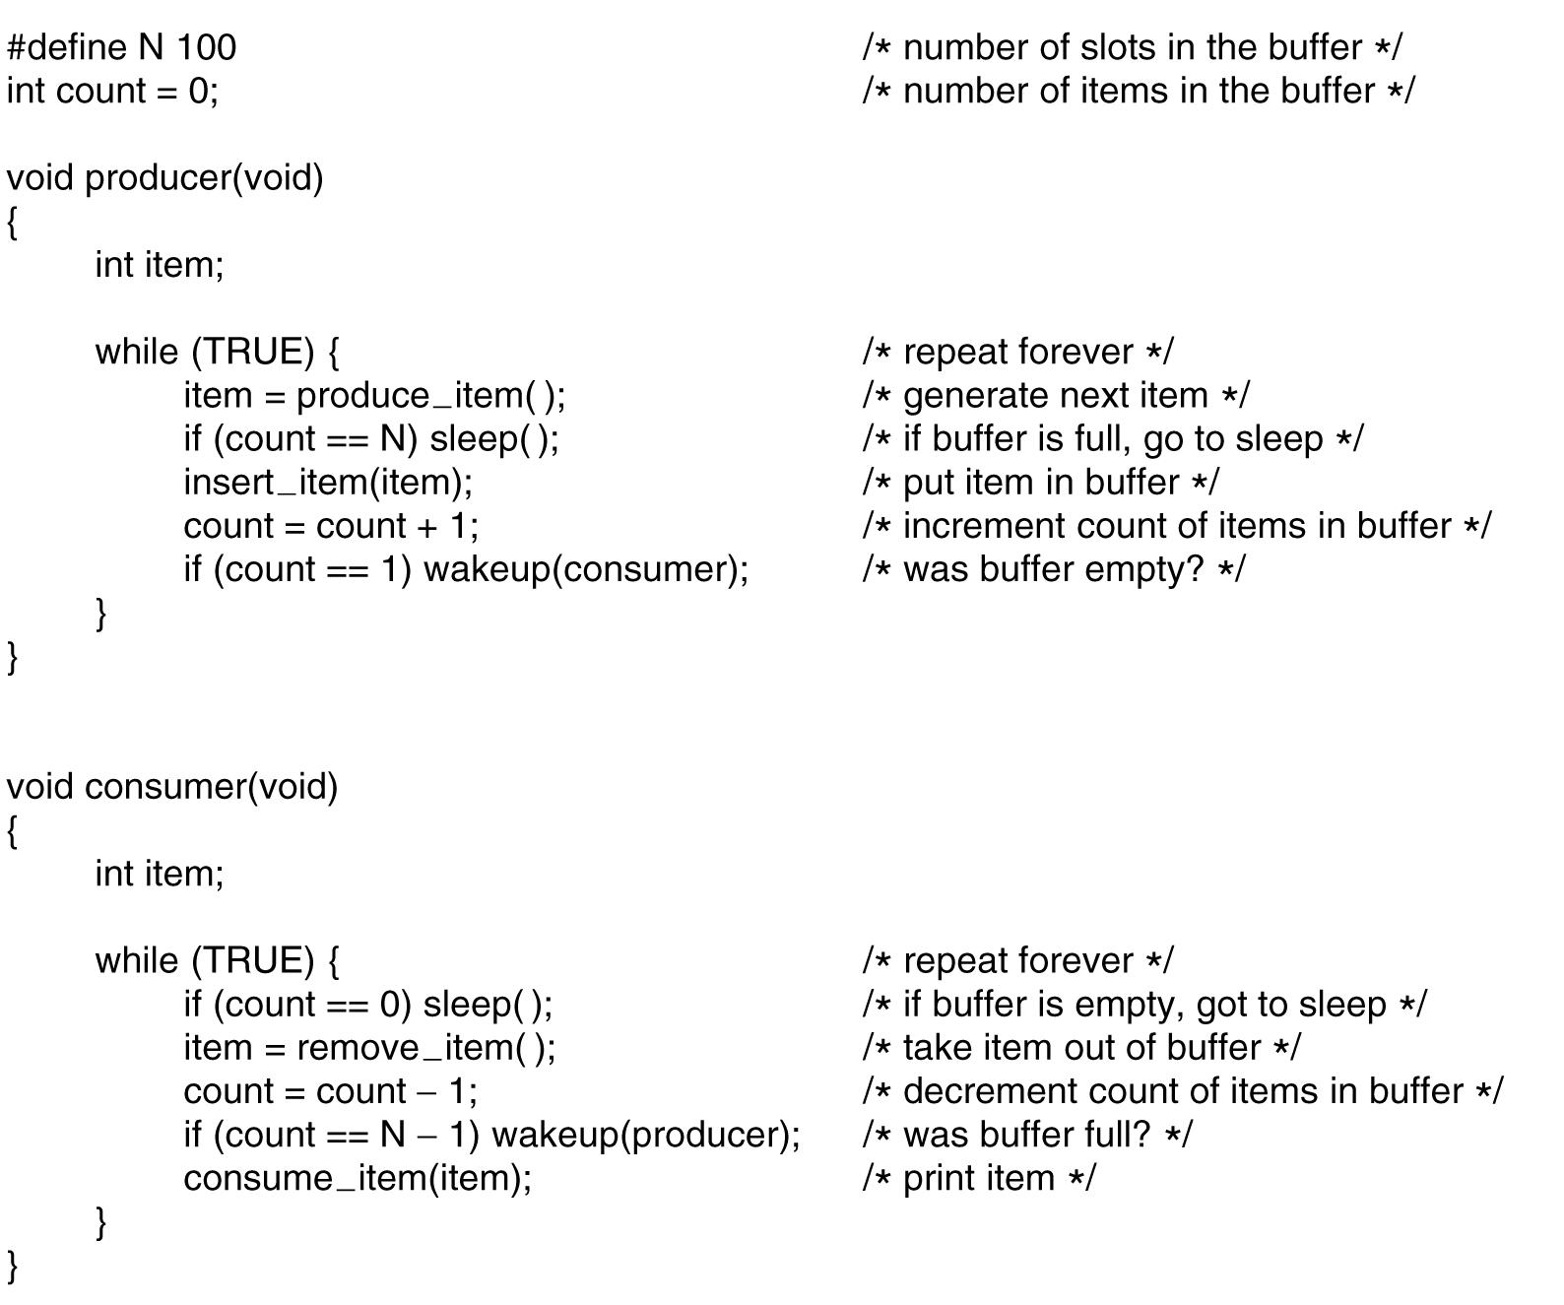
The Producer-Consumer Problem
Figure 2-27. The producer-consumer problem with a fatal race condition.
Notes:
What problem? When count==0 then consumer decide to sleep, but before he sleeps the producer try to wake him up -> he still sleep since he did not know.
Sooner or later, the producer will fill up the buffer and got to sleep as well -> both will sleep forever.
Solution? Waken bit. This works like a note from producer to consumer.

Slide 45
Semaphores (1)
Introduced by E. W. Dijkstra in 1965
A variable type semaphore (integer) to count # of wakeups
“down” operation: decrements if greater than 0 (uses one stored wakeup) or sleep if the value is 0
“up” operation: increments the value and one of sleeping processes waken up to complete its down
Both operations completed as a single indivisible atomic action
Also referred as P and V operations
P: Proberen (try), V: Verhogen (raise, make higher)

Slide 46
Semaphores (2)
“up” and “down” are usually implemented as system calls
With the OS briefly disabling all interrupts while testing the semaphore, updating, putting the process to sleep if needed
Notes:
Check the value of semaphore, change it, and possibaly go to sleep is on single atomic action

Slide 47
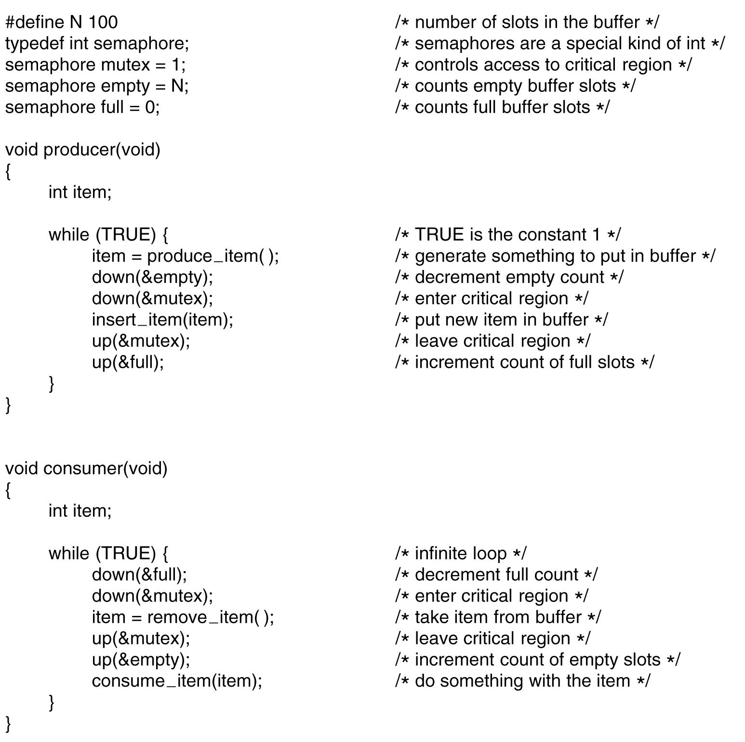
Three semaphores, full, empty, and mutex
full and empty are used for synchronization
mutex used for mutual exclusion
Can cause “deadlock” if the order switched
Figure 2-28. The producer-consumer problem using semaphores.

Slide 48
Mutexes
A simplified version of semaphore when count is not needed
A mutex variable has only two states: unlocked and locked
Sometimes called “mutex lock”, “binary semaphore”
Good and efficient for managing mutual exclusion
1 bit needed for implementation
An integer can also be used: 0 unlocked, and other value locked
mutex_lock/mutex_unlock procedures
If the mutex is unlocked, the mutex_lock call succeeds; otherwise blocked until mutex_unlock called

Slide 49
Outline
Questions?
InterProcess Communication
Mutexes, Monitors
Message passing, Barriers
Scheduling
Process behavior and when to schedule
Categories of scheduling algorithms and goals
Scheduling in batch systems and interactive systems
Policy v.s. mechanism, thread scheduling

Slide 50
Scheduling
Whenever two or more processes/threads compete for the CPU to run, we need a form of “scheduling”
Scheduler: the OS component makes the scheduling decision
Scheduling algorithm: the algorithm the scheduler uses
Process/thread scheduling share similar issues, but with subtle difference too

Slide 51
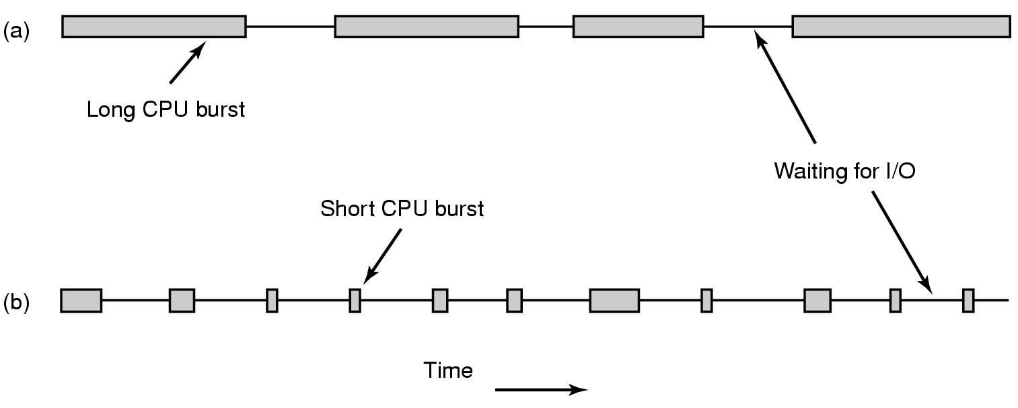
Process Behavior (1)
Figure 2-38. Bursts of CPU usage alternate with periods of waiting for I/O. (a) A CPU-bound process. (b) An I/O-bound process.

Slide 52
Process Behavior (2)
Compute-bound: spend most time computing
I/O-bound: spend most time waiting for I/O

Slide 53
When to Schedule
When a new process created
When a process exits
When a process blocks on I/O, on a semaphore, etc.
When an I/O interrupt occurs
Nonpreemptive
Preemptive
Notes:
Preemtive: 5ms
Nonpreemptive (run until completion): process will volenteer to give up CPU on its I/O

Slide 54
Categories of Scheduling Algorithms
Batch
Interactive
Notes:
The users of a batch operating system do not interact with the computer directly.
Batch system still exist in in corporate mainframe, where people are not involve.
Usually non-preemptive.

Slide 55
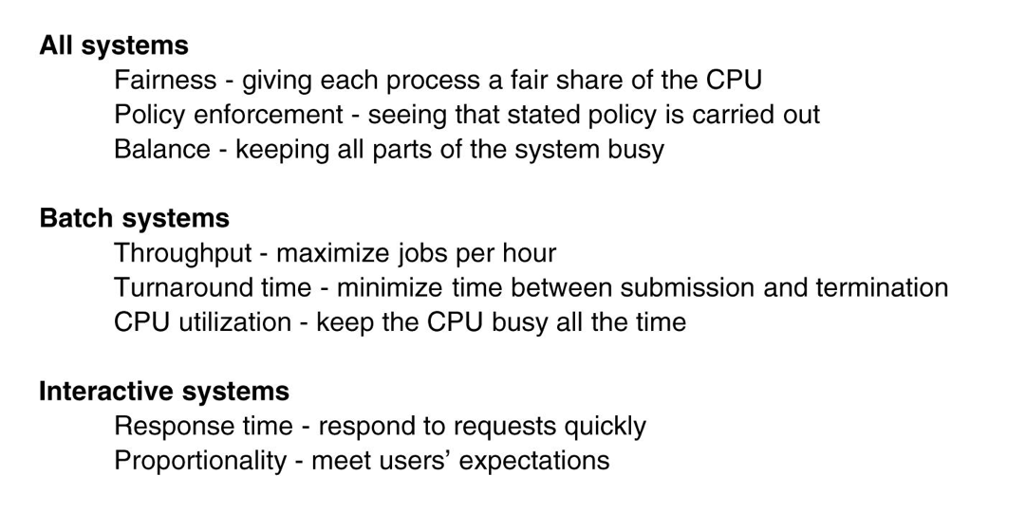
Scheduling Algorithm Goals
Figure 2-39. Some goals of the scheduling algorithm under different circumstances.
Notes:
All system goal Balance: For example keep CPU and I/O run all the time.
-> Better to mix CPU bound and I/O bound processes. Why?
What if I load all CPU bound into the memory?
What if I load all I/O bound into the memory?
Turnaround time is the statistical average from the moment that a batch job is submitted, until when it is completed.
Maximize throughput may not necessary to minimize turnaround time. Why? See page 155.

Slide 56
Scheduling in Batch Systems (1)
First-Come First-Served (FCFS)
Nonpreemptive
Processes are assigned CPU in the order they request it
Single queue of ready processes
When a blocked process becomes ready, put on the end of queue
Easy-to-implement, fair, but low throughput, high turnaround time

Slide 57
Scheduling in Batch Systems (2)
Shortest Job First (SJF)
Nonpreemptive
Assumes run times are known
Scheduler picks the shortest job first
(a) has average turnaround times of 14 mins
(b) has average turnaround times of 11 mins
Figure 2-40. An example of shortest job first scheduling. (a) Running four jobs in the original order. (b) Running them in shortest job first order.

Slide 58
Scheduling in Batch Systems (2)
Shortest Job First (SJF)
Counter example on page 158

Slide 59
Scheduling in Batch Systems (3)
Shortest Remaining Time Next (SRTN)
Preemptive
Assumes run times are known
Scheduler picks the process whose remaining run time shortest
Newly arrived jobs are compared to current processes remaining time

Slide 60
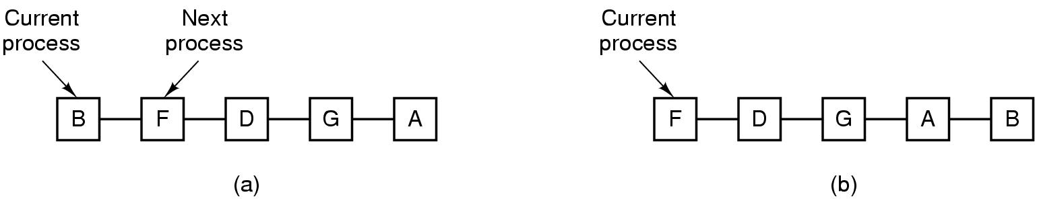
Scheduling in Interactive Systems (1)
Round-Robin (RR) Scheduling
Each process assigned a time interval, quantum
Preempted & switched (process switch/context switch) to other processes when quantum elapsed
Granularity of quantum: tradeoff, overhead & response time
Figure 2-41. Round-robin scheduling. (a) The list of runnable processes. (b) The list of runnable processes after B uses up its quantum.
Notes:
For example, processes need 1ms for context switching and 4ms for processing. Overhead =20%
Another example of 1ms and 99ms. Overhead = ? . Is this good for bus waiting?
Conclusion on page 159

Slide 61
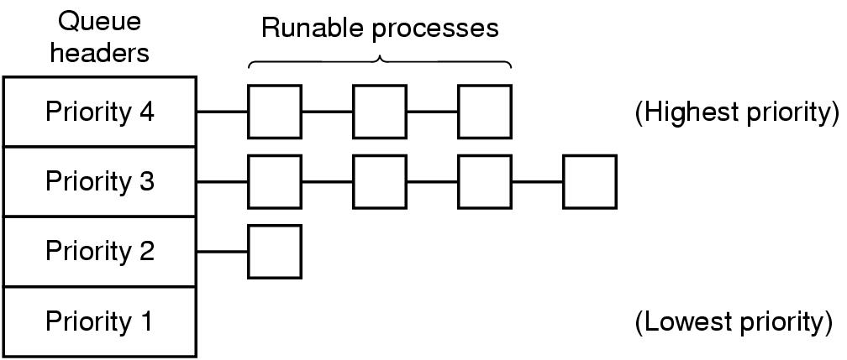
Scheduling in Interactive Systems (2)
Priority Scheduling
Each process assigned with a priority
Runnable process with highest priority allowed to run
Often combined with RR: priority among classes and RR in each class
Multiple Queues (MQ)
Figure 2-42. A scheduling algorithm with four priority classes.
Notes:
For example daemon process sending emails should be lower priority than music player.
To prevent higher priority process to run forever, we can decrease their priority, change priority dynamically.

Slide 62
Scheduling in Interactive Systems (3)
Lottery Scheduling
Processes given “tickets”
Scheduler picks a “ticket” randomly
Important processes can be given extra tickets
Fair-share Scheduling
Considers owners of processes
Each owner allocated portions of CPUs

Slide 63
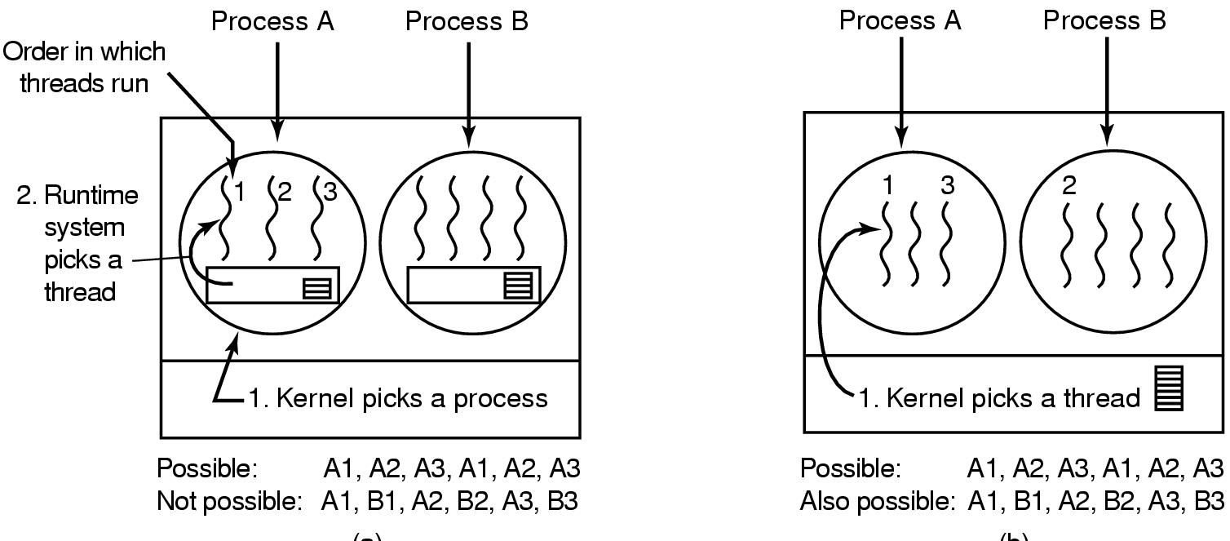
Thread Scheduling (1)
Differ depending on user-level/kernel-level threads
User-level:
OS scheduler only schedules processes
Thread scheduler determines threads scheduling
“application-specific” thread scheduling possible
Figure 2-43. (a) Possible scheduling of user-level threads with a 50-msec process quantum and threads that run 5 msec per CPU burst.

Slide 64
Thread Scheduling (2)
Kernel level:
OS scheduler aware of threads and schedule threads directly
Can also consider the process a thread belongs to
Performance: a kernel-level thread switch requires a full context switch
E.g. schedules a thread belonging to the same process v.s. another thread
Figure 2-43. (b) Possible scheduling of kernel-level threads with the same characteristics as (a).

Slide 65
Memory Management
Programmers desire private, infinitely large, infinitely fast, nonvolatile memory
Memory hierarchy
Memory manager
Memory abstractions
Keep track memory usage
Memory allocation and deallocation

Slide 66
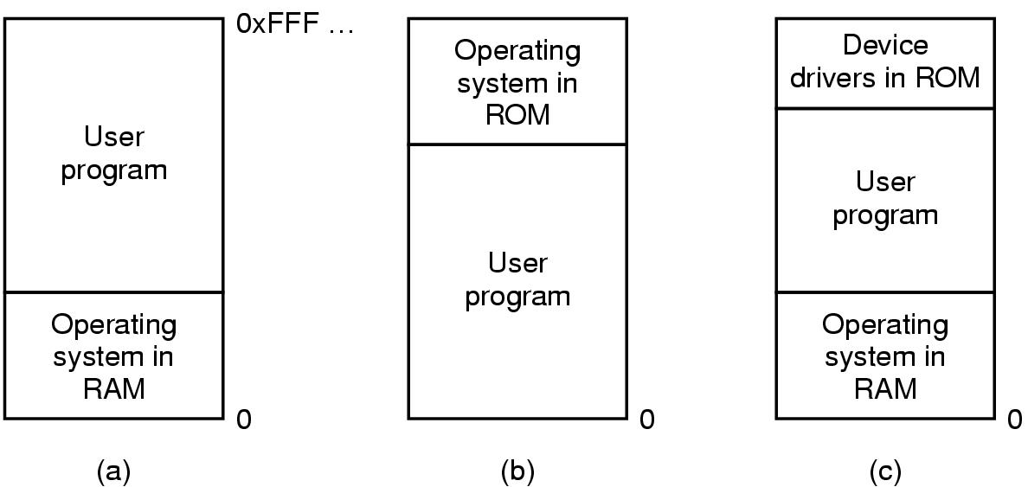
No Memory Abstraction
Each program access physical memory directly
MOV REGISTER1, 0x1000
BIOS
Figure 3-1. Three simple ways of organizing memory with an operating system and one user process.
Notes:
Since this is physical memory, not able to handle more than 1 program at a time. Since they can read/write on the same physical memory.
Multithreading can get some parallelism but can not have unrelated programs at a time.
problems with (a) and c): a bug in user program can wipe out OS.
b) Is still used for embeded system. Since microwaves, radios, washing machines, all programs are known in advance.

Slide 67
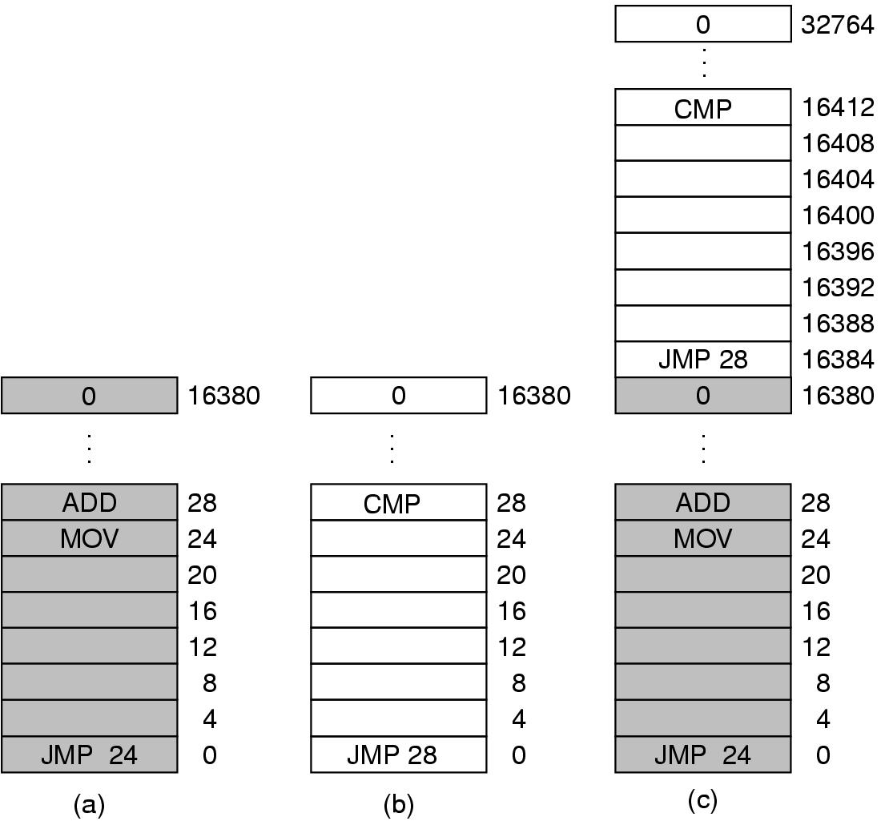
Multiple Programs Without Memory Abstraction
Static relocation (slow loading)
Requires programs smaller than physical memory
Figure 3-2. Illustration of the relocation problem.
Notes:
1) Possible with swapping (discussed later) but might be overhead.
2) Possible with static relocation to resolve the problem in Figure 3-2. -> this slow down the loading.

Slide 68
Memory Abstraction: Address Space
Major drawbacks without memory abstraction:
User programs address physical memory directly and can damage the operating system (intentionally/by accident)
Difficult to have multiple programs running at once

Slide 69
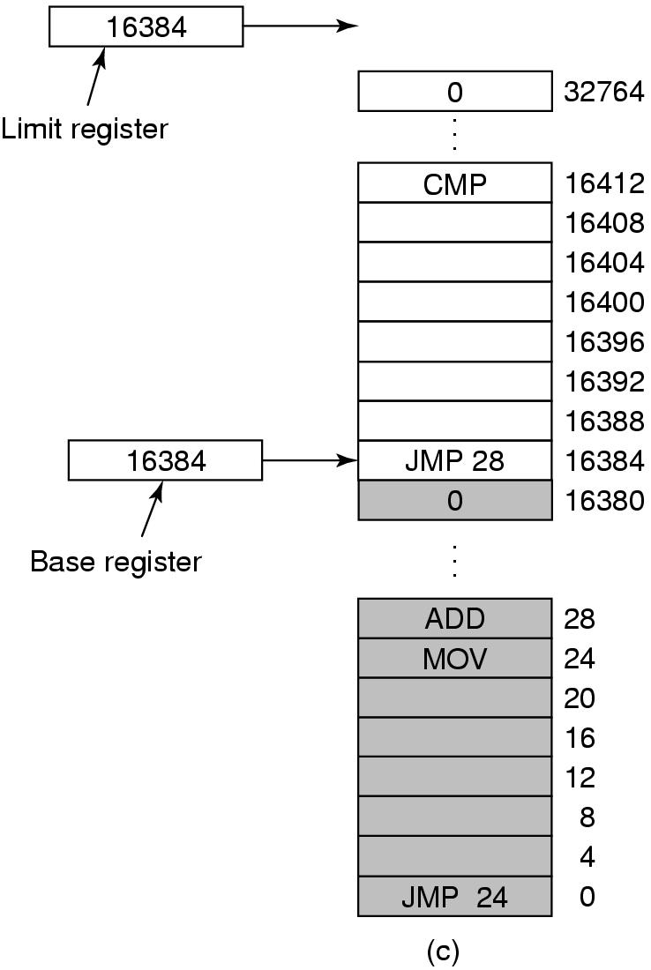
Notion of an Address Space
An abstraction of memory
A set of addresses that a process reference memory
Independent from each other
A simple solution with base and limit registers
“dynamic relocation”
Need an addition for each memory reference
Figure 3-3. Base and limit registers can be used to give each process a separate address space.
Notes:
“dynamic relocation”: map process address space to physical memory

Slide 70
When Physical Memory Not Enough…
When physical memory not large enough to hold all processes
Swapping: bringing in each process in entirety when running and bringing out to disks when not
E.g. idle processes stored on disk
Virtual memory: allows programs to run even when they are only partially in main memory

Slide 71
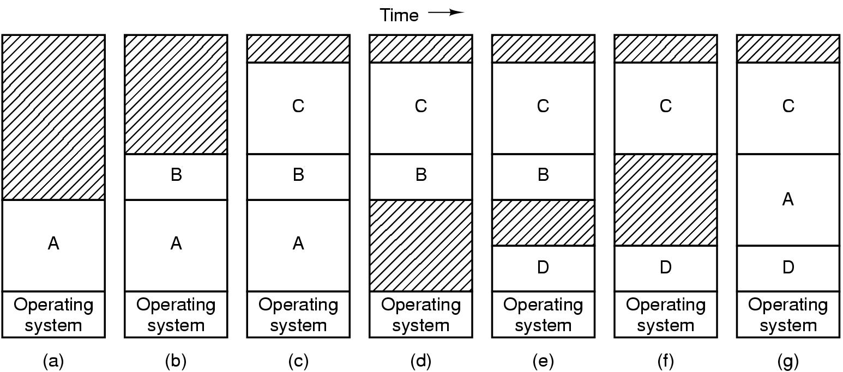
Swapping (1)
Figure 3-4. Memory allocation changes as processes come into memory and leave it. The shaded regions are unused memory.
Need hardware/software solution for relocating addresses
E.g. base and limit registers
Notes:
Memory compaction: combine multiple hole to create a big one.

Slide 72
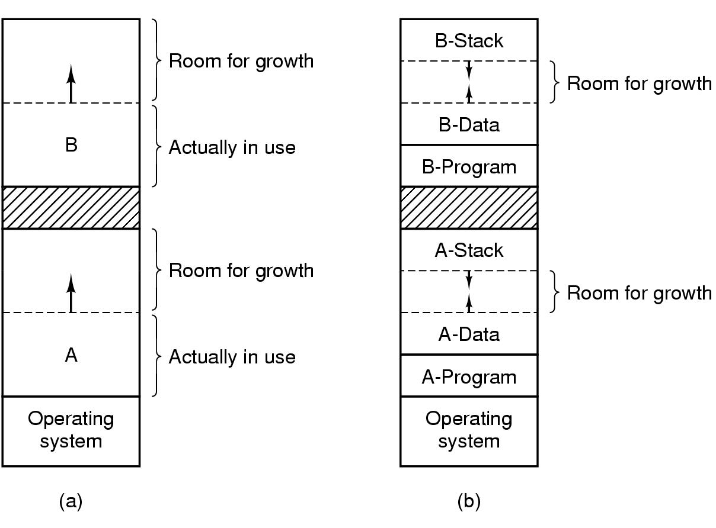
Swapping (2)
Extra memory can be allocated if processes grow
Instead of moving processes around (find large enough “holes”)
Figure 3-5. (a) Allocating space for growing data segment. (b) Allocating space for growing stack, growing data segment.

