Slide 1
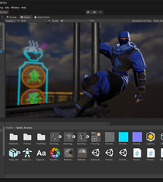
Introduction to Unity3D
Presented by: Vinh T. Nguyen, PhD
Monday, Oct 19, 2020, Texas Tech University

Slide 2
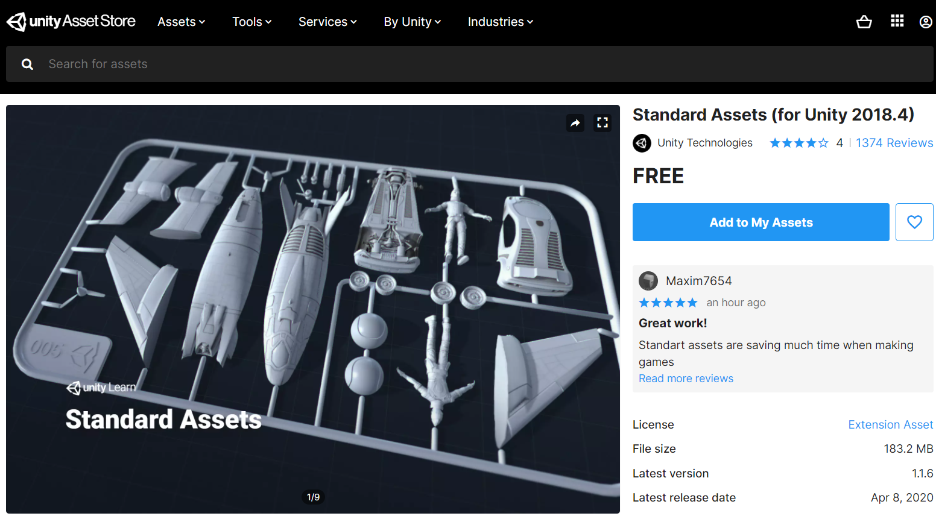
Where to start?
Check Unity version

Slide 3
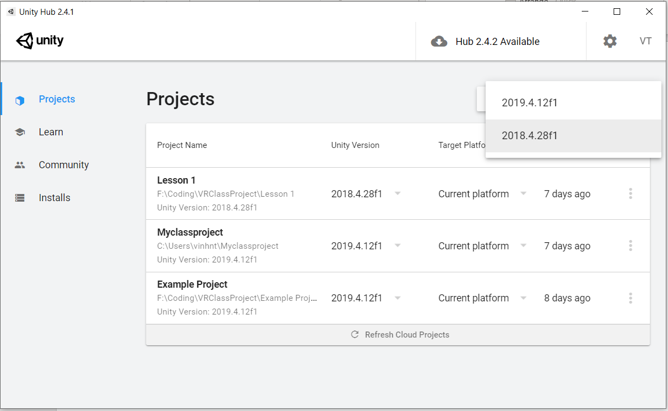
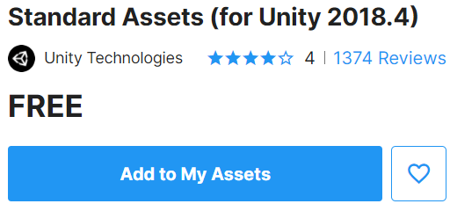
Check Unity asset version

Slide 4
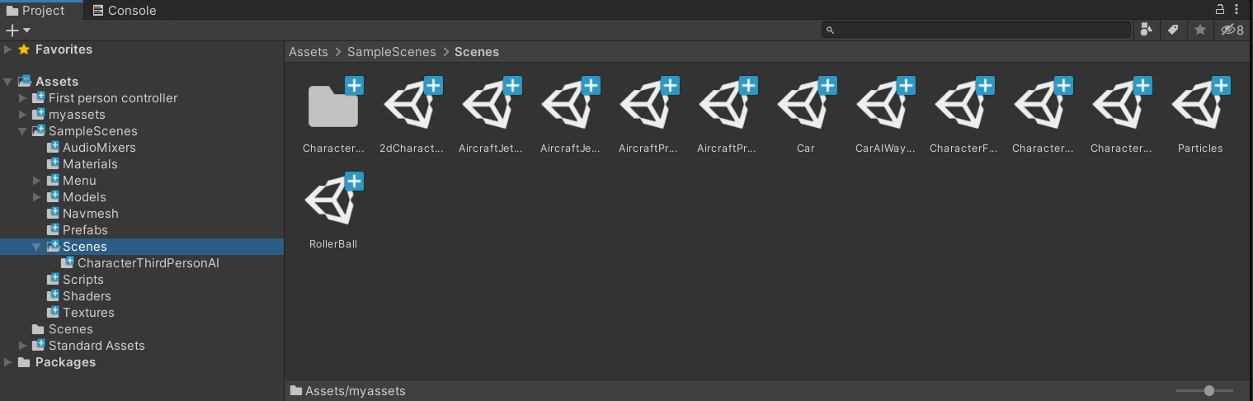
Check Unity asset version
After imported assets, you will find it under Assets folder, including source code, prefab, sample scenes…

Slide 5
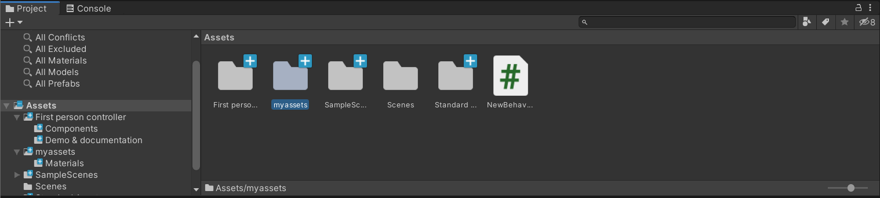
Customize your project
Create an object with materials, for example ceiling/floor
Step 1: Import your assets (e.g., image, 3d models…)

Slide 6
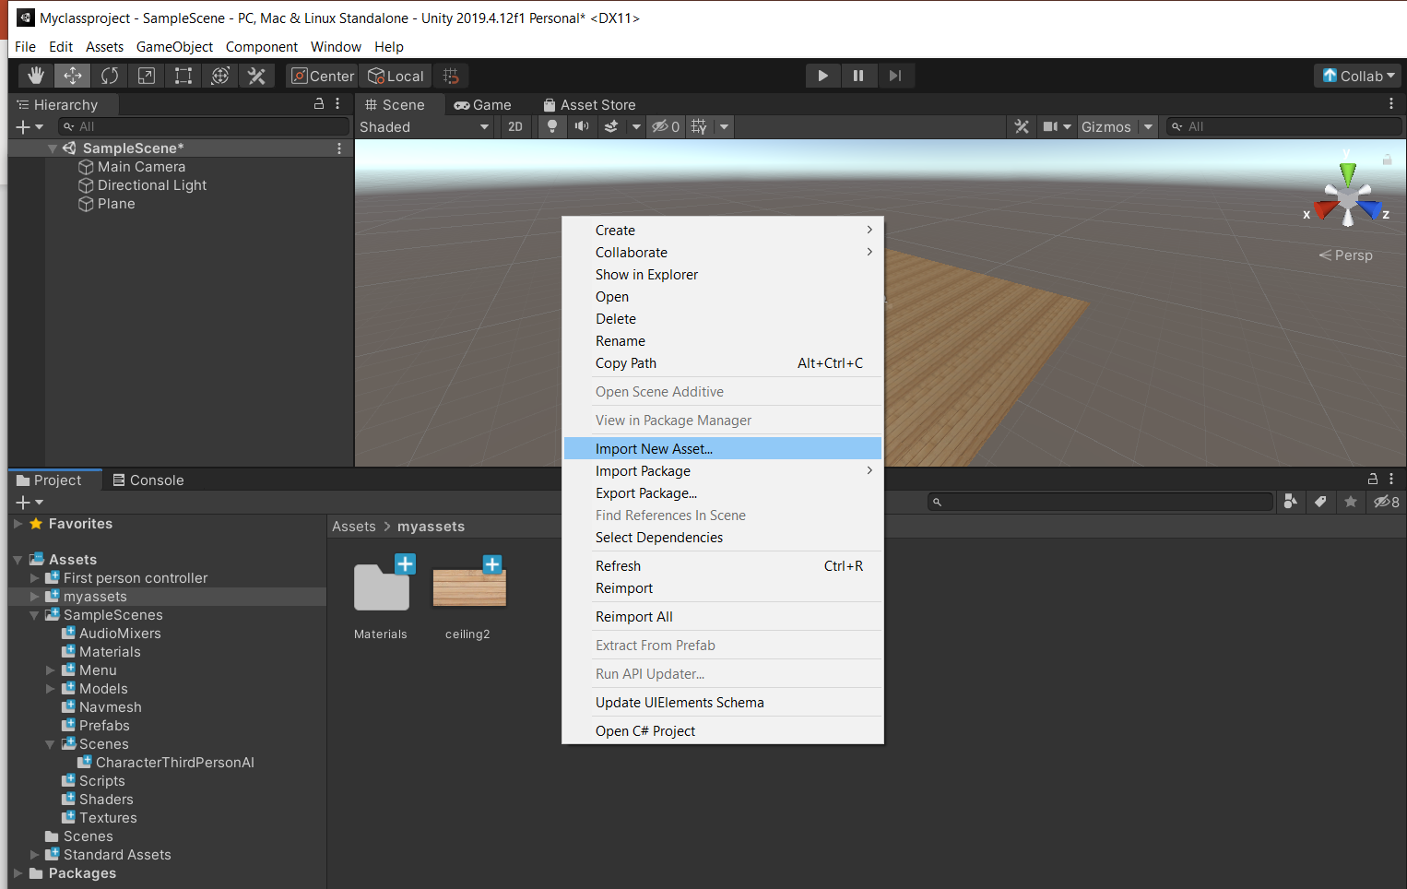
Customize your project
Create an object with materials, for example ceiling/floor
Step 2: Right click for Import New Asset… or you can drag/drop your images/models directly into your assets folder

Slide 7
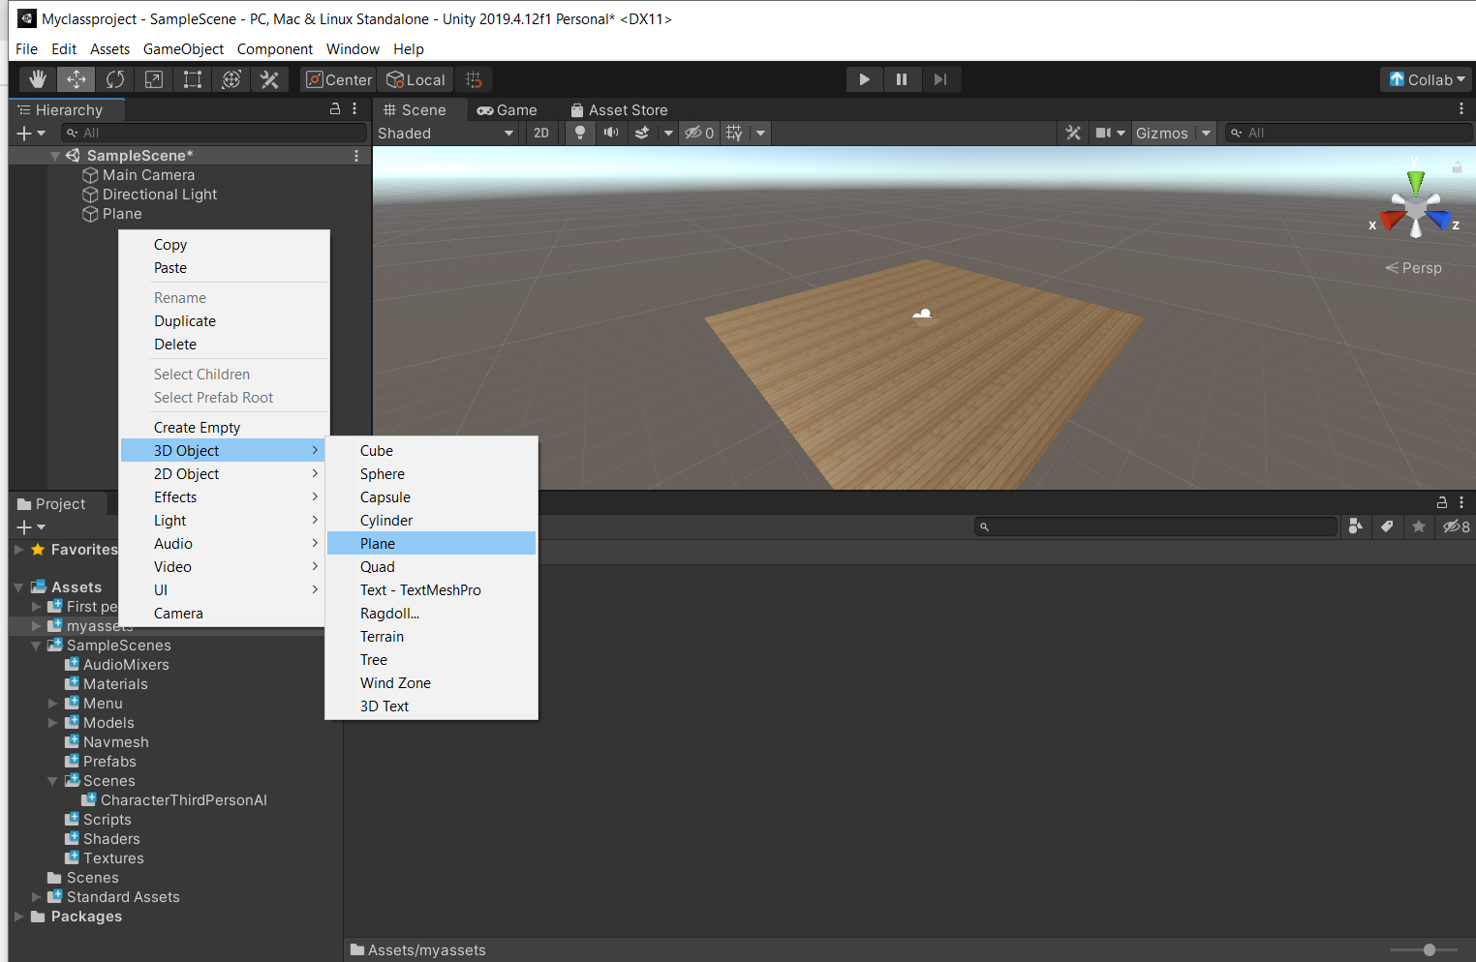
Customize your project
Create an object with materials, for example ceiling/floor
Step 3: Create your new primitive object (or entity in A-Frame). For example, a plane (for flat surfaces such as walls/floor/ceiling)

Slide 8
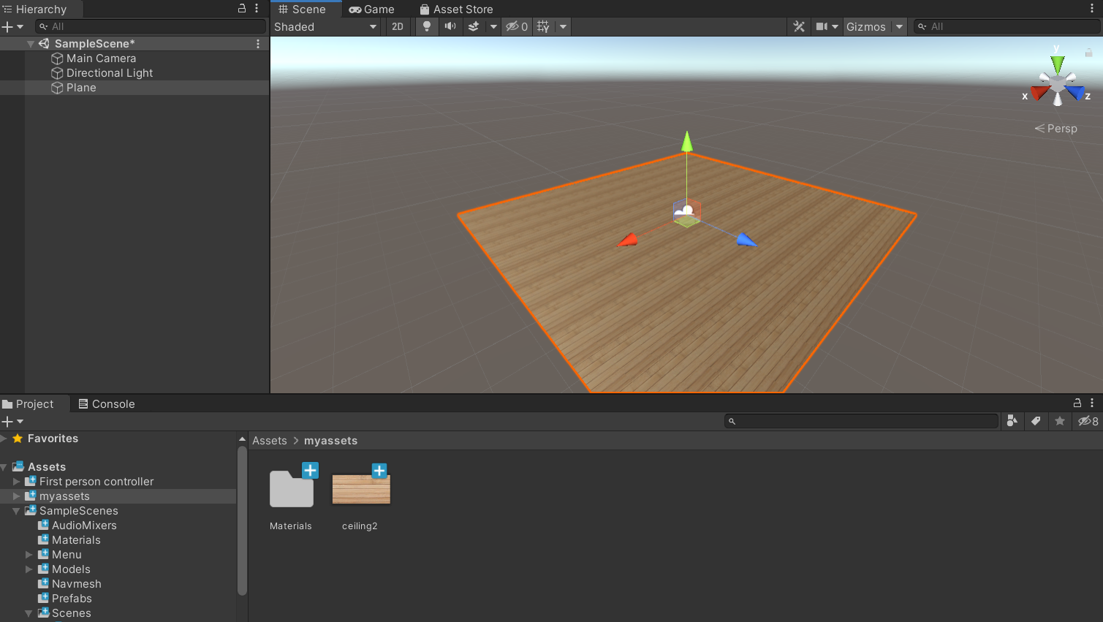
Customize your project
Step 4: Drag your material directly to the object either in the Hierarchy or Scene view

Slide 9
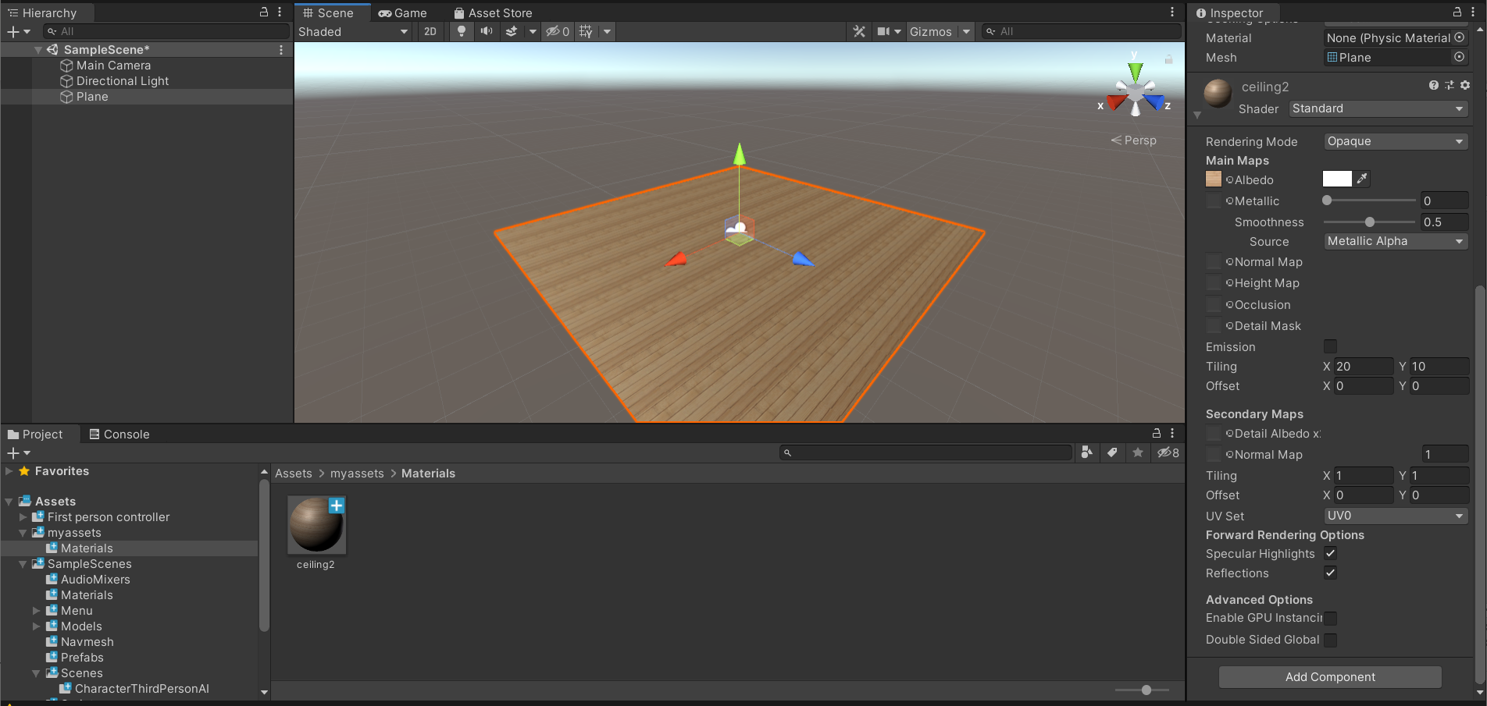
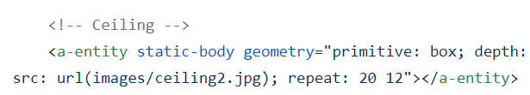
Customize your project
Step 5: Change the size of the materials (or repeat property in A-frame).

Slide 10
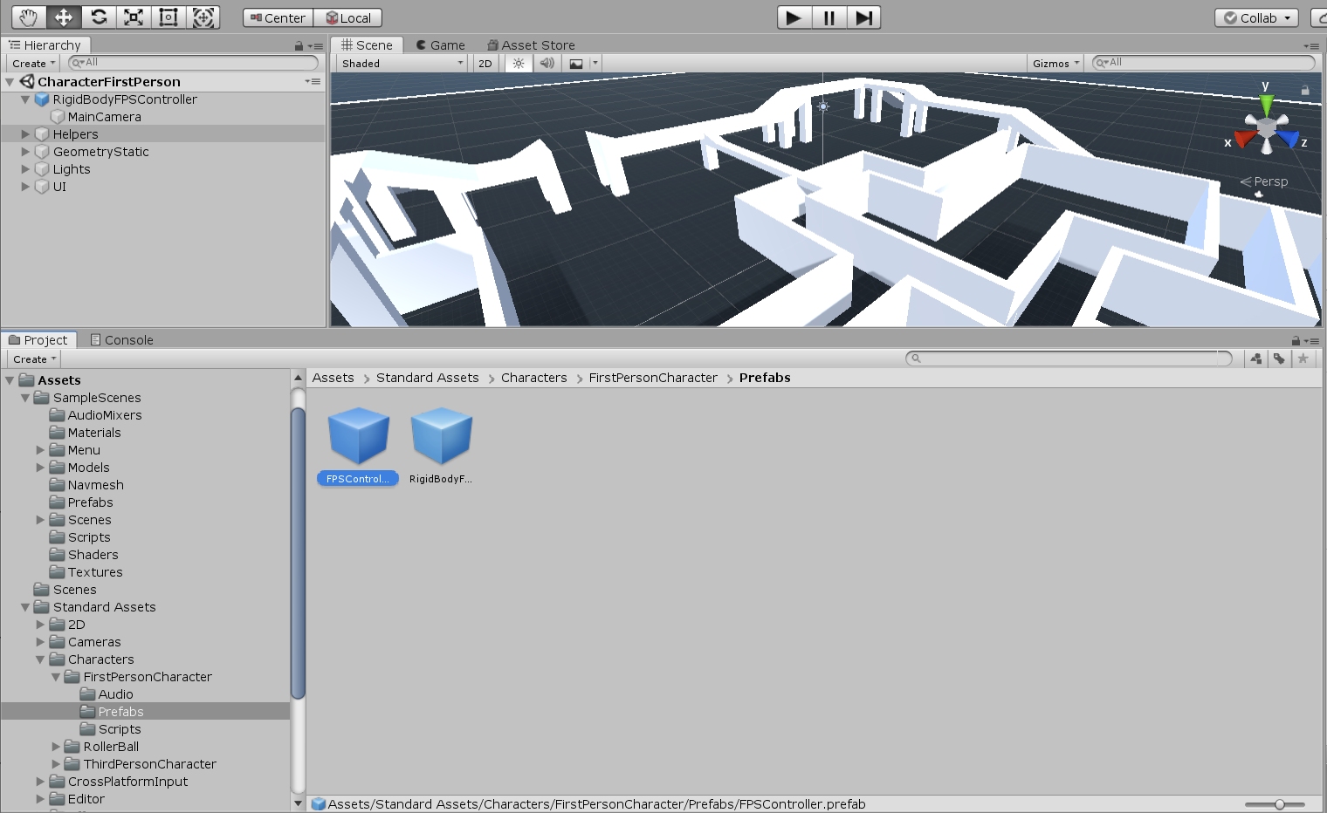
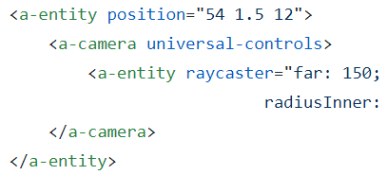
Adding navigation to the scene
You can add First Person Controller, or Third Person Controller. All the codes are already there to use.
This is equivalent to a-camera in A-Frame
3
2
1

Slide 11
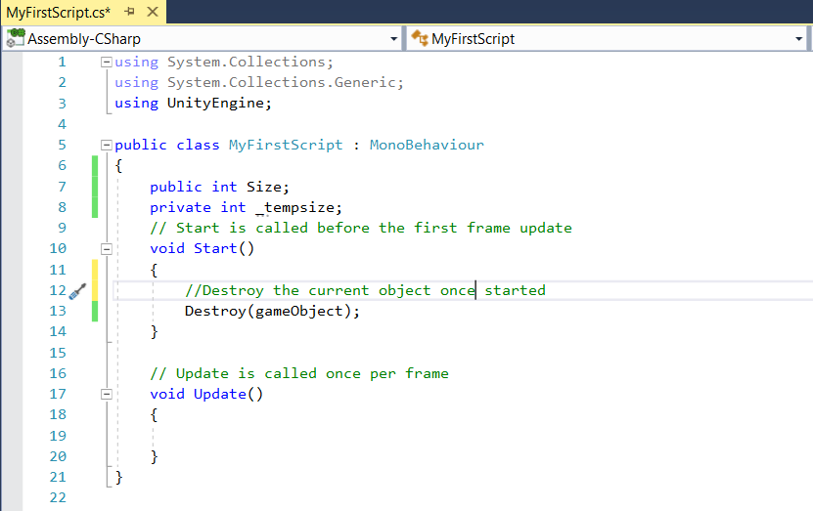
Writing scripts some notes
Note:
- By default, every script is derived from Monobehaviour, use it for event handler unless your class is only used for storing information.
- We have private/public variables like any other programming language mechanism.
- In JavaScript, we use this to refer to its object, in Unity we use gameObject

Slide 12
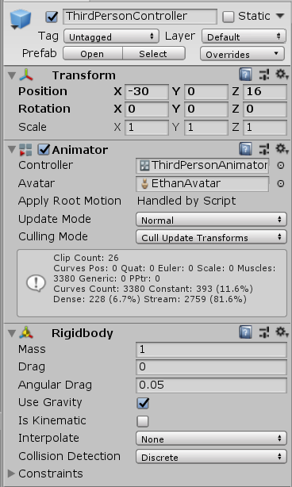
Writing scripts some popular functions
For default components
transform.position = new Vector3(0, 0,0)
transform.rotation = Quaternion.Euler()
For attached components
gameObject.GetComponent<Rigidbody>();

Slide 13
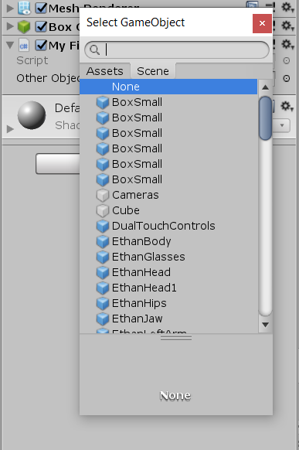
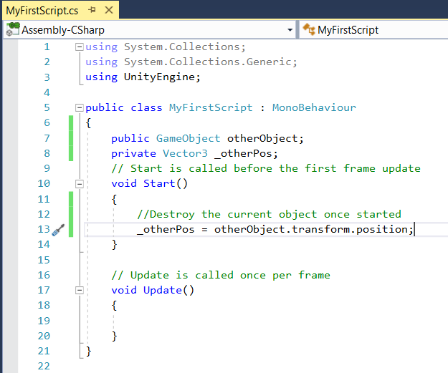
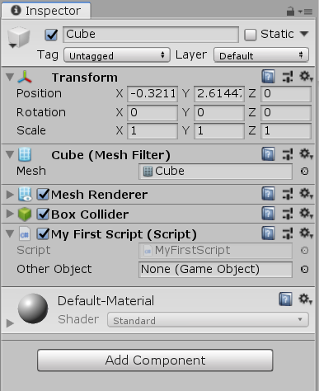
Writing scripts some popular functions

Slide 14
Questions?

