Slide 1
Client Server Architecture and Data Persistence Options

Slide 2
Outline
Client/Server Architecture for the Web
Persistence Data Options for the Web
IndexedDB
Server (e.g., MongoDB)
Web Server (e.g., Node.js)

Slide 3
Client/Server and persistence options
Cookie, IndexedDB, etc.,
Web Client
(Google Chrome, Firefox, etc.)
Request (GET, POST, etc.)
Web Server
(Apache, Node.js, etc.)
DBMS
(MongoDB, MySQL, etc.)
Response (html, js, css, etc.)
User’s own machine
Company’s machine(s)
Front-end
Back-end

Slide 4
IndexedDB
https://developer.mozilla.org/en-US/docs/Web/API/IndexedDB_API
Is a client-side storage for significant amounts of structured data
Uses indexes to enable high-performance searches of this data

Slide 5
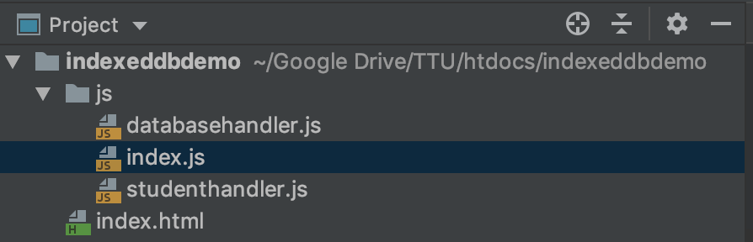
A sample IndexedDB project

Slide 6
Database handler
databasehandler.js
function getDb(onsuccess){ const dbrequest = indexedDB.open("studentdb"); dbrequest.onupgradeneeded = function(){ let db = dbrequest.result; if (!db.objectStoreNames.contains('tblStudents')){ db.createObjectStore('tblStudents', {autoIncrement: true}); } }; dbrequest.onsuccess = function () { let db = dbrequest.result; onsuccess(db); } }

Slide 7
Student Table Handler
studenthandler.js
class StudentHandler { put(st, onSuccess) { getDb(db => { const tx = db.transaction('tblStudents', 'readwrite'); const tbl = tx.objectStore('tblStudents'); tbl.put(st).onsuccess = () => { onSuccess(); db.close();//close the connection }; }); } loadAll(onSuccess) { getDb(db => { const tx = db.transaction('tblStudents', 'readonly'); const tbl = tx.objectStore("tblStudents"); tbl.openCursor().onsuccess = (evt) => { const cursor = evt.target.result; onSuccess(cursor, () => { db.close();//close the connection }); } }); } }

Slide 8
The functions
index.js
const studentHandler = new StudentHandler(); function addStudent(st) { studentHandler.put(st, () => { console.log("Insert sucessfully"); }); } function loadStudents() { studentHandler.loadAll((cursor, onComplete) => { if (cursor) { console.log(cursor.value); cursor.continue(); } else { //Completed looping, call the onComplete to close conn. console.log("Done"); onComplete(); } }); }

Slide 9
Load the scripts
index.html
<!DOCTYPE html> <html lang="en"> <head> <meta charset="UTF-8"> <title>IndexedDB Demo</title> <script src="js/databasehandler.js"></script> <script src="js/studenthandler.js"></script> <script src="js/index.js"></script> </head> <body> </body> </html>

Slide 10
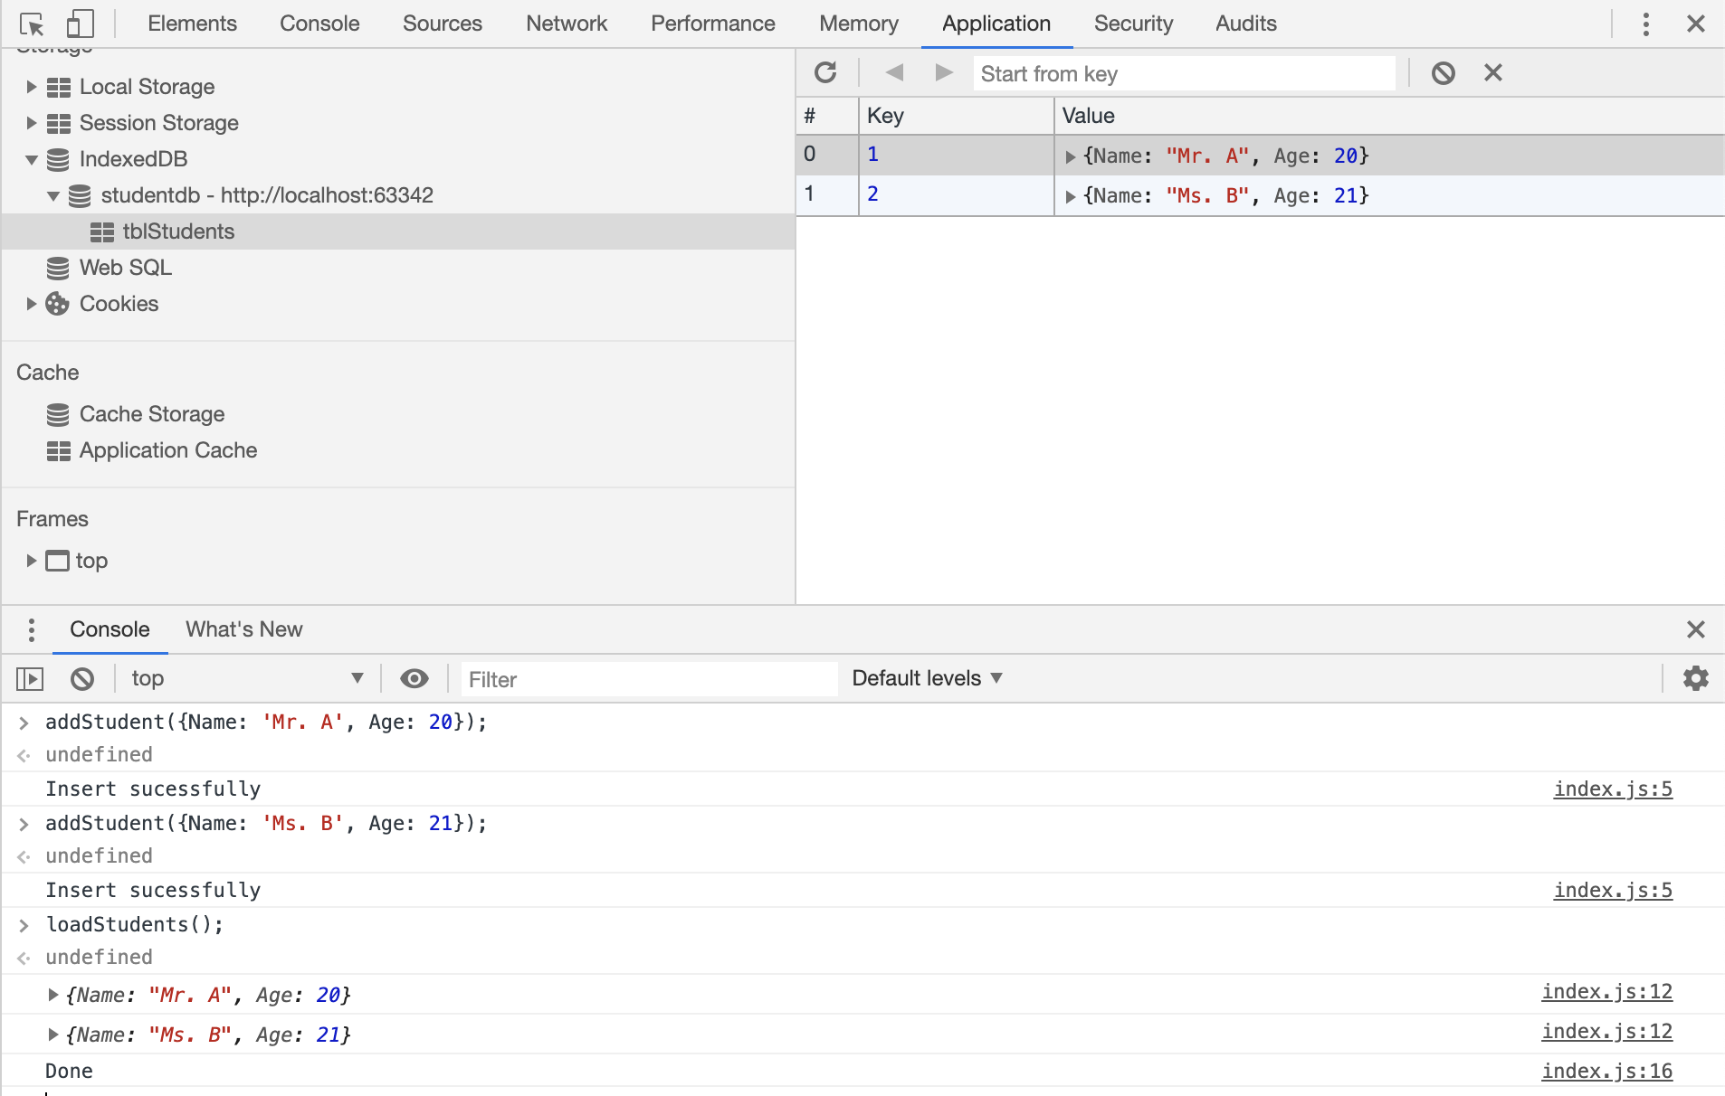
Test the functions

Slide 11
Node.js
Installation
https://nodejs.org/en/download
Run-time environment for JavaScript
Built on top of Google’s V8 engine
Used to execute JavaScript on any platform that Node.js can be installed
Features
JS code is compiled instead of interpreted
Node.js is single threaded
Non-blocking asynchronous execution
Sharing and reusing JS code (e.g., client validation vs. server validation)
Frameworks (Express.js, Backbone.js, Ember.js, etc.)

Slide 12
Node Package Manager (npm)
www.npmjs.com
To find hundreds of thousands of modules (949,986 by the time of this writing) that can be installed and used
This is one reason for the success of Node.js
Installing a module form the World:
$ npm install packageName
Share your module to the World:
Upload it to www.npmjs.com public registry

Slide 13
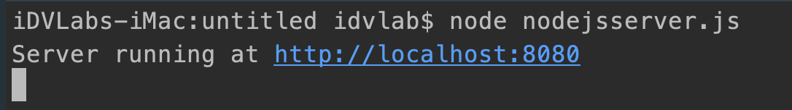
A simple web server with Node.js
Coding the server (nodejsserver.js)
const http = require('http'); http.createServer(function (req, res) { res.writeHead(200, {'Content-Type': 'text/plain'}); res.end('Hello World\n'); }).listen(8080, 'localhost'); console.log('Server running at http://localhost:8080');
Starting the server (from Terminal)
Testing the result (from Browser)

Slide 14
NoSQL vs. RDBMS
RDBMS
+consistency, -availability, and -partitioning
NoSQL
-consistency, +availability, and +partitioning
Popular subsets of NoSQL
Document stores, key-value stores, and graph-based solutions
MongoDB
Belongs to the document store category

Slide 15
MongoDB features
JSON friendly
Means the data stored and retrieved are JavaScript objects
Schemaless
Increases flexibility (can still enforce this at application level)
Heavy reads
It’s designed to support read-intensive tasks
Scalability
Scale well horizontally and vertically

Slide 16
Installation, starting, and running scripts
Installation
https://docs.mongodb.com/manual/installation
Starting
$ mongod --config /usr/local/etc/mongod.conf
Executing scripts
$ mongo

Slide 17
A Node.js MongoDB C/S App
API Reference: http://mongodb.github.io/node-mongodb-native

Slide 18
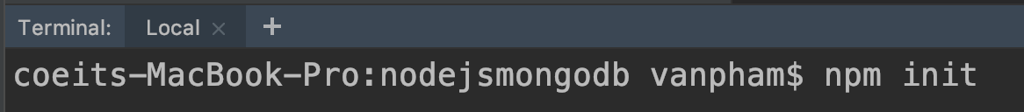
Initializing and getting dependent module
Initializing
Getting the dependent modules

Slide 19
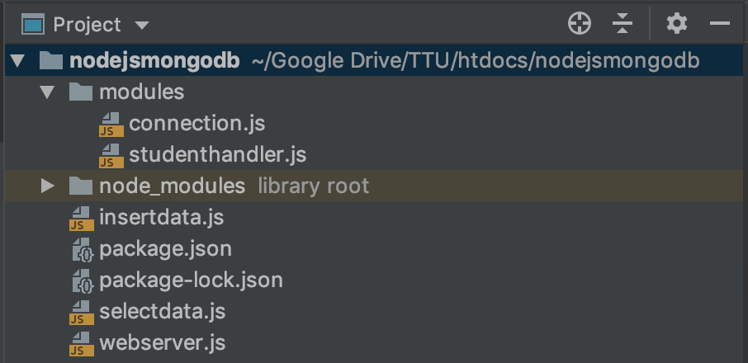
Project structure

Slide 20
The connection
connection.js
const MongoClient = require('mongodb').MongoClient; const mongoUrl = 'mongodb://localhost:27017'; exports.getConnection = function getConnection(onSuccess) { MongoClient.connect(mongoUrl, {useNewUrlParser: true}, (error, conn) => { if (error) throw error; onSuccess(conn); }); }

Slide 21
Student Handler
studenthandler.js
const dbName = 'nodejsmongodb'; const collectionName = 'students'; const connection = require('./connection'); exports.insertStudent = function(st, onSuccess){ connection.getConnection((conn)=>{ const db = conn.db(dbName); const collection = db.collection(collectionName); collection.insertOne(st, {}, (error, result)=>{ if(error) throw error; onSuccess(result); conn.close();//This is to close the connection }); }); } exports.selectAll = function(onSuccess){ connection.getConnection((conn)=>{ const db = conn.db(dbName); const collection = db.collection(collectionName); collection.find({}, (error, cursor)=>{ if(error) throw error; onSuccess(cursor, ()=>{ conn.close();//Close the connection }); }); }); }

Slide 22
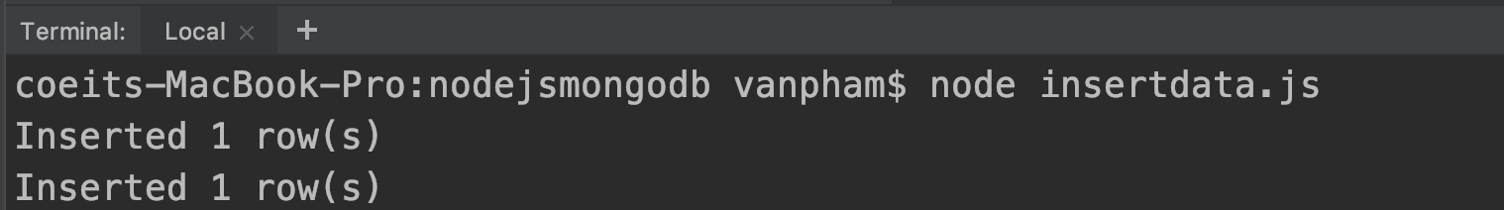
Insert data test
insertdata.js
const studenthandler = require('./modules/studenthandler'); const st1 = {'Name': 'Mr. A', 'Class': 'VVA'}; const st2 = {'Name': 'Ms. B', 'Class': 'VVB'}; studenthandler.insertStudent(st1, (result)=>{ console.log(`Inserted ${result.ops.length} row(s)`); }); studenthandler.insertStudent(st2, (result)=>{ console.log(`Inserted ${result.ops.length} row(s)`); });
Run it in the terminal

Slide 23
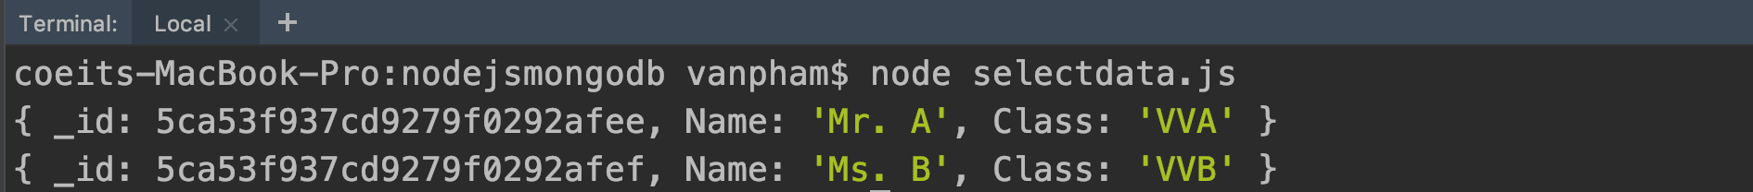
Select data test
selectdata.js
const studenthandler = require('./modules/studenthandler'); studenthandler.selectAll((cursor, onComplete) => { cursor.forEach(doc => { console.log(doc); }, () => { onComplete();//At the end of the loop, close the connection }); });
Run it in the terminal

Slide 24
Using MongoDB CLI
Start MongoDB (if you haven’t done so)
$ mongod --config /usr/local/etc/mongod.conf
$ mongo
Commands to show the data
> use nodejsmongodb
> show collections
> db.students.find().pretty()
Drop a collection
> db.students.drop()

Slide 25
Setting up a RESFUL Web Server
webserver.js
const http = require('http'); const querystring = require('querystring'); const studenthandler = require('./modules/studenthandler'); http.createServer((req, res) => { const parts = req.url.split('?'); const op = parts[0]; const data = querystring.parse(parts[1]); if (op === "/insert") { studenthandler.insertStudent(data, (result) => { res.writeHead(200, {'Content-Type': 'text/plain', 'Access-Control-Allow-Origin': '*'}); res.end('success'); }); } else if (op === "/select") { studenthandler.selectAll((cursor, onComplete) => { cursor.toArray((error, docs)=>{ res.writeHead(200, {'Content-Type': 'application/json', 'Access-Control-Allow-Origin': '*'}); res.end(JSON.stringify(docs)); }); }); } }).listen(8888, 'localhost'); console.log('Listening on http://localhost:8888');

Slide 26
Cross-Origin Resource Sharing (CORS)
https://developer.mozilla.org/en-US/docs/Web/HTTP/CORS

Slide 27
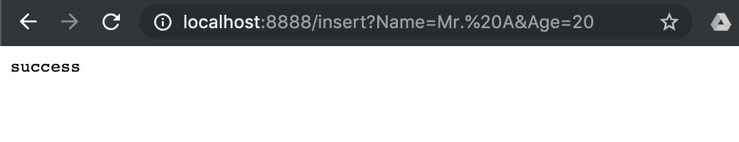
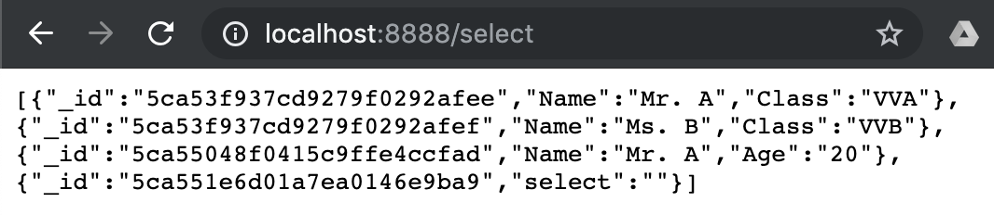
Request to the web server from browser
Insert
Select

Slide 28
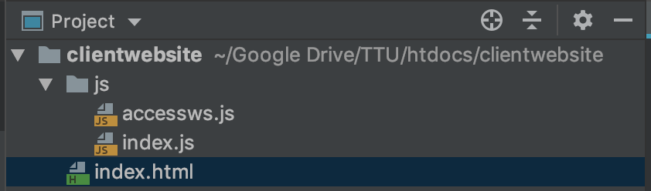
Web client application

Slide 29
Accessing web service
accessws.js
function getResource(url, processResult) { const xhr = new XMLHttpRequest(); xhr.onreadystatechange = function () { if (this.readyState != 4){ return; } if (this.status == 200) { const result = this.responseText; processResult(result); } }; xhr.open("GET", url, true); xhr.send(); }

Slide 30
The functions
index.js
const baseUrl = 'http://localhost:8888'; const insertCmd = '/insert'; const selectCmd = '/select'; function insertStudent(st){ let objKeys = Object.keys(st); let query = `${objKeys[0]}=${st[objKeys[0]]}`;//First parameter for (let i = 1; i < objKeys.length; i++) {//Other parameters let theKey = objKeys[i]; query += `&${theKey}=${st[theKey]}` }; const url = baseUrl + insertCmd + '?' + query; getResource(url, result=>{ console.log(result); }); } function selectStudents(){ const url = baseUrl + selectCmd; getResource(url, result=>{ console.log(result); }); }

Slide 31
Load the functions
index.html
<!DOCTYPE html> <html lang="en"> <head> <meta charset="UTF-8"> <title>MongoDB Client</title> <script src="js/accessws.js"></script> <script src="js/index.js"></script> </head> <body> </body> </html>

Slide 32
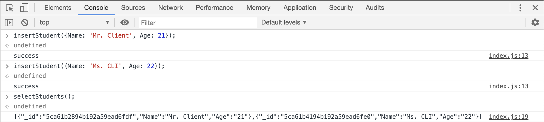
Test the functions

Slide 33
References/Resources
IndexedDB:
https://developer.mozilla.org/en-US/docs/Web/API/IndexedDB_API
Node.js and MongoDB:
Satheesh, M., D'mello, B. J., & Krol, J. (2015). Web development with MongoDB and NodeJS. Packt Publishing Ltd.
MongoDB
https://docs.mongodb.com/manual/installation
Node.JS MongoDB API
http://mongodb.github.io/node-mongodb-native
CORS:
https://developer.mozilla.org/en-US/docs/Web/HTTP/CORS

