Slide 1
Automated Performance Modeling of HPC Applications Using Machine Learning
Dhruv Chetan Mehta
Dhruv Chetan Mehta

Slide 2
Content
Performance Modeling
HPC (High-Performance Computing)
Review of Literature
Automated Performance Modeling
Main Idea of the Paper
Architecture
Architecture of the Training Phase
Architecture of the Predicting Phase
Results

Slide 3
Performance Modeling
Modelling means prediction i.e. estimating the performance of a new system, estimating the impact of change on an existing system or estimating the impact of a change of workload on an existing system
Performance modeling and analysis has been and continues to be of great practical and theoretical importance in research labs in the design, development and optimization of computer and communication systems and applications
Includes a broad spectrum of research activities from the use of more empirical methods (ranging from experimental tweaking of simple existing models up to building and experimenting with prototype implementations) through the use of simulation to more sophisticated mathematical methods

Slide 4
HPC (High-Performance Computing)
Practice of aggregating computing power that delivers a much higher performance than one could get out of a typical computer
HPC brings together several technologies such as computer architecture, algorithms, programs and electronics, and system software under a single canopy to solve advanced problems effectively and quickly
A highly efficient HPC system requires a high-bandwidth, low-latency network to connect multiple nodes and clusters
HPC technology is implemented in multidisciplinary areas including: Biosciences, Geographical data, Climate Modeling etc

Slide 5
Review of Literature
Analytical Model: Has arithmetic formulae describing parallel program performance & can offer prediction of execution time faster
Drawback: Needs human-experts with understanding of a particular HPC application
Replay-Based Model: Built from historical execution traces containing information about computing and communication of the HPC program. Through these traces a synthetic program can be reconstructed for replaying behaviors of the original program & predicting its performance
Drawback: Requires large storage space to keep the traces (hundreds or MBs to tens of GBs). Moreover, a synthetic program can only represent 1 execution path of the original program which restricts the application
Statistical Model: Uses machine learning techniques to fit the mapping function between performance metrics and some more features. With the training data, this model can make predictions without domain knowledge & human efforts
Drawback: Absence of domain experts to parse non-scalar inputs and input parameters cannot cover all performance features

Slide 6
Main Idea of Paper
In this paper, they proposed a performance modeling and prediction method, which identifies runtime features that is highly relevant to performance, without requiring domain knowledge and human efforts
It automatically inserts instrumentation code, detects runtime features, and analyzes feature data
The random forest regression approach is used to predict execution time
With this approach, the performance model can fit the complex nonlinear mapping function between features and performance. It can also analyze the statistical importance of each feature and only reserve a subset of important features to further reduce the overhead of instrumentations
This research focus is inspired by the fact that a typical HPC application consists of three phases: initialization, repetitive calculation, and termination. Among these three phases, the initialization phase is usually used to define what will be calculated and how to be calculated

Slide 7
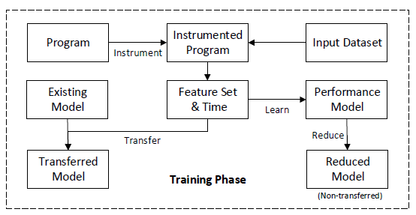
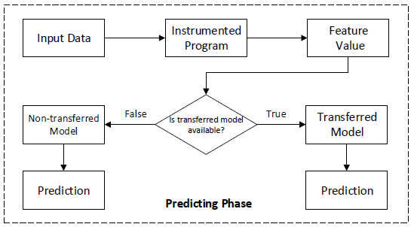
Architecture

Slide 8
Architecture
Our method of performance modeling and prediction includes two phases: a training phase and a predicting phase, as shown above
The training phase is used to collect data and build a performance model. It mainly consists of four stages: instrumentation, model learning, feature reduction, and model transfer
The predicting phase is used to handle a new input data of the target program, calculate the value of features, and output a predictive execution time with the transferred model or the non-transferred model depending on whether the transferred model is available

Slide 9
Training Phase : Instrumentation
To capture behavior patterns of parallel programs without domain knowledge, we collect the runtime features through instrumentation
Instrumentation is a dynamic analysis for a program, which extracts program features from sample executions
The instrumentor automatically analyzes the abstract syntax tree (AST) of the source code of the target program, and inserts detective code around assignments, branches, loops, and communications to generate the instrumented program
Assignment: The size of a problem and the amount of calculation are decided by key variables like the problem size, iteration count, convergence condition, and solution accuracy. To discover the key variables from the source code, we insert the instrumentation code after assignments
Branches: Branches can lead to different execution paths, which may have significantly different execution times. We insert instrumentation code after the conditional statement of branches and record their results as runtime features
Loops: The amount of iterations of loops has a direct impact and correlation with the performance. An instrumentation code line is inserted in each loop

Slide 10
Training Phase : Instrumentation
MPI Communications: Communication tracing can capture information of a network, like latency, bandwidth automatically, but tracing MPI events of a parallel program completely generates traces that often need very complex analysis even though a program has fixed behavior. We take the data size and the number of targets of MPI communication function calls to represent communication features

Slide 11
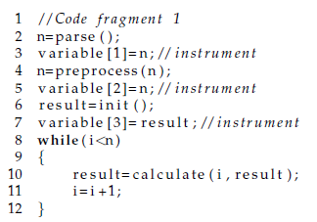
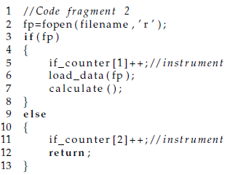
Examples of Instrumentation
Assignment: Branches:

Slide 12
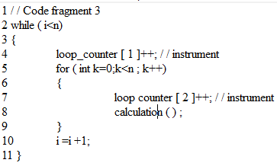
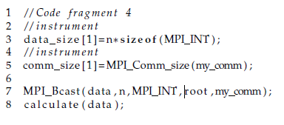
Examples of Instrumentation
Loops: MPI Communication:

Slide 13
Training Phase : Model Learning
After collecting runtime features via instrumentation, we then try to discover the correlation between features and program execution time
Each sample is expressed as (x; y), where x is a vector consisting of m features and y is the corresponding execution time. The goal of this regression problem is to find a mapping relation, f : x -> y
Random forest is widely used in classification or regression tasks. Besides the capability of modeling complex nonlinear data, another advantage of random forest is that it can process mixed different types of features including float, integer, and enumeration
Such a characteristic makes it suitable to model the runtime features we trace from MPI program execution. Besides, random forest can analyze the importance of each feature
It enables reducing redundant features and corresponding instrumentations

Slide 14
Training Phase : Feature Reduction
After the first 2 methods, we generate a fairly complex model, because a parallel program may contain many assignments, branches, loops, and communications
This will increase the number of feature and take significant storage and introduce extra overhead but such a complex model tends to be over-fitting, which has a poor generalization performance
This gets us to the third part of the training phase i.e. feature reduction
Reduction by Time:
  Some features are too expensive to fetch their values when predicting the execution time of a new input
  This problem can be solved by setting a time threshold that only reserves the features below the threshold
  The trade-off between reduction effectiveness and prediction accuracy depends on the characteristics of the target application
Reduction by Importance:
  After reducing features by time threshold, we can further remove some features that have less impact on performance

Slide 15
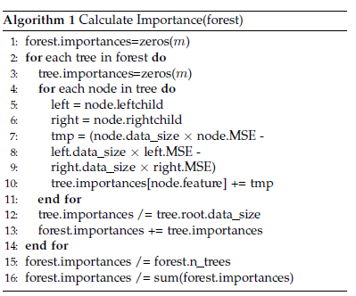
Training Phase : Feature Reduction
This is the pseudocode of calculating the importance of features using the random forest.
Traditional dimensionality reduction techniques, like principal component analysis (PCA) or singular value decomposition (SVD), can effectively reduce the number of features.

Slide 16
Training Phase : Model Transferring
The methodology we spoke about till this point requires training and testing on same platform but the platform settings may be modified or the application may need to be run on a completely new platform
It is feasible to repeat the modeling process, like collecting data, building model, and reducing features, on the new platform, but the new model may not achieve the desired accuracy until a sufficient amount of execution samples are collected and analyzed. This challenge is commonly referred as the cold start problem
We introduce an instance-transfer method to solve this problem. An instance refers to an execution sample. An execution sample of an application on a certain platform
can be regarded as a measure of this platform, and the measurement result is represented by a (m+1)-dimension point (y; x1;...;xm). Thus on two different platforms, multiple executions will generate two point sets with different marginal probability distributions of y in the same (m+1)-dimension space

Slide 17
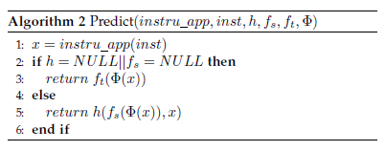
Predicting Phase
The predicting phase of our method is simpler than the training phase. There are two types of predictions: (1) using a non-transferred model to predict the performance on the target platform with all trace data from this platform itself, and (2) using a transferred model to predict the performance on the target platform with help from a source platform
Algorithm 2 shows the procedure of predicting the execution time of an application with an input instance on the target platform

Slide 18
Predicting Phase
Its parameters include the instrumented application instru app, an input instance inst of the application, the transfer function h(.), the performance model on the source platform fs(.) (a random forest trained by all trace data from the source platform), the performance model on the target platform ft(.) (a random forest trained by all trace data from the target platform), and the polynomial expansion function Ø(.)
First, it executes the instrumented application with inst
If a source model or a transfer function does not exist, we can only make a prediction with the model ft()
If a source model fs() and a corresponding transfer function h() exist, we first use fs() to produce a prediction, and then transfer the prediction to the target platform
In general, both the non-transfer model ft() and the transfer model h(fs((x)); x) can predict the execution time of inst on the target platform

Slide 19
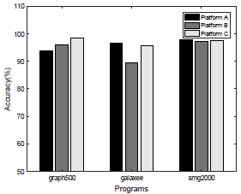
Results
They ran each application on each platform 1,000 times with different input parameters. In other words, each modeling task had 1,000 data samples. The input parameters we used for experiments were generated from the parameter value range of each application uniformly and randomly.
The three parallel programs used for the experimental study are Graph500, GalaxSee, and SMG2000.
The figure besides shows the experimental results of three applications on three platforms. Considering all experimental configurations, the accuracy of predicting the performance rank of each sample pair is around 90%. It confirms that in most cases, their model can predict the correct rank relationship when comparing the performance of two different input parameters.

