Slide 1
Splitting Interfaces: Making Trust Between Applications and Operating Systems Configurable
Professor Name: Tommy Dang
Presented by: Sai Bhavesh Nooka

Slide 2
CONTENTS
1) Introduction
2) Main Problem
3) Approach to handle the security
4) Design of the system
5) Applications
6) Results
7) Conclusion
8) References

Slide 3
INTRODUCTION
In current commodity systems, applications have no way of limiting their trust in the underlying operating system (OS), leaving them at the complete mercy of an attacker who gains control over the OS. This work describes the design and implementation of Proxos, a system that allows applications to configure their trust in the OS by partitioning the system call interface into trusted and untrusted components.

Slide 4
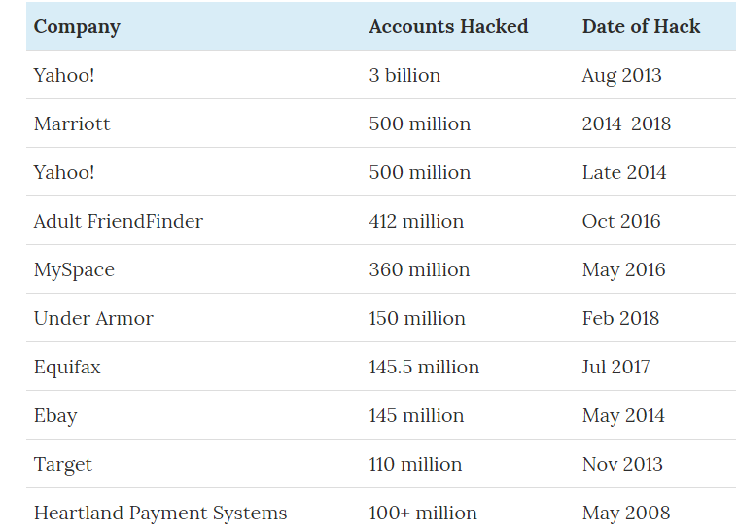
INTRODUCTION
Trends of attacks in the recent time:

Slide 5
MAIN PROBLEM
Most of the application now a days needs administrative privileges i.e.; admin control to run on the system. So, when the attackers attack they can get a control over OS and kernel (Middleware between apps to access Hardware of a machine)
As the kernel code is large, it gives attacker a lot of scope to inject drivers or code to hack the data. When this happens, they can even get a control over app that are security sensitive apps

Slide 6
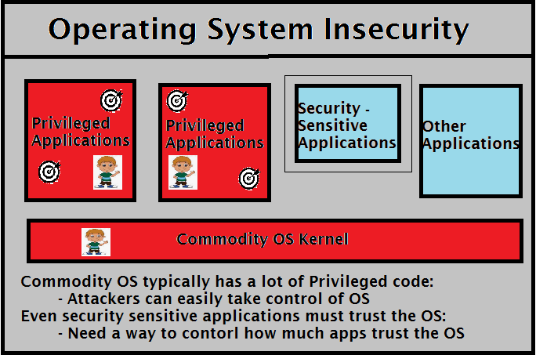
MAIN PROBLEM

Slide 7
APPROACH TO HANDLE THE SECURITY
App depend on OS for all the operations and we have two types of apps
1) security sensitive apps
2) other apps
Main scope is how app will not trust OS but still will get the resources accessed. For this, Security – Sensitive Application (SSA) is separated from Commodity OS Kernel
SSA is not aware that it is separated and tries to make internal calls. So, a private OS is added to handle only SSA calls by using Virtual Machine Management

Slide 8
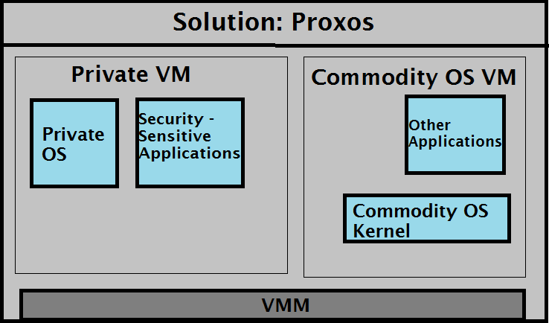
APPROACH TO HANDLE THE SECURITY

Slide 9
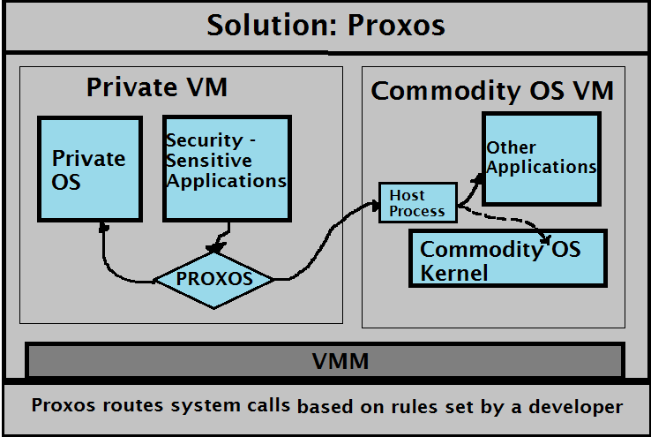
DESIGN OF THE SYSTEM
Proxos (Proxy Operating System) is a middleware to send the calls from SSA to private OS and to other external applications
SSA can access other apps or kernel using “Host Process”

Slide 10
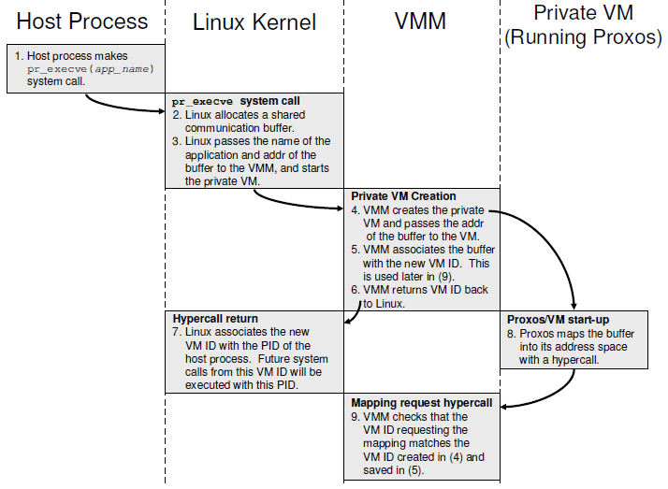
DESIGN OF THE SYSTEM
Process Diagram:

Slide 11
DESIGN OF THE SYSTEM
Developer Rules:
Proxos routes system calls based on rules set by the developer. Developer needs to set which data needs to be handles by secured OS and non secured
For example, Proxos may route read system calls differently depending on what file is being read.

Slide 12
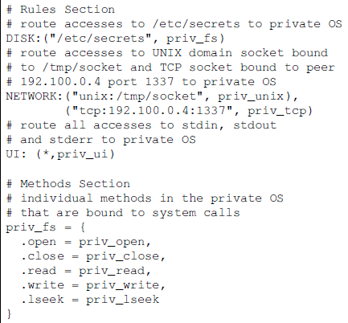
DESIGN OF THE SYSTEM
Sample Developer Rules (This example shows a simple set of routing rules that protects operations on a particular file, two network sockets, and the standard I/O streams)

Slide 13
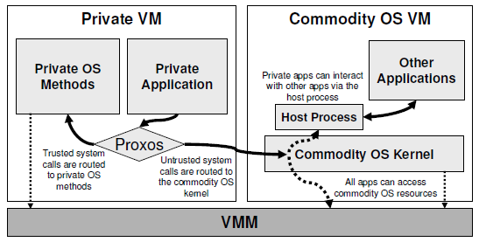
DESIGN OF THE SYSTEM
Summary of Design:

Slide 14
APPLICATIONS
There are 3 applications ported to Proxos
  First application is a secure web browser that protects user information
  Second application is an SSH server that protects system-critical information such as passwords and host keys even if the commodity OS is compromised, but still allows users who login to gain a full shell on the commodity Linux OS
  Final application is an SSL certificate service that we use with an Apache web server to implement SSL transactions. In this case, the private keys corresponding to the certificate are protected

Slide 15
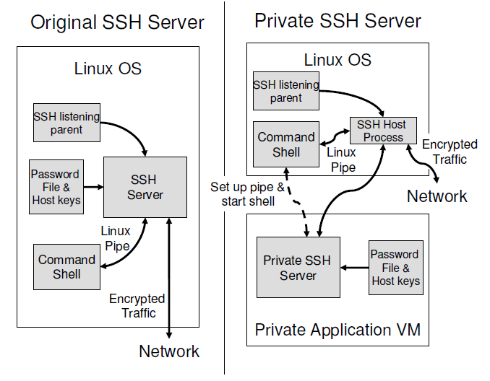
APPLICATIONS
Comparison of the original SSH server and our private SSH server:

Slide 16
RESULTS
To evaluate the average overhead a forwarded system call experiences, an SSH client was used to login to our private SSH server over the loopback device and measured the time taken to copy files ranging from 32MB to 256MB over the SSH connection. Each file transfer was performed five times on both the private SSH server and a native SSH server running on Xen. The standard deviation was less than 1.5% across our measurements.

Slide 17
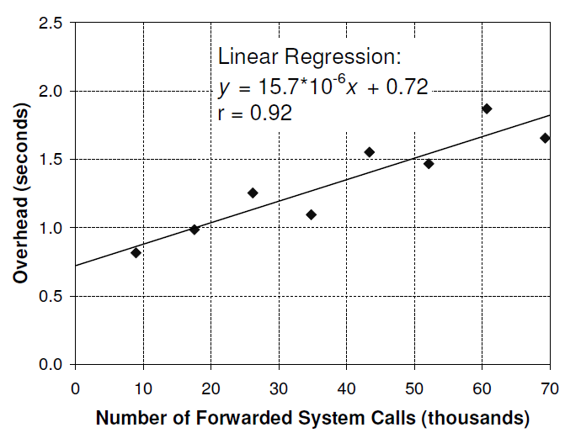
RESULTS
The below figure depicts SSH benchmark. Overhead of the private SSH server versus the number of system calls forwarded to Linux is plotted in the graph

Slide 18
CONCLUSION
Current commodity OSs export an interface that is too permissive to privileged applications, allowing compromised applications to gain control of the operating system kernel and attack other applications.
Proxos allows applications to partition the interface between them and the commodity OS kernel into trusted and untrusted components by specifying system call routing rules.
The end result is that Proxos allows application developers to protect applications from a compromised kernel without having to make major source code modifications.
By building a Proxos prototype and porting several representative applications, it is found that specifying trust at the system call interface is a powerful and simple way of isolating applications from the operating system. Proxos routing rule specifications are short and simple.

Slide 19
REFERENCES
M. Hohmuth, M. Peter, H. H¨artig, and J. S. Shapiro. Reducing TCB size by using untrusted components - small kernels versus virtual-machine monitors. In Proceedings of the 11th ACM SIGOPS European Workshop, Sept. 2004.
E. Bugnion, S. Devine, and M. Rosenblum. Disco: running commodity operating systems on scalable multiprocessors. In Proceedings of the 16th ACM Symposium on Operating Systems Principles (SOSP 1997), pages 143–156, Oct. 1997.
N. Feske and C. Helmuth. A Nitpicker’s guide to a minimalcomplexity secure GUI. In Proceedings of the 21st Annual Computer Security Applications Conference (ACSAC 2005), pages 85–94, Dec. 2005.

