Slide 1
Minimizing Maximum Response Time & Delay Factor in Broadcast Scheduling
Paper by:
Chandra Chekuri, Sungjin Im† & Benjamin Moseley‡ (June 11, 2009)
Presented By: Vamsidhar Reddy

Slide 2
Agenda:
Abstract
Introduction
Minimizing the maximum response time
Minimizing Maximum Delay Factor and Weighted Response time
Lower Bound for a Natural Greedy Algorithm LF
Conclusion

Slide 3
Abstract
We consider online algorithms for pull-based broadcast scheduling. In this setting there are n pages of information at a server and requests for pages arrive online. When the server serves (broadcasts) a page p, all outstanding requests for that page are satisfied.
We study two related metrics, namely maximum response time (waiting time) and maximum delay-factor and their weighted versions. We obtain the following results in the worst-case online competitive model.
How different from other papers?

Slide 4
Introduction
Broadcast scheduling is motivated by several applications in wireless and LAN based systems.
To distinguish broadcast scheduling from “standard” job scheduling, we refer to the latter as unicast scheduling — we use requests in the context of broadcast and jobs in the context of unicast scheduling.
In this paper, we focus on scheduling to minimize two related objectives: the maximum response time and the maximum delay factor. We also consider their weighted versions.
It is easy to see that FIFO is optimal in unicast scheduling). Despite the claim, no proof was published. It is only recently, almost a decade later, that Chang et al. [10] gave formal proofs for these claims for unit-sizes pages
In this paper we consider the sequential model [14], the most restrictive one, in which the server broadcasts each page sequentially and a client receives the page sequentially without buffering; see [25] on the relationship between different models

Slide 5
Theorem 1.1. FIFO is 2-competitive for minimizing maximum response time in broadcast scheduling even with different page sizes.
Maximum (Weighted) Delay Factor and Weighted Response Time: The delay factor of a schedule is a
metric recently introduced in [10] (and implicitly in [7]) when requests have deadlines. Delay factor captures
how much a request is delayed compared to its deadline.
Terms: J_{p,i} , a_{p,i} , d_{p,i}, S_{p,i} .
constant competitive algorithms were given for minimizing maximum delay factor in both unicast and broadcast scheduling; the algorithms are based on resource augmentation [20] wherein the algorithm is given a speed s > 1 server while the offline adversary is given a speed 1 server.
They showed that SSF (shortest slack first) is O(1/ε)-competitive with (1 + ε)-speed in unicast scheduling. SSF does not work well in the broadcast scheduling. A different algorithm that involves waiting, SSF-W (shortest slack first with waiting) was developed and analyzed in [12]; the algorithm is O(1/ε2)-competitive for unit-size pages with (2 + ε)-speed and with (4 + ε)-speed for different sized pages.
In this paper we obtain improved results by altering the analysis of SSF-W in a subtle and important way. In addition we show that the algorithm and analysis can be altered in an easy fashion to obtain the same bounds for weighted response time and delay factor.

Slide 6
Theorem 1.2. There is an algorithm that is (1 + ε)-speed O(1/ε2)-competitive for minimizing maximum delay factor in broadcast scheduling with unit-sized pages. For different sized pages there is a (2 + ε)-speed O(1/ε2)-competitive algorithm. The same bounds apply for minimizing maximum weighted response time and maximum weighted delay factor.
Remark 1.3. Minimizing maximum delay factor is NP-hard and there is no (2 − ε)-approximation unless P = NP for any ε > 0 in the offline setting for unit-sized pages. There is a polynomial time computable 2-speed schedule with the optimal delay factor (with 1-speed) [10]. Theorem 1.2 gives a polynomial time computable (1 + ε)-speed schedule that is O(1/ε2)-optimal (with 1-speed).
SSF (which is equivalent to maximum weight first for weighted response time) is O(1/ε)-competitive with (1 + ε)-speed for job scheduling but is not competitive for broadcast scheduling — it may end up doing much more work than necessary by transmitting a page repeatedly instead of waiting and accumulating requests for a page.
A greedy algorithm was labeled LF (longest first) since it can be seen as an extension of the well-studied LWF (longest-wait-first) for average flow time. Since LWF is known to be O(1)-competitive with O(1)-speed for average flow time, it was suggested in [11] that LF may be O(1)-speed O(1)-competitive for maximum delay factor.
Theorem 1.4. For any constants s, c > 1, LF is not c-competitive with s-speed for minimizing maximum delay factor (or weighted response time) in unicast scheduling of unit-time jobs.
Notes:
Our algorithm SSF-W can be viewed as an interesting tradeoff between SSF and LF. SSF gives pref- erence to small slack requests while the LF strategy helps avoid doing too much extra work in broadcast scheduling by giving preference to pages that have waited sufficiently long even if they have large slack. The algorithm SSF-W considers all requests whose delay factor at time t (or weighted wait time) is within a constant factor of the largest delay factor at t and amongst those requests schedules the one with the smallest slack.

Slide 7
Minimizing the Maximum Response Time
In this section we analyze FIFO for minimizing maximum response time when page sizes are different. We first describe the algorithm FIFO
FIFO begins broadcasting page p at time t. At any time during this broadcast, we will say that J_{p,i} forced FIFO to broadcast page p at this time. When broadcasting a page p all requests for page p that arrived before the start of the broadcast are simultaneously satisfied when the broadcast completes.
Any request for page p that arrive during the broadcast are not satisfied until the next full transmission of p.

Slide 8
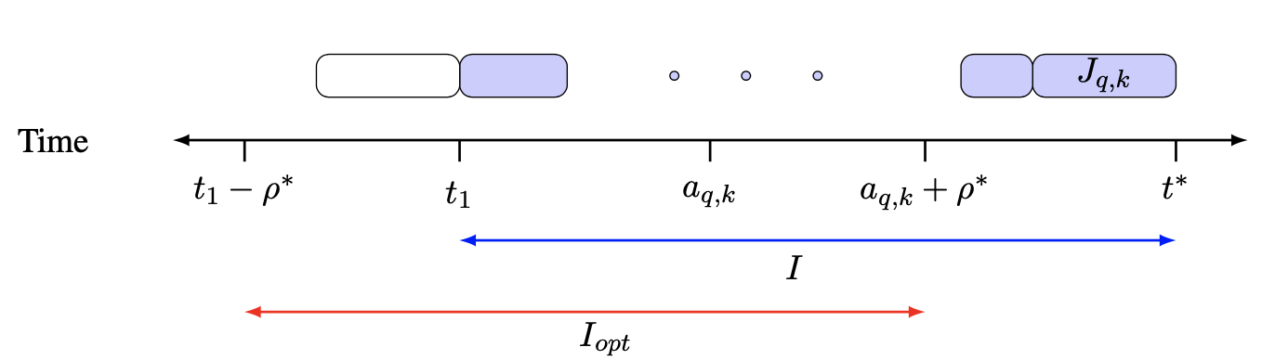
Lemma 2.1. OPT cannot merge any two requests in J1 into a single broadcast.
Lemma 2.2. All requests in JI arrived no earlier than time t1 − ρ .
Proof. For the sake of contradiction, suppose some request J_{p,i} ∈ J1 arrived at time a_{p,i} < t1 − ρ* .
During the interval [a_{p,i} + ρ* , t1] the request Jp,i must have wait time at least ρ* . However, then any request which forces FIFO to broadcast during [a_{p,i} + ρ∗, t1] must have response time at least ρ∗, contradicting the definition of t1.

Slide 9
Minimizing Maximum Delay Factor and Weighted Response time
Unit Sized Pages
Weighted Response Time and Weighed Delay Factor
Varying Sized Pages

Slide 10
Unit Sized Pages
In this section we consider the problem of minimizing the maximum delay factor when all pages are of unit size.
In the standard unicast scheduling setting where each broadcast satisfies exactly one request, it is known that the algorithm which always schedules the request with smallest slack at any time is (1 + ε)-speed O( 1/ε )-competitive [12].
However, in the broadcast setting this algorithm, along with other simple greedy algorithms, do not provide constant competitive ratios even with extra speed.
The reason for this is that the adversary can force these algorithm to repeatedly broadcast the same page even though the adversary can satisfy each of these requests in a singe broadcast.
Due to this, we consider a more sophisticated algorithm called SSF-W (Shortest-Slack-First with Waiting).

Slide 11
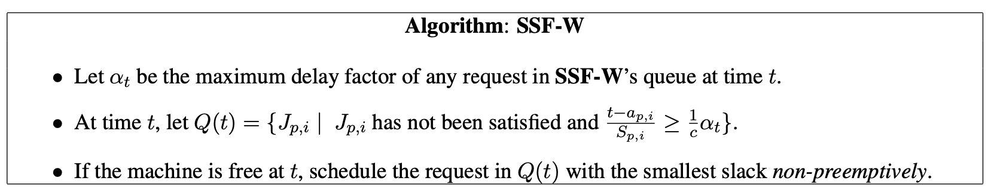
SSF-W Algorithm

Slide 12
Lemma 3.1. OPT cannot merge any two requests in J1 into a single broadcast.
Lemma3.2.|I|=|[t1,t*]|≥(c² −c)S_{q,k}α*.
Lemma 3.3. Any request in JI must have arrived after time t1 − 2 S_{q,k}α*c.
Lemma3.4. Suppose c is a constant s.t. c > 1+2/ε. If SSF-W has (1+ε)-speed then α ^{SSF-W} ≤c² α* .
Weighted Response Time and Weighed Delay Factor
Before showing that SSF-W is (2 + ε)-speed O( 1/ ε² )-competitive for minimizing the maximum delay factor
with different sized pages, we show the connection of our analysis of SSF-W to the problem of minimizing weighted response time. In this setting a request J_{p,i} has a weight w_{p,i} instead of a slack.
The goal is to minimize the maximum weighted response time max_{p,i} w_{p,i}(f_{p,i} −a_{p,i}).
We develop an algorithm which we call BWF-W( for Biggest-Wait-First with Waiting).
This algorithm is defined analogously to the definition of SSF-W.

Slide 13
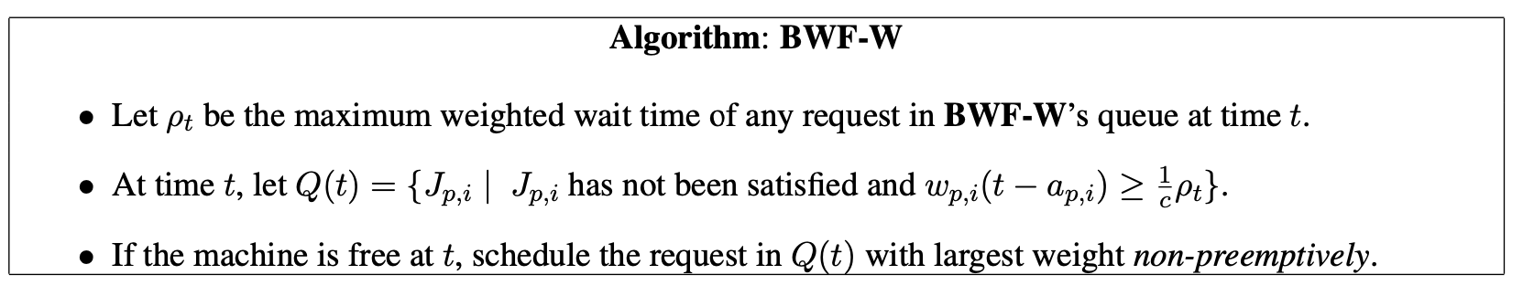
BWF-W Algorithm
Notes:
It may also be of interest to minimize the maximum weighted delay factor. In this setting each request has a deadline and a weight. The goal is to minimize max_{p,i} w_{p,i}(f_{p,i} − a_{p,i})/S_{p,i}. For this setting we develop another algorithm which we call SRF-W (Smallest-Ratio-First with Waiting).

Slide 14
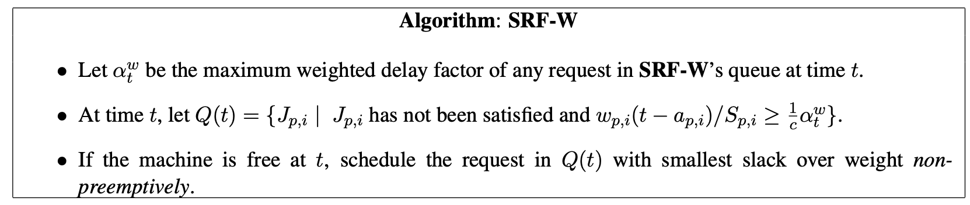
SRF-W Algorithm

Slide 15
Varying Sized Pages
We develop a generalization of SSF-W for this setting which is similar to the generalization of SSF-W given in [12]. For each page p, we let l_{p} denote the length of page p. Since pages have different lengths, we allow preemption.
Therefore, if t1 is the time where the broadcast of page p is started and t2 is the time that this broadcast is completed it is the case that l_{p} ≤ t2 − t1.
A request for the page p is satisfied by this broadcast only if the request arrives before time t1. A request that arrives during the interval (t1, t2] does not start being satisfied because it must receive a sequential transmission of page p starting from the beginning. It is possible that a transmission of page p is restarted due to another request for page p arriving which has smaller slack.
The original transmission of page p in this case is abandoned. Notice that this results in wasted work by the algorithm. It is because of this wasted work that more speed is needed to show the competitiveness of SSF-W.

Slide 16
Lower Bound for a Natural Greedy Algorithm LF
we consider a natural algorithm which is like SSF-W. This algorithm, which we will call LF for Longest Delay First, always schedules the page which has the largest delay factor.
Notice that LF is the same as SSF-W when c = 1. However, we can show a negative result on the algorithm for minimizing the maximum delay factor.
This demonstrates the importance of the tradeoff between scheduling a request with smallest slack and forcing requests to wait.
The algorithm LF was suggested and analyzed in our recent work [11] and is inspired by LWF which was shown to be O(1)-competitive with O(1)-speed for average flow time [15].
In [11] LF is shown to be O(k)-competitive with O(k)-speed for Lk norms of flow time and delay factor in broadcast scheduling for unit sized pages.
Note that LF is a simple greedy algorithm. It was suggested in [11] that LF may be competitive for maximum delay factor which is the L∞-norm of delay factor.

Slide 17
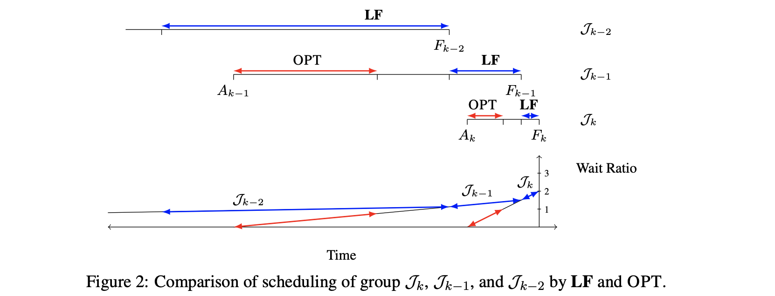

Slide 18
Lemma 4.1. LF, given speed s, processes J₀ during [A₀, F₀] and Ji during [F_{i−1}, F_{i}], 1 ≤ i ≤ k.
Lemma4.2. Ri =c(1− 1 /sc)^{k−i} for 0≤i≤k.
Lemma 4.3. Consider a schedule which processes each job in J₀ during [F_{k} , F_{k} + |J0 |] and each job in J_{i} during [A_{i}, A_{i} + |J_{i}|] for 1 ≤ i ≤ k. This schedule is valid and, moreover, the maximum wait ratio witnessed by this schedule is at most one.
From Lemma 4.2 the maximum delay factor witnessed by LF is c and by Lemma 4.3 the maximum delay factor witnessed by OPT is 1. Hence, we have the proof of Theorem 1.4.

Slide 19
Conclusion
In this paper, we showed an almost fully scalable algorithm1 for minimizing the maximum delay factor in broadcasting for unit sized jobs.
The slight modification we make to SSF-W makes the algorithm more practical. Using the intuition developed for the maximum delay factor, we proved that FIFO is in fact 2-competitive for varying sized jobs closing the problem for minimizing the maximum response time online in broadcast scheduling.
Although the new algorithm for the maximum delay factor with unit sized jobs is almost fully scalable, it explicitly depends on speed given to the algorithm. Can one get another algorithm independent of this dependency?
Notes:
For different sized pages, it is still open on whether there exists a (1 + ε)-speed algorithm that is O(1)-competitive. For minimizing the maximum response time offline it is of theoretical interest to show a lower bound on the approximation ratio that can be achieved or to show an algorithm that is a c-approximation for some c < 2.

Slide 20

THANK YOU

