Slide 1
Dynamo: Amazon’s Highly Available Key-value Store
Yuanxu Xu
20.02.2020

Slide 2
Agenda
Design the shopping cart button
Cap Theorem
Dynamo architecture
  Consistent hashing
  Vector clocks
  Fault-tolerant techniques
Dynamo based projects

Slide 3

Design the shopping cart button
  Always-on
  Key - value
Two buttons that built a trillion company

Slide 4
RDBMS

Slide 5
CAP Theorem

Slide 6
Distributed Systems before Dynamo
Master-slave, write is the bottleneck

Slide 7
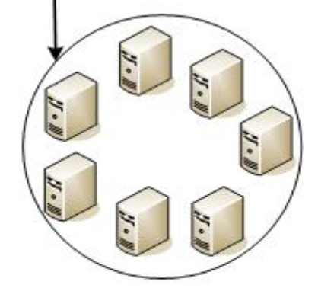
Dynamo Design Considerations
Incremental scalability
Symmetry
Decentralization
Heterogeneity
Dynamo instance

Slide 8
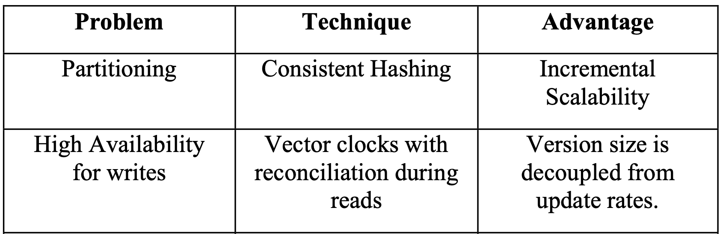
Key Dynamo Techniques

Slide 9
Regular Partitioning
An intuitive hash function ‘key % n’
Add a server: key % (n+1)

Slide 10
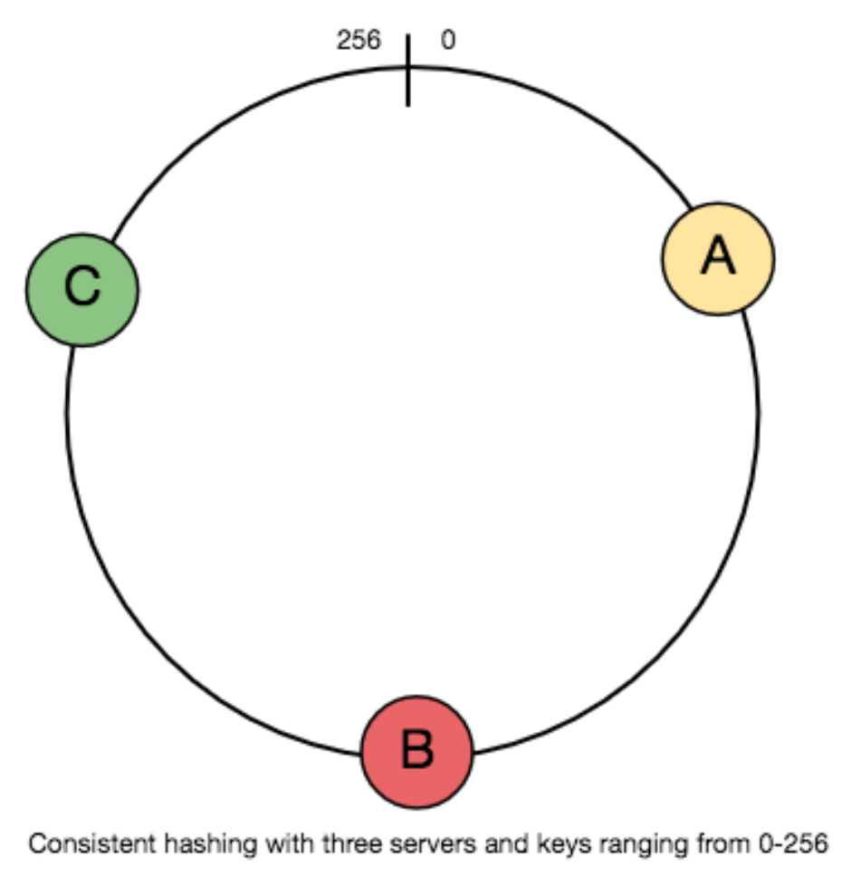
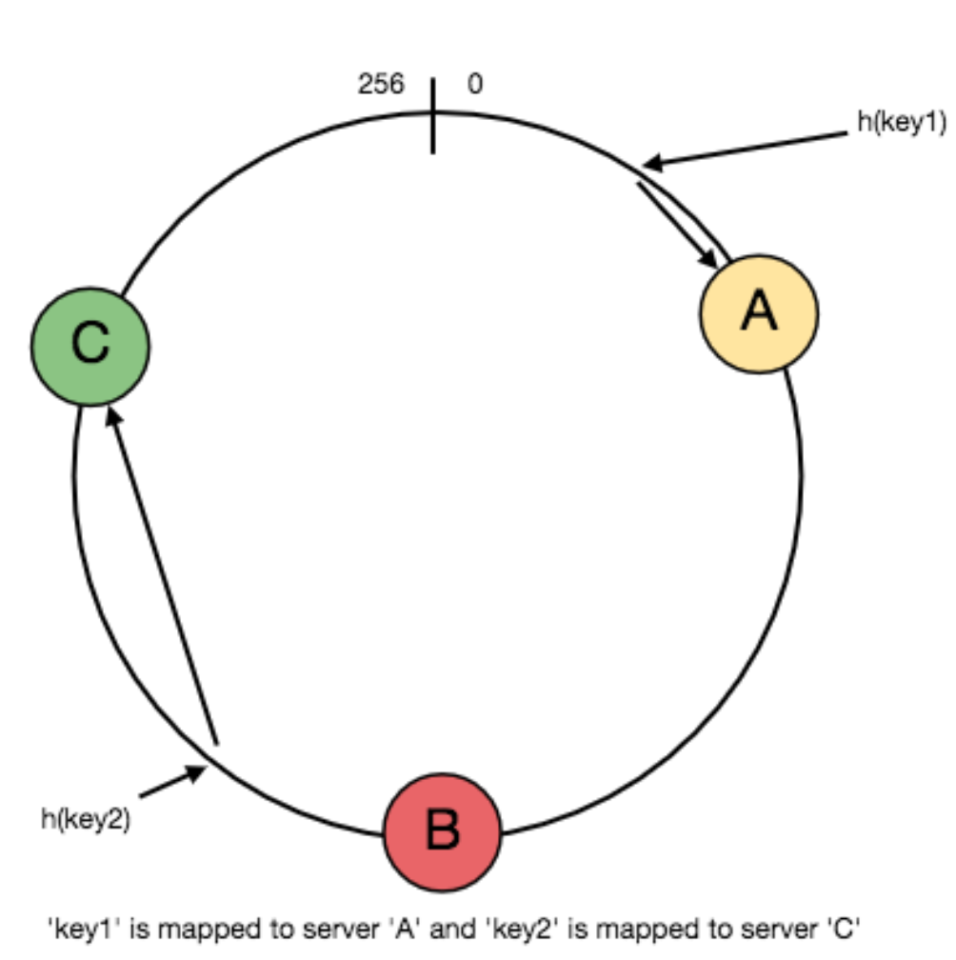
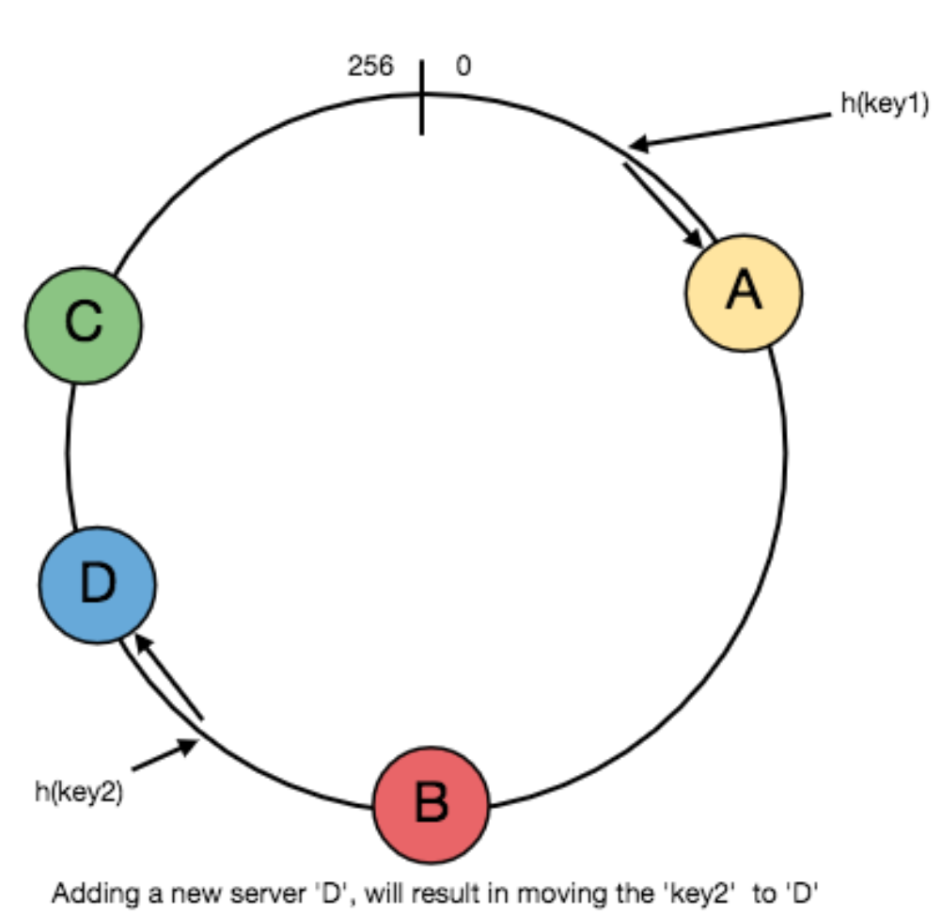
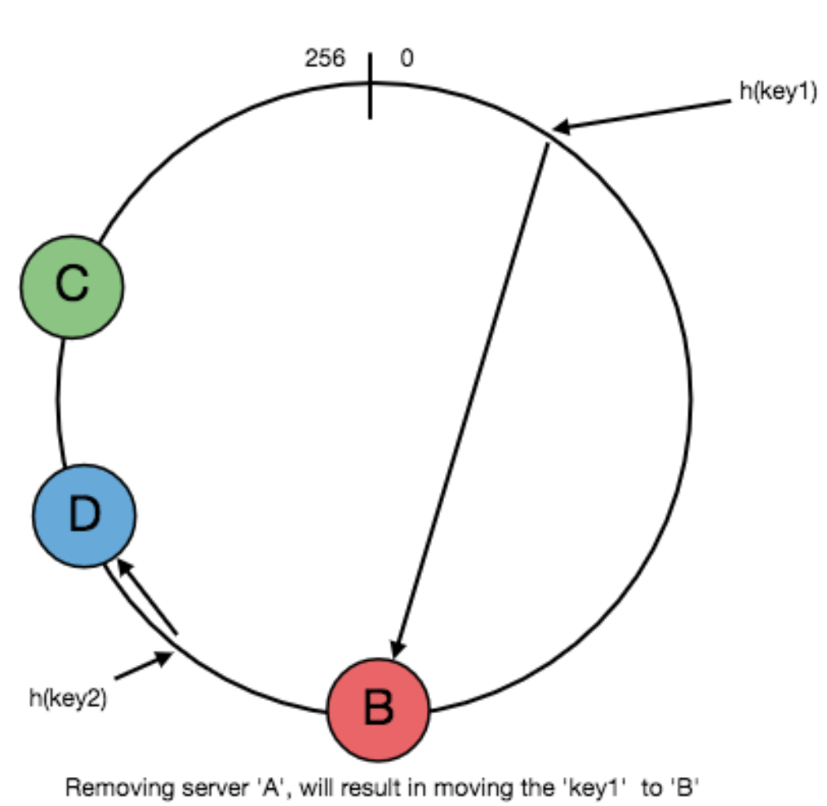
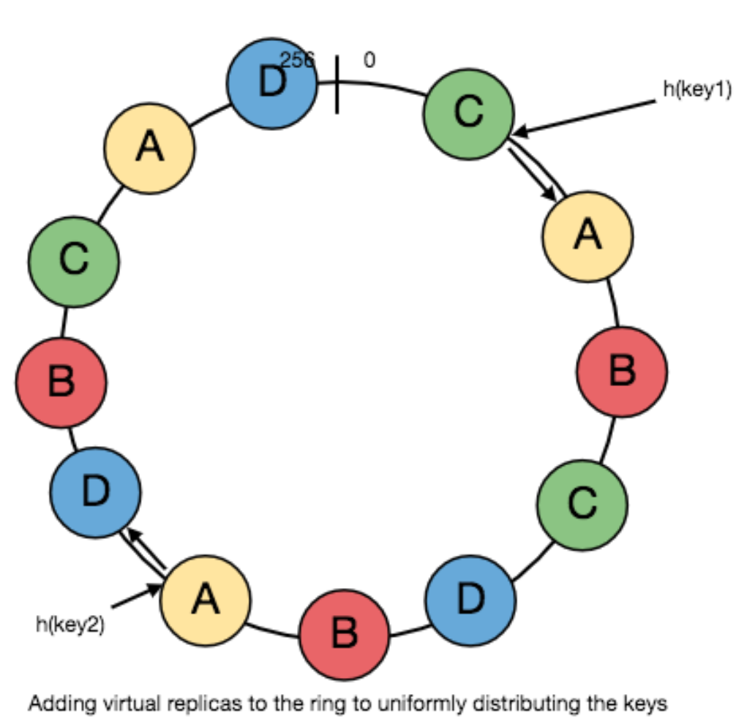
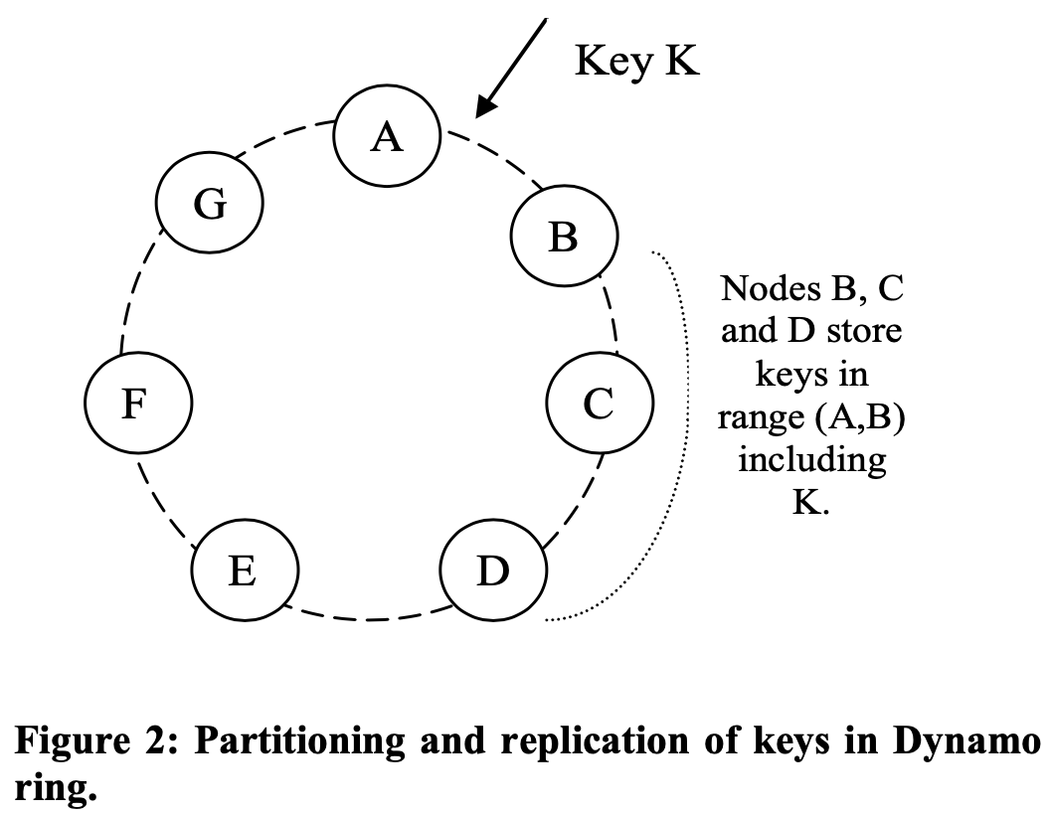
Consistent Hashing

Slide 11
Key Dynamo Techniques

Slide 12
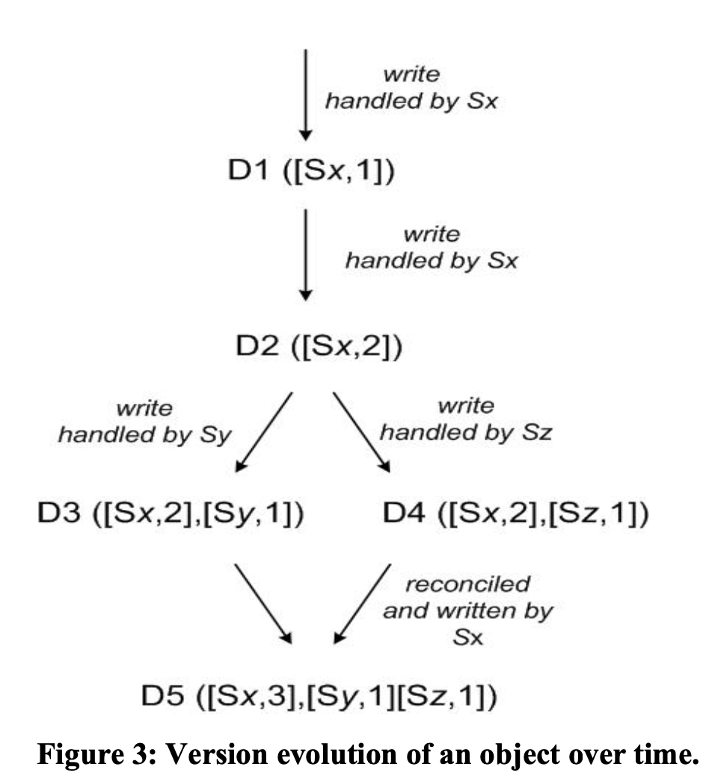
Vector Clock in Dynamo
[Server, Counter] Pairs
D1 - D5: D object, version 1 - 5
Sx, Sy, Sz: Servers

Slide 13
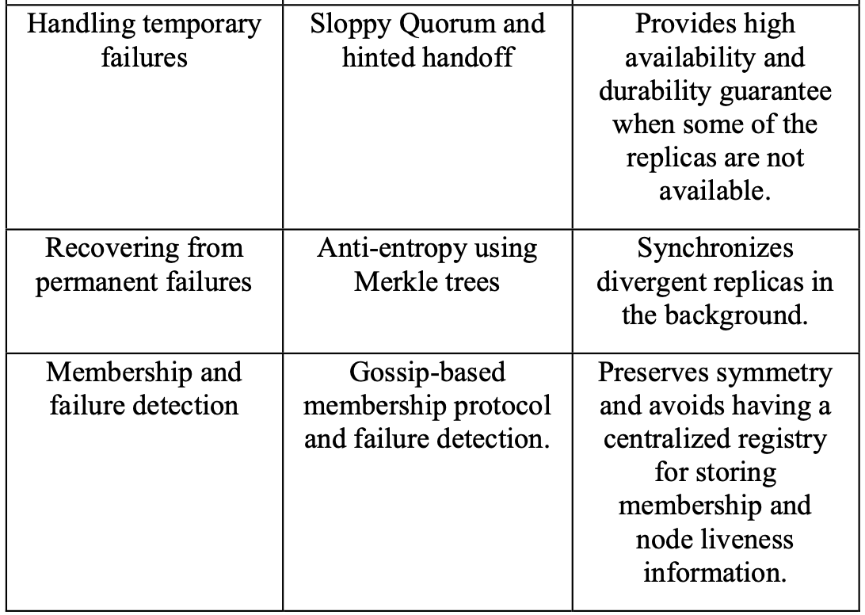
Fault-tolerant techniques

Slide 14
Dynamo Based Projects
Q&A

