Slide 1

Customizable and Extensible Deployment for Mobile/Cloud Applications
Presented by
Supadchaya Puangpontip
MArch 2020
Zhang, I., Szekeres, A., Van Aken, D., Ackerman, I., Gribble, S.D., Krishnamurthy, A. and Levy, H.M., 2014. Customizable and extensible deployment for mobile/cloud applications. In 11th {USENIX} Symposium on Operating Systems Design and Implementation ({OSDI} 14) (pp. 97-112).

Slide 2
Agenda
Motivation and Background
Sapphire
  Architecture
  Programming Model
  Implementation
Experiences and Evaluation
  Microbenchmarks
  Performance
Conclusion

Slide 3
Motivation and Background

Slide 4
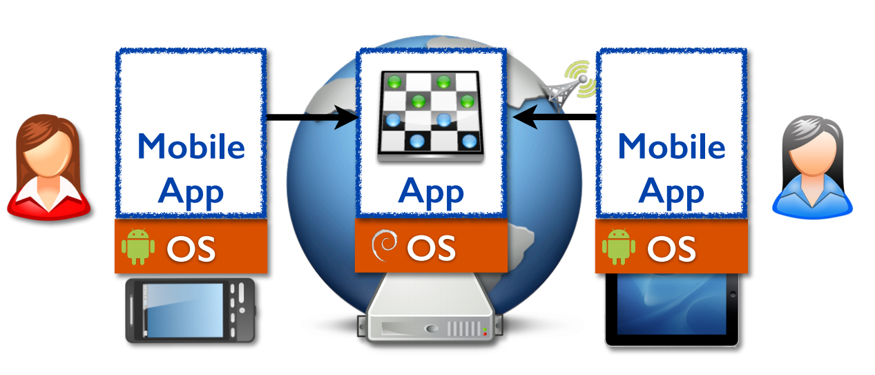
Today’s applications
multi-user, multi-platform and multi-node
Notes:
Changes: the development of small but powerful, mobile devices and the move to massive-scale cloud computing.
These changes have led to a shift away from traditional desktop applications to modern mobile/cloud applications.

Slide 5
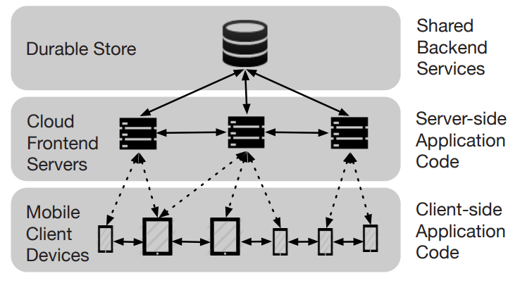
Code for Today’s Applications
Notes:
Code for today’s applications spans cloud servers and mobile devices.
Client-side code runs on varied mobile platforms, while server-side code runs in the cloud, typically using shared backend services like distributed storage.
As a consequence, modern applications have become inherently distributed, with data and code spread across cloud backends and user devices such as phones and tablets.

Slide 6
Problems
How to coordinate data and computation across nodes and platforms
How to hide performance limitations and failures
How to manage different programming environments and hardware resources
These are distributed systems problems
Notes:
Application programmers face new challenges

Slide 7
Problems
Where data and computation should be located
What data should be replicated or cached
What data consistency level is needed
These decisions depend on application requirements
Notes:
To address these challenges, programmers must make many distributed deployment decisions

Slide 8
Problems
decisions depend on application requirements
→ mixing deployment decisions with complex app logic in the code
→ difficult to implement, debug, maintain, and evolve
→ difficult to make deployment decisions
Need a flexible system that allows them to easily create and modify distributed application deployments without needing to rewrite major parts of their application.
Notes:
To address these challenges, programmers must make many distributed deployment decisions

Slide 9
Sapphire

Slide 10
Goal
Create a distributed programming platform spanning devices and the cloud
    integrates the heterogeneous distributed environment
    simplifies communications, code/data mobility, and replication
Separate application logic from deployment logic.
    simplifies programming, evolution, and optimization
Facilitate system extension and customization
    delegates distribution management to an extensible deployment layer
    gives flexibility to easily make or change deployment options
Notes:
A key concept of Sapphire’s design is the separation of application logic from deployment logic. That is, deployment code is factored out of application code, allowing the programmer to focus on the application logic. At the same time, the programmer has full control over deployment decisions and the flexibility to customize them.

Slide 11
Sapphire
is a general-purpose distributed programming platform designed for flexibility and extensibility
simplifies the design and implementation of mobile/cloud apps
removes complexity of managing a wide-area, multi-platform environment
provides developers with the fine-grained control needed to meet critical application needs
Notes:
new programming system for deploying mobile/cloud applications.

Slide 12
Sapphire is …
for deploying mobile/cloud applications
not for deploying backend services
  But can integrate the backend services to the app
not for building user interfaces (UI)

Slide 13

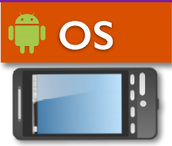

Sapphire Architecture
Sapphire Application
Deployment Managers (DM)
Deployment Kernel (DK)

Slide 14
Sapphire Application
Sapphire Object
Sapphire Object
Sapphire Object
Deployment Managers (DM)
Deployment Kernel (DK)

Slide 15
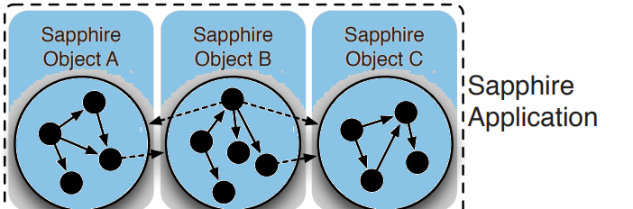
Sapphire Application
Partitioned into Sapphire Objects, which:
Run in a single address space with RPC
Execute anywhere and move transparently
Provide a unit of distribution for deployment managers
Notes:
Each SO functions as a single unit of distribution, like a virtual node.
share a logical address space that spans all cloud servers and client-side devices.
That is, a Sapphire application is written so that all SOs can invoke each other directly through simple location-independent procedure calls.
A Sapphire Object encapsulates data and computation into a “virtual node” that: (1) ensures that each data/computation unit (a Sapphire Object) will always have its code and data on the same node, (2) lets the system transparently relocate or offload that unit, (3) supports easy replication of units, and (4) provides an easy-tounderstand unit of failure and recovery. These benefits make Sapphire Objects a powerful abstraction; using fine-grained programmer-defined Sapphire Objects, instead of a coarse-grained client/server architecture, increases both flexibility in distributed deployment and programmer control over performance.

Slide 16
Deployment Kernel
Sapphire Object
Sapphire Object
Sapphire Object
Deployment Managers (DM)
Deployment Kernel (DK)

Slide 17
Deployment Kernel
Sapphire Object
Sapphire Object
Sapphire Object
Deployment Managers (DM)
DK Server
DK Server
OTS Server
Notes:
consists of a set of servers that run on every mobile and back-end computing device used by the application, and a centralized Object Tracking System (OTS) for tracking Sapphire Objects
key feature of the Sapphire kernel is its support for the programming and execution of Deployment Managers
DK provides direct API support for DMs

Slide 18
Deployment Kernel
Is a flexible and extensible distributed runtime system
Provides best-effort distribution services, including:
  Sapphire Object tracking, mobility and replication
  Making and routing RPC to Sapphire objects
  Managing, distributing and running deployment managers.
Notes:
provides only the most basic distribution
It does not support more complex tasks, such as fault tolerance, failure management, reliability, and consistency
the goal of the DK is to create an integrated execution platform across mobile devices and servers
management and location tracking of Sapphire Objects
location-transparent inter-object communications (RPC),
low-level replica support
services to simplify the writing and execution of Deployment Managers

Slide 19
Deployment Managers
Sapphire Object
Sapphire Object
Sapphire Object
Deployment Managers (DM)
DK Server
DK Server
OTS Server
Notes:
consists of a set of servers that run on every mobile and back-end computing device used by the application, and a centralized Object Tracking System (OTS) for tracking Sapphire Objects
key feature of the Sapphire kernel is its support for the programming and execution of Deployment Managers
DK provides direct API support for DMs

Slide 20
Deployment Managers
Sapphire Object
Sapphire Object
Sapphire Object
Code-offloading
Lease Caching
Replication
DK Server
DK Server
OTS Server
Notes:
Each Sapphire Object can optionally have an attached DM which provides runtime distribution support in addition to the minimal features of the DK.
The programmer selects a DM to manage each SO;
e.g., he may choose a DM that handles failures to improve fault-tolerance,
cache data locally on a mobile device for performance.

Slide 21
Deployment Managers (DMs)
Extend the functions and guarantees of the deployment kernel
Interpose on Sapphire object events
Customize and control the behavior of individual SOs in the distributed mobile/cloud environment
Easy to choose and change without modifying the application
Notes:
a collection of pluggable Deployment Manager (DM) modules that extend the kernel to support application-specific deployment needs, such as replication and caching
Since DMs are intended to manage distribution, the DK creates a distributed execution environment in which they operate
= a DM is itself distributed and its components can operate on different nodes.
When the DK instantiates a Sapphire Object with an attached DM, it also instantiates and distributes the DM’s components. -> The DK provides transparent RPC between the DM components of an SO instance for coordination between component

Slide 22
DM Design Examples
the design and implementation of classes of DMs from the Library
Code-offloading
Peer-to-peer
Replication
Scalability
Discussion
Notes:
Use to show the DM API can be used to extend the DK for a wide range of distributed management features.

Slide 23
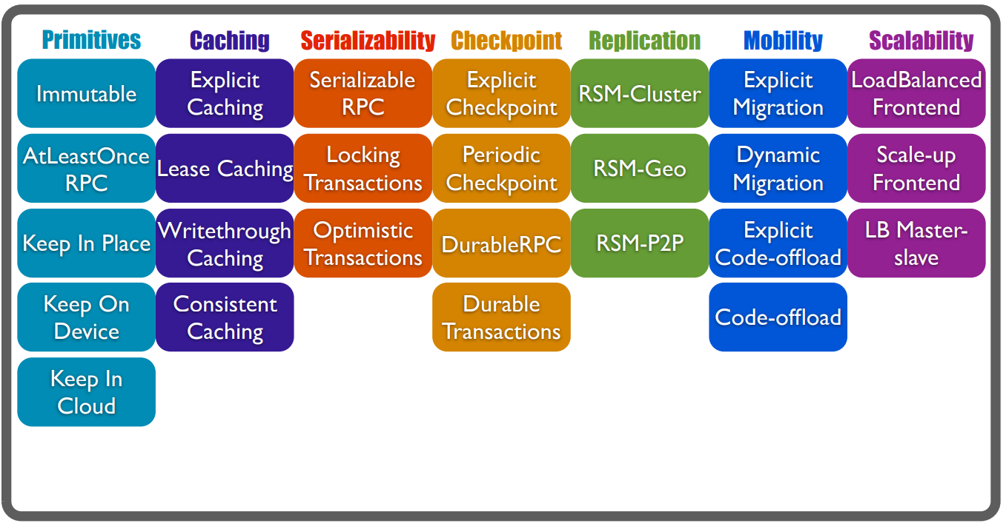
DM Library
Notes:
We have built a library of DMs supporting common distribution tasks used by applications today

Slide 24
DM API
Deployment manager components, which the DK creates, deploys and invokes:
Proxy: co-located with remote references to the Sapphire Object
    responsible for caller-side tasks – e.g. routing method calls
Instance Manager: co-located with the Sapphire Object
    responsible for callee-side tasks – e.g. keeping replicas of the SO synchronized
Coordinator: co-located with fault-tolerant OTS (Object Tracking Service)
    responsible for centralized tasks – e.g. failure handling
Notes:
-- symmetric nature of SOs, the caller of the method may be on a cloud server and the SO itself may be on a client device
All three components are optional; a DM can define one or more of the components, and the DK will instantiate only those components that are defined.

Slide 25
Example Deployment
References
Instance A
Centralized
stub
SO
Replica1
Proxy
Instance Manager
Coordinator
stub
Proxy
Replica2
stub
SO
stub
Proxy
Instance Manager
Proxy
Deployment Kernel (DK)
DK-FT
= fault-tolerant DK nodes
Notes:
example deployment of the DM components for a single Sapphire Object A
The DK may instantiate many Proxies and Instance Managers but at most one Coordinator, as shown in this figure.
The center box (marked “Instance A”) indicates that A has two replicas, marked replica 1 and replica 2.
Each replica has its own copy of the Instance Manager.
If the DM request a third replica of A, the DK would also create a new Instance Manager for that replica.
A replica and its Instance Manager are always located on the same node
DK-FT host the OTS, that support reliable centralized tasks for DMs and the DK
4 other SOs. Each contains a reference to A = RPC stub, to which the DK has attached an instance of A’s DM Proxy component.
Making an RPC to A through the DK and its DM proceeds as follows.
The DK reflects the call via an onRPC() upcall to the attached Proxy. The upcall to the Proxy lets A’s DM intercept an RPC on the caller’s node where, for example, it can implement client-local caching. If the Proxy wants to forward the call to replica 1 of A, it simply invokes replica 1’s Instance Manager which runs in the same DK server as replica 1. The Instance Manager will pass the RPC through to replica 1 of A
Because the Proxies and Instance Managers for A are all part of the same Deployment Manager, they all understand whether or not the SO (A, in this case) is replicated, and, if so, how that replication is implemented. The choice of which replica to call is made inside the DM components, which are aware of each other and can communicate with each other directly through RPCs.
Finally, the DK instantiates one Coordinator for each DM instance. The OTS manages Coordinators, keeping them faulttolerant and centrally accessible. It is well known that a centralized coordinator can simplify many distributed algorithms (e.g., eliminating the need for leader election). Since the DK needs the OTS to tracking Sapphire Objects, it was easy to provide fault-tolerance for some DMs as well. We do not expect every DM to have a Coordinator, and even if there is a Coordinator, it is used sparingly for management tasks that are easiest handled centrally, such as instantiating new replicas in the event of failures. In this sense, Coordinators are similar to other centralized management systems

Slide 26
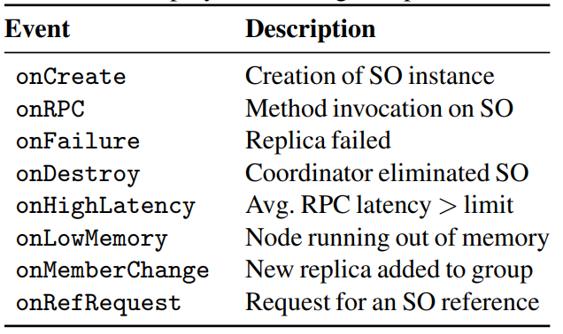
Upcalls
The DK invokes DM components using upcalls
Each component receives a different set of upcalls according to the component’s responsibilities
Notes:
By interposing on SO e.g. method invokation, DMs can implement a variety of distributed management features transparently and generically

Slide 27
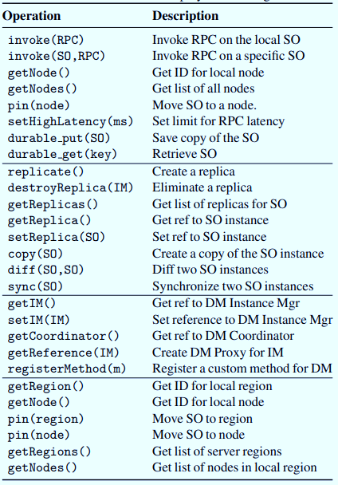
DK API for DM
In each upcall, the DM component can
perform management tasks on the SO using a set of primitives
communicate directly with each other through a transparent RPC mechanism
Notes:
perform management tasks on the SO using a set of primitives supported by the DK
DM components of an SO instance communicate directly with each other through a transparent RPC mechanism provided by the DK
DK supports only the most basic replication functions, namely, creating a new replica for an SO and reporting on replica locations. All decisions about the number of replicas, when to create or delete them, how to synchronize them, and how to handle failures occur at the DM level.

Slide 28
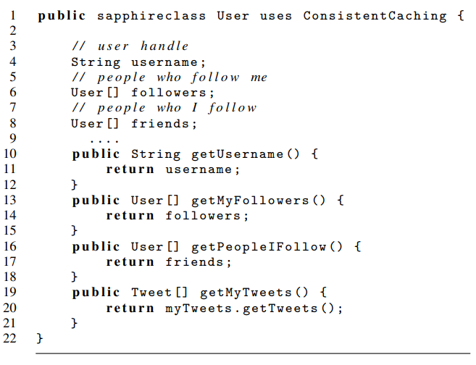
Programming Model
Sapphire Objects
Specify DM
DM
is object-based
  Can be integrated with any OOP
Defining SO
Calling SO
Choosing Deployment Managers
Internal Java Obj – string
copy of the username object stored inside the SO
a copy of the array containing references to User SOs
Notes:
To develop a Sapphire application, the programmer first builds the application logic as a single object-oriented program. He then breaks the application into distributed components by declaring a set of application objects to be Sapphire Objects. Sapphire Objects can still call each other via normal method invocation, however, these calls may now be remote invocations. Finally, the programmer applies Deployment Managers (DMs) to SOs as desired for additional distributed management features
create a uniform programming model integrating mobile devices and the cloud without hiding performance costs and trade-offs from the programmer.
So, the programmer makes explicit choices in the decomposition of the application into SOs, then the system provides location-independent communication,
= simplifies programming in the distributed environment.

Slide 29
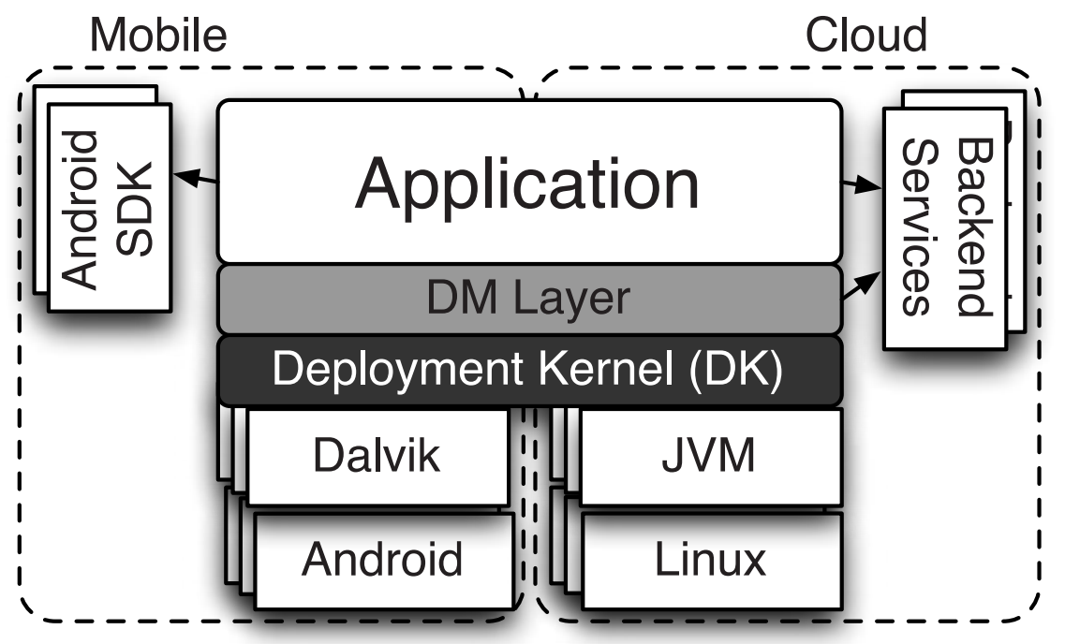
Implementation
Notes:
Sapphire application and runtime system
We used Sun’s Java 1.6.0 38 JVM to run Sapphire in the cluster
the tablets and phones ran Sapphire on the Android 4.2 Dalvik VM.
We used Java RMI for low-level RPCs between DK nodes.
We used Voldemort as the storage back-end for our checkpointing DMs.
Java RMI provides only point-to-point communication and only supports calls to Java objects that have a special Java RMI-provided interface. Thus, we could only use Java RMI for low-level communication between DK servers and the OTS. To achieve transparent communication between SOs and between DM components, we built a compiler (862 LoC) that creates stubs for SOs and for DM Instance Managers and Coordinators
We also rely on Apache Harmony’s implementation of RMI serialization – with Java reflection to marshall and unmarshall objects – for sending, diffing and copying objects

Slide 30
Experiences and Evaluation

Slide 31
Sapphire Applications
Development Ease
  easy to develop mobile/cloud apps
  can write code without explicitly addressing distribution management
Deployment Flexibility
  can choose from alternative distribution management schemes
  can change deployment decisions without rewriting application code
Management Code Generality
  can build generic distribution management components that can be used both within an app and across different apps
Notes:
1 easy to develop mobile/cloud apps either from scratch or by porting non-distributed mobile device applications to Sapphire.

Slide 32
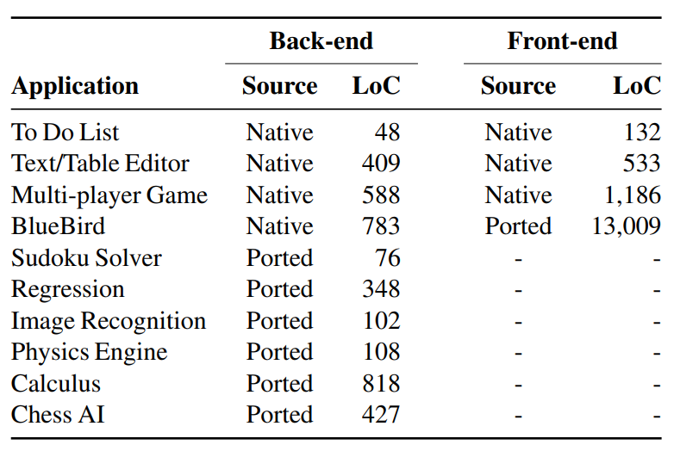
Sapphire Applications
Notes:
front-end code (the UI) and back-end code (application logic).
The source column indicates whether we developed new native Sapphire code or ported open-source code to Sapphire

Slide 33
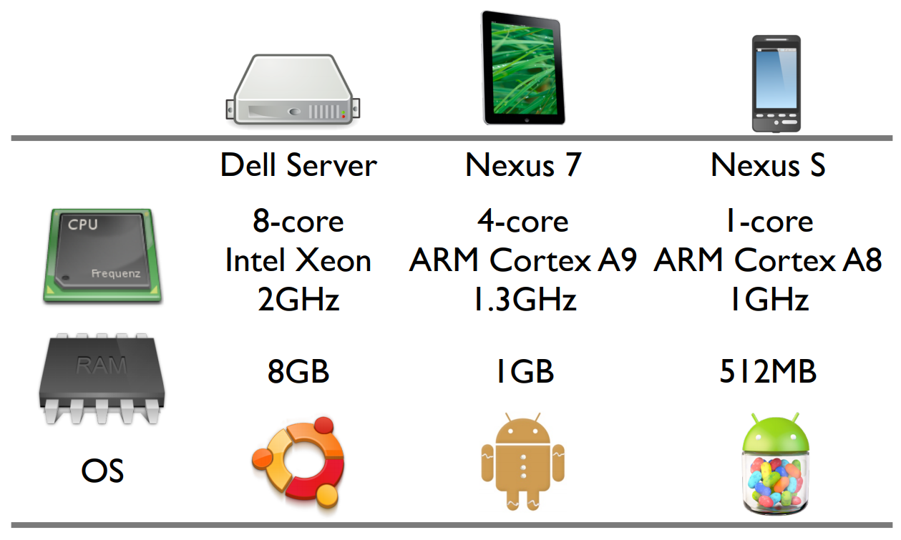
Experimental Setup

Slide 34
Microbenchmarks
RPC Latency Comparison
Throughput Comparison
Sapphire DK Operation Cost

Slide 35
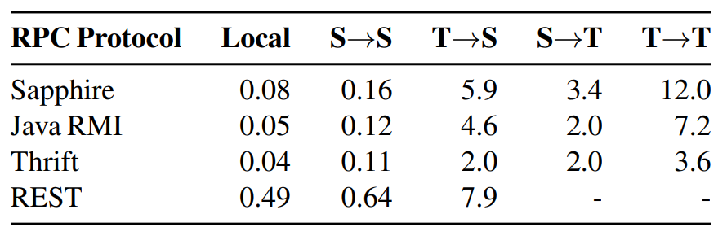
RPC Latency Comparison
server-to-server
server-to-tablet
tablet-to-server
tablet-to-tablet
Notes:
While Thrift was slightly faster in all cases, Java RMI and Sapphire were comparable and were both faster than the Java REST library
without optimization, Sapphire was faster than REST
Sapphire uses Java RMI for communication between DK servers; however, we dispatch method calls to SOs through the DK

Slide 36
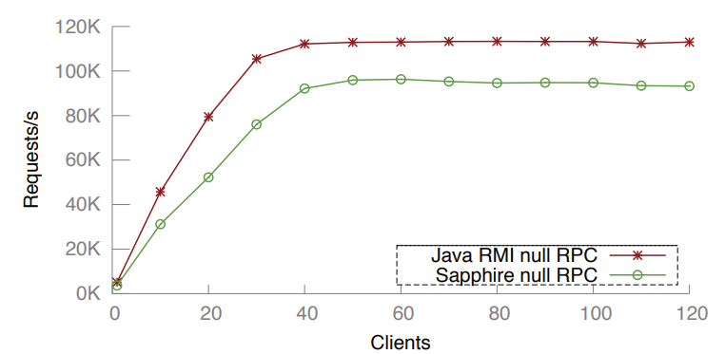
Throughput Comparison
Notes:
Java RMI object throughput approximately 15% higher than that for Sapphire Objects. This is because Sapphire null RPCs are not truly empty: they carry a serialized structure telling the DK how to direct the call
This reduced the throughput difference to 3.6%;
this 3.6% is the additional cost of Sapphire’s RPC dispatching in the DK, with the remainder due to the cost of serialization for the dispatching structure.

Slide 37
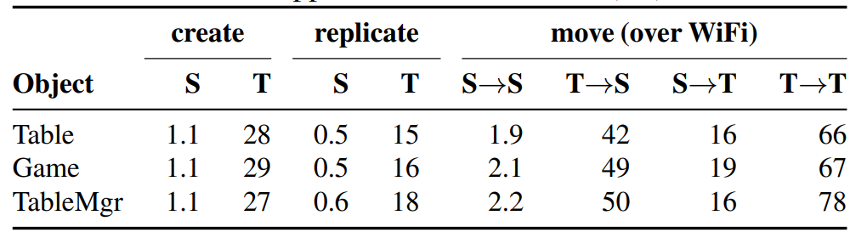
Sapphire DK Operation Cost
Latency of several DK services call
depends on the size and complexity of the object
Notes:
DK call latency depends on the size and complexity of the object, since we use Java serialization
latency results for creating, replicating, and moving SOs on servers and tablets. Operation latencies were low when executed on cloud servers. Tablets were considerably slower than cloud servers. However, we expect most management operations such as these to be performed in the cloud (i.e., we do not expect tablets to create large numbers of SOs).
The SO instantiation process can be expensive because the DK must create several objects locally: the SO, the SO stub, the DM Proxy and the DM Instance Manager. The DK must also create the DM Coordinator remotely on a DK-FT node and register the SO with the OTS. Communication with the DK-FT node and the OTS accounted for nearly half the instantiation latency.

Slide 38
Deployment Manager Performance
Caching
Scalability
Code offloading
Peer-to-Peer Deployments

Slide 39
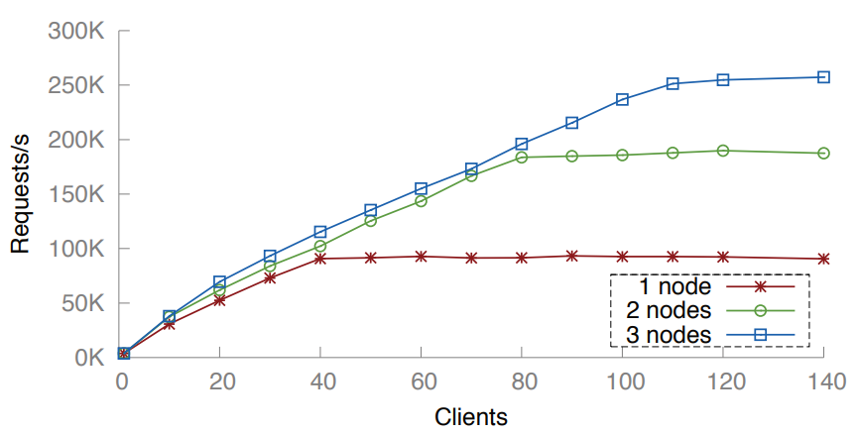
Scalability
Notes:
throughput of the SO serving null RPCs when the DM creates up to 3 replicas.
scaled linearly with the number of replicas until the network saturated at 257,365 requests/second

Slide 40
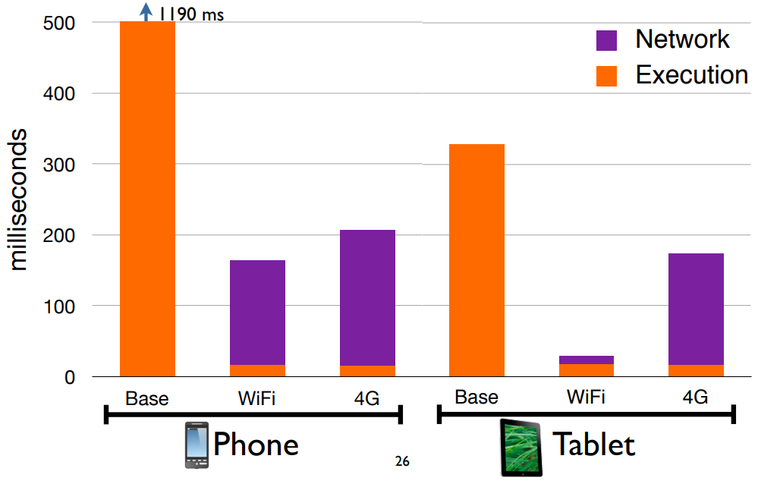
Code-offloading for Physics Engine
Notes:
latencies for running each application locally on the device (shown as Base), offloaded to the cloud over WiFi, and offloaded over 3G.
The offloading trade-offs varied widely across the two platforms due to differences in CPU speed, wireless, and cellular network card performance
For the Physics engine, offloading was universally better, but it was particularly significant for the mobile device, which was not able to provide real-time simulation without code offloading.
These cross-platform differences in performance show the importance of flexibility. An automated algorithm cannot always predict when to offload and can be costly. Therefore, it is important for the programmer to be able to easily change deployment to adapt to new technologies.

Slide 41
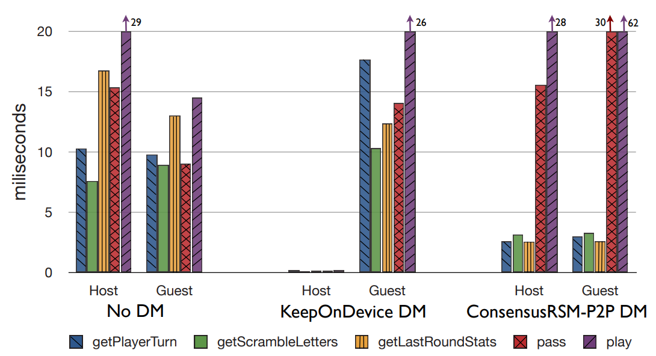
Peer-to-Peer Multiplayer Game
Notes:
shows the latency of the game’s read methods
With the Game SO in the cloud, read and write latencies were high for both players. With the KeepOnDevice DM, the read and write latencies were extremely low for the device hosting the SO, but somewhat higher for the other player, compared to the cloud version. Finally, with the ConsensusRSM-P2P DM, read latencies were much lower for both devices, while write latencies were higher.
In our scenario, the two tablets and the server were on the same network. In cases where the two players are close on the network and far from the server, the peer-to-peer DMs would provide a valuable deployment option
With the DMs, no cloud servers were needed to support the Game SO; this reduced server load, but Game SOs were no longer available if the hosting device were disconnected. This experiment shows the impact of different deployment options and the benefit of being able to flexibly choose alternative deployments to trade off application performance, availability, and server load.

Slide 42
Conclusion
Modern applications implement difficult distributed deployment tasks
Sapphire is a new programming system for deploying mobile/cloud apps
  ease of programming in a distributed environment
  flexibility in deployment
  programmer control over performance.
Deployment Kernel creates an integrated environment with location-independent communication across mobile devices and clouds
Deployment layer contains a library of Deployment Managers, which make it easy to choose, change and build deployment.

Slide 43
Q&A
Thank You

