Slide 1
REPT: Reverse Debugging of Failures in Deployed Software
Zach alaniz
cs-5352
Advance operating systems

Slide 2
Debugging/Software failures
Software failures and debugging can be crucial. This can effect customers and actual users.
Execution logs can be helpful but is it worth the cost for high performance overhead? Most overheads will log and trace but neglect the normal runs.
Where does that leave the developer then? Well memory dumps can capture most failures. However, debugging memory dumps can provide limitations on information and can leave bugs unfixed.
There needs to be a broader sense of debugging. Atlas, two categories that are found is Automatic Root Cause Diagnosis (ARCD) and Failure of Reproduction (FR).

Slide 3
Automatic Root cause diagnosis / failure reproduction
attempts to automatically decide whether the culprit statements are the cause of a program fail. This comes with limitations for example requiring code modification, inability to handle complex software efficiently, and subset of failures. Moreover, the none of the systems have been in tested for practice.
Root cause diagnosis can help a developer understand the failure, but a deeper perception is needed to the conditions. Finally, leading into fixing the bug when the system does not provide.
Failure reproduction allows developers to examine program inputs and state the cycle of the failure. This can be combated exhausting testing techniques for e.g. (symbolic execution, model checking, and state-space collection). Furthermore, these techniques require heavyweight runtime monitoring and there is already limitations to other debugging methods
There must be a practical solution

Slide 4
What about reverse debugging or Time travel debugging?

Slide 5
What is rept?
REPT is a practical system that permits reverse debugging in software for deployed systems
This is system supposed to recover data values from thousand instructions before the failure. The seems impossible? However, it is not and REPT can take on these challenges.
There are two key concepts for REPT. First is REPT’s hardware; tracing while recording a programs control flow will allow a low performance overhead. Second, Rept uses a technique called novel binary analysis. This technique allows recovery data flow information, and this is supported by the logged control flow information. As well as, the data values are saved in the memory dump.
In laymen terms: REPT permits reverse debugging with combined logged control flow and the recovered data flow

Slide 6
What are the challenges that Rept face?
Irreversible Instructions
Missing Memory Writes
Concurrent Memory Writes

Slide 7
Irreversible Instructions
What if every instruction became reversible? This can be determined before the program state and its execution. This would make REPT’s design straightforward and easily understood.
To reverse a program’s instruction, first invert each instruction’s semantics and recover data values in each position during the instruction sequence.
Though many instructions can be irreversible and information destroying.
The authors followed up by using forward execution and recovering values. These recovering values cannot be recovered normally in backward execution.

Slide 8
Missing Memory Writes
Unknown address are bad in memory and makes memory handling bad. Moreover, most memory cannot be determined statically. This makes data values hard to recover and REPT may not know the destination of the memory writing.
The author presumes that all memory locations are unknown. Furthermore, this can be too traditional and can cause miss data values from being recoverable. Though if REPT ignores the memory writing then the analysis will leave it invalid value at the memory location.
This can generate other memory locations and registers. The solution that the authors chose to combat this issue is error detection.

Slide 9
Concurrent Memory Writes
Finally, the last challenge is the identification in the order of shared memory access. To deduce the order of execution in concurrent memory may not possible. That’s even with timestamps provided from hardware.
REPT will have to properly handle these memory accesses otherwise it will confuse the wrong values for these memory locations.
The authors solved this challenge by restricting the analysis in data values recovered from concurrent memory accesses.

Slide 10

Design of Rept
$\text{For} \text{brevity}\text{, }\text{we} \text{define} \text{an} \text{instruction} \text{sequence} \text{as} \text{I} \text{= \{}I_{i}\text{|}\text{i} \text{= 1,2,...,}\text{n}\text{\} }\text{where} I_{i}\text{represents} \text{the} \text{i}\text{−}\text{th} \text{instruction} \text{executed} \text{in} \text{the} \text{sequence}\text{. }\text{We} \text{assume} \text{that} \text{the} \text{memory} \text{dump} \text{is} \text{available} \text{after} \text{the} \text{n}\text{−}\text{th} \text{instruction}\text{’}\text{s} \text{execution}\text{. }\text{We} \text{define} \text{a} \text{program}\text{’}\text{s} \text{state}\text{, }\text{S}\text{, }\text{as} \text{a} \text{collection} \text{of} \text{all} \text{data} \text{values} \text{in} \text{registers} \text{and} \text{memory} \text{locations}\text{. }\text{We} \text{define} S_{i} \text{as} \text{the} \text{program} \text{state} \text{after} \text{the} \text{i}\text{−}\text{th} \text{instruction} \text{is} \text{executed}\text{. }\text{Therefore}\text{, }S_{0} \text{represents} \text{the} \text{program} \text{state} \text{before} \text{the} \text{first} \text{instruction} I_{1} \text{is} \text{executed}\text{, }\text{and} S_{n} \text{represents} \text{the} \text{program} \text{state} \text{stored} \text{in} \text{the} \text{memory} \text{dump}$
In context of $S_{i}$, this will be considered as complete if all the register and memory are known. $I_{i}$, is defined as reversible if, given a complete state, $S_{i}$. Then it can be recovered such as $S_{i−1}$ completely otherwise it is the instruction is irreversible.

Slide 11
Design of REPT contd.
Instruction Reversal
Irreversible Instruction Handling
Recovering Memory Writes
Handling Concurrency

Slide 12

Instruction Reversal
REPT assumes an input is a single instruction sequence with only reversible only reversible instructions. Moreover, every instruction is considered reversible then REPT can reverse the effects of each instruction. Then it can recover the initial program state from the end of the instruction to the beginning.
For instance, if the instruction sequence has a single instruction $I_{1}$ = add rax,rbx and $S_{1}$ = {rax=3, rbx=1}, then the analysis can recover $S_{0}$ = {rax=2, rbx=1}.

Slide 13

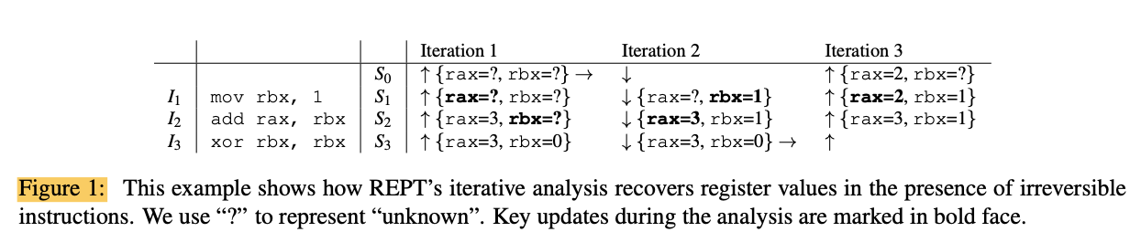
Irreversible Instruction Handling
Irreversible instruction handling is almost the same as instruction reversal except it doesn’t include any memory access.
The key visualization for deducing a recovered destroyed value is forward analysis.
This means if there is a destroyed value that is derived from some registers or memory locations and their values are available then it is recoverable. This is done by forward and backward analysis till there are no new values are recovered.
Notes:
For instance, xor rbx,rbx is irreversible, because rbx’s value before the instruction is executed cannot be recovered sim- ply based on this instruction’s semantics and rbx’s value after the instruction is executed. Therefore, the straight- forward backward analysis for reversible instructions is not applicable in general.
Conceptually, given the instruction sequence I and the final state Sn, we first mark all register values as unknown in program states from S0 to Sn−1. Then we do backward analysis to recover program states from Sn−1 to S0. After this step, we perform forward analysis to update program states from S0 to Sn−1.
We repeat these steps until a fixed point is reached: i.e., no state is updated in a backward or forward analysis. When we update a program state, we only change a register’s value from unknown to an inferred value. Crucially, this analysis will not produce conflicting inferred values because all the initial values are correct and no step in the analysis can introduce a wrong value based on correct values. This also guarantees that the iterative analysis will converge.

Slide 14
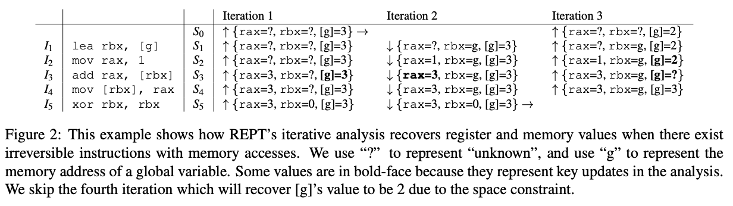
Recovering Memory Writes
Recovering memory writes is almost the same as instruction reversal except now it has irreversible instructions and memory access.
The idea to solve the missing memory write issue is error correction. Rept uses the memory values that are possibly valid to conclude other values and to correct these values later (if the values are invalid based on conflicts).
Notes:
the address of a memory access may not always be known. For a memory write instruction whose destination is unknown, we cannot correctly update the value for the destination memory. A missing update may introduce an obsolete value, which would negatively impact subsequent analysis. A conservative approach that marks all memory as unknown upon a missing memory write would lead to an unnecessary and unacceptable information loss.
the first iteration of the backward analysis, since we do not know rbx’s value in S4, we do not change the value at the ad- dress g. In the second iteration of the forward analysis, there is a conflict for rax in S3. The original value is 3, but the newly inferred value would be 4 (rax + [g] = 1 + 3 = 4). Our analysis keeps the original value of 3 because it was inferred from the final program state which we assume is correct. In the third iteration of the back- ward analysis, based on rax’s value before and after the instruction I3, we can recover [g]’s value to be 2.

Slide 15
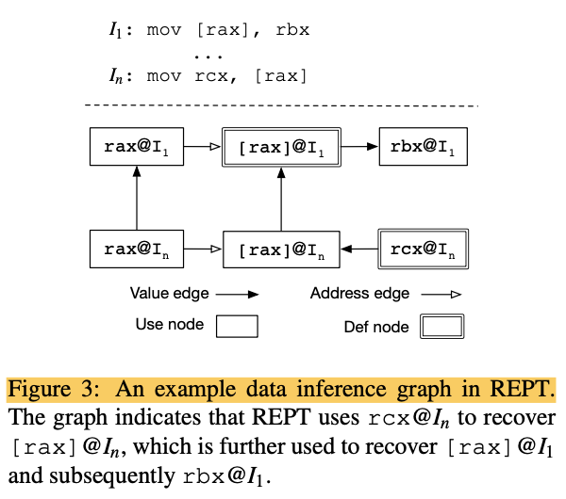
Recovering Memory Writes contd.
Data inference graph: The data inference graph is different from a traditional data flow graph in the sense that it tracks how a data value is inferred in either forward or backward directions while a data flow graph tracks the program’s data flow in just one direction.
Error correction value conflict and edge conflict. A value conflict happens when an inferred value does not match the existing value. An edge conflict happens when a newly identified def node of a memory location breaks the previously assumed def-use relationship between two nodes connected through a vertical edge.
Notes:
In this example, we use rcx to recover [rax], and then use the latter to recover rbx. Here we assume that rax’s value is not changed between I1 and In.
A node in the data inference graph represents a register or a memory location that is accessed in an executed instruction. A node is called a use node if it’s corresponding register or memory location is for read. Similarly, a node is called a def node if it is for write. For instance, rbx@I1 is a use node, and rcx@In is a def node.
Finally, REPT treats data in the memory dump as use nodes because their values can be propagated backwards like other use nodes.
When REPT detects a conflict, it stops the analysis of the current instruction, identifies the invalid node, then runs the invalidation process. For both types of conflicts, the invalidation process starts with an initial node
If REPT identifies an initial node for invalidation, it first processes each of its outgoing value and address edges. For a value edge, the target node is marked as unknown
REPT maintains a blacklist of invalidated values for each node. Every time a node is invalidated; its value is added to its blacklist. Once a value is in a node’s blacklist, the node cannot take that value anymore. This ensures that the iterative analysis process will not enter the conflicting state again and consequently guarantees that the algorithm will eventually converge.
the blacklists to prioritize the convergence of the analysis over the improvement in data recovery.

Slide 16
Handling Concurrency
Think about facing multiple instructions being executed simultaneously on multiple cores. Secondly, there is no exact order from these large number of instructions. Rept can handle this by doing two solutions, first is leverage the timing information logged and Second is recognized the memory writes in only operations whose orders may affect data recovery.
REPT first divides them into subsequences, then merges them into a single conceptual instruction sequence based on the inferred orders
Notes:
With timestamps inserted in an instruction sequence, we refer to the instructions between two timestamps as an instruction subsequence. We refer to the two times- tamps as the start and end time of the subsequence.
If one subsequence’s end time is before another subsequence’s start time, we say the first subsequence is executed before the other subsequence. Otherwise, we say their order cannot be inferred, and the two subsequences are concurrent. the order of two subsequences in the same instruction sequence can always be determined based on their positions in the instruction sequence.
Given multiple instruction sequences executed simultaneously on multiple cores, REPT first divides them into subsequences, then merges them into a single conceptual instruction sequence based on the inferred orders. REPT arbitrarily inserts one before the other in the newly con- structed sequence
A natural question is whether the data recovery is affected by this arbitrary choice of ordering two concurrent subsequences.
if we change the order of two subsequences that have concurrent mem- ory accesses to the same location and one of them is write, we may get different values for the memory location.
REPT places them into the merged instruction sequence.
REPT detects if it has a concurrent memory write to the same location. If so, REPT takes the following steps to limit the use of the memory access in the data inference graph. First, REPT removes all vertical edges of the node representing the memory access and invalidates the target nodes of outgoing vertical edges. Then, REPT labels the memory access node so that it will not be used in vertical edges. This is because REPT does not know if the memory access happens before or after the concurrent memory write to the same location. However, REPT still allows horizontal value edges to infer this node’s value.
picking an arbitrary order for concurrent instruction subsequences would affect the detection of concurrent memory writes to the same location.
REPT’s analysis works if there are no two separate concurrent writes such that one affects the inference of another’s destination.
A remaining question is whether picking an arbitrary order for concurrent instruction subsequences would af- fect the detection of concurrent memory writes to the same location.
REPT’s analysis works as long as there are no two separate concurrent writes such that one affects the inference of another’s destination. We acknowledge that this possibility exists and depends on the granularity of timing information. Given the timestamp granularity supported by modern hardware, we deem this as a rare case in practice

Slide 17
Implementation
Online Hardware Tracing: REPT leverages Intel Processor Trace (PT) to log control-flow and timing information of a program’s execution. REPT currently uses the per-thread circular buffer mode to trace user-space execution of all threads within a process. REPT sup- ports configuring the circular buffer size and the granularity of timestamps.
Offline Binary Analysis: REPT takes a memory dump with Intel PT trace as in- put, and outputs the recovered execution history of each thread. It conducts the forward and backward analysis until it converges.
Notes:
If a conditional branch is executed only if a register’s value is 0, then REPT can infer the register’s value once it observes that the branch is taken.

Slide 18
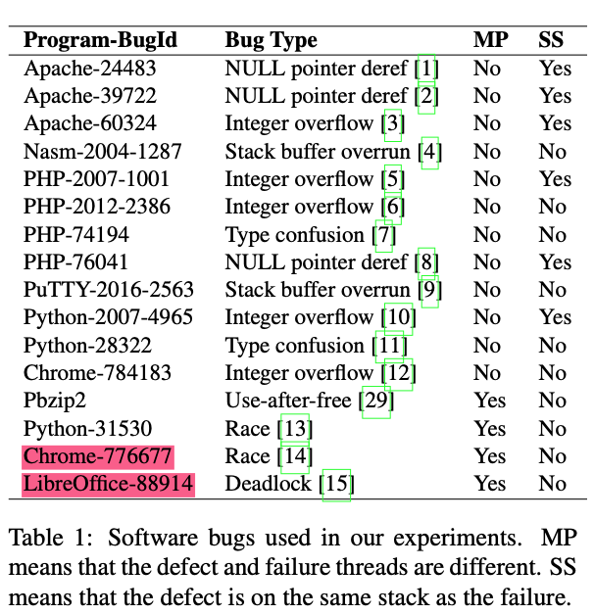
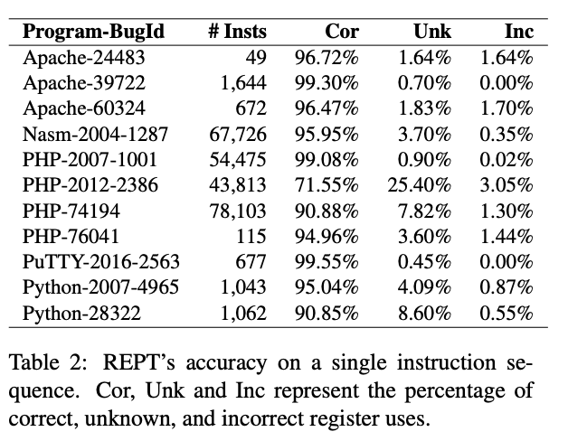
Notes:
We do not evaluate Chrome-776677 or LibreOffice-88914 because REPT does not work for them
REPT does not work for Chrome-776677 because the collected trace contains in-place code update for jitted code, which fails Intel PT trace parsing. REPT does not work for LibreOffice-88914, because this is a deadlock bug that triggers an infinite loop, which easily fills up the circular trace buffer and causes the program execution history before the loop to be lost.

Slide 19
Reviewing Rept
Accuracy: Rept uses Time-Travel Debugging (TTD) a slow precise record/replay tool
  Single-thread accuracy: 16 bugs and find that the destination is a register for 95% of memory reads.
  Multiple thread accuracy: such an approach may not perfectly reflect a multithreaded program’s actual behavior on a bare metal machine.
Efficiency: for the 14 bugs REPT can analyze. We can see that REPT finishes its analysis within 20 seconds for all the 14 bugs.
Effectiveness: REPT is effective if the values of variables that are involved in the bug fix are correctly recovered.
Deployment: The very first production bug that is successfully resolved with the help of REPT had been left unfixed for almost two years because developers can- not reproduce the crash locally.
Notes:
1) How accurately can REPT recover data values?
(2) How efficiently can REPT recover data values?
(3) How effectively can REPT be used to debug failures?
(4) What is the deployment status?
We can see that REPT achieves a high accuracy. In most cases, the percentage of correct register uses is above 90% for tens of thousands of instructions;
Unfortunately, memory alloca- tion operations are hard to reverse because the metadata information (i.e., chunk sizes) may be completely over- written by reallocations, resulting in a large percentage of unknowns
Overall, the accuracy decreases as the number of instructions increases, and the rate of decrease depends on the program and the workload.
When we compare the data values, we only check register uses (i.e., a register used as a source operand or the address of a destination memory operand). We do not check defs (i.e., a destination operand) because we want to avoid double counting.
When computing the data recovery accuracy, we do not need to count both. We do not check memory uses (i.e., a memory used as a source operand) because memory values are usually read into registers before they take on any operations.
TTD supports record and replay of multithreaded programs running on multiple cores by logging timestamps at each system call and synchronization operation
With the reverse debugging enabled by REPT, the developer is able to step through the function based on the reconstructed execution his- tory and quickly find out the root cause and fix the bug. In summary, a two-year-old bug was fixed in just a few minutes thanks to REPT.

Slide 20
limitations
First, the control flow trace may not be long enough to capture the defect (e.g., the free call is not in the trace for a use-after-free bug).
Second, data values that are necessary for debugging the failure are not recovered (e.g., the heap address passed to the free call is not recovered for a use-after-free bug).
Notes:
We cannot simply use a large circular trace buffer to solve this problem because the data recovery accuracy decreases when the trace size increases.
REPT currently does not capture any data during a program’s execution. To fundamentally solve these two limitations, we will need to log more data than just the memory dump.
The current implementation of REPT only supports reverse debugging of user-mode executions.
The challenge is that the data recovery of REPT is not perfect, so the research question is how to perform automatic root cause analysis based on the imperfect information provided by REPT.
REPT has been focused on software running on a single machine. When developers debug distributed systems, they usually rely on event logging.
REPT has not been able to apply to mobile applications because there is no efficient hardware tracing like Intel PT available on mobile devices.

Slide 21
Conclusion of rept
REPT can accurately and efficiently recover data values based on a control flow trace and a memory dump by performing forward and backward execution iteratively with error correction.
REPT can recover data values with high accuracy in just seconds, and its reverse debugging is effective for diagnosing 14 out of 16 bugs.

Slide 22
Q/a
Any questions?

