Slide 1

A comparison of approaches to large scale data analysis
Slide presented By: Zekarias G. Setotaw

Slide 2
contents
Introduction
Two Approaches to Large Scale Data Analysis
Architecture Elements
Performance Benchmarks
Conclusion

Slide 3
Introduction
Clustering of a computing nodes drives the interest of programming them so that it enables to solve computing problems.
Related to this, MapReduce and parallel DBMS(database management system) models were suitable with their respective tradeoffs.
The goal of this paper is to understand the differences between the MapReduce approach to performing large-scale data analysis and the approach taken by parallel database systems and suggest a way to get the best out of them.

Slide 4
Two approaches
The two approaches runs on “shared nothing” collection of computers. Using this the overview of the systems are as follows:
MapReduce: there are many functions in this platform the Map, Reduce, Splitter and Scheduler but the basics are:
Map: The Map function reads a set of “records” from an input file,
does any desired filtering and/or transformations, and then outputs
a set of intermediate records in the form of new key/value pairs.
Reduce: all output records from the Map phase are consumed by the same Reduce instances which combines the records assigned to it in some
way, and then writes records to an output.

Slide 5
Parallel DBMSs: capable of running on clusters of shared nothing nodes. The two key aspects that enable parallel execution in DBMSs are:
(1) tables are partitioned over the nodes in a cluster and
(2) the system uses an optimizer that translates SQL commands into plan whose execution is divided amongst multiple nodes.

Slide 6
Architecture Elements
 | MapReduce | Parallel DBMSs
Schema Support | Does not require it. When there is no sharing it is flexible. | Requires them. Should conform the paradigm.
Indexing | it does not provide a built-in indexes. | hash or Btree indexing reduces the scope of the search dramatically. Most database systems also support multiple indexes per table.
Programming Model | one is forced to write algorithms in a low-level language in order to perform record-level manipulation. there is widespread sharing of MR code fragments to do common tasks, such as joining data sets. To alleviate the burden of having to reimplement repetitive tasks, the MR community is migrating high- level languages on top of the current interface to move such functionality into the run time. | State what you want. Analogous to multiple joins/subqueries in DBMS – E.g., select from subquery

Slide 7
Data distribution | data passed onto the next stages of the computation | send the computation to the data
Execution Strategy | pull mechanism to draw in input files - induces large disk seeks | push mechanism to transfer data (no materialization of the split files)
Flexibility | SQL does not facilitate the desired generality that MR provides. | Some programming environments allow developers to benefit from the robustness of DBMS technologies without the burden of writing complex SQL

Slide 8
Performance Benchmarks
Goal
Understand differences in load and query time for some common data processing tasks.
Benchmark Environments:
Hadoop
Open Source Implementation of Map Reduce
Hadoop Version 0.19.0
DBMS-X
Row Based Format
Doesn't compress data
Vertica
Column Based Format
Compress data by default
Run on 100 node Linux cluster

Slide 9
Conducted Experiments:
Original MR task - grep task - representative of MR use cases
Loading
Execution
Analytical tasks - HTML documents processing similar to web crawler
Loading
Selection
Aggregation
Join
UDF Aggregation
Both DBMS-X and Vertica execute most of the tasks much faster
than Hadoop at all scaling levels.

Slide 10
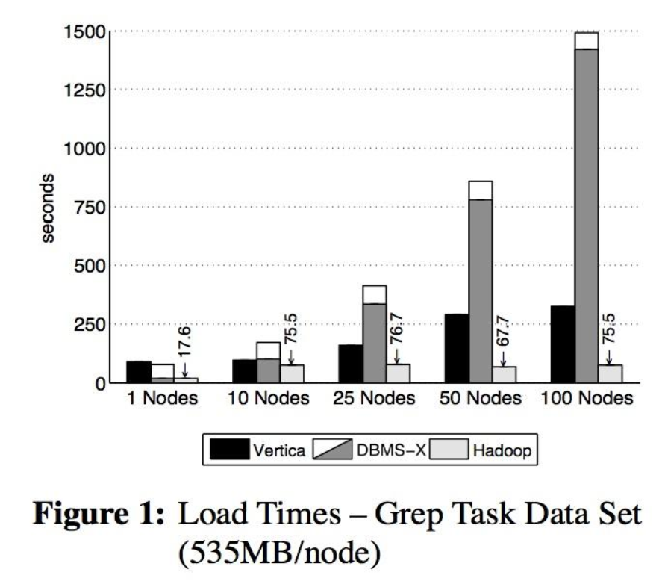
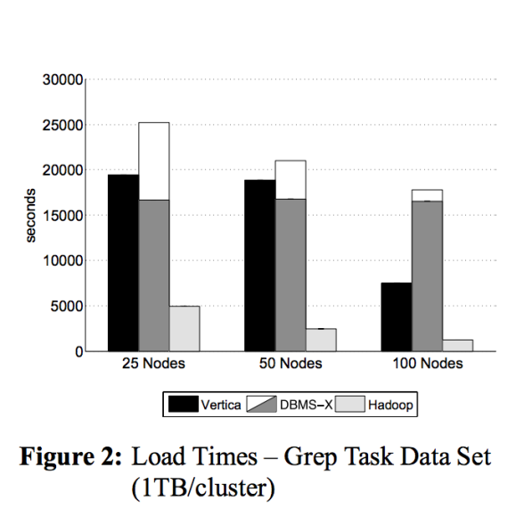
Results and Findings
Loading time

Slide 11
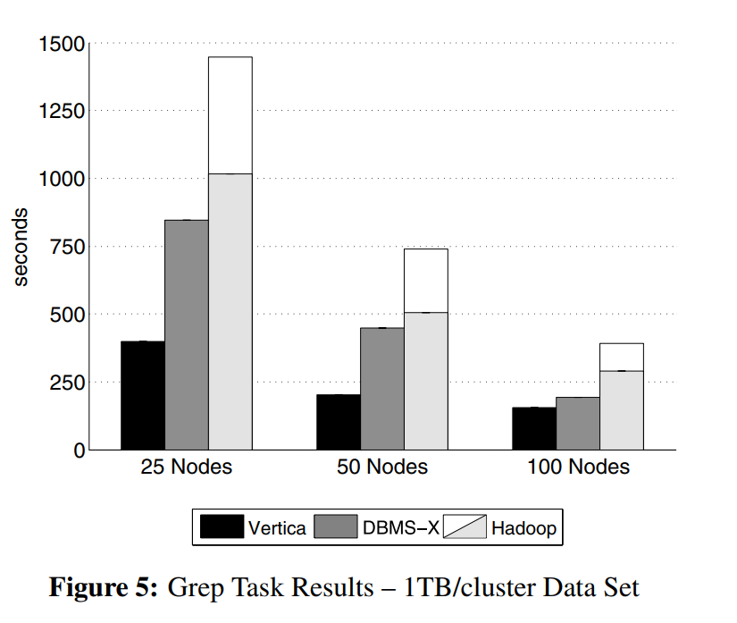
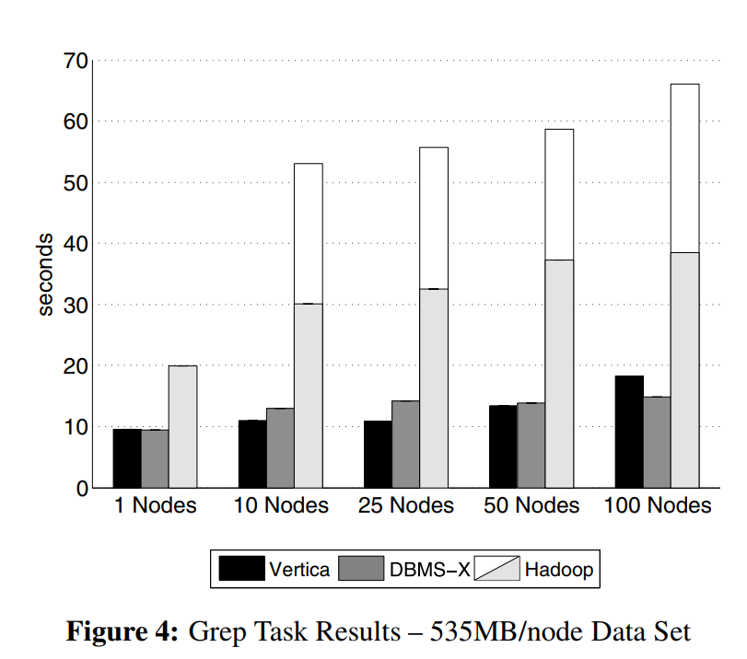
Task Execution time

Slide 12
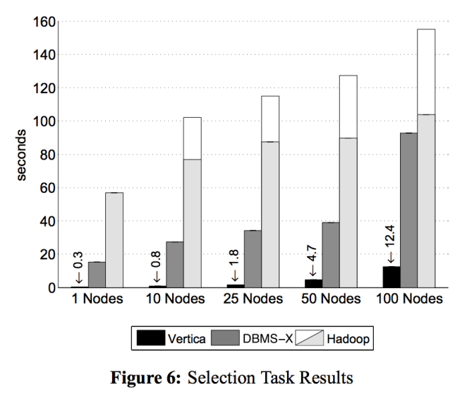
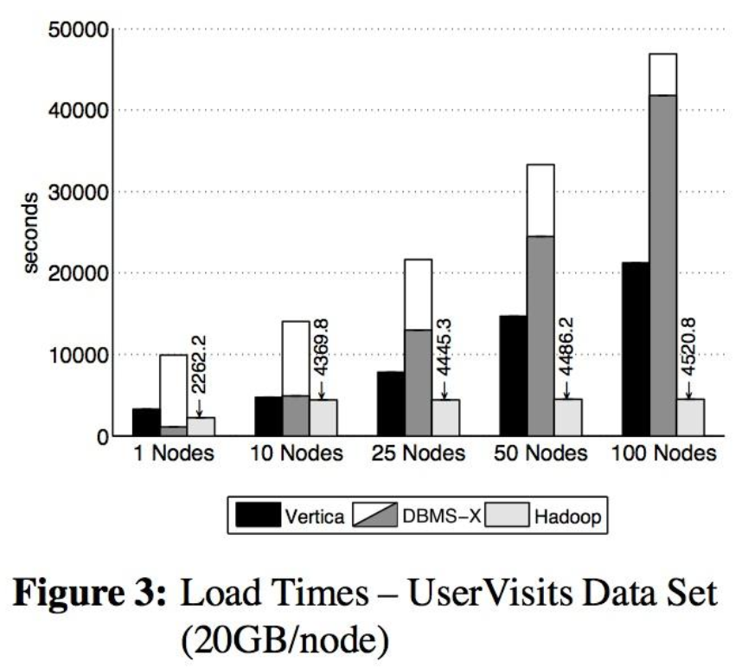
Analytical tasks
Documents, User Visits and Rankings tables

Slide 13
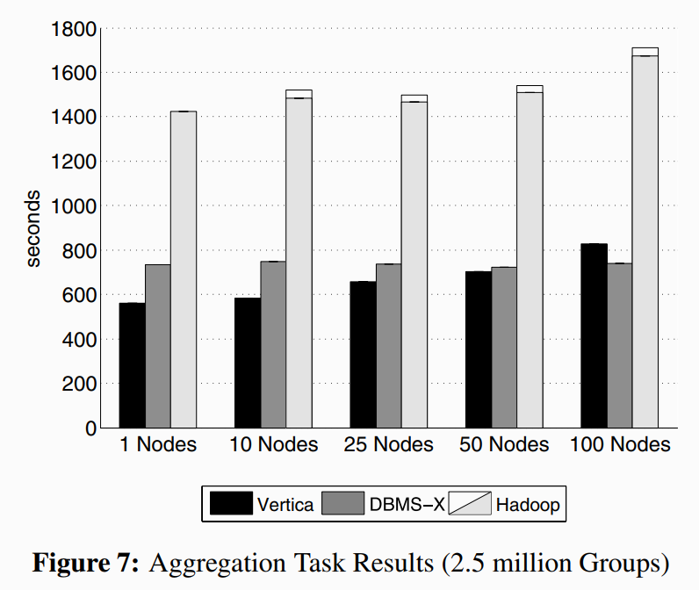
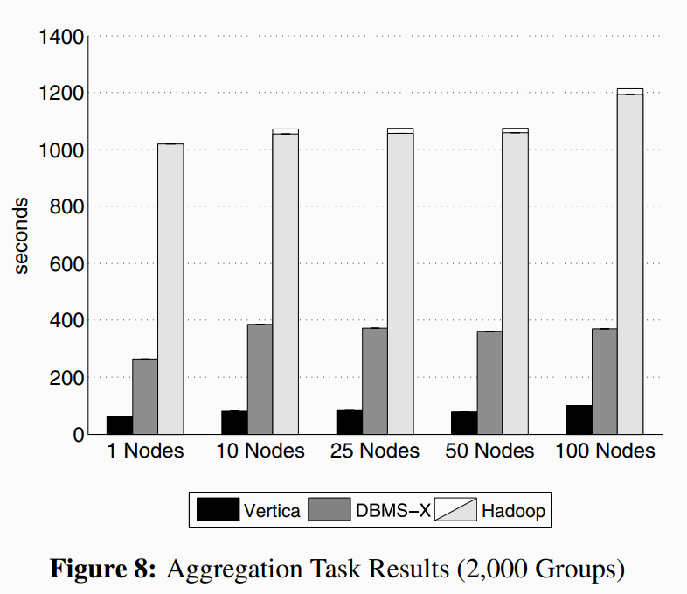
Aggregation tasks

Slide 14
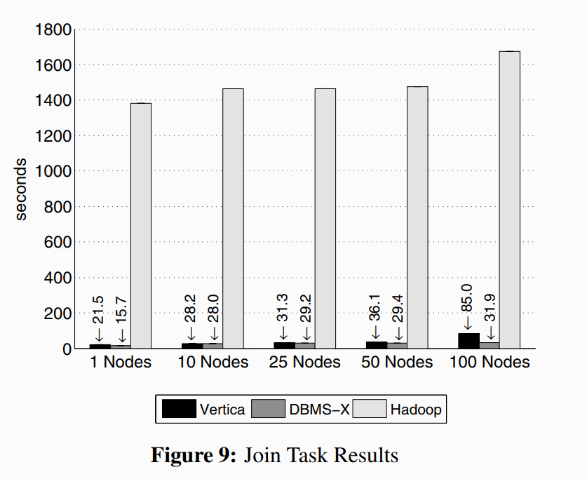
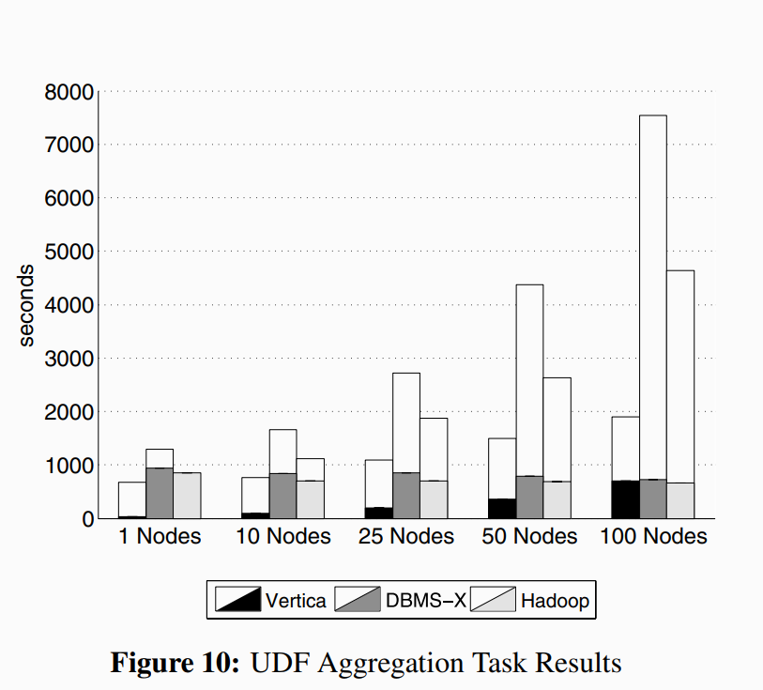
Join and UDF

Slide 15
Analysis of the Results and findings:
System level aspects
System Installation, Configuration, Tuning, Task Start-up, Compression, Loading and Data Layout, Execution Strategies and failure model.
User level aspects
Ease of use
Additional tools

Slide 16
DBMS-X was 3.2 times faster than MR and Vertica was 2.3 times faster than DBMS-X.
Parallel DBMS-X lesser energy needs.
B-tree indices, novel storage mechanisms, aggressive compression techniques and sophisticated parallel algorithms for querying large amounts of relational data.
Hadoop has upfront cost advantage - hence attracted such a large user community.
Extensibility is USP of MR
Fault tolerance of MR

Slide 17
It comes with a potentially large performance penalty, due to the cost of materializing the intermediate files between the map and reduce phases.
SQL is particularly bad
MR makes a commitment to a “schema later” or even “schema never” paradigm. But this lack of a schema has a number of important consequences. This difference makes compression less valuable in MR and causes a portion of the performance difference between the two classes of sy

Slide 18
conclusion
Parallel database systems displayed a significant performance
advantage over Hadoop MR in executing a variety of data intensive
tasks.
Parallel systems did not do a good job on the UDF aggregation tasks.
Parallel systems have less fault tolerance as compared to Hadoop.
For parallel databases, they believe that both commercial and open-source systems will dramatically improve the parallelization of user-defined functions.
It is better to consider implementation concepts that systems should take from both kinds of architectures.

Slide 19
References
https://dl.acm.org/doi/10.1145/1559845.1559865
https://pdfs.semanticscholar.org/90c5/2cc9304b1544e90d9118bba25abf608012c8.pdf

