Slide 1
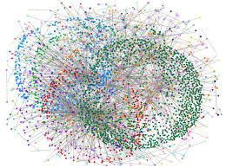
AKIN: A streaming graph partitioning algorithm for distributed graph storage systems
Presenter: Bao Dien Quoc Nguyen
R#: 11260127
Authors: Wei Zhang, Yong Chen, Dong Dai

Slide 2

Content
Introduce the problem
Main contributions of the paper
The AKIN algorithm
Results of experiments in the paper

Slide 3
Content
Introduce the problem
Main contributions of the paper
The AKIN algorithm
Results of experiments in the paper

Slide 4
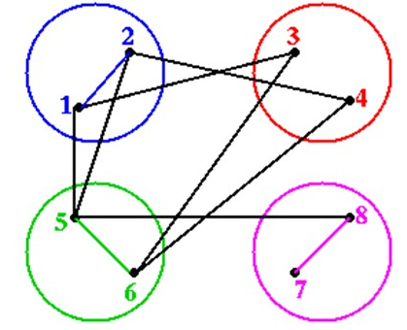
Graph partition problem
Many applications can be represented as a graph
The number of vertices decides the workload
Vertex
Computation
Edge
Communication
Execution of these applications in parallel platform requires:
Balanced partition workload
Minimum cross-partition communications
Edge(5,8) is a cross-partition link
Balanced partition size
Minimum cut-size
Cut-size: the number of cross-partition links

Slide 5
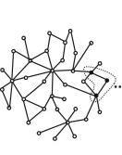
Streaming graph partition problem
Distributed system
Size: large, dynamically growing
Data structure: no global
Partition: fast

Slide 6
Content
Introduce the problem
Main contributions of the paper
The AKIN algorithm
Results of experiments in the paper

Slide 7
Main contributions
Algorithm | Type | Advantage | Disadvantage
METIS | Offline | Partition balance Minimum cut-size | Limitation of memory Intensive computational overhead
Deterministic Hashing | Online | Partition balance Fast | No effort in minimizing the cut-size
Fennel | Online | Partition balance Fast | Limitation in minimizing the cut-size
Partition balance
AKIN
Reduce the cut-size
Fast partitioning

Slide 8
Content
Introduce the problem
Main contributions of the paper
The AKIN algorithm
Results of experiments in the paper

Slide 9





The algorithm
Vertex $υ$ arrives
Vertex 𝜐 arrives
Deterministic Hash Function
Assign $υ$ to $P_{i}$
Assign 𝜐 to 𝑃_𝑖
$$i=h(υ)$$
𝑖=ℎ(𝜐)
$P_{i}$ is base partition
Edge $e(υ,u)$ arrives
Edge e(𝜐,𝑢) arrives
Find $P_{t}$ where similarity-based heuristic function is maximum
Find 𝑃_𝑡 where similarity-based heuristic function is maximum
Assign $e(υ,u)$, $υ$, and $u$ to $P_{t}$
Assign e(𝜐,𝑢), 𝜐, and 𝑢 to 𝑃_𝑡
available
$$υ → P_{i}$$
$$u → P_{j}$$
Size constraint is reached
$P_{t}$ is hosting partition
Assign $e\left(υ,u\right)$ to $P_{i}$

Slide 10

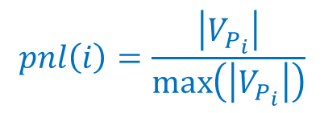


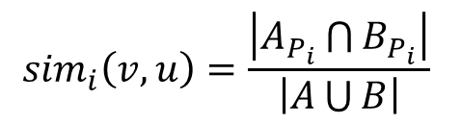

Heuristic function
$$H_{i}\left(u,v\right)=α×{sim}_{i}\left(v,u\right)−β×pnl(i)$$
$${sim}_{i}\left(v,u\right)=\frac{\left|A_{P_{i}}\bigcap{B_{P_{i}}}\right|}{\left|A\bigcup{B}\right|}$$
$$pnl\left(i\right)=\frac{\left|V_{P_{i}}\right|}{\max\left(\left|V_{P_{i}}\right|\right)}$$
$A_{P_{i}}$ and $B_{P_{i}}$: set of outgoing neighbors on partition $P_{i}$ of $v$ and $u$
Avoid biased evaluation
$A$ and $B$: set of all outgoing neighbors of $v$ and $u$
0 common neighbor
$$v$$
$$e\left(v,u\right)$$
If size constraint is not reached
0 common neighbor
$$u$$
Migration
0 common neighbor
2 common neighbors
1 common neighbor

Slide 11
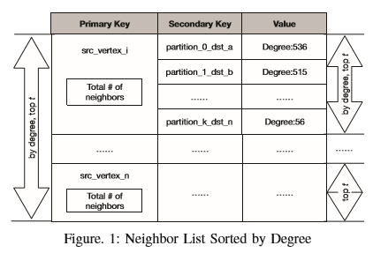
Fixed-length neighbor list
The list consists of:
ID of neighbor vertex
ID of neighbor vertex’s partition
Degree of neighbor vertex
Neighbors of top n highest degree
Easy to compare sets of neighbors
Length: n

Slide 12
Content
Introduce the problem
Main contributions of the paper
The AKIN algorithm
Results of experiments in the paper

Slide 13
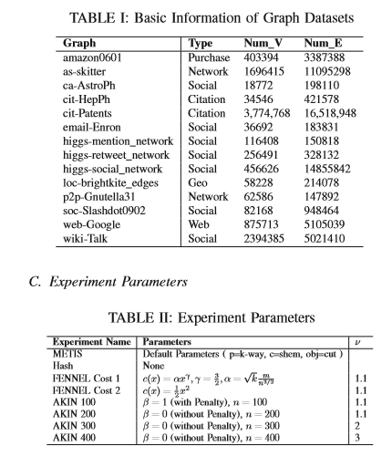

Datasets and parameters
$υ$: the coefficient of partition size constraint
Loosen the size constraint to gather more similar vertices

Slide 14
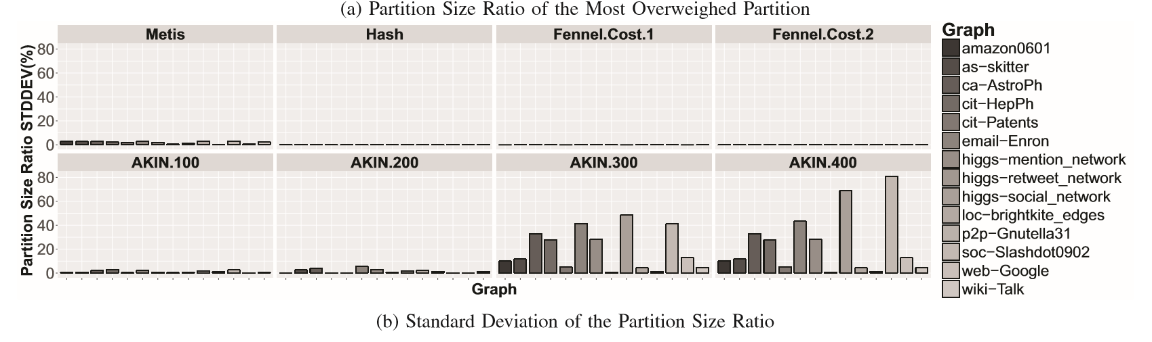

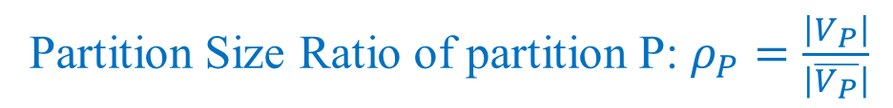



Partition balance evaluation
$$υ=1.1$$
$β=1$
$υ=1.1$
$β=0$
$υ=2$
$β=0$
$υ=3$
$β=0$
Partition Size Ratio of partition P: $ρ_{P}=\frac{\left|V_{P}\right|}{\left|\overline{V_{P}}\right|}$
Small standard deviation means balanced size

Slide 15
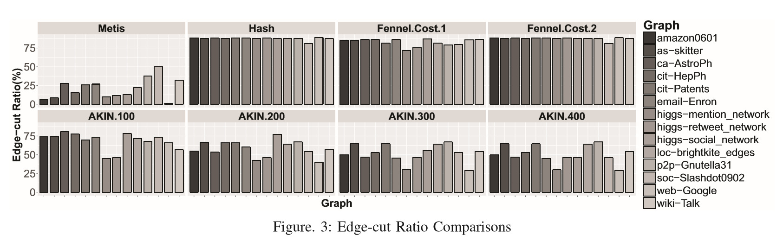
Edge-cut ratio comparison
$$υ=1.1$$
$β=1$
$υ=1.1$
$β=0$
$υ=2$
$β=0$
$υ=3$
$β=0$
Edge-cut ratio: $λ=\frac{\left|C\right|}{\left|\overline{E}\right|}$ where C denotes the set of all cross-partition edges
Minimize the Edge-cut ratio

Slide 16
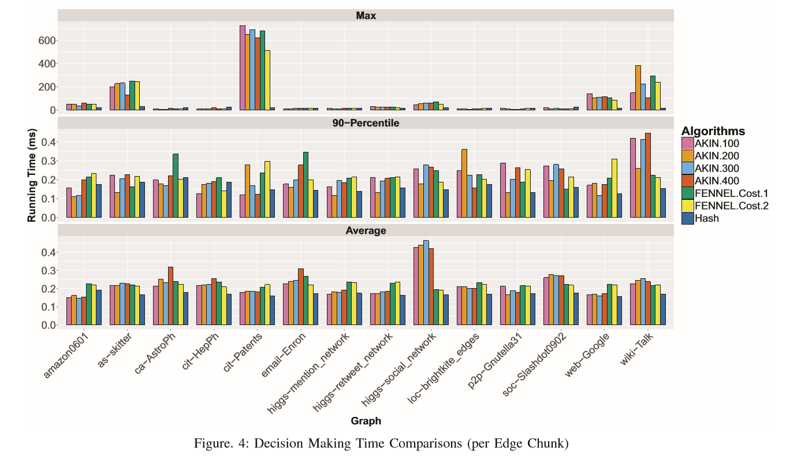
Decision making time comparison

Slide 17
Thank You
Bao Dien Quoc Nguyen
R#: 11660127

