Slide 1
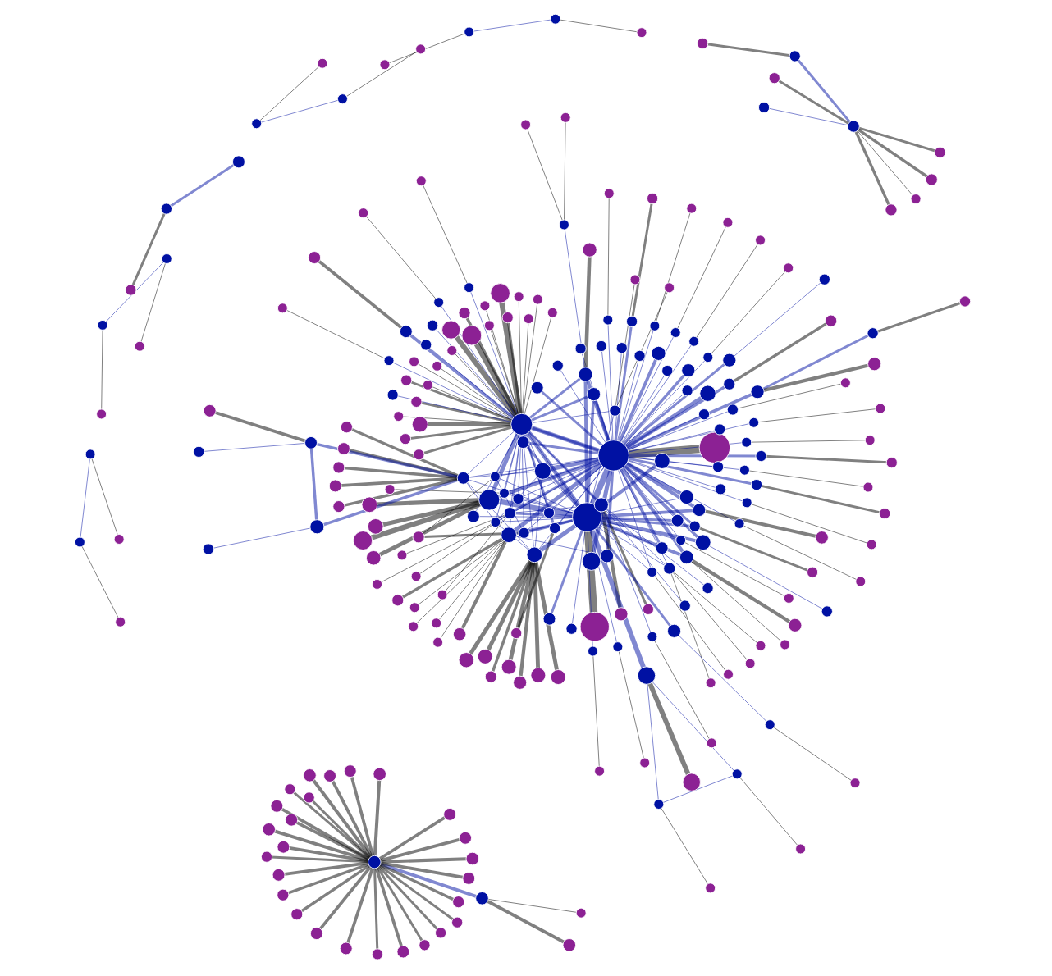
Redhat
Canonical
Ubuntu_linux
Oracle
Debian
Debian_linux
Mozilla
Firefox

