Slide 1
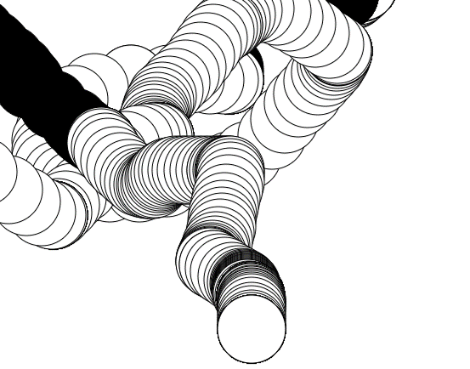
P5js- event handling
Ngan Nguyen
October 2019

Slide 2




Materials
P5js tutorial use in this presentation
Official material
Recommendation
P5js web editor: 1.2: p5.js Web Editor - p5.js Tutorial
P5js series: Code! Programming with p5.js
Html with p5js: 8: HTML / CSS / DOM - p5.js Tutorial
P5js video capture example
w3school: (js, html, css)
Materialize, Bootstrap - Responsive UI
jQueryUI - More control on UI

Slide 3
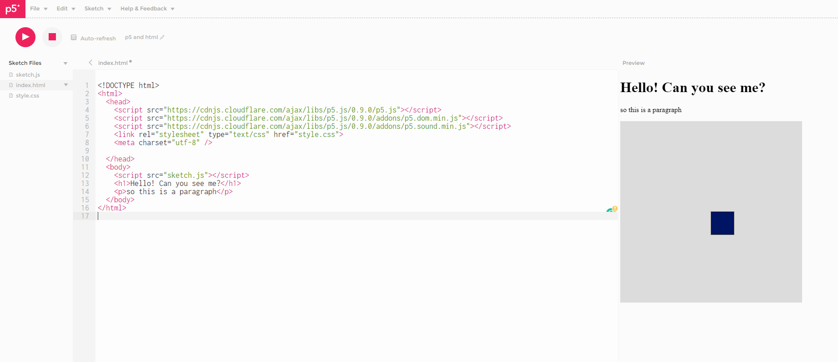
HTML?
https://editor.p5js.org/Zipexpo/sketches/v4syGpX6L
HTML is the standard markup language for Web pages.
With HTML you can create your own Website.
HTML is easy to learn - You will enjoy it!
Document Object Model (DOM)

Slide 4
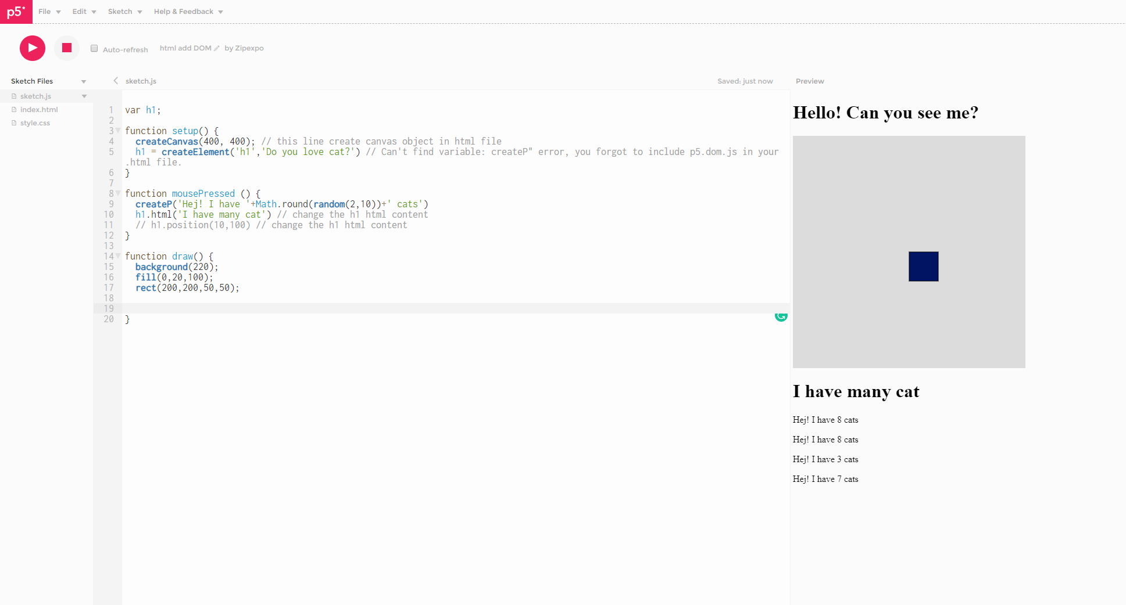
HTML with p5js
https://editor.p5js.org/Zipexpo/sketches/ZygUsbXlv
createP()
createDiv()
createButon()
createImg()
….
createElement()
https://p5js.org/reference/#/p5/
.html(<your content>)
.position(<x>, <y>)
Make new DOM
Manipulating DOM

Slide 5
DOM events callbacks
https://editor.p5js.org/Zipexpo/sketches/ZygUsbXlv
mybtn = createButton(<your content>); mybtn.mousePressed(<your function>);

Slide 6
SimpleUI
https://editor.p5js.org/Zipexpo/sketches/bpmnboTK4
. mousePressed()
.mouseOver()
.mouseOut()
.changed()
.input()
mybtn = createButton(<your content>);
myslider = createSlider(<min>,<max>,<default>) ;
myinput = createInput(<content>);
Make new UI element
Callback handler

Slide 7

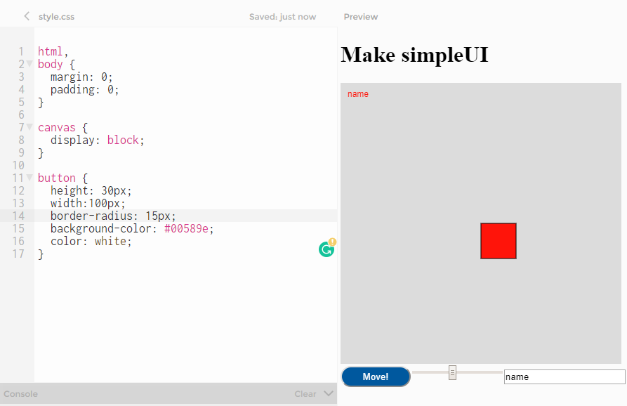
Decoration!!
Let make round button!!!
https://editor.p5js.org/Zipexpo/sketches/bpmnboTK4
CSS: Cascading Style Sheets
mytag {
background-color: black;
}
.myclass {
color: red;
}
#myId {
margin: 10px;
}
selector
attribute: value

Slide 8
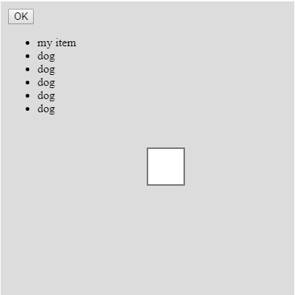
Organize UI?
https://editor.p5js.org/Zipexpo/sketches/q5yvEbBdL
canvas.parent(<your selector>) <your element>.parent (<your selector>)

Slide 9
Video capture example
https://p5js.org/examples/dom-video-capture.html

Slide 10
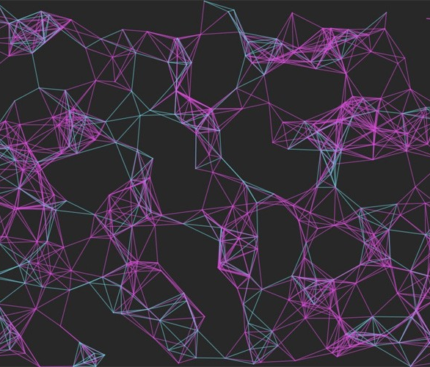
THANK YOU!
Ngan Nguyen
Email:
Ngan.V.T.Nguyen@ttu.edu

