Slide 1
Processing GUI libraries

Slide 2
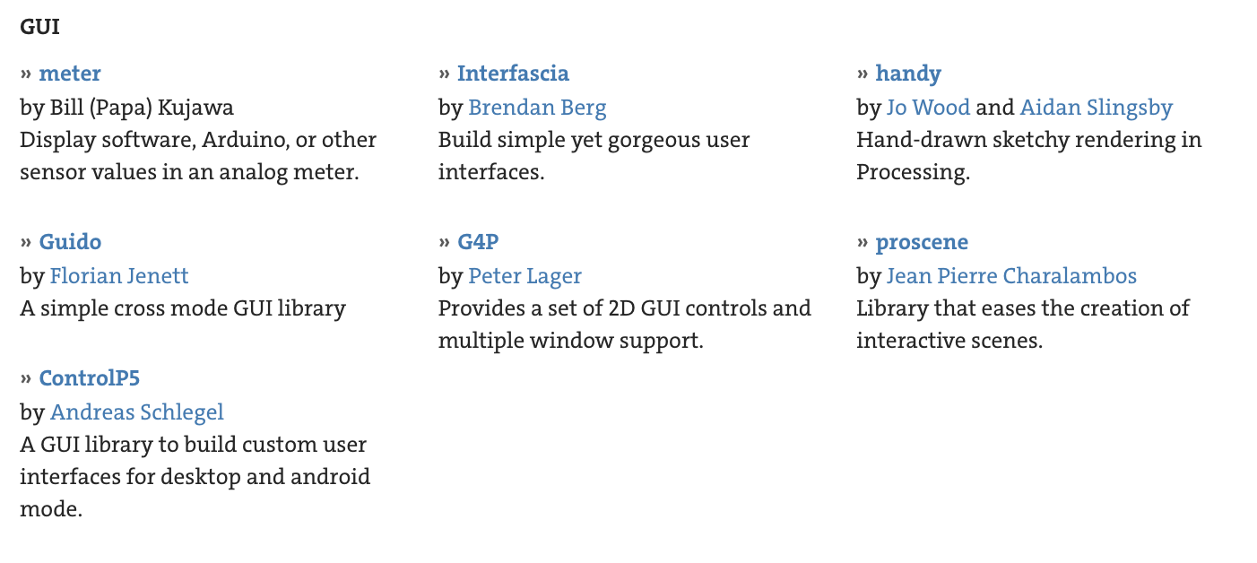
Processing GUI libraries
(https://processing.org/reference/libraries/#gui)

Slide 3
Which one to choose?
Features: can they meet your needs?
Sample screenshots: are they appealing?
Learning curve: can you read the document quickly?
Find some examples: are they easy to read, easy to code, flexible?

Slide 4
ControlP5
Installation
Sketch → Import Library → Add Library
Search for ControlP5 and install
Source codes, examples, documentations
Github: https://github.com/sojamo/controlp5
Documentation: http://www.sojamo.de/libraries/controlP5/

Slide 5
Main steps
Adding ControlP5
import controlP5.*
ControlP5 cp5;
void setup(){
…
cp5 = new ControlP5(this);
}
Adding/Accessing controller
…
int mySlider;
…
void setup(){
slider = cp5.addSlider(“mySlider”).setPosition(20, 20).setSize(200, 20);
}
void draw(){
//Use variable println(slider.getValue());
//Use name
Slider slider = cp5.get(Slider.class, "mySlider");
println(slider.getValue());
//Use variable name
println(mySlider);
}

Slide 6
Event handling
Adding buttons
import controlP5.*
ControlP5 cp5;
void setup(){
…
cp5 = new ControlP5(this);
cp5.addButton(“myButton1”);
cp5.addButton(“My Button2”);
}
Handling event
//Generic handler
void controlEvent(ControlEvent theEvent){
println(theEvent.getController().getName());
}
//Using name
void myButton1(){ println(“Clicked on button 1”);
}

Slide 7
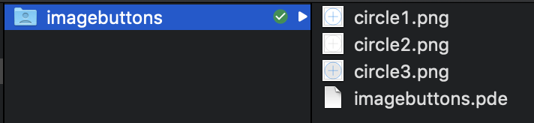

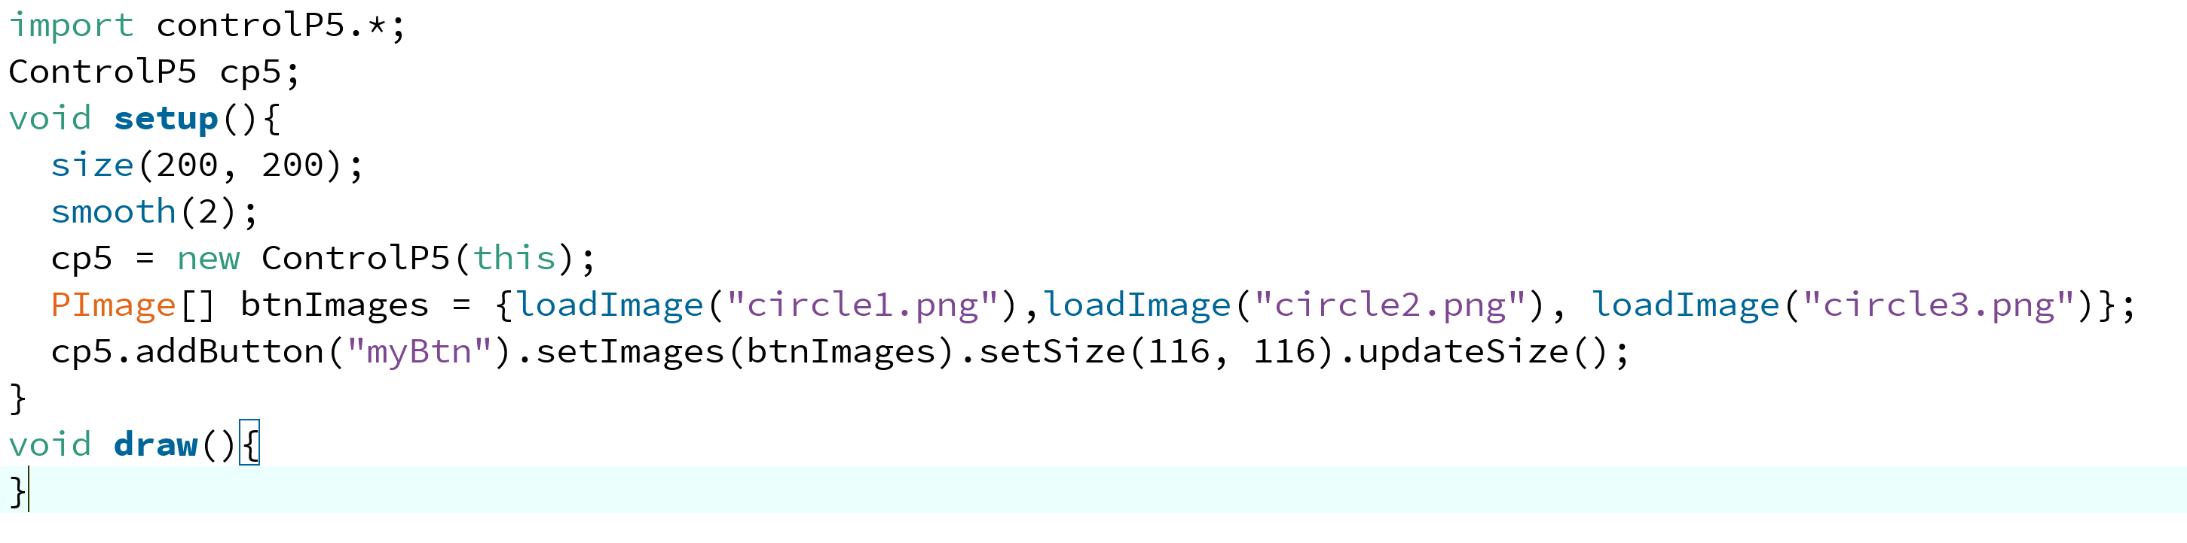
Images
Project structure

Slide 8
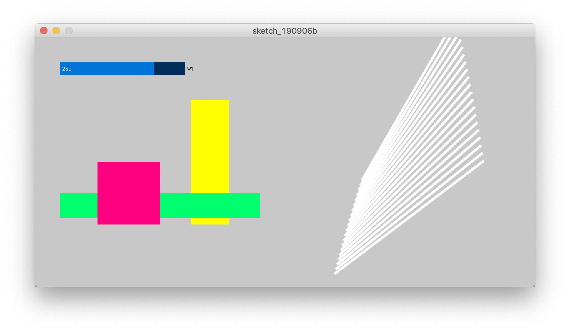
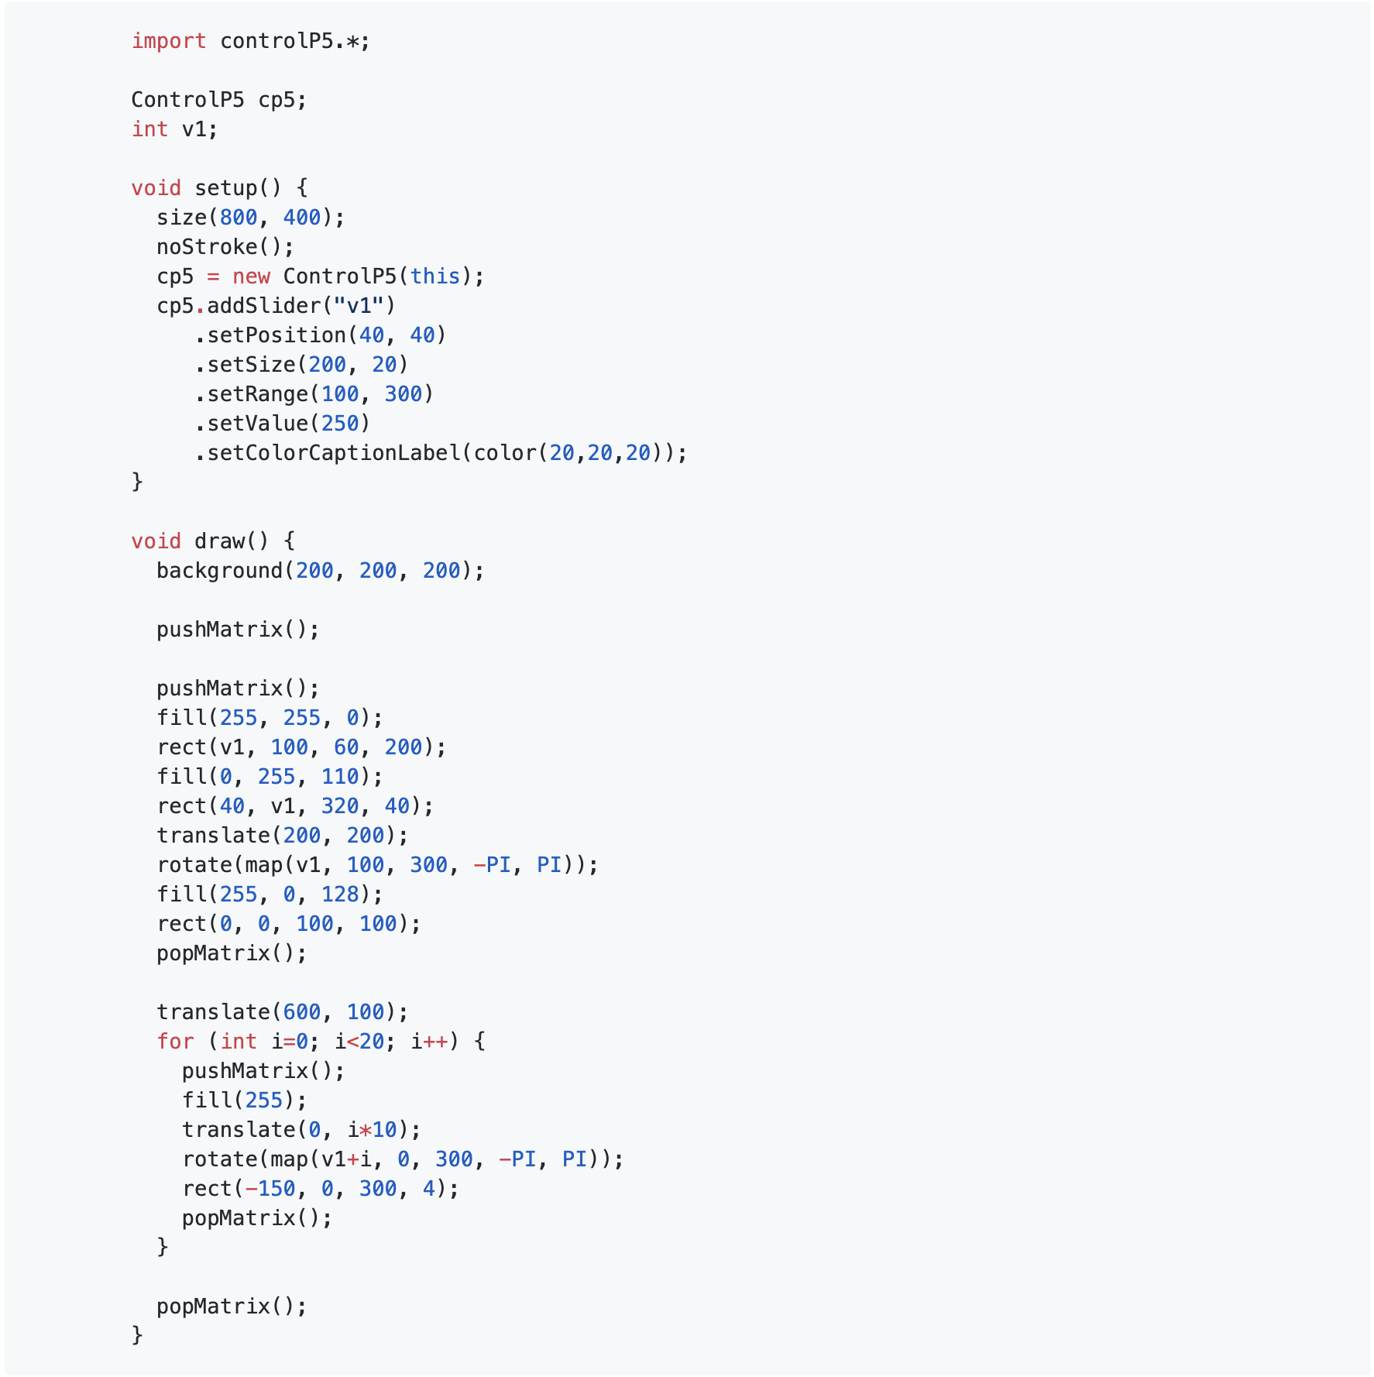
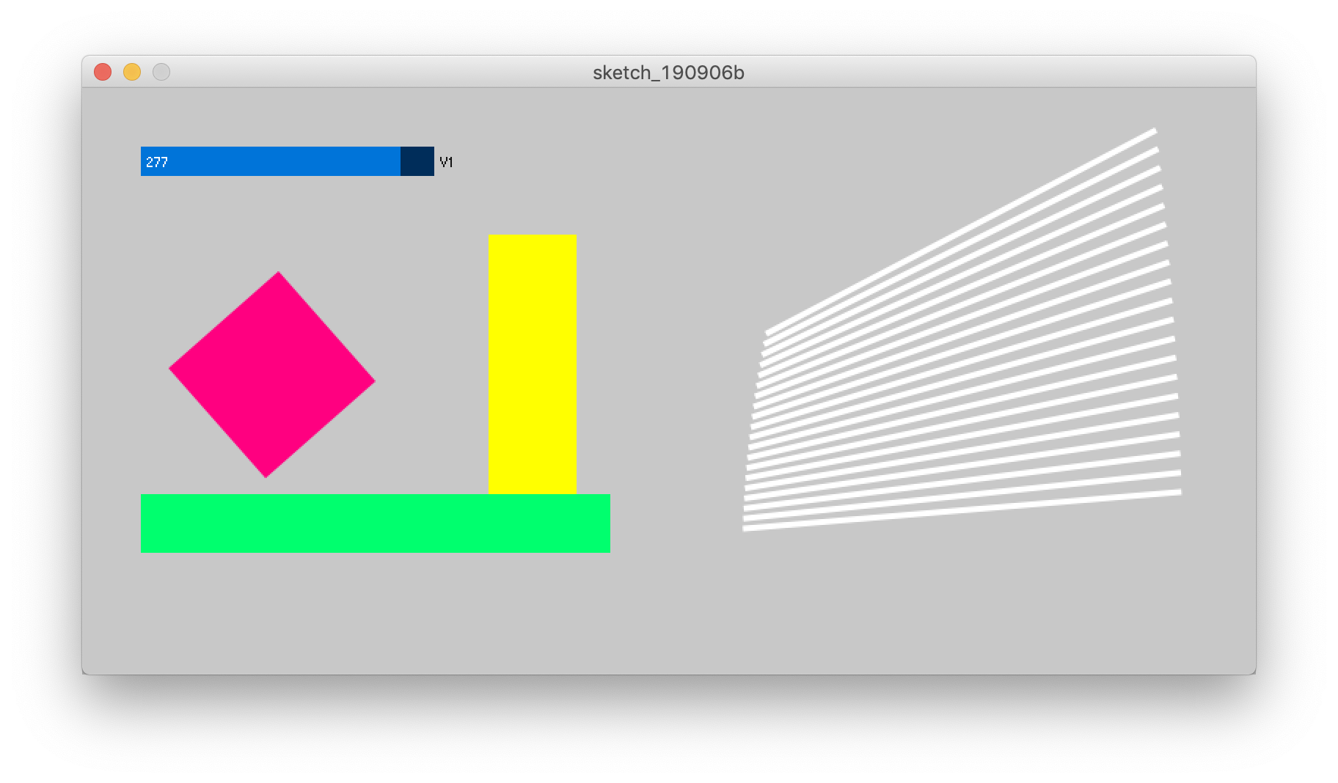
More Examples (https://github.com/sojamo/controlp5)

