Slide 1
2019-TTU-1: Visualizing, Monitoring, and Automating Data Centers
Presenter: | Tommy Dang, PhD, TTU
Project Participants: | Tommy Dang, PhD, TTU Yong Chen, PhD, TTU Allen Sill, PhD, TTU

Slide 2
Project Overview
Monitoring data centers is challenging due to their size, complexity, and dynamic nature.
This project proposes visual approaches for situational awareness and health monitoring of HPC systems. The visualization requirements are expanded on the following dimensions:
  HPC spatial layout
  Temporal domain (historical vs. real-time tracking)
  System health services such as temperature, memory usage, fan speed, and power consumption.

Slide 3
Project Overview
We therefore focus the following design goals:
  Provides spatial and temporal overview across hosts and racks,
  Allows system administrators to filter by time series features such as sudden changes in temperatures for system debugging, and
  Inspects the correlation of system health services in a single view.

Slide 4

Project Goals
Quaters
  Q1: We develop a set of visual features to capture unusual pairwise projections of HPC variables;
  Q2: Variables are collectively used to build models and predict future events;
  Q3: We plan to test both multidimensional and multidimensional on various use cases of HPC of different sizes and complexities; and
  Q4: Write and present investigations and findings.
Deliverables
  HPC multidimensional prototypes for visualizing health status of HPC centers within a single
  Predictive framework for temperature, fan speed, and power consumption
  An intelligent interface that allows viewers to quickly narrow down features or event of interest Reports and findings
Notes:
We actually managed to both expand the risk analytics from the county level to larger geospatial boundaries and to smaller geospatial boundaries (zipcodes)

Slide 5
Project Team Members
Faculty
  Dr. Tommy Dang
  Assistant Professor, Texas Tech University
  Dr. Yong Chen
  Associate Professor, Texas Tech University
  Dr. Allen Sill
  HPCC Managing Director, Texas Tech University
Students
  Ghazanfar Ali, PhD Student, Texas Tech University
  Vinh Nguyen, PhD Student, Texas Tech University

Slide 6
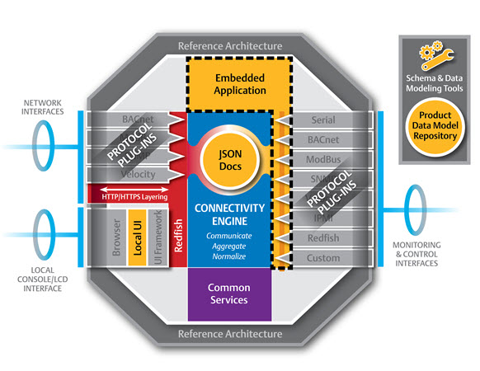

Background and Related Research
DMTF released Redfish. Nagios Core is integrated with Redfish API to fetch system status.
Notes:
a priori approach – instead of establishing a research question prior to performing an experiment, we let the data tell us which variables are important

Slide 7
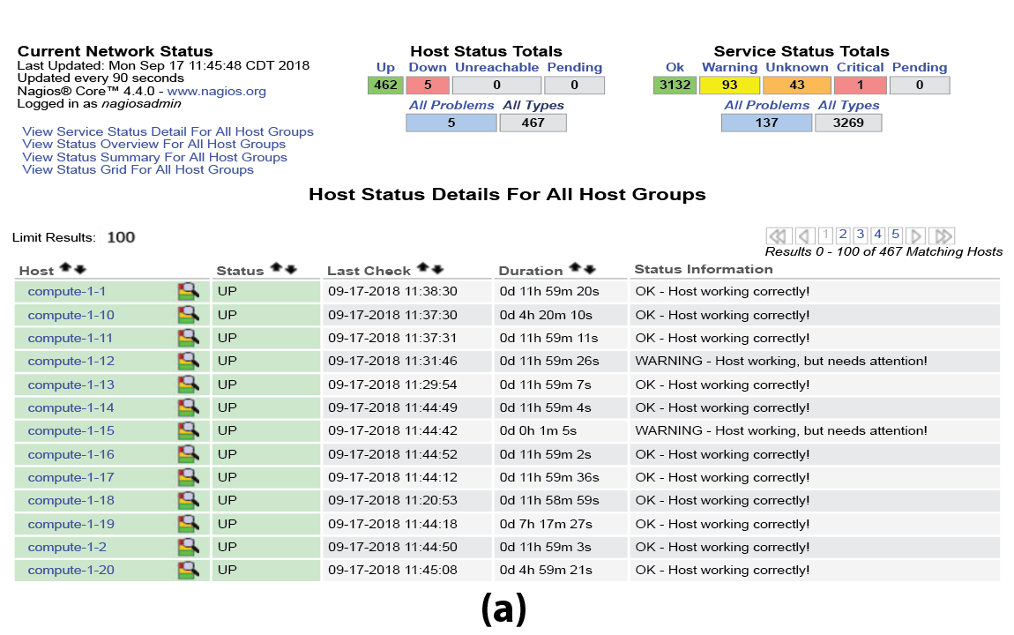
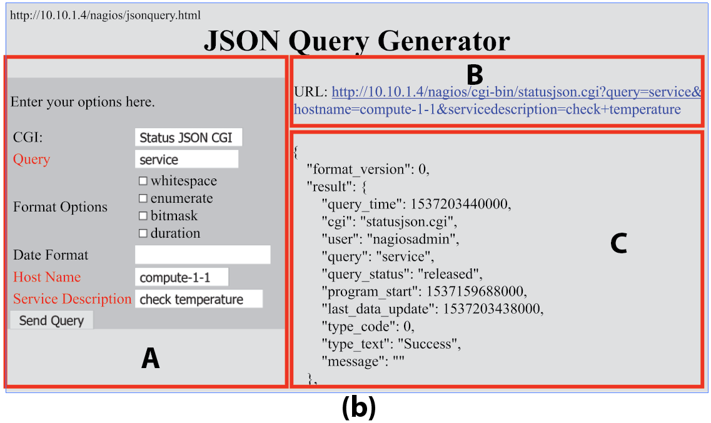
Background and Related Research
Notes:
a priori approach – instead of establishing a research question prior to performing an experiment, we let the data tell us which variables are important

Slide 8
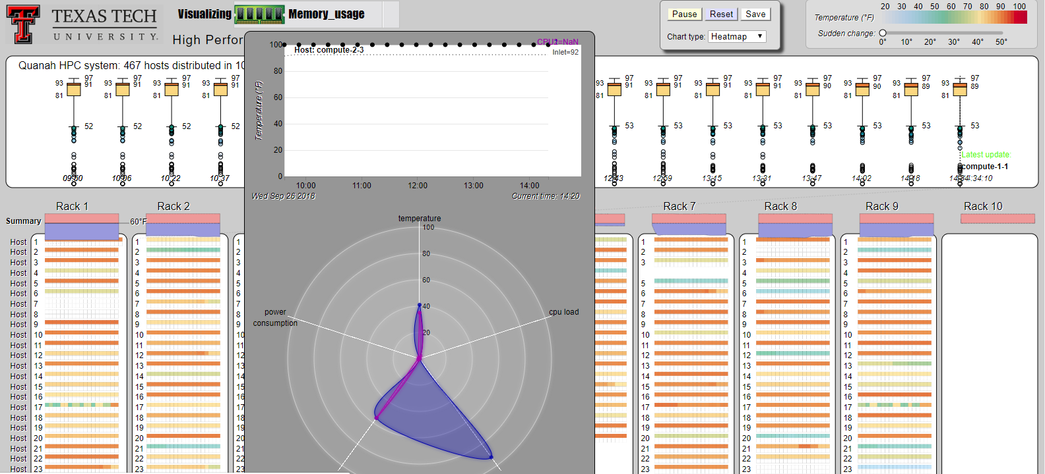
Background and Related Research
Notes:
a priori approach – instead of establishing a research question prior to performing an experiment, we let the data tell us which variables are important

Slide 9
Demo
Web interface 1: https://idatavisualizationlab.github.io/HPCC/
Web interface 2: https://idatavisualizationlab.github.io/HPCC/vizOverheatSep26/index.html
Notes:
Will talk about each project individually
Dissemination: Drew’s poster is on risk simulation in colon/rectal cancer, which we will be investigating at the zip code level instead of county level
Aakriti’s paper on transdisciplinary teams, which has been presented at previous CAC meetings

Slide 10
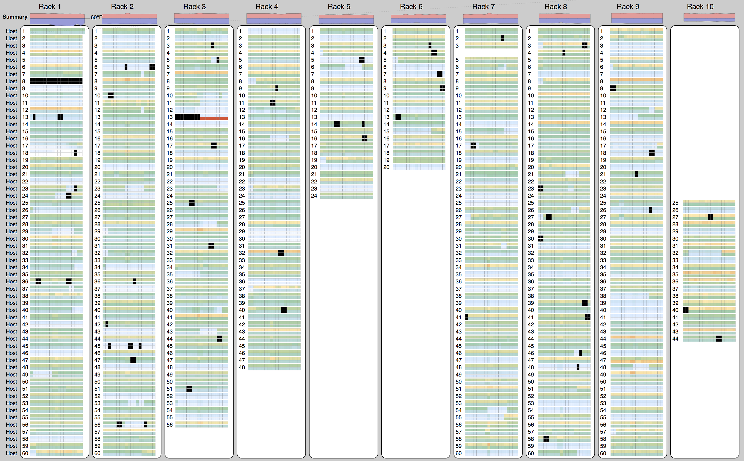
HPCC on Sep, 26 2018: CPU temperature

Slide 11
Deliverables and benefits
Deliverables
New modeling to identify hotspots developed
Simulations for risk analytics tested in all counties with small number of variables
Document processing tested at a magnitude of 10x documents with time reduced by
Benefits
Speed of processing
Meaningful insights using big data

Slide 12
New Activities and Outcomes
Activities
Continued replacement and expansion of Exposome 2.0 with Exposome 3.0 RSS feeds for more complete data from 1947 to present
Recruit new healthcare company memberships
Outcomes
Exposomal modeling is continuing to be used for disease prediction
More efficient ways to simulate and process data

Slide 13
Synergy
We continue to work with the LCDC for risk prediction
We have been asked by the Univ. of KY to perform risk simulation for diabetes in their grant to ADA
We have been asked by Baylor University to perform risk simulation for mental illness in their grant to SAMSHA
We have resubmitted a grant to NIH to expand suffix tree clustering to policy documents and risk analysis to health effects from extreme heat

Slide 14
Goals
We continue work to re-recruit Covenant Hospital Systems
We will continue to make meaningful connections between the data and the factors being studied

Slide 15
LIFE Form Input
Please take a moment to fill out your L.I.F.E. forms.
http://www.iucrc.com
Select “Cloud and Autonomic Computing Center”
then select “IAB” role.
What do you like about this project?
What would you change?
(Please include all relevant feedback.)

