Slide 1
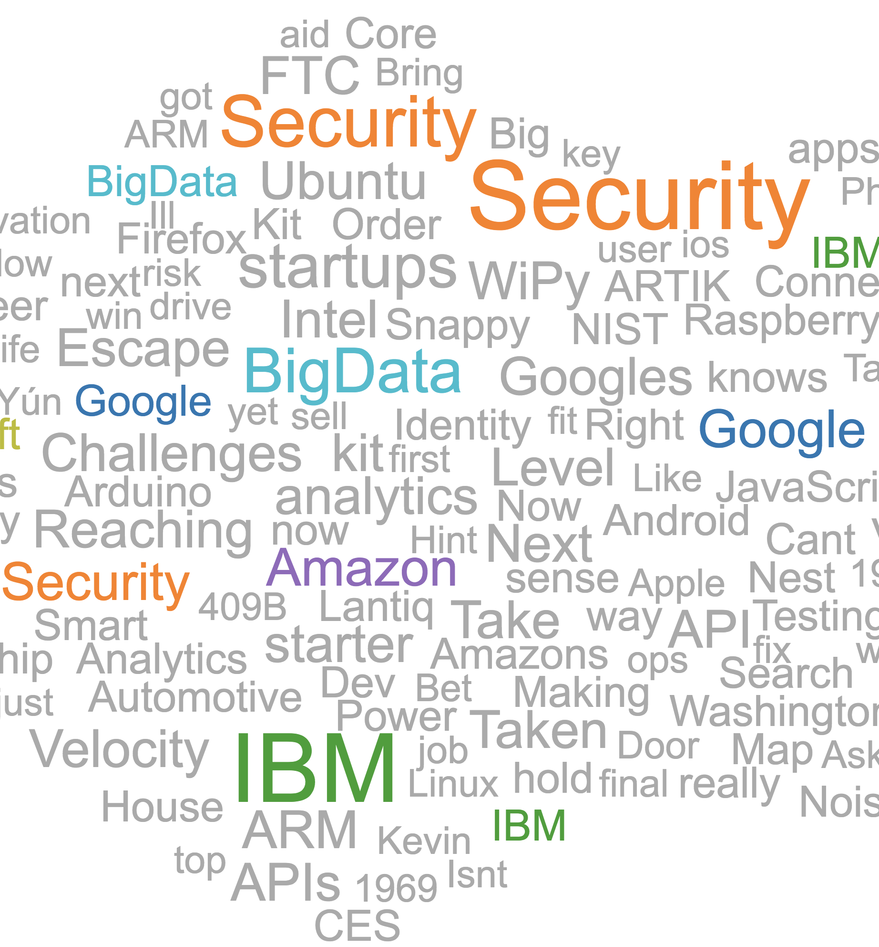


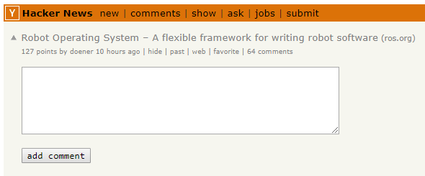

HackerNews
Extracted
multidimensional
data
Coordinated multiple views
Trending
terms
Authors
Ratings
Comments
Posts

