Slide 1

HR Database

Slide 2
Business Scenario
Business requirement
The video game company saw explosive growth with a sudden appearance onto the gaming scene with its new AI-powered video game console. As a result, they went from a small 10 person operation to 200 employees and 5 locations in under a year. HR was having trouble keeping up with the growth since they were still maintaining employee information in a spreadsheet. While that worked for ten employees, it became increasingly cumbersome to manage as the company expands. As such, the HR department requested a database capable of managing their employee information.
Dataset
The HR dataset is an Excel workbook consisting of 206 records, with eleven columns. The data is in human-readable format and was not normalized at all. The data lists the names of employees, as well as information such as job title, department, manager's name, hire date, start date, end date, work location, and salary.
IT Department Best Practices
The IT Department has certain Best Practices policies for databases, as detailed in the Best Practices document.

Slide 3
Step 1
Business and Technical Requirement

Slide 4
Database Request
Hi,
As you may already know, we have recently experienced a lot of growth. Our AI powered video game console WOPR has been hugely successful and as a result, our company has grown from 10 employees to 200 in only 6 months (and we are projecting a 20% growth a year for the next 5 years). We have also grown from our Dallas, Texas office, to 4 other locations nationwide: New York City, NY, San Francisco, CA, Minneapolis, MN, and Nashville, TN.
While this growth is great, it is really starting to put a strain on our record keeping in HR. We currently maintain all employee information on a shared spreadsheet. When HR consisted of only myself, managing everyone on an Excel spreadsheet was simple, but now that it is a shared document I am having serious reservations about data integrity and data security. If the wrong person got their hands on the HR file, they would see the salaries of every employee in the company, all the way up to the president.
After speaking with the manager of IT, he suggested I put in a request to have my HR Excel file converted into a database. He suggested I reach out to you as I am told you have experience in designing and building databases. When you are building this, please keep in mind that I want any employee with a domain login to be have read only access the database. I just don't want them having access to salary information. That needs to be restricted to HR and management level employees only. Management and HR employees should also be the only ones with write access. By our current estimates, 90% of users will be read only.
I also want to make sure you know that am looking to turn my spreadsheet into a live database, one I can input and edit information into. I am not really concerned with reporting capabilities at the moment. Since we are working with employee data we are required by federal regulations to maintain this data for at least 7 years; additionally, since this is considered business critical data, we need to make sure it gets backed up properly.
As a final consideration. We would like to be able to connect with the payroll department's system in the future. They maintain employee attendance and paid time off information. It would be nice if the two systems could interface in the future
I am looking forward to working with you and seeing what kind of database you design for us.
Thanks,
Head of HR

Slide 5
Business Requirement
Purpose of the new database:
HR department wants to keep up with the growth of the company and ensure data integrity and security of the employee records.
Describe current data management solution:
Currently, all employee records are maintained on a shared Excel spreadsheet.
Describe current data available:
The current data consists of 206 records, with eleven columns, including the names of employees, job title, department, manager's name, hire date, start date, end date, work location, and salary.
Who will own/manage data
HR department will own and maintain the data.
Who will have access to database
Any employee with a domain login has read only access to the database. Management and HR employees also have write access.
Is any of the data sensitive/restricted
Salary information is restricted to management and HR employees.

Slide 6
Business Requirement
Estimated size of database
About 200 rows.
Estimated annual growth
For the next five years, HR projected a 20% annual growth. There are about 200 employees now. The projected growth will lead to the size of 500 employees at the end of year five.
Additional data requests:
There is a request to connect the HR database with the payroll database that maintains employee attendance and paid time off information.

Slide 7
Technical Requirement
Justification for the new database
The shared spreadsheet is not sufficient to keep up with the growth of the company. It also imposes data integrity and data security risks to the company. The new database will alleviate the strain of record keeping and improve the data integrity and data security.
Database objects
There are eight tables in the HR database, including Employee, Education, Job, Department, Location, Address, Salary, and Employee History.
Data ingestion
The data ingestion method will be ETL.

Slide 8
Technical Requirement
Data governance (Ownership and User access)
Ownership: HR will own and maintain the data.
User Access: Any employee with a domain login has read only access to the database. Management and HR employees also have write access. Salary information is restricted to management and HR employees.
Scalability
Replication can be implemented if reporting or other reading needs arise. Sharding can be implemented to satisfy increased writing needs.
Flexibility
Define and document integration priorities and frequency.
Monitor the integration process and put various check points
Storage & retention
Storage: 1GB partition on spinning disk
Retention: at least 7 years required by federal regulations
Backup
The data is considered business critical. Backup schedule is full backup once per week and incremental backup daily.

Slide 9
Step 2
Relational Database Design

Slide 10
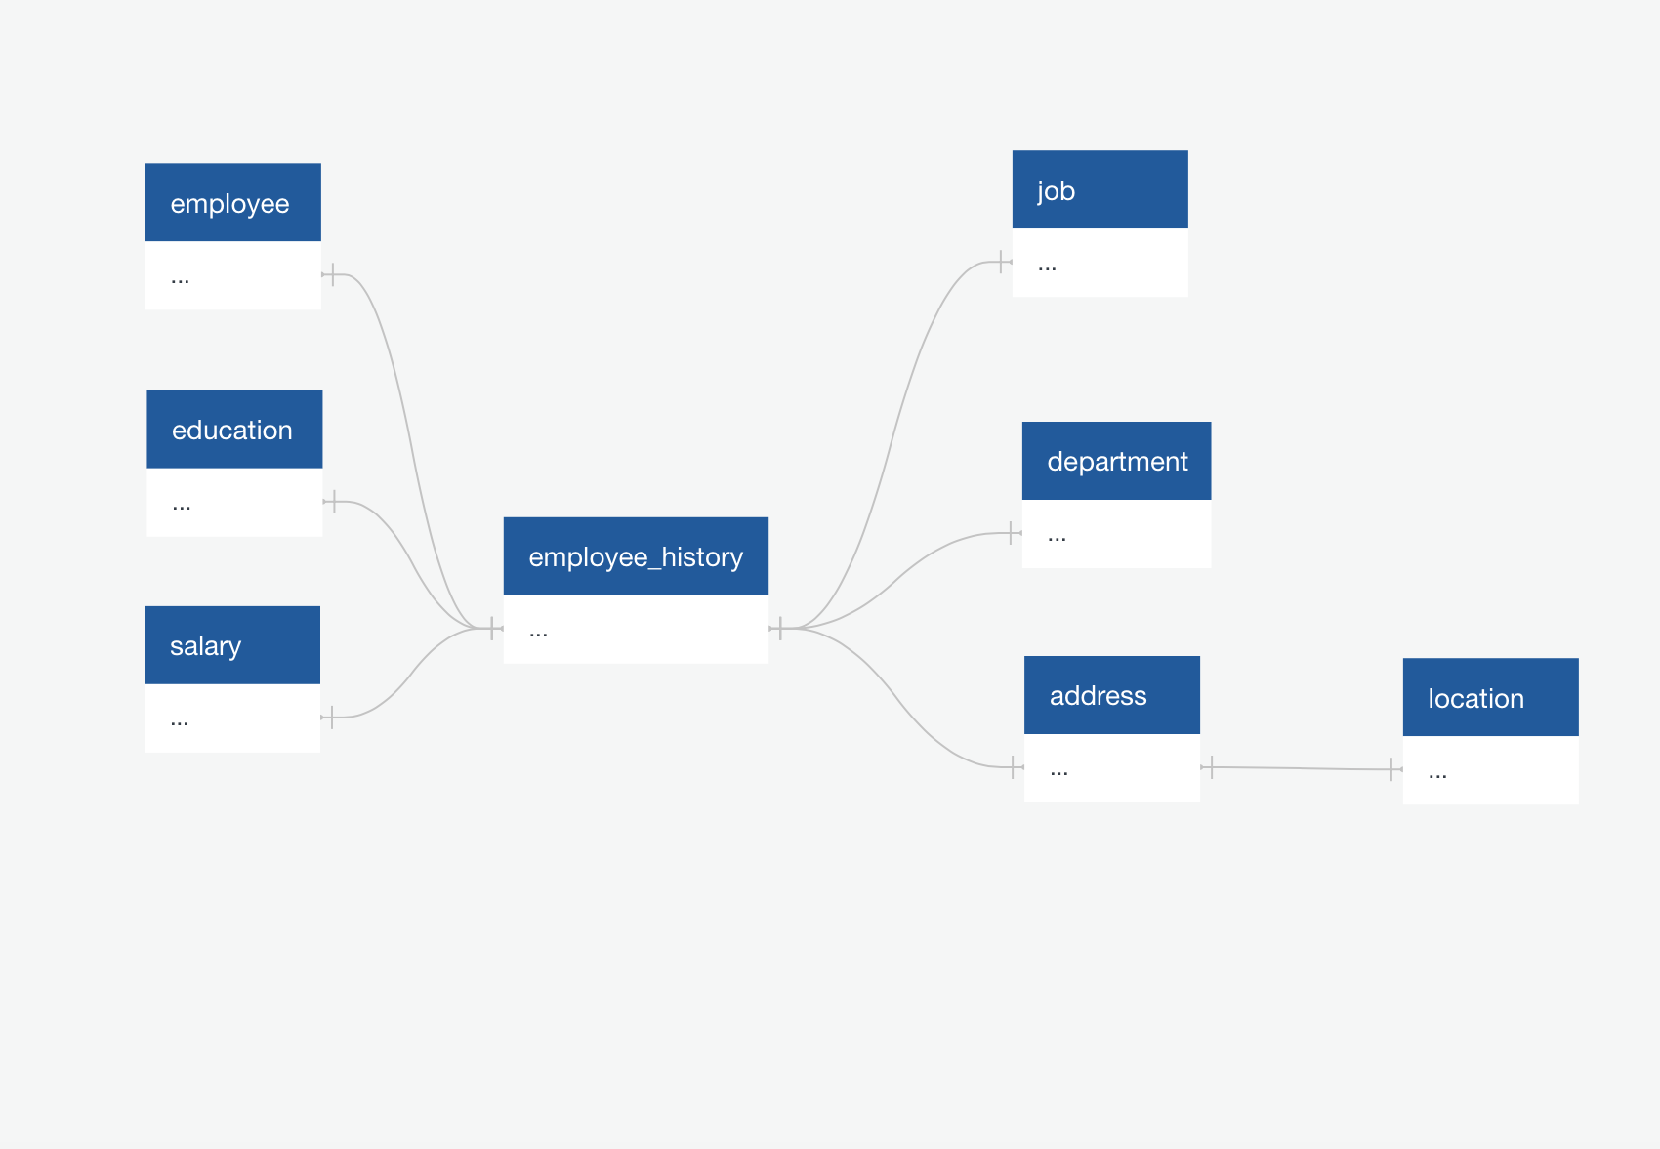
ERD
Conceptual

Slide 11
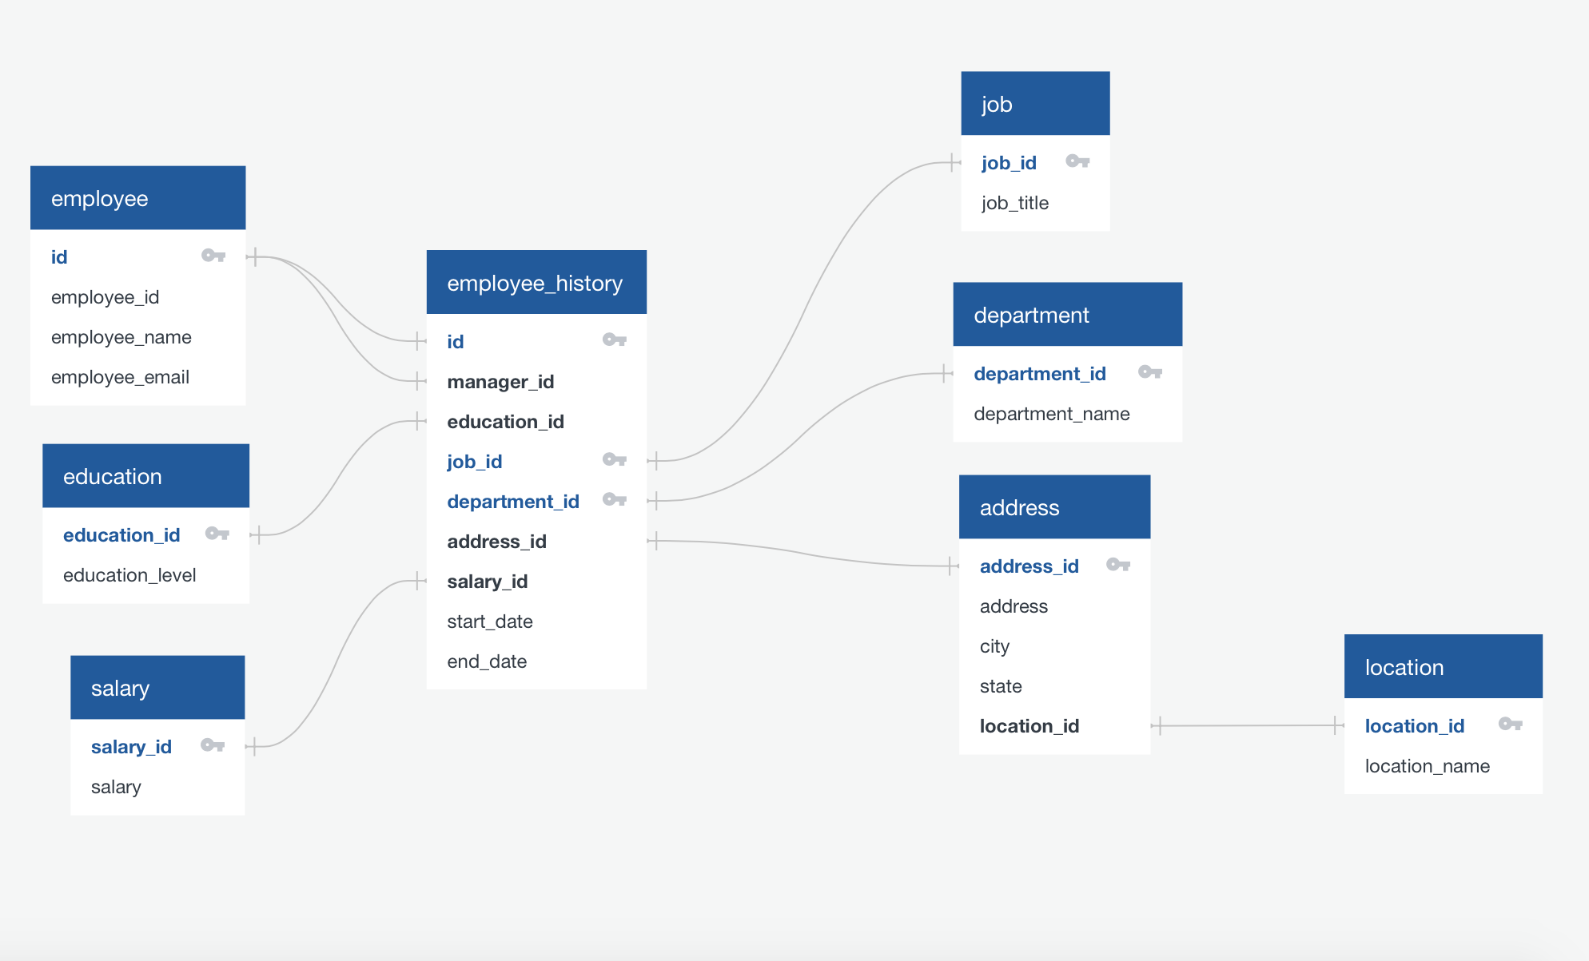
ERD
Logical

Slide 12
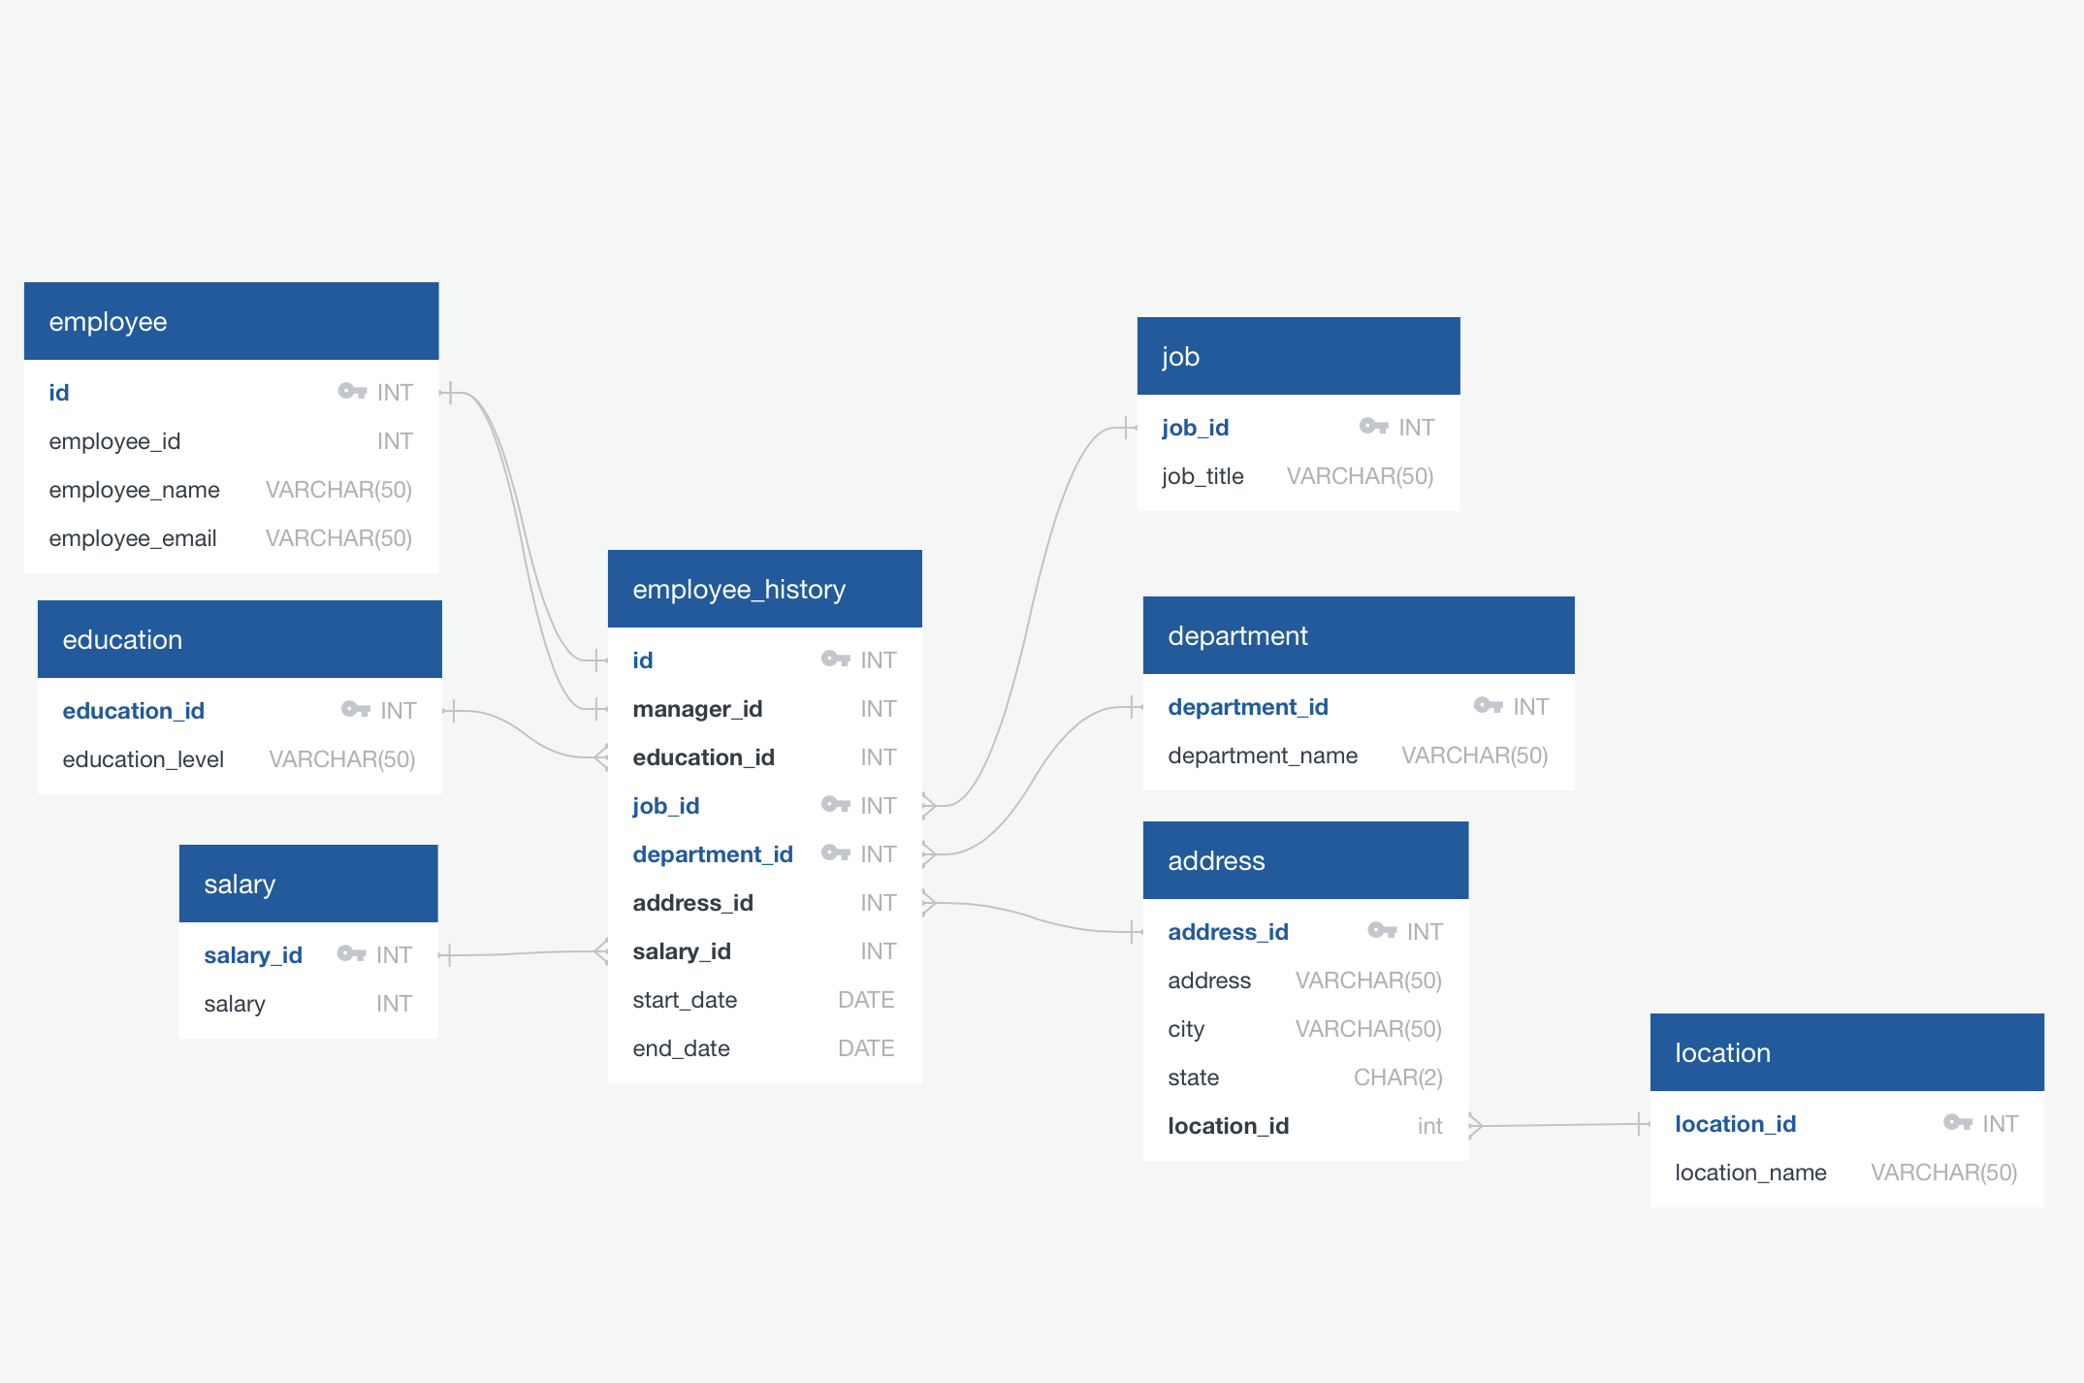
ERD
Physical

Slide 13
Step 3
Create A Physical Database

Slide 14
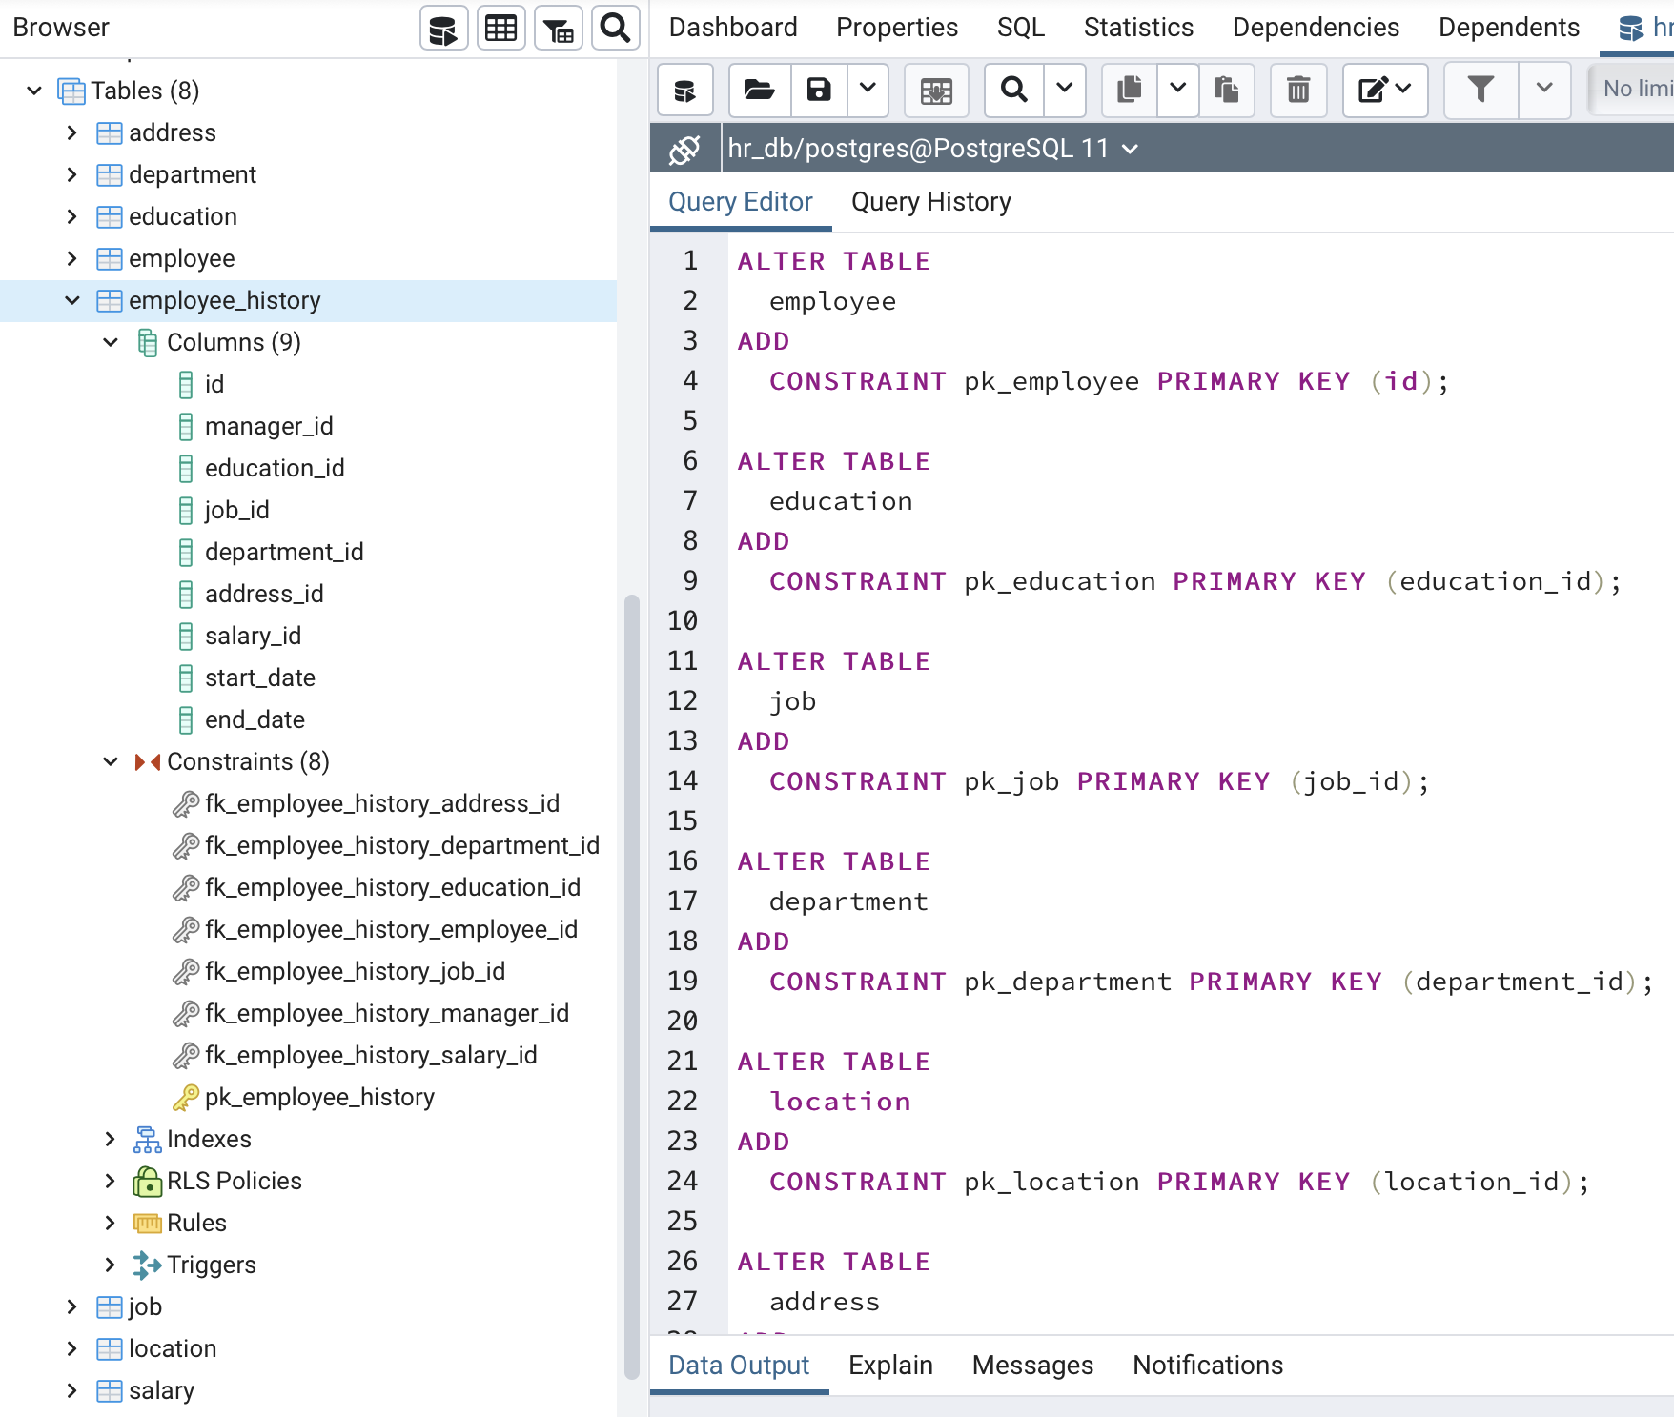
DDL
I used python for the ETL process and SQL script to add primary key and secondary key constraints.

Slide 15
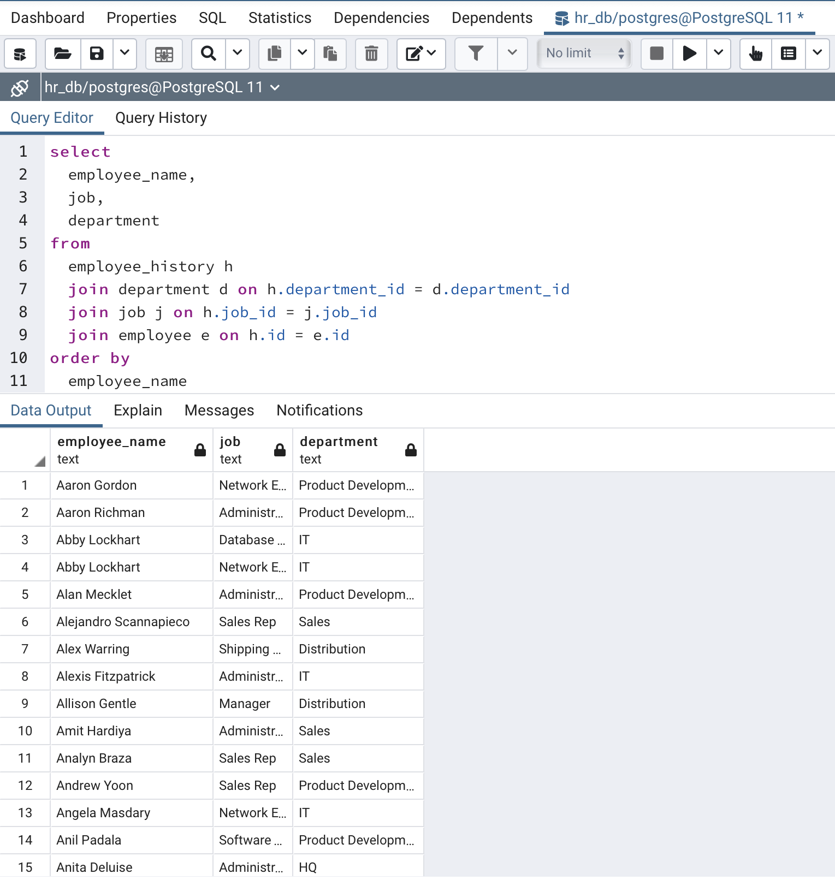
CRUD
Query 1: Return a list of employees with Job Titles and Department Names

Slide 16
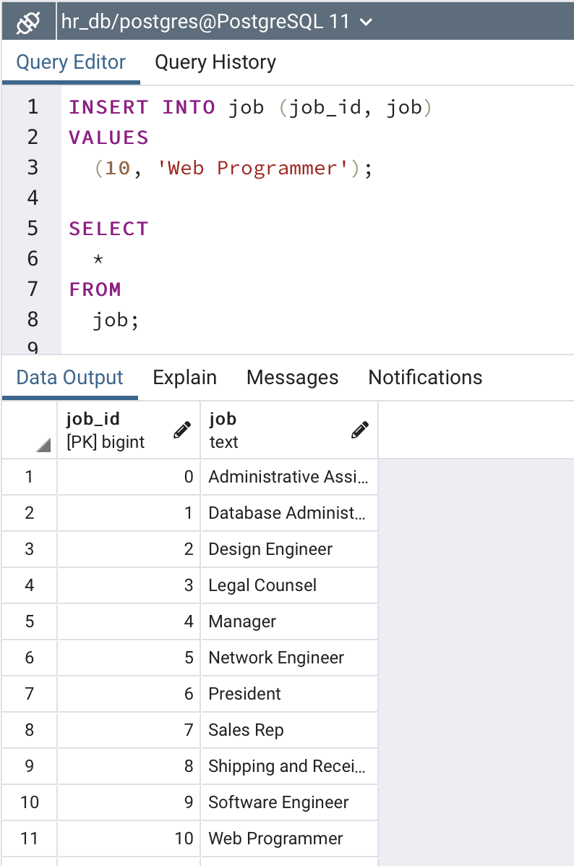
CRUD
Query 2: Insert Web Programmer as a new job title

Slide 17
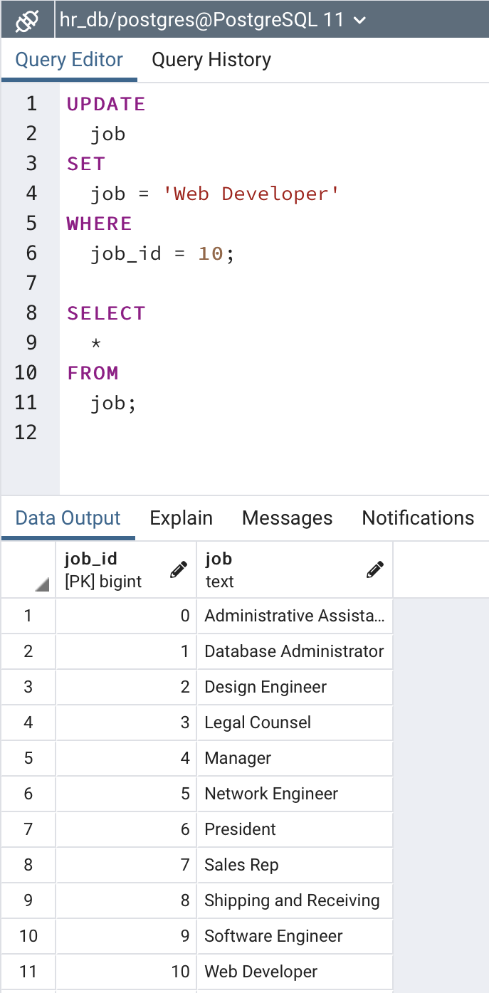
CRUD
Query 3: Correct the job title from web programmer to web developer

Slide 18
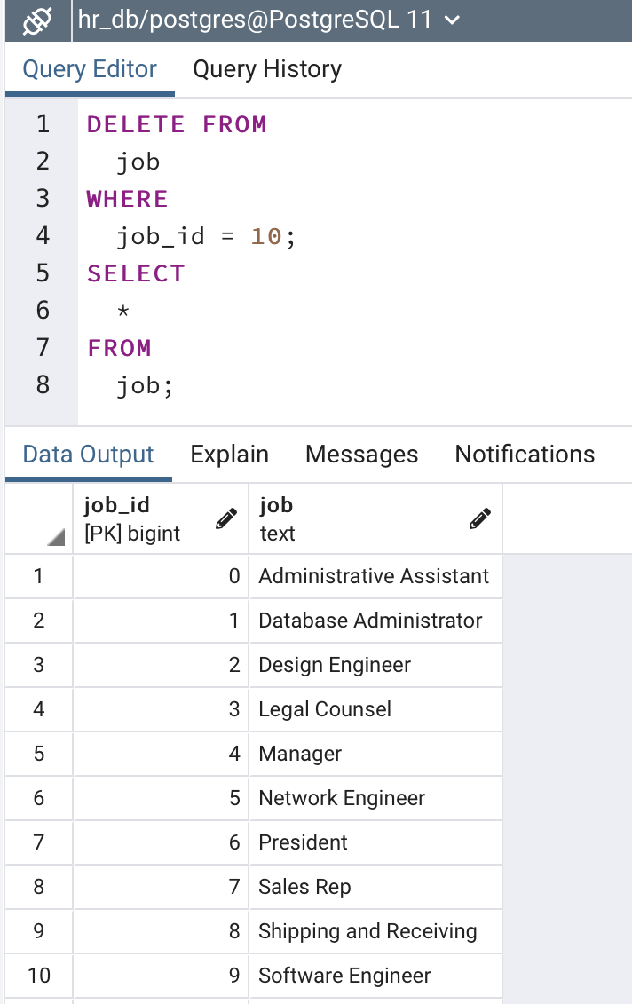
CRUD
Query 4: Delete the job title Web Developer from the database

Slide 19
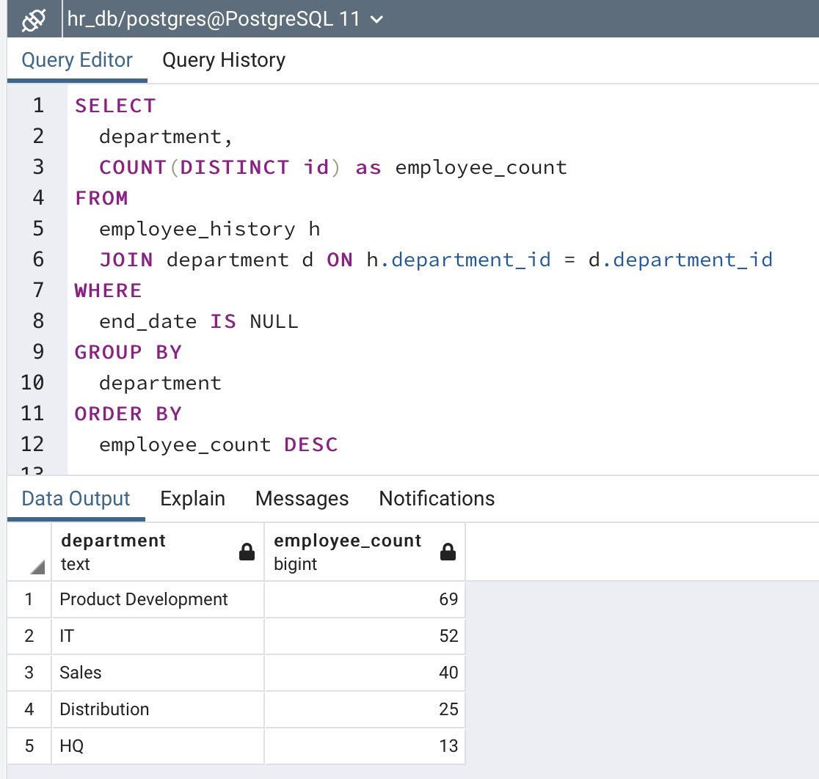
CRUD
Query 5: How many employees are in each department?

Slide 20
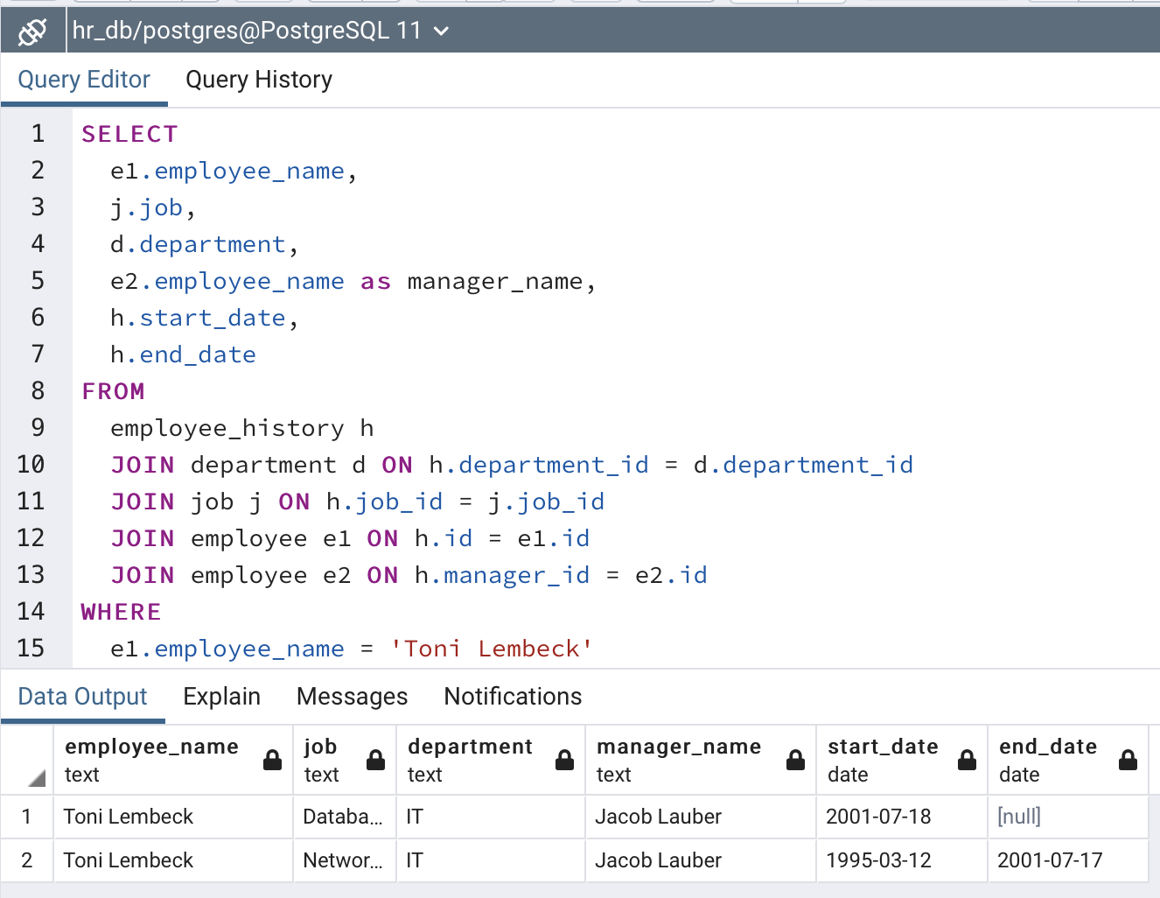
CRUD
Query 6: Returns current and past jobs (include employee name, job title, department, manager name, start and end date for position) for employee Toni Lembeck.

Slide 21
CRUD
Describe how to apply table security to restrict access to employee salaries using an SQL server.
Grant employees with a domain login read-only access to all tables in the HR Database and revoke access to the salary table for the employees who are not management or HR.

Slide 22
Step 4
Additional Features

Slide 23
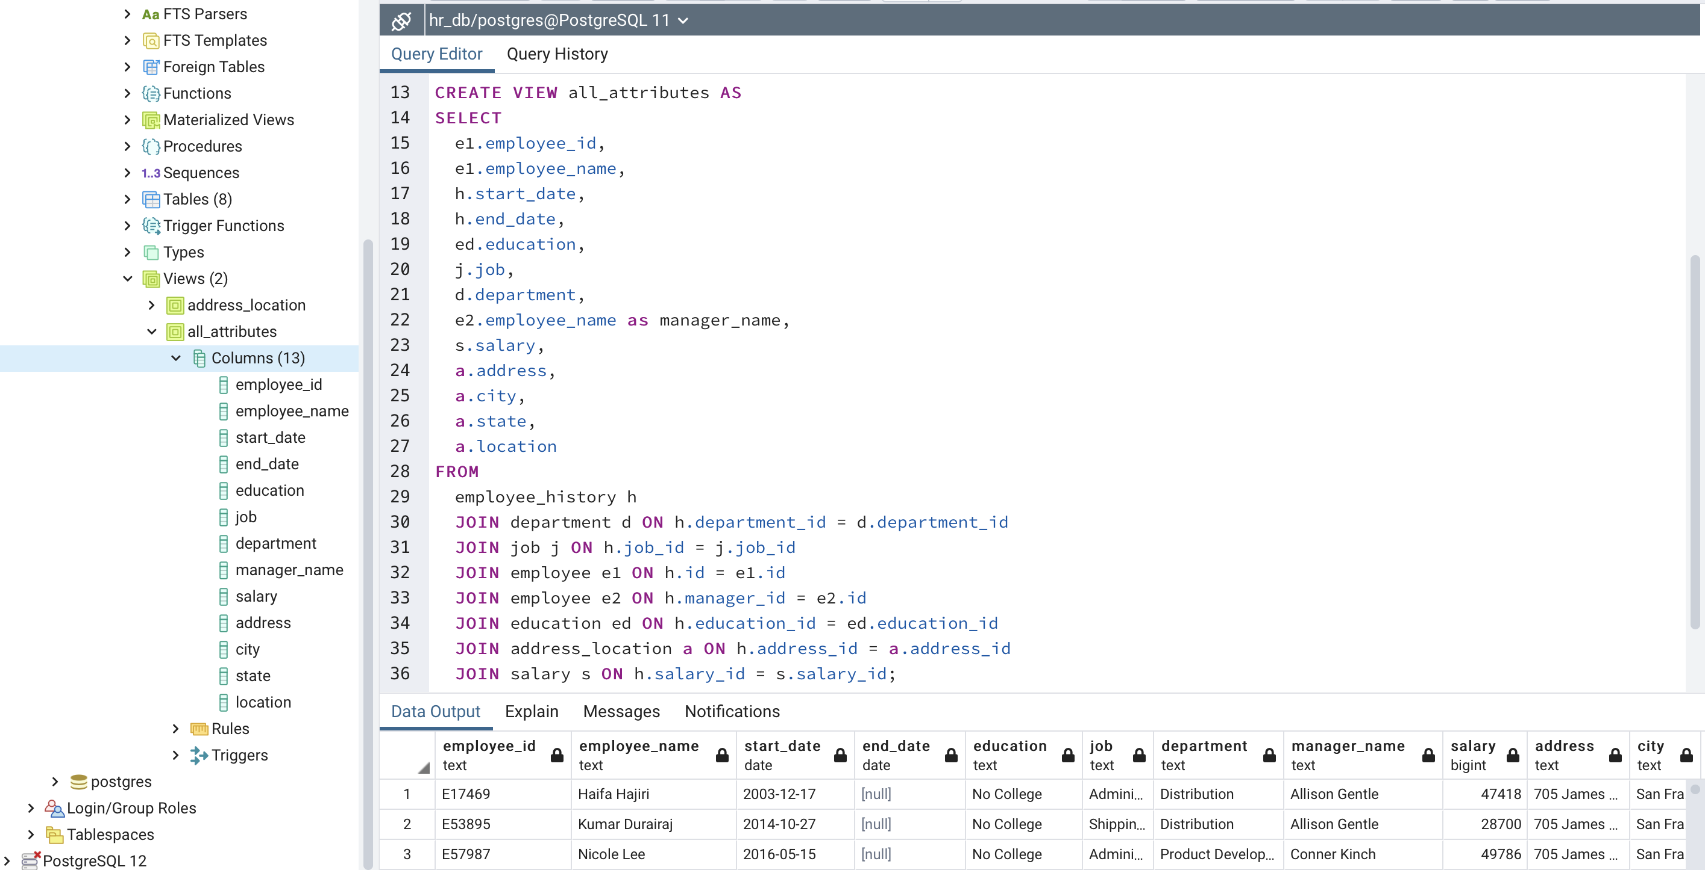
Additional Feature 1
Create a view that returns all employee attributes.

Slide 24
Appendix

