Slide 1
House Sale Price Prediction
Submitted by:
Deepro Sengupta

Slide 2
Background
Client is an United States based real estate firm
The firm looking to expand into the Australian real estate market.

Slide 3
The Problem statement
Identify which independent variables affect housing sale price the most.
By what degree do each independent variables affect housing price.
Build a model to predict housing sale price.

Slide 4
The data
Data source: Provided by Client
Contains 81 columns and 1,168 rows
Target Variable name: ‘SalePrice’

Slide 5
The data: summary statistics key takeaways
The mean is larger then the 50th percentile and there is a huge difference between the 75th percentile and max values for many columns. This indicates the presence of outliers.

Slide 6
Data pre-processing Steps
Step 1: Handling Missing values:
Categorical Columns: All missing values replaced with mode of the column.
Numeric Columns: All missing values replaced using random number imputation.
Step 2: Hypothesis Testing for Identifying Significant Independent Columns
Categorical columns: Chi-square test of significance.
Numeric columns: Pearson correlation test.
Step 3: Skewness Removal: The following methods were used to handle skewness.
Inverse Transformation: on column MSSubClass.
Log Transformation: on column LotArea.
Cube-root Transformatino: on columns OverallCond, GrLivArea, BsmtFullBath, KitchenAbvGr, TotRmsAbvGrd, & Fireplaces
Square-root Transformation: on columns BsmtFinSF1, BsmtUnfSF, 1stFlrSF, & 2ndFlrSF
Yea-Johnson Transformation: on columns TotalBsmtSF, HalfBath, EnclosedPorch, 3SsnPorch, ScreenPorch, PoolArea & YearBuilt.
Step 4: Outlier Removal using IQR-Method.

Slide 7
Data Modelling & Evaluation
Algorithms used:
Linear Regression
Random Forest Regression
Decision Tree Regression
Support Vector Regression
K-Neighbors Regression
Multi-Layer Perceptron Regression
Evaluation Metrics: R2-Score & RSME
Final Model Selection Criterion:
It has the highest R2-score.
The has the lowest RSME indicating that the errors are not widely spread.
Test-Train score difference is not high indicating there is no overfitting.
Final Model: Random Forest Regressor

Slide 8
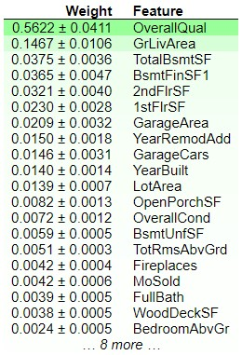
Conclusion
The table on left shows results after performing Permutation importance.
While only significant columns were considered for model building, permutation importance reveals OverallQual is the most important feature.
R2-score of the final model is 83.19%
RSME of the final model is 33500.74

