Slide 1
Customer Retention Analysis
Submitted by:
Deepro Sengupta

Slide 2
The Problem statement
Perform data analysis on the given dataset in order to identify aspects of an e-commerce firm that aids in customer retention and repeat purchases.

Slide 3
The data
Data source: Provided by Client
Contains: 71 columns and 269 rows

Slide 4
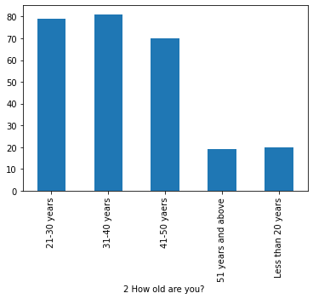
Data Analysis
Most online shoppers in the sample belong in the age group of 21-30 years, 31-40 years, 41-50 years.
This indicates the older people are less into online shopping.
Of the people in the group ‘51 and above’, while most have adapted to smartphones and have easy access to shopping websites, they still shop less online and can be targeted with improve repeat purchase and retention

Slide 5
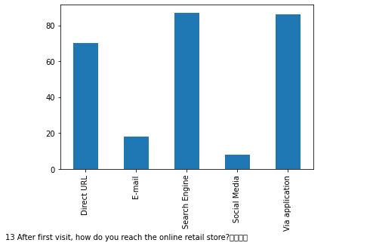
DATA ANALYSIS
Search Engine, Application and Direct URL is the most preferred way to reach the online ecommerce website.
While email and social media channels are least, they are some tools used by people daily and better email as well as social media campaign can be designed to monetize these channels as well

Slide 6
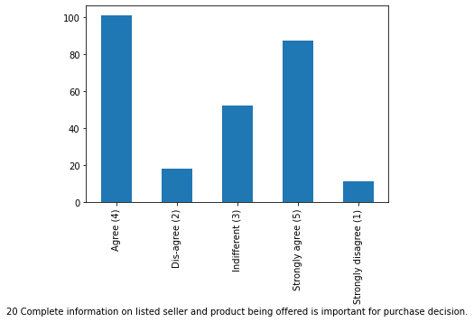
DATA ANALYSIS
Most respondent agree that complete seller as well as product information contribute to purchase decision and is an important factor.

Slide 7
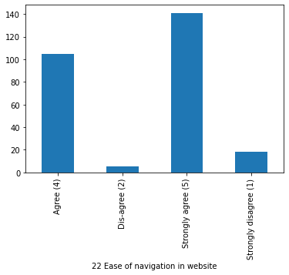
DATA ANALYSIS
Most respondent strongly agree that websites should be easily navigable

Slide 8
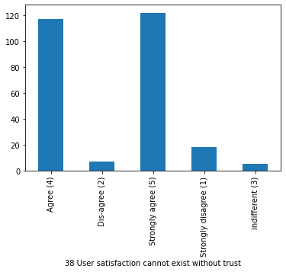
DATA ANALYSIS
Trust is an important factor in order to deliver user satisfaction

Slide 9
DATA ANALYSIS
The Chi-square test of independence revealed that most of the columns have significant relation with other columns
However, this test also revealed that age, gender and location does not have significant relation with most columns. This indicates that these factors do not matter much when it comes to customer retention.

