Slide 1
ProjectEx · Todo CLI
Build a Todo CLI with Claude Code
Manual companion — built, run, and committed for real
CLAUDE-CODE-MANUAL · ProjectEx — Todo CLI Walkthrough

Slide 2
Goal & Stack
What you'll build in this walkthrough
Goal
• A small Todo CLI: add / list / done / rm / edit
• Focus on the Claude Code workflow, not the code
• See Plan Mode, Subagents, and Hooks in action
Stack
• Node.js — built-ins only, zero dependencies
• Test runner: node:test (ships with Node)
• Storage: flat JSON file (gitignored)
Time
• About 45–60 minutes for a beginner
CLAUDE-CODE-MANUAL · ProjectEx — Todo CLI Walkthrough
2 / 12

Slide 3
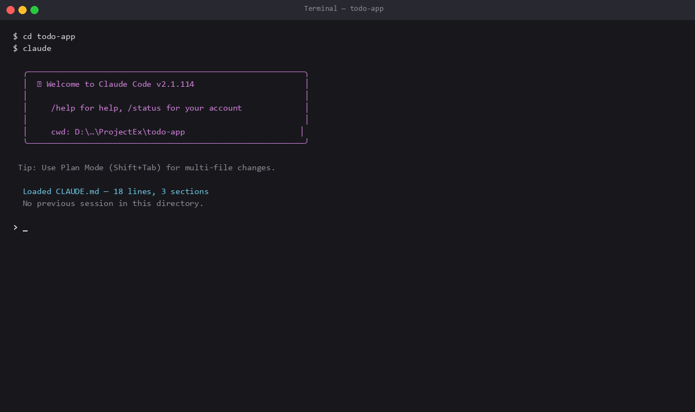
Step 1: Start a Claude session
• `cd` into your project directory first
• Run `claude` to start the session
• Claude auto-loads `CLAUDE.md`
• Verify cwd in the welcome banner
• Tip: Shift+Tab → Plan Mode for multi-file changes
CLAUDE-CODE-MANUAL · ProjectEx — Todo CLI Walkthrough
3 / 12

Slide 4
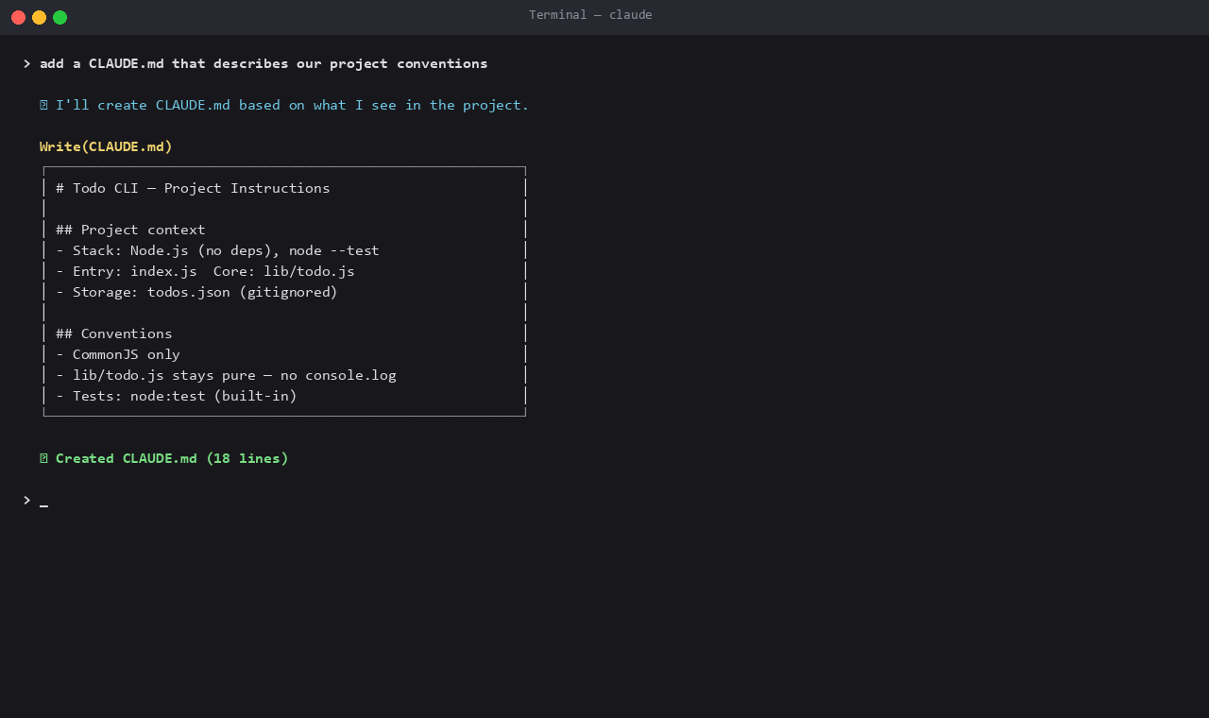
Step 2: Author CLAUDE.md
• Ask Claude to scan the repo and draft CLAUDE.md
• Capture stack, conventions, and don'ts
• This file loads automatically every session
• Reduces miscommunication on style and constraints
• See chapter 7 — CLAUDE.md
CLAUDE-CODE-MANUAL · ProjectEx — Todo CLI Walkthrough
4 / 12

Slide 5
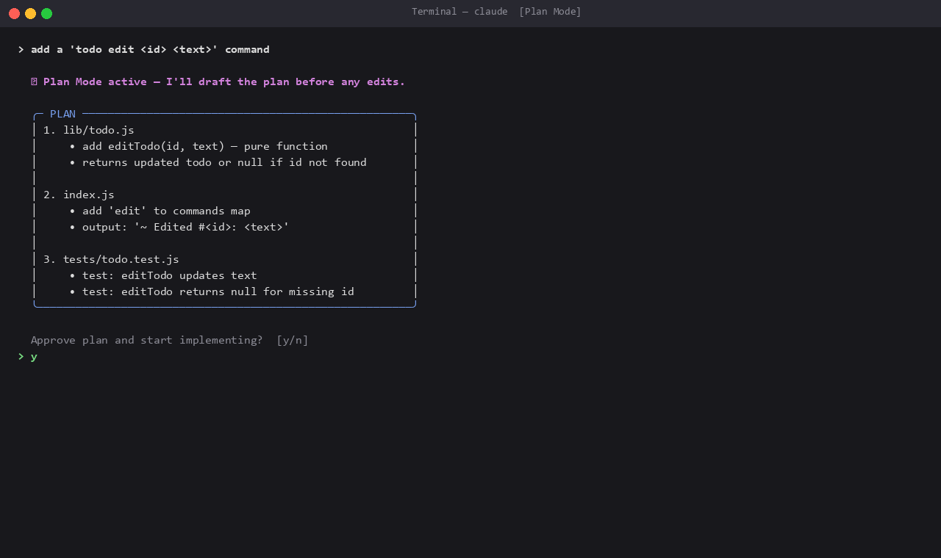
Step 3: Plan Mode — plan before edits
• For multi-file changes, switch to Plan Mode
• Claude drafts a plan and waits for approval
• Review scope before any file is touched
• Approve with `y` to start implementing
• See chapter 14 — Context Management
CLAUDE-CODE-MANUAL · ProjectEx — Todo CLI Walkthrough
5 / 12

Slide 6
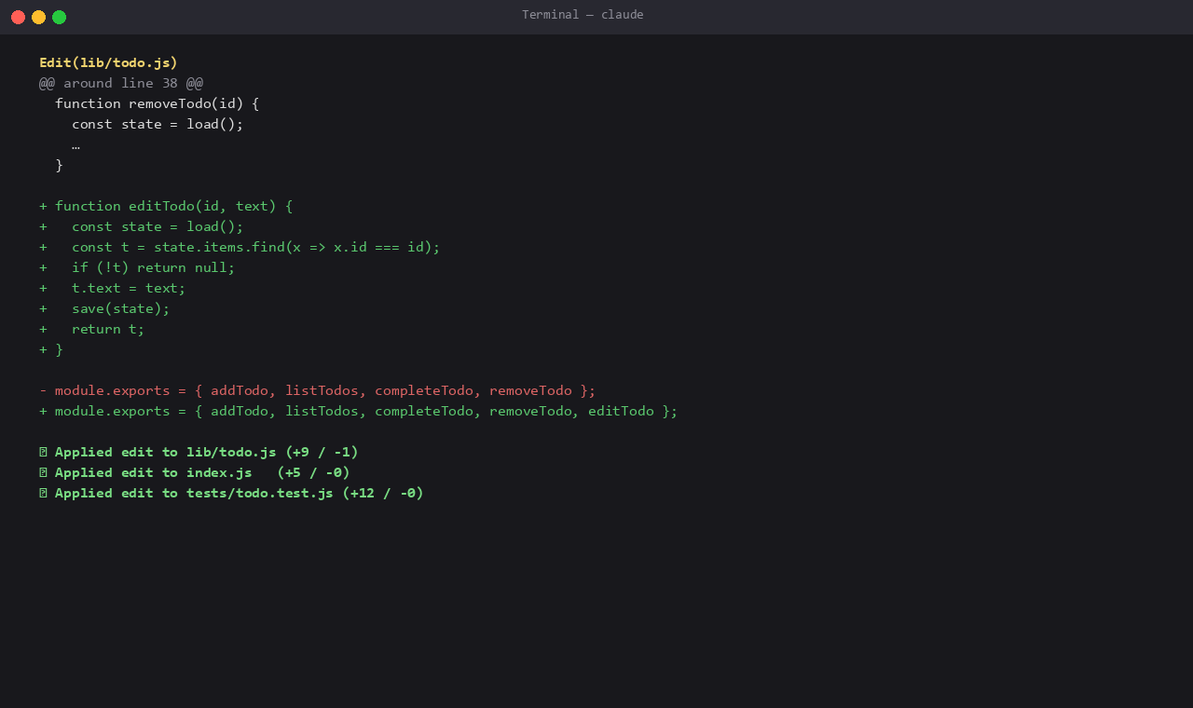
Step 4: Implement & inspect the diff
• Claude edits one file at a time, per the plan
• Diff shown with + (green) / – (red) before write
• PostToolUse hook runs `npm test` after each edit
• If tests fail — fix before continuing
• See chapter 10 — Hooks
CLAUDE-CODE-MANUAL · ProjectEx — Todo CLI Walkthrough
6 / 12

Slide 7
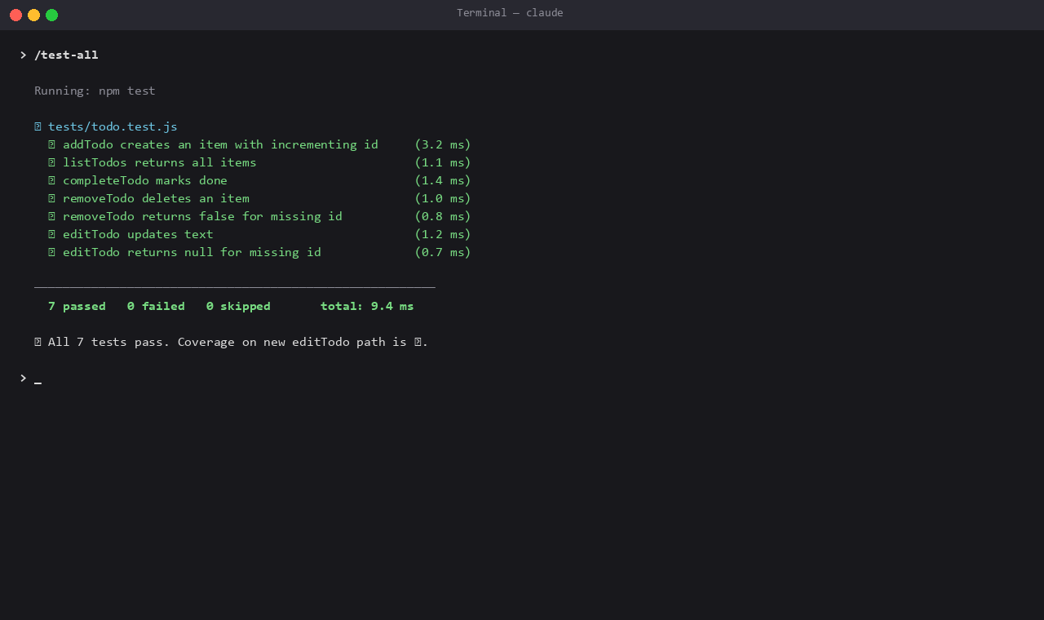
Step 5: Run all tests
• Invoke our custom slash command `/test-all`
• `allowed-tools` restricts it to `npm test` only
• Claude reports PASS/FAIL in one line
• On failure: it suggests a fix without applying it
• See chapter 11 — Skills / Slash Commands
CLAUDE-CODE-MANUAL · ProjectEx — Todo CLI Walkthrough
7 / 12

Slide 8
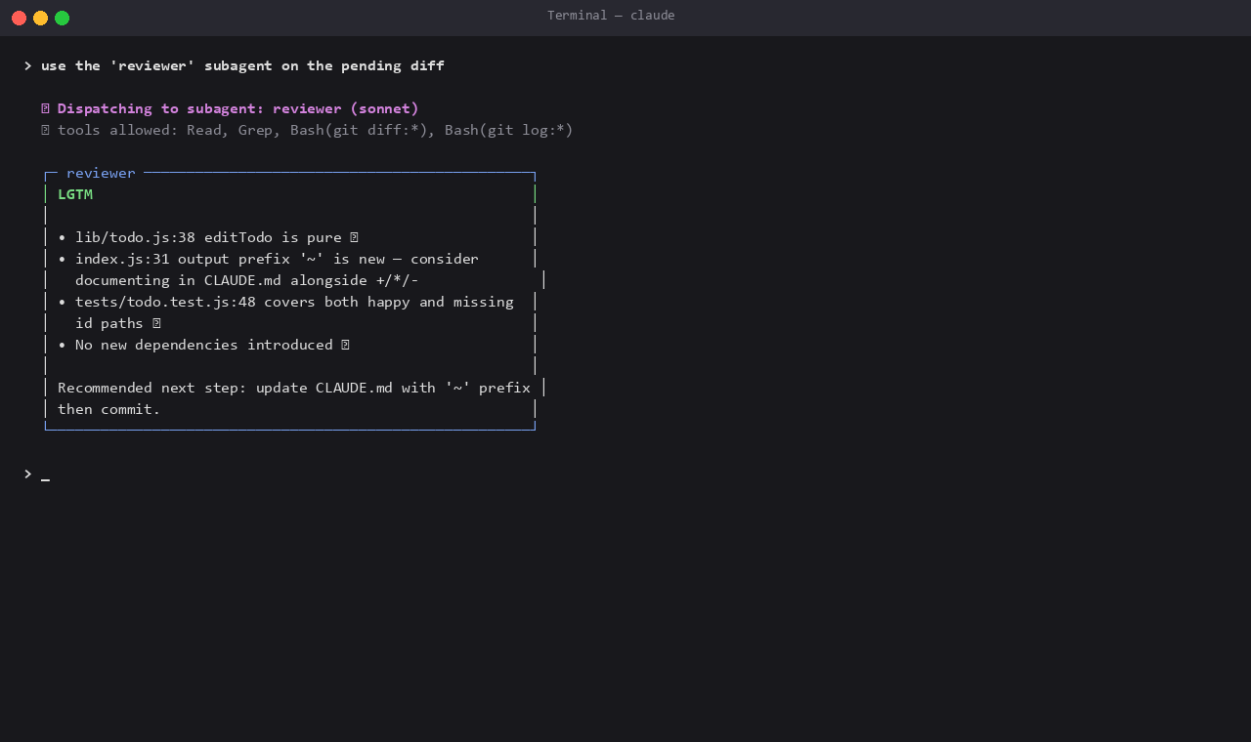
Step 6: Subagent code review
• Dispatch the configured `reviewer` subagent
• Runs in an isolated context — main session stays clean
• Tools: Read, Grep, git diff/log only
• Returns LGTM / NEEDS WORK with a punch list
• See chapter 12 — Subagents
CLAUDE-CODE-MANUAL · ProjectEx — Todo CLI Walkthrough
8 / 12

Slide 9
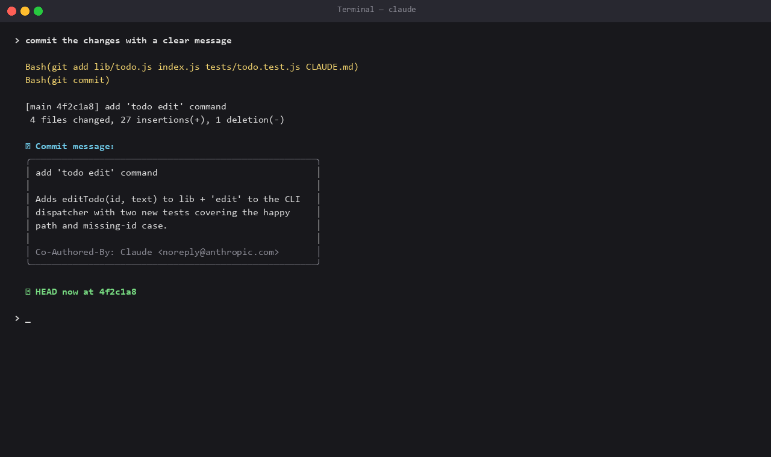
Step 7: Commit through Claude
• Claude drafts the commit message from the diff
• Focus on "why" over "what"
• Adds Co-Authored-By: Claude…
• `Bash(git commit:*)` is pre-allowed in settings
• See chapter 15 — Git Integration
CLAUDE-CODE-MANUAL · ProjectEx — Todo CLI Walkthrough
9 / 12

Slide 10
Hooks & Skills used here
Hook: PostToolUse (Edit|Write)
• Auto-runs `npm test` after every edit
• Configured in `.claude/settings.json`
Slash command: /test-all
• File: `.claude/commands/test-all.md`
• `allowed-tools` restricts it to `npm test`
Subagent: reviewer
• File: `.claude/agents/reviewer.md`
• model: sonnet · tools: Read/Grep/git diff/git log
Permissions
• allow: npm test, node *, git status/diff/log/add/commit
• deny: rm -rf, git push --force, writes to todos.json
CLAUDE-CODE-MANUAL · ProjectEx — Todo CLI Walkthrough
10 / 12

Slide 11
Lessons learned
What worked well
• Plan Mode reduced rework on multi-file changes
• Subagent isolation kept the main context clean
• Hooks made tests part of the workflow, not an afterthought
Watch out for
• Don't allow `Bash(*)` — keep the allowlist narrow
• Slow hooks slow every single edit
• Long CLAUDE.md eats context — keep it lean
Next steps
• Add `todo prio <id> <high|low>` via Plan Mode
• Schedule a daily todo-review task
CLAUDE-CODE-MANUAL · ProjectEx — Todo CLI Walkthrough
11 / 12

Slide 12
Further reading — manual links
Directly relevant chapters
• Ch 7 — CLAUDE.md (persistent project instructions)
• Ch 10 — Hooks (event handlers)
• Ch 11 — Skills / Slash Commands
• Ch 12 — Subagents
• Ch 14 — Context Management (Plan Mode)
• Ch 15 — Git Integration
Going deeper
• Ch 28 — Tutorial Day 2: Build a Todo App in 1 hour
• Ch 30 — Cookbook (40+ recipes)
• Ch 32 — Security & Privacy Best Practices
This example's source
• ProjectEx/todo-app — runnable code + tests
• ProjectEx/claude-config — CLAUDE.md, hooks, agents
CLAUDE-CODE-MANUAL · ProjectEx — Todo CLI Walkthrough
12 / 12

