Slide 1
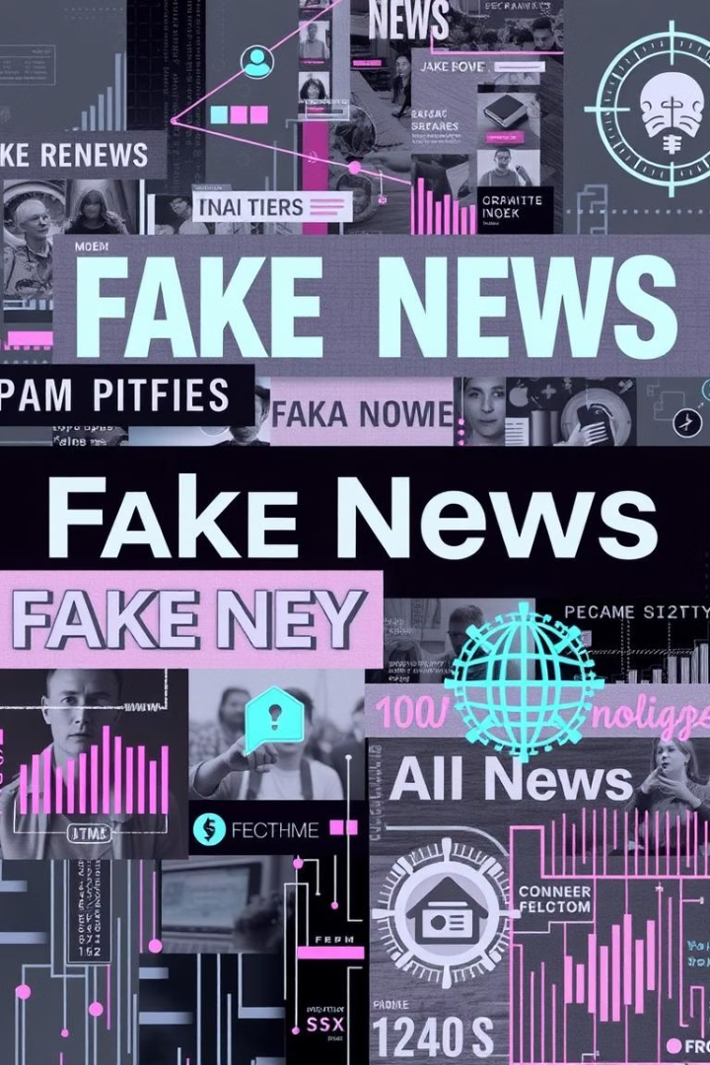
Combating Misinformation: A Fake News Detection Web App
The spread of fake news threatens society’s trust. Our web app leverages AI to analyze and verify news articles. Combining advanced APIs and visual insights, users receive clear identification of fake news and reliable explanations.

Slide 2
System Architecture: Overview
Data Acquisition
Analysis
Presentation
Collect news from Reddit, Wikipedia RAG, and multiple news APIs for diverse sources.
Gemini 1.5 Pro classifies news authenticity; sentiment analysis adds context.
Interactive visualizations with detailed explanations aid user understanding.

Slide 3
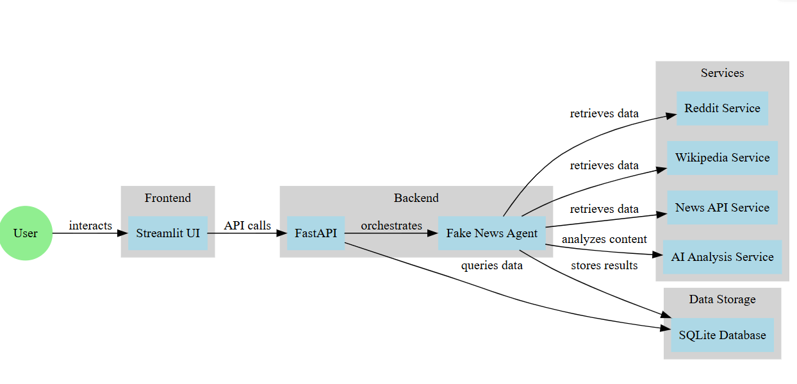

Slide 4
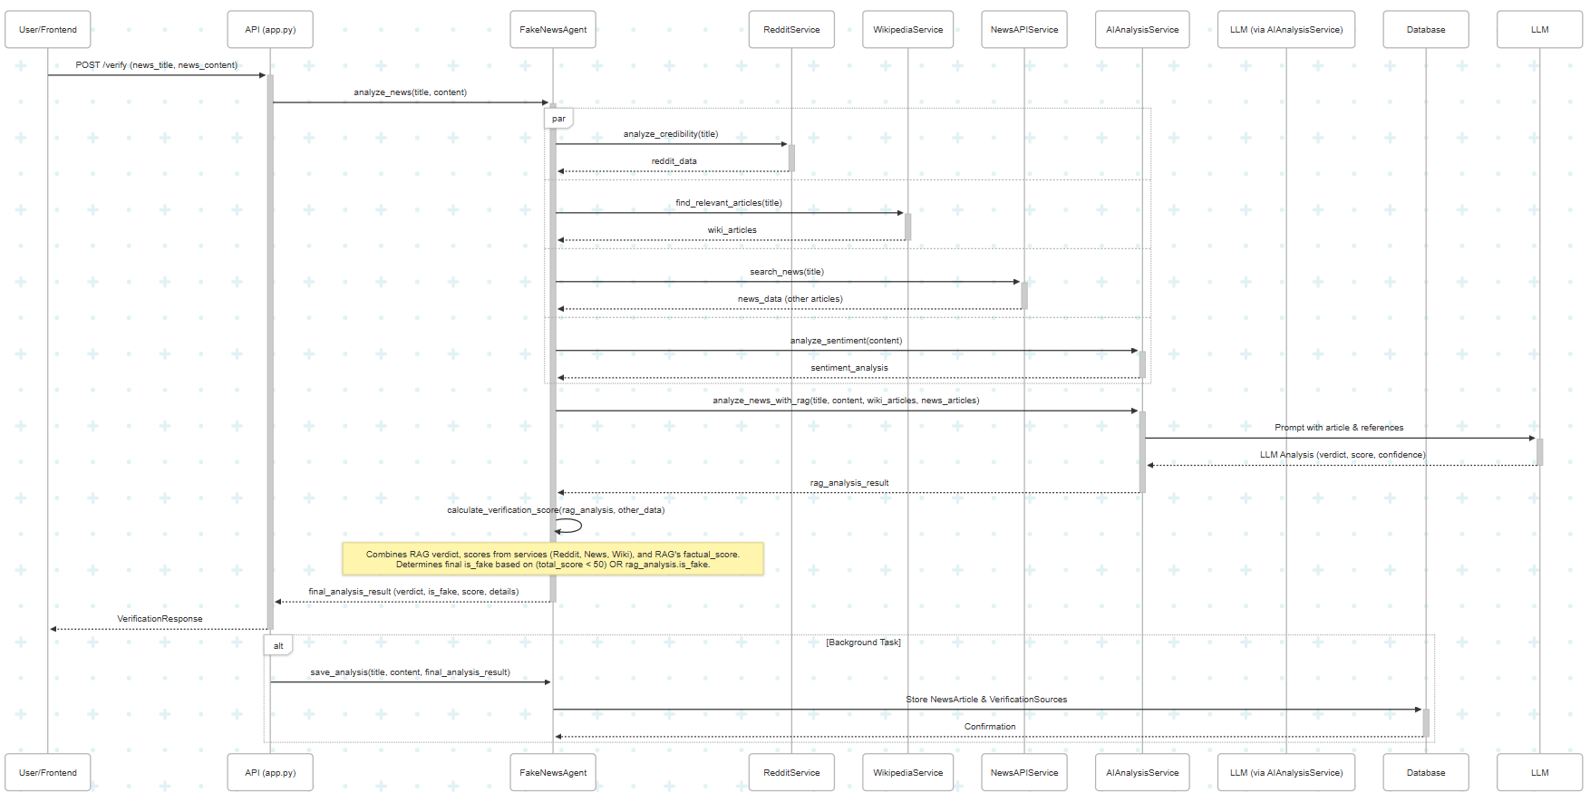

Slide 5
Microservice Implementation
The project appears to adopt a "microservices style" as encouraged by the hackathon guidelines, primarily through logical separation of concerns within a single deployable application, rather than fully independent, network-separated microservices. Here's how it's structured:
Service Layer (app/services/):
You have distinct Python modules for different functionalities:
ai_service.py: Handles AI-powered analyses like sentiment, factuality classification, and the core RAG-based news analysis with LLMs.
news_service.py: Likely fetches news articles from external APIs (like NewsAPI).
reddit_service.py: Interacts with Reddit for data/analysis.
wikipedia_service.py: Fetches information from Wikipedia.
Each of these acts as a specialized component, focusing on a single area of responsibility, which is a key characteristic of microservices.
Agent as Orchestrator (fake_news_agent.py):
The FakeNewsAgent acts as an orchestrator or a higher-level service. It doesn't perform the raw data fetching or AI analysis itself but rather coordinates calls to the various services in the app/services/ directory
For example, when analyze_news is called, it gathers data from Reddit, Wikipedia, NewsAPI, and performs AI analysis by calling the respective services.
API Layer (app.py):
This FastAPI application exposes the functionality of the FakeNewsAgent (and potentially other services) as HTTP endpoints (e.g., /verify).
This is the "well-defined interface" mentioned in the microservices definition. The frontend or other external clients would interact with the system through these API endpoints.
Frontend (app/frontend/streamlit_app.py):
The Streamlit application acts as the user interface and communicates with the backend by making requests to the FastAPI endpoints.

Slide 6
What worked for us !
Rapid Prototyping with GenAI:
Boilerplate Code Generation: Using GenAI tools (as outlined in docs/genai_prompts.md) to generate initial Python class structures for services (like ai_service.py), FastAPI endpoints, or Streamlit UI elements likely accelerated the early stages of development.
Modular Design ("Microservices Style"):
The separation of concerns into distinct services (ai_service.py, news_service.py, reddit_service.py, wikipedia_service.py) and an orchestrating agent (fake_news_agent.py) created a more manageable and understandable codebase. This modularity is a good step towards a microservices architecture.
Choice of Core Technologies:
FastAPI for Backend API: FastAPI is well-suited for building efficient and developer-friendly APIs, which seems to be the case for app.py.
Implementation of Advanced AI Techniques (Conceptually):
The use of Retrieval Augmented Generation (RAG) in ai_service.py (analyze_news_with_rag) is a sophisticated approach. Conceptually, this is a strong point, aiming to provide more contextually grounded and accurate analyses from LLMs.
Integration of Local AI Models:
Employing Hugging Face Transformers for local sentiment analysis (distilbert-base-uncased-finetuned-sst-2-english) and factuality classification (MoritzLaurer/DeBERTa-v3-base-mnli-fever-anli) can reduce reliance on external paid APIs for these specific sub-tasks, offering more control and potentially lower operational costs.

Slide 7
vs What didn’t !
PyTorch and CUDA Acceleration: Setting up PyTorch with CUDA for GPU acceleration was challenging due to complex dependency issues and version incompatibilities.
LLM Hallucination During Code Generation: Language models sometimes "hallucinated" or generated code that used non-existent functions, incorrect parameters, or was otherwise flawed, requiring careful review and correction.
Parsing Structured Data from LLM Responses: Reliably extracting specific pieces of information (like scores or verdicts) from the free-form text generated by LLMs proved difficult, often requiring fallback mechanisms when parsing failed.
Complex Model Initialization and Fallbacks: Managing the initialization of AI models (Gemini, and local Hugging Face Transformers) and implementing robust fallback logic (e.g., if an API key is missing or a service fails) added complexity to the system.

Slide 8
Data Pipeline: Acquiring and Preparing News Data
Reddit API
Extracts trending discussions and news from social communities.
Wikipedia RAG
Provides contextual facts supporting fact-checking consistency.
News APIs
NewsData.io, GNews, and NewsAPI cover wide ranges of global news.
Processing
Data cleaning and structuring ensure high-quality inputs for models.

Slide 9
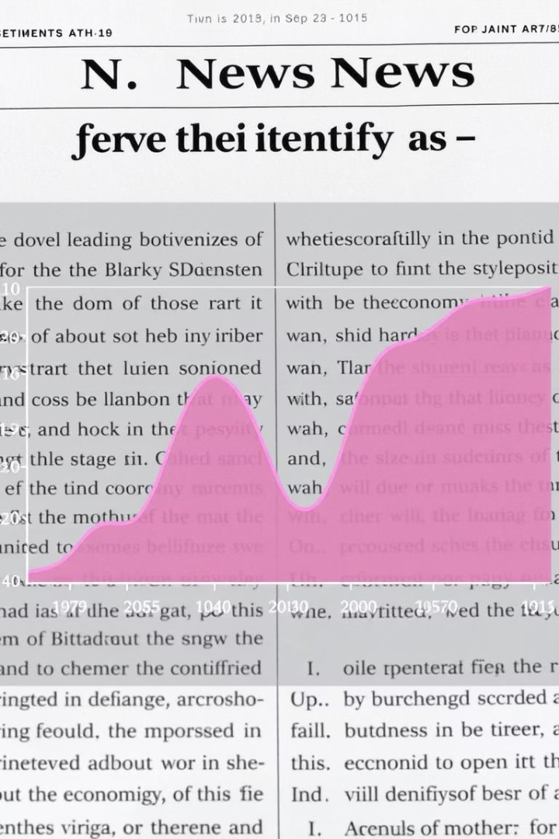
Sentiment Analysis: Uncovering Emotional Context
NLP Techniques
Integration
Extract tone and emotion from news text using SpaCy and NLTK
Sentiment scores inform the likelihood of misinformation presence.

Slide 10
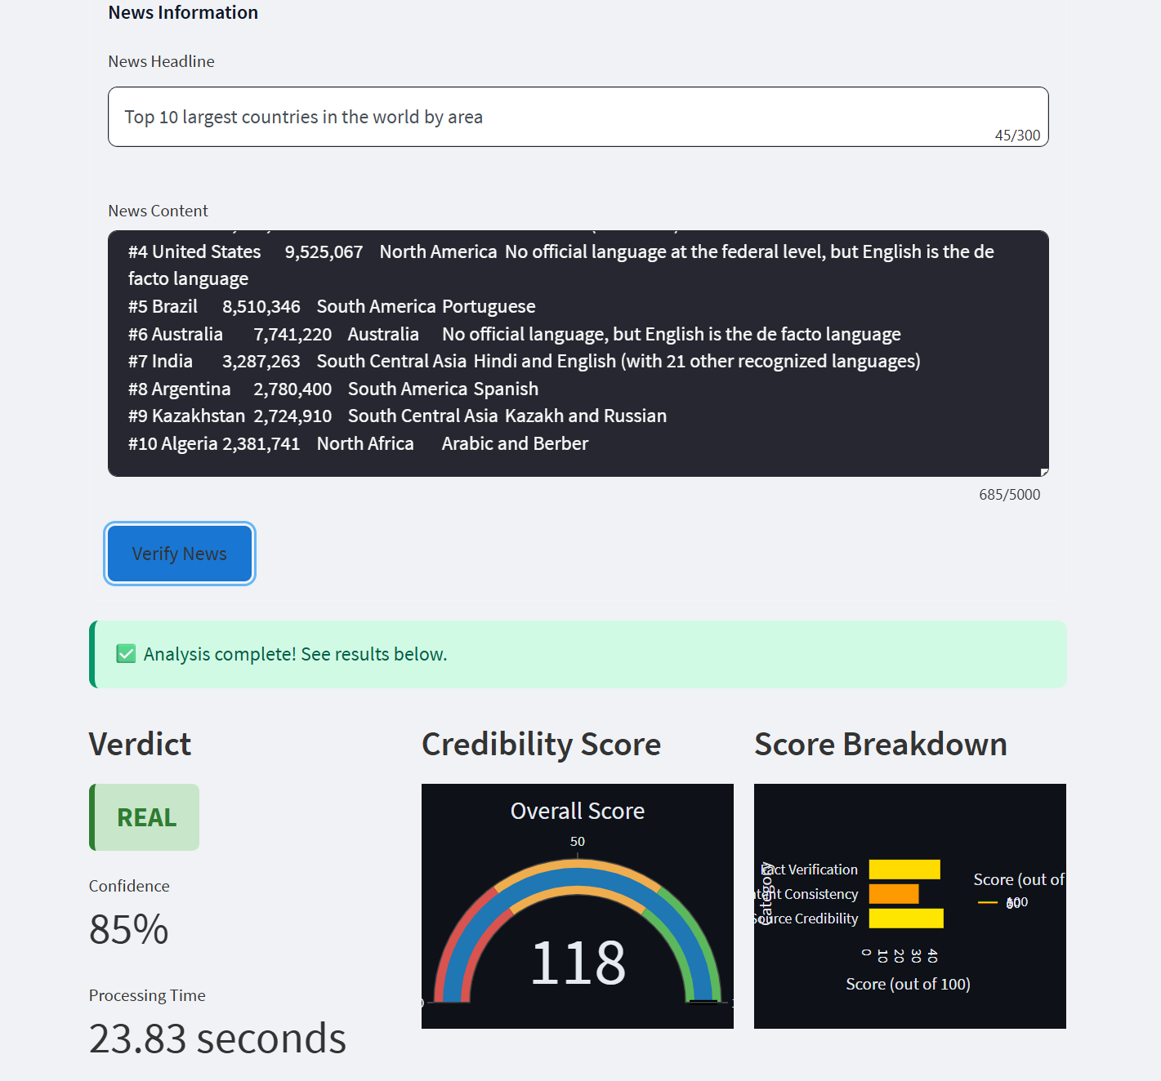
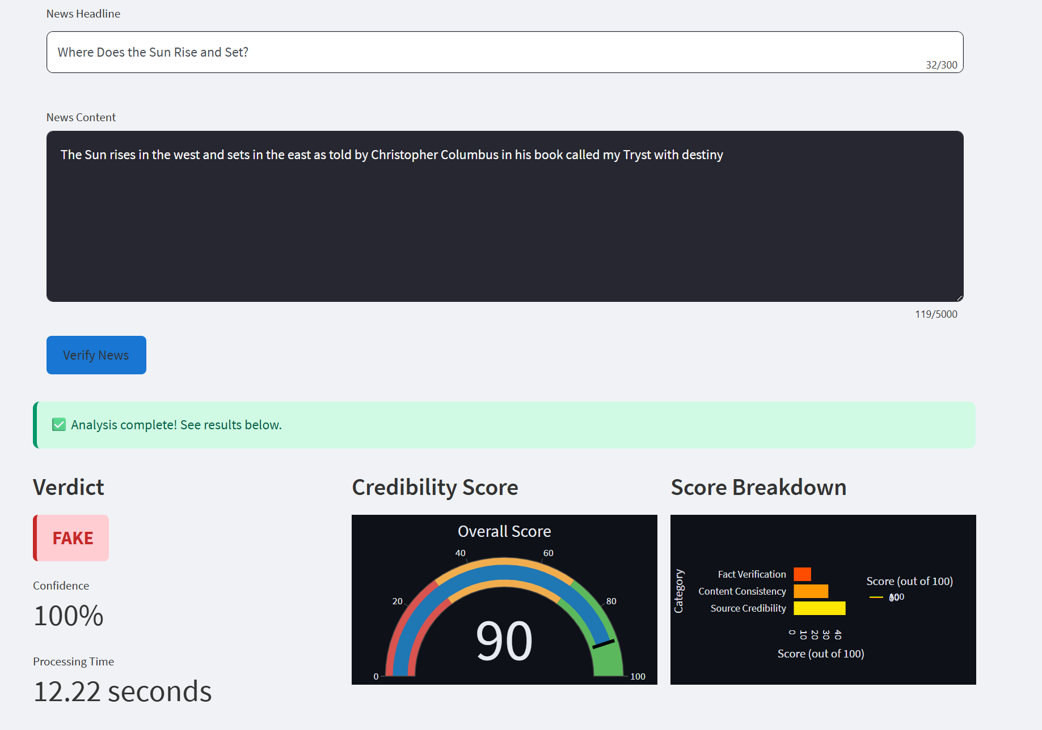

Slide 11
Tech Stack: Powering the Application
Backend
Frontend
Model
Deployment
FastAPI enables fast, scalable API endpoints for data handling.
Streamlit delivers an interactive, responsive user interface.
Gemini 1.5 Pro via API powers intelligent news verification.
Hosted on Render for seamless accessibility anytime, anywhere.

Slide 12




Visualization: Interactive Insights for Users
Sentiment Distribution
Source Credibility
Fake News Probability
Graphical view of emotional tone across news samples.
Ratings reflect trustworthiness of news origins.
Calculated likelihood displayed with clear indicators.

Slide 13
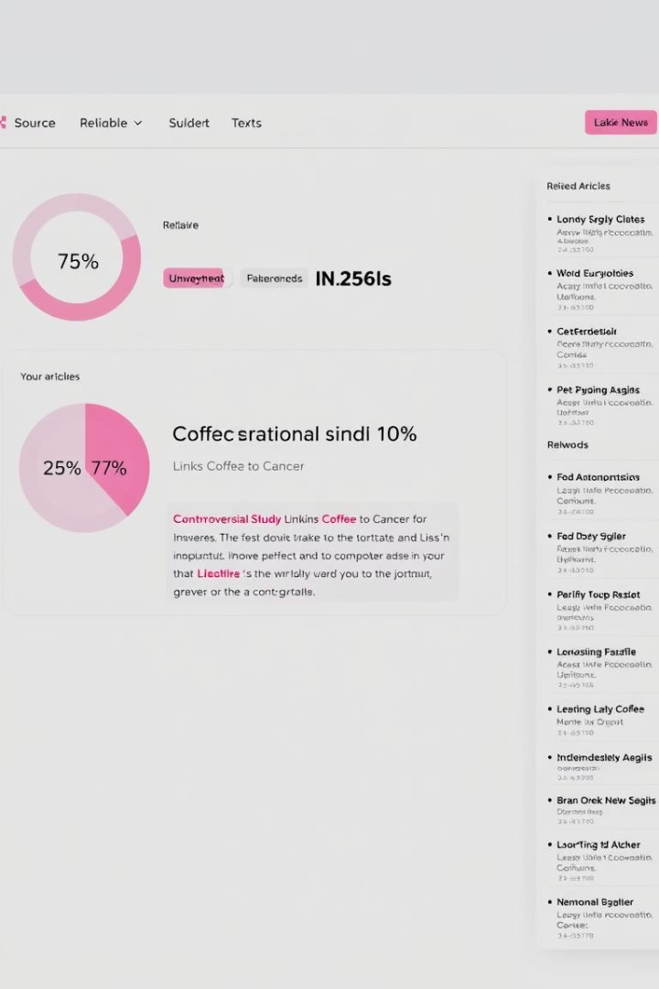



Deployment and Demo: Fighting Fake News, One Article at a Time
Access
App deployed on Render for global availability.
Demo
Live demonstration showcases real-time fake news detection.
Future Work
Expanding data sources, enhancing accuracy, and richer visuals planned.
Our app empowers users to discern truth with reliable AI and clear visuals.

