Slide 1

Combating Misinformation: A Fake News Detection Web App
The spread of fake news threatens society’s trust. Our web app leverages AI to analyze and verify news articles. Combining advanced APIs and visual insights, users receive clear identification of fake news and reliable explanations.

Slide 2
Data Pipeline: Acquiring and Preparing News Data
Reddit API
Extracts trending discussions and news from social communities.
Wikipedia RAG
Provides contextual facts supporting fact-checking consistency.
News APIs
NewsData.io, GNews, and NewsAPI cover wide ranges of global news.
Processing
Data cleaning and structuring ensure high-quality inputs for models.

Slide 3
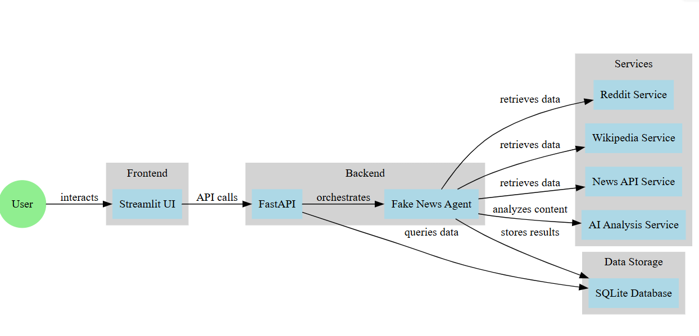

Slide 4
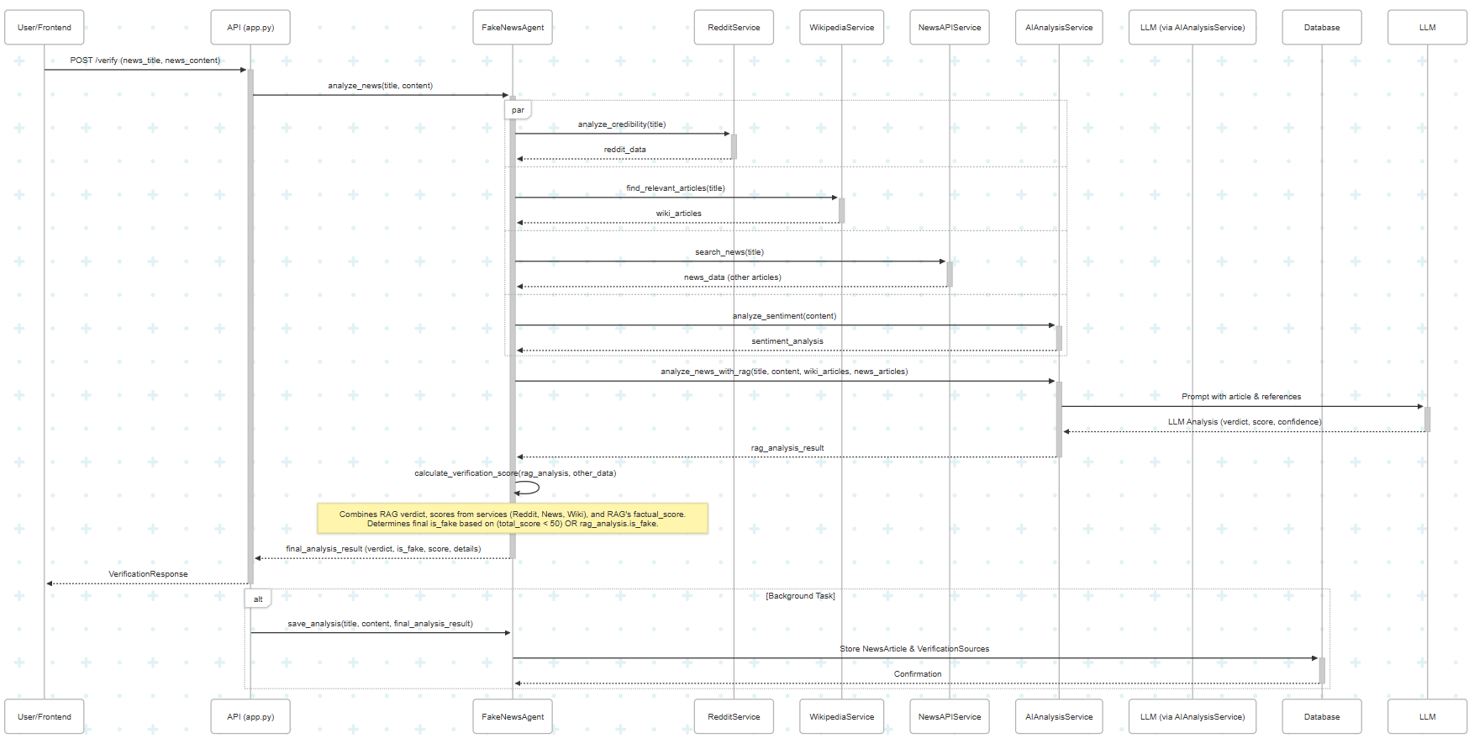

Slide 5
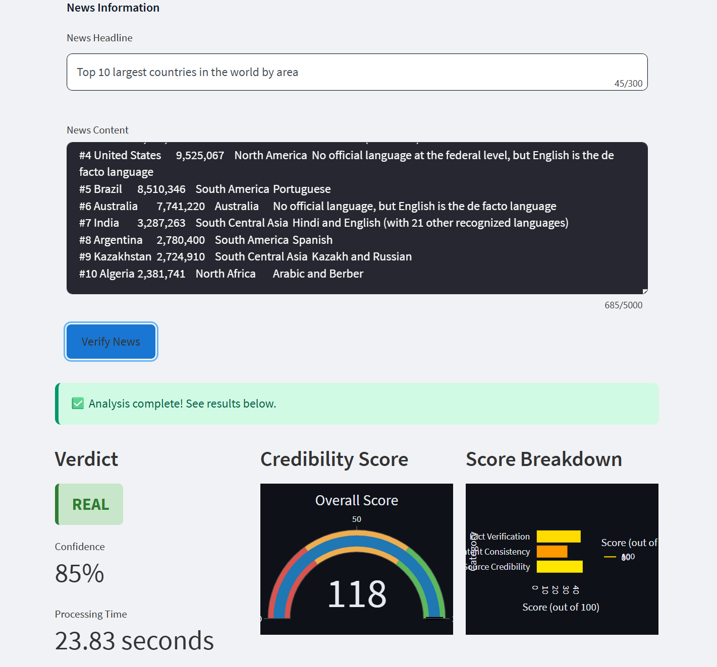
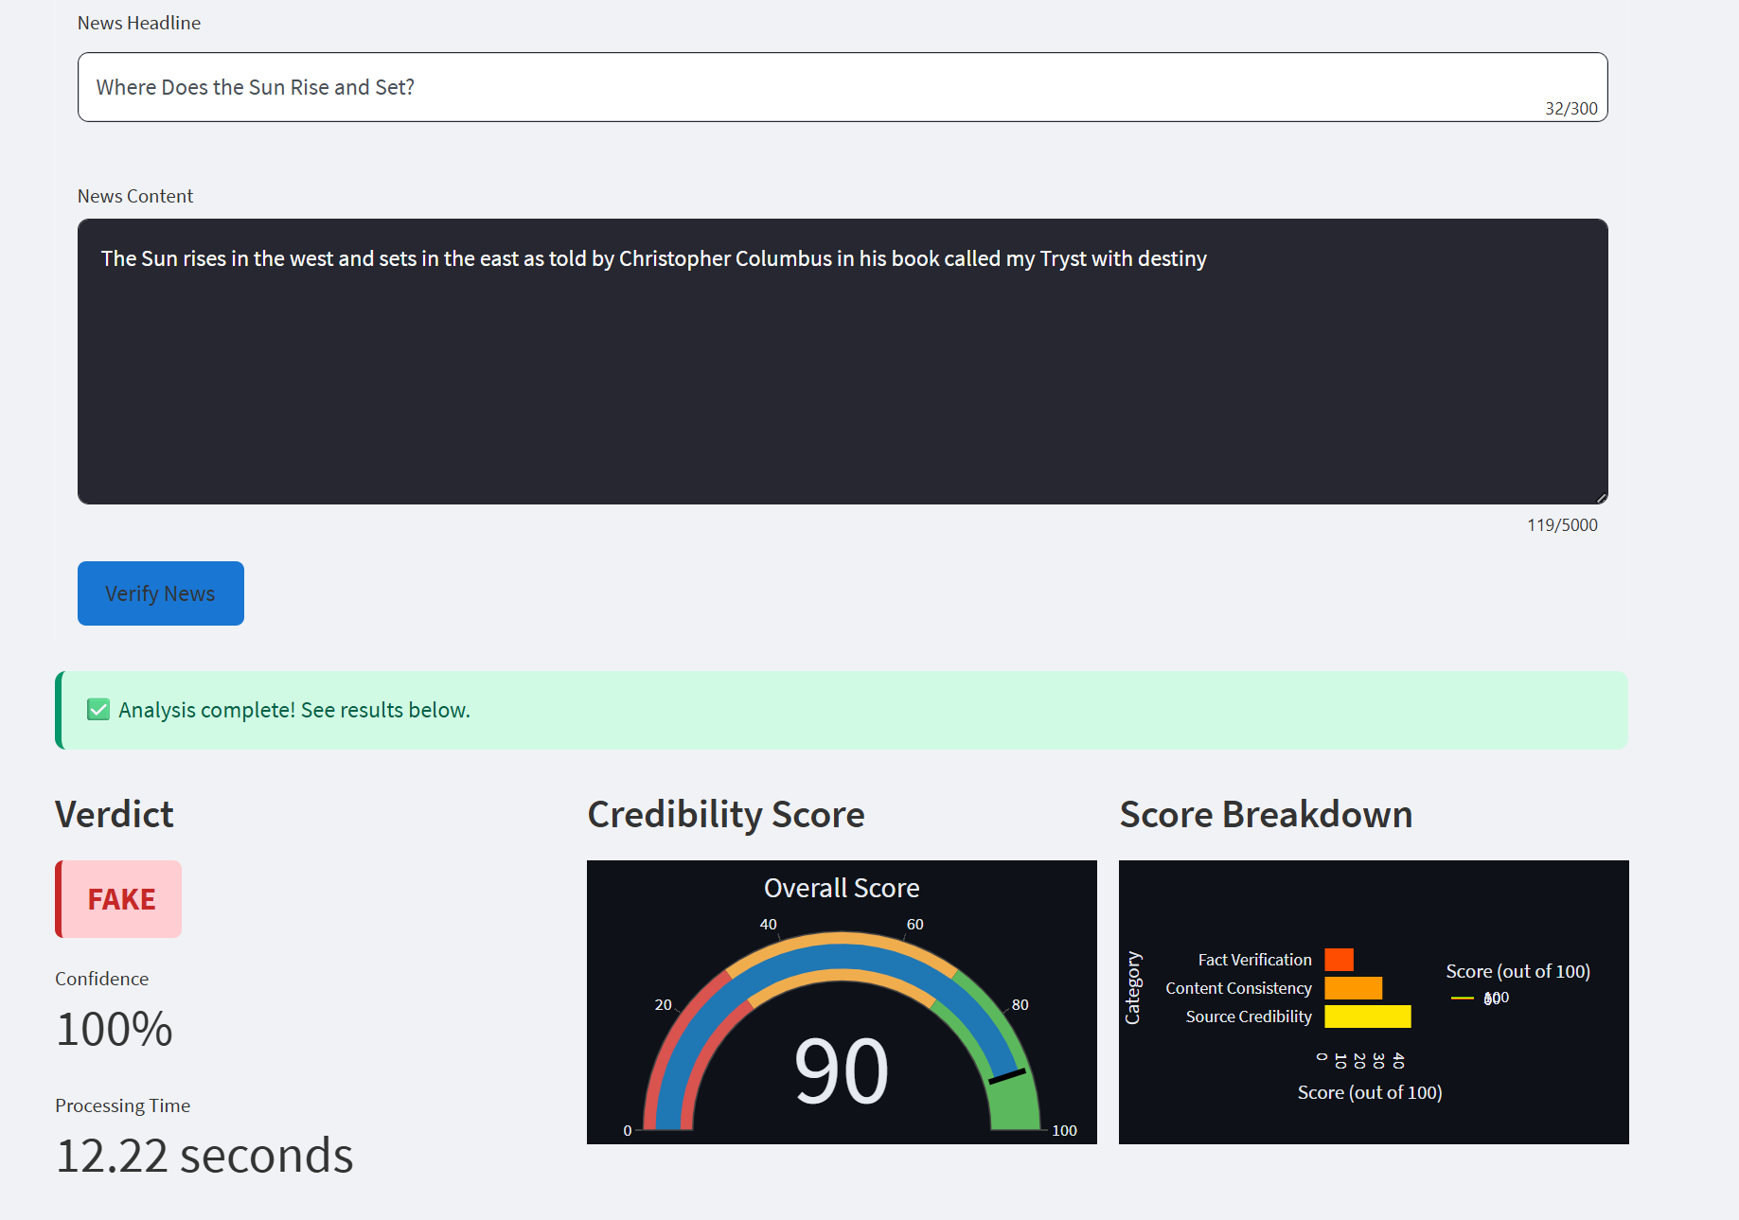

Slide 6
Tech Stack: Powering the Application
Backend
Frontend
Model
Deployment
FastAPI enables fast, scalable API endpoints for data handling.
Streamlit delivers an interactive, responsive user interface.
Gemini 1.5 Pro via API powers intelligent news verification.
Hosted on Render for seamless accessibility anytime, anywhere.

