Slide 1
XtremWeb-HEP tutorial
2nd DEGISCO project meeting
December 7th-9th, 2010
LAL

Slide 2
XtremWeb-HEP tutorial
EDGeS infrastructure : XtremWeb-HEP
Software requirements
Security issues
Install and configure XtremWeb-HEP Client
Data management
Jobs management
Example of macro file

Slide 3
EDGeS infrastructure
BOINC-based DGs
new public BOINC DG
EDGeS@home
10.000 PCs
local
BOINC DG
Westminster
1.500 PCs
1881 (125%)
new public XtremWeb DG
EDGeS@home
1.000 PCs
local
BOINC DG
Correlation
Systems
public
BOINC DG
Ibervicis
24000 PCs
public
BOINC DG
SZDG
30.000 PCs
public
XtremWeb DG
IN2P3
300 PCs
EGEE VO
public
BOINC DG
AlmereGrid
1700 PCs
public
BOINC DG
Extremadura
70.000 PCs
public
XtremWeb DG
AlmereGrid
3.000 PCs
local
XtremWeb DG
IN2P3
200 PCs
XtremWeb/XWHEP-based DGs

Slide 4
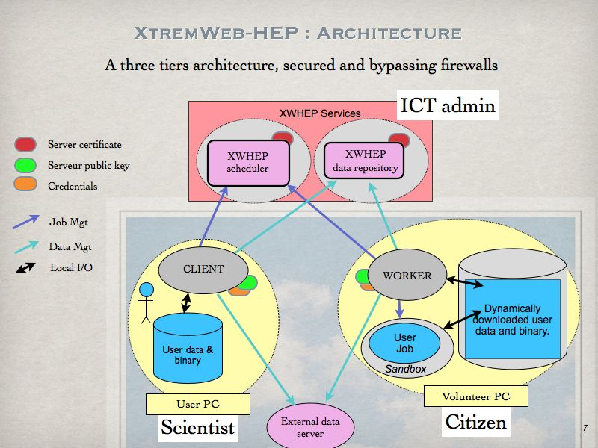

Slide 5

XtremWeb to EGEE bridge
Security, monitoring and logging are the main issues in Pilot Jobs. (http://edms.cern.ch/document/855383)
User X.509 Cert
jLite : proxy init
  jLite
  by Oleg Sukhoroslov
  http://code.google.com/p/jlite/
User X.509 proxy
User job submission
Server certificate
Pilot job
submission
Server public key
VOMS
Server
WMS
XW Coordinator
(scheduller)
Get
Executable
Worker Node
User job
Application Respository
service
Pilot Job
Private worker
User job
XW
workers
SubCluster

Slide 6


EGEE to XtremWeb bridge
EGEE EDGeS VO
XtremWeb server
EDGeS CE
P-GRADE Portal
WMS
service
QM WS client
QM
WS Interface
XW plugin
DB
EDGeS
AR
LCG-CE 1
LCG-CE N
WN
WN
WN
WN
WN
WN
XtremWeb Worker
pool
WN
WN
WN
…
WN
WN
WN

Slide 7
XtremWeb-HEP tutorial
EDGeS infrastructure : XtremWeb-HEP
Software requirements
Security issues
Install and configure XtremWeb-HEP Client
Data management
Jobs management
Example of macro file

Slide 8

XtremWeb-HEP : Software requirements
Supported operating systems:
Stable version of Scientific Linux >= 5.5,
Stable version of Debian >=5.0.6,
Mac Os X >= 10.4
Sun JRE 1.6
Scientific-Linux “Virtual Box” disk image is available.

Slide 9
XtremWeb-HEP : Software requirements
Scientific-Linux 5.5 “Virtual Box” disk image is available.
To use it, copy the files SciLin55.ovf and sl55-verynew.vmdk and in the VirtualBox file menu “import virtual application” choose SciLin55.ovf.
If you don't have X509 certificate you can also use a livecd (file xwlivecd.iso), by creating a new virtual machine with only a cdrom drive.

Slide 10
XtremWeb-HEP tutorial
EDGeS infrastructure : XtremWeb-HEP
Software requirements
Security issues
Install and configure XtremWeb-HEP Client
Data management
Jobs management
Example of macro file

Slide 11
XtremWeb-HEP : Security requirements
You must have a certificate recognised by the XtremWeb-HEP server.
To connect to XtremWeb-HEP installed at LAL, you can download the LAL's list of certificate :
http://www.xtremweb-hep.org/spip.php?article101
You must belong to a VO accepted by LAL's CA list (e.g. : vo.lal.in2p3.fr )

Slide 12
XtremWeb-HEP : Security configuration
Export your certificate from your browser in PKCS12 format (.p12 extension) to $HOME/.globus/
Convert it in PEM format in $HOME/.globus directory using openssl :
$> openssl pkcs12 -nocerts -in cert.p12 -out $HOME/.globus/userkey.pem
$> openssl pkcs12 -clcerts -nokeys -in cert.p12 -out \ $HOME/.globus/usercert.pem
$> chmod 0600 userkey.pem
$> chmod 0644 usercert.pem

Slide 13
XtremWeb-HEP : Security configuration
jLite by Oleg Sukhoroslov
http://code.google.com/p/jlite/
written in Java
installable on PC having JRE1.6
lightweight
access grid infrastructures using X509
  gLite
  XtremWeb-HEP
PC @ Home
jLite : proxy init
X509 proxy
X509 user cert
VOMS
Server

Slide 14
XtremWeb-HEP : Security configuration
1 - Download jLite
http://code.google.com/p/jlite
2 - Uncompress the archive in your home directory
$> unzip jlite-0.2.zip
3 - Download the LAL's list of certificates :
http://www.xtremweb-hep.org/spip.php?article101
4 - Uncompress the archive in ${JLITE_HOME}
$> unzip cacerts.zip
=> this replaces the « etc » directory in $JLITE_HOME

Slide 15
XtremWeb-HEP : Security configuration
5 – Add vo.formation.idgrilles to LAL's VO list.
Add the file vo.formation.idgrilles.fr.vo.ncm-vomsclient in the
${JLITE_HOME}/etc/vomses directory, with this content :
"vo.formation.idgrilles.fr" "cclcgvomsli01.in2p3.fr" "15012" "/O=GRID-FR/C=FR/O=CNRS/OU=CC-IN2P3/CN=cclcgvomsli01.in2p3.fr" "vo.formation.idgrilles.fr"

Slide 16
XtremWeb-HEP : Security configuration
Set the environment variable X509_USER_PROXY with the path and name of your proxy :
export X509_USER_PROXY=$HOME/.globus/myproxy
Thus jLite will know where to create the proxy, and XWHEP where to find it.

Slide 17
XtremWeb-HEP : Security configuration
Use of jLite
Run the “proxy-init.sh” script to create the proxy.
This script is located in “client” subdirectory in jLite directory.
$JLITE_HOME/bin/proxy-init.sh <a VO to which you belong>
will ask your passphrase and will generate your proxy and store it in $X509_USER_PROXY

Slide 18
XtremWeb-HEP tutorial
EDGeS infrastructure : XtremWeb-HEP
Software requirements
Security issues
Install and configure XtremWeb-HEP Client
Data management
Jobs management
Example of macro file

Slide 19
XtremWeb-HEP : install the client
Download the XtremWeb-HEP client installation package
http://www.xtremweb-hep.org/spip.php?article52
The available platforms are :
  Macosx (.mpkg)
  Scientific-Linux (.rpm)
  Debian (.deb)

Slide 20
XtremWeb-HEP : configure the client
$> mkdir $HOME/.xtremweb
$> cp ${XWHEP_HOME}/conf/xtremweb.client.conf \ $HOME/.xtremweb
For Macosx ${XWHEP_HOME} is /Applications/xwhep.client
For Linux it is /opt/xwhep-client-${VERSION}
Since you must have a certificate, you must delete the login and password parameters in $HOME/.xtremweb/xtremweb.client.conf
Try your first xwhep command e.g. :
$> xwversion

Slide 21
XtremWeb-HEP tutorial
EDGeS infrastructure : XtremWeb-HEP
Software requirements
Security issues
Install and configure XtremWeb-HEP Client
Data management
Jobs management
Example of macro file

Slide 22
XtremWeb-HEP : data management
The XtremWeb-HEP middleware manages data that may be referred by registered applications and submitted jobs.
A data is an object referring a content available on the network through an URI and associating several attributes such as the name, the MD5 sum, the size, the owner and the access rights.
A data may also have optional attributes such as the operating system and the architecture.

Slide 23
XtremWeb-HEP : data management
To register a single file you can use
$> xwsenddata <path-and-filename>
The client outputs the URI of the new data
xw://xwserv.lal.in2p3.fr:4321/36a51a67-0186-43a7-b71f-bca56b889b33
You can also register several files and folders by grouping them in a zip file.
When a job referring to this data is submitted, the elected worker will decompress it and make the files available.

Slide 24
XtremWeb-HEP : data management
This is an example of using a zip file to register several files in a data.
Create datadir with files
$> mkdir datadir; for (( i=1; i<=5; i++ )) do echo "file number $i" > datadir/${i}.txt; done
Zip the datadir folder
$> zip -r datadir.zip datadir

Slide 25
XtremWeb-HEP : data management
Upload the ziped folder datadir.zip on xwhep server
$> xwsenddata datadir.zip
The client outputs the URI of the new data
xw://xwserv.lal.in2p3.fr:4321/36a51a67-0186-43a7-b71f-bca56b889b33
Verify your data (datadir.zip) is available
$> xwdatas xw://xwserv.lal.in2p3.fr:4321/36a51a67-0186-43a7-b71f-bca56b889b33
To delete a data you can use xwrm command.
$> xwrm xw://xwserv.lal.in2p3.fr:4321/36a51a67-0186-43a7-b71f-bca56b889b33

Slide 26
XtremWeb-HEP : application management
Retrieve the list of registered applications
$> xwapps

Slide 27
XtremWeb-HEP tutorial
EDGeS infrastructure : XtremWeb-HEP
Software requirements
Security issues
Install and configure XtremWeb-HEP Client
Data management
Jobs management
Example of macro file

Slide 28
XtremWeb-HEP : job management
A job is a reference to a registered application. A job may contains command line parameters. A job may reference datas.
The only required attribute is the reference to a registered application.
You can submit a job by using the xwsubmit command which takes at least the name of the registered application name as argument
(e.g. : “ls”) with the optional job arguments (e.g. : “-l”).
$> xwsubmit ls -l

Slide 29
XtremWeb-HEP : job management
If you use input files you have to make them available by using --xwenv option with local file or folder or with a registered data URI.
Here we use the data URI we registered previously.
Submit a job
$> xwsubmit cat --xwstdin datadir/1.txt –-xwenv \ xw://xwserv.lal.in2p3.fr:4321/36a51a67-0186-43a7-b71f-bca56b889b33

Slide 30
XtremWeb-HEP : job management
You can check the job status at any time
$> xwstatus
UID='7c5da2cf-1168-461b-b8fc-2a586599f175', STATUS='RUNNING', COMPLETEDDATE=NULL, LABEL=NULL, ERROR_MSG=NULL

Slide 31
XtremWeb-HEP : job management
You can check the job status at any time
$> xwstatus
UID='7c5da2cf-1168-461b-b8fc-2a586599f175', STATUS='COMPLETED', COMPLETEDDATE='2010-11-10 13:45:00', LABEL=NULL, ERROR_MSG=NULL

Slide 32
XtremWeb-HEP : job management
When the job is completed, you retrieve its result
$> xwresults 7c5da2cf-1168-461b-b8fc-2a586599f175
This downloads the result file.
The result file may be an archive or a single file.

Slide 33
XtremWeb-HEP tutorial
EDGeS infrastructure : XtremWeb-HEP
Software requirements
Security issues
Install and configure XtremWeb-HEP Client
Data management
Jobs management
Example of macro file

Slide 34
Example of macro file
Create a macro file xwmacro.txt
--xwsendwork cat –-xwstdin datadir/1.txt --xwenv xw://xwserv.lal.in2p3.fr:4321/36a51a67-0186-43a7-b71f-bca56b889b33
…
--xwsendwork cat –-xwstdin datadir/5.txt --xwenv xw://xwserv.lal.in2p3.fr:4321/36a51a67-0186-43a7-b71f-bca56b889b33
Submit the macro file
xwversion --xwmacro xwmacro.txt > jobuids

Slide 35
Example of macro file
Create another macro file (Add --xwget at the beginning of each line and --xwformat at the end of each line)
sed -i 's/^/--xwget /' jobuids
sed -i 's/$/ --xwformat xml/g' jobuids
Monitor the jobs
xwversion --xwmacro jobuids > res

Slide 36
Example of macro file
LOOPTEST=1
while [ $LOOPTEST -ne 0 ]; do
PENDING=`cat res | grep PENDING | wc -l`;
echo "$PENDING pending jobs";
RUNNING=`cat res | grep RUNNING | wc -l`;
echo "$RUNNING running jobs";
LOOPTEST=$(( $PENDING + $RUNNING ));
sleep 20;
xwdownload --xwmacro jobuids > res;
done

Slide 37
Example of macro file

