Slide 1




Grille Paris Sud
Xtremweb-HEP :A securized and inter-connectedDesktop Grid
Oleg Lodygensky
Laboratoire de l’Accélérateur Linéaire

Slide 2
XtremWeb-HEP
Introduction
Deployment
Inter grids connection
Applications
Conclusion

Slide 3

Volunteer Computing
A three tier architecture using idle time CPU provided by volunteers.
Centralized and securized services
scheduler
repository
etc.
Submit/retrieve
Download/update
Distributed User
submit jobs, datas
retrieve results
Distributed Volunteer PC
compute jobs
store datas

Slide 4
Volunteer Computing
Volunteer
cluster
Desktop Grid
 | Condor | Boinc | XWHEP | XtremWeb | OurGrid
volunteer ressources | ✓ | ✓
multi OSes | ✓ | ✓
type | cluster | desktop grid
deployment | per domain | global
firewall bypassing | ✗ | ✓
shared FS | ✓ | ✗
authentication | delegated | included
authorization | delegated | ✗ | ✓ | ✗ | ✓
X509 | ✗ | ✗ | ✓ | ✗ | ✓
Sandbox | ? | ? | ✓ | ✓ | ✓ ✓
data | ✓ | ✓ | ✓ ✓ | ✗ | ✗
multi users | ✓ | ✗ | ✓ | ✓ | ✓
multi applications | ✓ | ✗ | ✓ | ✓ | ✓
volunteer experience | ✓ | ✓ | ✗ | ✗ | ✗
large deployment | ✓ | ✓ | ✗ | ✗ | ✗

Slide 5

XtremWeb-HEP
A three tiers architecture, securized and bypassing firewalls
XWHEP Services
Server certificate
XWHEP scheduler
XWHEP
data repository
Serveur public key
Credentials
Job Mgt
Data Mgt
Local I/O
XWHEP client
Computing service
(worker)
Dynamically downloaded user data and binary.
PC
User
Job
User data & binary
External data server
Sandbox
Volunteer PC
Volunteer PC integrity : sandbox

Slide 6
XtremWeb-HEP
Introduction
Deployment
Inter grids connection
Applications
Conclusion

Slide 7
Authentication
Distributed parts connect using services public key and must present valid credentials
XWHEP Services
Server certificate
XWHEP scheduler
XWHEP
data repository
Serveur public key
Credentials
Job Mgt
✗
Data Mgt
✗
XWHEP client/worker
✗
✗
XWHEP client/worker
XWHEP client/worker

Slide 8



Authorization
Private
app
Group
app
XWHEP Services
Public
app
XWHEP scheduler
XWHEP
data repository
Public workers
Public worker can execute public jobs of all users (and public jobs only)
Group workers
Private workers
Group worker can execute public and group jobs of all users of its group
(and its group only)
Public
job
Group
job
Private worker can execute all jobs of its owner
(and its owner only)
Private
job

Slide 9
XtremWeb-HEP
Introduction
Deployment
Inter grids connection
Applications
Conclusion

Slide 10
Pilot Jobs
Pilot Jobs is a way to use a Grid infrastructure to deploy end user jobs with an external scheduler (i.e. a scheduler which is not part of the infrastructure itself).
XtremWeb and Condor teams have introduced this as “Glide-in” in
“XtremWeb & Condor : sharing resources between Internet connected Condor pools.”
O. Lodygensky, G. Fedak, F. Cappello, V. Neri, M. Livny, D. Thain
CCGRID 2003, Tokyo, JAPAN; May 12-15, 2003.
EGEE experiments use Pilot Jobs
LHCb Dirac
CMS Glide-in
ATLAS Panda
ALICE

Slide 11

Pilot Jobs
Security, monitoring and logging are the main issues in Pilot Jobs. (http://edms.cern.ch/document/855383)
User X.509 Cert
Retreived signed
DG user job
User X.509 proxy
XW Coordinator
(scheduler)
Server certificate
Download
DG user
X509 proxy
Server public key
DG user job deployment, status, results
Submit Pilot job
w/ user X509 proxy
DG user job submission
with X509 proxy
Site Computing Resource
XW Bridge
DG User
Meta-scheduler
(WMS)
Public worker
WN
Group worker
Pilot Job
jLite : proxy init
Private worker
Private worker
  jLite
  by Oleg Sukhoroslov
  http://code.google.com/p/jlite/
VOMS Server
Pilot Job submitted as EGEE Job

Slide 12
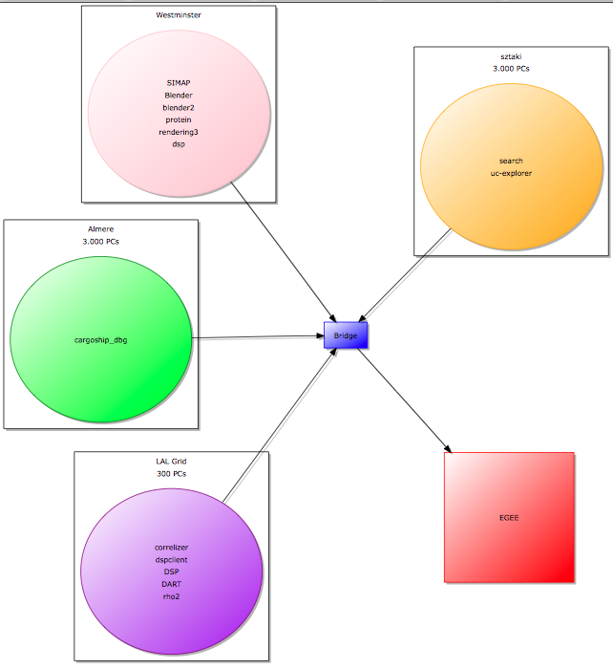

Pilot Jobs

Slide 13
XtremWeb-HEP
Introduction
Deployment
Inter grids connection
Applications
Conclusion

Slide 14
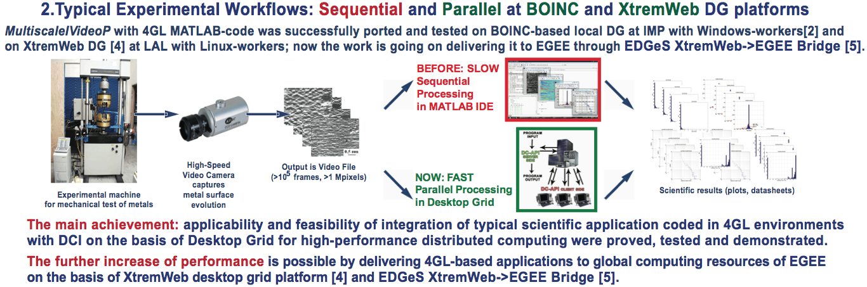
Applications
Porting Multiparametric MATLAB Application for Image and Video Processing to Desktop Grid for High-Performance Distributed Computing
Yuri Gordienko, Institut de Physique du Metal - Kiev - Ukraine

Slide 15
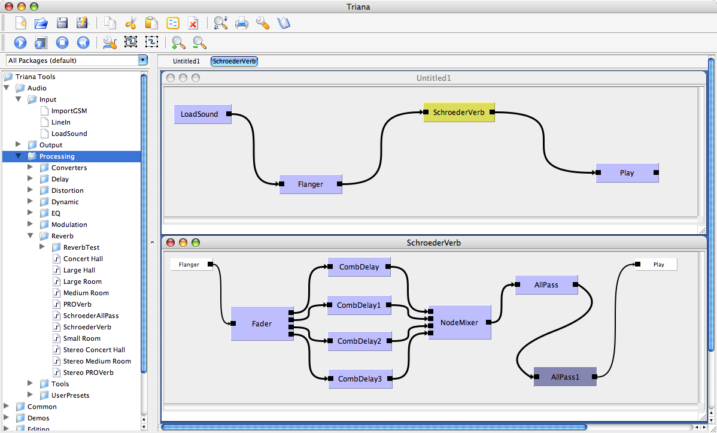
Applications
DART: A Framework for Distributed Audio Analysis and Music Information Retrieval
Eddie Al-Shakarchi, Cardiff University - UK

Slide 16
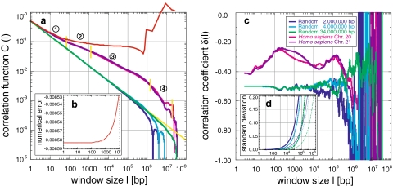
Applications
DNA Correlation Applications
A. Abuseiris, Erasmus - NL

Slide 17
XtremWeb-HEP
Introduction
Deployment
Inter grids connection
Applications
Conclusion

Slide 18
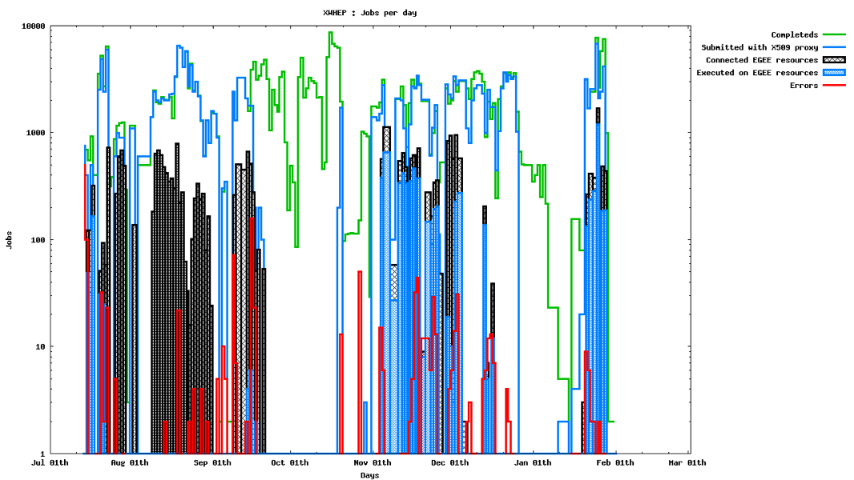
Conclusions
Since July 2009
EGEE ressources (hosts / connections) | 727 / 34 260
DG ressources (hosts /connections) | 400 / 70 025
COMPLETED | 569 416
COMPLETED on EGEE ressources | 12 164
ERROR | 8 273

Slide 19
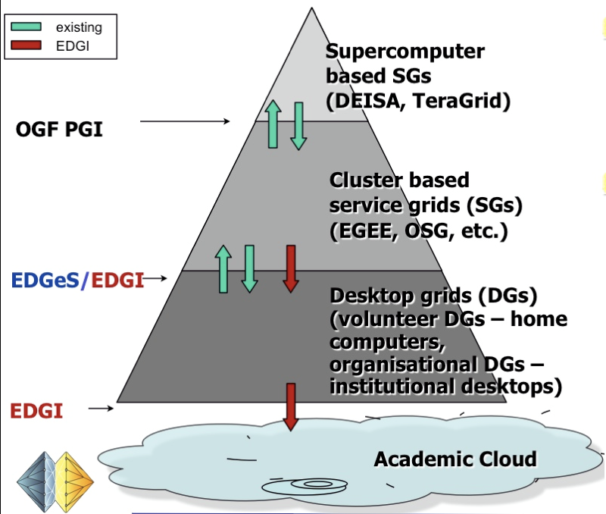
Conclusions
EDGeS

Slide 20
Web Sites
http://www.xtremweb-hep.org/spip.php?article30
http://www.lri.fr/PoleGrid/GridUps/

