Slide 1















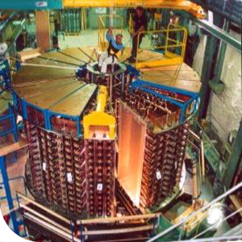



From Volunteer Computing
To Volunteer Cloud
LAL, Univ Paris-Sud, IN2P3/CNRS,
Orsay, France
Oleg LODYGENSKY lodygens@lal.in2p3.fr
Etienne URBAH
urbah@lal.in2p3.fr
Simon DADOUN
simon.dadoun@dr4.cnrs.fr
Gilles FEDAK gilles.fedak@inria.fr
Simon DELAMARE
simon.delamare@inria.fr
Derrick KONDO
derrick.kondo@inria.fr
Laurent DUFLOT duflot@lal.in2p3.fr
Xavier GARRIDO
garrido@lal.in2p3.fr
Anthony SIMONET
anthony.simonet@inria.fr
Peter KACSUK kacsuk@sztaki.hu
Jozsef KOVACS
smith@sztaki.hu
Zoltan FARKAS
zfarkas@sztaki.hu
How can Users submit
to Desktop Grids ?
– Virtual Machines
– Legacy Applications
✓ FlyingGrid by
XtremWeb-HEP
✓ GBAC by SZTAKI DG
FlyingGrid by XtremWeb-HEP
Administrator
http://www.flyinggrid.org/
User PC
Use cases and Applications :
XtremWeb-HEP Server
Centralized and secured Services store Applications and Data :
• Scheduler
• Repository
• etc.
Volunteer PC with VirtualBox installed
SuperNemo
R O O T
User VM
Remote Execution
User Application
FlyingGrid permits Users to submit Virtual Machines
to Desktop Grids powered by XtremWeb-HEP
Scientist
Citizen
GBAC by SZTAKI DG
1
12
Volunteer PC
VirtualBox
SZTAKI DG Client
3G Bridge
GBAC wrapper binary
Virtual Machine
2
11
3
Configuration File
5
GBAC Guest Extensions
SZTAKI DG
Server
10a
Virtual Appliance
Shared Directory
6
Sandbox
Legacy Application Inputs
Legacy App. Inputs
Legacy App. Inputs
GBAC
permits Users
to submit
Legacy Applications to Desktop Grids powered by
SZTAKI DG
10b
4
Input Files
Input Files
Input Files
Binaries (Linux 32 bits)
Binaries (Linux 32 bits)
Binaries (Linux 32 bits)
7
9
Output Files
8
Output Files
Output Files

