Slide 1



15th IDGF tutorial
"Getting the most out of Desktop Grids for your application"
Virtualizing Applications over XtremWeb-HEP Desktop Grid
O. Lodygensky, E. Urbah
Laboratoire de l’Accélérateur Linéaire

Slide 2
Virtualizing Applications over XtremWeb-HEP Desktop Grid
Usage of Virtual Machines with Desktop Grids
Usage of Virtual Machines
with Desktop Grids
Management of Virtual Machines
Use case : SuperNemo

Slide 3










Virtualizing Applications over XtremWeb-HEP Desktop Grid
Usage of Virtual Machines with Desktop Grids
Overview
Centralized and secured services store applications and data
scheduler
repository
etc.
Distributed resource may declare the virtualbox application.
StratusLab proposes distributions with the IaaS paradigms.
Remote
Execution
Distributed resource (volunteer PC)
download the virtual disk
create and run a new VM inside its local VirtualBox
Distributed User
submit a virtualbox job with a virtual disk

Slide 4



Virtualizing Applications over XtremWeb-HEP Desktop Grid
Usage of Virtual Machines with Desktop Grids
Contextualization of Virtual Machines
It is not simple to create a virtual disk (VD) containing a virtualized OS.
we need a repository of «template» VD to ease the user life
any user can still create and use its own VD
any VD can be contextualized
bootable VD
typically a live CD (350Mb)
XWHEP
worker
created on the fly by the worker
(=> not downloaded)
mounted on /scratch
typically 8Gb
this is a variable size file
=> upload size then depends on result size (max: 8Gb - hopefully less)
/dev/hda
contextualization VD
if exists, mounted on /context
if exists, /context/context.sh executed at the end of boot process
/dev/hdd
/dev/hdb

Slide 5

Virtualizing Applications over XtremWeb-HEP Desktop Grid
Usage of Virtual Machines with Desktop Grids
Interconnection over Desktop Grids
Centralized and secured services
Submit/monitor
Download job / Upload results
SmartSockets Hub
(1) Register
(2) Retrieve
(1) Register
(2) Retrieve
(1) Register
(2) Retrieve
XWHEP
client
XWHEP
smartsockets
proxy
XWHEP
worker
XWHEP
smartsockets
proxy
XWHEP
worker
XWHEP
smartsockets
proxy
(3) connect
launches
launches
A communicating application
untouched code
reconfigured only
(3)
A communicating job
untouched code
reconfigured only
A communicating job
untouched code
reconfigured only
User PC
Volunteer PC
Volunteer PC
(3)
Bypassing FireWalls and NAT

Slide 6
Virtualizing Applications over XtremWeb-HEP Desktop Grid
Management of Virtual Machines
Usage of Virtual Machines with Desktop Grids
Management of Virtual Machines
Use case : SuperNemo

Slide 7
Virtualizing Applications over XtremWeb-HEP Desktop Grid
Management of Virtual Machines
Registration of Virtual Disks
$> xwapps
UID='3df0653c-b3f0-439e-b5f6-c28c9bd306e3', NAME='bnbss'
UID='afdfc5c6-12a7-4f54-9e34-e782f62d3991', NAME='VINA'
UID='8f582f85-100e-4505-8bd7-22dc0c5a6dfd', NAME='sgmuons' UID='2e3ac23a-ed6b-4041-89bd-64af6a23be87', NAME='dsp'
UID='de7d2350-c0e1-4229-8615-1939340c4bd9', NAME='isdep'
UID='210eaeaa-9e79-41a7-b35f-d0b442af0f52', NAME='FFMPEG'
UID='0b7c51d9-717d-48e2-8be7-c3e315b0eec9', NAME='slinca'
UID='7a0485cd-ab1d-491c-9a36-3c9aa5ab19db', NAME='scale'
UID='fb596ec5-758e-46c8-a766-f8df72f5b4df', NAME='larbin-crawler' UID='b3f6def6-54ba-4bd2-a13a-b484d2a558a3', NAME='phog'
UID='a01a943f-90e1-47b2-b09f-ea283b8c345a', NAME='timebnbss2' UID='3656ad84-ebfe-46e9-a85e-c4937fb6a48b', NAME='dart.jar' UID='4b31c175-8986-42f2-9533-5e84fbe00d46', NAME='ubuntu'
UID='d01181c0-0425-41cc-800c-359946970ce4', NAME='guineapig-pp-1.1.1' UID='0564240b-e2a1-471b-823e-38d3e9f7a988', NAME='atlasvm'
$>
UID='4b31c175-8986-42f2-9533-5e84fbe00d46', NAME='ubuntu'
UID='0564240b-e2a1-471b-823e-38d3e9f7a988', NAME='atlasvm'

Slide 8
Virtualizing Applications over XtremWeb-HEP Desktop Grid
Management of Virtual Machines
Contextualization of Virtual Disks
# install public key
mkdir -p /home/xwuser/.ssh
cp /context/id_rsa.pub /home/xwuser/.ssh/authorized_keys
chmod 700 /home/xwuser/.ssh/
chmod 600 /home/xwuser/.ssh/authorized_keys
$> ls
context.sh
id_rsa.pub
$> xwcontext --source context.d
Creating dynamic image with size 11534336 bytes (11MB)...
Your new contextualization drive : ./xwcontext_disk.vdi
$> ls
context.d
xwcontext_disk.vdi
End user
Public key
End user
Contextualization disk

Slide 9
Virtualizing Applications over XtremWeb-HEP Desktop Grid
Management of Virtual Machines
Submission of Virtual Disks
The SSH forwarding port number
The SSH forwarding port number
The end user contextualization disk
The end user contextualization disk
$> xwsubmit ubuntu --sshport 2022 \
--xwlistenport 2022 \
--context xwcontext_disk.vdi \
--xwenv xwcontext_disk.vdi
xw://xwserv.lal.in2p3.fr/3f1c8b0a-4f97-4d42-a67d-b340ba8dd45e
Job (the VM) command line options :
--sshport
--context
XWHEP client command line options :
--xwlistenport
--xwenv

Slide 10
Virtualizing Applications over XtremWeb-HEP Desktop Grid
Management of Virtual Machines
Get Status of a Virtual Machine
The port number the job is listening
The end user contextualization disk
The VM command line
$> xwworks xw://xwserv.lal.in2p3.fr/3f1c8b0a-4f97-4d42-a67d-b340ba8dd45e uid="3f1c8b0a-4f97-4d42-a67d-b340ba8dd45e"
status="RUNNING"
listenport="2022"
cmdline="--sshport 2022 --context xwcontext_disk.vdi"
dirinuri="xw://xwserv.lal.in2p3.fr/c12262e3-6b77-4d49-a7f9-abcd445b8c9d"
smartsocketaddr="134.158.90.153-54700:3001@134.158.76.199-4329~xwhep#"
The SmartSockets Address automatically set by the middleware since there is a listen port

Slide 11
Virtualizing Applications over XtremWeb-HEP Desktop Grid
Management of Virtual Machines
Create job tunnel endpoint for connection to VM
A new XWHEP
client command
The VM URI
$> xwproxy \
xw://xwserv.lal.in2p3.fr/3f1c8b0a-4f97-4d42-a67d-b340ba8dd45e \
--xwlistenport 3333 &
A local port
on client side
The 'XWHEP proxy client' should be started in background.
  Command line options :
--xwlistenport : a local port the proxy listens
The 'XWHEP proxy client' forwards incoming connections to the VM through the SmartSockets tunnel

Slide 12
Virtualizing Applications over XtremWeb-HEP Desktop Grid
Management of Virtual Machines
Connection to the VM using SSH
The standard
SSH client
$> ssh xwuser@localhost -p 3333
The local proxy port
on client side
The login must be « xwuser »
The proxy is running on localhost

Slide 13
Virtualizing Applications over XtremWeb-HEP Desktop Grid
Management of Virtual Machines
VM File System Layout
xwuser@ubuntu:~$ df -h
Filesystem Size Used Avail Use% Mounted on
/cow 249M 4.3M 244M 2% /
udev 241M 4.0K 241M 1% /dev
tmpfs 100M 220K 100M 1% /run
/dev/sr0 261M 261M 0 100% /cdrom
/dev/loop0 241M 241M 0 100% /rofs
tmpfs 249M 4.0K 249M 1% /tmp
none 5.0M 0 5.0M 0% /run/lock
none 249M 0 249M 0% /run/shm
/dev/sda1 11M 13K 11M 1% /context
/dev/sdb1 4.0G 73M 3.7G 2% /mnt/xwscratch
The contextualization
disk
/dev/sda1 11M 13K 11M 1% /context
/dev/sdb1 4.0G 73M 3.7G 2% /mnt/xwscratch
The scratch disk

Slide 14
Virtualizing Applications over XtremWeb-HEP Desktop Grid
Management of Virtual Machines
Shut down of the VM
xwuser@ubuntu:~$ poweroff

Slide 15
Virtualizing Applications over XtremWeb-HEP Desktop Grid
Use case : SuperNemo
Usage of Virtual Machines with Desktop Grids
Management of Virtual Machines
Use case : SuperNemo
Double Neutron decay : Search of decay without neutrino

Slide 16
Virtualizing Applications over XtremWeb-HEP Desktop Grid
Use case : SuperNemo
Save Contextualization Disk
End user
contextualization disk
$> xwsenddata xwcontext_disk.vdi
xw://xwserv.lal.in2p3.fr/f22d0f40-3962-49ae-bab1-83f2f73f6864

Slide 17
Virtualizing Applications over XtremWeb-HEP Desktop Grid
Use case : SuperNemo
Submission
SSH forwarding port number
SSH forwarding port number
The end user
contectualization disk
End user
contextualization disk
$> xwsubmit ubuntu --sshport 2022 \
--xwlistenport 2022 \
--context xwcontext_disk.vdi \
--xwenv f22d0f40-3962-49ae-bab1-83f2f73f6864 \
--scratch aahd2.vdi \
--xwenv 7b1c140d-12c1-49dd-ad69-2ab3a75c1607
xw://xwserv.lal.in2p3.fr/3f1c8b0a-4f97-4d42-a67d-b340ba8dd45e
SuperNemo
application disk
SuperNemo
application disk
Job (the VM) command line options :
--sshport
--context
--scratch
XWHEP client command line options :
--xwlistenport
--xwenv
By default, the VM creates an empty scratch disk. But the end user has a chance to provide its own one.
Here, we provide the SuperNemo application disk.

Slide 18
Virtualizing Applications over XtremWeb-HEP Desktop Grid
Use case : SuperNemo
SSH connection
1) Open a SmartSocket tunnel endpoint (in background)
$> xwproxy \
xw://xwserv.lal.in2p3.fr/3f1c8b0a-4f97-4d42-a67d-b340ba8dd45e \
--xwlistenport 4444 &
2) Connect using SSH
$> ssh xwuser@localhost -p 4444

Slide 19
Virtualizing Applications over XtremWeb-HEP Desktop Grid
Use case : SuperNemo
File system
xwuser@ubuntu:~$ df -h
Filesystem Size Used Avail Use% Mounted on
/cow 249M 4.3M 244M 2% /
udev 241M 4.0K 241M 1% /dev
tmpfs 100M 220K 100M 1% /run
/dev/sr0 261M 261M 0 100% /cdrom
/dev/loop0 241M 241M 0 100% /rofs
tmpfs 249M 4.0K 249M 1% /tmp
none 5.0M 0 5.0M 0% /run/lock
none 249M 0 249M 0% /run/shm
/dev/sda1 11M 13K 11M 1% /context
/dev/sdb1 4.0G 73M 3.7G 2% /mnt/xwscratch
The contextualization
disk
/dev/sda1 11M 13K 11M 1% /context
/dev/sdb1 4.0G 73M 3.7G 2% /mnt/xwscratch
The scratch disk = the SN application disk

Slide 20
Virtualizing Applications over XtremWeb-HEP Desktop Grid
Use case : SuperNemo
Configure the software
xwuser@ubuntu:~$ source /home/testuser/core/core-trunk.sh && source /home/testuser/base/base-tag.sh && source /home/testuser/snsw/snsw-trunk.sh

Slide 21
Virtualizing Applications over XtremWeb-HEP Desktop Grid
Use case : SuperNemo
Compute events
xwuser@ubuntu:~$ sng4_production --config $SNG4_ROOT/resources/snemo/config_1/manager.conf

Slide 22
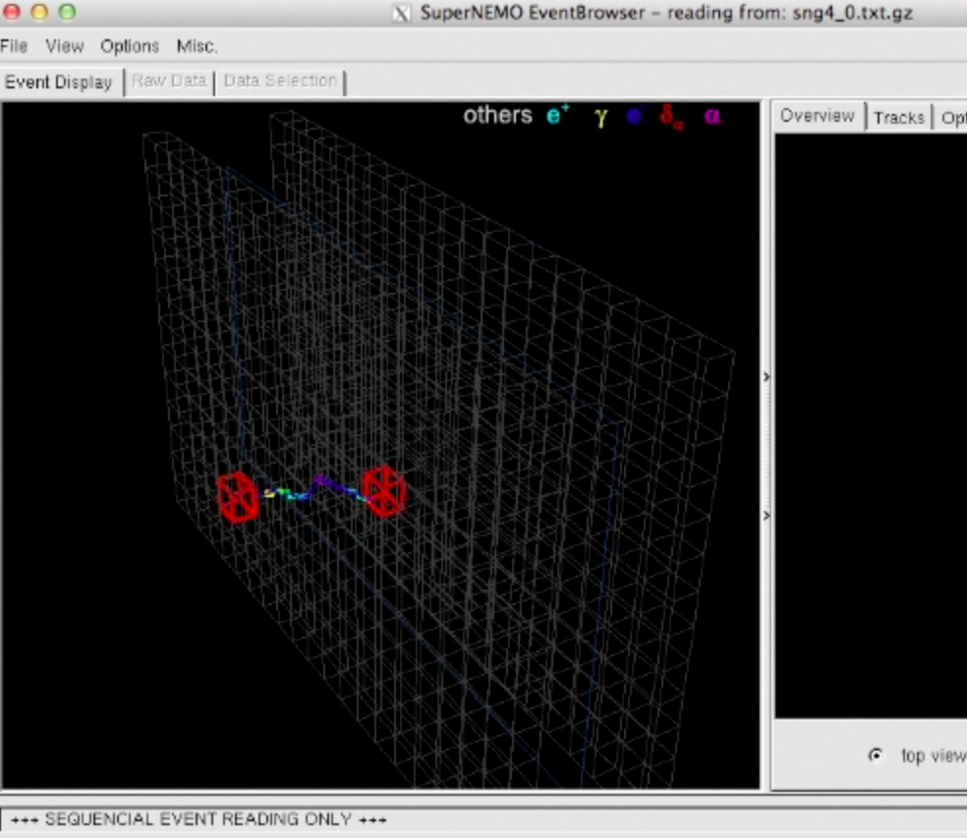
Virtualizing Applications over XtremWeb-HEP Desktop Grid
Use case : SuperNemo
Open the event display
xwuser@ubuntu:~$ snemo_event_browser sng4_0.txt.gz

Slide 23
Virtualizing Applications over XtremWeb-HEP Desktop Grid
Use case : SuperNemo
Shut down
xwuser@ubuntu:~$ poweroff

