Slide 1

Delay Prediction in Supply Chains: A Hybrid Graph-Based and Machine Learning Approach
Candidate: Volpato Mattia
Supervisor: Prof. Michele Ciavotta
Company Co-Supervisor: Eng. Bruno Puzzolante
Master degree
Computer Science

Slide 2
Agenda
M4ESTRO Project Overview
Motivation & Purpose Key Contributions
Dataset & External Sources
Pilot and Tracking data
Traffic, Weather and Holiday data
Supply Chain Modeling
Supply Chain Graph Model
Markov Chain Routing Model
Paths Extraction and Probability Distributions
Historical Indicators
Definition
Implementation
Realtime Indicators
Overview
Definition
Implementation
Protoype & Experimental Evaluation
Prototype Architecture
Evaluation Methodology
Quantitative Evaluation
Sensitivity Analysis
Evolution of Shipment Estimates
Conclusion
Future Developments

Slide 3
M4ESTRO Project Overview

Slide 4

Motivation & Purpose
M4ESTRO Project OVERVIEW
Motivation
Project
Goals
Global disruptions (pandemics, conflicts, climate events) expose the fragility of manufacturers’ supply chains.
Resilience and adaptability are now essential to ensure continuity and competitiveness.
M4ESTRO is a European project uniting 18 partners from 8 countries, including industrial pilots, technology providers and research institutions.
Launched on 1 December 2023, duration of 42 months.
Develop a resilient, transparent, and adaptive ecosystem under the Manufacturing-as-a-Service (MaaS) paradigm, enhancing supply chain flexibility and robustness.
Industrial Manufacturing As a sErvice STRategies and models for flexible, resilient, and re-configurable value networks through Trusted and Transparent Operations.
Notes:
M4ESTRO, un progetto europeo di 42 mesi iniziato il 1 dicembre 2023…
Il cui obiettivo è sviluppare una piattaforma per il MaaS…
Per fronteggiare eventi come conflitti, pandemie, cambiamento climatico…

Slide 5
Key Contributions
Disruption indicators: monitor operations, detect real-time anomalies, measure impacts and enable rapid responses.
Task 1.2: design indicators to detect internal disruptions, within a single-manufacturer supply chain.
M4ESTRO Project OVERVIEW
Supply Chain Modeling
Mathematical framework for modeling a single-manufacturer supply chain.
Indicators Design
Indicators to quantify:
Dispatch and shipment process durations.
Real-time traffic and weather impacts on shipments.
Effect of national holidays on dispatch processes.
Prototype
Development of a prototype using pilot partner data and deployment on AWS cloud infrastructure.
Notes:
Basato sul concetto di indicatore come una misura quantitativa ed interpretabile di un determinato aspetto della catena di approvvigionamento…
I requisiti per il task sotto la mia responsabilità includevano…

Slide 6
Dataset & External Sources

Slide 7



Pilot and Tracking Data
Dataset & EXTERNAL SOURCES
Pilot Order Data
Carrier Tracking Data
Geographical Data
FAE Technology, core dataset provider: one-hundred order records with supplier locations, timestamps and tracking links.
17Track API to retrieve shipment events across multiple carriers, including location, timestamp, and status.
Geonames API to standardize shipment events and supplier locations at a city level.
Three sources forming the core dataset, providing the foundational data that captures the supply chain structure.
Notes:
Le sorgenti di dati principali includevano…

Slide 8





Traffic, Weather and Holiday Data
Dataset & EXTERNAL SOURCES
Traffic Data
Weather Data
Holiday Data
TomTom API to retrieve road traffic data, comparing ideal vs real-time conditions between two locations.
Visual Crossing API to retrieve weather data, providing real-time conditions for any location.
Calendarific API to retrieve national holidays worldwide, providing indications on supplier closures.
Three complementary sources enrich the core dataset, providing a complete representation of the supply chain.
Notes:
Queste sorgenti primarie sono state arricchite con …

Slide 9
Supply Chain Modeling

Slide 10
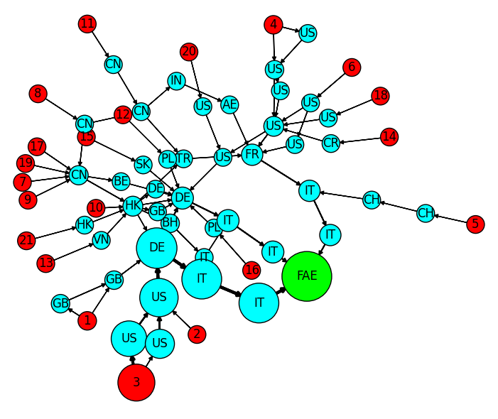
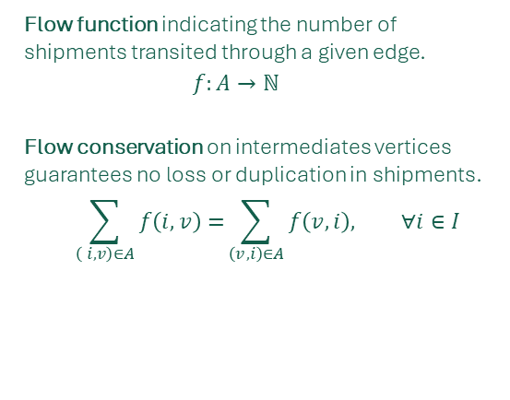

Supply Chain Graph Model
Supply CHAIN Modeling
Graph Structure
Directed Acyclic Graph (DAG)
Vertices partitioned into:
Supplier sites (sources).
Intermediate facilities.
Manufacturer (sink).
$$V=S∪I∪\{m\}$$
Shipments Flow
Flow function indicating the number of shipments transited through a given edge.
$$f:A→ℕ$$
Flow conservation on intermediates vertices guarantees no loss or duplication in shipments.
$$\sum_{\left( i, v\right)∈A}{f\left(i,v\right)=}\sum_{\left(v, i\right)∈A}{f\left(v,i\right), ∀i∈I}$$
Supplier sites
Intermediate locations
Manufacturer
Notes:
La catena di approvvigionamento è stata modellata come …
Il concetto di flusso, preso dalla letteratura, assicura che ogni spedizione origini in un fornitore e termini nell’azienda manufatturiera.

Slide 11
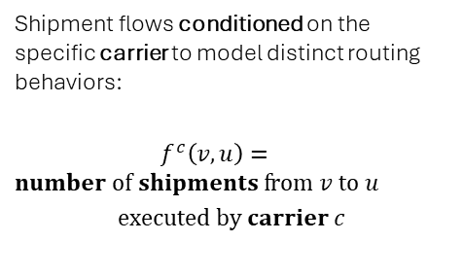
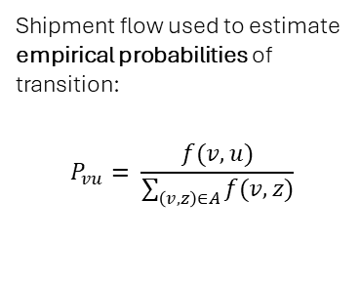
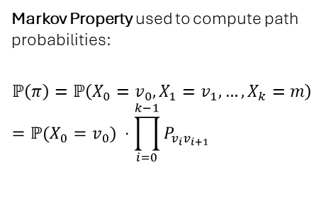
Markov Chain Routing Model
Supply CHAIN Modeling
Empirical Probabilities
Probabilistic Routing
Carrier-Conditioned Dynamics
Shipment flow used to estimate empirical probabilities of transition:
$$P_{vu}= \frac{f(v,u)}{\sum_{\left(v,z\right)∈A}{f(v,z)}}$$
Markov Property used to compute path probabilities:
$$ℙ\left(π\right)=ℙ\left(X_{0}=v_{0},X_{1}=v_{1}, …,X_{k}=m\right)=ℙ(X_{0}=v_{0}) ⋅\prod_{i=0}^{k−1}{P_{v_{i}v_{i+1}}}$$
Shipment flows conditioned on the specific carrier to model distinct routing behaviors:
$f^{c}\left(v,u\right)=number of shipments from v to u$
$$executed by carrier c$$
Shipments are represented as maximal paths ending in the manufacturer. The routing process is modeled using discrete-time Markov chains, capturing shipment trajectories as stochastic processes based on empirical transition probabilities derived from historical shipment flows.
Notes:
Per descrivere le dinamiche di routing è stato utilizzato un modello basato su catene di Markov, in cui …

Slide 12
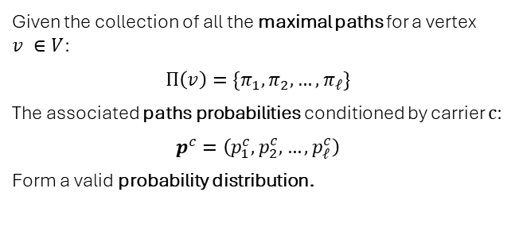
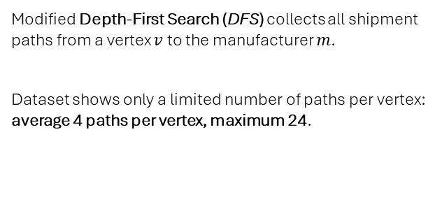
Paths Extraction and Probability Distributions
Supply CHAIN Modeling
Paths Extraction Methodology
Probability Distribution Computation
Modified Depth-First Search (DFS) collects all shipment paths from a vertex $v$ to the manufacturer $m$.
Dataset shows only a limited number of paths per vertex: average 4 paths per vertex, maximum 24.
Given the collection of all the maximal paths for a vertex $v ∈V$:
$$Π\left(v\right)=\{π_{1},π_{2},…,π_{ℓ}\}$$
The associated paths probabilities conditioned by carrier $c$:
$$p^{c}=\left(p_{1}^{c},p_{2}^{c},…,p_{ℓ}^{c}\right)$$
Form a valid probability distribution.
For each vertex, carrier behavior is modeled by considering all possible paths to the manufacturer, along with the probability that each path is followed.
Notes:
Successivamente, tutti i possibili cammini da un vertice alla destinazione con le rispettive probabilità, che formano una distribuzione valida, vengono estratti …

Slide 13
Historical Indicators

Slide 14
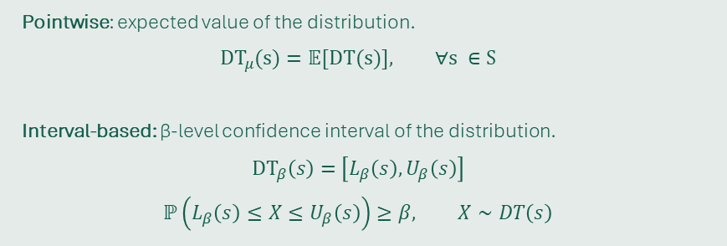
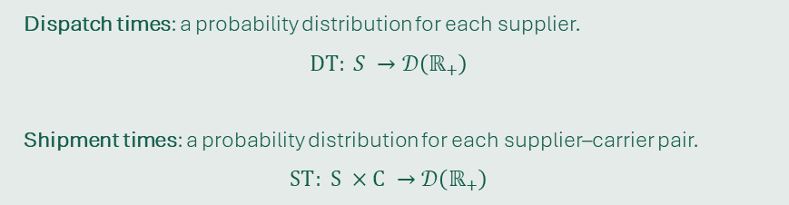
Definition
Historical indicators are stastistical measures that characterize key operational times in the order fulfillment process, based exclusively on historical data.
HISTORICAL Indicators
Time Probability Distributions
Dispatch times: a probability distribution for each supplier.
$$DT: S →𝒟\left(ℝ_{+}\right)$$
Shipment times: a probability distribution for each supplier–carrier pair.
$$ST: S ×C →𝒟\left(ℝ_{+}\right)$$
Statistical Metrics
Pointwise: expected value of the distribution.
$$DT_{μ}(s)=𝔼[DT(s)], ∀s ∈S$$
Interval-based: β-level confidence interval of the distribution.
$$DT_{β}\left(s\right)=\left[L_{β}\left(s\right),U_{β}\left(s\right)\right]$$
$$ℙ\left(L_{β}\left(s\right)≤X≤U_{β}\left(s\right)\right)≥β, X∼DT\left(s\right)$$
Notes:
Gli indicatori storici consistono in misure statistiche basate esclusivamente su dati storici …

Slide 15
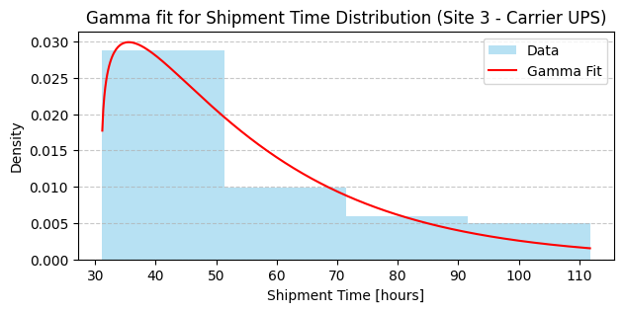
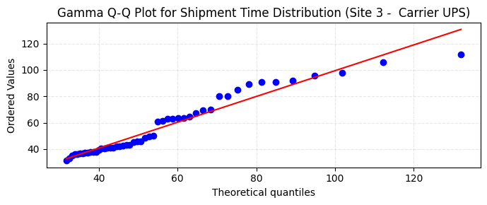
Implementation
HISTORICAL INDICATORS
Theoretical Distribution
Fitting Procedure
Gamma distributions chosen for their established use in supply-chain literature.
Parameter estimation via Maximum Likelihood Estimation.
Outlier removal: Interquartile Range (IQR) method. Goodness-of-fit checks: Q–Q plots and histograms. Statistical validation: Kolmogorov–Smirnov tests show no evidence against the Gamma assumption.
Notes:
In accordo la letteratura, distribuzione Gamma come riferimento per l’implementazione degli indicatori storici, insieme al criterio di MLE per il fitting e visualizzazioni e test statistici per la validazione.

Slide 16
Realtime Indicators

Slide 17
Overview
Realtime indicators are statistical measures that provide actionable insights into the current state of the supply chain, combining:
Historical indicators.
Supply chain graph.
Real-time data.
Realtime Indicators
Realtime Indicators Hierarchy
Granularity | Scope
Vertex | Supplier and carrier facility.
Route | Carrier route between two locations.
Path | Supplier to manufacturer carrier path.
Graph | Overall supply chain network.
Notes:
Indicatori realtime integrano quelli storici con la struttura a grafo e le informazioni ottenute da servizi esterni.
Organizzati in diversi livelli di granularità, i livelli superiori aggregano i più specifici per ottenere informazioni più significative.

Slide 18
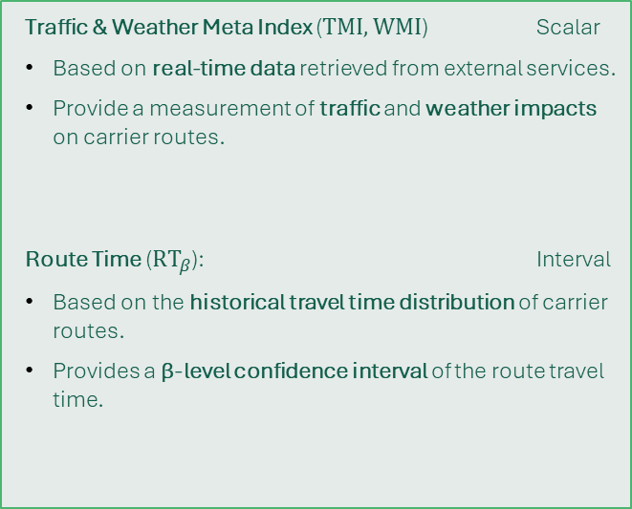
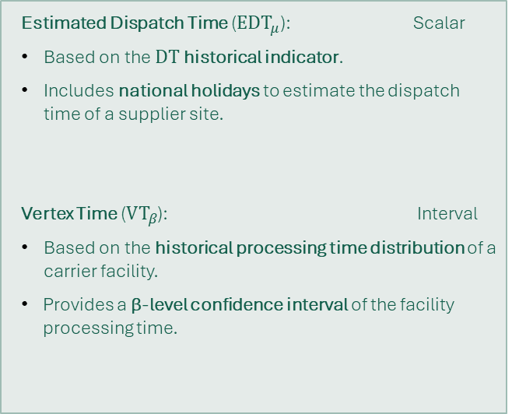
Definition (1)
HISTORICAL INDICATORS
Vertex Level
Route Level
Estimated Dispatch Time ($EDT_{μ}$): Scalar
Based on the $DT$ historical indicator.
Includes national holidays to estimate the dispatch time of a supplier site.
Vertex Time ($VT_{β}$): Interval
Based on the historical processing time distribution of a carrier facility.
Provides a β-level confidence interval of the facility processing time.
Traffic & Weather Meta Index ($TMI, WMI$) Scalar
Based on real-time data retrieved from external services.
Provide a measurement of traffic and weather impacts on carrier routes.
Route Time ($RT_{β}$): Interval
Based on the historical travel time distribution of carrier routes.
Provides a β-level confidence interval of the route travel time.
Notes:
A livello di vertici due indicatori per descrivere tempi di processamento dei fornitori (considerando le chiusure aziendali) e delle località intermedie.
A livello di archi due indicatori per quantificare l’impatto di traffico e clima e il tempo richiesto per percorrere l’arco.

Slide 19
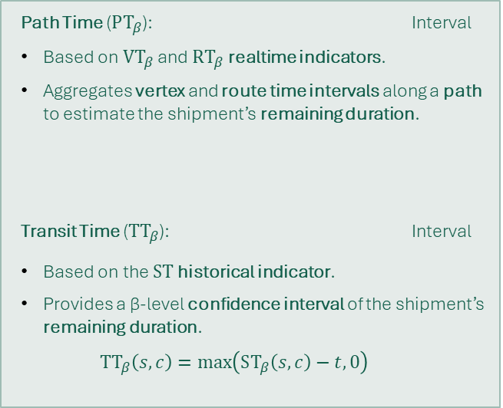
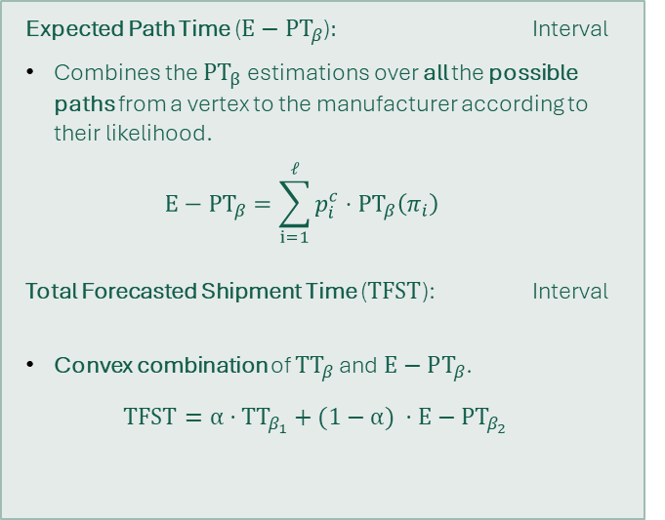
Definition (2)
HISTORICAL INDICATORS
Path Level
Graph Level
Path Time ($PT_{β}$): Interval
Based on $VT_{β}$ and $RT_{β}$ realtime indicators.
Aggregates vertex and route time intervals along a path to estimate the shipment’s remaining duration.
Transit Time ($TT_{β}$): Interval
Based on the $ST$ historical indicator.
Provides a β-level confidence interval of the shipment’s remaining duration.
$$TT_{β}\left(s,c\right)=\max\left(ST_{β}\left(s,c\right)−t,0\right)$$
Expected Path Time (${E−PT}_{β}$)$:$ Interval
Combines the ${PT}_{β}$ estimations over all the possible paths from a vertex to the manufacturer according to their likelihood.
$${E−PT}_{β}=\sum_{i=1}^{ℓ}{p_{i}^{c}⋅PT_{β}\left(π_{i}\right)}$$
Total Forecasted Shipment Time ($TFST$): Interval
Convex combination of $TT_{β}$ and $E−PT_{β}$.
$$TFST=α⋅{TT}_{β_{1}}+(1−α) ⋅{E−PT}_{β_{2}}$$
Notes:
A più alto livello due indicatori per descrivere il tempo richiesto per uno specifico cammino nel grafo: …
Infine, questi ultimi due vengono uniti tramite una combinazione convessa per determinare il tempo totale di spedizione.

Slide 20
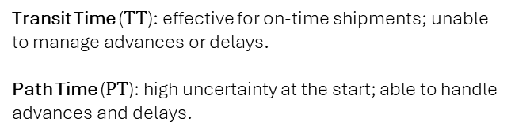

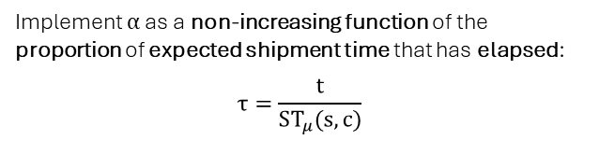
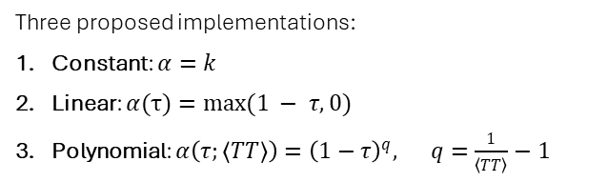
Implementation (1)
REALTIME INDICATORS
Objective
Solution
Transit Time ($TT$): effective for on-time shipments; unable to manage advances or delays.
Path Time ($PT$): high uncertainty at the start; able to handle advances and delays.
Implement $α$ as a non-increasing function of the proportion of expected shipment time that has elapsed:
$$τ=\frac{t}{ST_{μ}(s, c)}$$
Early phase: prioritize Transit Time to manage higher uncertainty and limited timing deviations.
Progressing phase: prioritize Path Time as uncertainty decreases and timing deviations emerge.
Three proposed implementations:
Constant: $α=k$
Linear: $α(τ)=\max{(1 − τ,0)}$
Polynomial: $α\left(τ;\left\langle TT\right\rangle \right)={\left(1−τ\right)}^{q}, q=\frac{1}{\left\langle TT\right\rangle }−1$
$$TFST=α⋅TT+(1−α)⋅PT$$
Notes:
Ci siamo chiesti come implementare il fattore di peso per sfruttare le qualità di entrambi i componenti: …

Slide 21
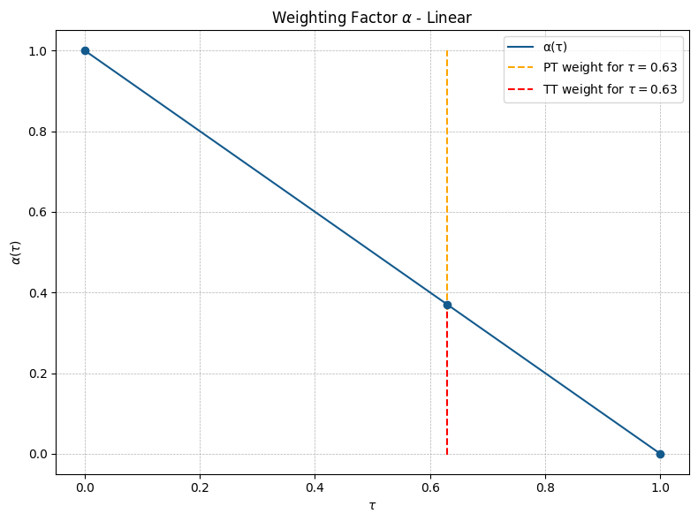
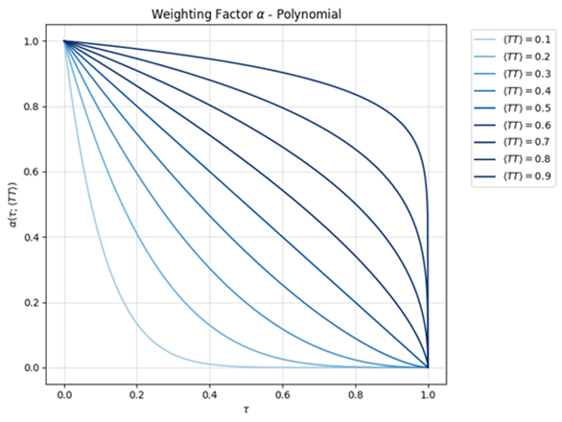


Implementation (2)
REALTIME INDICATORS
$$α\left(τ;\left\langle TT\right\rangle \right)={\left(1−τ\right)}^{q}, q=\frac{1}{\left\langle TT\right\rangle }−1$$
$$α(τ)=\max{(1 − τ,0)}$$
Prioritize PT over TT as shipment time progresses.
Tune $〈TT〉$ to minimize the total estimation error of TFST relative to the observed shipment times.
Notes:
Implementazione lineare: l’importanza del TT cala linearmente a favore del PT
Famiglia di funzioni polinomiali: parametro <TT> da tunare

Slide 22
Protoype & Experimental Evaluation

Slide 23
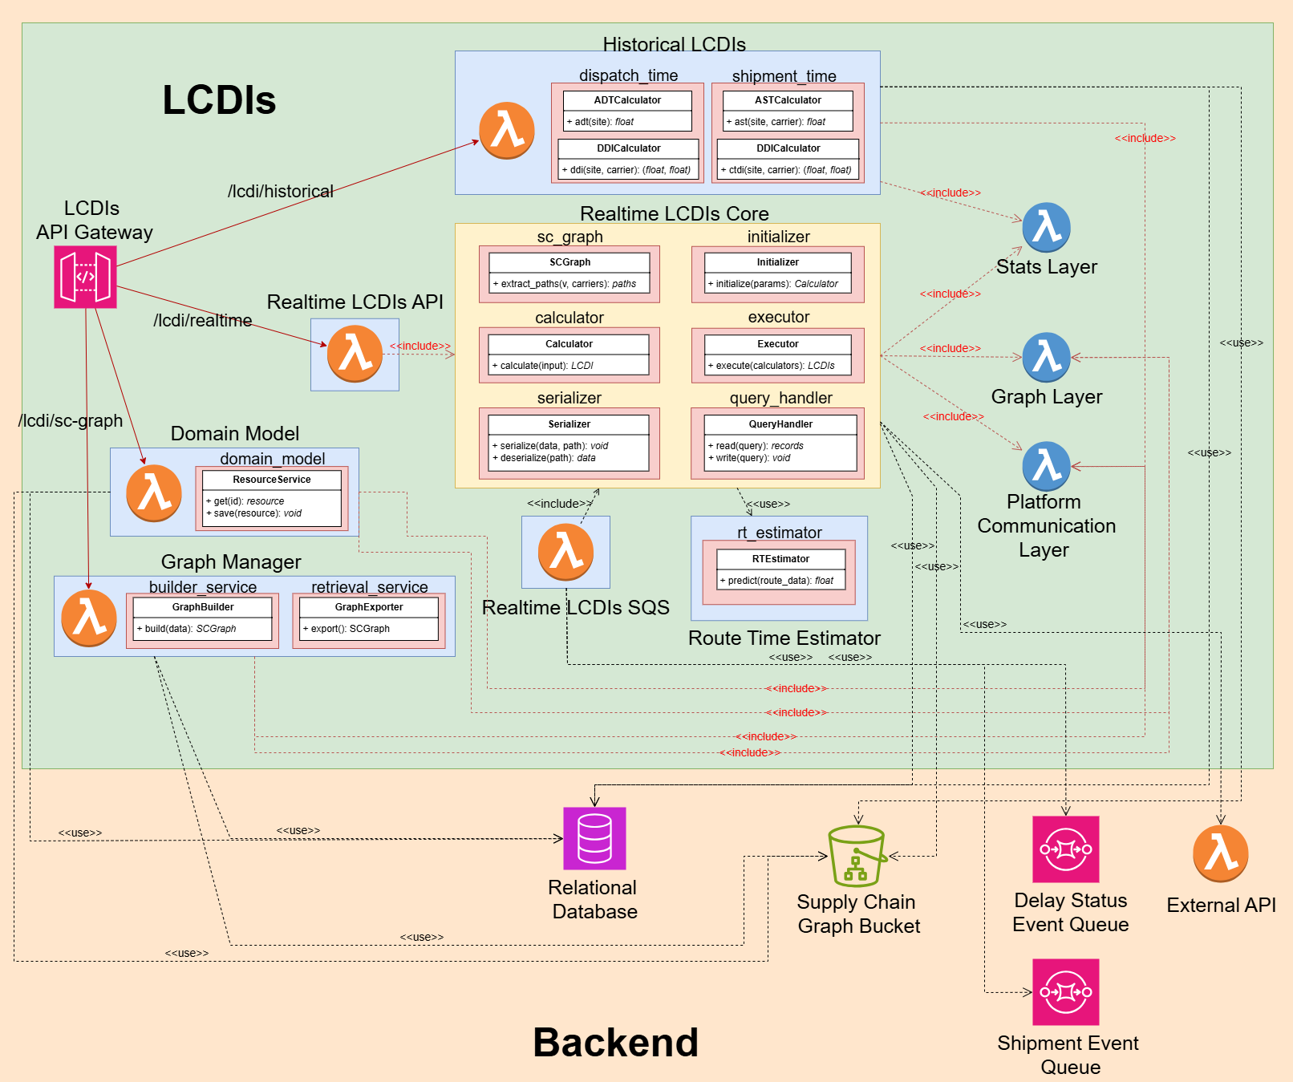
Prototype Architecture
Prototype & Experimental evaluation
Implementation & Deployment
Developed in Python with deployment on AWS:
Lambda Functions & Layers.
RDS (Relational Database Service).
S3 (Object Storage).
API Gateway.
SQS (Simple Queue Service).
Modularity & Configurability
Dynamic hyperparameter tuning via centralized configuration table.
Modular design enabling independent evolution of individual components.
Notes:
Architettura del prototipo, sviluppato utilizzando le risorse offerte da AWS e disegnato per avere un alto livello di modularità e indipendenza delle componenti, al fine di …

Slide 24
Evaluation Methodology
PROTOTYPE & Experimental evaluation
Time Resolution
Evaluation steps
Distributions fitted using hourly-resolution data.
System evaluated at daily scale using two approaches:
Hourly-based: metrics computed from hourly predictions, then reported by day.
Daily-based: predictions discretized into business days, with metrics directly evaluated at this scale.
Quantitative evaluation on:
Sharpness: width of predicted intervals.
Coverage: proportion of observations within the predicted interval.
Interval Score: single measure accounting for both sharpness and coverage.
Sensitivity Analysis: assessing model coverage across varying confidence levels.
Visualization of the evolution of shipment estimates.
Evaluation focused on the system’s ability to accurately predict delivery time windows for orders, leveraging event data reported by carriers throughout the shipment process.
Notes:
Sistema valutato sulla capacità di stimare i tempi di spedizione degli ordini.
Tutto il sistema si basa su tempi a livello di ore, ma il nostro partner industriale richiedeva stime a livello di giorni lavorativi:
Stime orarie: calcolate e valutate in ore e poi riportate in giorni;
Stime giornaliere: discretizzate e valutate in giorni.

Slide 25
Quantitative Evaluation
Prototype & Experimental evaluation
Operational Stage | Sharpness (days) |  | Coverage (%) |  | Interval Score (days)
 | Hourly | Daily | Hourly | Daily | Hourly | Daily
Dispatch | 2.15 | 2.20 | 0.28 | 0.56 | 4.22 | 4.26
Shipment | 1.03 | 1.18 | 0.52 | 0.84 | 1.45 | 1.63
Training Set – 90% Confidence
Operational Stage | Sharpness (days) |  | Coverage (%) |  | Interval Score (days)
 | Hourly | Daily | Hourly | Daily | Hourly | Daily
Dispatch | 2.87 | 3.00 | 0.3 | 0.5 | 7.81 | 7.44
Shipment | 1.30 | 1.55 | 0.63 | 0.86 | 1.99 | 2.20
Test Set – 90% Confidence
Notes:
Primo step: metriche quantitive di sharpness, coverage ed interval score
Includendo anche la stima del processo di dispatch, performance inaffidabili
Considerando solo il processo di spedizione, stime giornaliere vicini ai livelli di confidenza richiesti.

Slide 26
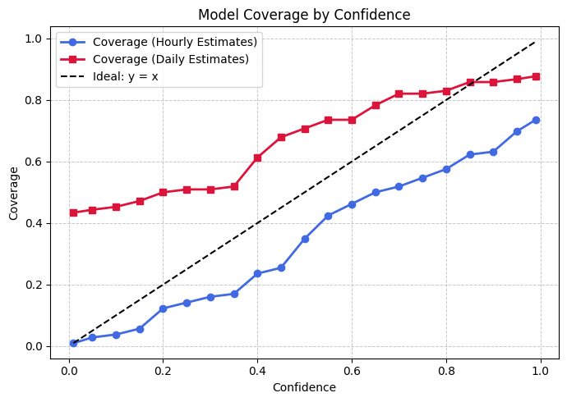
Sensitivity Analysis
Prototype & Experimental evaluation
Evaluation
Coverage assessed on the test set across multiple nominal confidence levels.
Hour-resolution estimates show under-reliability.
Day-resolution estimates show over-reliability up to a nominal confidence of 0.85
Notes:
Analisi di sensitività conferma inaffidabilità per le stime orarie, mentre quelle giornaliere risultano affidabili fino a livelli di confidenza molto alti

Slide 27
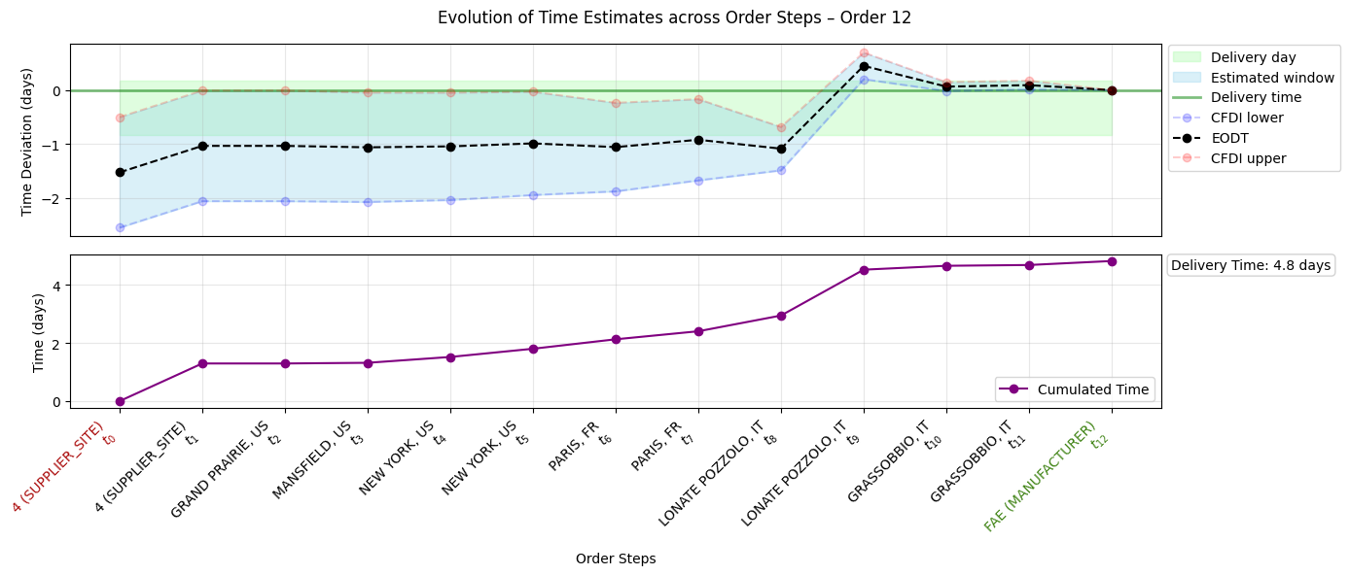
Evolution of Shipment Estimates (1)
Prototype & Experimental evaluation
Notes:
Visualizzazione delle stime con il procedere della spedizione:
Nel grafico inferiore l’avanzare del tempo a seconda dei vari step
Nel grafico superiore l’intervallo stimato e il giorno di consegna effettivo

Slide 28
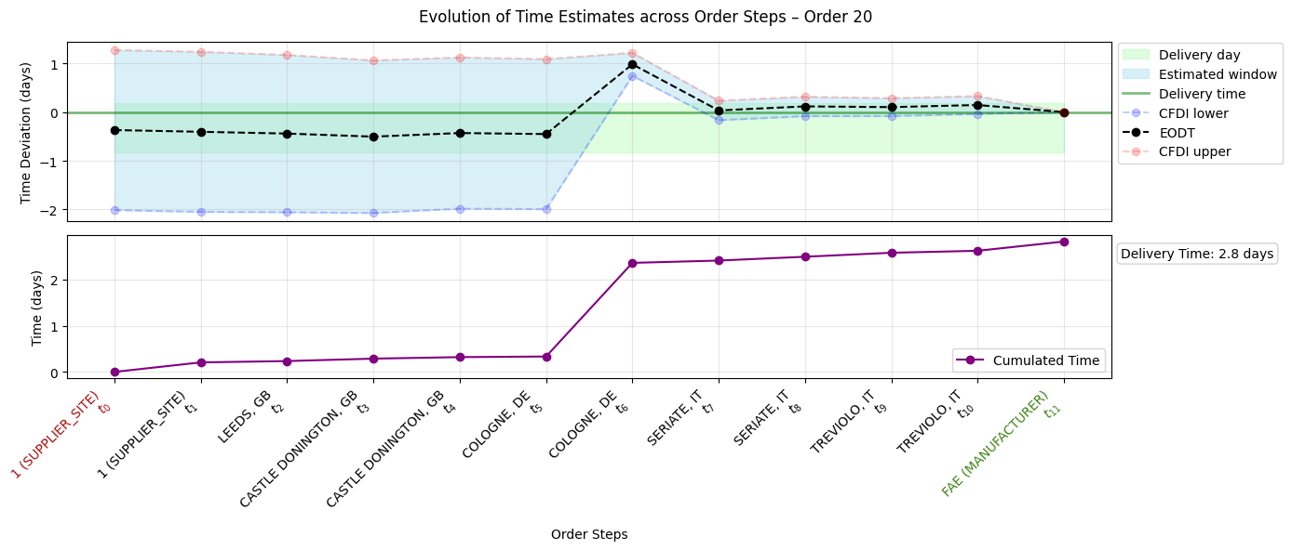
Evolution of Shipment Estimates (2)
Prototype & Experimental evaluation
Notes:
Incertezza cala con il proseguire della spedizione, dovuto al ridotto numero di possibili cammini

Slide 29
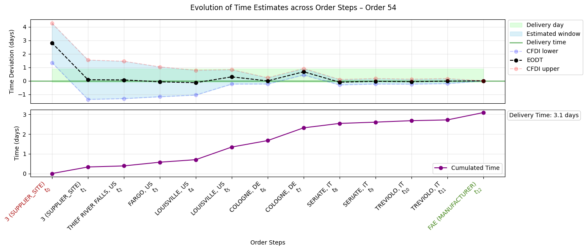
Evolution of Shipment Estimates (3)
Prototype & Experimental evaluation

Slide 30
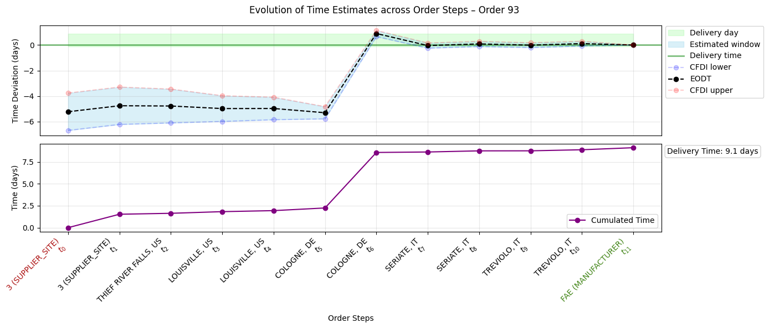
Evolution of Shipment Estimates (4)
Prototype & Experimental evaluation
Notes:
Errore rilevante nei primi step della spedizione, dovuto al ritardo accumulatosi a Colonia ( dedotto dall’inclinazione del segmento)

Slide 31
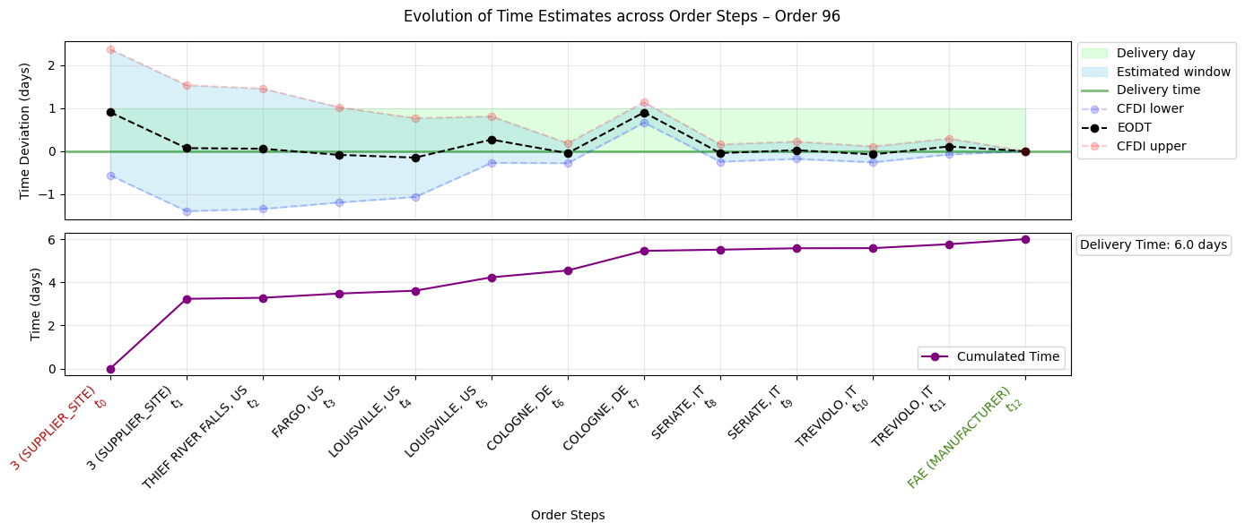
Evolution of Shipment Estimates (5)
Prototype & Experimental evaluation

Slide 32
Conclusion

Slide 33
Future Developments
Future development should focus on acquiring more data to improve calibration and support the implementation of more sophisticated solutions for specific indicators.
conclusion
Data Expansion
Expand the dataset and refine all data-driven components to improve calibration, enhance indicators and increase reliability of predictions.
Refinement of Indicators Implementation
Implement and validate more advanced solutions for specific indicators.
Multi-Manufacturer Extension
Extend framework to support multiple manufacturers and more complex operational contexts.
Notes:
Futuri sviluppi includono innanzitutto la raccolta di una maggiore quantità di dati, con la quale sarà poi possibile fornire implementazioni più raffinate degli indicatori
Inoltre il framework dovrà essere esteso per aggregare dati da più di un’azienda manufatturiera.

Slide 34
References
CONCLUSION
L. R. Ford and D. R. Fulkerson, “Maximal flow through a network,” Canadian Journal of Mathematics, vol. 8, no. 3, pp. 399–404, 1956.
J. R. Norris, Markov Chains. Cambridge University Press, 1998.
G. Grimmett and D. Stirzaker, Probability and Random Processes, 3rd.Oxford University Press, 2001.
A. V. Hill, J. M. Hays, and E. Naveh, “A model for optimal delivery time guarantees,” Journal of service research, vol. 2, no. 3, pp. 254–264, 2000
T. Gneiting and A. E. Raftery, “Strictly proper scoring rules, prediction and estimation,” Journal of the American Statistical Association, vol. 102,no. 477, pp. 359–378, 2007.
Y. Huang, A. Bárdossy, and K. Zhang, “Sensitivity of hydrological models to temporal and spatial resolutions of rainfall data,” Hydrology and Earth System Sciences, vol. 23, no. 6, pp. 2647–2663, 2019.

