Slide 1
Mobile Game Server Demo Rock Paper Scissors

Slide 2
Outline
A prototype-level demonstration of a mobile game server implementation
rock paper scissors game
Implementation of a two-player rock-paper-scissors game based on a turn-based game as demo content
Attempting to implement a server architecture capable of producing mobile games such as Clash of Clans

Slide 3
Server Architecture
API Server
Stateless
HTTP-based Rest API Server
Responsible for logging in and running the game
Game Server
Stateful
WebSocket-based real-time communication server
Responsible for game matching and game play

Slide 4
Game Architecture and Key Messages
API Server
Rest API
Game Server
WebSocket Server
1. Log in
2. Game Server Address
3. User Matching and Gameplay
Client
C# based PC Client (Mobile Client Simulation)

Slide 5
Demo video introduction
Here is a short video content displayed
Shows the start of the API server and game server
After two real clients connect to the server, they play a game of rock, paper, scissors
Clients use message boxes to display sequential messages and receive input

Slide 6
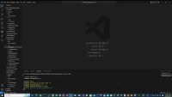
Demo Video

Slide 7
Server technology stack
LibShare
TypeScript
Modules that can be shared, such as DB and Session
API Server
TypeScript
Node.js
Express
Game Server
TypeScript
Node.js
WebSocket
Redis
Real-time sharing information such as sessions
Mongo DB
Permanent information like user

Slide 8
Design #1: API Server Distributed Processing
Redis-based session and session expiration implementation
Cookieless load balancing when running multiple stateless API servers
API Server
API Server
API Server
Redis
Real-time sharing information such as sessions

Slide 9
Design #2: Game Server Distributed Processing
The API server sends the server address for connecting to the game to the client, and the client connects to that address
It can be implemented to check the status of the game servers and send the address of one of the game servers with capacity.
Game Server
API Server
Game Server
Choose one of several game servers
Game Server
Connect
Game Server Address
Client

Slide 10
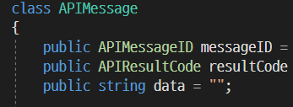
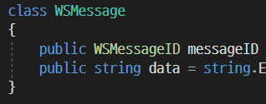
Design #3: JSON-based Message
Rest API Message
WebSocket Message
This is the part that is converted to JSON format Various actual data is passed as JSON string to the data property

Slide 11
Design #4: Client
C# based Test PC client
Technologies like WebSocket and JSON are also essential for C# mobile game servers, and the client library has them

Slide 12
Later implementation
https support
JWT

