Slide 1



Data Engineer Bootcamp
Capstone Project
Fawaz Ayashi
Zaynab Alshhry
Yara Sulami

Slide 2



01
Project Objects
Agenda
Project Name
02
Data Overview
03
Project Steps
04
Project Achievement
05
Future

Slide 3

Project Objectives
What are the project requirements?
What tool you are going to use?
How to design the project process?
How to split the project work?

Slide 4
How to design the project process?
Create Inventory table
Build Lambda function
Build tables, schema and dimension
Set up Airbyte
Build dashboard at Metabase

Slide 5
Data Overview
Tables that included in this project are:
What are the relationships between the tables?
we used “coalesce” to cleansing null and avoid any issue .
Which table do you need to load data continuously? Which table needs only loading once?

Slide 6
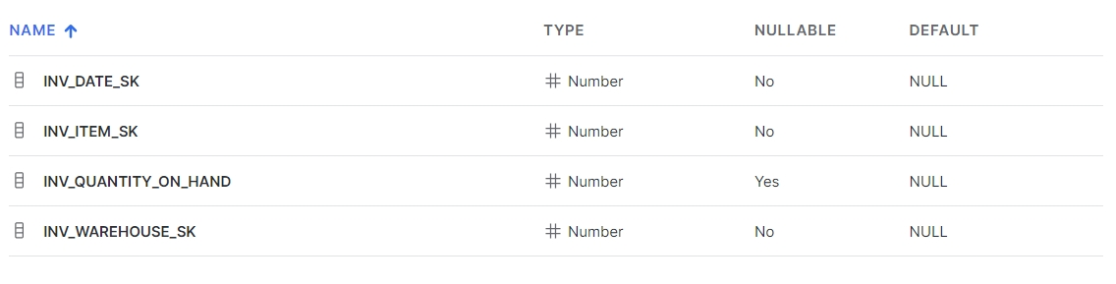
Part One: Data Ingestion
Frist, we built inventory table manually in snowflake

Slide 7
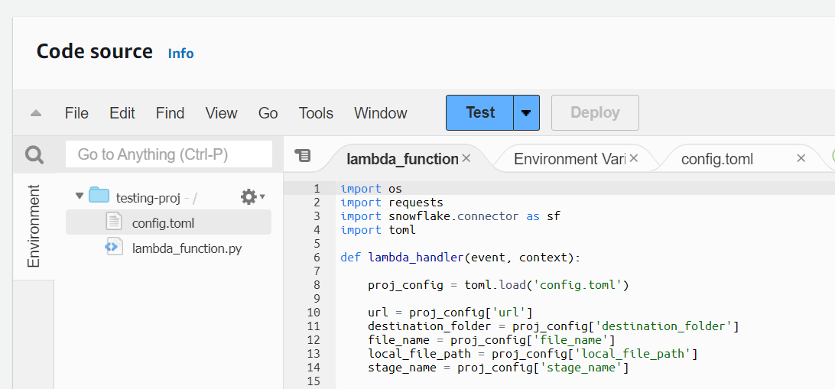
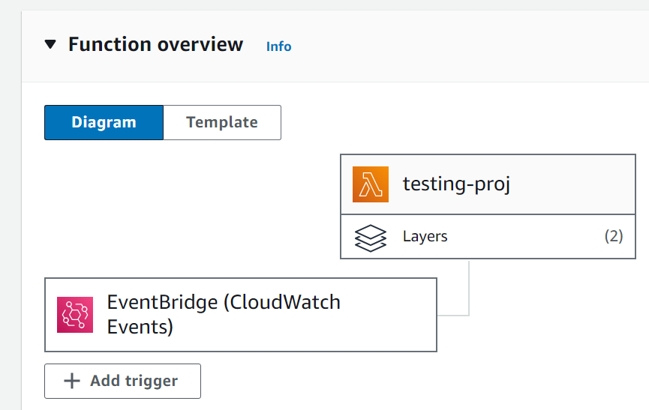
Part One: Data Ingestion
Second, we built lambda function and set up a daily cron

Slide 8
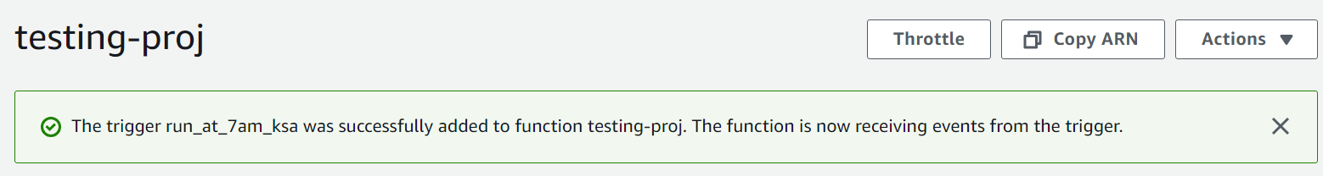
Part One: Data Ingestion
Second, we built lambda function and set up a daily cron

Slide 9
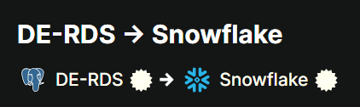
Part One: Data Ingestion
third, we set up a connection between Postgres and snowflake to pass the TPCDS data using Airbyte

Slide 10
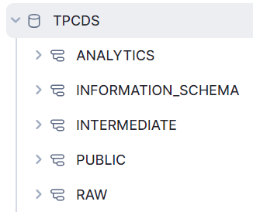
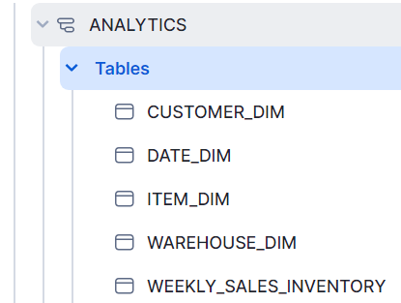
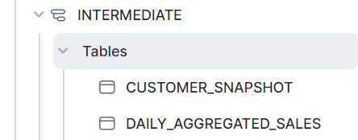
Part Two: Data Transformation
In this stage we built new tables from their original data and new schema

Slide 11
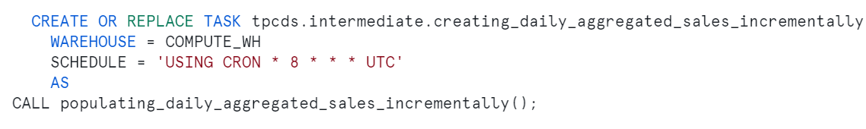
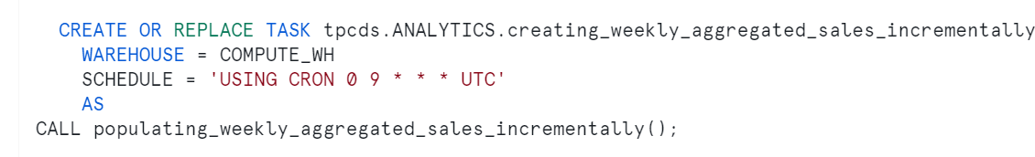
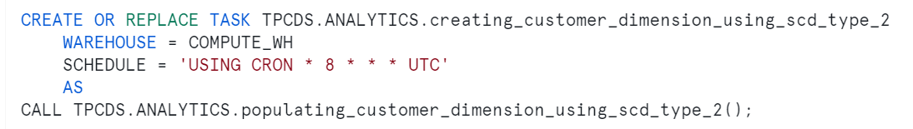
Part Two: Data Transformation
Then we built Scheduling function

Slide 12
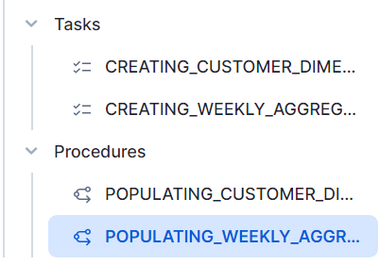
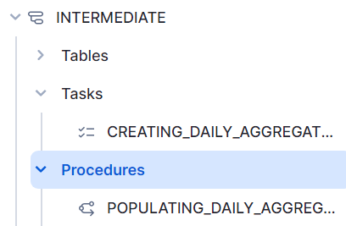
Part Two: Data Transformation
Then we built Scheduling function

Slide 13
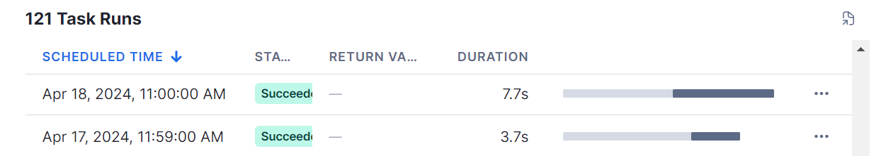
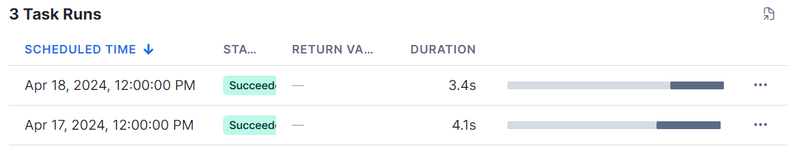
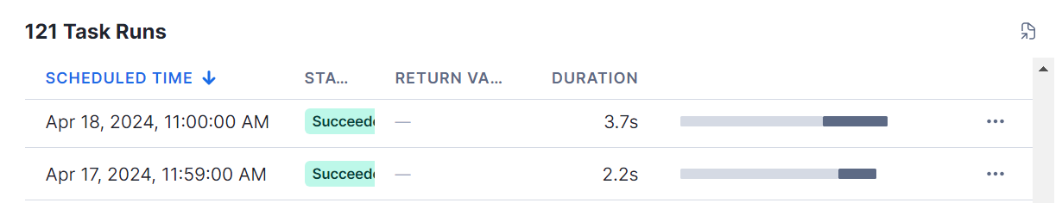
Part Two: Data Transformation
Then we built Scheduling function

Slide 14
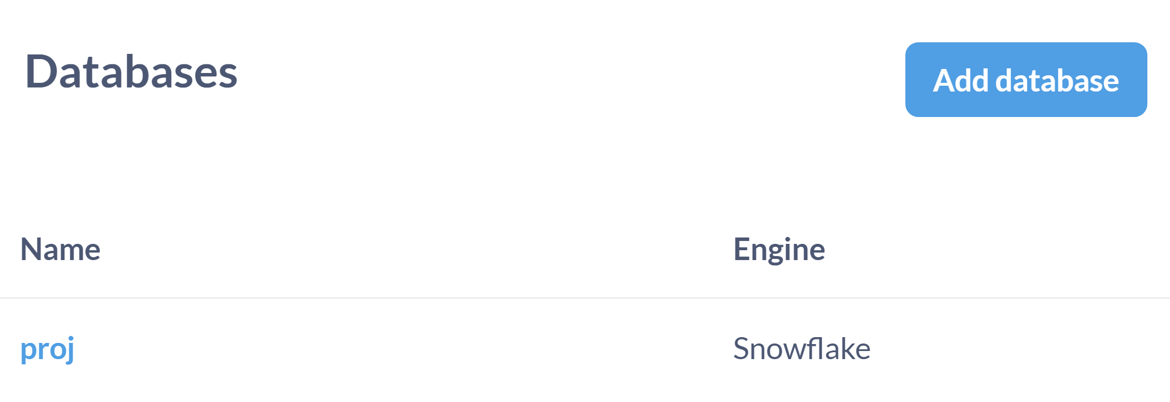
Part Three: Data Analysis
In this stage which is last one, we built dashboard using Metabase
Frist we established a connection between Snowflake Metabase

Slide 15
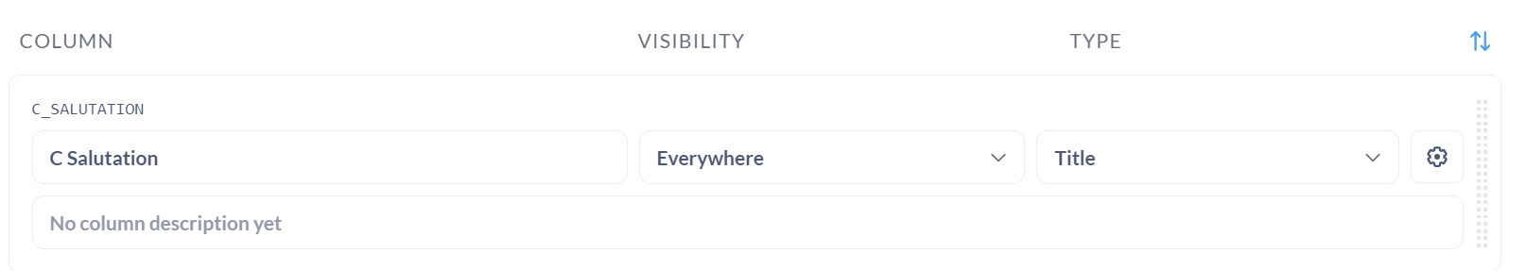
Part Three: Data Analysis
We modified some type of columns

Slide 16
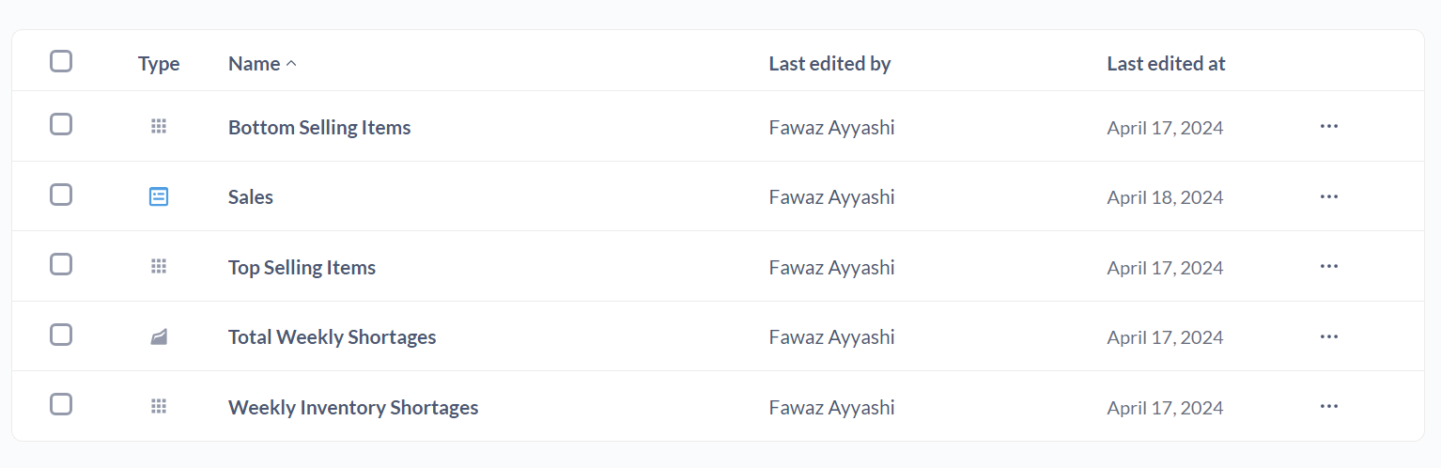
Part Three: Data Analysis
We answered the 3 questions, then we built a dashboard

Slide 17
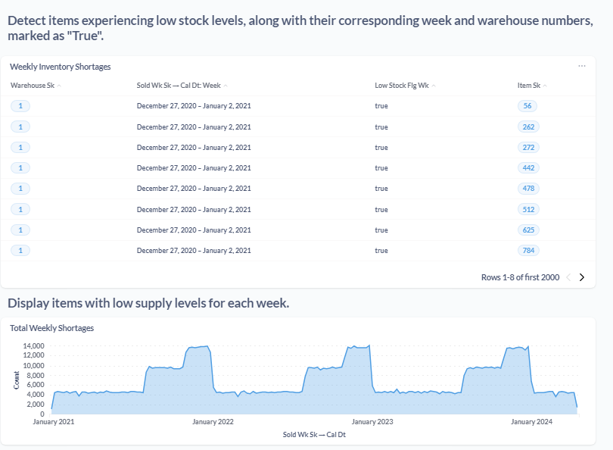
Part Three: Data Analysis
And here is the dashboard

Slide 18
Future
Build more business requirements and more questions
Build segmentation method to identify who is loyal customer and who is not

Slide 19
Thank you!

