Slide 1
Fraud Detection using Machine Learning
Project by Sameer Kamble

Slide 2
Problem Statement
As online payments are growing, online financial fraud is also increasing fast.
This causes losses for customers and damages the bank’s reputation.
To prevent this, it is important to detect fraudulent transactions early.
Goal - We need a model that can find frauds accurately while reducing false positives (flagging legit transactions as fraud).

Slide 3
Project summary
Dataset source - Kaggle
Size of data - 63.62 lakhs rows and 11 columns
Tools used - Python
Library - Pandas, Numpy, Scikit learn, Matplotlib, Seaborn, etc.

Slide 4
Data Preprocessing
Imported the data and removed unnecessary columns.
Checked for nulls and converted all object cols to number using Label Encoder.
Performed EDA-
> Dataset is highly imbalanced (required sampling) only 6570 recs of frauds out of 63L recs.
> Found most used transaction types (cash-out, payment, cash-in)
> Plotted heatmap to check co-relations between cols. (no relation found)

Slide 5
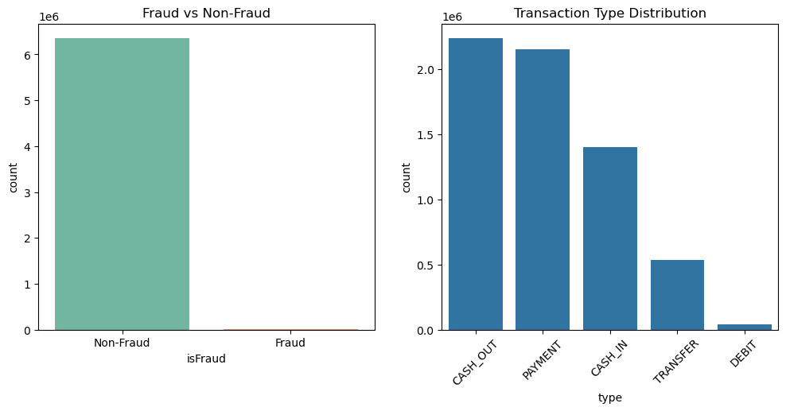

Slide 6
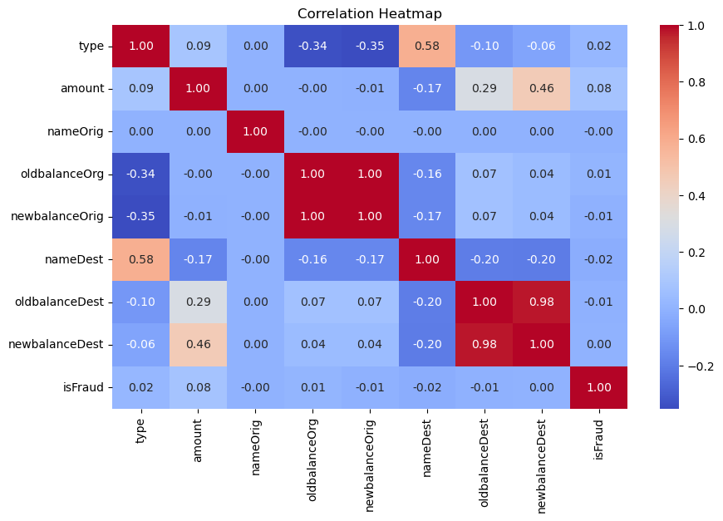

Slide 7
Data preprocessing
Data split & resampling-
Considered 80% - 20% split, performed under and oversampling on Train data : (Used SMOTE and RandomUnderSampler from imblearn)
After resampling (Non fraud rec- 1016704, fraud rec- 508352)
Data is now balanced and is in ratio 2:1
Test data remained untouched to maintain authenticity.

Slide 8
Model building
Started with baseline models like Logistic, Decision Tree to set a benchmark.
Evaluation matrix considered is Precision, Recall and f1-score for class 1.
Tried advance models as well like Random forest, KNN and neural network (MLP).
Tried boosting techniques – XGBoost.
Used Isolation forest – which is specifically used for anomaly detection.
Total 7 models were built.

Slide 9
Model building - Evaluation
Best performing model is Random Forest with 98% Recall, 42% Precision and 59% F1 Score.
Some models drastically failed and some were near boundary line. However, considering the requirement of the model, selected model evaluation parameters and finalised the Random forest model.
Accuracy for almost all model were 100% which may be misleading as most of the records were for class 0 (imbalanced data).

Slide 10
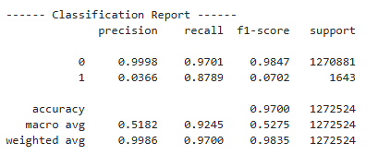
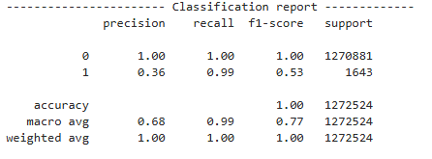
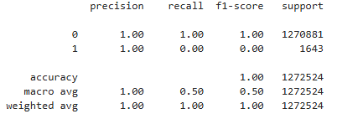
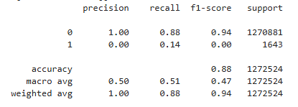
CLASSIFICATION REPORTS
Logistic Regression
XG-Boost
MLP
Isolation forest

Slide 11
Model tuning
As we’ve selected best performing model (Random Forest), we can use Cross Validation with Grid Search to optimise it further.
Coss-validation + Grid search helps build a model that is more accurate and generalizes well, without manually guessing hyperparameters.
Fitted 3 folds for each 30 models, totaling 90 fits and best parameters were -

Slide 12

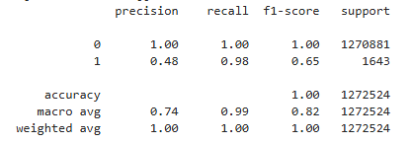
Final Model
Used Random Forest with Best parameters, model further improved by 6% in Precision and 6% in F1 score.
Final Scores :
98% Recall (Class 1)
48% Precision (Class 1)
65% F1 Score (Class 1)
Overall Accuracy 100%
Confusion matrix & classification report.

Slide 13
Model Performance Summary
High Overall Accuracy (~100%)
The model classifies the vast majority of transactions correctly, showing strong overall learning.
Excellent Recall for Fraud Cases (98%)
The model detects almost all actual frauds, which is critical in real-life banking scenarios.
Very Low False Negatives
Only 26 fraud cases were missed out of 1,643 – showing strong reliability in catching fraud.
Handles Imbalanced Data Well
Despite the extreme class imbalance (fraud is <0.1% of data), the model is still able to identify frauds effectively.
Good F1-Score for Fraud (0.65)
Balanced performance between precision and recall – especially important in fraud where both matter.

Slide 14
Challenges
Class Imbalance
Fraud cases are extremely rare compared to normal transactions (Used sampling techniques)
High Cost of False Negatives
Missing a fraud transaction (false negative) can lead to financial losses and customer dissatisfaction.
(Hence, recall is more important than just accuracy)
Choosing the Right Evaluation Metrics
Accuracy alone is misleading in imbalanced datasets.
Needed to rely on Recall, Precision, F1-Score, and Confusion Matrix for better evaluation.
Model Selection and Hyperparameter Tuning
Tried different models like Logistic Regression, Random Forest, and XGBoost.
Needed cross-validation and GridSearchCV to find the best performing model.
Large Dataset Size & Processing Time
The dataset had over 63 lakhs transactions, making processing and training time-consuming.
Required efficient data handling and model training techniques to optimize performance.

Slide 15
Learning and suggestions
Got to know about new algorithms and techniques (Isolation forest, sampling techniques and fine tuning techniques – Randint)
We can use real life data to get more relevant information like location, time, merchant category of transactions which can help model perform even better.
The model is future-proof because online transactions will keep growing, so the need for this kind of fraud detection will stay or even increase.
Added value – Reduce financial losses, Protects customer and bank’s reputation,
Automated manual review, etc.
Consider deploying the model for real-time fraud detection to catch suspicious transactions instantly.

Slide 16
Thank you for your time and attention… ☺
I look forward to your feedback and any questions you may have.

