Slide 1
Amazon Cloud
By Steve Torres and Misty Mays

Slide 2
Presentation Topics
What is Amazon?
What is cloud computing?
Amazon Web Services (AWS)
Amazon Cloud Drive Info and APIs
Amazon EC2 Info and APIs
Amazon S3 Info and APIs
Case Studies
Competition

Slide 3
What is Amazon?
World’s largest online retailer
Cloud services provider
US based company
Jeff Bezos incorporated in July of 1994
Originally a book seller
Launched AWS in 2006

Slide 4
What is Cloud Computing?
On-demand delivery of IT services and applications over the Internet
Uses resources as a utility
No in-house infrastructures
Self-service provisioning
Elasticity
Pay per use
Three types: Private, public or hybrid
Three broad service categories: Iaas, Paas, Saas

Slide 5
Amazon AWS
Launched in 2006
One of the first companies to offer cloud computing services
Regions with central hubs called availability zones
Provides online services for websites and client-side applications
Customers are billed according to usage

Slide 6
Amazon AWS
Public cloud services
Sold on demand
Infrastructure as a service (Iaas)
Virtual server instance and storage
APIs
Migrate workloads to virtual machines

Slide 7
Some AWS Services
Elastic Cloud Compute (EC2)
Simple Storage Service (S3)
CloudDrive
Dynamo Database (DynamoDB or DDB)
CloudSearch
Redshift
ElastiCache
Over three dozen total services

Slide 8








Some Companies that Use AWS

Slide 9
AWS Account
Must sign up for an account with AWS to use services
Once you sign up you have access to all services on AWS
Pick and choose what services you need
AWS Console Hub- User friendly, point and click interface

Slide 10
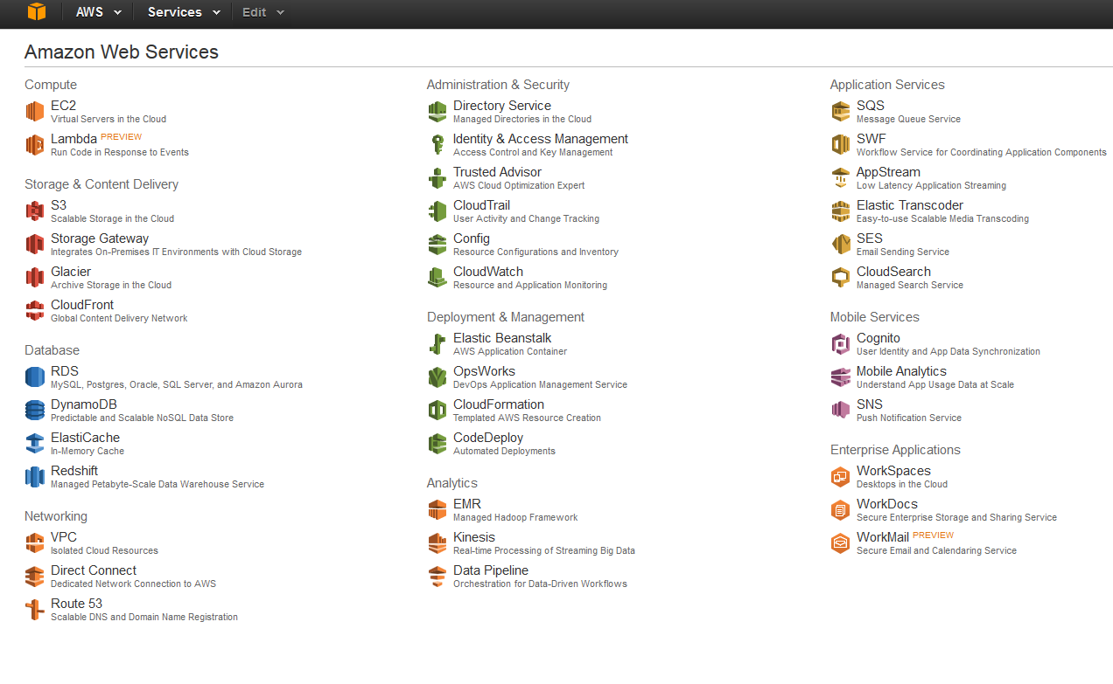

Slide 11
Amazon EC2
Amazon Elastic Cloud Compute
Provides resizable compute capacity in the cloud
Various instance types and pricing options to fit customers’ needs - AMIs
Preconfigured templates for instances
Secure login with key pairs
Elastic IP addresses
Metadata or tags
Virtual private clouds
Notes:
http://aws.amazon.com/ec2/pricing/

Slide 12
Using EC2 - Creating
Launch an Amazon EC2 Instance
Connect to Instance
CloudWatch
Add a Volume to Instance
Clean up Instance and Volume

Slide 13
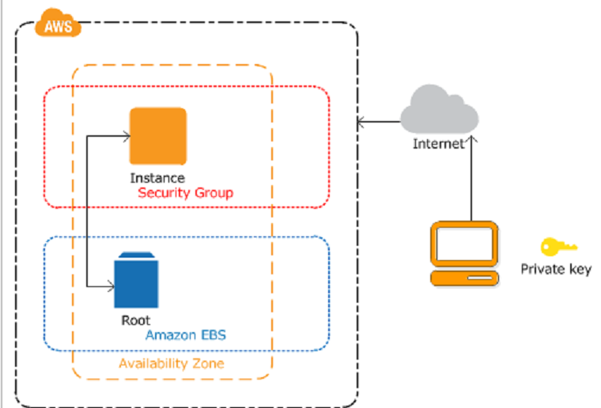
Using EC2- Creating

Slide 14
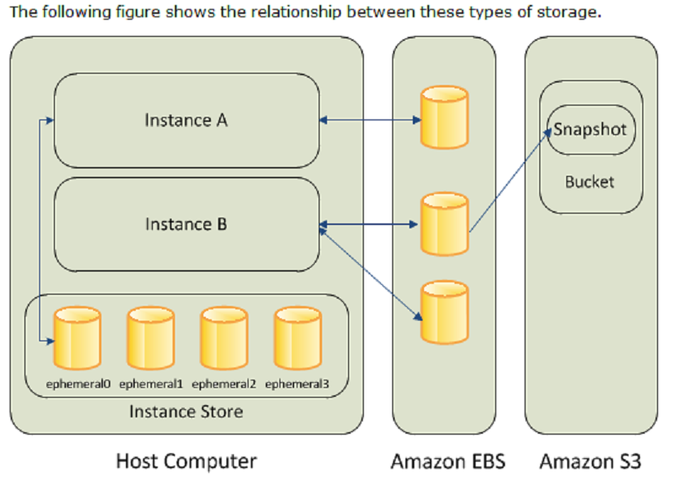
Using EC2 – Adding Volume

Slide 15
Using EC2 - APIs
Amazon EC2 Query API - REST
HTTP or HTTPS requests
Use HTTP verb GET or POST and a Query parameter named Action
Action examples
AMIs – CopyImage, CreateImage
Instances – DescribeInstance, GetConsoleOutput
Key Pairs - CreateKeyPair

Slide 16
Using EC2 - APIs
A Query API consists of the following:
Endpoint, Action, Parameters, Version, Authorization parameters, DryRun, SecurityToken
A Query response returns an XML data structure that is specific to the request and usually named according to the operation

Slide 17
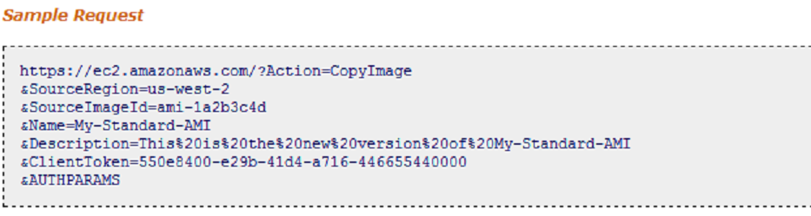
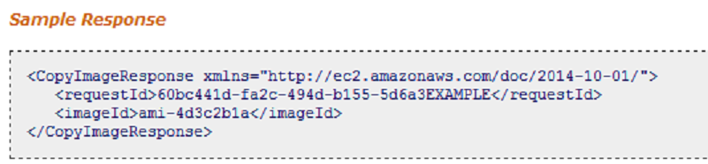
EC2 APIs - Example

Slide 18
Case Study - Netflix
Failure with their current database prompted change.
Fully integrated to cloud with AWS
EC2 allows Netflix to quickly launch as many virtual servers as needed based on customer traffic.
Netflix takes advantage of AWS availability zones

Slide 19
Amazon S3
Scalable storage
Low-latency data storage infrastructure
Low cost
Store any type of data
Key-based object store
Data stored in buckets
Standards-based REST and SOAP APIs

Slide 20
Using S3 - Functionality
Create a Bucket
Add an Object to a Bucket
View an Object
Move an Object
Delete an Object and Bucket

Slide 21
S3 REST APIs
Representational State Transfer
Most systems using REST based APIs communicate over HTTP with HTTP with verbs
GET
POST
PUT
DELETE

Slide 22
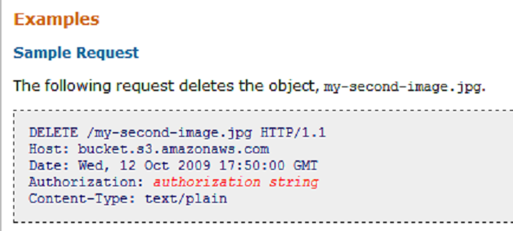
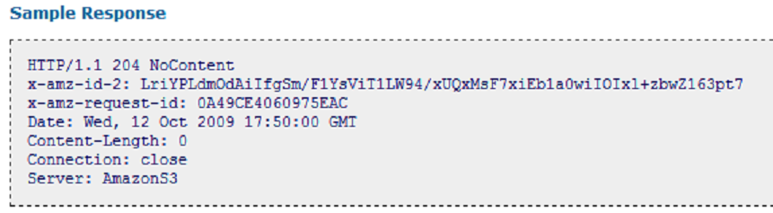
S3 REST API Example

Slide 23
S3 SOAP APIs
Simple Object Access Protocol
Uses XML for message format and HTTP for application layer protocols
SOAP APIs are being outdated with any new version of S3 and are not compatible with HTTP any longer
Companies currently using SOAP APIs with HTTPS are still able to function but will need to switch to REST APIs if they plan to use any new functionality

Slide 24
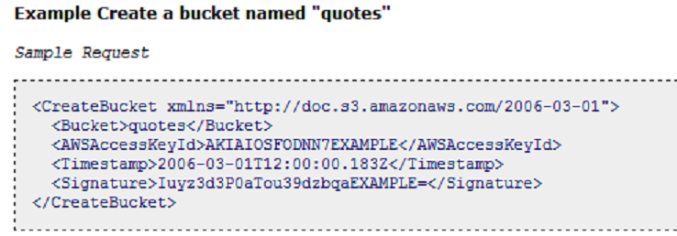
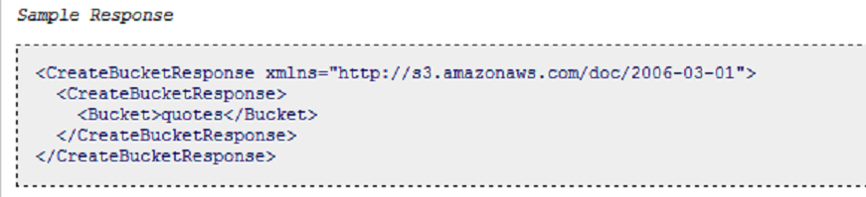
S3 SOAP API Example

Slide 25
Pinterest Case Study
Pinterest uses a few different AWS services
Uses S3 to store about 8 billion objects in their buckets with 410 TB of data stored, all different types of data
Uses Auto Scaling to control their server needs
Uses Elastic Load Balancing to distribute traffic across servers
Availability zones allows Pinterest to reroute any potential outages from one of their data centers.

Slide 26
Amazon Cloud Drive API
Provided by AWS and available for other companies to use
Lets users access photos, videos, documents and other files in the Amazon Cloud Drive
With APIs, it is possible to upload, view, edit, download and organize digital content
A safe and always accessible way to store content

Slide 27
Using Cloud Drive
Registering your app
Uses Login with Amazon API for authentication
Whitelisting your app
App needs to be whitelisted in order to read/write any node-related operations (Node API)
Authorizing your app
Two types of authorization
Implicit grant
Authorization code grant
APIs

Slide 28
Login with Amazon API
Uses OAuth 2.0 authorization
Let’s users login with their current Amazon account
Studies show that users like to log in with credentials they already know and trust
For example, Zappos.com uses Login with Amazon and 40% of their new customers choose to login with their Amazon credentials

Slide 29
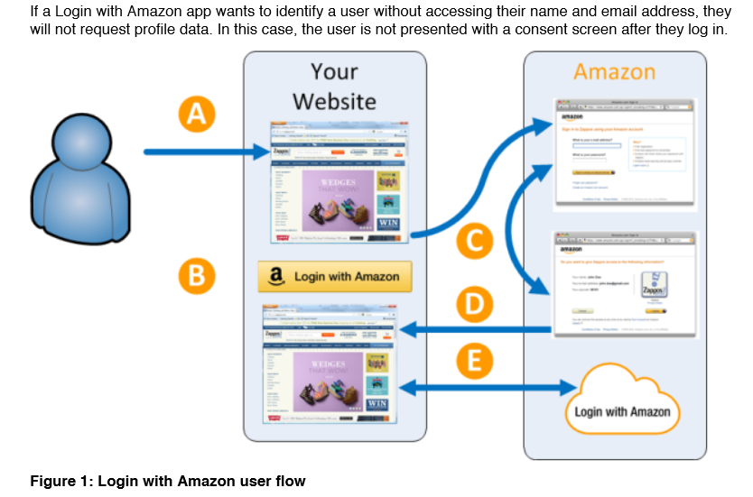
Login with Amazon API

Slide 30
Implicit Grant Authorization
Redirects user to Login with Amazon API
https://www.amazon.com/ap/oa
Parameters
client_id – app identification
scope – two permission levels, read/write
Response_type – token
Redirect_uri: return url to your app

Slide 31
Authorization Code Grant – Step 1
Redirects user to Login with Amazon to obtain code
client_id : Identification of the app scope : clouddrive:read and clouddrive:write, response_type : for authorization code grant, should be: code redirect_uri : One of the return urls you added to your app when signing up

Slide 32
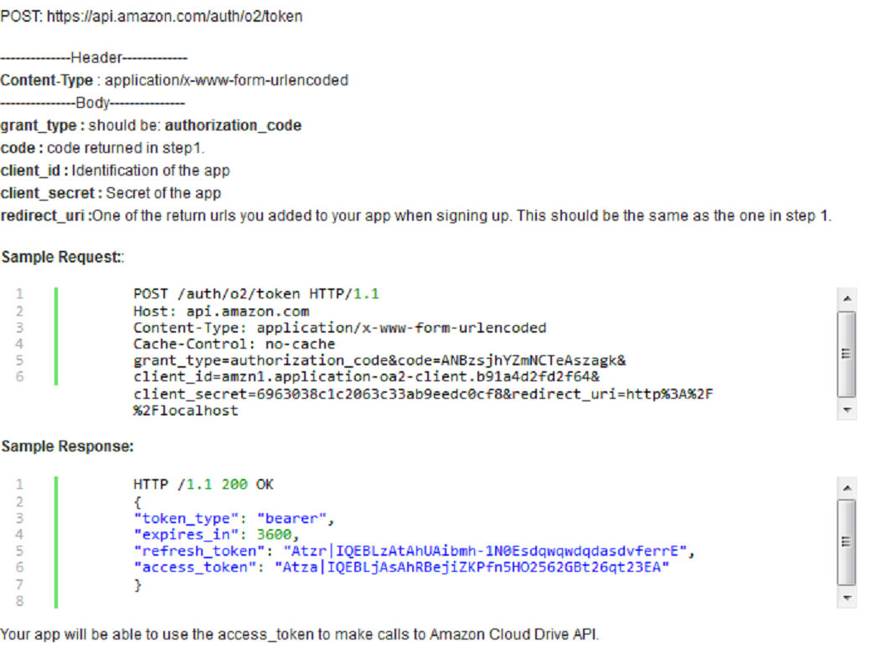
Authorization Code Grant – Step 2
2. The returned code asks for an access_token which will be used to call the Cloud Drive API

Slide 33
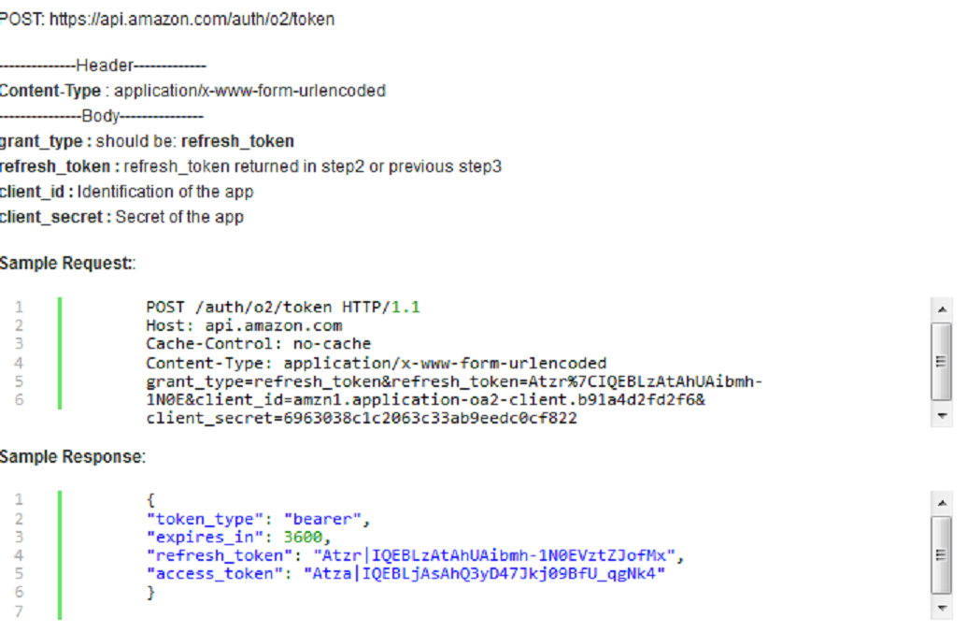
Authorization Code Grant – Step 3
Refresh_token function obtains new access_token when expired

Slide 34
Specific CloudDrive APIs
http://docs.aws.amazon.com/AWSJavaSDK/latest/javadoc/index.html
Account API – gets details about account
Nodes API – create, read and update contents in account
Changes API – keep up with changes in account
Trash API – trash nodes and put them in recycle bin

Slide 35
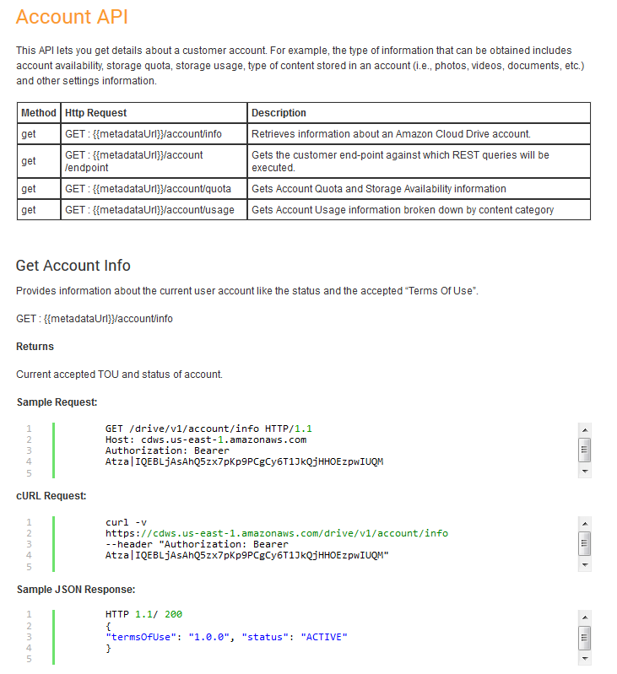
Cloud Drive Account API

Slide 36
AWS in the Web 2.0 World
Cloud Computing is a technology that requires user interaction, something impossible for Web 1.0
Web 2.0 enables simplicity on connecting user with web application/services to increase productivity and reduce stress
Web 2.0 along with other technologies make possible the complete interaction between pages, mobile, applications, etc.

Slide 37
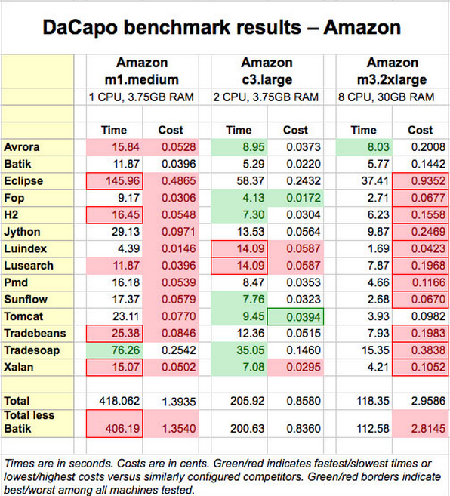
Financial Aspects of AWS

Slide 38
Competition
Google Compute Engine (GCE)
Public Cloud Model, Iaas
Late into the market, but offers lower costs
Windows Azure
Public Cloud Model, Iaas
Offering 99.99% up time. If some data is lost, the company gives credit for the downtime.
Google
Microsoft

Slide 39
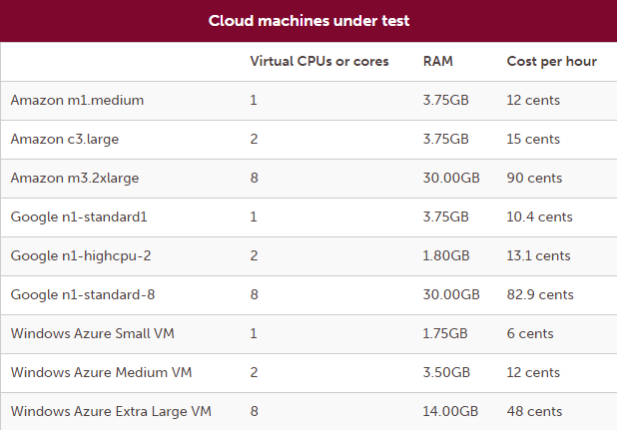
Competition

Slide 40
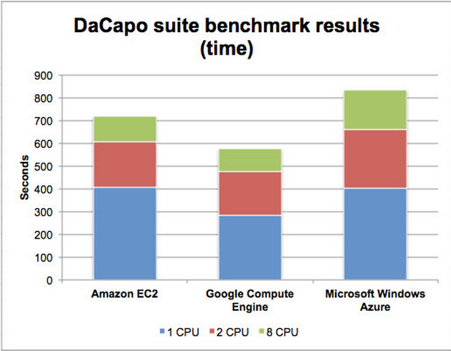
Competition cont'd

Slide 41
Additional Info for the Class
Anyone can sign up for a free tier account to AWS
There are many tutorials and certifications available for all the services that AWS offers
Link to start the sign up process
http://aws.amazon.com/

Slide 42
References
http://whatis.techtarget.com/definition/Amazon
http://en.wikipedia.org/wiki/Amazon.com
http://phx.corporate-ir.net/phoenix.zhtml?p=irol-corporateTimeline&c=176060
http://www.infoworld.com/article/2610403/cloud-computing/ultimate-cloud-speed-tests--amazon-vs--google-vs--windows-azure.html
http://searchcloudcomputing.techtarget.com/news/2240235969/Choosing-between-AWS-vs-Google-vs-Azure-cloud-storage
http://www.tomsitpro.com/articles/azure-vs-aws-cloud-comparison,2-870.html
https://www.cloudyn.com/wp-content/uploads/2014/08/What%E2%80%99s-behind-the-cloud-vendors-AWS-GCE-and-Azure.pdf
http://searchcloudcomputing.techtarget.com/definition/cloud-computing
http://phx.corporate-ir.net/phoenix.zhtml?c=176060&p=irol-mediaKit
http://aws.amazon.com/ec2/
http://docs.aws.amazon.com/AWSEC2/latest/UserGuide/concepts.html
https://developer.amazon.com/public/apis
https://images-na.ssl-images-amazon.com/images/G/01/lwa/dev/docs/website-developer-guide._TTH_.pdf
http://aws.amazon.com/solutions/case-studies/netflix/
http://aws.amazon.com/solutions/case-studies/pinterest/

