Slide 1


Slide 2

RECAP....

Slide 3
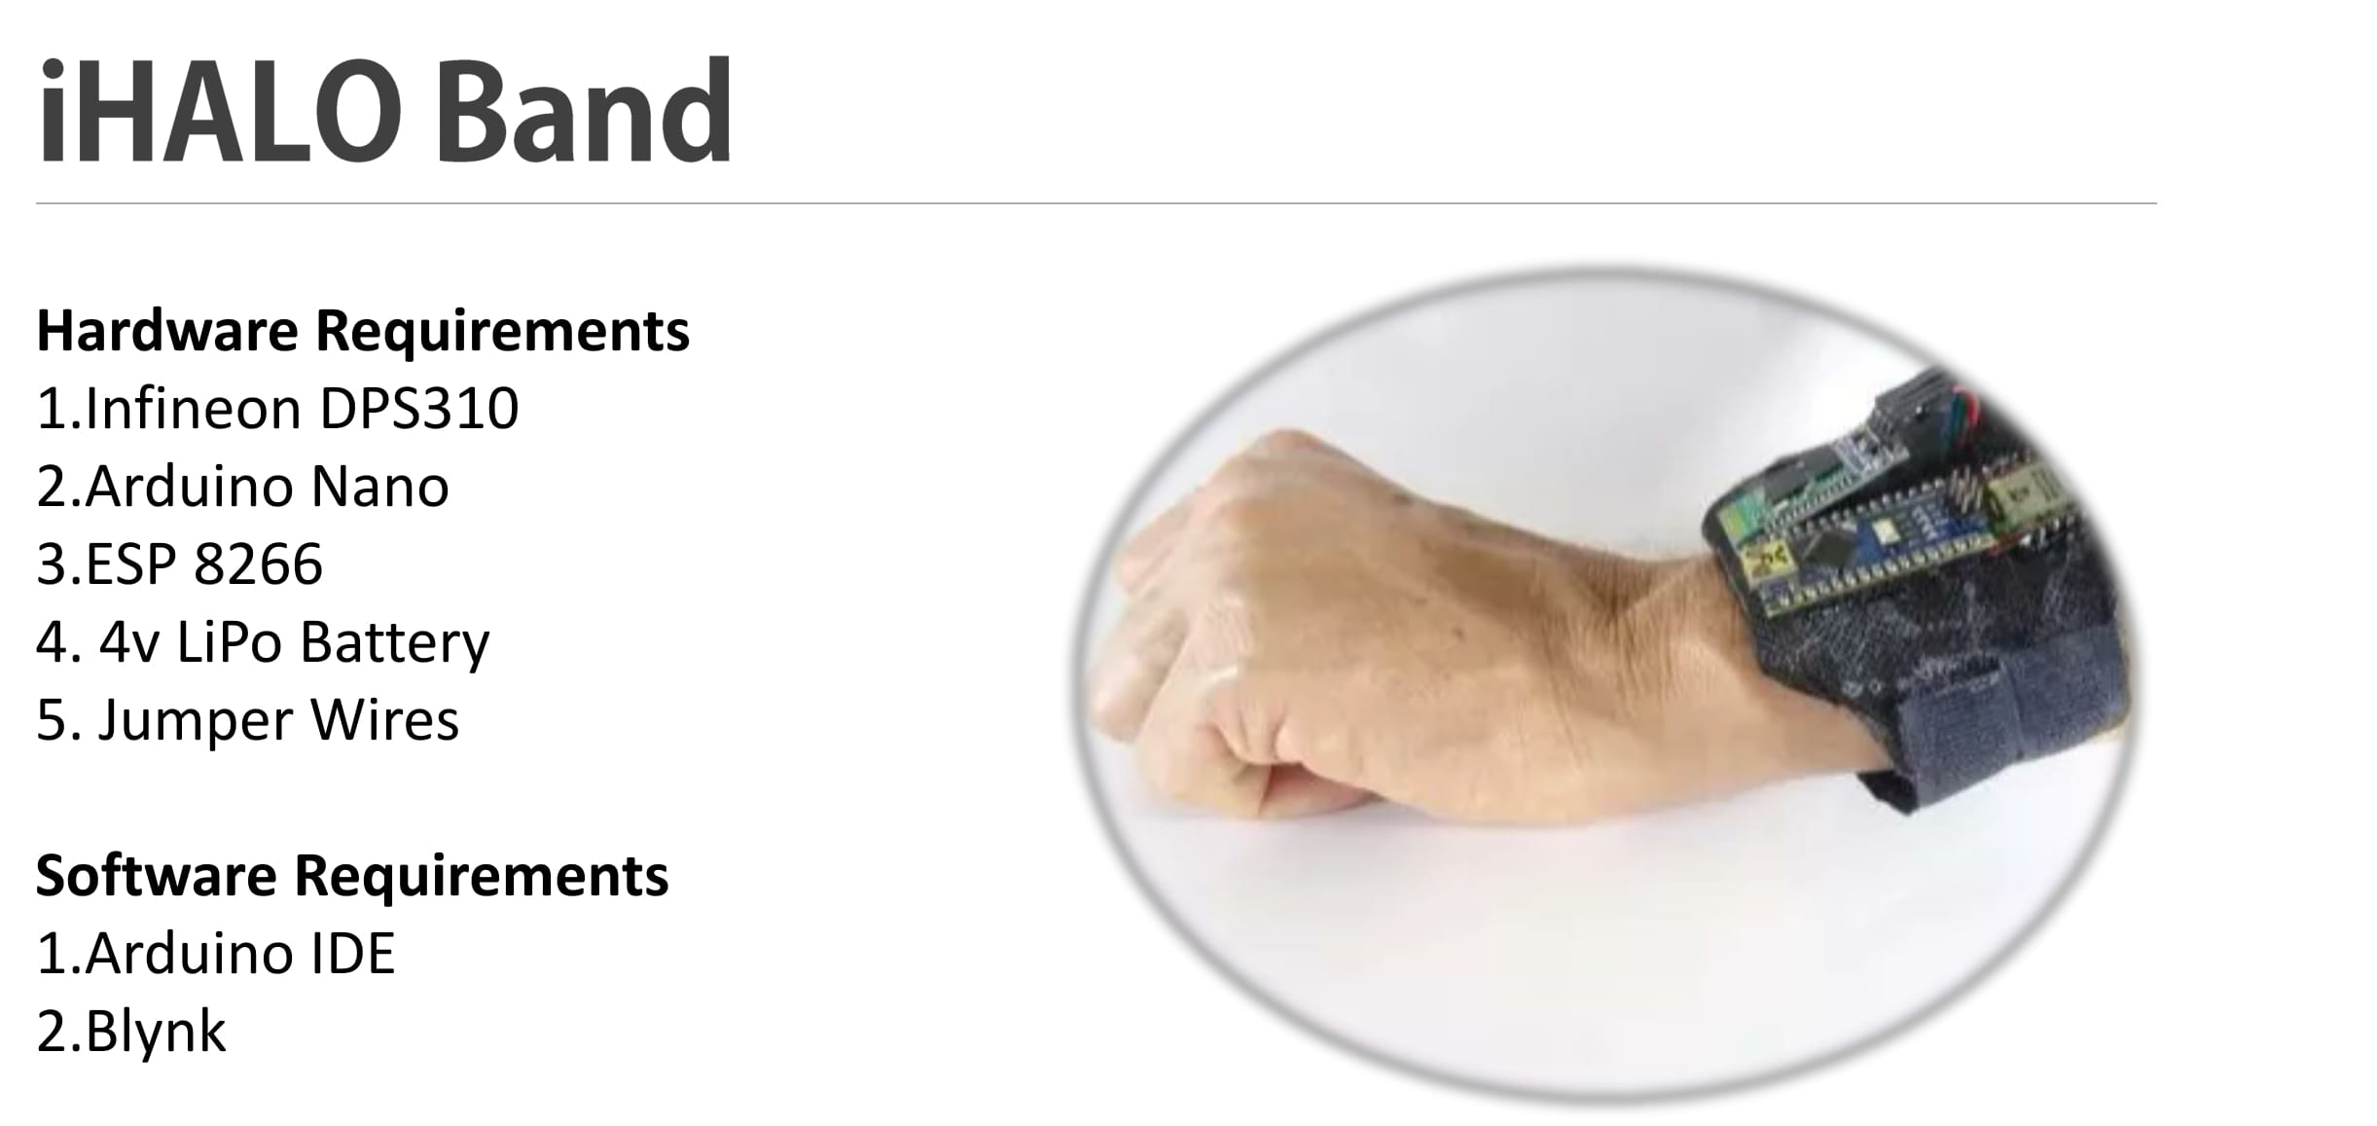
RECAP....

Slide 4

Our story....

Slide 5
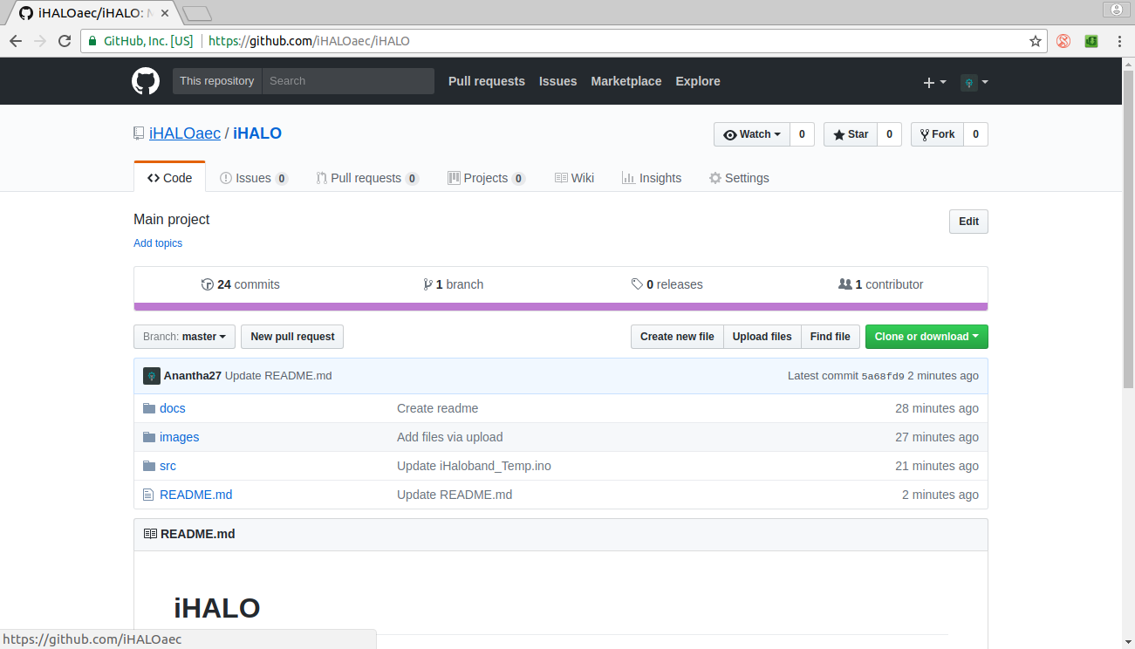
iHALO in Github

Slide 6
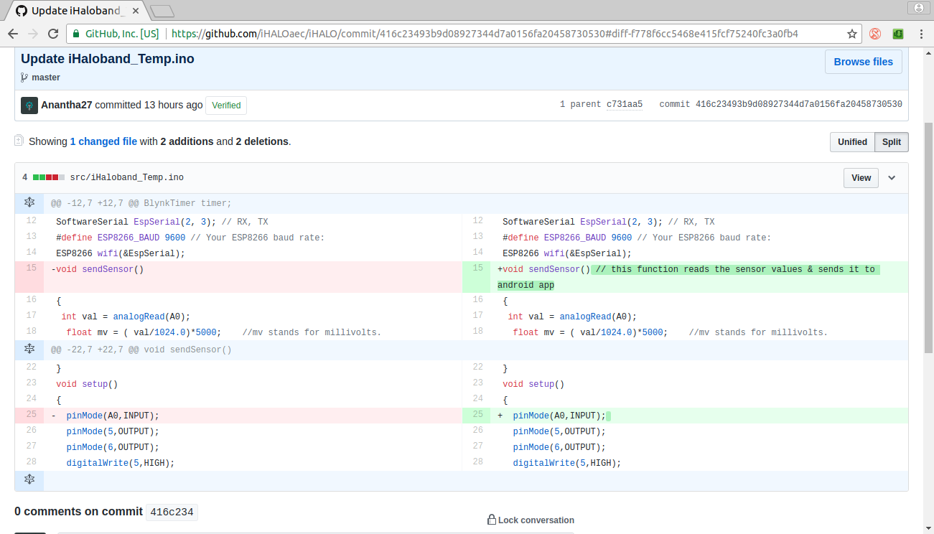
Github Features...

Slide 7
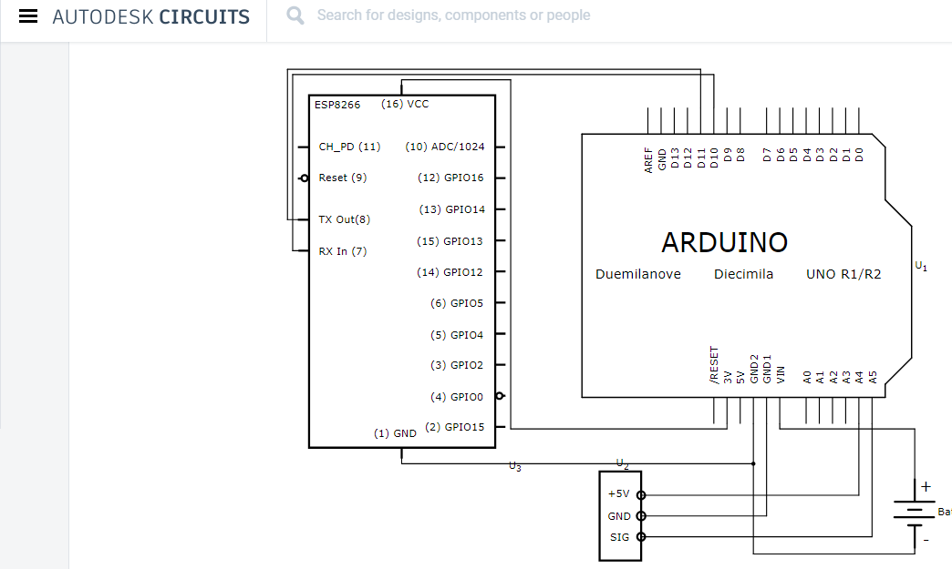
Circuit Diagram

Slide 8
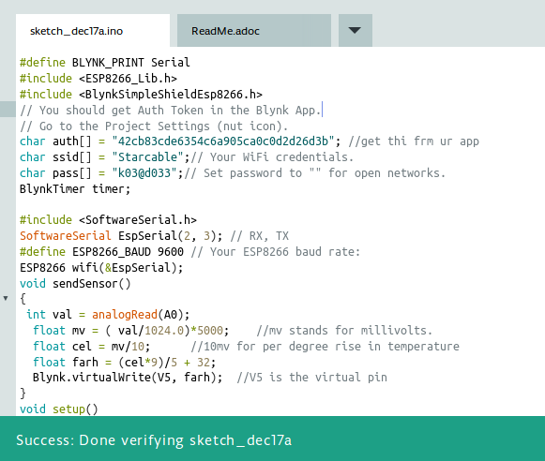
Arduino C Code (Part 1)

Slide 9
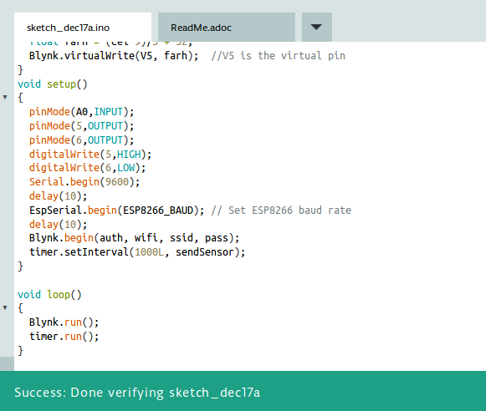
Arduino C Code (Part 2)

Slide 10
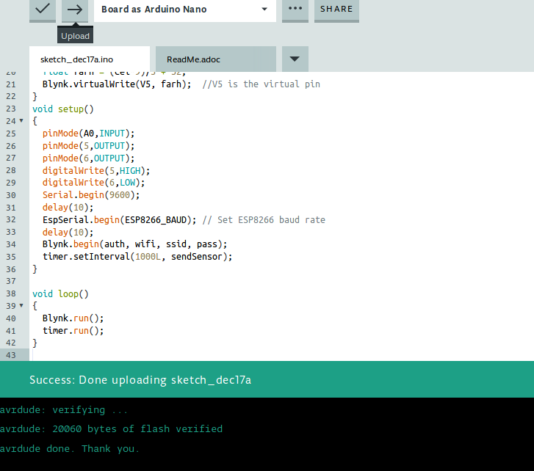
Uploading......

Slide 11
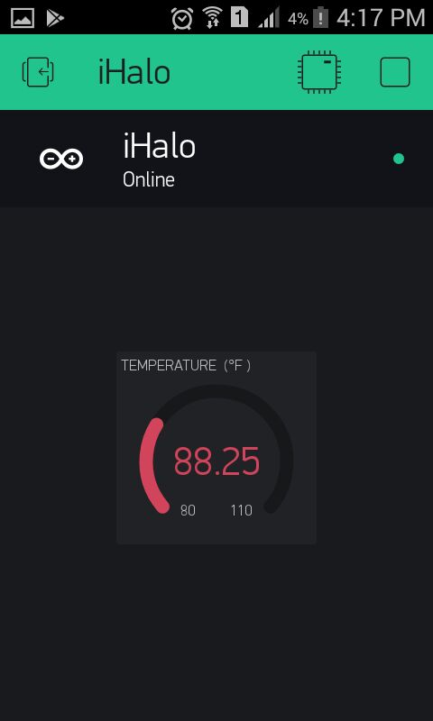
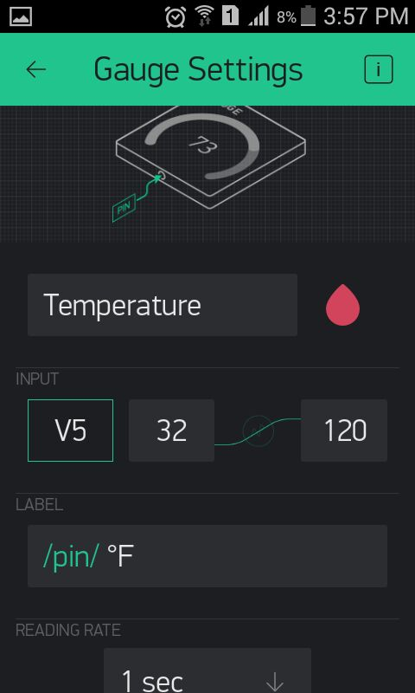
Android Interface (iHalo Band)

Slide 12
DEMONSTRATION
- iHALO Band

Slide 13

THANK YOU
https://github.com/iHALOaec/iHALO

