Slide 1


1
Automating Classification of Maintenance Needs Using AI
Transforming Manual Equipment Maintenance Processes into Efficient AI-Driven Solutions
Presented by Haneen Al-Mabadi

Slide 2


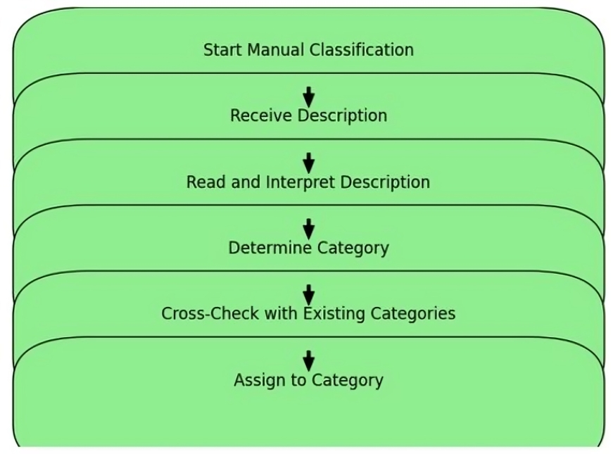
2
Identifying the Problem
Description:
Manual process for classifying descriptions into 41 categories was time-consuming and error-prone. Inconsistencies and human errors were affecting overall efficiency.
This flowchart illustrates the manual classification process
Time-Consuming: The manual process required significant time and effort. Error-Prone: Frequent human errors resulted in misclassifications, requiring additional reviews and corrections. Inconsistency: Different staff members often interpreted descriptions differently, leading to inconsistent categorizations. Impact on Efficiency: Overall inefficiency and reduced operational accuracy.

Slide 3
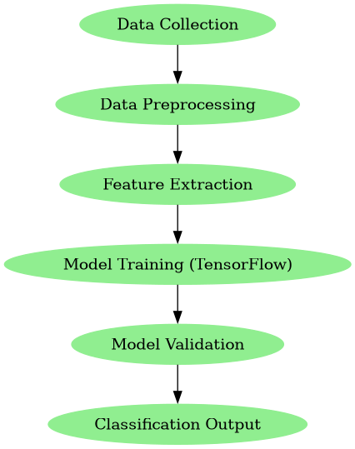
2
Key Features:
Automated data analysis Real-time predictions Adaptability to different data inputs

Slide 4
2
Innovative AI-Driven Solution
Description:
Developed an AI model that automates the classification process. Implemented using advanced algorithms and tools like TensorFlow and Streamlit. Achieved high accuracy of 86.552%.
Technical Highlights:
Extensive data preprocessing to handle diverse descriptions. Model trained and fine-tuned for optimal performance. Efficient batch processing for large datasets.
Significant Impact and Future Prospects
Impact:
Reduced time and effort for classification. Improved accuracy and consistency. Streamlined workflow and set a new standard for efficiency.

Slide 5
Thank You
Presented by Haneen Al-Mabadi

