Slide 1
OpenSwitch 15
2008/10/6

Slide 2
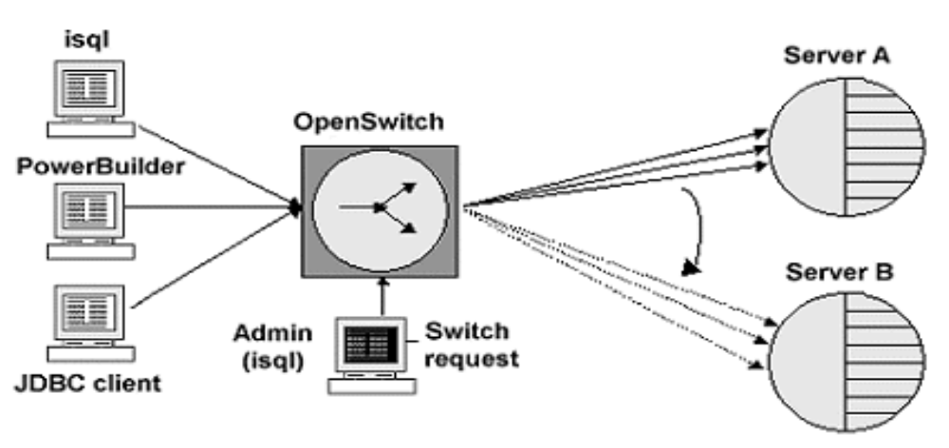
What is OpenSwitch
OpenSwitch is Sybase open server gateway application placed between client connections such as isql, or any application developed using Sybase’s Open Client,ODBC or JDBC libraries, and two or more Adaptive Servers.
Notes:
保证系统连续可用性，将客户端从主点转到备点。
Database server ASE,IQ
Synchronization, Movement & Access * UO, Rep Server, RTDS
Modeling PD
Information Delivery UA, EP
Middleware Integration Options repconnect, OpenServer

Slide 3
What is OpenSwitch(cont..)
It provides the facility to transparently transfer incomming connections to any Sybase server product(ASE,ASIQ,OpenSwitch), either manually in response to an administrative request,or automatically in response to an Adaptive Server failure.
Notes:
保证系统连续可用性，将客户端从主点转到备点。

Slide 4
What is OpenSwitch(cont..)
Sybase OpenSwitch is a continuous availability solution.
Sybase OpenSwitch ensures continuous availability to systems-with no hassle, no confusion, and no need for them to reconnect.
Sybase OpenSwitch routes end-users from the primary system to a back-up system in the middle of the day, in the middle of the application, without missing a beat.

Slide 5
Why OpenSwitch
Application downtime costs millions and puts customer relationships at risk
When systems go down , e-business are out of business
Downtime can be the kiss of death
OpenSwitch can reduce downtime

Slide 6
Features of Open Switch
Failure detection and recovery
Server pooling and routing
Load balancing and chaining
Central management capabilities
Customization to enable integration with 3rd party high-availability solutions

Slide 7
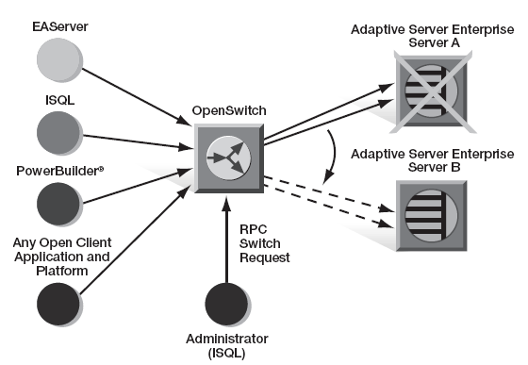
Failure detection and recovery
If the remote Adaptive Server is down or the connection is killed, transfer the connection to the next available Server
If a transaction if procssing , inform the client “ deadlock” message ,the client must reissue the last transaction. In fact, the connection is terminated.
Notes:
In fact ,the

Slide 8
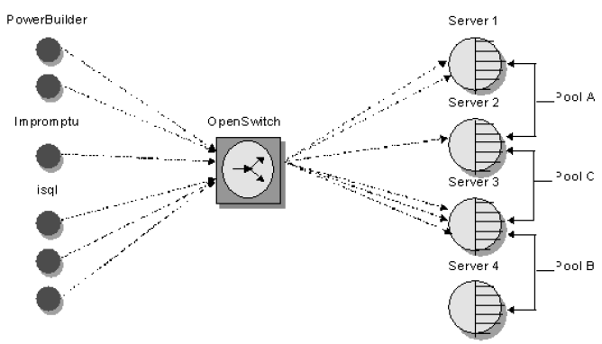
Server pooling and routing
Support more than one client application,individual applications or groups of applications be treated as a logical unit,ensuring the administrative requests or automatic failover at the same time and in the same way.
Allows to create one or more logical group of servers and to route individual connections to a given pools of servers according to the user name,host name or application name

Slide 9
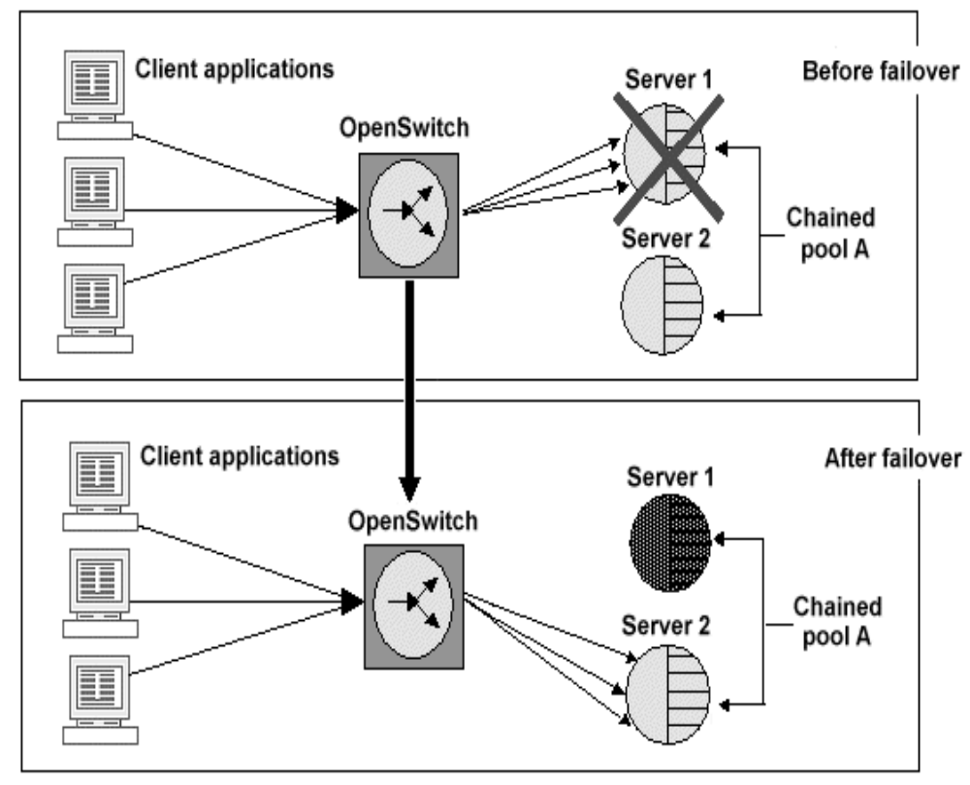
Load balancing and chaining
In chained pool,all connections are routed to the first server defined within the pool,administrative requests or automatic failover send all connections to the next server in the pool.

Slide 10
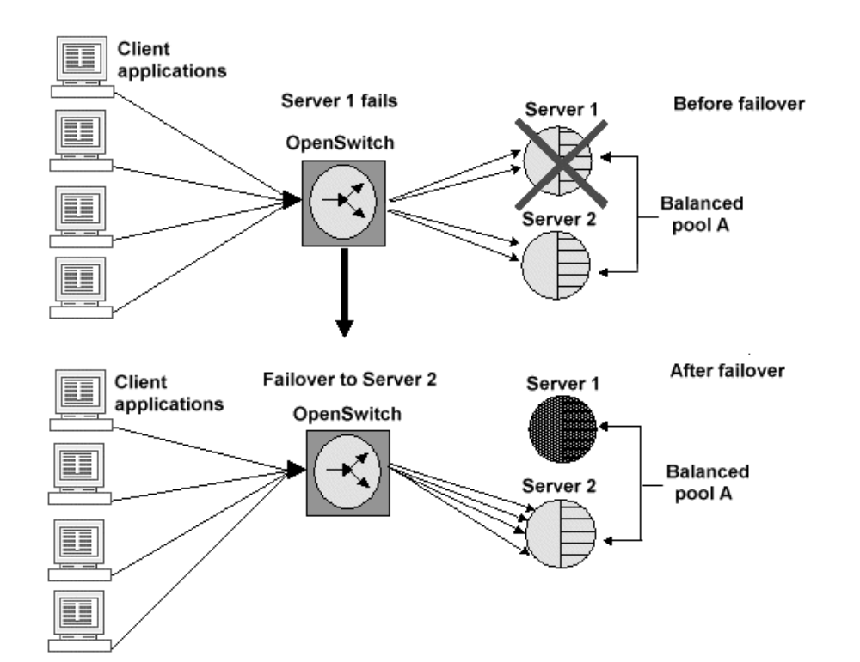
Load balancing and chaining
In balanced mode, all servers in the pool are utilized simultaneously(load balanced),all connections on the failed server are redistributed,in round-robin fashion,among the remaining servers

Slide 11
Central management functionalities
Define server pools
Load-balance connections across server pools
Dynamic configure connections
Cache outgoing connections
Temporarily suspend one or more connections
Implement time-based resource governing

Slide 12
Other features
Connection caching
Connection suspend/resume
Resource governing
User messaging
Dynamic SQL supported
International character set
Notes:
Cs_prepare, cs_execute, cs_cursor_declare,…
能进行字符集的转换

Slide 13
Installation and configuration
System requirement:
Windows: 64M RAM,300M disk,TCP,
above NT 4.0 SP6 or 2000 SP 3
Unix: 64M RAM,300M disk,TCP
HP-UX 11.0
HP-True 64 Unix5
AIX 4.3.3
AIX5.1
Solaries 2.8
RedHat AS 2.1

Slide 14
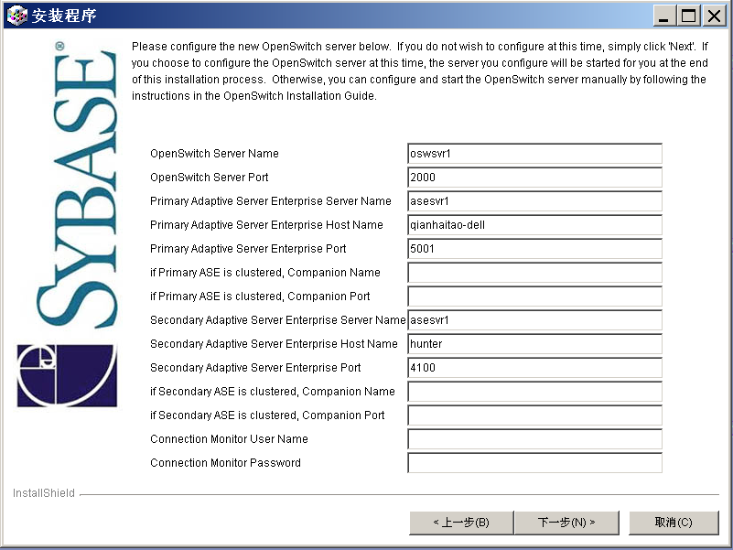
Installation and configuration(cont..)

Slide 15
Installation and configuration(cont..)
Primary and secondary server should have different name
Can log on OpenSwitch as administrative user to modify configuration parameter dynamicly
Can modify configuration file

Slide 16
Configuration file
[CONFIG]
Setting of values for central location
[SERVER]
Setting and status of Adative Servers available
[POOL]
a group of Adative Servers and the set of connections for each group
[LIMIT_RESOURCE]
With the –r flag or RMON configuration option , specifies which connections are candidates for resource governing and which resources should be limited

Slide 17
Configuration file: example
[SERVER=m104dbp01]
STATUS=UP
[SERVER=ase1254]
STATUS=UP
[POOL=pool1:MODE=CHAINED,CACHE=0,STATUS=UP]
servers:
ase1254
m104dbp01
[LIMIT_RESOURCE:ACTION=CANCEL,BUSY=300]
appname: [Ii]mpromptu
Notes:
1，所有以 abcd打头的用户连接到pool1
2，资源控制：程序isql ,esql 交易时间超过100秒，resource monitor将其kill
迟钝,敏感取决与查询计划的选择,默认是敏感型的.如果查询计划是hash join,或者merge join就是非敏感型的

Slide 18
Starting and stopping
Start on Unix:
Go to $SYBASE/OpenSwitch-12_5/bin
./OpenSwitch –c ../config/OpenSwitch.cfg
Start on Windows:
Start OpenSwitch.bat –c ..\config\OpenSwitch.cfg
Stop :
Log on OpenSwitch as administrative user
Rp_shutdown

Slide 19
Registered Procedures
Used to perform the switching process,monitor and administive user activilities
Rp_switch : switch target server manually
Rp_cfg: reread given configuration file
Rp_kill: kill connection or group of connection
Rp_pool_... : pool administration
Rp_start/stop :start(stop) group of connections
Rp_help : display every registered procedures

Slide 20
Customization
Coordinated with sybase replication server
Third party hardware-specific HA solution(Sun,HP,IBM,Microsoft)
API to develop Coordination Module(CM) to implement ‘intelligence switch’
Provide notification via E-mail,SMS,telephone

Slide 21
Coordination Module(CM)
A coordination module is a program that connects to the OpenSwitch server to control client logins and failover patterns within OpenSwitch. It cane be customized to fit specific needs,and you can run multiple coordination modules against multiple OpenSwich servers to create is a redundancy environment so that no single OpenSwitch is a point of failure.

Slide 22
Tips & Tricks
Add /usr/sbin to PATH environment variable
if OpenSwitch Can’t find ping command, it can’t connect to database servers
Add bound.cpus=1 to $SYBASE/openswitch-15_1/sysam/switchserver_name.properties if machine contains more than 1 processors
Increase TEXTSIZE from 1048576 to 2147483647 if you have text columns
BCP in operation is not allowed in OpenSwitch

