Slide 1
Advanced Analysis of Performance Problems with Adaptive Server Enterprise Monitoring Tables
Michael Wallace, Principal Systems Consultant, Sybase, Inc
Jeff Tallman, SW Engineer II/Architect, Sybase, Inc.
Peter Dorfman, Senior SW Engineer, Sybase, Inc.

Slide 2
Agenda
MDA Table Relationships
Common mistakes in MDA-based monitoring
How to use related tables to get desired statistics
Setting Up a Monitoring Environment
Job Scheduler & MDA Repositories
What to collect & when
Problem Solving using MDA Tables
Performance Diagnosis
Configuration Tuning
Server Profiling

Slide 3

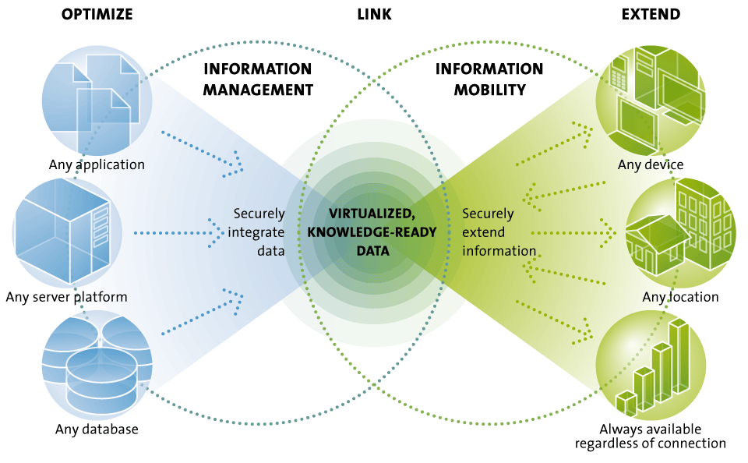
THE UNWIRED ENTERPRISE ACHIEVES AN INFORMATION EDGE
If at first you don't optimize, you won't succeed

Slide 4
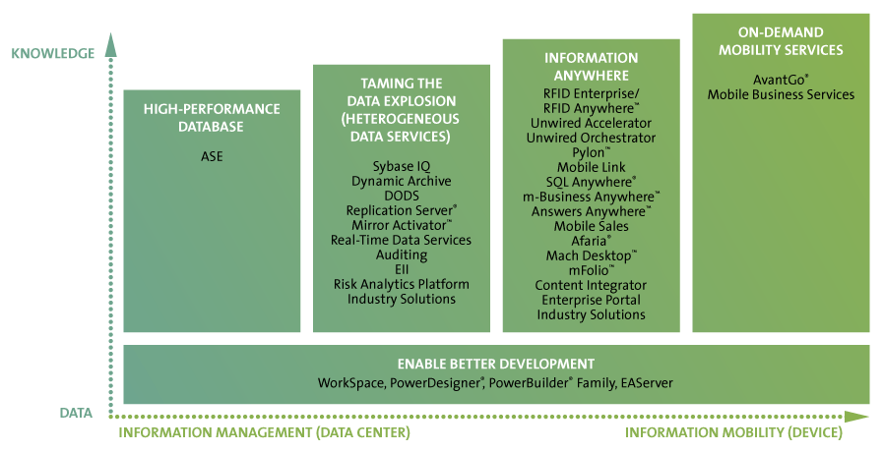
SYBASE SOLUTIONS
Here's where it all begins…now let's make it faster!!!
Notes:
An information edge is created with data becomes usable knowledge at the point of action.
It starts with high performance databases where the applications reside. (???)
Data services are used to integrate and optimize heterogeneous data resources turning them into virtualized, knowledge-ready information that can now be applied as business intelligence.
That information can be then securely extended to the point of action in an always-available state and extended still through on-demand or hosted services.
Leveraging a unified application development platform that integrates and enables rapid client/server, Web and mobile application development & reuse.

Slide 5
Assumptions, Goals, etc.
Assumptions:
You are already familiar with MDA tables, installation, setup, use
Goals
You will learn how to construct a MDA-based monitoring environment that you can implement at your site – today.
You will learn how to spot and diagnose the common performance problems
You will learn the best practices for using the MDA tables effectively
Disclaimer
While the techniques we are discussing are field proven, every performance problem can have unique nuances that points to a different cause

Slide 6
MDA → Monitoring & Diagnostics API
C level functions exposed as database RPC’s
Signaled by the $ preceeding the rpc name
No tempdb or data storage requirements
Memory for pipes only
But … does rely on a remote connection (OmniServer-<spid>)
Nothing unique about the 'loopback' name
Borrowed from tcp localhost nomenclature
You must change this for HA installs
Loopback → e.g. loopback_1 and loopback_2
You will change it for remote monitoring
Loopback → real server network name in sysservers

Slide 7
Common Mistakes in MDA monitoring
Excessive Polling
E.g. sampling every second
If more than every minute, you'd better have a real good reason
Drives cpu & network I/O artificially high
Collecting Everything for Everybody
Instead of using MDA parameters (especially SPID & KPID)
"turn it all on and wait for magic to happen"…it won't!!!
Using with sp_sysmon
more on this later
Joining MDA tables (or subqueries)
Accuracy problems if self-joins, subqueries – even normal joins
Results in worktables (what is the access method for the join?)
Enabling pipe tables too early
Determine that you have a bad query before looking for it

Slide 8
sp_sysmon & MDA
Some of the counters are shared with sp_sysmon
monTableColumns.Indicator & 2 = 2
So don’t run concurrently
unless sp_sysmon used with noclear option in 12.5.3
Otherwise it clears the counters and you have no record from the MDA perspective what the counter values were – just that some idiot (yourself?) cleared the counters
Replace periodic runs of sp_sysmon with MDA
Easier to parse results anyhow
Better info than ‘5 tablescans’ → actually know who did the tablescans and which tables
(and that they were all in tempdb, so who cares).
Sp_sysmon unique monitors
RepAgent performance metrics
One of the few remaining sp_sysmon unique capabilities

Slide 9
A Word about Counter Persistence
Most counters are “cumulative” and wrap at 2B
not reset for each sample period
monTableColumns.Indicator & 1 = 1
Sooo….to get rate info, you will need to compare the values “now” with the last sampled “values”
Either subtract the current from last ….or plot over time to see trend
Some counters are "transient"
monProcessStatement – ya gotta be quick
Rationale:
When doing performance monitoring, you need to consider:
The counter value
The rate of change (Δ / time)
Monitoring often is "looking back" – not "as it happens"

Slide 10
A Few Other Caveats
Counters & Clock Ticks
Counters that measure time are measured in cpu ticks
This can lead to inaccuracies at low volumes – i.e. measuring the amount of ticks short statements or a single I/O takes is about impossible – look at 1,000's/10,000's
Changing the server cpu tick length may help accuracy, but may hurt application performance.
It also can be inaccurate when ASE is bumped off of the cpu
i.e. tempdb devices on UFS will cause a ASE to sleep – it is likely that ASE will get bumped from the cpu
Guidelines:
Don't worry about the small stuff (i.e. 100ms) – look for the big pain points (they will be visible)

Slide 11
For Example (monProcessWaits):
SPID | Waits | WaitTime | Description
22 | 6 | 200 | wait for buffer read to complete
22 | 352 | 2500 | waiting for CTLIB event to complete
22 | 1 | 0 | waiting on run queue after yield
22 | 14 | 499400 | waiting for incoming network data
22 | 48 | 0 | waiting for network send to complete
SPID | Waits | WaitTime | Description
22 | 6 | 200 | wait for buffer read to complete
22 | 391 | 3100 | waiting for CTLIB event to complete
22 | 1 | 0 | waiting on run queue after yield
22 | 1 | 0 | waiting on run queue after sleep
22 | 16 | 523800 | waiting for incoming network data
22 | 50 | 0 | waiting for network send to complete
* Translations for these and others come later….

Slide 12
MDA MetaData
1 = Cumulative
2 = sp_sysmon
3 = 1 & 2
This table lists which columns you should provide to improve performance of the mda accesses (i.e. eliminates collecting everything) – ala the “where clause”

Slide 13
CPU & DiskIO
“Data, Log, Tempdb”
“Engine Load”
“IO Polling”
“Hot Devices”
“HK Tuning”
“I/O Waits & Time”
→ 12.5.x
→ 12.5.3 ESD 2+
→ 15.0b2+

Slide 14
Where’s the Holdup???
“Server Cumulative Waits”
(aka Context Switches)
“db log contention”
“Where I am spending all my time waiting”
“Currently Waiting On”

Slide 15
Contention…Contention…
“Deadlock Pipe”
vs. Print Deadlock Info
“Who…”
“Where…”
“Deadlock Details”

Slide 16
Who’s Hogging the System???
“Who to Blame”
“CPU…”
“I/O…”
“Locks…”
“tempdb…”
“activity…”
“Network Bandwidth”

Slide 17
"My Queries Are Slow…"
“Currently Executing Queries”
“Previous Queries”
“CPU Hog"
“Waiting"
“IO Hog"
"Long Running"
“Currently Executing SQL”
“Text Chunk #"

Slide 18
Statement & SQLText Gotchas & Tips
monProcessStatement/monSysStatement
LineNumber Gotchas
Not all exec'd line numbers will appear
Should – but don't
Being researched why not
May be a pipe sizing issue?
Line numbers can repeat, skip
Loops, if/else, etc.
monSysSQLText/monProcessSQLText
Text is chunked (ala syscomments)
monSysSQLText.SequenceInBatch
monProcessSQLText.SequenceInLine
monSysPlanText.SequenceNumber

Slide 19
User Object Activity
“Index level I/O detail”
“Proc/Trigger”
Bad/Poor Index choices
Tempdb I/O’s
“scan counts…”
“temp & work tables…”

Slide 20
Table Statistics
“How many pages were read from the base table (IndexID=0,1) – Are we table scanning?”
“tempdb object sizes (DBID=2)”
“Hot tables/ indexes”
“Unused indexes”
“Who has the cartesian product in tempdb??? (DBID=2)”
“How many index rows were inserted/updated as a result of each DML operation?”
“DML statistics”
“DML & Proc Exec Count
(in some versions)*”
“Table/Index Contention”
* In some ASE versions, Operations tracked stored proc execs – discontinued in later releases”

Slide 21
Table/Partition Stats (15.0)

Slide 22
Data & Procedure Cache
“Allocated vs. Used by Pool Size”
“Cache Misses”
“Wash Size”
“How many & which procs are cached”
“Cache Hogs”
“Popular Objects”
“Proc Cache Size"
(less statement & subquery cache

Slide 23
Tempdb Analysis (DBID=2)
“Join monProcessObject to monProcess to get tempdb sizing for multiple tempdb’s by application/login names”
“Size & IO”
“Space Hogs”
“Logged I/O”
“Tempdb Objects”
“Tempdb Cache Usage”
(can be used to size individual tempdb caches if multiple tempdb's)

Slide 24
Agenda
MDA Table Relationships
Common mistakes in MDA-based monitoring
How to use related tables to get desired statistics
Setting Up a Monitoring Environment
Job Scheduler & MDA Repositories
What to collect & when
Problem Solving using MDA Tables
Performance Diagnosis
Configuration Tuning
Server Profiling

Slide 25


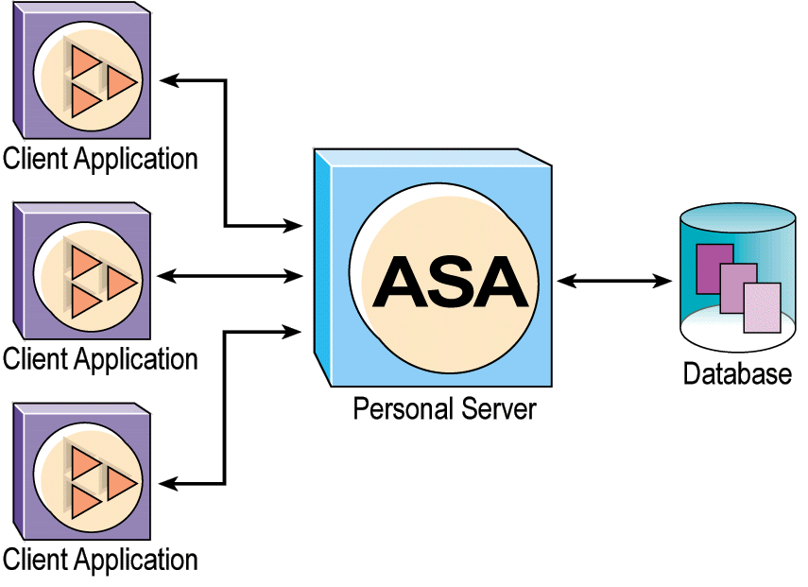
MDA Collection Environment
Monitored Servers
ASE w/
Job Scheduler
MDA Repository DB's
Local (LAN) Collector
Central MDA Repository
(optional)

Slide 26
MDA Environment Components
Monitored Server
Has MDA tables installed locally for adhoc/local monitoring
Static configuration parameters set
MDA Collection
Central Repository (Optional)
Mainly used when cross-server analysis
ASE w/ Job Scheduler to move data from local collectors
Local (LAN) Collector
LAN-based – not WAN based
Consists of ASE w/ Job Scheduler
Good use of ASE 15 – get a jump start by using it here
MDA Repository DB
One MDA Repository per ASE server monitored

Slide 27
MDA Repositories
Why Repositories?
Avoids redundant/excessive direct monitoring by all the DBA's
Provides historical data for trend analysis
Provides join/subquery support
Avoids impacting the IO, etc. of monitored server
Provides a level of protection for production servers
App developers can query statistics without needing mon_role
One MDA DB for each server monitored
Rationale:
MDA tables can vary slightly with each version of the server
Allows easier archive/retrieval for analysis
Should be local (LAN) to monitored server
Avoid impact due to prolonged data transfers via CIS

Slide 28
Local Collector ASE's
Add DBA's & App Developer Logins
DBA's can have sa_role as normal – plus mon_role
App Developers may use a single app_dev role or have roles for each individual application
Create multiple tempdb's
Fairly good size to support analysis driven work tables
Bind different logins to different tempdb's
Setup Job Scheduler
See instructions later
Tune for CIS/Bulk operations
See CIS tuning recommendations
Create each MDA repository DB
Details to follow

Slide 29
Job Scheduler Install Tips
Tricky parts to installation/setup
You have to read the manual
Add the JS server to the collector's sysservers
sp_addserver <myJSserver>, ASEnterprise, <servername>
Recommend you create a “mon_user” w/ password
Grant all the roles to the mon_user
Grant mon_role, sa_role, js_admin_role, js_user_role
Sa_role is not required – local to repository server - If not granted sa_role, you may want to alias mon_user as dbo in all the repository databases to avoid permission hassles.
Note that we are discussing the mon_user used by the collector – individual DBA's, app developers, etc. will need their own respective roles/permissions
Map the external login
Sp_addexternlogin <myJSserver>, mon_user, mon_user, <password>

Slide 30
Job Scheduler Scheduling Steps
Create individual jobs for each profiling proc
Make sure timeout is high – i.e. 180 mins
Create repeating schedule
Make sure it starts in future (i.e. 10-15 mins)
Schedule jobs before schedule starts
Again, long timeout as appropriate
Use sp_sjobcontrol sjob_12, run_now to test
Start the jobs
sp_sjobcontrol null, start_js

Slide 31
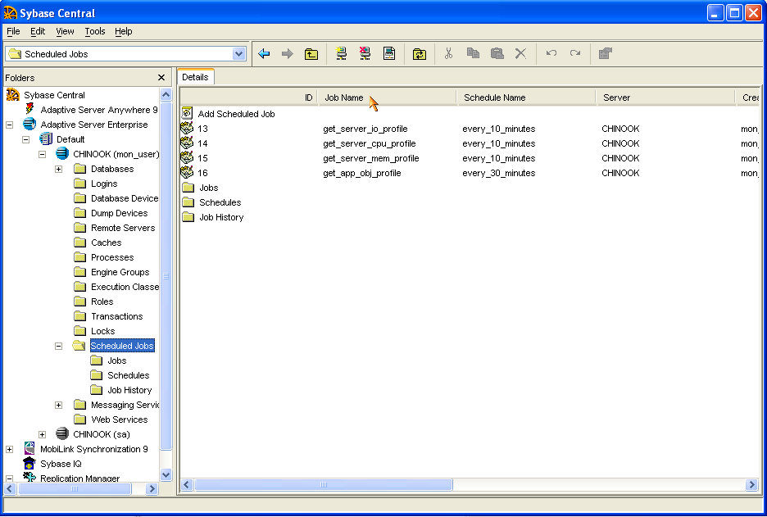
Screen Shots

Slide 32
CIS & Database Tuning
Tuning CIS to compete with bcp:
--exec sp_configure "enable cis", 1 /* on by default */
exec sp_configure "cis bulk insert array size", 10000
exec sp_configure "cis bulk insert batch size", 10000
exec sp_configure "cis cursor rows", 10000
exec sp_configure "cis packet size", 2048
exec sp_configure "cis rpc handling", 1
exec sp_configure "max cis remote connections", 20
Database options
Select into/bulkcopy
Truncate log on checkpoint
Delayed commit (ASE 15)
This will help significantly

Slide 33
MDA Tables & Performance
Most non-pipes will not have significant impact
Some that do:
Statement/Per Object/SQL Text statistics & pipe (5-12%)
SQL Plan & Pipe (22%)
Guidance:
Leave them off until necessary if you don't have the headroom
i.e. if contention starts, enable object statistics to see where
Only use the SQL/Plan pipes only when necessary
Enable object/statement statistics periodically and collect information for analysis/profiling of the application
Procedure execution profile
Table/Tempdb usage profile
When using statement statistics, you may need a large pipe
statement pipe max messages = 50,000+

Slide 34
Impact on SQL Language Commands
All Disabled
834.8
(0)
Monitoring Enabled Only
824.6
1.2%
Server Wait Events Enabled
831.5
0.4%
Process Wait Events
825.6
1.1%
Object Lock Wait Timing
823.2
1.4%
Deadlock Pipe
816.8
2.2%
Errorlog Pipe
814.1
2.5%
Object Statistics Enabled
726.2
13.0%
Statement Statistics Enabled
732.2
12.3%
Statement Pipe Enabled
730.6
12.5%
SQL Text Pipe Enabled
715.2
14.3%
Plan Text Pipe Enabled
653.6
21.7%
10 JDBC threads @ 2000 atomic inserts each, committing every 10 using SQL Language Statements

Slide 35
Impact on Fully Prepared Statements
All Disabled
2399.8
(0)
Monitoring Enabled Only
2379.4
0.8%
Server Wait Events Enabled
2366.4
1.4%
Process Wait Events
2346.3
2.2%
Object Lock Wait Timing
2348.6
2.1%
Deadlock Pipe
2376.3
1.0%
Errorlog Pipe
2371.2
1.2%
Object Statistics Enabled
2299.4
4.2%
Statement Statistics Enabled
2302.7
4.0%
Statement Pipe Enabled
2297.9
4.2%
SQL Text Pipe Enabled
2288.3
4.6%
Plan Text Pipe Enabled
1875.6
21.8%
10 JDBC threads @ 2000 atomic inserts each, committing every 10 using DYNAMIC_PREPARE=true

Slide 36
Creating MDA Repository DB:
MDA proxy tables for monitored server
Make a copy of that server's installmontables – add a use db at the top and then change loopback to the servername in sysservers
Local copies of system tables
Unioned copies of sysobjects (sysindexes optional)
Only ID's & Names – but with DBID appended
master..sysdatabases, syslogins (suid & name)
MDA catalog (monTables, monTableColumns, monTableParameters, monWaitClassInfo, monWaitEventInfo)
Repository tables
Same schema as proxy tables
but with SampleDateTime added to PKey
Don't enforce any FKeys
Lightly indexed for joins, queries
Stored procedures
Unique collection procs for each db due to variations in MDA tables
Unique analysis procs for each db due to different applications

Slide 37
Monitoring
Server Profiling
Server resource usage, configuration settings
Application Profiling
Application resource usage
Table & Index level IO statistics
Hot tables, contention, spinlock contention, tempdb usage
(On Demand) User Monitoring
IO & CPU time statistics
Table & Index level IO statistics
Statement level statistics
Query plan, SQL text

Slide 38
Tables to Poll
System
Application
monDeviceIO
monIOQueue
monErrorLog
monState
monCachePool
monDataCache
monProcedureCache
monSysWaits
monEngine
monNetworkIO
monDeadLocks
monOpenObjectActivity
monOpenDatabases
monSysStatement
Optional (pipe table)
Aggregated info for stored procedure/trigger analysis
Long running procs
Frequently exec'd procs

Slide 39
Intermediate Polling
Memory/Cache
Resource Hogs
monCachedObject
monCachedProcedures
monProcess
monProcessActivity
monProcessObject
monProcessProcedures
monProcessWaits

Slide 40
Detailed Tables for SPID(s)
SQL/Exec
Object Contention
monProcess
monProcessActivity
monProcessProcedures
monProcessStatement
monProcessSQLText
monSysStatement
monSysSQLText
monProcessWaits
monProcessObject
monLocks

Slide 41
Sample Profiling Jobs & Analysis
Server profiling – every 10 minutes
sp_mda_server_cpu_profile
monSysWaits, monEngine, monState
Top n WaitEvents, cpu usage and when counters were cleared
sp_mda_server_io_profile
monDeviceIO, monIOQueue, monNetworkIO
IO waits, hot devices, io tuning
sp_mda_server_mem_profile
monCachePool, monDataCache, monProcedureCache
Cache Usage/Free, Cache Efficiency, Pool Sizing, Stalls
Application Profiling – every 30 minutes
sp_mda_app_obj_profile
monOpenDatabases, monOpenObjectActivity
Hot tables, contention, tempdb usage, DML executions
monCachedObject, monCachedProcedures
Named cache effectiveness, cache hogs, proc concurrency
monDeadLocks

Slide 42
Collector Proc Template
-- use a common timestamp for enabling joins; this effectively is
-- part of your key and allows you to join tables within the same
-- sample period…a common mistake is to use the sample
-- time for each table individually
Select @sampletime=getdate()
-- select all local proxy MDA tables into tempdb to avoid CIS binding
-- issues, etc. Note we did not use master..monSysWaits
--– we are using the local proxies that point to the monitored server
Select * into #monSysWaits from monSysWaits
Select * into #monEngine from monEngine
-- insert into repository tables from tempdb
Insert into mdaSysWaits (collist)
select @sampletime, <collist> from #monSysWaits
Insert into mdaEngine (collist)
select @sampletime, <collist> from #monEngine

Slide 43
Agenda
MDA Table Relationships
Common mistakes in MDA-based monitoring
How to use related tables to get desired statistics
Setting Up a Monitoring Environment
Job Scheduler & MDA Repositories
What to collect & when
Problem Solving using MDA Tables
Performance Diagnosis
Configuration Tuning
Server Profiling

Slide 44
MDA Based Monitoring
Fault Isolation
Slow Response Times (SW, HW, etc.)
Contention
Query Performance
Stored Procedure Performance
Server Configuration & Tuning
Multiple Tempdb Sizing
Cache Utilization & Sizing
Server Profiling
Proc Execution Rates
Transaction Rates
Application Resource Usage

Slide 45
Slow Response Times
The key is monProcessWaits/monSysWaits
This will tell you whether the next step is query related, client software, hardware or contention in ASE
If known SQL query related, you may be able to skip monProcessWaits and go directly to monProcessActivity/ monProcessStatement/monSysStatement
Most closely approximates sp_sysmon context switching section
…but gives you the details you always lacked
…and lets you focus down to the process detail level
Unfortunately, the “WaitEvents” need a bit of decoding as they are in engineer-eese
Wait Event classes
Wait Events

Slide 46
WaitEvent Classes
ID | Description
0 | Process is running (we wish)
1 | waiting to be scheduled (cpu)
2 | waiting for a disk read to complete (read)
3 | waiting for a disk write to complete (write)
4 | waiting to acquire the log semaphore (log contention)
5 | waiting to take a lock (lock contention)
6 | waiting for memory or a buffer (address contention)
7 | waiting for input from the network (client speed)
8 | waiting to output to the network (client fetch/net sat)
9 | waiting for internal system event (PLC, index balance)
10 | waiting on another thread (contention)

Slide 47
ASE ProxyDB MDA monProcessWaits
WaitEventID | Waits | WaitTime | Description
36 | 3098 | 698500 | wait for mass to stop changing
171 | 9847 | 531700 | waiting for CTLIB event to complete
31 | 178274 | 200200 | wait for buffer write to complete
51 | 169434 | 180200 | waiting for disk write to complete
55 | 181921 | 137000 | waiting for disk write to complete
259 | 3 | 85100 | waiting until last chance threshold is cleared
29 | 806 | 8500 | wait for buffer read to complete
52 | 6953 | 5200 | waiting for disk write to complete
54 | 48 | 1200 | waiting for disk write to complete
214 | 182433 | 600 | waiting on run queue after yield
272 | 19 | 500 | waiting for lock on PLC
150 | 33 | 400 | waiting for semaphore
250 | 6 | 400 | waiting for incoming network data
251 | 500 | 0 | waiting for network send to complete
Example from a platform migration test – remember 36, 51, 55, 52, 54
Notes:
Red – mass changes due to large io processing
Orange – suspect this is waiting data to come in – i.e. waiting for ct_fetch()
Yellow – i/o write wait times
Blue – this is an example of the suspends – for this run, it only log suspended 3 times thanks to the log pruner
An alternative explanation would that the top three are all related to incoming data – where 1 & 3 refer to the dirty page writes and #2 refers to the wait time on pending array inserts

Slide 48
What’s a MASS???
Memory Address Space Segment
synchronizes access to buffers by waiting until no one else is writing the buffer
chunk of contiguous memory containing one or more 2K pages (the quantity being determined by the configured pool size, 2K, 4K, etc).
Analogous to “extents”
With large IO the state of any page in the MASS is taken to be the state of the MASS itself. This means, for example, if you use 16K IO then access is synchronized across all 8 2K pages - if one is being written to then all are considered to be written to.
Large IO writes → tempdb select/into, bcp, array inserts, etc. User queries will not reflect large I/O

Slide 49
MASS Waits…
Event ID | Description
30 | wait in bufwrite for mass to finish changing before writing buffer
36 | wait for mass write to complete before setting change flag
37 | wait for mass to finish changing before setting change flag
53 | waiting in writedes for mass to finish changing before writing buffer
69 | wait in DBCC delbuf for mass to finish changing before removing buffer
From earlier, we were waiting on slow disks (hence 36 – write completion)…memory or logical I/O would have been 30 or 37 (depending)…this also could be a sign of a cartesian or unexpectedly large result in tempdb has saturated the IO

Slide 50
Disk Write Waits…
Event ID | Description
50 | Write was restarted because previous attempt failed – if you see this check sys error log
51 | waiting for last MASS on which i/o was issued
52 | waiting for last MASS on which i/o was issued by some other task
53 | waiting in writedes for mass to finish changing before writing buffer
54 | waiting to write of the last page of the log
55 | waiting after write of the last page of the log
From earlier, slow disks hit us on the MASS large I/O’s and waiting for the log to flush to slow disks (disks were U160 – not SAN) – yellow – otherwise, it was then 52 & 54 (negligible delays)
Remember 51 & 52 (MASS caused delays)

Slide 51
Those Pesky Semaphores
Which ones?
Normal table, row, page locks?
Transaction log?
Device?
Answer: It Depends
Typically will be logical lock on a row or page
See what other events are near it that typically drive a semaphore
I.e. if disk writes 54 & 55 – then log semaphore is indicated
Compare sum(LockWaits) from monOpenObjectActivity
If latches are high – likely is exclusive lock on last index page in DOL table for monotonically increasing indices
If waiting for buffer reads/run queue after sleep are high – answer could be high read activity (semaphore = shared lock)

Slide 52
Common Wait Events: Client S/W
Client Related S/W Issues
waiting for CTLIB event to complete
non-data related: i.e. waiting for TDS tokens such as ACK for packets sent, or waiting on next command to be sent (i.e. gap between ct_command() and ct_send())…if CIS is involved, it is waiting on ct_fetch()/result set materialization at remote server
Next move is to look at the client code
waiting for network send to complete
This is data stream related – outbound commands (RPC’s, RepAgent, etc.) will be ‘waiting for CTLIB event to complete’ due to waiting for ct_sendpassthru(), etc. to execute.
Next table to check out is monProcessNetIO – probably going to be a change to fetch block size in program and/or packet size
waiting for incoming network data
Equivalent to ‘awaiting command’ – nothing expected, ..or…
Big gap could point to network handling of language cmds time (try ct_dynamic) or BLOB processing

Slide 53
Common Wait Events: ASE
Transaction Log Delays:
waiting until last chance threshold is cleared
Transaction log keeps filling and crossing the lct – you need to add a threshold to dump earlier, or make the log bigger
Something to watch if tempdb is filling
Waiting for semaphore
WaitEventID = 150
Check monOpenDatabases and compare appendLogRequests to appendLogWaits
Disk I/O wait events 54 & 55
54 – you are waiting to write to the last log page
55 – you are waiting for the last log page you wrote to flush
You don’t commit until page is flushed to disk

Slide 54
Common Wait Events: Contention
Contention
Wait to acquire latch
Address locking contention (tran log)
DOL index contention (last index page – ASE 15 partition table/local index)
Waiting for semaphore
Typically normal row/pg lock, but could be log semaphore or spinlock contention
Wait for someone else to finish reading in mass
Memory access contention
May show up with Wait Event 52 – "waiting for last MASS on which i/o was issued by some other task"
Possible causes:
Tempdb in same data cache as primary tables
user does select/into (bulk I/O)
The last mass in use will be appended to with the new logical pages being written
But the previous user is still reading the previous pages
Most likely cause – two nearly concurrent select/into's in tempdb
See above progession – think about it – select/into tempdb and then you immediately read out
Next task has to wait to access memory
Most Likely Answer: multiple tempdb's

Slide 55
Common Wait Events: H/W
H/W Issues: CPU contention
waiting on run queue after yield
Task reached timeslice - No I/O wait, so task is cpu-intensive
in memory scan, join operations, sorting, looping logic in proc, etc.
waiting on run queue after sleep
Could also indicate high write activity
i.e. BCP, or other write intensive process will sleep while waiting I/O…
Remember, log writes also mean SPID sleeps –
Slow cpu's could result in higher waits on log semaphore and disk writes 54 & 55
Either one could be due to a cpu pig
next step is to look at monProcessActivity.CPUtime
If no obvious cpu hogs, you may need to add cpu's/online additional engines
H/W issues: Device I/O related
wait for buffer read to complete
Logical read or network read
wait for buffer write to complete
Logical write (update in cache before disk flush)/network send
waiting for disk write to complete
Exceeded disk i/o structures and delayed for pending i/o queue???

Slide 56
Common Wait Events (Config)
“waiting while no network read or write is required”
Netserver checked and no network read/write pending
Server level – shouldn’t see this in monProcessWaits
Check "i/o polling process count"
If CPU & IO bound – reduce "i/o polling process count"
For 12.5.3 – look at the following in monEngine: DiskIOChecks, DiskIOPolled, DiskIOCompleted

Slide 57
Query Performance
Step 1: Gather current statement statistics
monProcessStatement & monProcessSQLtext
May have to use monSysStatement/monSysSQLtext for previous queries
Find out the cpu & i/o pattern for the query
Find out the SQL text (without being truncated)
Proc is also in monProcessStatement
Step 2: Get SPID Resource Consumption
monProcessActivity
Get CPU time, IO (phys, log, reads/writes), locks held
Get Wait Time
Get Tempdb objects (TempDBobjects, WorkTables)
Step 3: If High Wait Time – Find cause
monProcessWaits
Check for contention, network issues, I/O
Step 4: If High I/O Write waits or Tempdb is suspect
monProcessObject & monOpenObjectActivity
Temp table sizes, rows IUD & Reads on tempdb (DBID=2)
monProcessObject also tells what indexes a process is using

Slide 58
Query Performance
Step 5: If Contention
Check monOpenObjectActivity to find table(s) with most contention (LockWaits)
Check monProcess for Blocking
Check monLocks, monDeadLocks
Step 6: If Proc (somewhere in proc is slow)
Understand: Batch → Context → Line Number
For example, if your first batch calls a proc at line 5 (batch=1; context=1; line number=5) , the proc is a new context (2) and each line within the proc now increases.
monProcessStatement only gives metrics on current statement within the current batch/context/line
Issue may have been previous statement or loop
monSysStatement – historical view of the query tree
CPU, I/O, etc. at various sample points – not every line (should be – but isn't)

Slide 59
monSysStatement Queries
-- long running statements/stored procedures
select SPID, KPID, BatchID, ContextID, DBID, ProcedureID, StartTime,
ElapsedTime=datediff(ss,StartTime,max(EndTime)),
CPUTime=sum(CpuTime),LogicalReads=sum(LogicalReads),
PagesModified=sum(PagesModified)
from monSysStatement
group by SPID, KPID, BatchID, ContextID, DBID, ProcedureID, StartTime
having datediff(ss,StartTime,max(EndTime)) > 5 –- 5 seconds
-- frequently executed (or high IO or….) stored procedures
select DBID, ProcedureID, StartTime, ElapsedTime=datediff(ss,StartTime,max(EndTime)),
CPUTime=sum(CpuTime), LogicalReads=sum(LogicalReads),
PagesModified=sum(PagesModified)
into #procExecs
from monSysStatement
where ProcedureID!=0
group by DBID, ProcedureID, StartTime
select DBID, ProcedureID, ExecCount=count(*), avg(ElapsedTime), max(ElapsedTime),
avg(CPUTime), max(CPUTime), avg(LogicalReads), max(LogicalReads),
avg(PagesModified), max(PagesModified)
from #procExecs
group by DBID, ProcedureID
order by 3 desc, 4 desc, 6 desc

Slide 60
Usage: SP backtrace
My SP has hit an unexpected error condition, how did it get there?
The user/application developer can create a SP to be called that prints the executed SQL and the backtrace of SPs to help diagnose the problem - similar to ASE’s ucbacktrace to errorlog.
Must be called from within the outer executing proc/trigger
Previously executed statements are in monSysStatements
CREATE PROCEDURE sp_backtrace @spid int, @kpid int AS
BEGIN
SELECT SQLText
FROM master..monProcessSQLText
WHERE SPID=@spid AND KPID=@kpid
PRINT “Proc/Trigger Call Stacktrace:"
SELECT ContextID, DBName, OwnerName, ObjectName, ObjectType
FROM master..monProcessProcedures
WHERE SPID=@spid AND KPID=@kpid
ORDER by ContextID desc
END
Notes:
This could be useful to some application developers with complicated stored procedures that have varying calling sequences based on different conditions. If, for example, an unexpected error condition occurs in some SP one can find out where the SP was called from by creating an sp_backtrace SP similar to the above and calling it when the unexpected error occurs.
Here is some sample output, after creating nested SPs each calling the next up the chain until sp_backtrace is called at the bottom level.
SQLText
----------
exec proc_nest_1
(1 row affected)
Stacktrace:
ContextID DBName OwnerName ObjectName
----------- -------------------- --------------- --------------
15 testdb cushion sp_backtrace
14 testdb cushion proc_nest_14
13 testdb cushion proc_nest_13
12 testdb cushion proc_nest_12
11 testdb cushion proc_nest_11
10 testdb cushion proc_nest_10
9 testdb cushion proc_nest_9
8 testdb cushion proc_nest_8
7 testdb cushion proc_nest_7
6 testdb cushion proc_nest_6
5 testdb cushion proc_nest_5
4 testdb cushion proc_nest_4
3 testdb cushion proc_nest_3
2 testdb cushion proc_nest_2
1 testdb cushion proc_nest_1
(16 rows affected)
(return status = 0)

Slide 61
Batch SQL Exec Trace
Trace the execution path/statements for a SQL Batch
You may need a copy of sysobjects to translate proc/trigger names into English
If SPID/Batch is still running you may have to combine with monProcessStatement
You can use the ContextID to form indenting (pretty print)
select ContextID, StartTime=convert(varchar(30),StartTime,109),
ProcedureID, LineNumber, datediff(ms,StartTime,EndTime)
from monSysStatement
where SPID=@SPID and KPID=@KPID and BatchID=@BatchID
union all -- optional part for still executing batches
select ContextID, StartTime=convert(varchar(30),StartTime,109),
ProcedureID, LineNumber, datediff(ms,StartTime,getdate())
from monProcessStatement
where SPID=@SPID and KPID=@KPID and BatchID=@BatchID
order by ContextID, StartTime, ProcedureID, LineNumer

Slide 62
MDA: Configuration Tuning
Cache Sizing
Buffer Pool Sizes/Utilization
How much cache is:
Index
Text/Image chains (Indid=255)
Proc Cache
Multiple TempDB
For logged I/O operations watch monOpenDatabases.appendLogRequests & appendLogWaits column
But this is only part of the picture
Monitor monProcessActivity TempDbObjects & WorkTables
ULC Sizing
Disk structure sizing
Are pending IO's close to number of disk structures?

Slide 63
Server Profiling…
Focus on the "Waits"
Log, Tempdb, data IO, WaitEvents
Use MS Excel or OpenOffice to plot Requests vs. Waits
Look at monOpenObjectActivity for explanation
The next few slides are from a real-world customer:
Illustrates starting with server profiling to see where problems are
Drilling into problems with application profiling
Customer Application Scenario
Message processing for event tracking
Extensive BLOB writes for message data
BLOBs were logged for recoverability (remember this)
ObjectID's will be used to protect the customer identity
~36 Hours of MDA data collected

Slide 64
monSysWaits: The Server Picture
ID | Description | Waits | WaitTime
250 | waiting for incoming network data | 401,805,949 | 101,758,768
41 | wait to acquire latch | 13,961,640 | 3,131,597
179 | waiting while no network read or write is required | 766,149,850 | 2,380,910
150 | waiting for semaphore | 32,458,166 | 2,285,117
215 | waiting on run queue after sleep | 1,876,974,662 | 2,128,497
29 | wait for buffer read to complete | 121,549,964 | 1,811,070
251 | waiting for network send to complete | 422,275,581 | 919,717
19 | xact coord: pause during idle loop | 9,592 | 575,607
52 | waiting for disk write to complete | 19,736,242 | 419,969
124 | wait for someone else to finish reading in mass | 26,507,762 | 298,271
51 | waiting for disk write to complete | 32,364,721 | 296,411

Slide 65
Real World ….Tempdb

Slide 66
Real World …. Tempdb…

Slide 67
Real World …Tempdb (Impact)

Slide 68
Tempdb MASS Contention WaitEvents
52 → Someone writing MASS
51 → Waiting MASS write
124 → Someone reading MASS

Slide 69
Real World … Tempdb….
monOpenObjectActivity where DBID=2
ObjectID | IndexID | ObjectName | Writes | Pages Written
152484960 | 2 | #rev_items___00030220017953258 | 1,699,686 | 1,699,686
152484960 | 0 | #rev_items___00030220017953258 | 183,616 | 1,462,383
743159131 | 2 | wrk_bundle_item | 251,399 | 251,399
1429013510 | 0 | NULL | 24,814 | 194,256
49532598 | 0 | NULL | 22,626 | 177,291
1237012826 | 0 | NULL | 22,361 | 175,339
1045012142 | 0 | NULL | 22,346 | 175,065
2005015562 | 0 | NULL | 22,325 | 175,030
1621014194 | 0 | NULL | 22,201 | 174,059
241533282 | 0 | NULL | 21,865 | 171,371
…answer was that a single large batch process that was selecting records to purge into a temp table was the primary cause…..

Slide 70
Run Queue, Buffer Reads & Network Send Waits
215 → Run queue/sleep
29 → Buffer read
251 → Network Send

Slide 71
Real World….App DB Log….
10% or less would be better (and more normal?)

Slide 72
Real World….App DB Log….

Slide 73
Real World….App DB Log (Writes)….
ObjectID | Indid | Writes | Inserts | Updates | Deletes | Oper | LockReq | LockWait
1888009757 | 255 | 9,898,423 | 0 | 0 | 0 | 0 | 0 | 0
1920009871 | 255 | 9,338,257 | 0 | 0 | 0 | 0 | 0 | 0
1888009757 | 0 | 207,998 | 911,675 | 916,715 | 0 | 8,056,336 | 9,842,072 | 600
1920009871 | 0 | 156,461 | 857,907 | 845,701 | 0 | 7,685,013 | 9,246,818 | 543
1888009757 | 2 | 41,947 | 905,573 | 0 | 0 | 0 | 0 | 0
1920009871 | 2 | 41,776 | 852,734 | 0 | 0 | 0 | 0 | 0
1600008731 | 0 | 17,332 | 119,208 | 224,294 | 0 | 175,985 | 2,820,067 | 1,589
1280007591 | 0 | 17,050 | 127,100 | 238,605 | 0 | 178,598 | 2,337,163 | 1,476
1248007477 | 0 | 17,015 | 127,770 | 239,529 | 0 | 179,821 | 2,319,299 | 1,499
1312007705 | 0 | 16,808 | 126,183 | 236,688 | 0 | 178,323 | 2,509,669 | 1,422
80% of the writes were to BLOB's – given the speed of BLOB writes (STS index node maintenance, write offset location, extent allocation, etc.) – this likely is the cause of log contention.

Slide 74
Real World….App Contention…
DB | ObjectID | Indid | Writes | Inserts | Updates | Deletes | Oper | LockReq | Lock Wait
23 | 1568008617 | 0 | 2,677 | 0 | 1,081,275 | 0 | 1,282 | 3,318,644 | 108,330
20 | 1264007534 | 0 | 66,178 | 1,664,412 | 0 | 0 | 14,794,015 | 13,049,725 | 7,399
23 | 800005881 | 0 | 696,510 | 487,889 | 523,904 | 5,783,577 | 437,499 | 16,691,700 | 6,106
23 | 992006565 | 0 | 2,346,840 | 837,075 | 2,632,914 | 446,362 | 74,854 | 26,408,668 | 3,641
23 | 1111675008 | 0 | 2,512,390 | 626,267 | 2,141,810 | 446,334 | 80,153 | 12,391,711 | 2,714
23 | 1664008959 | 0 | 584,172 | 2,595,164 | 0 | 0 | 19,504,906 | 18,340,949 | 1,753
21 | 1600008731 | 0 | 17,332 | 119,208 | 224,294 | 0 | 175,985 | 2,820,067 | 1,589
21 | 1568008617 | 0 | 16,455 | 118,664 | 223,334 | 0 | 178,332 | 2,815,078 | 1,545
21 | 1536008503 | 0 | 16,586 | 121,161 | 228,014 | 0 | 179,945 | 2,854,600 | 1,532
21 | 1248007477 | 0 | 17,015 | 127,770 | 239,529 | 0 | 179,821 | 2,319,299 | 1,499
All things considered, not a lot of blocking, except DB 23 – looks like a several batch processes kick in updating ~1,000 rows at a time in parallel and they get serialized – should check to see if DOL, if lock escalation to table due to config at defaults for lock escalation, etc.

Slide 75
What Did It Mean???
BLOB Processing
Resulted in heavy inbound network issues
Driving some of the latch contention
Since it was logged, it was driving log semaphore contention
TempDB Contention
MASS contention between concurrent temp tables
Large batch process
App Contention
Not much, except the one DB (timed batch processes)
Overall Synopsis
CPU and Network bound more than disk
In fact, it waited longer on net sends than disk writes
This was due mainly to BLOB network processing and logging of BLOB's serializing access

Slide 76
Suggestions
BLOB Data
Larger page size + use XNL varchar + compress BLOB data
drop BLOBS
Tempdb
Split into multiple tempdb's
One dedicated tempdb for batch process(es)
3-4 application tempdbs
Use separate named cache for each
Reduce the MASS contention
Client
Use larger packet size for client
Upgrade HW to more current cpu's
Machines were 7+ years old

Slide 77
Summary
MDA Monitoring
Replaces periodic sp_sysmons
More detailed results & easier to analyze
Building a Monitoring Repository
Use a dedicated DB per server
Use scheduled profiling jobs (server & application)
Use on-demand user profiling collectors
Problem Isolation → Key Tables
Overall
monSysWaits/monProcessWaits, monOpenObjectActivity
Followed by monEngine, monIOQueue, monOpenDatabases
For query performance
monProcessActivity, monSysStatement, monSysSQLText

Slide 78
Q & A

