Slide 1
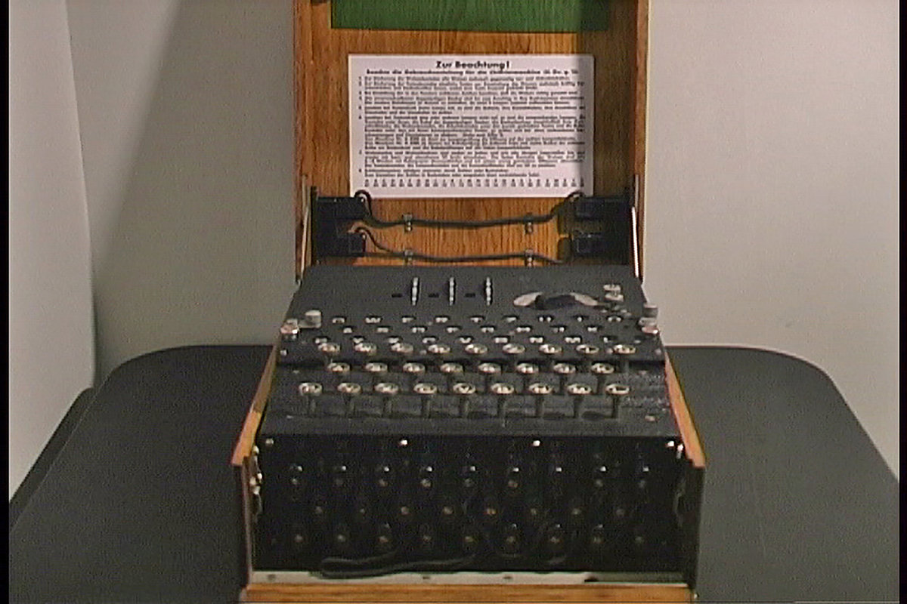
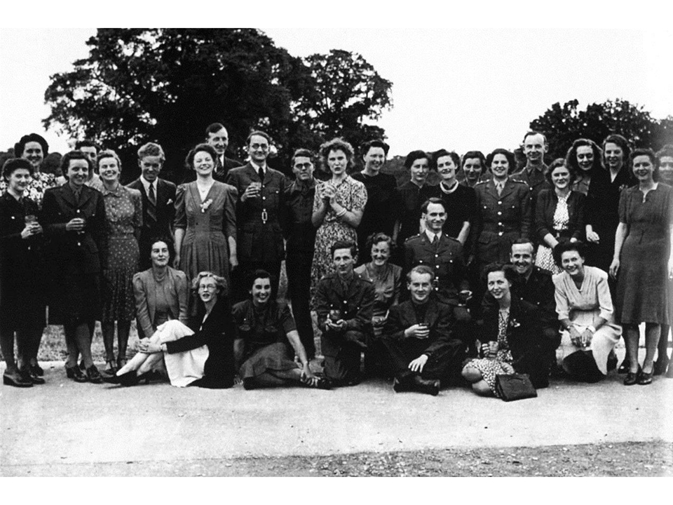
Decrypting Enigma
Triumph of the Nerds
By Justin Cabral
Notes:
I believe it was the triumph of the nerds because they used math to help save millions of lives.
On the left is an actual Enigma machine that was found after the war, and on the right

Slide 2
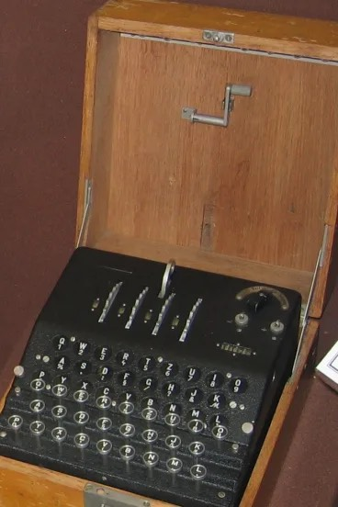
Brief History
The original enigma
Developed by Arthur Scherbius after WW1
Became a commercial product in the 1920’s
Adopted by German military before WW2
3 or 4 Fixed Rotors
No Plugboard
Notes:
Picture on the right is an original enigma without the plugboard.

Slide 3
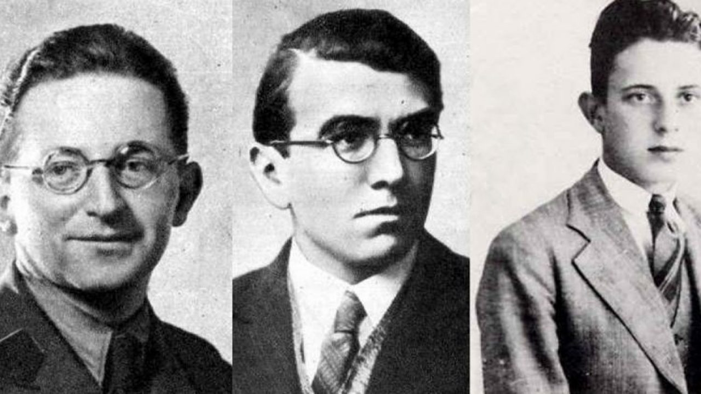
Brief History
Original Enigma Codebreakers
1930 Poland noticed a change in German encryption
Polish Cipher Bureau was established
Broke the code in 1932 using permutation theory
Marian Rejewski, Henryk Zygalski, Jerzy Rozycki
Didn’t share techniques until 1939 when WW2 started

Slide 4
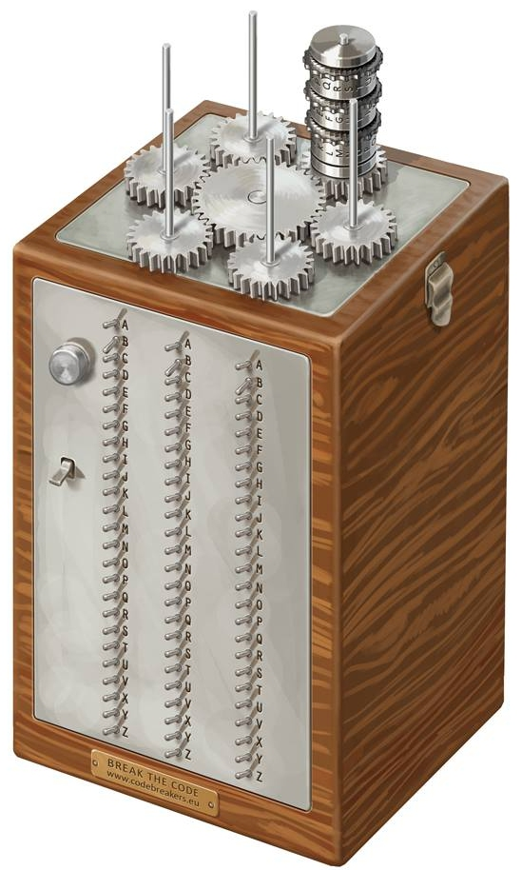
Brief History
The bomba machine
Created by Marian Rejewski
Mechanical Enigma Decrypter
Cost $50,000 to build in 1930’s
Equivalent of $850,000 today
Too costly for Poland during WW2

Slide 5
WW2 Starts…

Slide 6
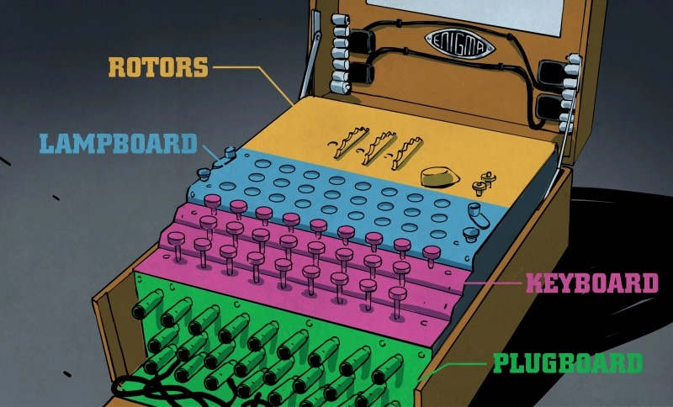
The Military/Navy Enigma Machine
An electromechanical stream cipher device
Nazi Military and Navy made two major changes
5-8 unique rotors that can be placed in different combinations
A plug-board system to swap letters and add more complexity
Notes:
Instead of having fixed rotors, they had a combination of configurations
When I say unique rotors, each rotor had a different set of internal cross wiring.
For example. Rotor #1 is cross wired to turn A into G, but rotor #7 is cross wired to turn A into X

Slide 7


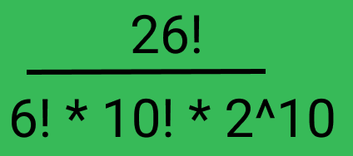


How Complex was it?
Lets do the math
Each rotor contains 26 different letters
There are 3 of 8 rotors that can be placed in any combination
26 Letter Plugboard that uses 10 pairs at a time
Total Ways to Configure
the Enigma Machine is…………
Notes:
26 cubed gives us 17,256 possible starting letter positions for the rotors
Then 8 * 7 * 6 gives us the 336 different ways you can arrange the 8 different rotors
Lastly the plugboard added an extreme amount of complexity.
26! for the letters, divived by ^6! For the letters not used, 10! For the amount of pairs, and 2^10 for the same pairs found.
Example: Pair AT and TA are the same so don’t them twice.
Take those two numbers, add them together and mulitiply the 3rd and you get roughly 159 quintillion possible Enigma combinations
Its no wonder why the germans thought it to be unbreakable

Slide 8
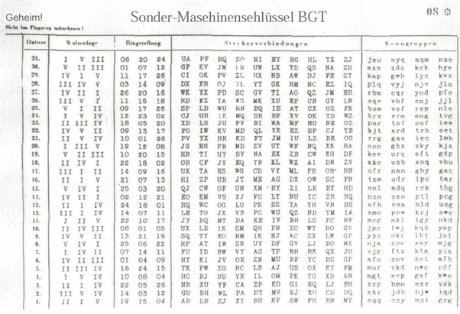
Enigma Settings
Keys kept on paper
Rotor Combinations
Initial Rotor Setting
Plugboard Configuration
Test letters
New configuration each month
Notes:
If for some reason the german military believed a sheet had been found, they would simply print new sheets.

Slide 9
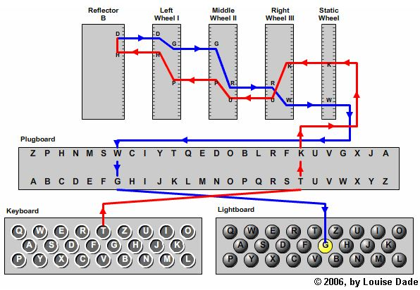
How does it work?
Lets look inside
Input - T
Output - G
Notes:
T is inputted and goes through the plugboard and comes out as K
Like I talked about early, each of those rotors contain different cross wirings as you can see here.
After the rotors it hits the reflector and returns through the rotors againd and once more through the plugboard
After all that, a lamp lights up on the lampboard and gives you the encrypted output which in this case is G

Slide 10
Enigma’s Critical Design Flaw
The Reflector
It meant a letter could never be encrypted as itself
T != T

Slide 11


How to exploit this flaw?
Wetterbericht (Weather Report)
The Nazi’s sent a weather report at 6am every morning
It meant you could check the text and make assumptions on plugboard pairs
Assume(t->g)
Notes:
As an example the Nazi’s would send a weather report at 6AM every morning
So theoretically, we should be able to make assumptions about the plugboard paris in the cipher output

Slide 12
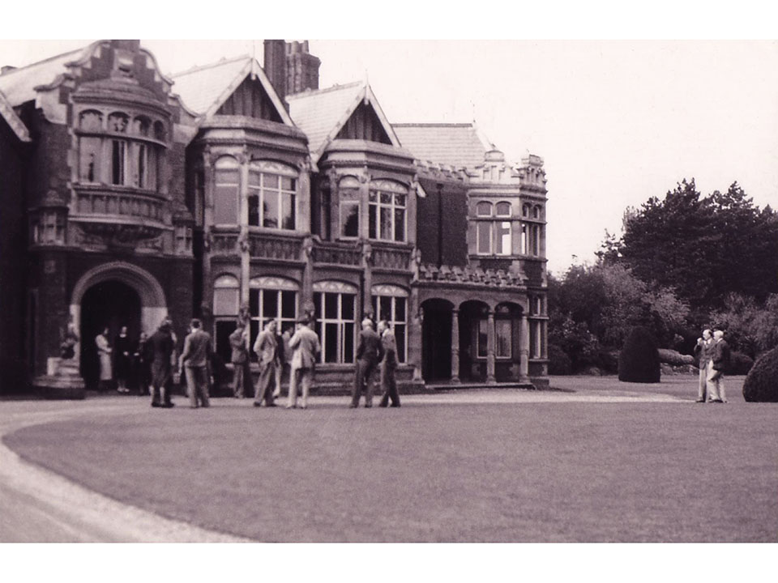
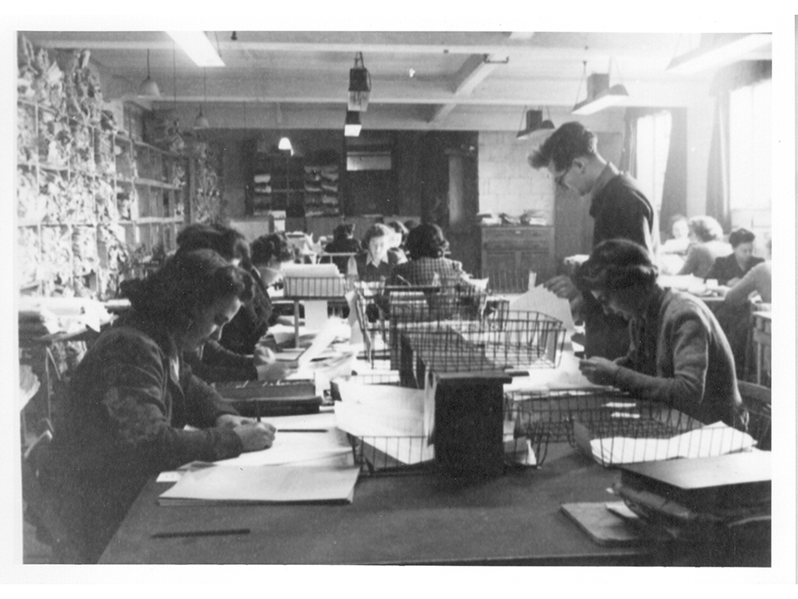
Thats what they did
Bletchley Park Hut 8
Worked out of the United Kingdom during WW2
Alan Turing invented the Bombe machine
Joan Clarke came up with ways to reduce operations
Hugh Alexander did work to recognize code patterns
Notes:
There were many more huts inside Bletchley but Hut 6 and 8 worked on the harder Military and Naval enigma that I’m going over

Slide 13
Reducing Operations
Clever tactics
The 3rd rotor rarely rotates in a message
First two rotors - > 26 * 26 = 676 characters
Most messages were less than this
Letter frequency analysis can be done
Notes:
Since most messages were transmitted in morse code, they were kept realatively short, this meant that most of the time, the 3rd rotor did not rotate
This meant that you could do some kind of letter frequency analysis

Slide 14
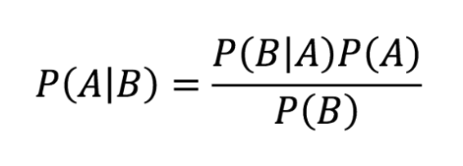
The Banburismus Technique
Alan Turing’s second invention at Bletchley Park
Cryptanalytic process
Sequential Conditional Bayesian Probability
Gave a score to single repeats, bigrams, and trigrams.
Classified from 1942 - 2010
Used in conjunction with the Banbury sheets
Notes:
What this process did was basically give a weighted score to what he thought were letter pairs
His technique made use of the Baye’s rule which is basically:
The probability that A is true given B is equal to the probability that B is true given A, multiplied by the probability of A divided by the probability of B

Slide 15
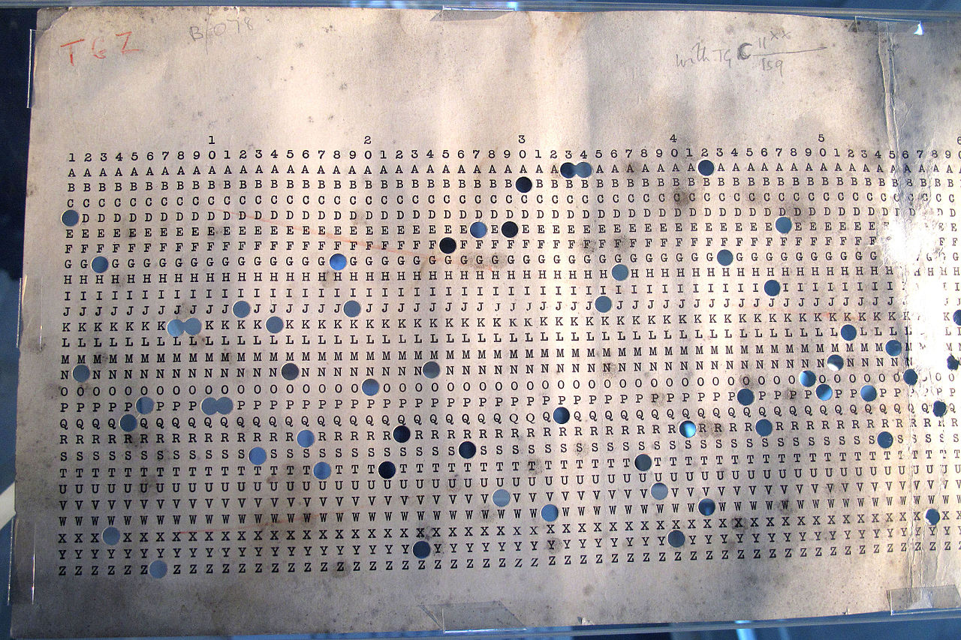
Banbury Sheets
More operation reduction
Hugh Alexander would work with these sheets
Find rotor positions before configuring Bombe machine
Reduce Bombe calculation time dramatically
Bombe only needed to work out what the 3rd rotor was
Every message ended in Heil Hitler
The double H’s, E’s and L’s aided in spotting patterns
Notes:
They would take the highest weighted letter scores and punch them out of the sheets
Then they would slide the sheets over the cipher text looking for possible pairings that would give away which rotors were in position 1 and 2
Knowing that each message ended in double H’s E’s and L’s helped this process dramatically

Slide 16
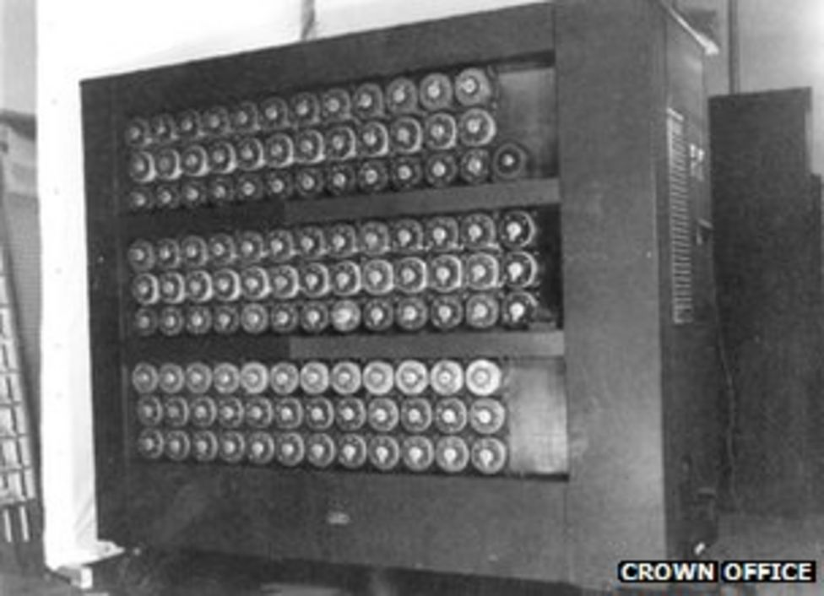
The Bombe Machine
How it worked
Basically many parallel enigma machines
Over 50 were made over the course of WW2
They work backwards to find configuration
Each start with an initial letter pair assumption
Work continues until an assumption is proven true
Can crack enigma in 20 minutes
Notes:
The UK only made around 5 of the Bombes, but the large majority was made by the United States which had more expendable resources

Slide 17
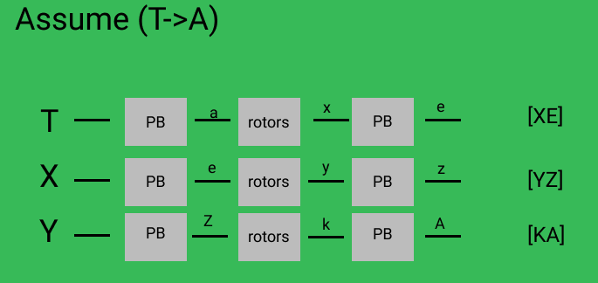
The Bombe Machine
How it worked
K is found to pair with A on Plugboard after deductions
This contradicts the original assumption, meaning the enigma rotor settings are incorrect.
Therefore all plugboard pairs found up until that point are no longer checked
The Bombe machine then flips the first rotor and tries assumption again
Notes:
So as an example:
Lets say you wire up the back of the enigma to check if T is paired with A on the plug board
It’s going to run through all of these deductions instantly, and if it finds a contradiction like in this case K is found to be paired with A
The rotor position would shift once and the process would repeat

Slide 18
July 9th, 1941
A historic day
The Bombe machine cracks it’s first enigma configuration
The allies are able to alert transport ships of Nazi U-Boat locations
Millions of lives are saved in the future as the war turns

Slide 19
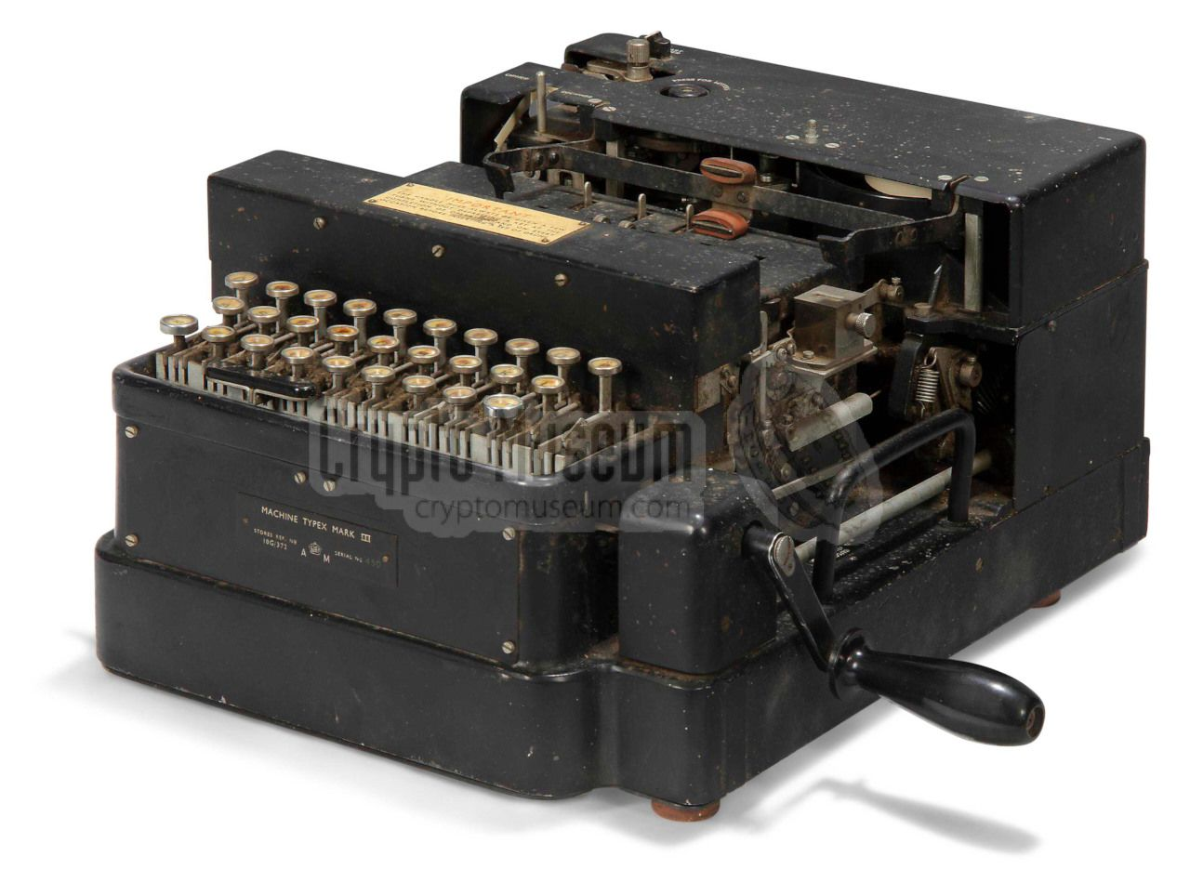
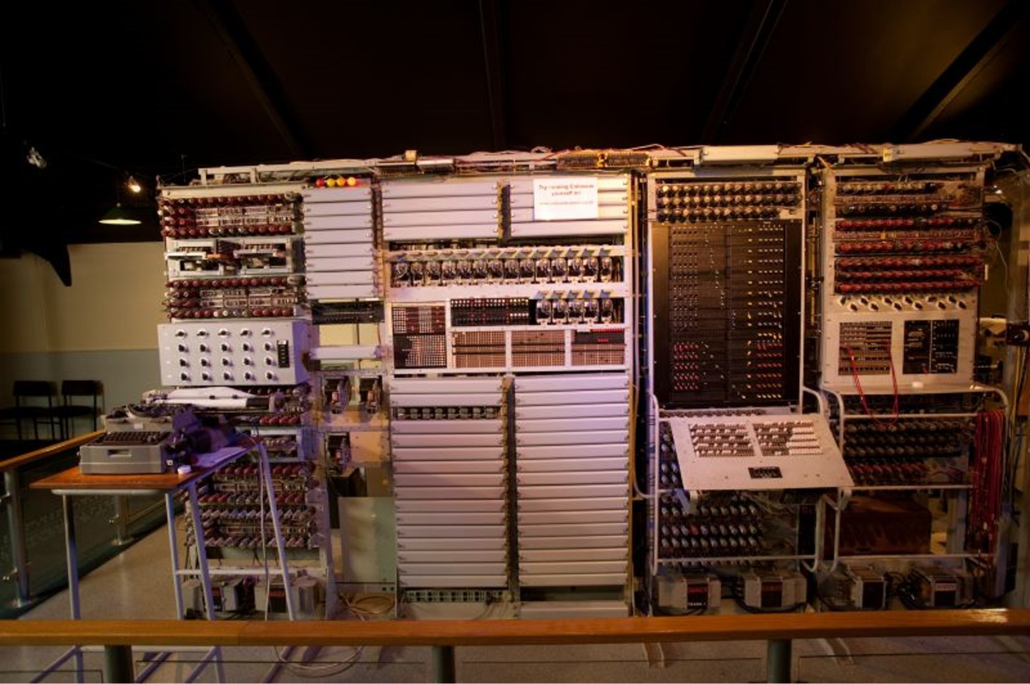
A New Age of National Security
Cryptography is the future
United Kingdom would develop the X machine which fixed Enigma flaws
United States would develop Colossus which was kept secret until 1970’s
X Machine
Colossus

Slide 20
And the rest is history….

