Slide 1
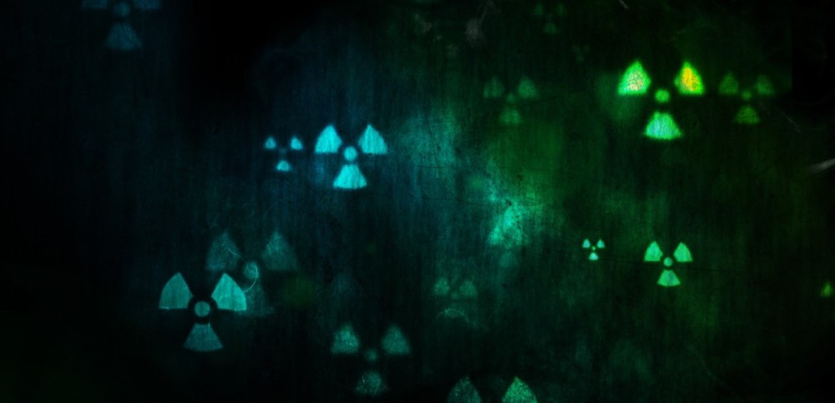
Fission & Fusion
How do we make new elements?
How can we harness the power of nuclear reactions?

Slide 2
Learning Objectives
Describe what fission and fusion are and explain the differences between them.
Predict energy changes as a result of fission and fusion reactions.
Write and balance nuclear reactions for fission and fusion reactions
State what is meant by mass defect in a fission/fusion reaction and how it relates to the energy released in the reaction
Describe the relationship between mass and energy using E = mc².
Describe mass defect and binding energy and their relationship.

Slide 3
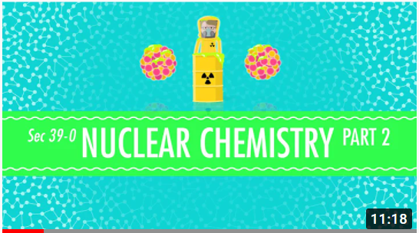
Introducing Nuclear Reactions

Slide 4
Mass & Energy
Where does nuclear energy come from?

Slide 5
Mass Defect
The total mass of a stable nucleus is always less than the masses of the constituent protons and neutrons.
This difference in mass is known as the mass defect.
Mass defect = mass of nucleons – mass of nucleus

Slide 6
Binding Energy
The missing mass is present as the binding energy of the nucleus.
If the mass of ⁴He was exactly equal to the mass of two neutrons + two protons, the nucleus could fall apart without any input of energy.
To be stable, it’s mass must be less than that of its constituents.
The nuclear binding energy represents the amount of energy that must be put into a nucleus to break it apart into its individual nucleons.

Slide 7
Mass & Energy
Mass defect and binding energy are related by Einstein’s famous equation:
E = mc²
Energy measured in Joules
Speed of light, 3 x 10⁸ m/s, don’t forget to square it!
Mass measured in kg

Slide 8
Energy from nuclear reactions
Energy is released in a nuclear reaction when the binding energy of the products is greater than the binding energy of the reactants.
This is the equivalent of saying that the mass of the products is less than the mass of the reactants. The difference in mass is released as energy.
  Very small nuclei release energy by increasing in size.
  Very large nuclei release energy by decreasing in size.

Slide 9
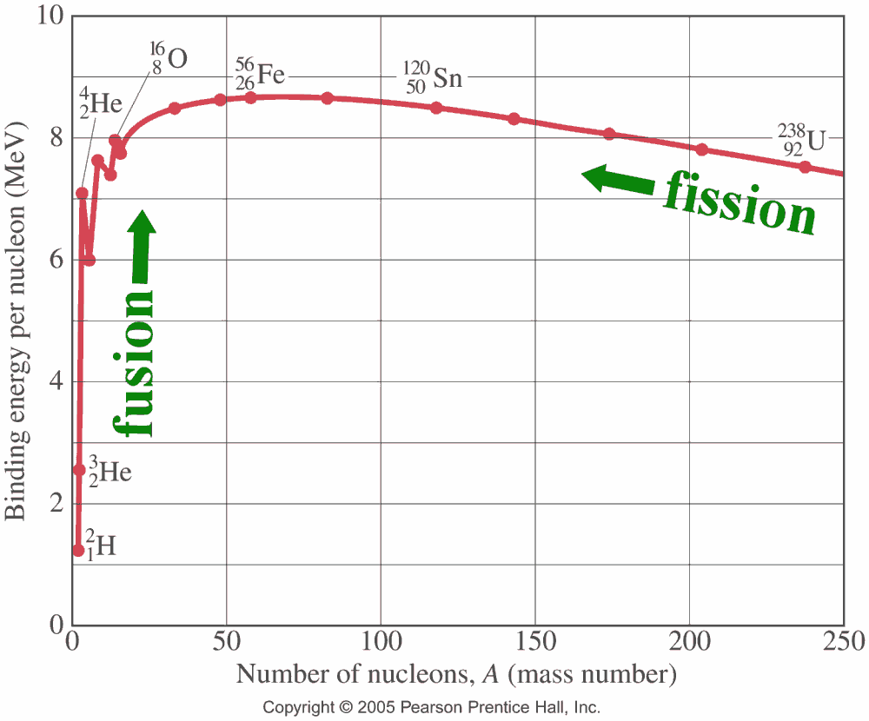
Binding energy per nucleon
Nuclei with a large binding energy per nucleon are most stable.
Smaller nuclei will undergo fusion to become more stable.
Larger nuclei will undergo fission to become more stable.

Slide 10
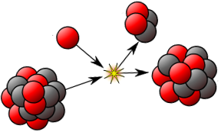
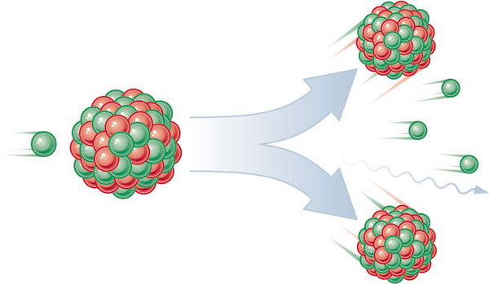
Fission
Splitting a heavier nucleus into smaller nuclei.
Can happen spontaneously (α decay) or can be induced by neutron capture.
Releases large amount of energy.
Often involves release of gamma photons and free neutrons.

Slide 11
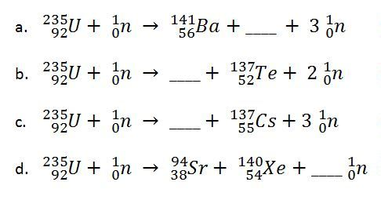
Examples of Fission

Slide 12
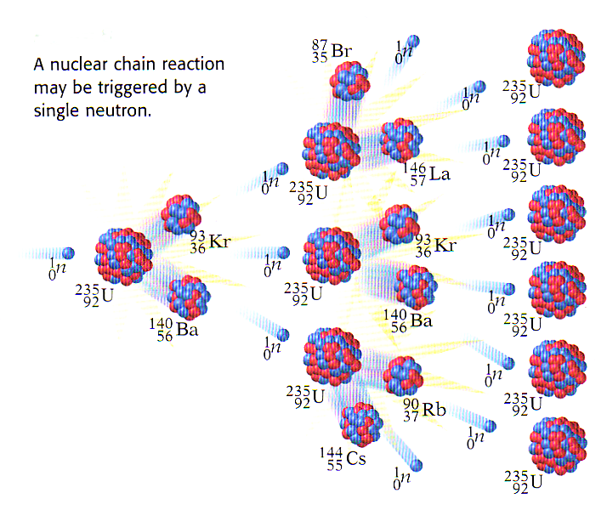
Chain Reactions

Slide 13
Using Nuclear Fission
Atomic Bomb (fission bomb) – Triggering a chain reaction in U-235 or Pu-239
  Must have a minimum amount of radioactive isotope to sustain a chain reaction (critical mass).
Nuclear Power Plants – Convert heat energy from fission chain reaction into electricity.
  Control chain reaction with control rods that absorb neutrons emitted after fission reaction.

Slide 14
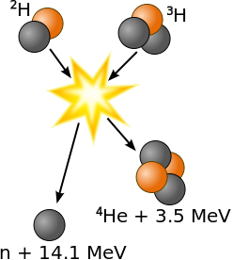
Fusion
Joining two lighter nuclei to form one heavier nucleus.
Releases a massive amount of energy.
Usually releases neutrons or protons as well as new nucleus.
Requires a huge amount of energy to overcome the electrostatic repulsion between nuclei, so very high temperature required.

Slide 15
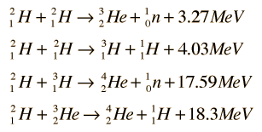
Examples of Fusion

Slide 16
Using Nuclear Fusion?
Fusion takes place in main sequence stars, and is what powers them.
Needs extremely high temperature and pressure to get fusion to take place – need to overcome electrostatic repulsion between nuclei.
We are researching how to generate and sustain a fusion reactor!

Slide 17
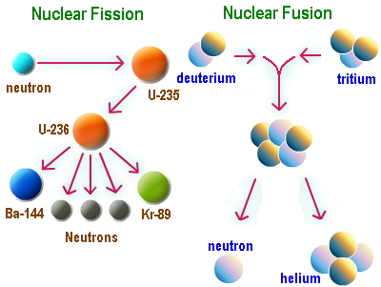

Slide 18
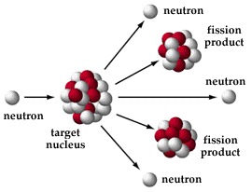
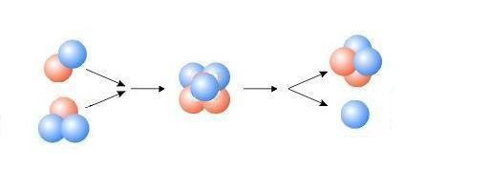
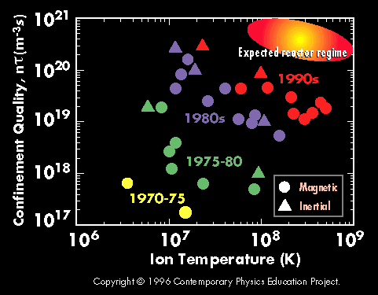
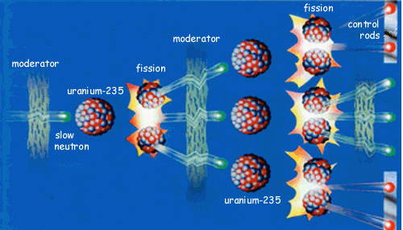
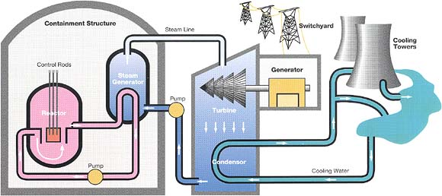
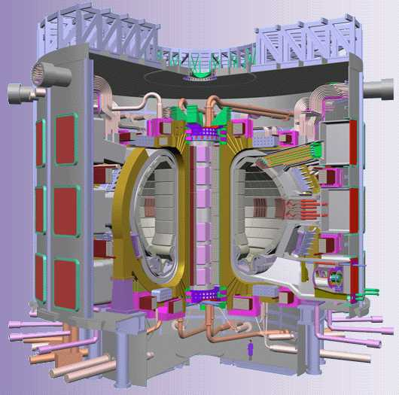
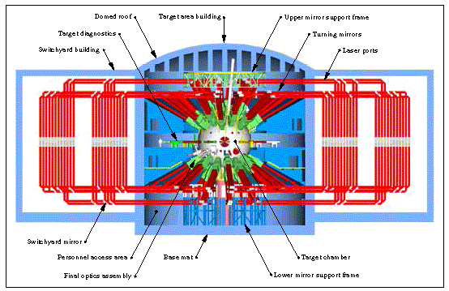
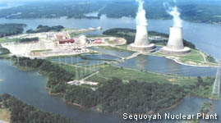
Fission & Fusion
Fission is the release of energy by splitting heavy nuclei such as Uranium-235 and Plutonium-239
D-T Fusion
Fusion is the release of energy by combining two light nuclei such as deuterium and tritium
D
⁴He
3.52 MeV
T
Neutron
14.1 MeV
How does a nuclear plant work?
Each fission releases 2 or 3 neutrons
These neutrons are slowed down with a moderator to initiate more fission events
Control rods absorb neutrons to keep the chain reaction in check
The goal of fusion research is to confine fusion ions at high enough temperatures and pressures, and for a long enough time to fuse
This graph shows the exponential rate of progress over the decades
Controlled Fission Chain Reaction
Confinement Progress
There are two main confinement approaches:
The energy from the reaction drives a steam cycle to produce electricity
Magnetic Confinement uses strong magnetic fields to confine the plasma
This is a cross-section of the proposed International Thermo-nuclear Experimental Reactor (ITER)
Nuclear Power Plant
Nuclear Power produces no greenhouse gas emissions; each year U.S. nuclear plants prevent atmospheric emissions totaling:
5.1 million tons of sulfur dioxide
2.4 million tons of nitrogen oxide
164 million tons of carbon
Nuclear power in 1999 was the cheapest
source of electricity costing 1.83 c/kWh
compared to 2.04 c/kWh from coal
Inertial Confinement uses powerful lasers or ion beams to compress a pellet of fusion fuel to the right temperatures and pressures
This is a schematic of the National Ignition Facility (NIF) being built at Lawrence Livermore National Lab

Slide 19
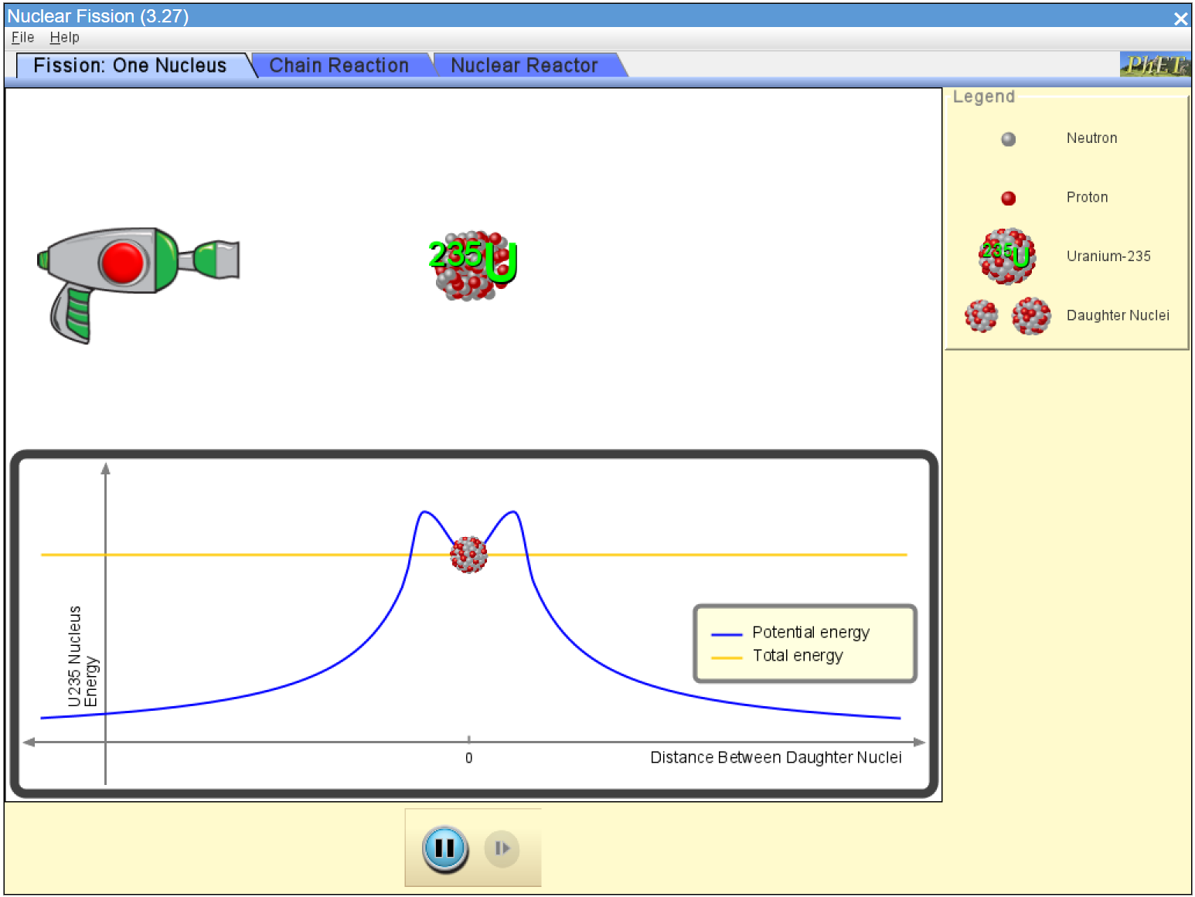
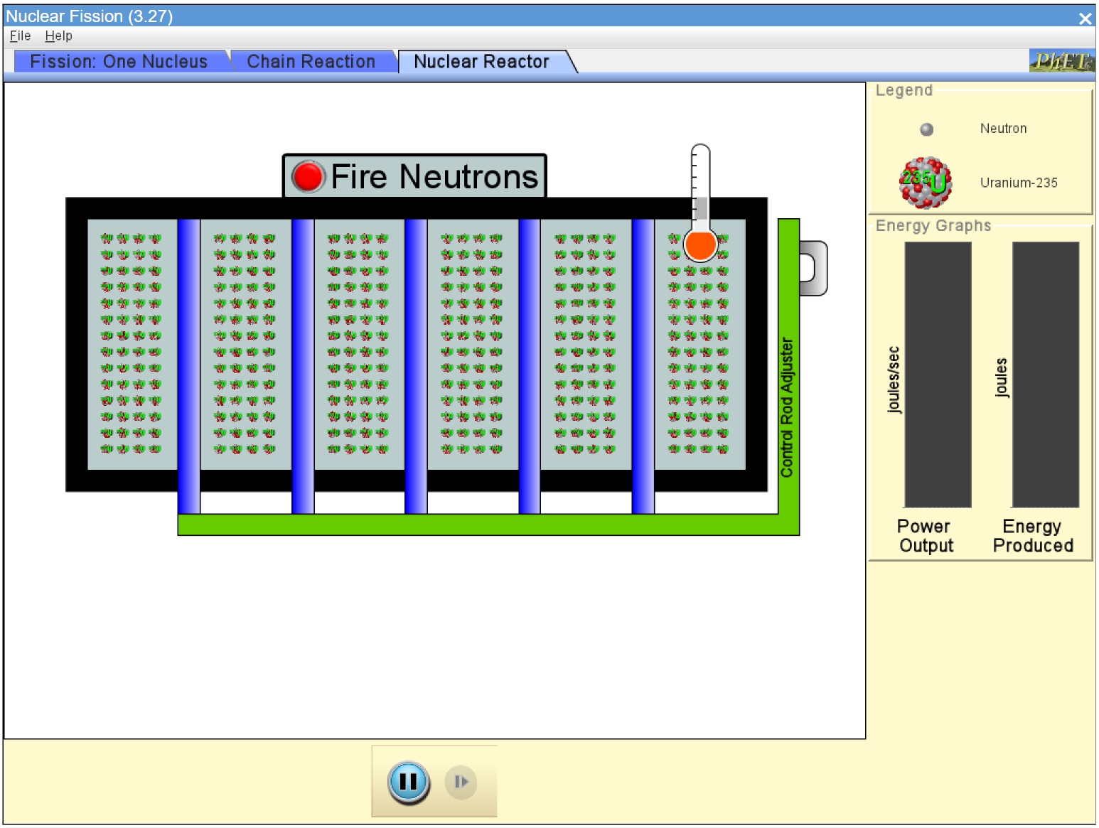
Investigating Fission Chain Reactions
Go to this website:
http://phet.colorado.edu/en/simulation/nuclear-fission
Run the nuclear fission simulator to learn about how nuclear fission works.
Complete the Chain Reaction worksheet, using some research to help along the way.
Check your answers from connect.

