Slide 1
Stages of Divine Revelation
Submitted by: Angelica Paulo BSCS-1

Slide 2
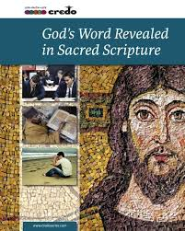
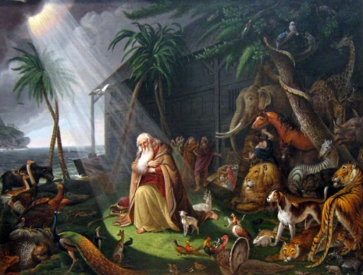
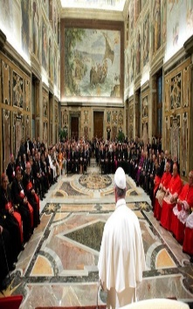
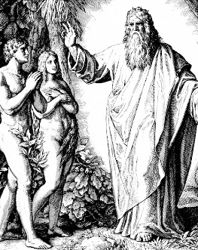
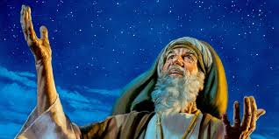
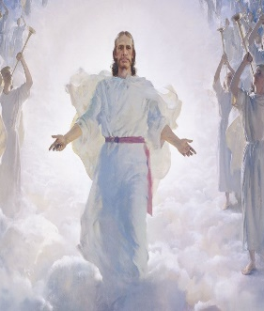
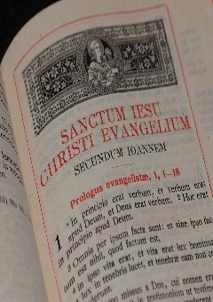
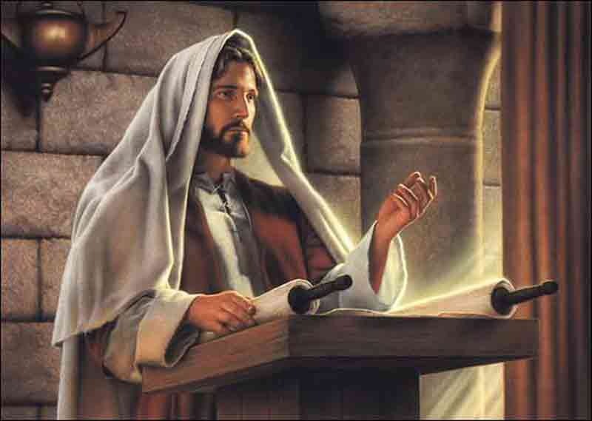
Timeline
CCC 54-64 God shows himself in the
Old Testament
CCC 70-72 God shows himself in
the Old Testament
CCC 76 Truth through
Scripture and tradition
CCC 97, 100 Truth
through scripture
and tradition
The Covenant with Noah
God chooses Abraham
CCC 85-87 Truth
Through scripture
and tradition
God has said everything in his Word
God forms his people Israel
CCC 101-104 The word
of scripture.
There will be no further Revelation
CCC 70-72 God shows himself in
the Old Testament
CCC 73 Jesus is the fullness of
revelation
CHRIST - THE UNIQUE
WORD OF SACRED
SCRIPTURE
The Magisterium of the
Church
There will be no further
Revelation
CCC 134, 423 We
believe in Jesus

Slide 3
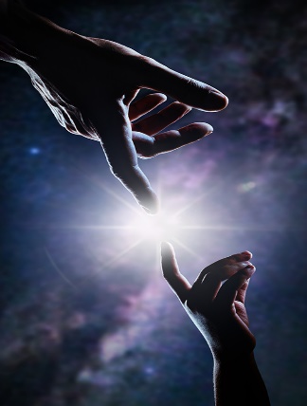

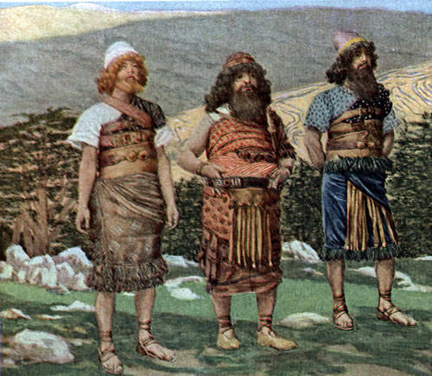
Timeline
God makes himself
known
God wishes to give eternal
life to all those who seek
salvation by patience in
well-doing.“
The fall of Adam thus represents
the way humanity became
conscious of good and evil.
The Covenant with
Noah
God blessed Noah
and his sons, saying
to them, "Be fruitful
and increase in
number and fill
the earth.
manifested himself to our first
parents from the very beginning.
" He invited them to intimate
communion with himself and clothed
them with resplendent grace and justice.
God at once sought to save
humanity part by part.
God promises never again to destroy
all life on Earth by flood and creates
the rainbow as the sign of this "everlasting covenant between
God and every living creature of all flesh that is on the earth".

Slide 4
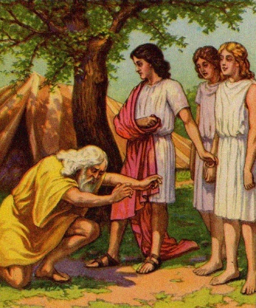
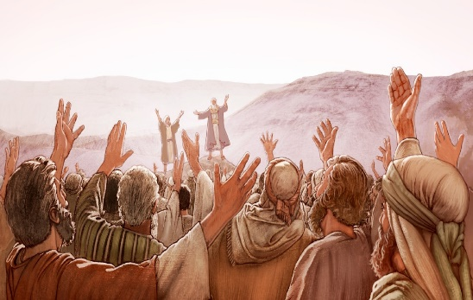
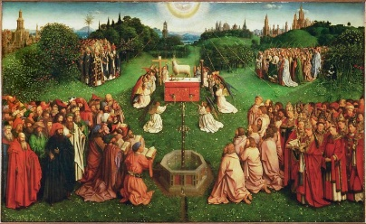
Timeline
I will surely bless you, and
I will multiply your descendants
like the stars in the sky and the
sand on the seashore.
Your descendants will possess
the gates of their enemies.
He offered them an
opportunity to
become the model
nation of His way
of life for all nations,
so that all people could
have His blessings. He
blessed Israel because
of the faith and
obedience of Abraham,
God chooses abraham
God forms his
People israel
Given here is evidence that Abraham
was a preacher and a gatherer of souls
wherever he went
God had said to Abram, “Leave your country,
your people and your father's household and go
to the land I will show you. “I will make you into a
great nation and I will bless you; I will make your name great
God chose Israel as the one He would work with. God said through the prophet Isaiah, “Yet hear now, O Jacob My servant, and Israel whom I have chosen” (Isaiah 44:1).

Slide 5
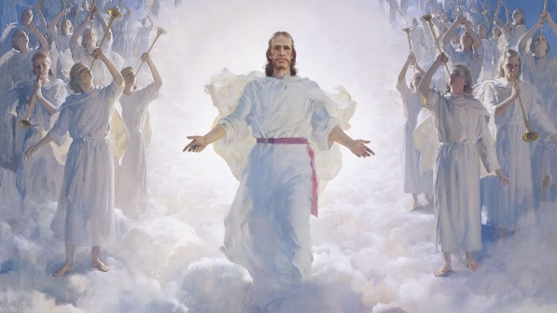
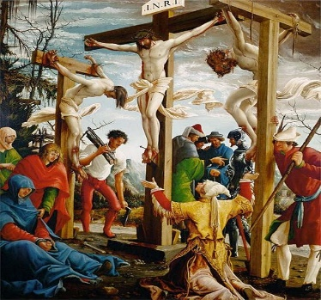
Timeline
In giving us his Son, his only Word he spoke everything
to us at once in this sole Word - and he has no more to say. because what he
spoke before to the prophets in parts, he has now spoken all at once by giving
us the All Who is His Son.
We proclaim our belief in Jesus Christ as our Saviour, God’s ultimate revelation
to us and as God.
Jesus not only reflects God, He reveals God. He was not a mere statue, a close
Representation of or likeness of God.
Jesus is the fullness
Of the revelation.
God has said everything
In his word

Slide 6
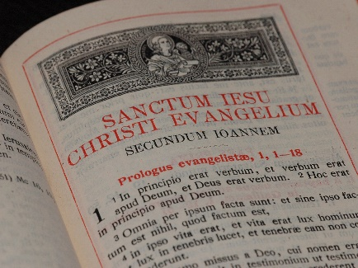
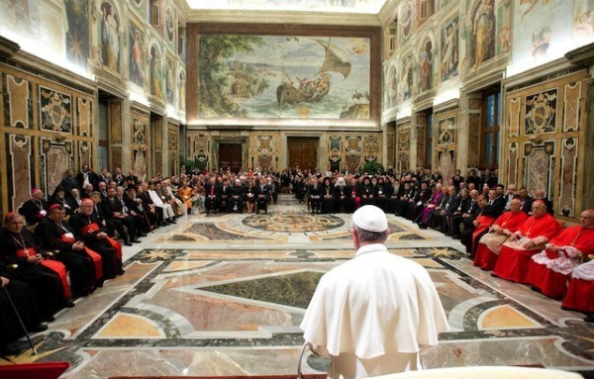
Timeline
Truth through
Scriptures and tradition
The Magesterium
Of the church
The authentic interpretation of the Word of God,
"whether in its written form or magisterium of the Catholic Church is the church's authority or office to give in the form of Tradition.
guarding the deposit and faithfully witnessing to it in every generation implies and demands themagisterial function of infallibly interpreting and defining the faith.
Christ commissioned the apostles to preach to all men
his Gospel, which is the source of all the truths
necessary for salvation and moral teaching. He also
ordered them to administer the heavenly gifts, the sacraments.
“Tradition” means “handing on”–the apostles handed on what
they themselves had received from Christ.

Slide 7
Conclusion
the book of the Revelation took us from the days
of the early church all the way into eternity in
the future and God’s revelation was progressive because his revelation was in stages, it was not
revealed everything at once the humanity. The scriptures were accurate John is assured that everything he has seen is both faithful and true.
God’s revelation was complete it is accurate in all that it teaches and the divine revelation brought
us salvation by sending his beloved son
In the manner of the letters of Paul, John ends
with the closing salutation, The grace of the Lord Jesus be with God's people.

Slide 8
Image Ref :
https://www.google.com/search?q=abraham+stars&tbm=isch&ved=2ahUKEwiS7ojdprjrAhVHapQKHedvAEAQ2-cCegQIABAA&oq=abraham+stars&gs_lcp=CgNpbWcQAzIHCAAQsQMQQzIECAAQQzIECAAQQzIFCAAQsQMyAggAMgIIADICCAAyAggAMgIIADICCABQ_dANWL_7DWD1_A1oAHAAeACAAcoaiAG8YJIBAzktNJgBAKABAaoBC2d3cy13aXotaW1nsAEAwAEB&sclient=img&ei=UAlGX5KGJcfU0QTn34GABA&bih=609&biw=1366#imgrc=Kt-tcIbwjYGN3M
https://www.google.com/search?q=CHRIST+-+THE+UNIQUE+WORD+OF+SACRED+SCRIPTURE+&tbm=isch&ved=2ahUKEwjhn_C_qLjrAhXzx4sBHaPABcMQ2-cCegQIABAA&oq=CHRIST+-+THE+UNIQUE+WORD+OF+SACRED+SCRIPTURE+&gs_lcp=CgNpbWcQA1Cz1FZYzNdWYM7ZVmgAcAB4AIABAIgBAJIBAJgBAKABAaoBC2d3cy13aXotaW1nsAEAwAEB&sclient=img&ei=LAtGX-HZD_OPr7wPo4GXmAw&bih=609&biw=1366#imgrc=CUjAUuPbBf8uPM
https://www.google.com/search?q=CHRIST+-+THE+UNIQUE+WORD+OF+SACRED+SCRIPTURE+&tbm=isch&ved=2ahUKEwjhn_C_qLjrAhXzx4sBHaPABcMQ2-cCegQIABAA&oq=CHRIST+-+THE+UNIQUE+WORD+OF+SACRED+SCRIPTURE+&gs_lcp=CgNpbWcQA1Cz1FZYzNdWYM7ZVmgAcAB4AIABAIgBAJIBAJgBAKABAaoBC2d3cy13aXotaW1nsAEAwAEB&sclient=img&ei=LAtGX-HZD_OPr7wPo4GXmAw&bih=609&biw=1366#imgrc=ubHFQDiQ09SWtM
https://www.google.com/search?q=REVELATION+ADAM+AND+EVE&tbm=isch&ved=2ahUKEwi8n_SArrjrAhUnzIsBHSotCpcQ2-cCegQIABAA&oq=REVELATION+ADAM+AND+EVE&gs_lcp=CgNpbWcQAzoFCAAQsQM6BAgAEEM6BwgAELEDEEM6AggAOgQIABAYUMXpGljLjBtg_I0baABwAHgDgAHfBIgB-zSSAQwwLjQuMS4yLjEwLjGYAQCgAQGqAQtnd3Mtd2l6LWltZ7ABAMABAQ&sclient=img&ei=8hBGX7zeMaeYr7wPqtqouAk&bih=609&biw=1366#imgrc=jstBf8va39vatM

