Slide 1
Analyzing the Effectiveness of Superhero U Ad Campaigns

Slide 2

Introduction
Trevor Munene -> Leads the team, liaising with sponsors via email and calls.
Sonu Yadav -> Manages project execution.
Atharva Jagdale -> Records meeting minutes and distributes notes.
Rohit Sinha -> Ensures project deliverables are met.
Paulina Paul -> Assists as project lead and assistant manager.

Slide 3

Superhero U
Superhero U, a global competition by GlobalShala, fosters innovation and creativity in high school and college students.
The three-round competition promotes ingenuity and problem-solving, empowering youth to drive positive change and cultivate entrepreneurship and social responsibility.
Facebook ads were used to advertise the event.

Slide 4

Facebook Ads
Facebook Ads is a powerful tool for businesses to reach their target audience on the platform.
Allows businesses to target speciﬁc audiences based on demographics, interests, and behaviors.
Metrics to evaluate performance include Cost-Per-Click (CPC), Cost-Per-Result (CPR), Click-Through Rate (CTR), Reach, and Impressions.

Slide 5

Overview of Ad Campaign
Multiple campaigns run simultaneously to maximize event visibility.
Measuring engagement metrics such as click-through rates, impressions, reach, unique clicks, amouint spent in INR, cost per click and result provides valuable insights into the impact of our ad campaigns.

Slide 6
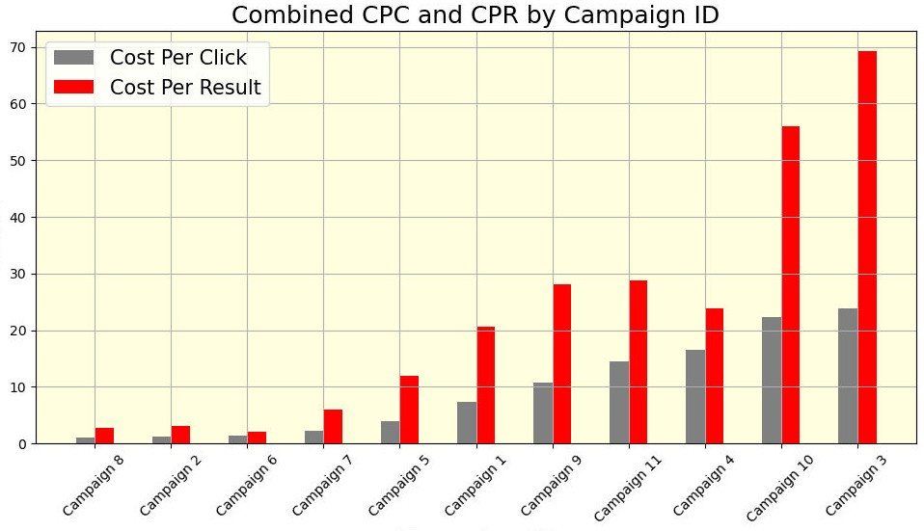
Campaigns Performance Overview
Bar Graph Comparison
Higher CPC and CPR indicate less efﬁcient campaigns.
Campaigns 3, 10, 4, and 11 highlighted.

Slide 7
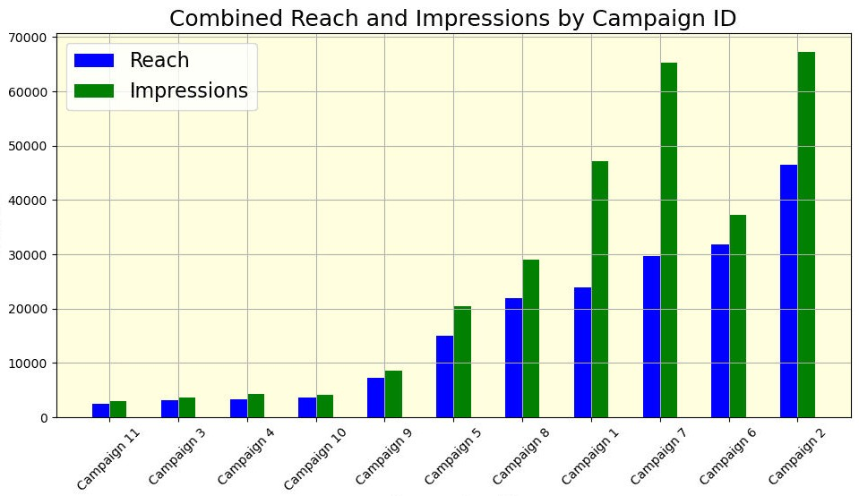
Reach vs. Impressions
Bar Graph
Campaigns 11, 3, 4, and 10 underperforming with low reach and impressions.

Slide 8
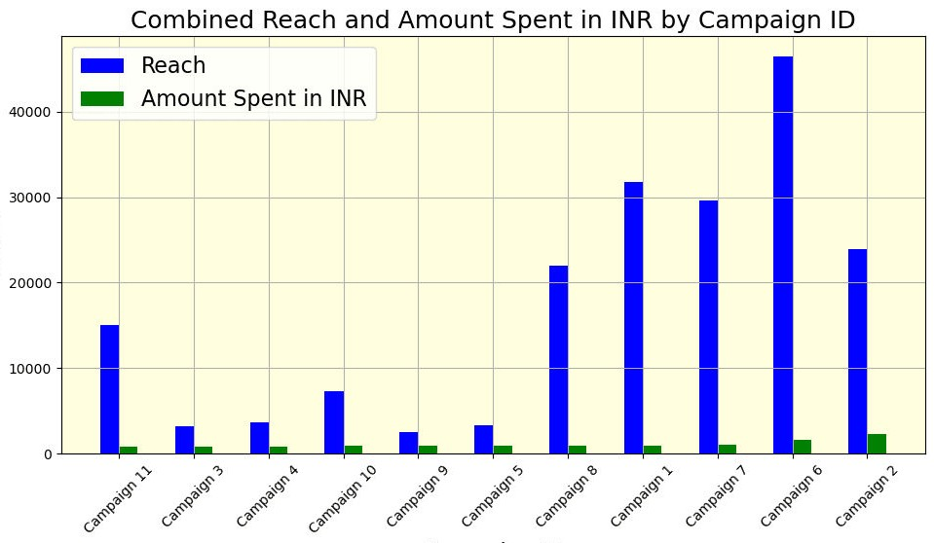
Combined Reach and Amount Spent
Bar Graph
Campaigns 3, 4, 9, and 5 show inefﬁciencies with low reach despite high expenditure.

Slide 9
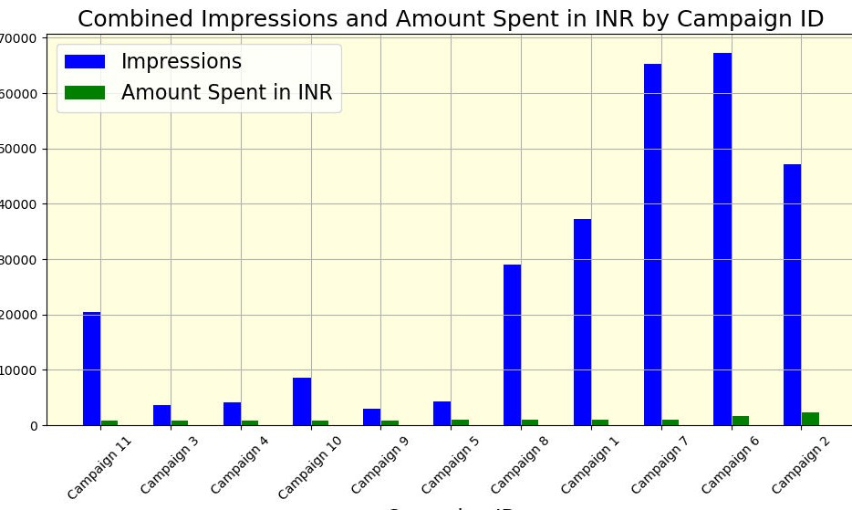
Combined Impressions and Amount Spent
Bar Graph
Campaigns 3, 4, 9 and 5 underperforming with low impressions for high costs.

Slide 10

Recommendation for Discontinuation
Campaign 3: High CPR, low reach, and impressions.
Campaign 4: Inefﬁcient in terms of CPC and CPR.
Campaign 10: High CPR and CPC, low overall performance.
Campaign 11: High costs with low returns.

Slide 11

Conclusion
We recommend discontinuing Campaigns 3, 4, 10, and 11.
Reallocation of resources to more effective campaigns will improve overall ROI and efﬁciency.

Slide 12
Thanks!

