Slide 1

MORPHOLOGICAL ANALYSIS
OF INUKTITUT
STATISTICAL NATURAL LANGUAGE PROCESSING FINAL PROJECT
Gina Cook

Slide 2
Why Inuktitut?
Official language of Nunavut
  Government
  Education
Search Engines
Spellcheckers
Dictionaries, Thesaurus
Grammar checkers

Slide 3
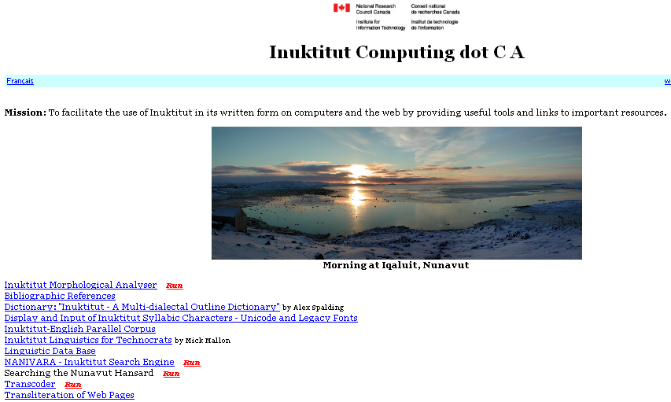
Inuktitut Resources

Slide 4
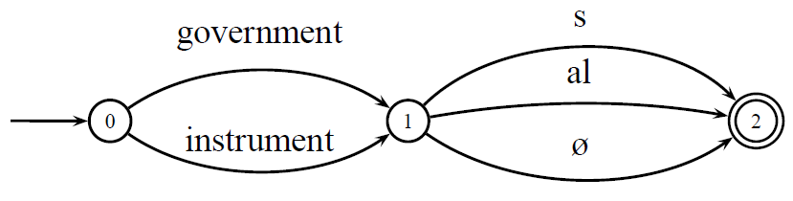
Morphology 101
Most languages have morphology
Most morphology consists of either suffixes or prefixes

Slide 5
Why Morphological Parsing?
Information Retrieval
  Remove morphs
Machine Translation
Named Entity Recognition
Natural Language Understanding
  Use morphs

Slide 6
Stemming
Useful for Information Retrieval
Reduces feature space

Slide 7
Full Parsing
Natural Language Generation
Machine Translation
Named Entity Tagging
Text Summarization

Slide 8
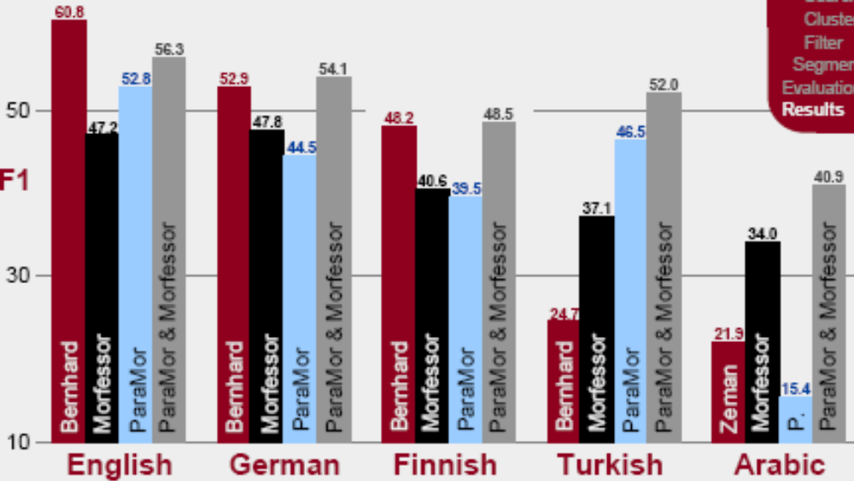
Low accuracy (F scores < 50%)
Performance heavily dependant on language type
Monson 2008

Slide 9
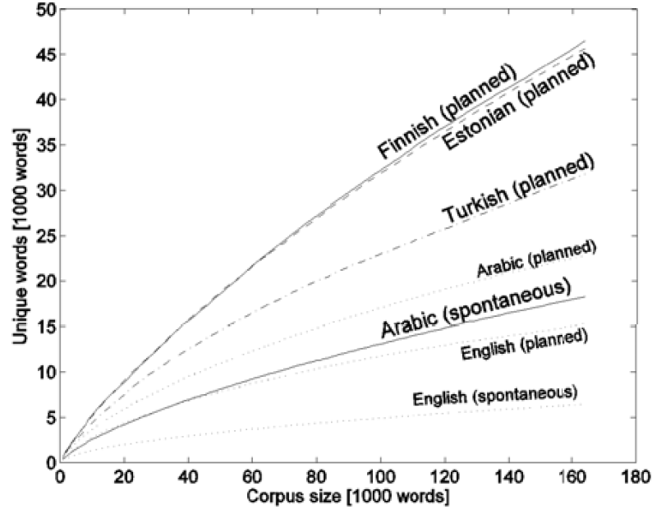
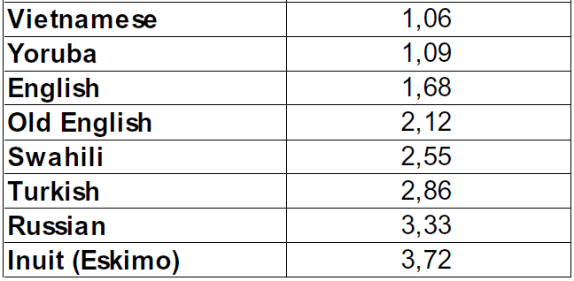
Morphology 102
Agglutinative languages more morphemes per word (Pirkola 2001)
And unlimited words (Kurimo 2008)

Slide 10
Five Approaches
Transition Likelihood
  Harris 1958
  Johnson & Martin 2003 (English, Innuktitut) HubMorph
  Bernhard 2007 (English, German, Finnish)
Minimum Description Length
  Brent 1995 MBDP-1
  De Marken 1995 Composition and Perturbation
  Goldsmith 2001,2006 Linguistica
  Creutz 2006 Morfessor
Paradigms
  Goldsmith 2001,2006 Linguistica
  Snover 2002
  Monson 2008 ParaMor
Word Edit Distance & Latent Semantic Analysis of word context
  Yarrow & Wicentowski 2000
Phonotactic/ Allomorphy
  Heinz MBDP-Phon-Bigrams

Slide 11
Compression
Morphological Parsing as Compression
  Tries
  Minimum Description Length

Slide 12
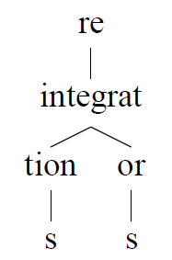
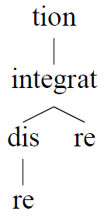
Harris 1955
Forward and Backward Tries

Slide 13
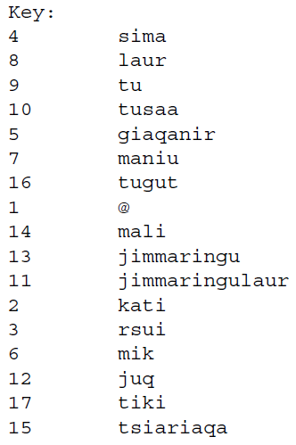
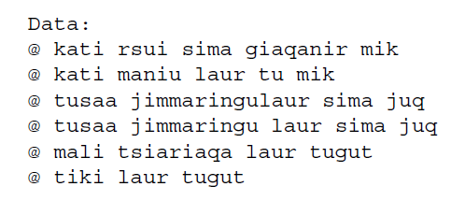
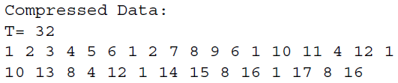
Minimum Description Length
The more morphs you find, the smaller the key

Slide 14
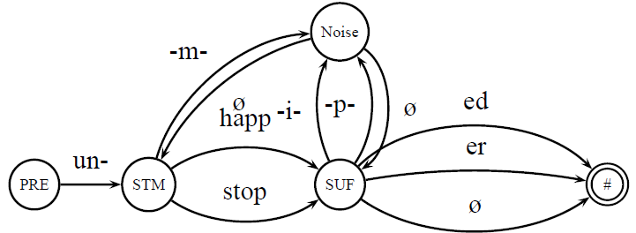
Creutz 2005: Morfessor
A Hidden Markov Model with 4 states
Morphemes are the strings which transition between them and the probabilities of that transition

Slide 15
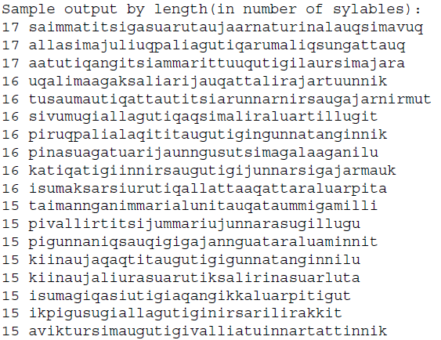
Morfessor Performance on Inuktitut
7% Precision
7% Recall
Why?

Slide 16
Morphology 103
Morphemes cannot appear in any order, the ordering is fixed
  Within a language
  For all human possible languages

Slide 17
FieldWorker 0.005
Goals
  Create a general system
  Grow from an initial assumption of root+suffix (which is true for all human languages argument+head)
  Expand to allow prefixing, multiple suffixes, compounding
  Flexible enough to allow for allomorphs
  Flexible enough to allow for nonlocal dependencies

Slide 18
Learning Grammar from morphological precedence relations
Discover template
  Take long words containing seed morphemes to discover full template
Discover morphemes
  Create dense corpora to find morphemes for each template category

Slide 19
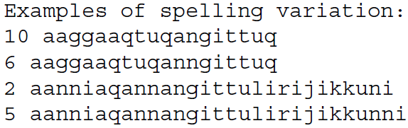
Creating an Inuktitut Corpus
Nunavut Hansard
  Spelling is unsystematic, introduces too much noise for statistical learning
Created a corpus from Inuktitut Magazine vol. 102-104
  Parallel corpus in Inuktitut, English and French
  17,000 Inuktitut words for 32,000 English words
  Consistent spelling

Slide 20
Overview
Corpus – word list
Word list – ranked possible morphs
Possible morphs – seed list
Seed list – precedence relations
Precedence relations – dense corpus
Dense corpus – precedence relations
Iterate

Slide 21
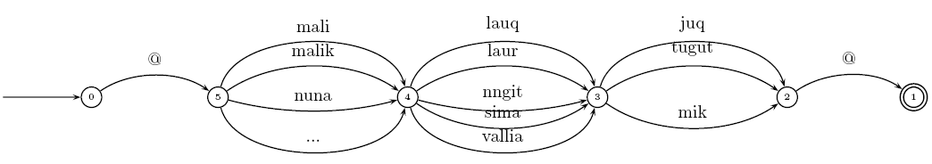
Sample Seed list

Slide 22
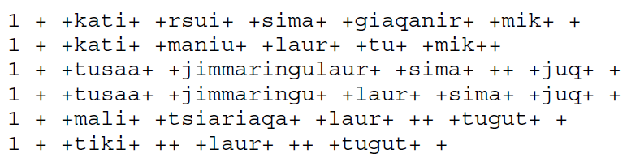
Gives a dense mini-corpus

Slide 23
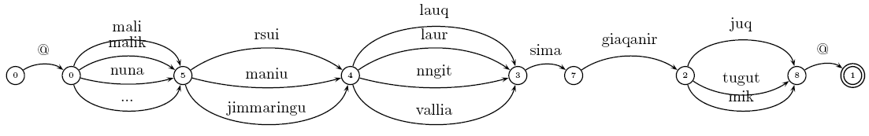
Which gives a new template

Slide 24
Progress

Slide 25
Evaluation
1 + +kati+ +rsui+ +sima+ +gia!qanir+ +mik+ +
1 + +kati+ +maniu+ +laur+ +tu+ +mik++
1 + +tusaa+ +jimma!ringu!laur+ +sima+ ++ +juq+ +
1 + +tusaa+ +jimma!ringu+ +laur+ +sima+ +juq+ +
1 + +mali+ +tsia!ria!qa+ +laur+ ++ +tugut+ +
1 + +tiki+ ++ +laur+ ++ +tugut+ +
Recall = 22/32 69%
Precision = 18/22 81%

Slide 26
Evaluation
Recall goes up as the model iterates
Precision goes down as the model iterates
Where to stop the model?

Slide 27
Morpho Challenge 2009 August
Run my algorithm on English, German, Finish, Turkish and Arabic corpora of Morpho Challenge 2008
If I am able to achieve respectable F-scores (~50%)
Submit my algorithm to Morpho Challenge 2009

Slide 28
References
Brent, Michael R and Xiaopeng Tao. 2001. Chinese text segmentation with mbdp-1: Making the most of training corpora. In 39th Annual Meeting of the ACL, pages 82–89.
de Marcken, Carl. 1995. Acquiring a lexicon from unsegmented speech. In 33rd Annual Meeting of the ACL, pages 311–313.
Goldsmith, J.A. (2001). Unsupervised Learning of the Morphology of a Natural Language. Computational Linguistics, 27:2 pp. 153-198.
Johnson, Mark. 2008a. Unsupervised word segmentation for Sesotho using adaptor grammars. In Tenth Meeting of ACL SIGMORPHON, pages 20–27. ACL, Morristown, NJ.
Johnson, Mark. 2008b. Using adaptor grammars to identify synergies in the unsupervised acquisition of linguistic structure. In 46th Annual Meeting of the ACL, pages 398–406. ACL, Morristown, NJ.
Kanungo, Tapas. 1999. "UMDHMM: Hidden Markov Model Toolkit," in "Extended Finite State Models of Language," A. Kornai (editor), Cambridge University Press. http://www.kanungo.com/software/software.htm http://www.umiacs.umd.edu/~resnik/nlstat_tutorial_summer1998/Lab_hmm.html
Pirkola, Ari. 2001. Morphologcial Typology of Languages for Information Retrieva, Journal of Documentation 57 (3), 330-348.
Schone, P., & Jurafsky, D. (2000). Knowledge-free induction of morphology using latent semantic analysis. In Proceedings of CoNLL-2000 and LLL-2000, pp. 67--72 Lisbon, Portugal.
Venkataraman, Anand. 2001. A statistical model for word discovery in transcribed speech. Computational Linguistics, 27(3):352–372.

