Slide 1
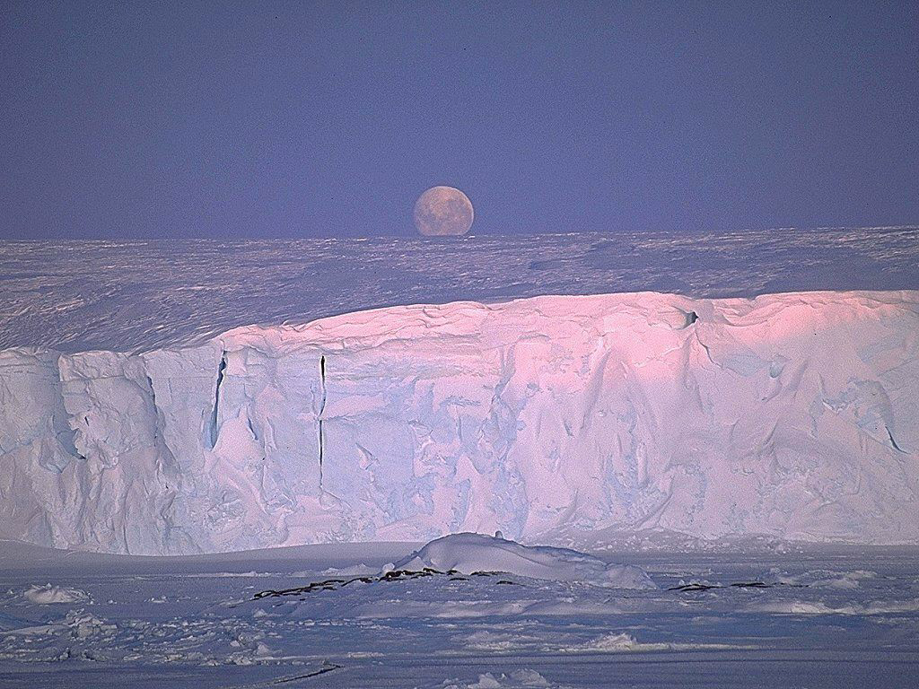
uqausiup ilanginnik nanisijjut
ᐅᖃᐅᓯᐅᑉ ᐃᓚᖏᓐᓂᒃ ᓇᓂᓯᔾᔪᑦ
ᐃᖃᓗᐃᑦ - ᕕᕗᐊᕆ 15, 2005-ᒥ

Slide 2

uqausiup ilanginnik nanisijjut
uqausiq-
word
-up
of a
ila-
part; portion
-nginnik-
its (the many ... of it)
nanisi-
-jjut
to find (what you are looking for)
tool; instrument
Inuktitut Word Decomposition
ᐃᖃᓗᐃᑦ - ᕕᕗᐊᕆ 15, 2005-ᒥ

Slide 3
Applications
Inuktitut Word Decomposition
Recognition of the root, suffixes and ending
of words
dictionary
search engine
spelling checker and corrector
grammatical analysis (parser)
language instruction
language training
statistics over corpora
ᐃᖃᓗᐃᑦ - ᕕᕗᐊᕆ 15, 2005-ᒥ

Slide 4
Sources
Dictionaries
Multi-dialectal outline dictionary (A. Spalding) – Aivilik
Ulirnaisigutiit (L. Schneider) – Nunavik
Uqausiit tukingit – Tununiq, North Baffin
Inuit uqausillaringit (Taamusi Qumaq) - Nunavik
Suffixes
& endings –
Morphology –
Phonology
Suffixes of the eskimo dialects of Cumberland
Peninsula and North Baffin Island (K. Harper)
Some aspects of the grammar of the eskimo dialects
of Cumberland Peninsula and North Baffin Island (K. Harper)
Dictionnaire des infixes de la langue esquimaude (L. Schneider)
Inuktituorutît – Grammaire purement esquimaude (L. Schneider)
Inuktitut – A grammar of North Baffin Dialects (A. Spalding)
Introductory Inuktitut, and all other works by M. Mallon
Inuit uqausiqatigiit (L.-J. Dorais)
ᐃᖃᓗᐃᑦ - ᕕᕗᐊᕆ 15, 2005-ᒥ

Slide 5
Dialects
Nunavut inuktitut
Nunavik (Northern Quebec) inuttitut
Nunatsiavut (Labrador) inuttut
Kalaallit Nunaat (Groënland) kalaallisut
ᐃᖃᓗᐃᑦ - ᕕᕗᐊᕆ 15, 2005-ᒥ

Slide 6
Inuktitut Morphology
Root + [Suffix]* + Grammatical ending
noun
verb
noun-to-noun
verb-to-verb
noun-to-verb
verb-to-noun
noun
verb
umiar + jua + liuq + ti + it
boat + big + to build + one whose occupation is + noun nominative plural
ship
ship builder
ᐃᖃᓗᐃᑦ - ᕕᕗᐊᕆ 15, 2005-ᒥ

Slide 7
Roots (nominal)
umiaq- boat
umiarjuaq ship (big boat)
umiarjualiuq- to build ships
umiarjualiurvik shipyard
umiaqpit of your boat
umialik one with a boat (boat owner)
ᐃᖃᓗᐃᑦ - ᕕᕗᐊᕆ 15, 2005-ᒥ

Slide 8
Roots (verbal)
sinik- sleep
siniktunga I sleep
sinigvik bed
siniliqtitauqattaqput* they are usually put to sleep
* from the Hansard, speaking of polar bears
ᐃᖃᓗᐃᑦ - ᕕᕗᐊᕆ 15, 2005-ᒥ

Slide 9
Lexicalized Stems
Composite lexicalized stems
(root + suffix(es))
commonly and regularly used as roots
aanniaqsiuqti
aanni^{(q)}aqsiuqti
aanniaqsiuqti- nurse
aanniasiuqtiqarmata they have a nurse
aanniasiuqtiqaqtitsinirmik the recruitment of nurses
ᐃᖃᓗᐃᑦ - ᕕᕗᐊᕆ 15, 2005-ᒥ

Slide 10
Suffixes
umiarjuaq ship (boat - big)
siniliqtitauqattaqput they are usually put to sleep
(sleep - to be doing <progressive action> -
to cause, to make someone -
to be one who is <passivization> -
usually, habitually - they)
umialiuq- to build boats (boat - to build)
maligaliurvik legislative assembly
(follow - something that is <passivization> -
to build - a place to, where one...)
n
n
v
v
v
v
v
n
v
v
n
v
n
n: noun
v: verb
ᐃᖃᓗᐃᑦ - ᕕᕗᐊᕆ 15, 2005-ᒥ

Slide 11
Noun endings
iglu a/the house
igluuk two/ the two houses
igluit (the) houses (many)
igluup of the house
igluga my house
iglumi in the house
iglunni in my house
case/function
possessed:
number
possessor:
person & number
ᐃᖃᓗᐃᑦ - ᕕᕗᐊᕆ 15, 2005-ᒥ

Slide 12
Verb endings
takuvunga I see
takuvutit you see
takuvisi do you see?
takuvara I see her
takuvaatigut he sees us
takugama because I see
takugavinga because you see me
mode
subject:
person & number
object:
person & number
ᐃᖃᓗᐃᑦ - ᕕᕗᐊᕆ 15, 2005-ᒥ

Slide 13
Constraints
Special conditions on what must:
immediacy
type
function
position
morpheme
mode
specificity
number
case
possessivity
transitivity
follow
precede
directly
remotely
direct pre-condition:
-ngau- must be attached to
a nominal stem in the dative case
("mut" ending)
mine
ujaraqsiurvingmunngauvut
(they are going toward the mine)
ᐃᖃᓗᐃᑦ - ᕕᕗᐊᕆ 15, 2005-ᒥ

Slide 14
Extent of a word
Root + [Suffix]* + Grammatical ending
1 inuktitut word
a word
a phrase
a complex sentence
umiaq
boat
umiaraapingmi
in a small boat
umialiurumanasuginngippara
I don’t think that he wants to build
a boat
ᐃᖃᓗᐃᑦ - ᕕᕗᐊᕆ 15, 2005-ᒥ

Slide 15
Inuktitut Morpho-Phonology
Root + [Suffix]* + Grammatical ending
the morphemes to put together are:
umiaq + juaq + liuq + ti + it
but you say and pronounce this:
umiar + jua + liuq + ti + it
umiarjualiuqtiit
ᐃᖃᓗᐃᑦ - ᕕᕗᐊᕆ 15, 2005-ᒥ

Slide 16
Morpho-phonological behaviours
  neutral (no change at all)
  deletion of the preceding consonant
  voicing of the preceding consonant
  nasalization of the preceding consonant
  assimilation of the preceding consonant
  insertion
  consonant alternating
  fusion
  self-decapitation
pilirivviktigut
(through the department)
Contexts
pilirivvisi
(your department)
i u a
t
k
q
pilirivvigjuarmi
(in a big department)
pilirivvingnut
(to departments)
pilirivvimmut
(with the department)
pilirivvisi
(your department)
tusaqpallaiqqaujutit
(you have probably heard)
uumajurasungniq
(hunting)
umiat
(boats)
ᐃᖃᓗᐃᑦ - ᕕᕗᐊᕆ 15, 2005-ᒥ

Slide 17
Linguistic Data Base
contextual morphemic forms & morpho-phonological behaviours
meanings (English, French [, Inuktitut])
syntactical [& semantic] information
Microsoft Access Tables
Roots
Words (commonly lexicalized; place names; undecomposable, etc.)
Demonstratives
Suffixes
Noun endings
Verb endings
Demonstrative endings
Constraints
ᐃᖃᓗᐃᑦ - ᕕᕗᐊᕆ 15, 2005-ᒥ

Slide 18
Size of the linguistic data base
Table | Size* (to this date)
Roots | 2087
Words | 1192
Demonstratives | 50
Suffixes | 352
Noun endings | 311
Verb endings | 1234
Demonstrative endings | 16
Constraints | 43
Morphemic forms | 2228
* current sizes – growing
ᐃᖃᓗᐃᑦ - ᕕᕗᐊᕆ 15, 2005-ᒥ

Slide 19
Phonological differences
Dialectal phonological differences
in consonant clusters
phonological
spelling
ilipsi
ilissi
ilitsi
iglu
illu
tiki&&uni
tikittuni
tikitsuni
(you)
(house)
(arriving, he ...)
ᐃᖃᓗᐃᑦ - ᕕᕗᐊᕆ 15, 2005-ᒥ

Slide 20
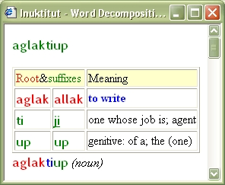
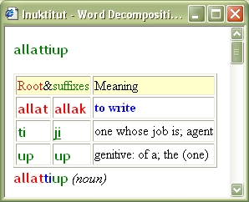
Example of dialectal differences
aglak = allak
t - ti = k - ti
ᐃᖃᓗᐃᑦ - ᕕᕗᐊᕆ 15, 2005-ᒥ

Slide 21
Possible applications for the Inuktitut Morphological Analyser
ᐃᖃᓗᐃᑦ - ᕕᕗᐊᕆ 15, 2005-ᒥ

Slide 22
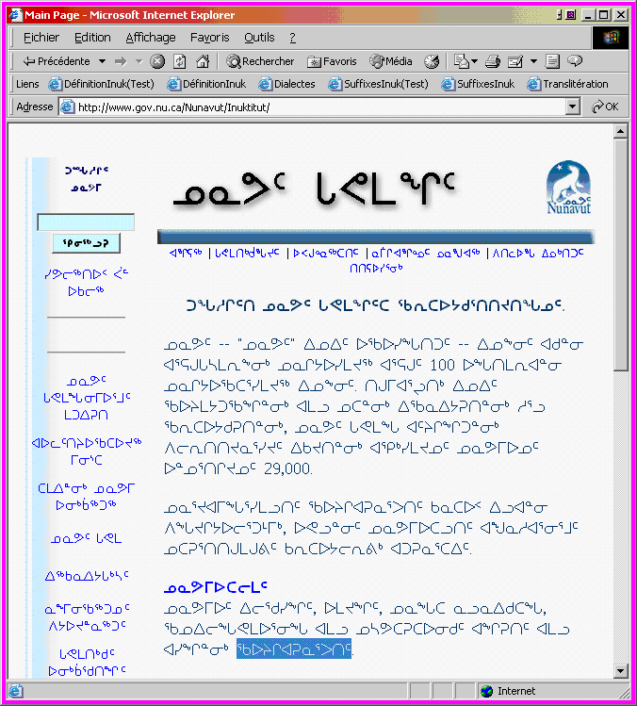
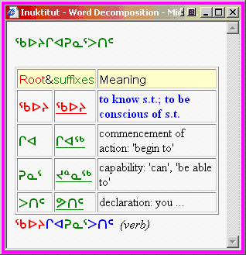
Dictionary Application
(English)
2. click
3. get an English description of the syllabic word in the Internet page
1. select
ᐃᖃᓗᐃᑦ - ᕕᕗᐊᕆ 15, 2005-ᒥ
Notes:
The word 'qaujigiarunarputit' in the page stands for: "You can get more information".
litteraly: "You can begin to know something".
The word is selected in an Internet page displayed in a browser, and a request is sent
to NRC to get its decomposition/description.

Slide 23
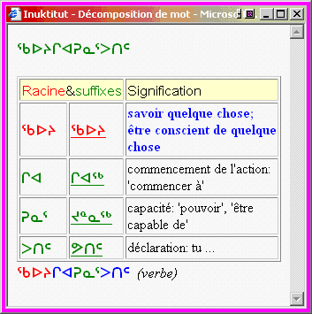
Dictionary Application
(French)
2. click
3. get a French description of the syllabic word in the Internet page
1. select
ᐃᖃᓗᐃᑦ - ᕕᕗᐊᕆ 15, 2005-ᒥ

Slide 24
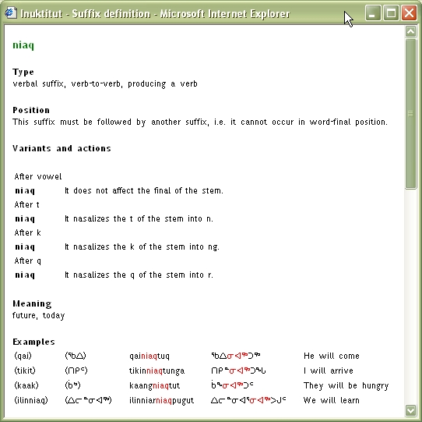
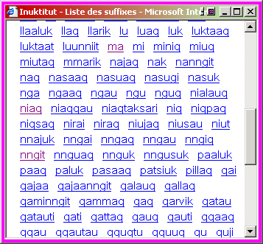
Dictionary Application
1. click
2. get a list of the suffixes
in the database
4. get a description of
the suffix
3. click
ᐃᖃᓗᐃᑦ - ᕕᕗᐊᕆ 15, 2005-ᒥ

Slide 25
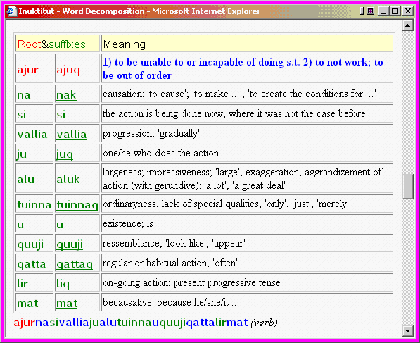
ajurnasivalliajualutuinnauquujiqattalirmat
“It often seems like
it is just getting
progressively
really more
difficult to do.”
* Words may also be in Roman alphabet
ᐃᖃᓗᐃᑦ - ᕕᕗᐊᕆ 15, 2005-ᒥ
Notes:
This word was given to us by Jeela Qilliqti in the Inuktitut class at Carleton University.
It means: It seems that it just keeps getting more difficult.

Slide 26
Search Engine Application
Search:
uqausilirinirmut kamisina
(Languages Commissioner)
Hits:
http://action.attavik.ca/home/langcom/iu_whatsnew.shtml
uqausilinirmut kamisinamik
http://langcom/rights/iu_role.html
uqausilinirmut kamisinaup
http://www.assembly.nu.ca/old/inuktitut/news/
uqausilinirmut kamisinaup, uqausilirinirmut kamisina
uqausilirijikkut kamisinangat
uqausilirinirmut kiggaqtuti
uqausilirinirmut kiggaqtuqti
uqausilirinirmut kiggaqtuiji
Other appellations:
ᐃᖃᓗᐃᑦ - ᕕᕗᐊᕆ 15, 2005-ᒥ

Slide 27
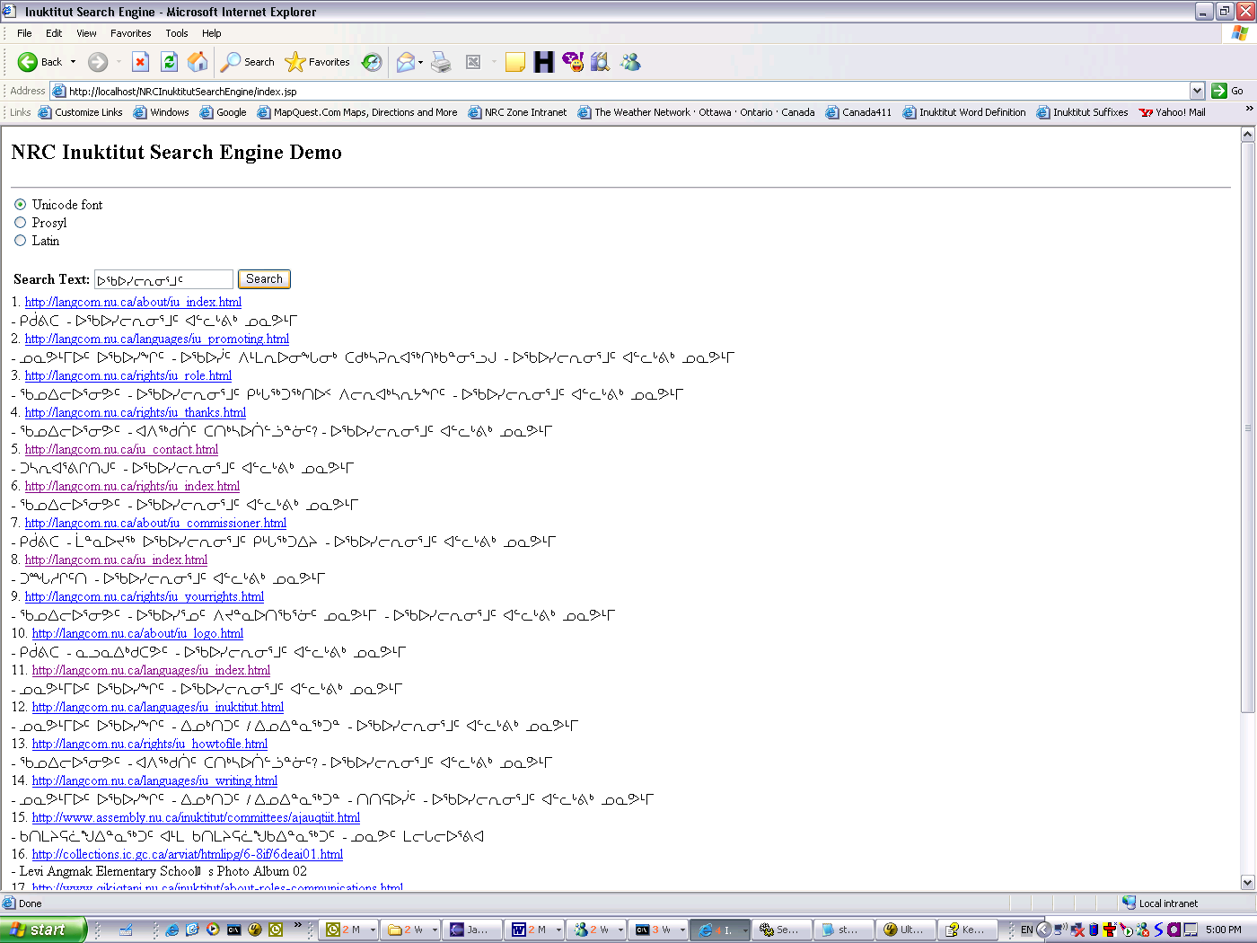
Search Engine Application (2)
ᐃᖃᓗᐃᑦ - ᕕᕗᐊᕆ 15, 2005-ᒥ

Slide 28
Spelling Checker
Wrong key
alianapigusuttiaqpunga
alianai gusuttiaqpunga
I am very glad that...
aliala igiallalauqtuq
alianaigiallalauqtuq
it was a thrill knowing that...
alianaugusuttummariulauqsutiglu
alianai gusuttummariulauqsutiglu
and they had a good time there
ᐊᓕᐊᓇᐱᒍᓱᑦᑎᐊᖅᐳᖓ
ᐊᓕᐊᓇᐃᒍᓱᑦᑎᐊᖅᐳᖓ
ᐊᓕᐊᓚᐃᒋᐊᓪᓚᓚᐅᖅᑐᖅ
ᐊᓕᐊᓇᐃᒋᐊᓪᓚᓚᐅᖅᑐᖅ
ᐊᓕᐊᓇᐅᒍᓱᑦᑐᒻᒪᕆᐅᓚᐅᖅᓱᑎᒡᓗ
ᐊᓕᐊᓇᐃᒍᓱᑦᑐᒻᒪᕆᐅᓚᐅᖅᓱᑎᒡᓗ
ᐃᖃᓗᐃᑦ - ᕕᕗᐊᕆ 15, 2005-ᒥ

Slide 29
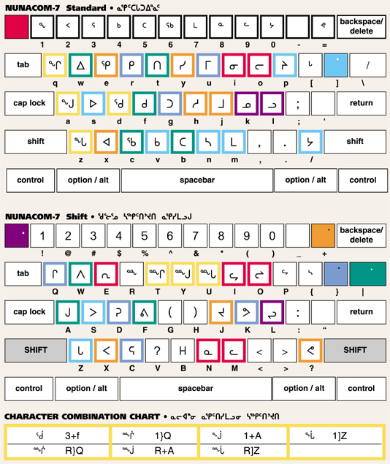
Typographic errors
Spelling Checker
alianapigusuttiaqpunga
alianai gusuttiaqpunga ᐊᓕᐊᓇᐱᒍᓱᑦᑎᐊᖅᐳᖓ
ᐊᓕᐊᓇᐃᒍᓱᑦᑎᐊᖅᐳᖓ
aliala igiallalauqtuq
alianaigiallalauqtuq
ᐊᓕᐊᓚᐃᒋᐊᓪᓚᓚᐅᖅᑐᖅ
ᐊᓕᐊᓇᐃᒋᐊᓪᓚᓚᐅᖅᑐᖅ
ᐃᖃᓗᐃᑦ - ᕕᕗᐊᕆ 15, 2005-ᒥ

Slide 30
Spelling Checker
Typographic errors
alianaugusuttummariulauqsutiglu
alianai gusuttummariulauqsutiglu ᐊᓕᐊᓇᐅᒍᓱᑦᑐᒻᒪᕆᐅᓚᐅᖅᓱᑎᒡᓗ
ᐊᓕᐊᓇᐃᒍᓱᑦᑐᒻᒪᕆᐅᓚᐅᖅᓱᑎᒡᓗ
ᐃᖃᓗᐃᑦ - ᕕᕗᐊᕆ 15, 2005-ᒥ

Slide 31
Spelling Checker
Typographic errors
and other causes
Wrong key/
long vowels
arragumi
arraagumi
this year
iksivauitaaq
iksivautaaq
Mr. Speaker
uqatii
uqaqtii
Mr. Speaker
ᐊᕐᕋᒍᒥ
ᐊᕐᕌᒍᒥ
ᐃᒃᓯᕙᐅᐃᑖᖅ
ᐃᒃᓯᕙᐅᑖᖅ
ᐅᖃᑏ
ᐅᖃᖅᑏ
In excess
Missing
final consonants
ᐃᖃᓗᐃᑦ - ᕕᕗᐊᕆ 15, 2005-ᒥ

Slide 32
Statistics Application
In a corpus (e.g. the Nunavut Hansard), find:
How many times is a given suffix used?
How many times is it used with another given suffix?
In what proportion is a given suffix used as opposed to
a dialectal equivalent?
What percentage of all the words are based on a given root?
etc.
ᐃᖃᓗᐃᑦ - ᕕᕗᐊᕆ 15, 2005-ᒥ

Slide 33
Current status
Morphological Analyser
Current success rate
82.75%
(February 15, 2005)
95.41%
(April 3, 2006)
Test bench: 1000 most frequent words from
Nunavut Hansard (>100 times each word)
Failures:
vocative case
missing finals
database (missing morpheme; unknown behaviour;
pronouns)
typos (short/long vowels; single/double consonants;
  missing/one-too-may character)
missing functionalities in IMA
ᐃᖃᓗᐃᑦ - ᕕᕗᐊᕆ 15, 2005-ᒥ

