Slide 1
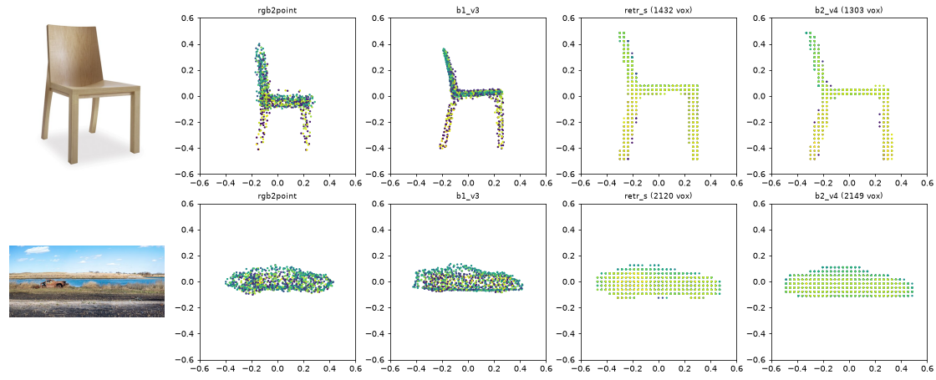
Group 8 | DPL, Topic 3 | FPT University
Single-Image 2D → 3D Reconstruction with Transformers
Final Report: Data Processing, Baseline Experiments, Proposed Method and Deployment
Đỗ Nguyễn Hữu Phúc (SE204297)
Nguyễn Tiến Vinh (SE204328)
Phạm Trường Minh Nhật (SE205274)
Supervisor: Nguyễn Xuân Huy
Photos (Wikimedia Commons): "Library Chair dakota jackson.jpg" by Dakota Jackson Inc., CC BY-SA 3.0; "Abandoned car in Marine Park (10852p).jpg" by Rhododendrites, CC BY-SA 4.0.
Notes:
One RGB image in, a 3D shape out: a point cloud or a voxel grid.

Slide 2
Agenda
Four chapters, following the fixed progress-report structure.
I
II
III
IV
Data Processing and Analysis
Baseline Experiments
Proposed Method: V1 → Vn
Visual Results, Feasibility and Deployed Product
Group 8 | DPL Topic 3
2
Notes:
Two baselines, one per 3D representation: point cloud (RGB2Point, WACV 2025) and voxel (3D-RETR, BMVC 2021).

Slide 3
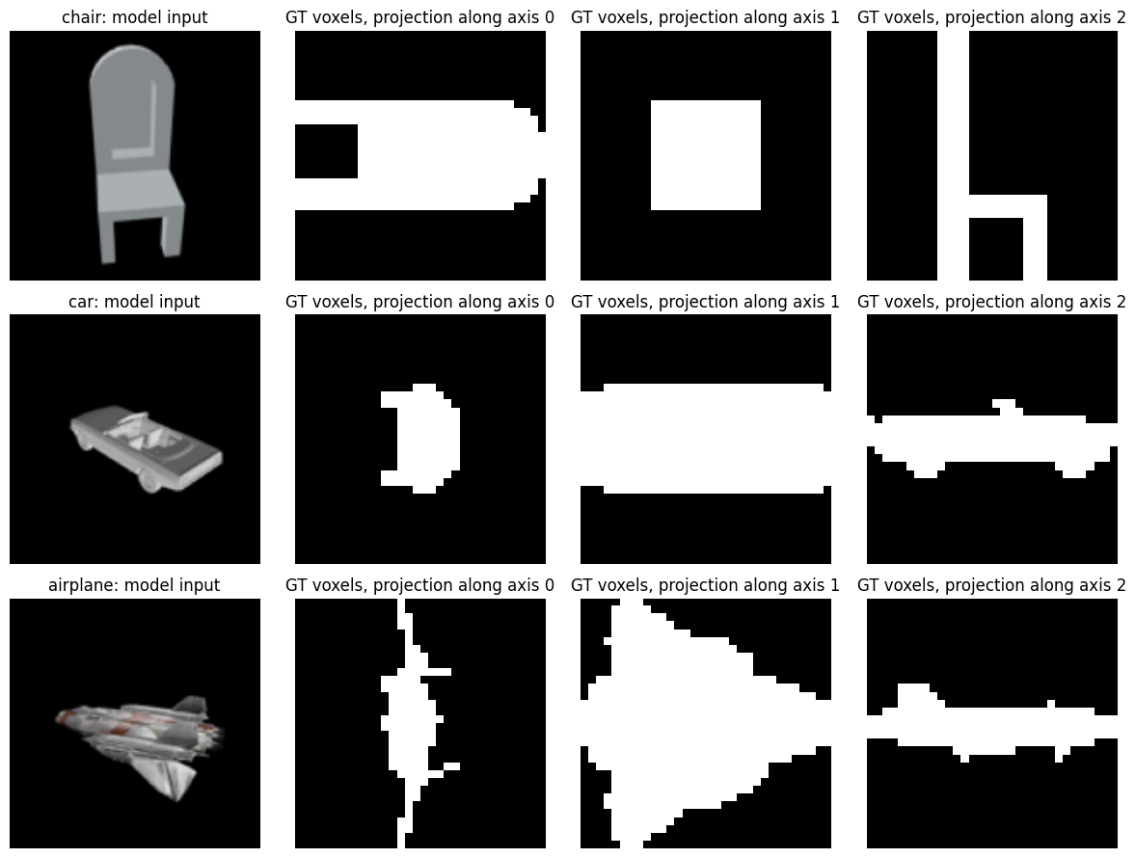
I
Data
Data sources
Four public releases merged by ShapeNet object ID, not self-collected.
Data
Public source
Samples used
Airplane, car images
RGB2Point release
276,960 (24 views)
Chair images, voxels
HF mirror of 3D-R2N2
67,780 (10 views)
GT point clouds
3D-LMNet
18,318 × 1024 pts
Real photos (test)
Pix3D
2,777 chairs
Split
3D-RETR ShapeNet.json
18,318 objects
About 23 GB, downloaded once, merged by ShapeNet object ID.
Inputs and GT voxels
Group 8 | DPL Topic 3
3
Notes:
The Stanford R2N2 server is down, so we merged four public releases. The 3D labels come with the data. Formats: PNG 137×137, binvox 32³, .npy point clouds.

Slide 4
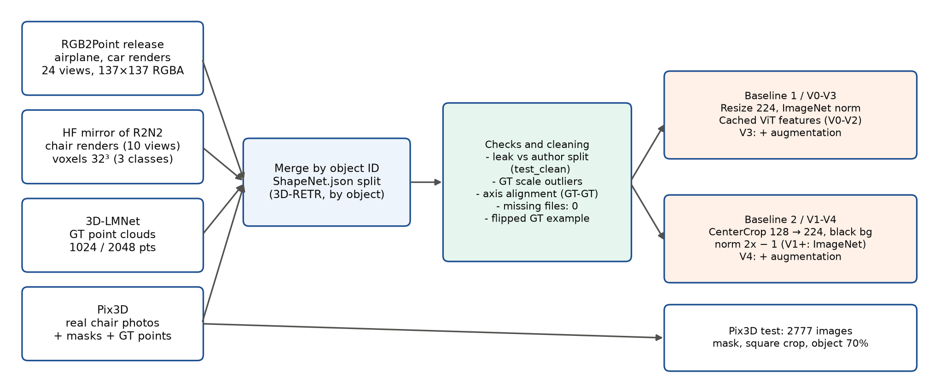
I
Data
Cleaning and labelling
We verify the included 3D ground truth; we do not relabel it.
Labels: 3D GT included; we check instead of annotate.
Leakage: 35-72% of test objects in the authors' train set → clean subset.
Axes: aligned by GT-to-GT Chamfer, not assumed.
Group 8 | DPL Topic 3
4
Notes:
All 3,668 test objects have images, points and voxels. test_clean has 1,664 images. 16 test objects with abnormal scale are kept and shown as worst cases; some R2N2 chairs have an upside-down GT. Pix3D filtered from 3,839 to 2,777 images (no truncation or occlusion). Tools: Python, NumPy, trimesh, our scripts.

Slide 5
I
Data
Split and class imbalance
A standard 70/10/20 split kept comparable with both baseline papers.
Train
Val
Test
Objects per class and split (count)
5,245
Class
Train
Val
Test
Views
Images
4,744
airplane
2,831
404
810
24
97,080
car
5,245
749
1,501
24
179,880
2,831
chair
4,744
677
1,357
10
67,780
1,501
1,357
Total
12,820
1,830
3,668
344,740
810
749
677
404
airplane
car
chair
Split by object, 70 / 10 / 20. Car dominates: 52.2% of images, chair only 19.7% (10 views).
Group 8 | DPL Topic 3
5
Notes:
By objects car is 40.9%, airplane 22.1%, chair 37.0%; by images the gap grows because chair has 10 views instead of 24. Standard 3D-RETR split kept so results stay comparable with the papers. Checkpoints chosen on val only.

Slide 6
I
Data
Handling the imbalance
Three lightweight techniques counter the car-heavy, chair-light distribution.
Before: share of images
After: share per epoch, per-object sampling
Share of training data per class (%)
52.2
Per-object sampling: one view per object per epoch.
40.9
37.0
28.2
Per-class metrics: no class weights (regression task).
22.1
19.7
Augmentation: shift, zoom, background colour, colour jitter.
airplane
car
chair
Chair share 19.7% → 37.0%.
Group 8 | DPL Topic 3
6
Notes:
Class weights and SMOTE are for classification; here the target is a shape. Per-object sampling is used by the voxel line; the point cloud line trains on every view, so chair gets fewer steps there. Augmentation (B1-V3, B2-V4) targets the render-to-photo gap; no flips because the GT is in a fixed frame.

Slide 7
II
Baselines
Experimental setup
Identical hardware, framework version and seed for both baselines.
Google Colab Pro, NVIDIA L4 24 GB, bf16 | PyTorch 2.11, timm 1.0.30 | seed 0 for every run
Baseline 1: RGB2Point
Baseline 2: 3D-RETR-S
Encoder
ViT-B/16, frozen
DeiT-Tiny, fine-tuned
Output
1024 points
32³ voxels
Loss
5 × Chamfer
Dice
Optimiser, lr
Adam, 1e-4
AdamW, 1e-4
Batch, epochs
32, 50
16, 50
Selection
best val CD
best val IoU
Group 8 | DPL Topic 3
7
Notes:
Optimiser, loss and batch follow each original code. The 3D-RETR code (PyTorch 1.8 / Lightning 1.3) was rewritten in plain PyTorch with the same layers.

Slide 8
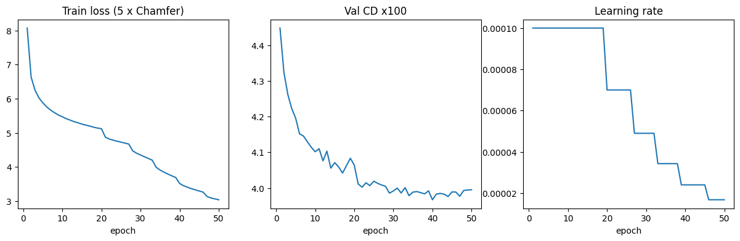
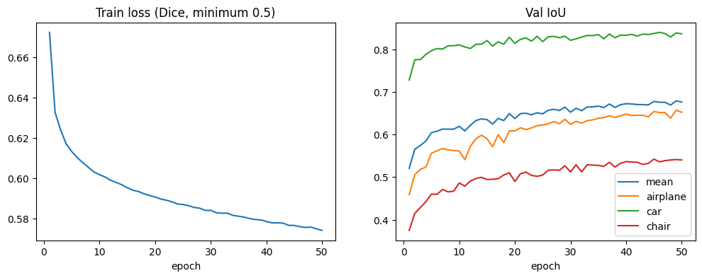
II
Baselines
Baselines: paper vs our execution
Our runs track the published numbers closely, class by class.
RGB2Point: CD / EMD ×100 ↓
3D-RETR-S: IoU ↑
Class
Paper
Ours
Class
Paper
Ours
airplane
2.73 / 5.01
2.588 / 4.687
airplane
0.696
0.649
car
4.05 / 3.59
4.003 / 3.370
car
0.858
0.841
chair
5.38 / 7.80
5.363 / 7.903
chair
0.579
0.543
mean
4.05 / 5.47
3.985 / 5.320
mean
0.711 *
0.678
* Mean of the 3 classes from the paper; the paper reports 0.674 over 13 classes.
Baseline 1 training
Baseline 2 training
Group 8 | DPL Topic 3
8
Notes:
ShapeNet test set, view 00 as in both original codes. Baseline 1: 175.0M parameters, 10.4 ms/image; Baseline 2: 10.34M parameters, 17.9 ms/image (L4).

Slide 9
II
Baselines
Gap analysis
Every remaining gap traces back to one identified, concrete cause.
within 6%
-0.016 to -0.047IoU
RGB2Point
3D-RETR-S
Fair check: beats released weights on test_clean (CD 4.082 vs 4.281).
Causes: 42 min vs 1-3 days of training; underfitting (train 0.710, test 0.678); chair 10 views.
Causes: different split; code ≠ paper; chair 10 views.
Both baselines reflect the papers; every gap has an identified cause.
Group 8 | DPL Topic 3
9
Notes:
RGB2Point code differs from its paper (lr 5e-4, hidden 4096, 1000 epochs, checkpoints chosen on test); we followed the paper (lr 1e-4, 50 epochs, val selection). 35-72% of our test objects are in the authors' training set. Pix3D chair IoU: 0.293 vs paper 0.290 (3D-RETR-B), not directly comparable (B vs S model; our IoU is approximate, GT points voxelised).

Slide 10
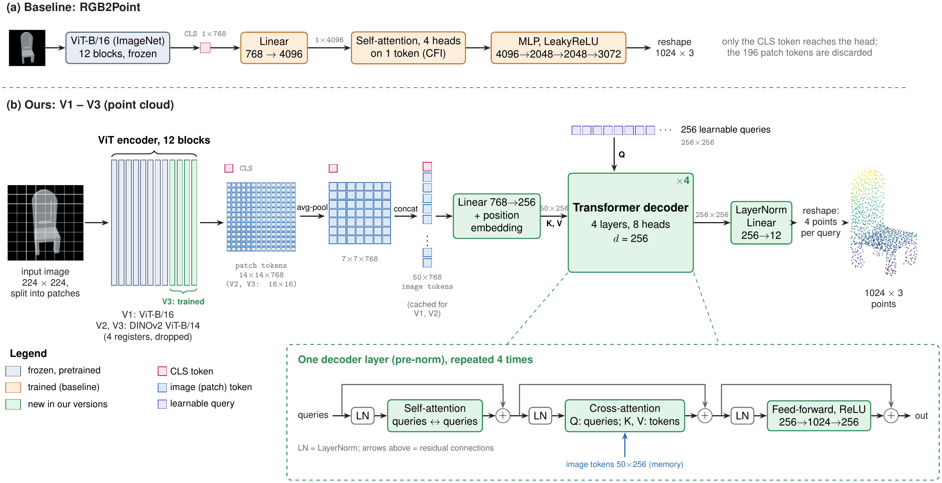
III
Proposed method A. Point cloud line
Point cloud line: architecture
Spatial tokens and learned queries replace the single-token head.
Each version changes one thing: V0 removes the head attention, V1 adds the query decoder, V2 swaps the encoder for DINOv2, V3 fine-tunes its last 4 blocks with augmentation.
Group 8 | DPL Topic 3
10
Notes:
The baseline only passes the CLS token to the head, so its self-attention runs over a single token and all spatial information in the 196 patch tokens is discarded. V1 keeps the CLS token plus the patch grid pooled to 7×7, 50 tokens in total; 256 learned queries read them through a 4-layer Transformer decoder and each query outputs 4 of the 1024 points. Trainable parameters drop from 89.2M to 4.5M because the large 4096-wide head is gone.

Slide 11
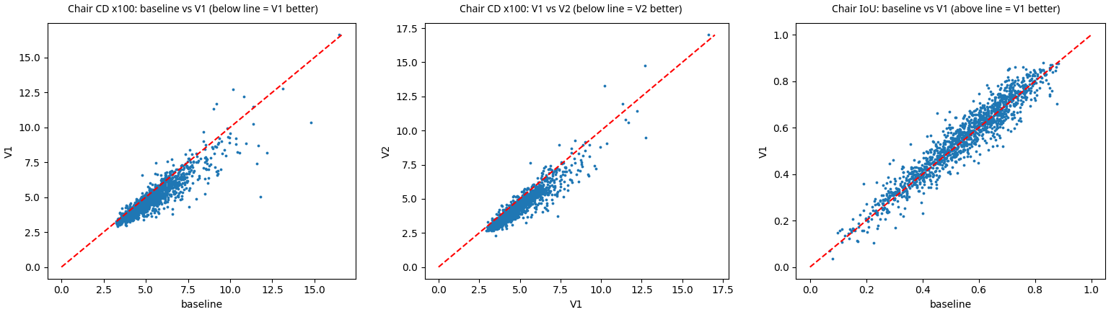
III
Proposed method A. Point cloud line
Point cloud line: why the baseline head fails, and V1
The head ignores the image layout, so predictions collapse toward an average chair.
Per-object test chairs: below the line (CD) or above it (IoU) = newer version better
V0, attention removed: CD 3.985 → 4.016 with 89.2M → 22.0M trainable; the attention did nothing.
Mean-shape collapse: two predicted chairs are closer than their GTs (CD 7.67 vs 11.21).
V1, query decoder: better on 74-85% of objects; chair CD -8.5%, hardest 10% of chairs 8.54 → 7.56.
Using the patch tokens fixes the bottleneck: mean CD 3.985 → 3.752 with 4.5M trainable parameters.
Group 8 | DPL Topic 3
11
Notes:
V0 is a control experiment: removing the attention over one token leaves CD almost unchanged and even improves chair EMD (7.90 → 6.36). V1 also makes predictions more diverse: the CD between two predicted chairs rises from 7.67 to 9.31 (GT 11.21). Cost: about 2.6 ms/image more on the L4 (10.4 → 13.0).

Slide 12
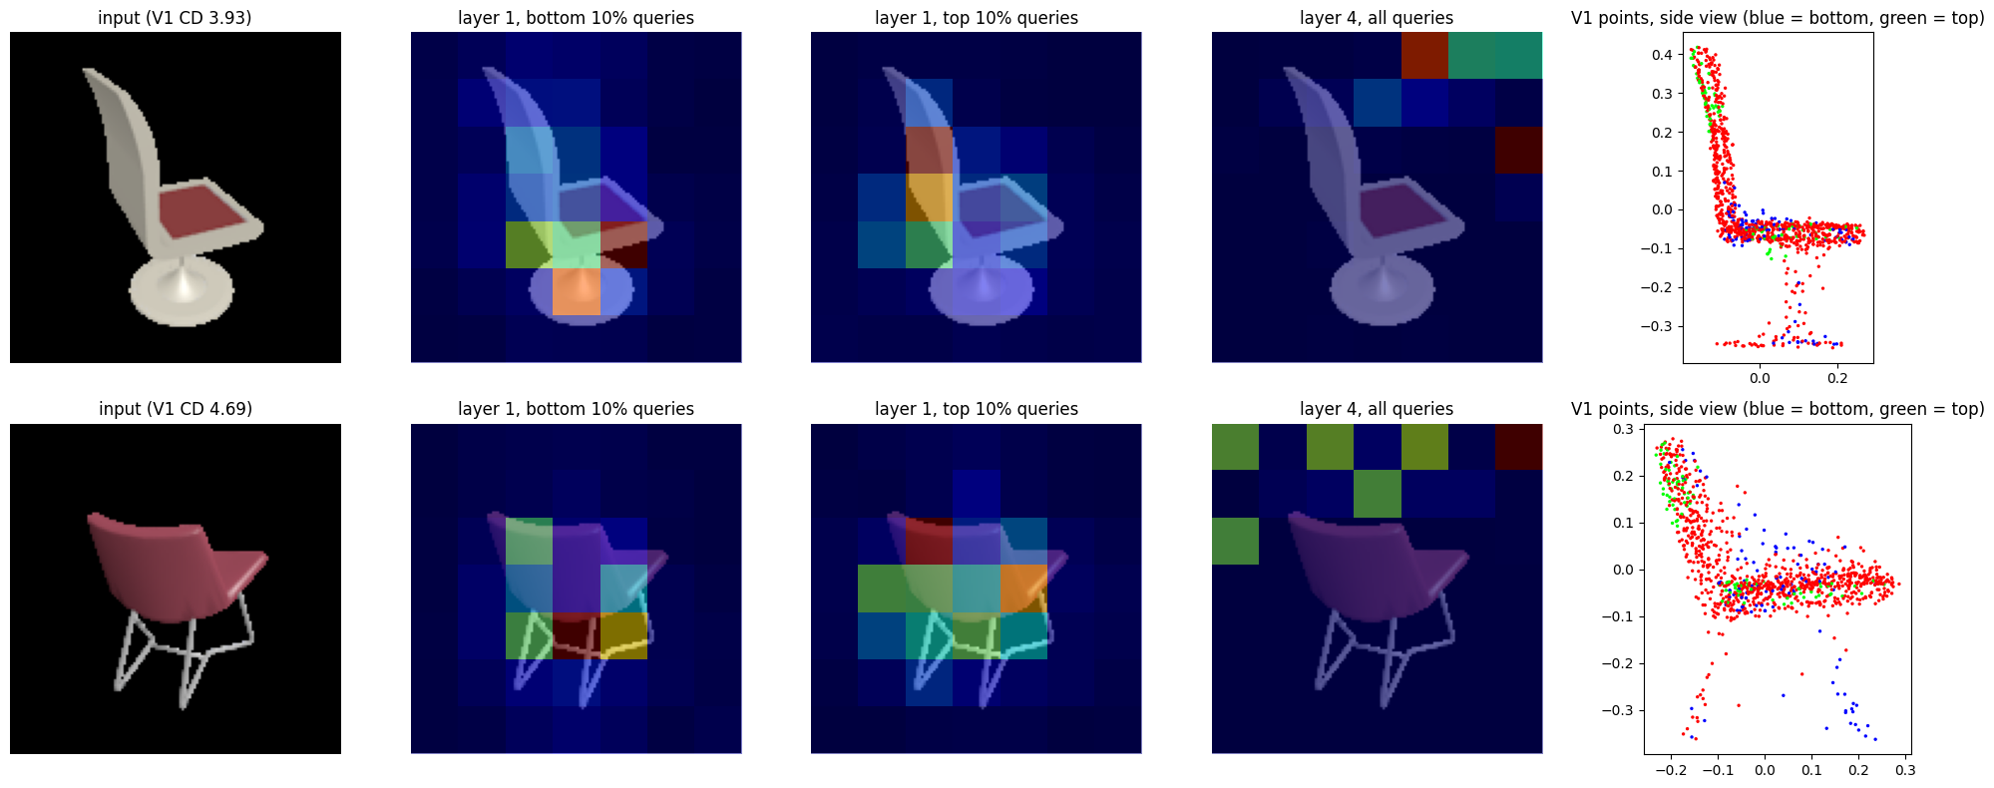
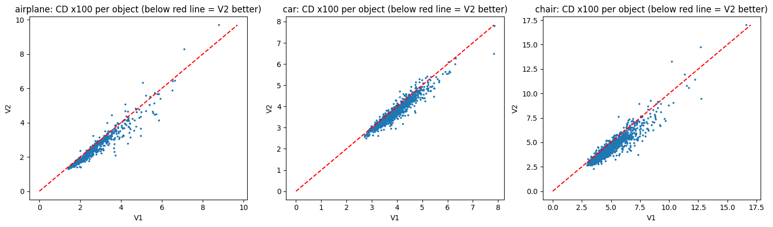
III
Proposed method A. Point cloud line
Point cloud line: V1 failure analysis and V2
Attention shows where V1 looks; DINOv2 features bring it back to the object.
V1 attention on the object: 0.372 (layer 1) → 0.003 (layer 4); the object covers 15.1% of the image.
Cause: patch tokens of a classification ViT carry global, not local, shape information.
V1 attention: layer 1 on chair parts, layer 4 on background
V2, DINOv2 encoder: attention on the object 0.003 → 0.235; better than V1 on about 92% of objects.
Per-object CD: below the line = V2 better
Group 8 | DPL Topic 3
12
Notes:
In layer 1 the queries of the lowest points look at the legs and base and the top queries at the backrest; in layers 3-4 all queries look at the same background cells (cosine 0.998). These are not high-norm artefact tokens; the late tokens of a classification ViT simply carry global information. V2 keeps the same decoder; mean CD 3.752 → 3.467, hardest 10% of chairs 7.56 → 6.77.

Slide 13
III
Proposed method A. Point cloud line
Point cloud line: ablation
Every step lowers the error; V3 mainly helps on real photos.
Version
CD ↓
EMD ↓
F@0.01 ↑
Pix3D CD ↓
Trainable (M)
ms/img
Baseline
3.985
5.320
0.230
6.545
89.2
10.4
V0
4.016
4.594
0.231
-
22.0
8.4
V1
3.752
4.452
0.245
6.272
4.5
13.0
V2
3.467
3.977
0.274
5.761
4.5
13.6
V3
3.424
3.884
0.273
5.486
32.9
14.4
Chamfer distance ×100, lower is better
ShapeNet test
Pix3D real chairs
6.545
6.272
5.761
5.486
3.985
4.016
3.752
3.467
3.424
Baseline
V0
V1
V2
V3
B1-V3: CD -14% on ShapeNet, -16% on real Pix3D chairs.
Group 8 | DPL Topic 3
13
Notes:
ShapeNet test set, view 00, mean over the three classes. V3 fine-tunes the last 4 DINOv2 blocks with augmentation for the real-photo gap: ShapeNet CD only 3.467 → 3.424, Pix3D CD 5.761 → 5.486. On test_clean the ranking is the same (baseline 4.082, V3 3.550). Single seed, so differences of a few hundredths may be noise.

Slide 14
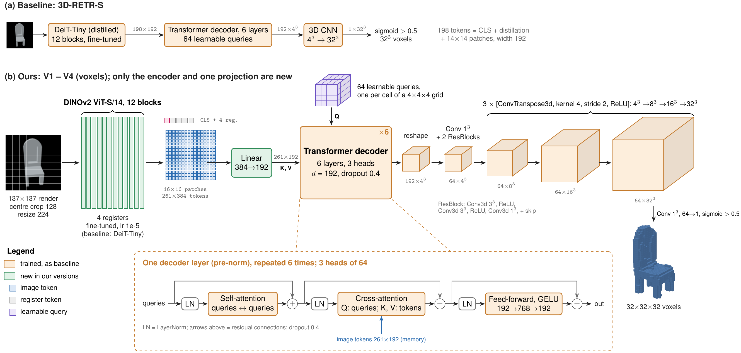
III
Proposed method B. Voxel line
Voxel line: architecture
A stronger encoder; the query decoder and 3D CNN are kept.
V1 swaps DeiT-Tiny for DINOv2 ViT-S/14; V2 tries 512 queries; V3 a cosine schedule; V4 adds augmentation.
Group 8 | DPL Topic 3
14
Notes:
64 learned queries, one per cell of a 4×4×4 grid, read the image tokens through a 6-layer decoder; the 3D CNN upsamples 4³ → 8³ → 16³ → 32³ and a sigmoid above 0.5 gives the voxels. V1 only replaces the encoder and adds a 384 → 192 projection, so parameters grow from 10.34M to 26.52M.

Slide 15
III
Proposed method B. Voxel line
Voxel line: diagnosis and V1-V4
The baseline underfits and misses thin parts; each version targets one cause.
Underfitting (train 0.710 vs test 0.678), not the encoder, limits this line.
Baseline 2: val IoU still rising at epoch 50
Version
One change
Motivated by
Mean IoU ↑
Baseline
-
-
0.678
V1
DINOv2 ViT-S/14 encoder
Lesson from point cloud V2
0.686
V2
512 queries, finer grid
Thin chair parts
0.686 (dropped)
V3
V1 + cosine lr
Underfitting
0.692
V4
V3 + augmentation
Real-photo gap
0.664
Group 8 | DPL Topic 3
15
Notes:
Thin chairs are hardest (IoU 0.471 for the thinnest quarter) and chairs are over-filled (precision 0.662 < recall 0.735). V1 reduces over-filling (precision 0.685) and beats the baseline on 60-68% of objects, but its train IoU is only 0.721, so the encoder was not the bottleneck. More queries (V2) did not help thin parts: the 32³ resolution and the Dice loss limit them. V3 and V4 build on V1.

Slide 16
III
Proposed method B. Voxel line
Voxel line: ablation
Best on renders (V3) and best on real photos (V4) are different models.
Version
Airplane
Car
Chair
Mean IoU ↑
Pix3D IoU ↑
Params (M)
ms/img
Baseline
0.649
0.841
0.543
0.678
0.293
10.34
17.9
V1
0.657
0.850
0.552
0.686
0.311
26.52
19.3
V2
0.654
0.850
0.553
0.686
0.302
26.34
18.9
V3
0.660
0.853
0.562
0.692
0.304
26.52
19.2
V4
0.625
0.832
0.536
0.664
0.327
26.52
18.6
IoU, higher is better
ShapeNet test (mean)
Pix3D real chairs
0.678
0.686
0.686
0.692
0.664
0.293
0.311
0.302
0.304
0.327
Baseline
V1
V2
V3
V4
Augmentation trades ShapeNet IoU (-0.028) for real photos (+0.023 over V3); the demo uses V4.
Group 8 | DPL Topic 3
16
Notes:
Pix3D IoU is approximate (GT points voxelised). The paper's larger 3D-RETR-B reaches 0.290 on Pix3D chairs; our small baseline gets 0.293 and V4 0.327. Single seed, so the +0.008 of V1 may be within run-to-run noise. The demo uses V4 because it receives real photos; this choice was made on Pix3D, so Pix3D is not fully held-out for V4.

Slide 17
III
Proposed method C. Both lines
Cross-representation comparison
Each representation wins on its own metric, close to the conversion limit.
Model
Mean IoU ↑
Mean CD ×100 ↓
Mean F@0.01 ↑
Ceiling: GT converted
0.723
3.664
0.197
Points: B1-V3 CD 3.424 is below the voxel ceiling (3.664).
RGB2Point (B1 base)
0.505
3.985
0.230
B1-V3 (points)
0.578
3.424
0.273
Voxels: B2-V3 IoU 0.692 is close to its ceiling (0.723).
3D-RETR-S (B2 base)
0.678
4.552
0.158
B2-V3 (voxels)
0.692
4.559
0.157
Group 8 | DPL Topic 3
17
Notes:
Voxels are converted to 1024 surface points and points to voxels (5 closings, interior filling); the GT converted the same way gives the ceiling. F of voxel outputs is capped near 0.197 by the 1/32 quantisation. The ranking of versions inside each line is mostly preserved, which supports the ablations.

Slide 18
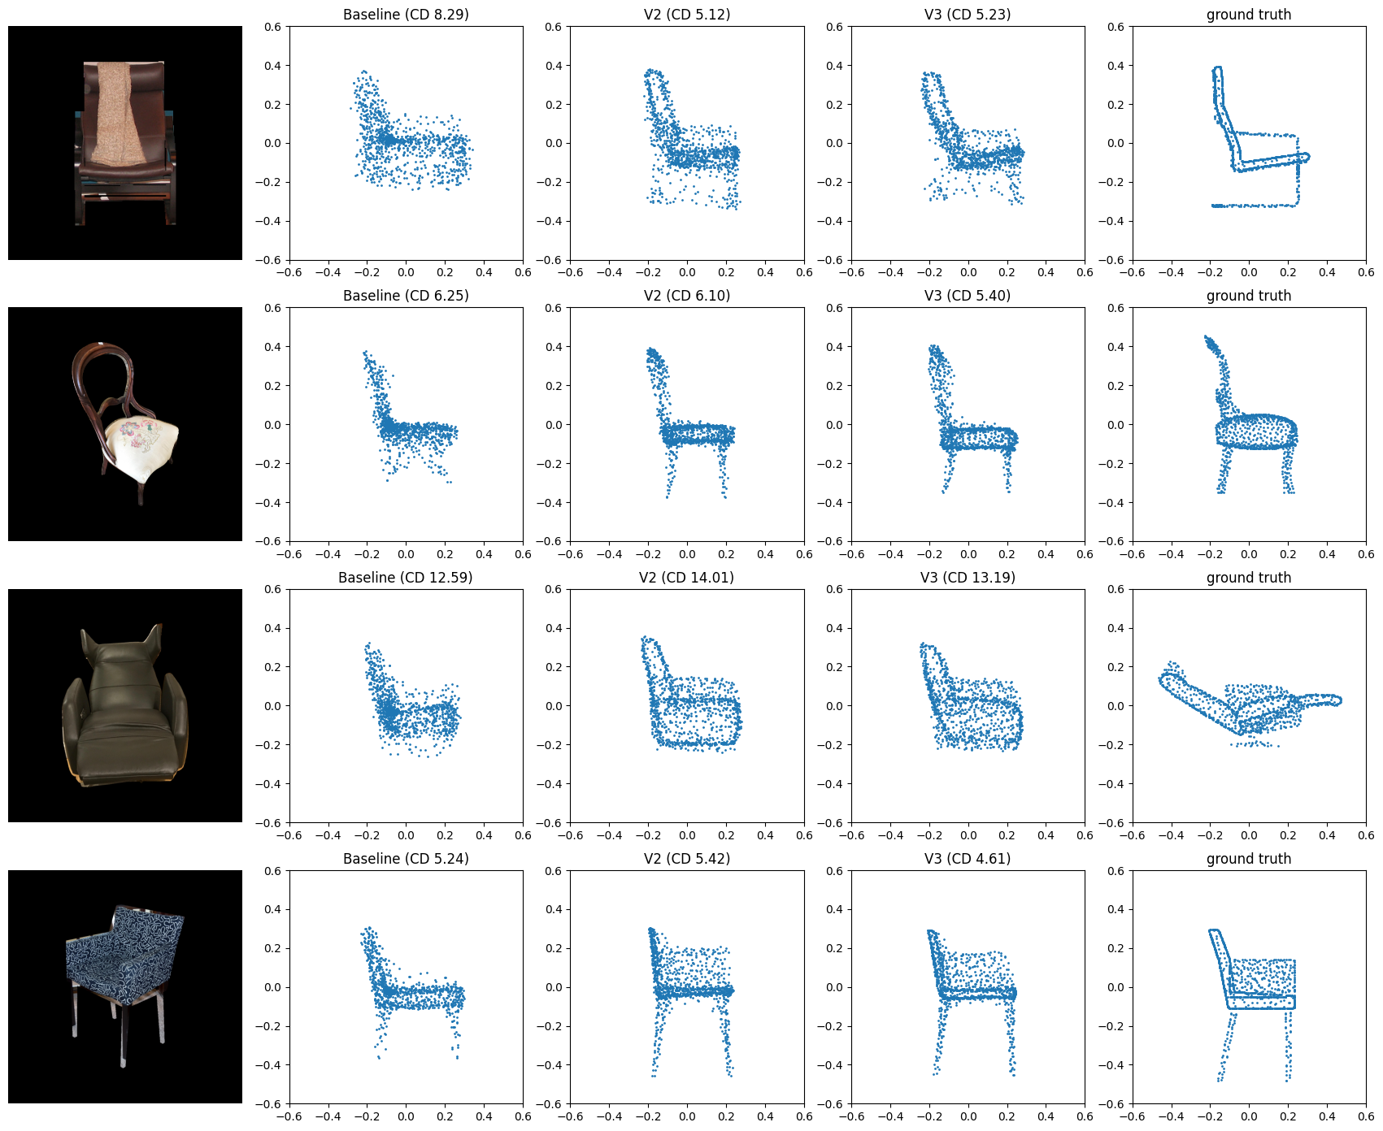
IV
Results and product
Visual results
Qualitative results on held-out Pix3D chairs and real internet photos.
Internet photos through the demo, 4 models
V3 recovers legs and backrest; reclining chairs still fail.
Pix3D real chairs: baseline, V2, V3, GT
Photos (Wikimedia Commons): "Library Chair dakota jackson.jpg" by Dakota Jackson Inc., CC BY-SA 3.0; "Abandoned car in Marine Park (10852p).jpg" by Rhododendrites, CC BY-SA 4.0.
Group 8 | DPL Topic 3
18
Notes:
Pix3D and the internet photos are never used for training. figures/pix3d_voxel.png shows the voxel line (baseline, V3, V4) if space allows or as a backup.

Slide 19
IV
Results and product
Product feasibility
Under 1 GB GPU memory, real time on GPU, more accurate on real photos.
Model
Params ↓
GPU ms (L4) ↓
GPU memory ↓
CPU ms (laptop) ↓
Weights fp16 ↓
RGB2Point
175.0M
10.4
0.89 GB
-
350 MB
B1-V3 (ours)
90.2M
14.4
0.44 GB
85-110
181 MB
3D-RETR-S
10.3M
17.9
0.08 GB
20-60
21 MB
B2-V4 (ours)
26.5M
18.6
0.18 GB
20-60
53 MB
Accuracy: best real-photo results (Pix3D CD 5.486, IoU 0.327).
Speed: real time on GPU; 2-3 s per image on Cloud Run.
Size: < 1 GB GPU memory.
FEASIBLE: deployed as a public web app and REST API on CPU.
Group 8 | DPL Topic 3
19
Notes:
Cloud Run with 2 vCPU, background removal included. Limits: thin parts, unusual viewpoints, cluttered photos.

Slide 20
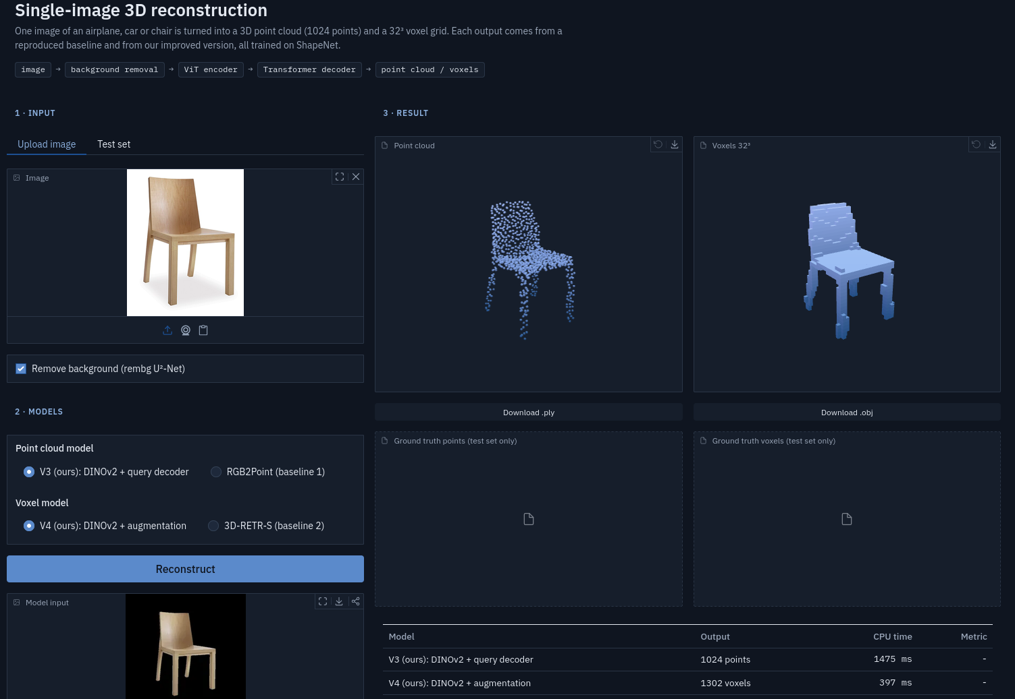
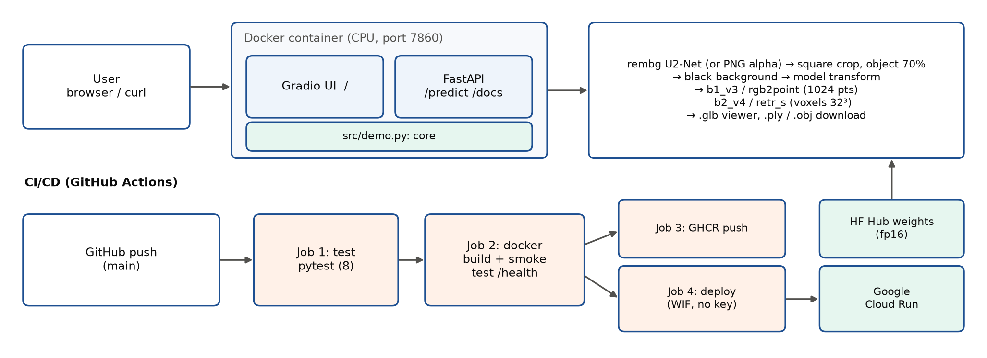

IV
Results and product
Task 3 delivered: application and deployment
A Gradio demo and a documented REST API, both auto-deployed.
Demo: upload a photo, get points and voxels
Photo (Wikimedia Commons): "Library Chair dakota jackson.jpg" by Dakota Jackson Inc., CC BY-SA 3.0.
One Docker container: Gradio demo + FastAPI. CI/CD: test → build → GHCR + Cloud Run.
image-to-3d-98814186060.asia-southeast1.run.app
Group 8 | DPL Topic 3
20
Notes:
Demo: upload a photo or pick a test object; one point cloud and one voxel model side by side; rotate, zoom, download .ply / .obj. API: /health, /models, /predict, /docs. Pipeline: rembg U2-Net background removal → square crop → model. CI/CD: 8 pytest tests, Docker build and smoke test, GHCR, deploy with Workload Identity Federation (no stored key). The Hugging Face Hub only hosts the weights; the app runs on Cloud Run. Backup visuals: figures/api_swagger.png, figures/background_removal.png (needs the photo credit).

Slide 21
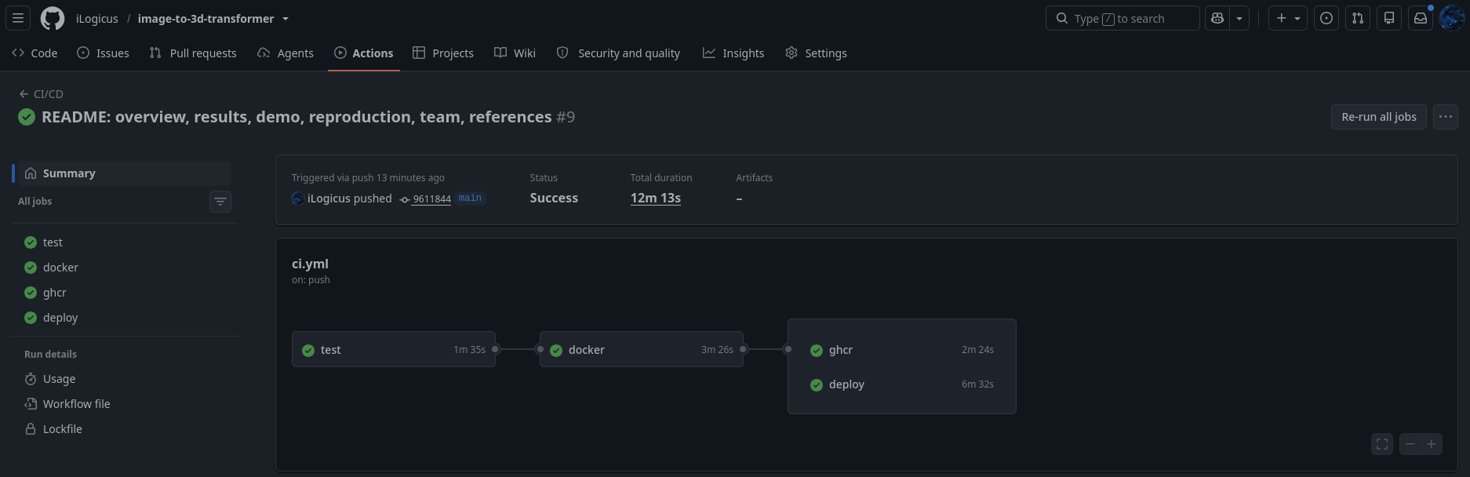

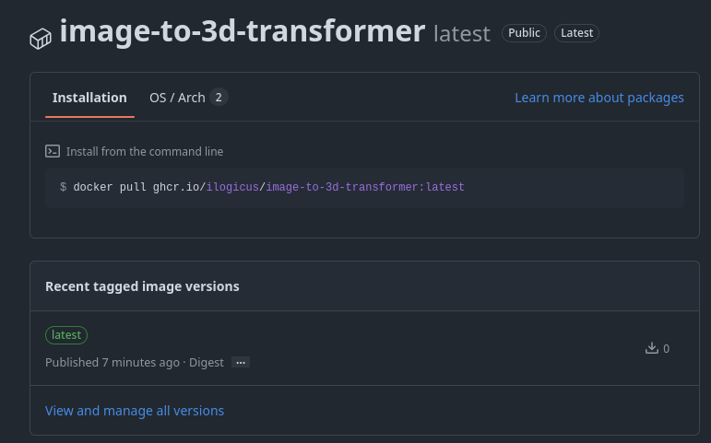
IV
Results and product
Team assignment
Shared ownership, with one member covering the full technical pipeline.
Member
Work
GitHub Actions: 4 jobs passed
Đỗ Nguyễn Hữu Phúc (SE204297)
Data, baselines, error analysis, all versions, demo, API, Docker, CI/CD, Cloud Run, report
Nguyễn Tiến Vinh (SE204328)
Report review; deployment and interface screenshots
Phạm Trường Minh Nhật (SE205274)
Slides; demo video
Cloud Run service
All members
Oral exam preparation
AI use (Claude, Anthropic) declared in the report, Appendix B.
GHCR image
Group 8 | DPL Topic 3
21
Notes:
Report review means numbers checked against the notebooks, spelling and citations.

Slide 22
IV
Results and product
Conclusion and future work
Reproduced, improved and deployed, with concrete next steps identified.
ShapeNet test
Pix3D real chairs
Chamfer distance ×100, lower is better
Conclusion
6.545
6.272
5.761
Reproduced both baselines on a leak-free split.
5.486
3.985
3.752
3.467
3.424
Points: CD -13% with 20× fewer trainable parameters (V2).
Voxels: best real-photo IoU 0.327 (vs 0.293).
Deployed: public web app and REST API.
Baseline
V1
V2
V3
Voxel IoU, higher is better
Future work
0.678
0.686
0.686
0.692
0.664
More: classes, seeds, longer training.
0.293
0.311
0.302
0.304
0.327
Finer: denser outputs for thin parts.
Real data: our own photos for evaluation.
Baseline
V1
V2
V3
V4
Group 8 | DPL Topic 3
22
Notes:
RGB2Point within 6% of the paper; 3D-RETR-S within 0.016-0.047 IoU after 42 minutes of training. Voxel line +0.014 IoU on ShapeNet (V3). Limitations: three classes, 32³ voxels and 1024 points, single seed.

Slide 23

Thank you. Questions?
Single-Image 2D → 3D Reconstruction with Transformers
Live demo
Code: github.com/iLogicus/image-to-3d-transformer
Group 8 | Supervisor: Nguyễn Xuân Huy
Group 8 | DPL Topic 3
23

