Slide 1



ecx.io Frontend Bootcamp — Javascript Day 03 29.06.2021.

Slide 2

Agenda
String
Number
Math
Date

Slide 3


Data Type - String
HTML provides structure and meaning to our text
CSS allows us to precisely style it
JavaScript contains a number of features for manipulating strings, creating custom welcome messages and prompts, showing the right text labels when needed, sorting terms into the desired order, and much more
Notes:
Since the Web is a largely text-based medium designed to allow humans to communicate and share information, it is useful for us to have control over the words that appear on it. HTML provides structure and meaning to our text, CSS allows us to precisely style it, and JavaScript contains a number of features for manipulating strings, creating custom welcome messages and prompts, showing the right text labels when needed, sorting terms into the desired order, and much more.

Slide 4
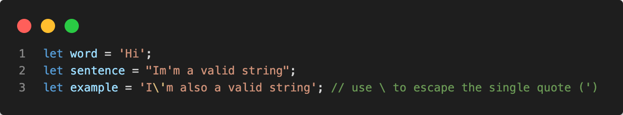
Data Type - String
In JavaScript, a string is a sequence of zero or more characters. A literal string begins and ends with either a single quote(‘) or double quote (“).
A string that starts with a double quote must end with a double quote and a string that begins with a single quote must end with a single quote.

Slide 5
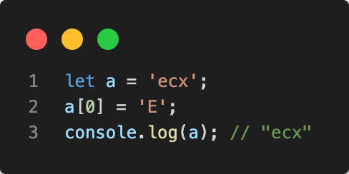
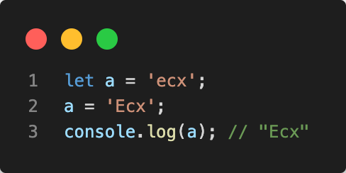
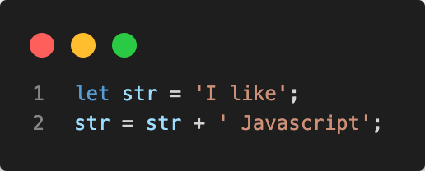
Data Type - String
JavaScript strings are immutable. It means that you cannot modify a string once it is created.
However, you can create a new string based on an operation on the original string, like this:
Notes:
In this example we declared the `str` variable and initialize it to a string of `I like`.
Second, we used the `+` operator to combine `I like` with ` Javascript` to make its value as `I like Javascript`.
Behind the scene, JavaScript engine creates a new string that holds the new string `I like Javascript` and destroys two other original strings `I like` and ` Javascript`.

Slide 6
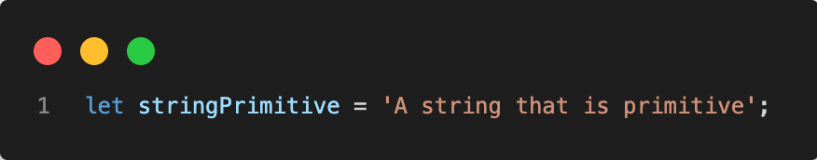
Data Type - String
Creating strings
Strings can be created as primitives, from string literals, or as objects, using the String() constructor:
String literals (denoted by double or single quotes) and strings returned from String calls in a non-constructor context (that is, called without using the new keyword) are primitive strings. JavaScript automatically converts primitives to String objects, so that it's possible to use String object methods for primitive strings. In contexts where a method is to be invoked on a primitive string or a property lookup occurs, JavaScript will automatically wrap the string primitive and call the method or perform the property lookup.

Slide 7
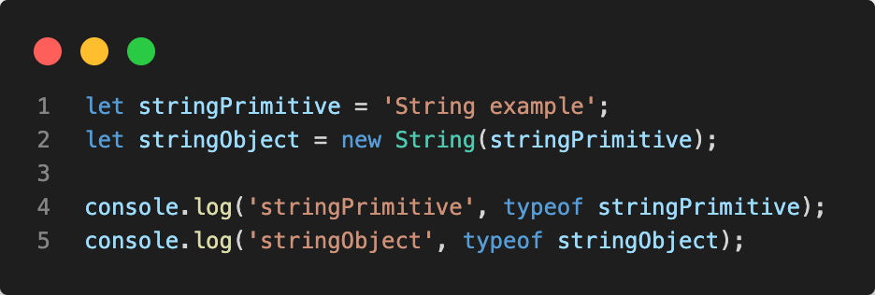
Data Type - String
The String object lets you work with a series of characters; it wraps Javascript's string primitive data type with a number of helper methods.
As JavaScript automatically converts between string primitives and String objects, you can call any of the helper methods of the String object on a string primitive.

Slide 8
Data Type - String
String Properties
Property | Description
constructor | Returns a reference to the String function that created the object
length | Returns the length of the string
prototype | The prototype property allows you to add properties and methods to an object

Slide 9
Data Type - String
String Properties – 12 most important
Property | Description
trim() | Removing white space
includes() | Determine if string contains substring
indexOf() | Finding the index of a substring
toUpperCase() | Capitalizes entire string
toLowerCase() | Lower cases entire string
replace() | Replaces strings with new values
slice() | Return a section of a string
split() | Converts string into an array of strings
repeat() | Repeats a string a specified number of times
match() | Returns array of matching strings
charAt() | Returns the character at an index
charCodeAt() | Return the unicode at an index
Notes:
The trim() function removes white space from the beginning and end of a string. You will find yourself using this one most often when processing the string of a user input field. It is easy to accidentally add spaces, and this ensures you handle the relevant characters.
The includes() function determines if a substring is contained in a larger string and returns true or false. This has many applications, but one common use-case is for string matching for searching/parsing.
Before includes() was introduced to the JavaScript spec, indexOf() was the primary way you would check if a substring existed in a string. It is likely you will still see code that uses indexOf, so understanding how it works is important. The function returns the index of the substring within the string. If the substring is not contained in the original string, it will return -1.
The replace() function is called on a string and will return a string with a pattern replaced by a replacement string. It takes either a regex or a string as the pattern. With a regex you can globally replace all matches (using the g option), but with a string it will only replace the first occurrence. In the example below, you will notice that world is replaced only once in the first call since it uses a string pattern.
The slice() method will extract a section of a string based on the index supplied and return it as a new string. This is useful when you know the structure of a string and want to retrieve a certain portion, or it can be used with the indexOf method which we learned earlier where you can find the index of the first occurrence of a substring and use that as a reference point for slicing. slice() takes the beginning index as the first parameter and an optional ending index as the second parameter — str.slice(beginIndex[, endIndex]). If no ending index is supplied, it slices to the end of the string starting with your beginIndex. If a negative beginIndex is used, it will slice backwards from the end of the string. The following is an example from MDN which depicts these cases.
The split() method takes a separator which you want to split apart the string on, and it returns an array of strings. This is useful when you know your string uses a certain character to separate data, or if you want to operate on specific substrings individually.
The match() method retrieves the matches when matching a string against a regular expression. The example below searches our string for all capital letters. It returns an array of strings for the values that match the regex.
Other methods: https://developer.mozilla.org/en-US/docs/Web/JavaScript/Reference/Global_Objects/String

Slide 10
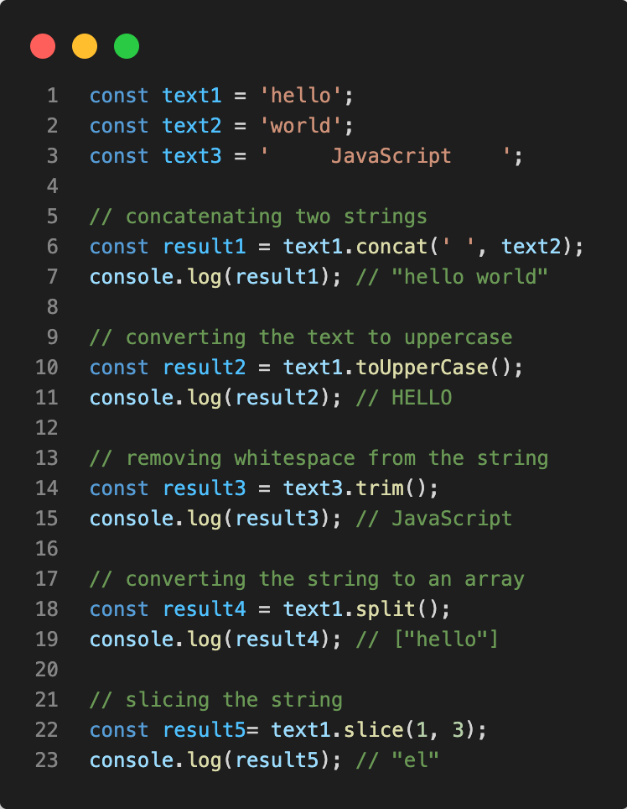
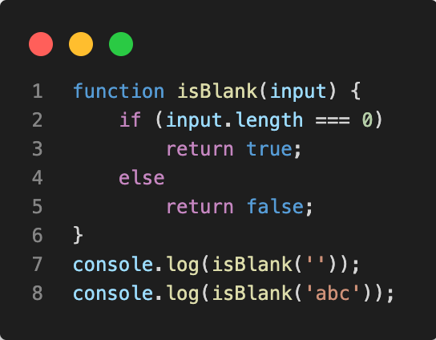
Examples
String methods
JavaScript function to check whether a string is blank or not.

Slide 11
Exercise
Write a JavaScript function to extract a specified number of characters from a string.
Test case:
- Use string "When I grow up I would like to work as a Frontend developer” and extract first 4 characters

Slide 12
Exercise
Write a JavaScript function to hide email addresses to protect from unauthorized user.
Test data:
console.log(protect_email("robin_scherbatskyh@example.com"));
"robin_sch...@example.com"

Slide 13
Data Type - Number
The Number type is a double-precision 64-bit binary format IEEE 754 value (numbers between -(2^53 − 1) and 2^53 − 1)
In addition to representing floating-point numbers, the number type has three symbolic values: +Infinity, -Infinity, and NaN ("Not a Number").

Slide 14
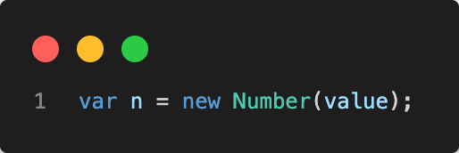
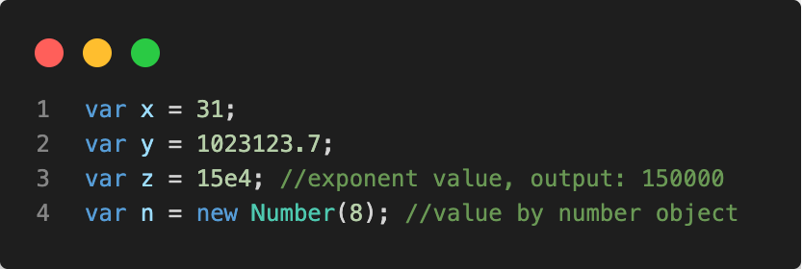
Data Type - Number
By the help of Number() constructor, you can create number object in JavaScript.
If value can't be converted to number, it returns NaN(Not a Number) that can be checked by isNaN() method.
You can direct assign a number to a variable also.

Slide 15
Data Type - Number
The JavaScript Number type is a double-precision 64-bit binary format IEEE 754 value, like double in Java or C#. This means it can represent fractional values, but there are some limits to what it can store.
A Number only keeps about 17 decimal places of precision; arithmetic is subject to rounding. The largest value a Number can hold is about 1.8E308. Numbers beyond that are replaced with the special Number constant Infinity.

Slide 16
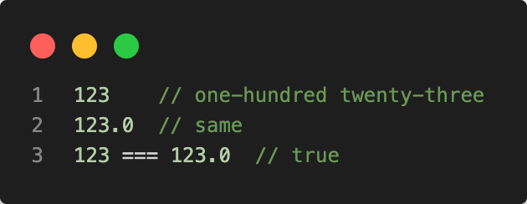
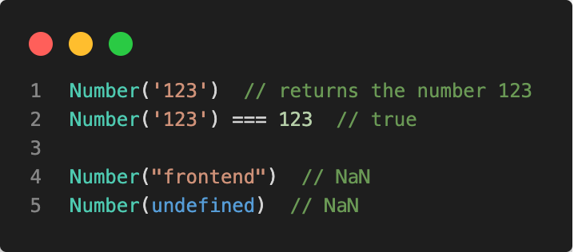
Data Type - Number
When used as a function, Number(value) converts a string or other value to the Number type. If the value can't be converted, it returns NaN.

Slide 17
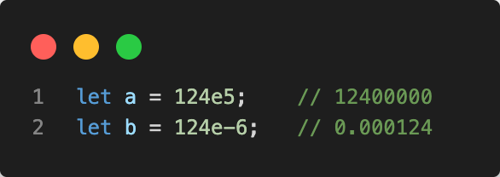
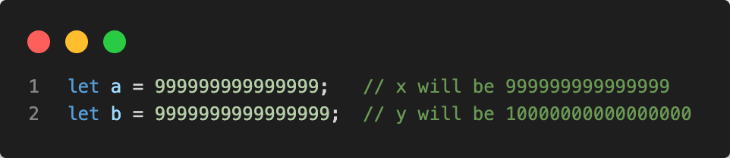
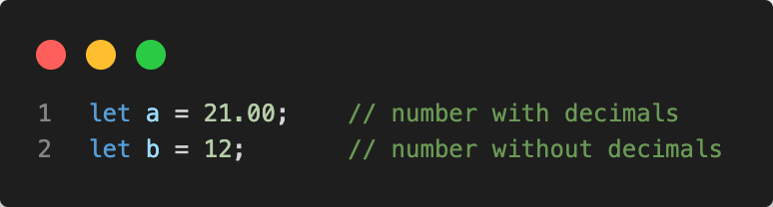
Examples
Number format
Precision
Precision

Slide 18
Data Type – Number
Static Properties
Property | Description
Number.EPSILON | The smallest interval between two representable numbers
Number.MAX_SAFE_INTEGER | The maximum safe integer in JavaScript (2^53 - 1)
Number.MAX_VALUE | The largest positive representable number
Number.MIN_SAFE_INTEGER | The minimum safe integer in JavaScript (-(2^53 - 1))
Number.MIN_VALUE | The smallest positive representable number—that is, the positive number closest to zero (without actually being zero).
Number.NaN | Special "Not a Number" value.
Number.NEGATIVE_INFINITY | Special value representing negative infinity. Returned on overflow.
Number.POSITIVE_INFINITY | Special value representing infinity. Returned on overflow

Slide 19
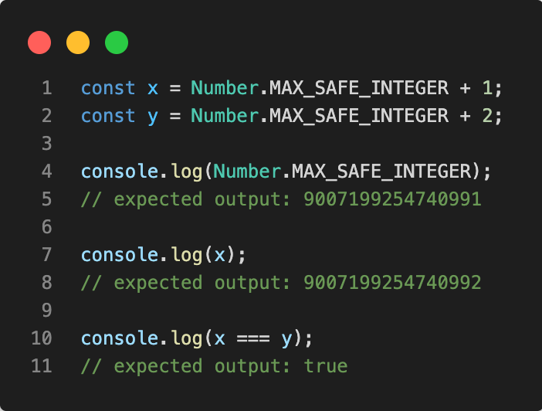
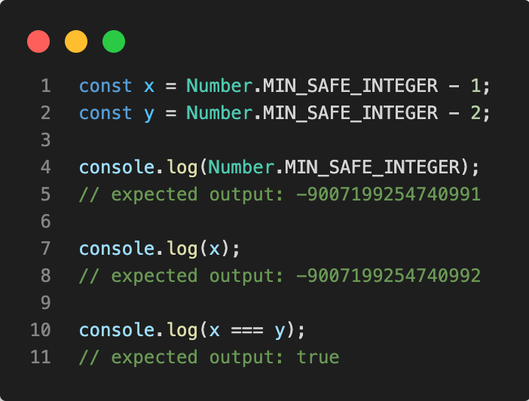
Examples
Number.MAX_SAFE_INTEGER
Number.MIN_SAFE_INTEGER

Slide 20
Data Type - Number
Static Methods
Number.isNaN() - Determine whether the passed value is NaN
Number.isFinite()- Determine whether the passed value is a finite number
Number.isInteger() - Determine whether the passed value is an integer
Number.isSafeInteger() - Determine whether the passed value is a safe integer (number between -(2^53 - 1) and 2^53 - 1)
Number.parseFloat(string) - This is the same as the global parseFloat() function
Number.parseInt(string, [radix]) - This is the same as the global parseInt() function.
Notes:
Link to Instance Methods - https://developer.mozilla.org/en-US/docs/Web/JavaScript/Reference/Global_Objects/Number

Slide 21
Math
The JavaScript Math object provides a number of useful properties and methods for performing mathematical tasks like, generating random numbers, rounding numbers, obtaining values such as PI and performing calculation, and so on.
It also includes methods for performing mathematical task that are normally impossible or too complex to perform using standard mathematical operators (+, -,*, and /) such as calculating sine or cosine values.
Unlike many other global objects, Math is not a constructor. All properties and methods of Math are static. You refer to the constant pi as Math.PI and you call the sine function as Math.sin(x), where x is the method’s argument. Constants are defined with the full precision of real numbers in JavaScript.
Notes:
Link to Instance Methods - https://developer.mozilla.org/en-US/docs/Web/JavaScript/Reference/Global_Objects/Number

Slide 22
Math
Important! Many Math functions have a precision that’s implementation-dependent.
This means that different browsers can give a different result. Even the same JavaScript engine on a different OS or architecture can give different results!
Notes:
Static properties and static methodshttps://developer.mozilla.org/en-US/docs/Web/JavaScript/Reference/Global_Objects/Math

Slide 23
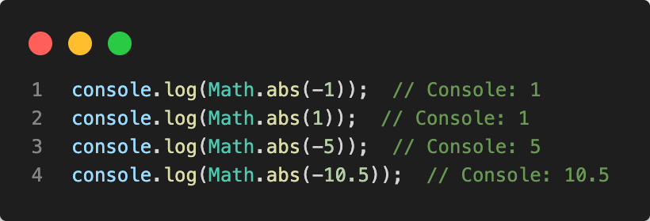
Examples
Getting the Absolute Value
The Math.abs() method is used to calculate the absolute (positive) value of a number. Therefore, -1 is returned as 1, -5 as 5, and so on. Here is an example:

Slide 24
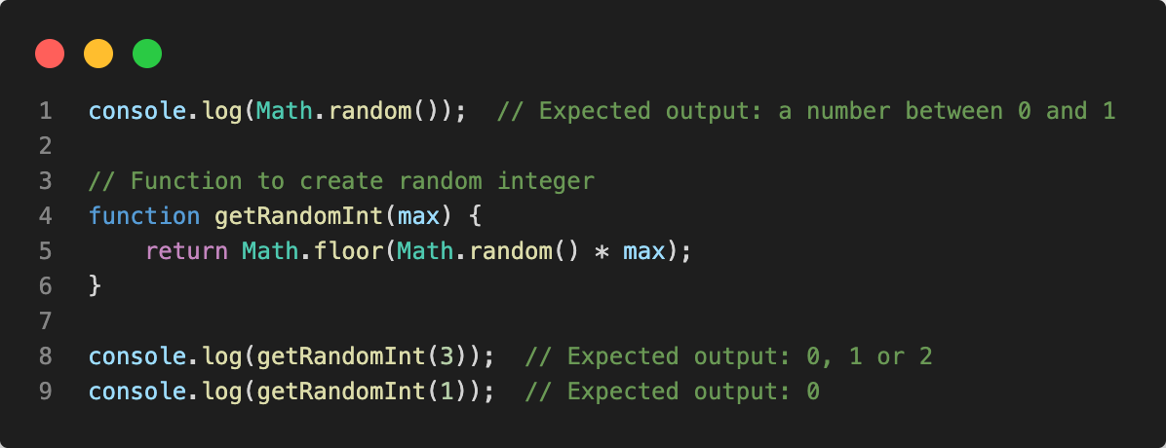
Examples
Generating a Random Number
The Math.random() method is used to generate a floating-point random number in the range from 0 inclusive up to but not including 1. However, if you want a random integer between zero and an integer higher than one, you could use the following solution:

Slide 25
Exercise
Write a JavaScript function to format a number up to specified decimal places.

Slide 26
Exercise
Write a JavaScript function for the Pythagorean theorem.
In mathematics, the Pythagorean theorem, also known as Pythagoras' theorem, is a relation in Euclidean geometry among the three sides of a right triangle. It states that the square of the hypotenuse (the side opposite the right angle) is equal to the sum of the squares of the other two sides. The theorem can be written as an equation relating the lengths of the sides a, b and c, often called the "Pythagorean equation".

Slide 27
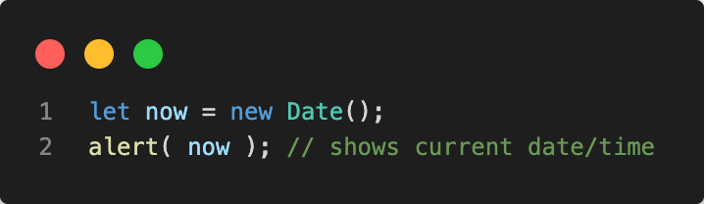
Date
Let’s meet a new built-in object: Date. It stores the date, time and provides methods for date/time management. For instance, we can use it to store creation/modification times, to measure time, or just to print out the current date.
To create a new Date object call new Date() with one of the following arguments:

Slide 28
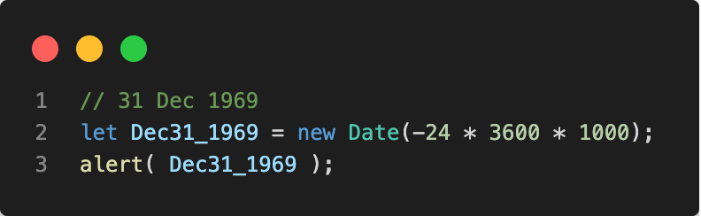
Date
An integer number representing the number of milliseconds that has passed since the beginning of 1970 is called a timestamp.
It’s a lightweight numeric representation of a date. We can always create a date from a timestamp using new Date(timestamp) and convert the existing Date object to a timestamp using the date.getTime() method.
Dates before 01.01.1970 have negative timestamps, e.g.:

Slide 29
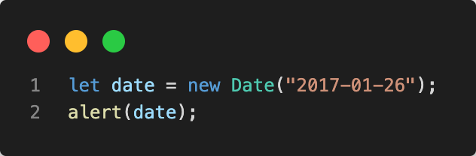
Date
If there is a single argument, and it’s a string, then it is parsed automatically.
Important: The time is not set, so it's assumed to be midnight GMT and is adjusted according to the timezone the code is run in.

Slide 30
Date format and time zone conversions
There are several methods available to obtain a date in various formats, as well as to perform time zone conversions. Particularly useful are the functions that output the date and time in Coordinated Universal Time (UTC), the global standard time defined by the World Time Standard. (This time is historically known as Greenwich Mean Time, as UTC lies along the meridian that includes London—and nearby Greenwich—in the United Kingdom.) The user's device provides the local time.
In addition to methods to read and alter individual components of the local date and time (such as getDay() and setHours()), there are also versions of the same methods that read and manipulate the date and time using UTC (such as getUTCDay() and setUTCHours()).
Notes:
List of all Static and Instance methods https://developer.mozilla.org/en-US/docs/Web/JavaScript/Reference/Global_Objects/Date

Slide 31
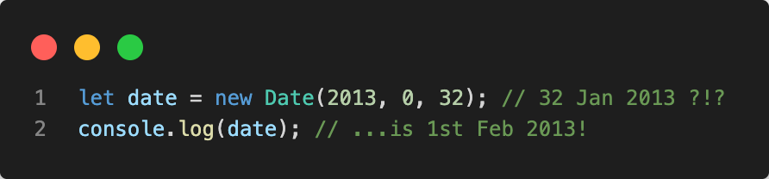
Examples
The autocorrection is a very handy feature of Date objects. We can set out-of-range values, and it will auto-adjust itself.

Slide 32
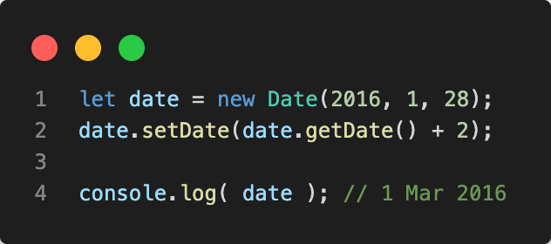
Examples
Out-of-range date components are distributed automatically.
Let’s say we need to increase the date “28 Feb 2016” by 2 days. It may be “2 Mar” or “1 Mar” in case of a leap-year. We don’t need to think about it. Just add 2 days. The Date object will do the rest:

Slide 33
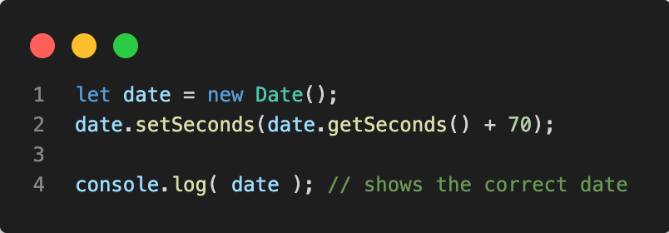
Examples
That feature is often used to get the date after the given period of time. For instance, let’s get the date for “70 seconds after now”:

Slide 34
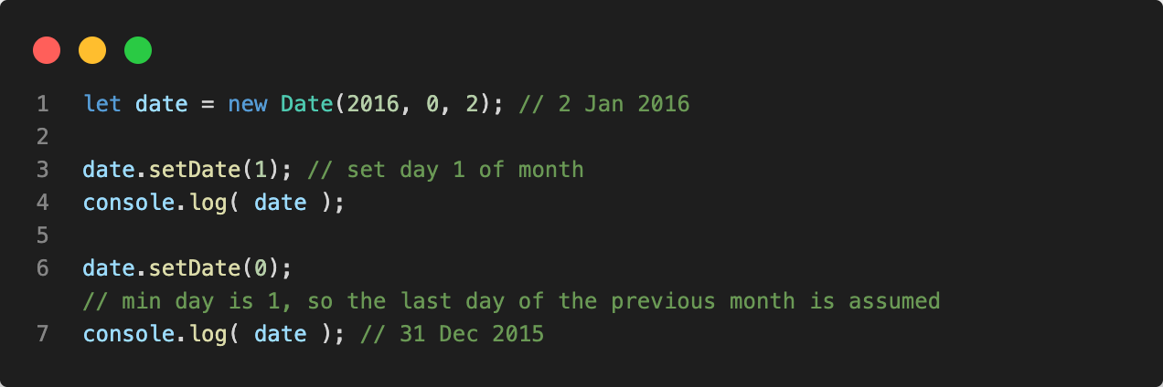
Examples
We can also set zero or even negative values. For example:

Slide 35
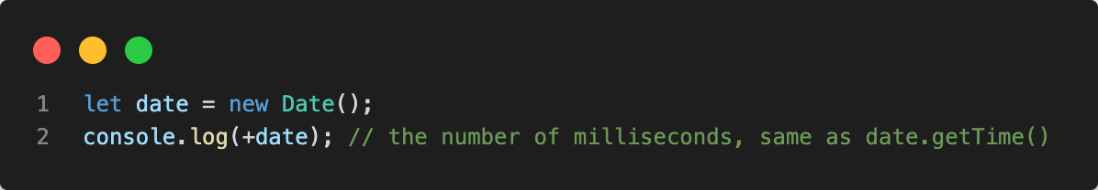
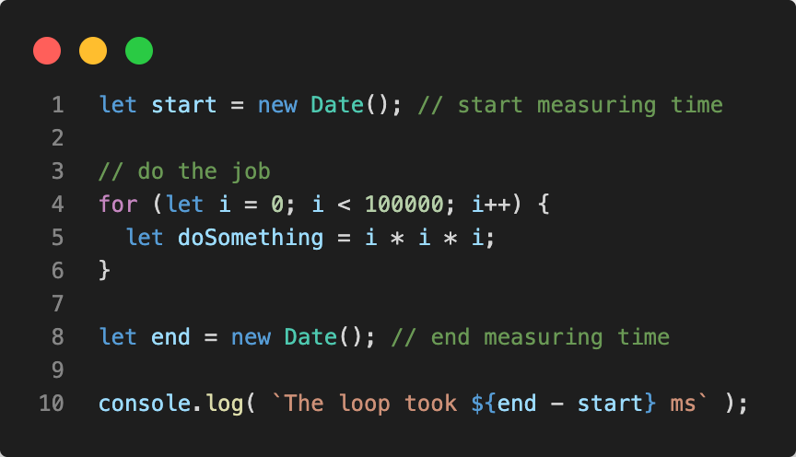
Date
When a Date object is converted to number, it becomes the timestamp same as date.getTime():
The important side effect: dates can be subtracted, the result is their difference in ms.
That can be used for time measurements:

Slide 36
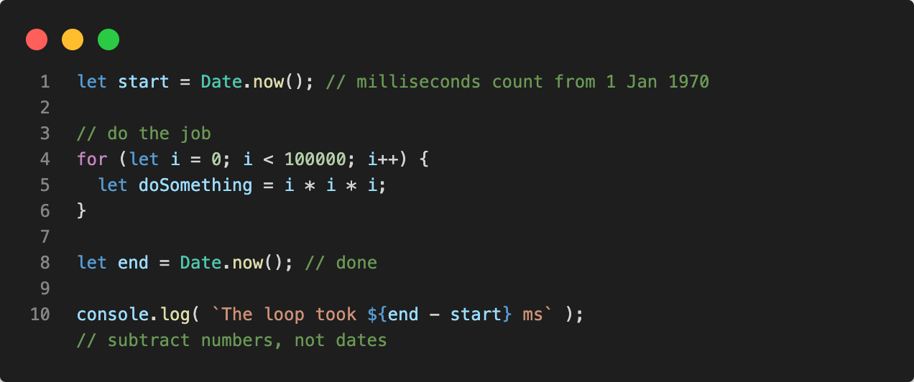
Examples
If we only want to measure time, we don’t need the Date object.
There’s a special method Date.now() that returns the current timestamp.
It is semantically equivalent to new Date().getTime(), but it doesn’t create an intermediate Date object. So it’s faster and doesn’t put pressure on garbage collection.
It is used mostly for convenience or when performance matters, like in games in JavaScript or other specialized applications.
So this is better:

Slide 37
Exercise
Write a JavaScript function to calculate age from a person.

Slide 38
Exercise for Friday
Write a JavaScript function to get the current date with separator as parameter.
Test Data :
console.log(curday('/')); console.log(curday('-')); Output:
"11/12/2021" "11-12-2021”
”01-10-2021”
2. Write a JavaScript function to get a two digit representation of a year..
Test Data:
dt = new Date(); console.log(sort_year(dt)); 18
dt = new Date(1989, 10, 1); console.log(sort_year(dt)); 89

Slide 39
Thank you
© Copyright IBM Corporation 2019.
All rights reserved. The information contained in these materials is provided for informational purposes only, and is provided AS IS without warranty of any kind, express or implied. Any statement of direction represents IBM’s current intent, is subject to change or withdrawal, and represent only goals and objectives. IBM, the IBM logo, and ibm.com are trademarks of IBM Corp., registered in many jurisdictions worldwide. Other product and service names might be trademarks of IBM or other companies.
A current list of IBM trademarks is available at Copyright and trademark information.

