Slide 1



ecx.io Frontend Bootcamp — Introduction to CSS 21.06.2021.

Slide 2



Introduction round

Slide 3
What will we do in this course?
Intro and Syntax
Selectors
Units
Layouts (flex, grid, float, table…)
Positioning (relative, absolute, sticky, fixed…)
Media Queries
Transforms
Animations
SASS (CSS pre-processor)
Methodologies
Frameworks
Notes:
In this Bootcamp, plan is to go over must-know things related to CSS:
What it is
How it works
How seelectors work in background (with emphasis on specificity)
We will talk about how to decide what layout type we should use for best practice (flex, grid etc…)
We will see how position works, and what are the differences between each type..
We will talk about Media queries and how can we use them outside the well known Breakpoint area
We will talk about Units and how to levarage the cascade in Cascading style sheets
How to work with Transforms
What are the best practices when ti comes to Animations and transitions
We will dive deep down in SASS the CSS pre-processor and see what powers it extends to short sighted CSS
We will point you to some well known methodologies and what they are
And at the end we will look at some Frameworks and see what problems do they resolve and why they exist, and why should we use one for example

Slide 4
Agenda
About & History
Syntax
Three Ways to Insert CSS
Box Model
Box Sizing
Properties
Comments
Reset
Selectors
Relational selectors
Pseudo/class/element selector
Notes:
In the following section we are going to take a look at what CSS is and how we define/write it.
We are going to take a look at must-know fundamentals like: box model and CSS properties.
We will also talk about Reset and Normalize a bit, to see what they are and why should we use one of them.

Slide 5
Introduction to CSS

Slide 6
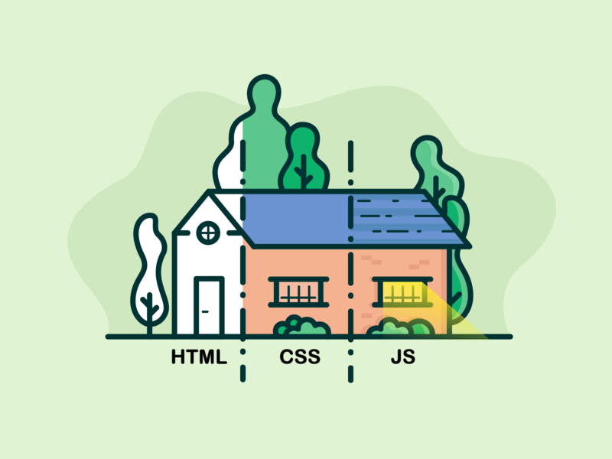
About CSS
Cascading Style Sheets
CSS is the language we use to style a Web page.
The name cascading comes from the specified priority scheme to determine which style rule applies if more than one rule matches a particular element.
Notes:
Allows a browser engine to paint elements of the page with specific features.
CSS is designed to enable the separation of presentation and content, including layout, colors, and fonts
CSS describes how HTML elements are to be displayed on screen, paper, or in other media
CSS saves a lot of work. It can control the layout of multiple web pages all at once
External stylesheets are stored in CSS files

Slide 7
History
Initial release; December 17, 1996
Latest release; April 12, 2016 (CSS 2.1)
Notes:
CSS was first proposed by Håkon Wium Lie on October 10, 1994. At the time, Lie was working with Tim Berners-Lee at CERN.
The idea behind it was to separate presentation and content of a web site.
The advantage of this approach is that updates and changes to the presentation need only be applied once (to the stylesheet) to affect all pages.

Slide 8
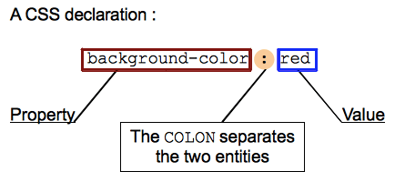
Syntax
The CSS syntax basic building blocks are:
The property which is an identifier, that is a human-readable name, that defines which feature is considered.
The value which describes how the feature must be handled by the engine. Each property has a set of valid values, defined by a formal grammar, as well as a semantic meaning, implemented by the browser engine.
Setting CSS properties to specific values is the core function of the CSS language.

Slide 9
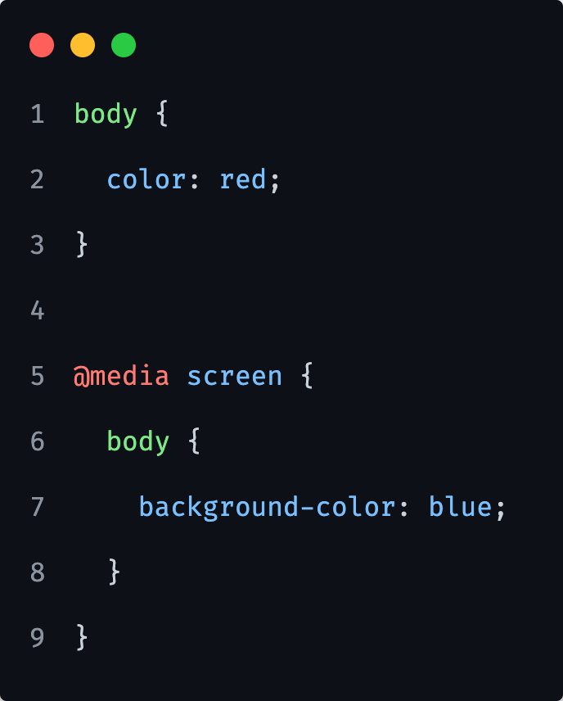
Declaration Blocks
Declarations are grouped in blocks, that is in a structure delimited by an opening brace { and a closing one, }.
Blocks sometimes can be nested, so opening and closing braces must be matched.
Notes:
Later in the SASS pre-processor section we will go over more details about this nesting and best practices.
For now it, is important to match the opening and closing ones respectively.

Slide 10
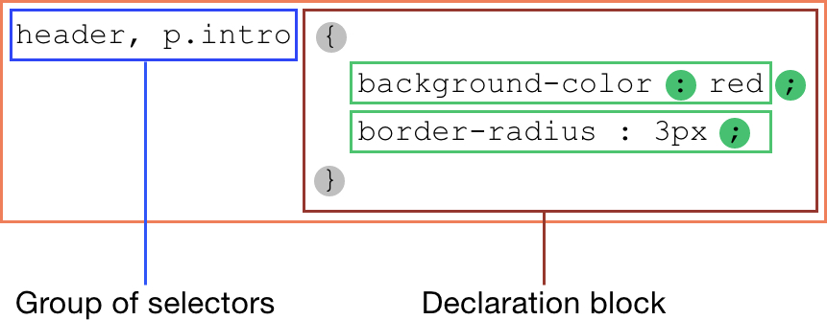
Rulesets
Each (valid) declaration block is preceded by one or more comma-separated selectors, which are conditions selecting some elements of the page.
A selector group and an associated declarations block, together, are called a ruleset, or often a rule.
A selector can be an HTML element or some identifier we set on an HTML element like a class or ID etc… In our example on the left, “p.intro” is pointing to a <p> tag with class ‘intro’.
Dot “.” indicates a class name.
Notes:
If style sheets could only apply a declaration to each element of a Web page, they would be pretty useless.
We will talk more about classes in Selectors section.

Slide 11
How do we define/write CSS

Slide 12
Three ways to insert CSS
inline
internal
external
Notes:
Important is to know about all 3 ways but it is not something you will use often.
For example, in very rare situations in the real world will you use intenral styles, it will mostly be external way.
Inline styles are usually used where we require some JavaScript manipulation, we will also take a look at this part a bit later in Specificity section.

Slide 13
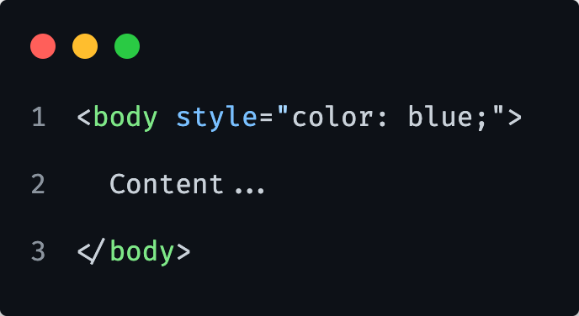
Inline
Notes:
Inline is applied directly on an element, so neither it’s internal to the page neither it’s globally available.
Inline will be applied over any other way (internal, external). It will take precedence.
They are ugly and violate separation of concern principle.

Slide 14
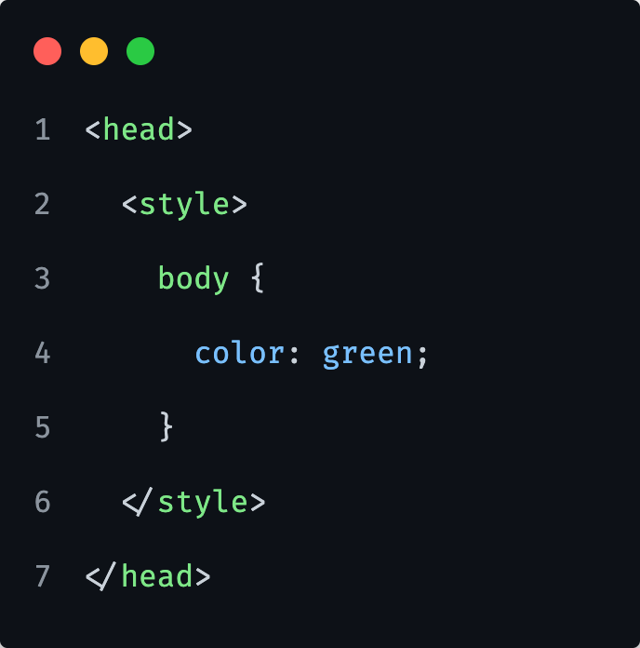
Internal
Notes:
An internal style sheet may be used if one single HTML page has a unique style for example.
Internal will be applied over external file, taking the precedence over it.

Slide 15
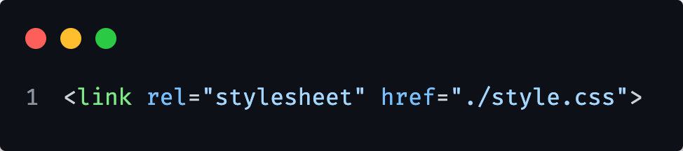
External
Notes:
Here we need to use a link element to link to a file, <link>
We also need to specify what is the rel(ationship) to the file, rel="stylesheet”
We need to specify where is it? -we use href property for the path to the file
We will talk a bit more about this topic in Specificity section.

Slide 16

1) Create an HTML file with initial structure.
2) Create <p> tag with random (lorem) text and apply inline style for text color and set it to blue.
3) Create a <div> tag with text “ACTIVE” and apply background green with color white. Apply the styles via internal approach (head).
4) Create a CSS file, link it to the HTML file and change <body> background color to lightgray.
Notes:
Let them do it first alone, give them 10 minutes.

Slide 17
Box model

Slide 18
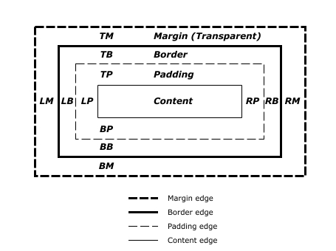
Box model
Each box has a content area (e.g., text, an image, etc.) and optional surrounding padding, border, and margin areas; the size of each area is specified by properties that can be seen on the diagram.
The following diagram shows how these areas relate and the terminology used to refer to pieces of margin, border, and padding.
Notes:
Before understanding how to create CSS layouts, you need to understand the box model.
The box model allows us to add a border around elements, and to define space between elements.
Content - The content of the box, where text and images appear
Padding - Clears an area around the content. The padding is transparent
Border - A border that goes around the padding and content
Margin - Clears an area outside the border. The margin is transparent

Slide 19
Box sizing
Box sizing specifies how the size of an element's box is measured.
Notes:
The box-sizing property defines how the width and height of an element are calculated: should they include padding and borders, or not.

Slide 20
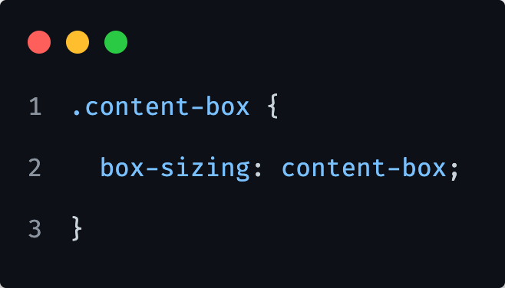
Box sizing
Content box
Content box measures the size (width, height) based on element content only.
That is, the width and height properties take into account only content, but not padding.
Notes:
content-box gives you the default CSS box-sizing behavior.
If you set an element's width to 100 pixels, then the element's content box will be 100 pixels wide, and the width of any border or padding will be added to the final rendered width, making the element wider than 100px.

Slide 21

Box sizing
Border box
Border box measures the size based on content, padding and border.
That is, the width and height properties take into account padding and border as well as content size.
Notes:
border-box tells the browser to account for any border and padding in the values you specify for an element's width and height.
If you set an element's width to 100 pixels, that 100 pixels will include any border or padding you added, and the content box will shrink to absorb that extra width.

Slide 22
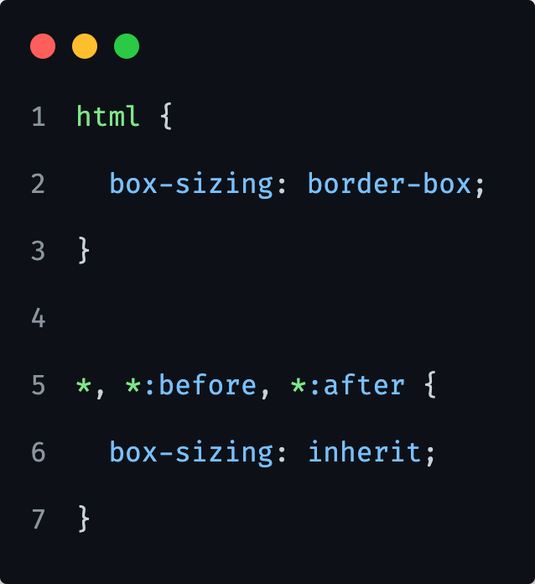
Box sizing
Probably the best and most convenient practice is one from CSS Tricks, that uses border box approach.
Notes:
This will make it easier to change the box-sizing in plugins or other components that leverage other behaviour.
But usually this is something you should not even think about, you always use this approach, familiar yourself with it and that’s it. It’s actually a no-brainer in reality.

Slide 23
Let’s look at Box Model and Box Sizing in developer tools.

Slide 24
1) Create an HTML file with initial structure.
2) Create a <div> tag with random (lorem) text and apply some margins and paddings to it. Also add some kind of a background color.
3) Try to change margin and padding separately and observe the changes via developer tools (computed tab). Notice the boundaries of a background, where they end.
4) Add a border to your previously created <div> and see how it affects it. (make it at least 10px thick, just so it’s clearer to see)
Notes:
Let them do it first alone, give them 10 minutes.

Slide 25
CSS Properties

Slide 26
CSS Properties
There are quite a lot properties we can use in CSS.
In following section, we are going to go over most used ones, or most common ones at least.
List of all props can be found on many different places, such list is also from w3schools that will be in the reference links page.

Slide 27
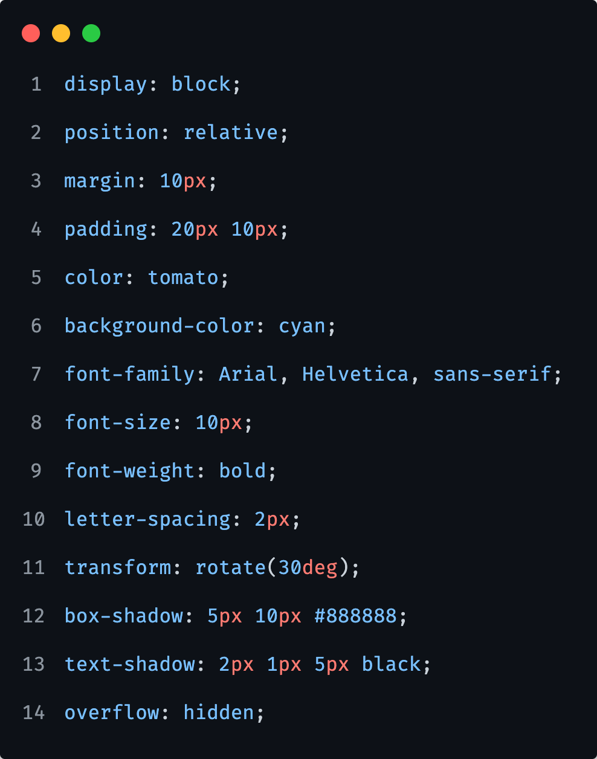
CSS Properties
Most common properties would include:
display, position, margin, padding, border, color, background, font-family, font-size, font-weight, letter-spacing, transform, transition, box-shadow, text-shadow, overflow etc.…
Each of this properties have a specific purpose and different types of values.
Most of them share some values; inherit, initial, unset.

Slide 28
CSS Properties
display
Specifies how a certain HTML element should be displayed.
position
Specifies the type of positioning method used for an element (static, relative, absolute or fixed).
margin
Sets all the margin properties in one declaration.
padding
A shorthand property for all the padding-* properties.
border
A shorthand property for border-width, border-style and border-color.
color
Sets the color of text.
background
A shorthand property for all the background-* properties.
font-family
Specifies the font family for text.
font-size
Specifies the font size of text.
font-weight
Specifies the weight of a font.
letter-spacing
Increases or decreases the space between characters in a text.
transform
Applies a 2D or 3D transformation to an element.
transition
A shorthand property for all the transition-* properties.
box-shadow
Attaches one or more shadows to an element.
overflow
Specifies what happens if content overflows an element's box.
Notes:
Let’s take a closer look at the mentioned properties and to what would they refer to

Slide 29
CSS Properties: shared values
inherit
specifies that a property should inherit its value from its parent element.
initial
is used to set a CSS property to its default value.
unset
resets a property to its inherited value if the property naturally inherits from its parent, and to its initial value if not.
In other words, it behaves like the inherit keyword in the first case, when the property is an inherited property, and like the initial keyword in the second case, when the property is a non-inherited property.

Slide 30
CSS Comments

Slide 31
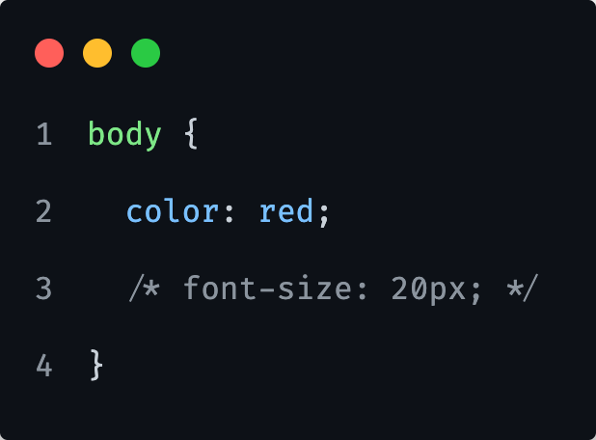
CSS Comments
To comment in CSS, simply place your plain text inside /* */ marks.
This tells the browser that they are notes and should not be rendered on the front-end.
Notes:
In CSS, you can add comments to explain or organize different sections of your stylesheet.
Doing so might seem like an extraneous step in the coding process, but comments can be extremely helpful when debugging or redesigning your website.
By design, comments have no effect on the layout of a document.

Slide 32
Let’s look together how some of this properties work.
Notes:
After below, show a closer look section from materials.
Take codepen and do some samples.
One such might be:
Create a DIV with some word.
Apply styles 1 by 1 and explain in short…
div {
background: red;
display: inline-block;
padding: 10px 20px 10px 20px;
padding: 10px 20px 10px;
padding: 10px 20px;
border: 15px solid blue;
border-radius: 7px;
width: 400px;
height: 400px;
color: white;
font-size: 40px;
font-weight: bold;
font-family: Verdana;
text-transform: uppercase;
letter-spacing: 1em;
text-align: center;
text-shadow: 3px 4px rgba(0, 0, 0, 0.4);
}

Slide 33
1) Create an HTML file with initial structure.
2) Create a <p> tag with random (lorem) text. Just after the text inside of your <p> tag, create a <span> tag with text “Read more”.
3) With CSS target a <span> element and apply a style “display: block;”.
<span> is an inline element, therefore without explicitly setting it to a block level element, it will just sit right next to previous content. And with CSS we can control how elements appear, as block level elements can appear as inline, so can inline appear as block level ones.
4) Try creating few other elements like <div>, <strong>, <em>… and try changing their display property. Use developer tools, to see all options you can apply to a certain property and to see the actual differences.
5) Create a <blockquote> element and add some lorem text inside (at least 25 words). Try changing its font-family, font-size, letter-spacing, line-height properties to see how it affects it. You can again use developer tools to see this in action as you change it there.
Notes:
Let them do it first alone, give them 15 minutes.

Slide 34
CSS Reset

Slide 35
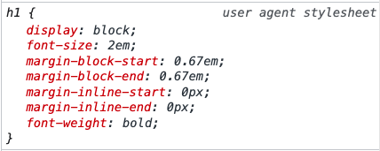
CSS Reset
By default, a Browser will apply its own set of CSS rules, that in real world we want to override.
Such example can be seen on the right with H1 in Chrome.
There are several ways how to achieve this.
We can write our own defaults, or we can use some pre-defined already.
Most popular are ResetCSS and Normalize.css
Notes:
Browsers render some HTML elements differently.

Slide 36
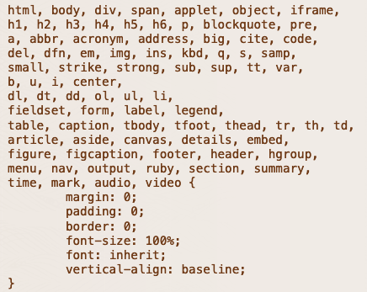
CSS Reset
Eric Meyers Reset CSS
The goal of a reset stylesheet is to reduce browser inconsistencies in things like default line heights, margins and font sizes of headings, and so on.
In other words, this is a starting point, not a self-contained black box of no-touchiness.
Notes:
On the image we see sample from Eric Meyers Reset CSS, how it resets the styles for HTML element tags.

Slide 37
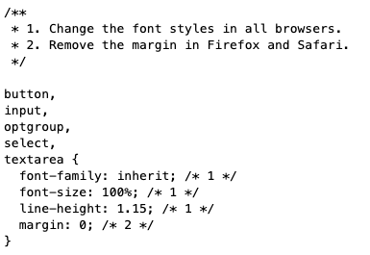
CSS Reset
Normalize.css
Makes browsers render all elements more consistently and in line with modern standards.
It precisely targets only the styles that need normalizing.
Notes:
On the image we can see how normalize actually defines some basic styling instead completely resetting them.

Slide 38
CSS Selectors

Slide 39
CSS Selectors
In CSS we can select elements by
Type
ID
Class
Attribute

Slide 40
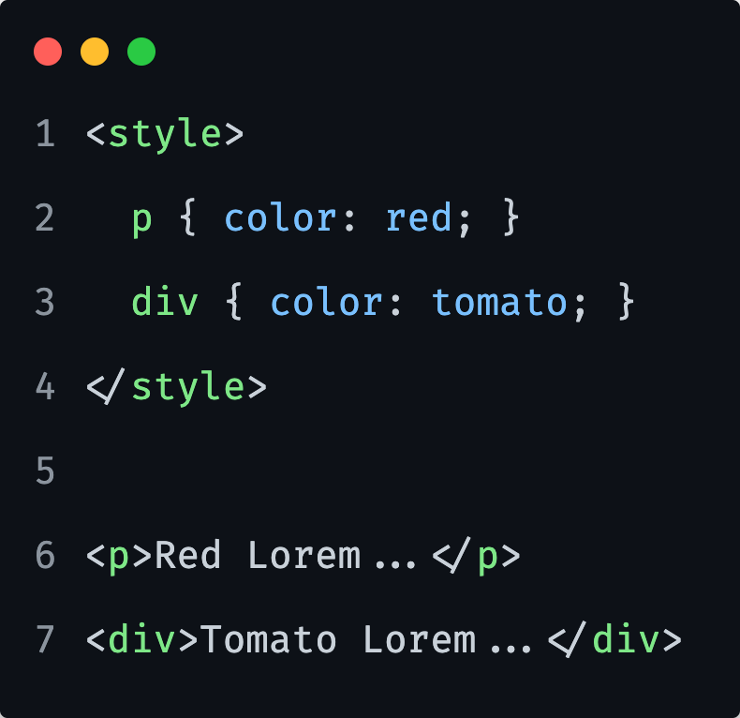
CSS Selectors
Type selector
HTML tag reference.
Will affect all HTML tag elements on the page.

Slide 41
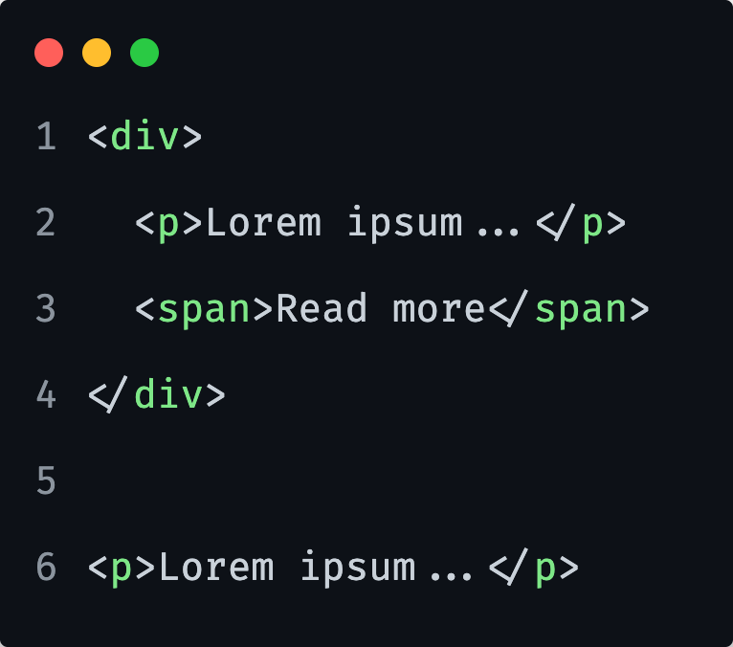
1) Create an HTML file with initial structure.
2) Create following HTML elements:
3) Set some styles for <p> tags.
Notice how the <p> tags are affected no matter of where they are.
Notes:
Let them do it first alone, give them 5 minutes.

Slide 42
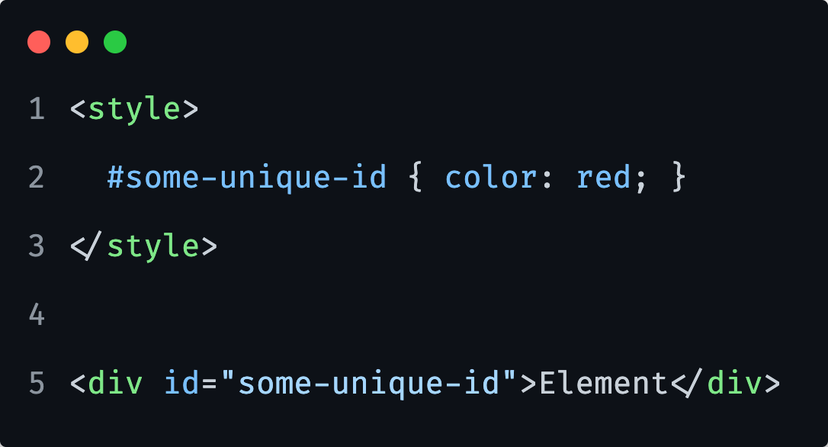
CSS Selectors
ID (Unique identifier) selector
We can not have multiple elements with same ID.
One (1) ID per page.

Slide 43
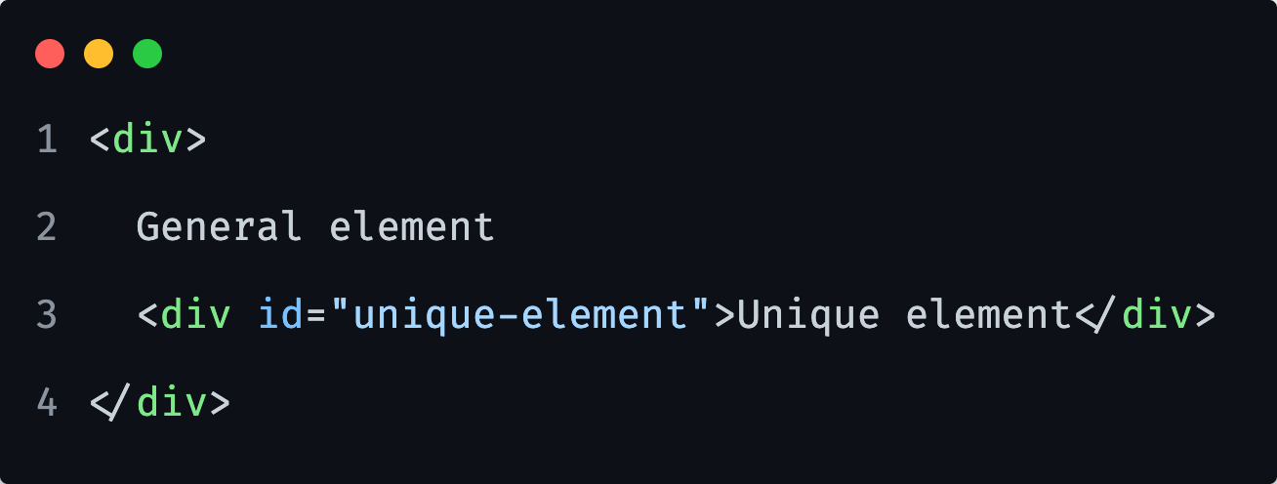
1) Create an HTML file with initial structure.
2) Create following HTML elements:
3) Set some styles for our ID element and set some styles for our general element.
For example, add a background color for general div and another color for our unique element.
Notes:
Let them do it first alone, give them 3 minutes.

Slide 44
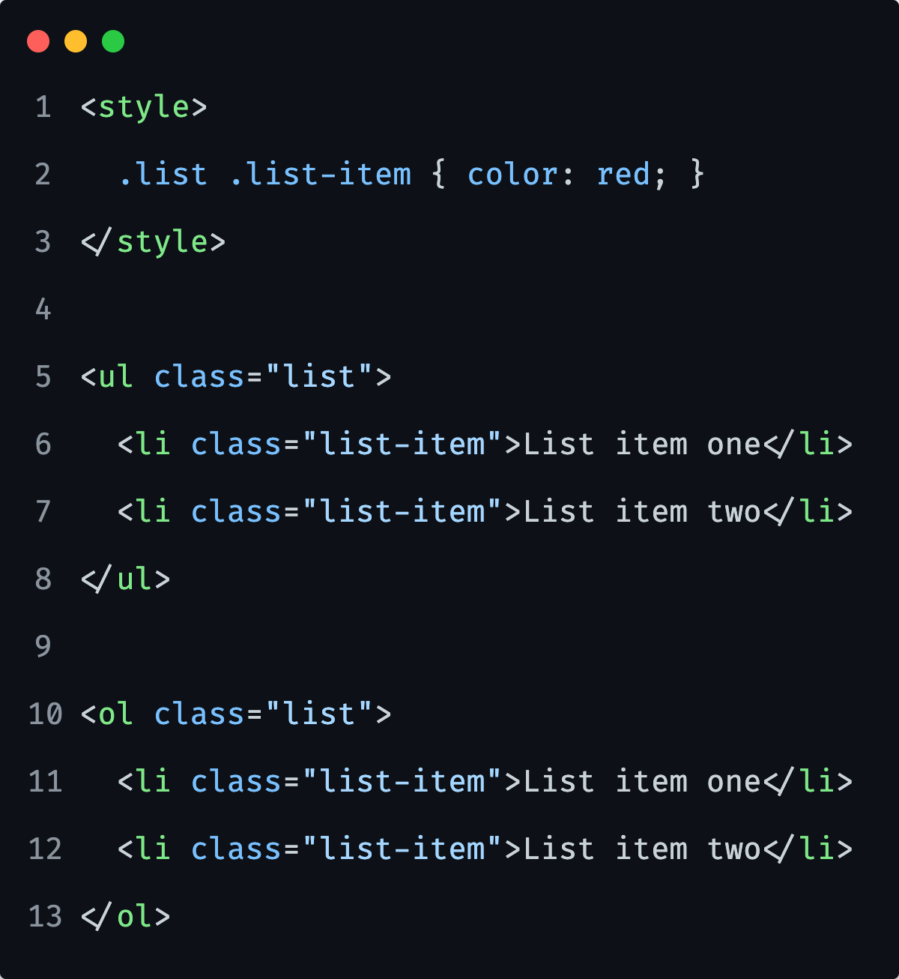
CSS Selectors
Class selector
We can have multiple elements with same class.
We use class to group same “style” type of elements.
For best practice, it would be best to always add classes to our markup, if it’s necessary.

Slide 45
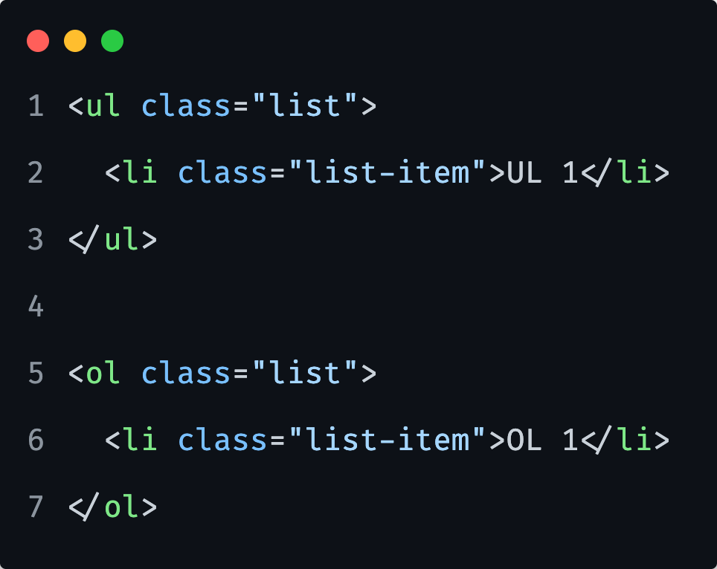
1) Create an HTML file with initial structure.
2) Create following HTML elements:
3) Set some styles to our classes.
Notice how it will affect both different types of lists as they share same class names.
Notes:
Let them do it first alone, give them 5 minutes.

Slide 46
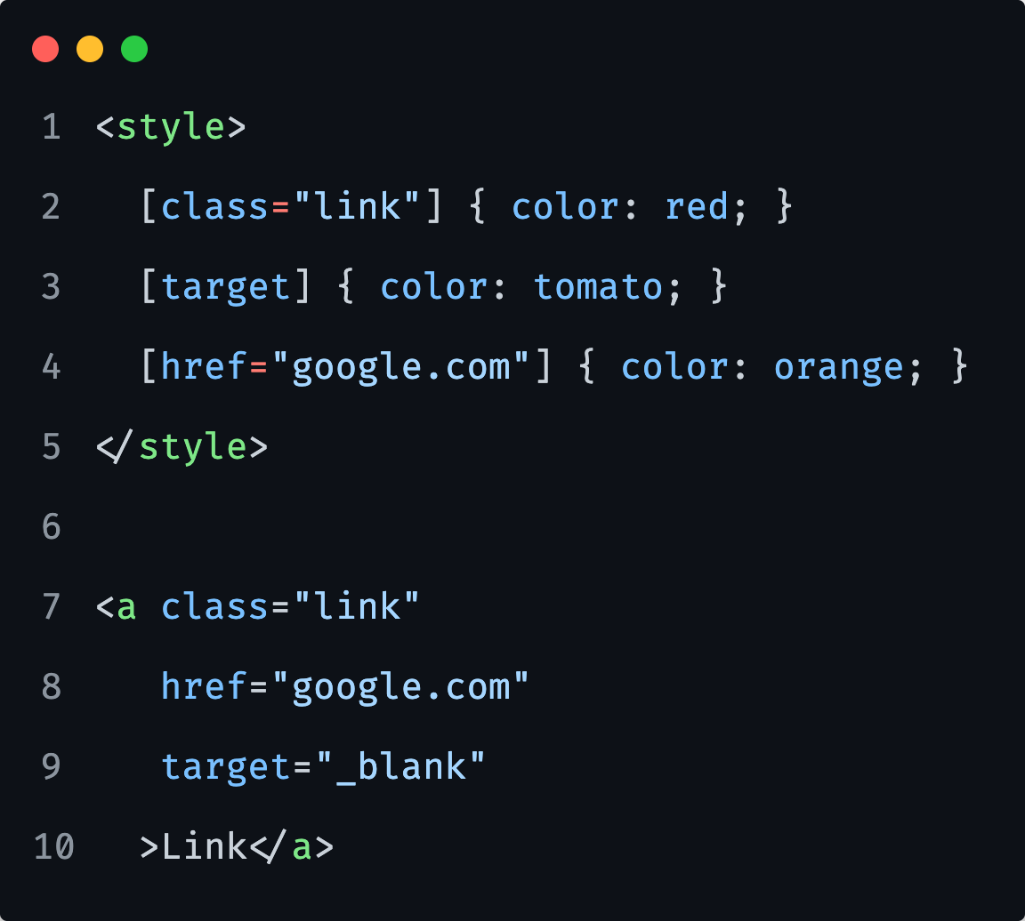
CSS Selectors
HTML element tag attribute selector
Not that common use.
Useful at times.
Will affect all elements with same attribute (div, p, span, etc.…)
Notes:
Be mindful that [class=“link”] is explicit, the element needs to have only `link` class to work.
Ok this is a stupid example, but you can think of another attribute like: target or href etc…

Slide 47
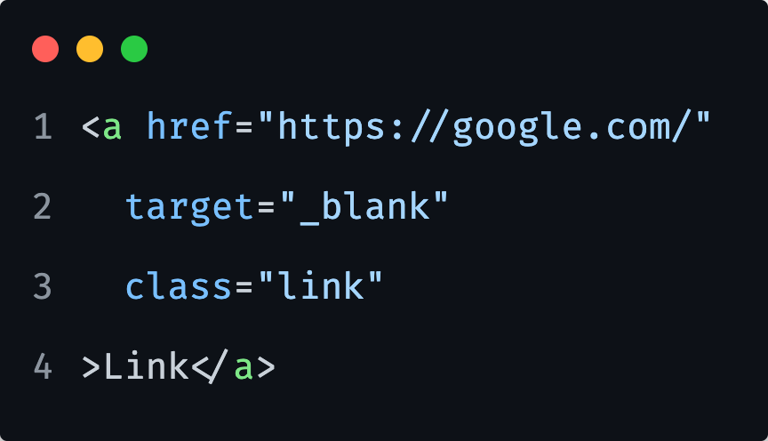
1) Create an HTML file with initial structure.
2) Create following HTML element:
3) Apply color with `href` attribute, apply bold font with `target` attribute and remove the underline (text-decoration) with `class` attribute selector.
Notes:
Let them do it first alone, give them 5 minutes.

Slide 48
CSS Selectors
Recap
Type
ID
Class
Attribute

Slide 49
Relational Selectors

Slide 50
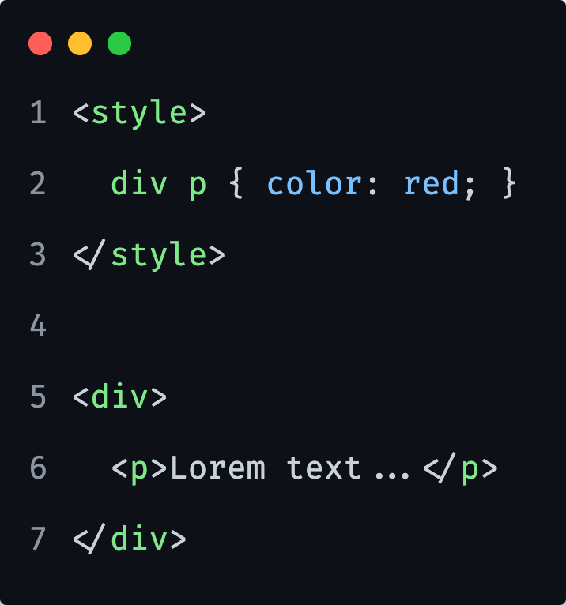
Relational Selectors
We can also select elements with relation to other elements.
Example on the left is called a ‘descendant selector’.
Matches all elements that are descendants of a specified element.
Notes:
No matter how deeply <p> is nested, all <p> tags will be affected by this selector.

Slide 51
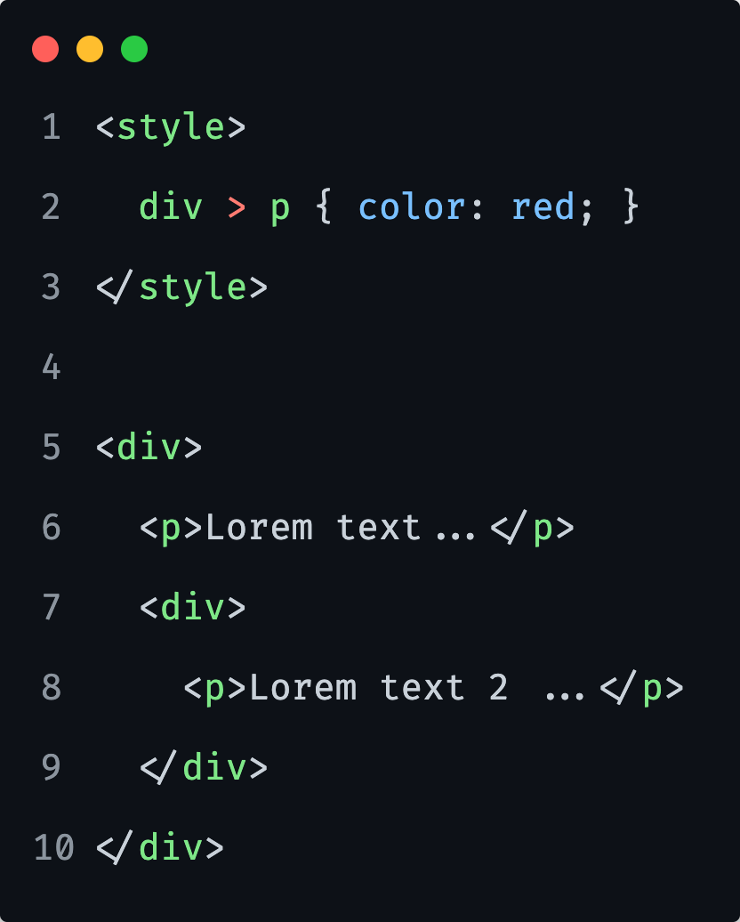
Relational Selectors
To match only a direct child of a specified parent selector, we use ”>” sign.
Matches all elements that are direct children of a specified element (or 1st level) (line 6).

Slide 52
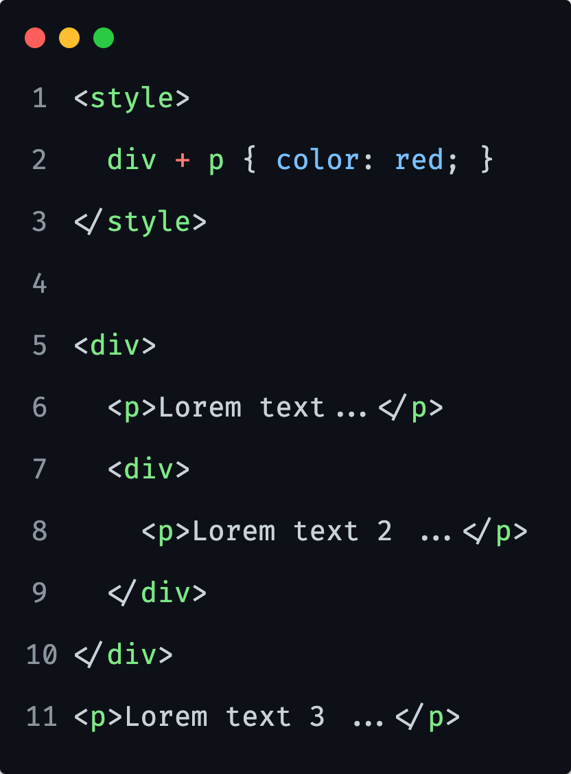
Relational Selectors
To match only a direct sibling of a specified selector, we use ”+” sign.
Matches an element that is right after specified element (line 11). Will not affect other elements after.
Notes:
If we were to have another <p> element on line 12., that <p> tag would not be affected. Only <p> tags that come right after <div> tags.

Slide 53
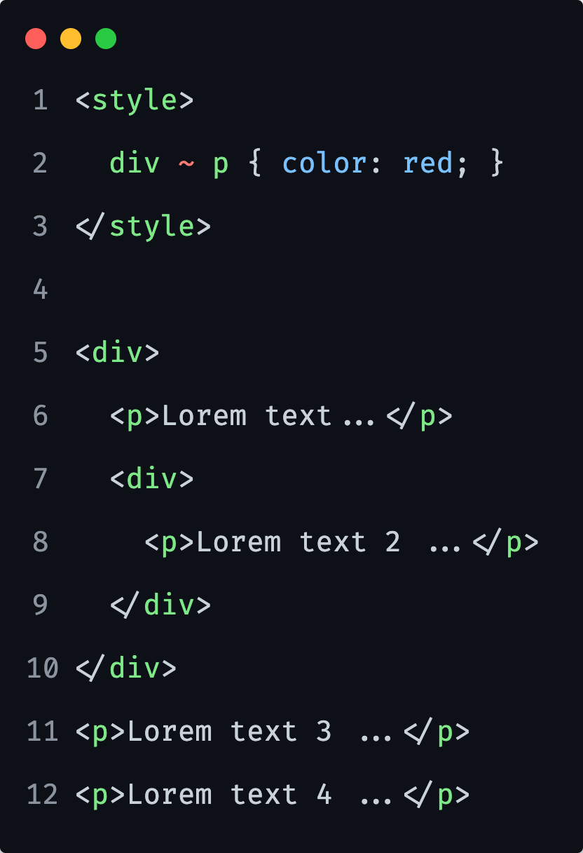
Relational Selectors
To match all siblings of a specified selector, we use ”~” sign.
Matches all elements that are right after specified element (line 11, 12).

Slide 54
Relational Selectors
Help us write cleaner markup.
They can be fragile.
Not as fast as basic selectors.
Notes:
Cleaner markup
We do not need to specify necessarily ID’s and Classes.
They are fragile
As they are dependant on the markup structure, as if we would to move elements around, the styles would not be applied correctly.
Not as fast
Problem is as browser reads the selector from the right side, meaning that it will first find all <p> tags and check if they are children of specified parent.
We could have only 1 <p> of 100’s of them on the page.
Even though this is not so important today, as it was before in the past, we should still be mindful and use this types only if necessary.

Slide 55
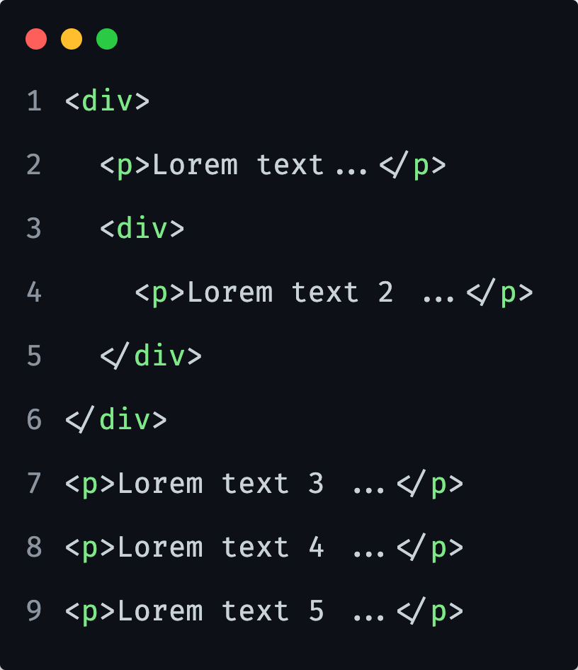
1) Create following HTML elements:
3) Target the <P> inside a <DIV> and apply red color.
4) Target the <P> directly inside <DIV> and apply orange color.
5) Target all <P> tags after <DIV> and apply blue color.
6) Target the <P> right after <DIV> and apply green color.
Notes:
Let them do it first alone, give them 10 minutes.
3) div p
4) div > p
5) div ~ p
6) div + p

Slide 56
Pseudo-class Selectors

Slide 57
Pseudo-class Selectors
All pseudo classes, start with colon.
Automatically applied by the browser.

Slide 58
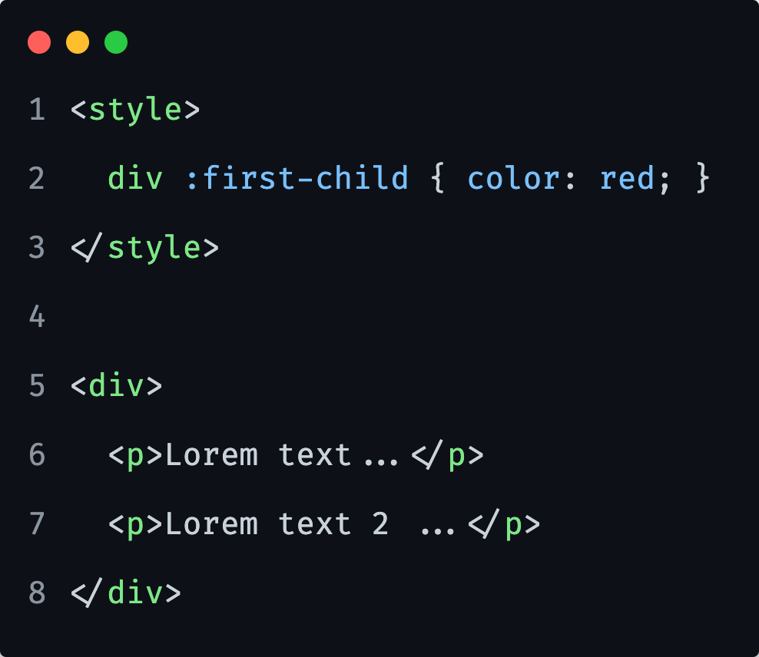
Pseudo-class Selectors
:first-child
It will select a first child inside a <div>.
Notes:
Its useful, but fragile, in above example if we would to add a heading, paragraph is no longer styled, as heading is the new first child.

Slide 59
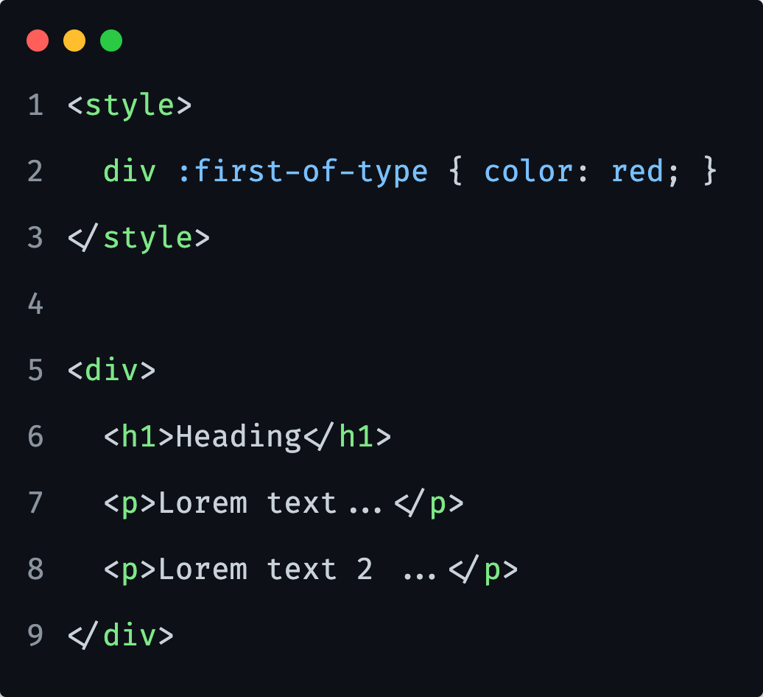
Pseudo-class Selectors
:first-of-type
Is applied to the first occurrence of elements of different types.
Notes:
Above code would be applied over all first of type elements, including heading and paragraph looking at our example.
If were to apply it in our case only for the <p> tags, we would need to extend the selector accordingly: `div p:first-of-type`.

Slide 60
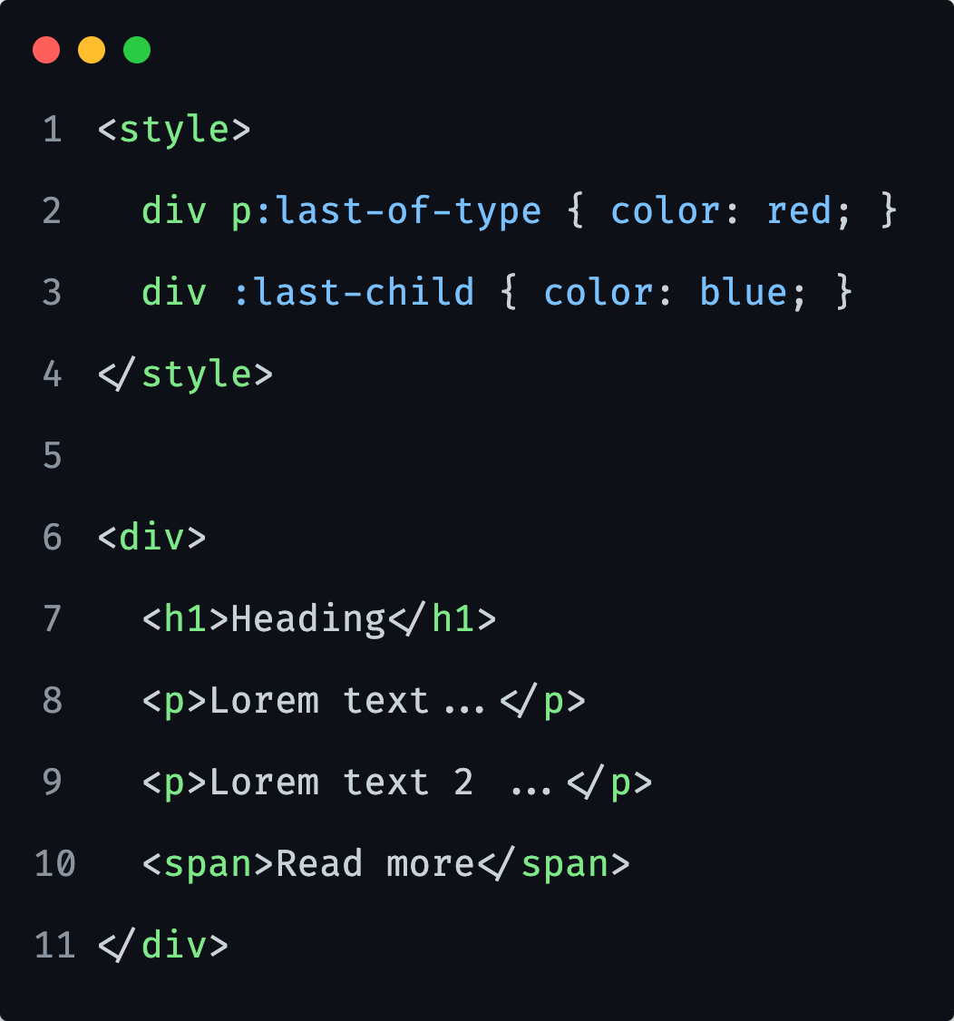
Pseudo-class Selectors
:last-child
:last-of-type
Similarly, to mentioned ”first” pseudo selectors, we also have “last” pseudo selectors.

Slide 61
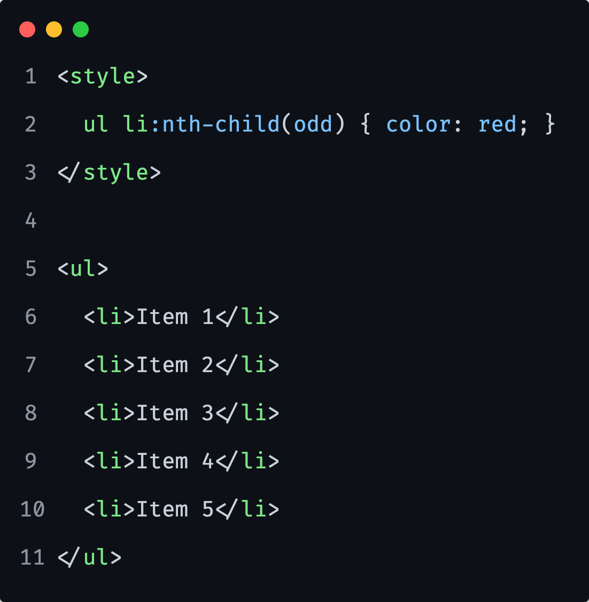
Pseudo-class Selectors
:nth-child
Allows you to select one or more elements based on their source order, according to a formula.
Notes:
Select the first list item => li:nth-child(1) { }
Select the 5th list item => li:nth-child(5) { }
Select every other list item starting with first => li:nth-child(odd) { }
Select every 3rd list item starting with first => li:nth-child(3n - 2) { }
Select every 3rd list item starting with 2nd => li:nth-child(3n - 1) { }
Select every 3rd child item, as long as it has class "el" => .el:nth-child(3n) { }
More info and generator will be provided via reference link section later.

Slide 62
1) Create following HTML elements:
3) Target the first paragraph in a <div> and make it blue.
4) Target the first type of paragraph occurrence and apply color green.
5) Try to replace selector positions and check the output.
Put selector from task 3, below selector of task 4.
Notes:
Specifcity is something we will cover in CSS Day 2.
Let them do it first alone, give them 8 minutes.

Slide 63
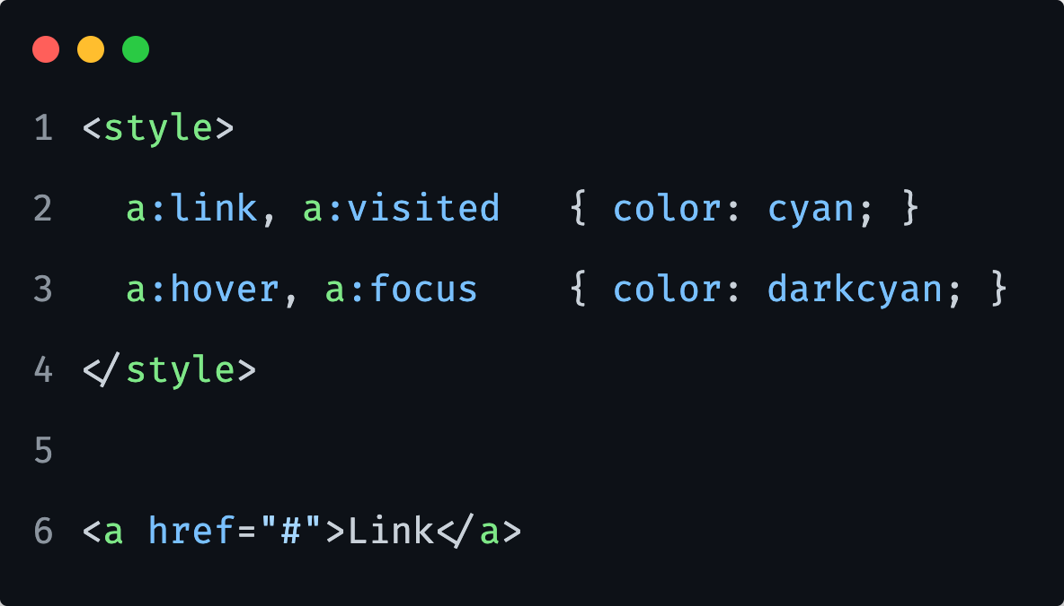
Pseudo-class Selectors
Hyperlinks <a>
Have multiple pseudo class selectors we can use and style.
a:link will target all links that are hyperlinks.
Notes:
Focus is important for the keyboard users and if we want to match the style to hover, what is usually the case.

Slide 64
1) Create hyperlink HTML element.
2) Change the styles of a hyperlink for all different states: visited, hover, focus and general.
Notes:
Let them do it first alone, give them 5 minutes.

Slide 65
Pseudo-element Selectors

Slide 66
Pseudo-element Selectors
All pseudo classes, start with a double colon.
Used when we want to style some parts of the element, like first letter…
Notes:
So colons
Double colons for pseudo elements
One colon for pseudo classes
When to use what
We use pseudo elements to style part of an element (first letter)
Pseudo classes we use to style elements in a particular state (hovered anchor etc)

Slide 67
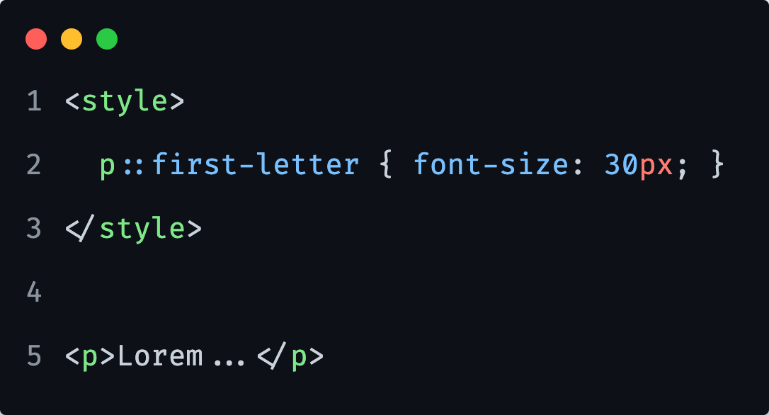
Pseudo-element Selectors
::first-letter
Will target the first letter of any specified element.

Slide 68
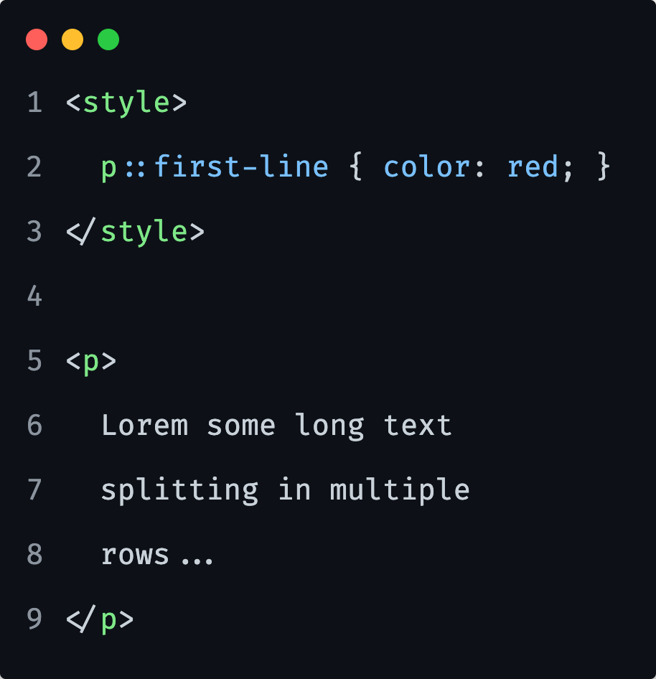
Pseudo-element Selectors
::first-line
Will target the first line of any specified element.

Slide 69
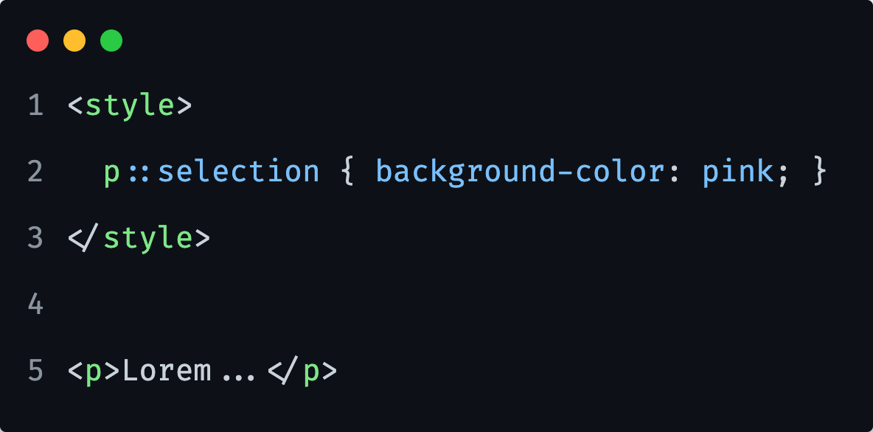
Pseudo-element Selectors
::selection
We can change the background of our text selection.
Notes:
P::selection (will only be applied on paragraphs, not all elements, we can remove the element type)

Slide 70
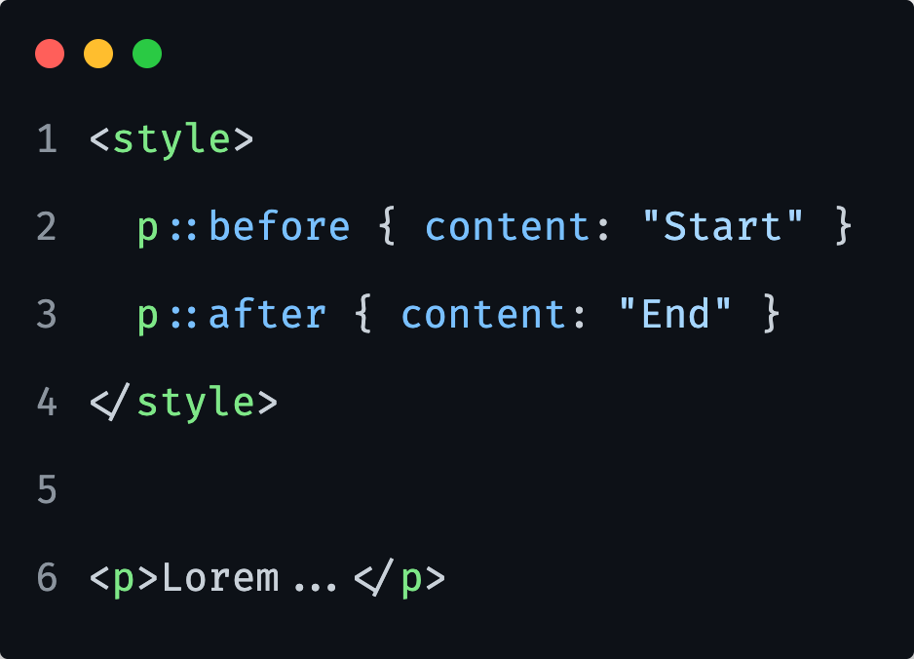
Pseudo-element Selectors
::before
::after
We can use following pseudo selectors, to insert content before the content of an element.

Slide 71
1) Create a <blockquote> element and apply quotation marks before and after the element. You can use simple “” as content.
2) Create a <p> and change it’s first letter and first line. Make first letter bigger, and first line should be of blue color.
Notes:
Let them do it first alone, give them 10 minutes.

Slide 72
Reference links

Slide 73

Reference links
HTML and CSS Basic Introduction
https://www.internetingishard.com/html-and-css/
MDN CSS: Cascading Style Sheets
https://developer.mozilla.org/en-US/docs/Web/CSS
Box Sizing best approach
https://css-tricks.com/inheriting-box-sizing-probably-slightly-better-best-practice/
CSS Properties list
https://www.w3schools.com/cssref/
Reset CSS
https://meyerweb.com/eric/tools/css/reset/
Normalize.css
https://necolas.github.io/normalize.css/
Selectors
https://www.w3schools.com/cssref/css_selectors.asp
https://www.w3schools.com/css/css_combinators.asp
https://css-tricks.com/useful-nth-child-recipies/
https://css-tricks.com/examples/nth-child-tester/
https://www.w3schools.com/css/css_pseudo_classes.asp
https://developer.mozilla.org/en-US/docs/Web/CSS/Pseudo-elements

Slide 74
Friday Exercises

Slide 75
1) Create an HTML file with initial structure. Also create some elements (multiple): <div>, <p>, <ul>, <ol>, <a>, <blockquote>, <table>.
2) Include Reset CSS in your document to remove all the stylings. Create a specific file for it and reference it in the document.
3) Apply inline style to one of your <div> elements and set its font to bold.
4) Create a CSS file and name it ‘main.css’. Link it to the HTML file and change <body> background color to lightskyblue.
5) Apply internal styles for your paragraphs, so they have font size of 18px and line-height of 24px.
6) Define styles for your lists: ul, ol. Can be basic; some list type and margin/padding. Try to combine some styles together for both lists, if possible. Also be aware of the list style position property.
7) Select all DIV's on the page and capitalize all the words.
8) Select each <li> tag and increase letter spacing by 2px, also change all words to lowercase.
9) Select each <li> inside <ol> and change text color to blue, uppercase all words and set the font to Verdana.
10) Change <a> styles (including pseudo selectors; hover, focus, visited). Change its color and remove the underline.
11) Select each <li> item and apply padding top/bottom of 8px and side paddings of 10px.
12) Set your <body> width to 600px and center it.
13) Select first letter of your paragraphs and change its font size and weight.
14) Style the blockquote, with ::before and ::after pseudo selectors to contain quotation marks at start and end of the text. Increase their font size and make it bold and set some color of your choosing.
Notes:
Friday Exercise

